Slide 1


Best of
ESOT Congress 2025
Lung

Slide 2
Disclaimer
This slide deck is designed for personal educational purposes only and should not be utilised for making patient management decisions. It is important to verify all information provided before treating patients or applying any therapies mentioned in these materials.

Slide 3
Information
This slide deck showcases the latest data presented at the ESOT Congress 2025.
All abbreviations displayed in these slides, along with a complete copy of the
original abstract text, can be found in the slide notes.
3. Click on the symbol to return to the contents page.

Slide 4
Content
LUNG
1190.
Efficacy of intravenous immunoglobulin for donor-specific antibodies after lung transplantation
1831.
First genome-wide association study of chronic lung allograft dysfunction
2023.
Seven years longitudinal measurements of TTV in lung transplant recipients
1045.
Immuno-guided prophylaxis for the prevention of CMV disease in low-risk lung transplant recipients
615.
Donor-specific blood transfusion delays rejection development in a mice lung transplantation model
1818.
Trajectories of FEV1 after lung transplantation and patient outcomes
2311.
Donor-derived cell-free mitochondrial DNA in lung transplantation, its relationship with primary graft dysfunction
2672.
CMV-IVIG modulates CD8 DR+ level and anti-CMV responses in organ recipients with difficult to control CMV infection
2200.
Predictive value of absolute levels of donor-derived cell-free DNA in early detection of lung allograft dysfunction
1462.
How aggressive is too aggressive: Navigating reflux and rejection after lung transplantation
1479.
Identifying leukocyte populations as biomarkers for chronic lung allograft dysfunction

Slide 5
Efficacy of intravenous immunoglobulin for donor-specific antibodies after lung transplantation
Background
De novo donor-specific antibodies (dnDSA) are associated with poor outcomes and reduced survival following lung transplantation.
Despite their clinical significance, treatment protocols remain variable and lack consensus
Aim
To evaluate the efficacy of intravenous immunoglobulin (IVIG) in eliminating dnDSA and to identify prognostic factors influencing treatment outcomes
Methods
Study:
n=47 lung transplant recipients with dnDSA (2015 - 2019)
Treatment:
IVIG 1 g/kg initially, followed by 0.5 g/kg at four-week intervals, up to three doses max.
Responders (elimination of dnDSA, n=23)
Non-responders (persistent dnDSA, n=24)
Assessment:
HLA antibodies via Luminex Single Antigen Bead assays before, during, and after treatment
Degenfelder P. et al., ESOT Congress 2025 (Abstract 1190)
Notes:
Abbreviations: DnDSA, De novo donor-specific antibodies; IVIG, Intravenous immunoglobulin; AMR, Antibody-mediated rejection; OR, Odds ratio; CI, Confidence interval.
Reference Number: 1190
EFFICACY OF INTRAVENOUS IMMUNOGLOBULIN FOR DONOR-SPECIFIC ANTIBODIES AFTER LUNG TRANSPLANTATION
Philip Degenfelder¹, Maximilian Vorstandlechner¹, Julia Kovacs¹, Julia Walter^{1,2}, Andrea Dick³, Sebastian Michel⁴, Christian Schneider¹, Michael Irlbeck⁵, Nikolaus Kneidinger⁶, Teresa Kauke^{1,3}
¹University Hospital of Munich (LMU), Division of Thoracic Surgery, Munich, Germany, ²University Hospital of Munich (LMU), Department of Medicine V, Munich, Germany, ³University Hospital of Munich (LMU), Division of Transfusion Medicine, Laboratory for Immunogenetics, Munich, Germany, ⁴University Hospital of Munich (LMU), Department of Cardiac Surgery, Munich, Germany, ⁵University Hospital of Munich (LMU), Department of Anesthesiology, Munich, Germany, ⁶Medical University of Graz, Department of Internal Medicine, Division of Pulmonology, Graz, Austria
Background: De novo donor-specific antibodies (dnDSA) are associated with poor outcomes and reduced survival following lung transplantation. Despite their clinical significance, treatment protocols remain variable and lack consensus. This study aimed to evaluate the efficacy of intravenous immunoglobulin (IVIG) in eliminating dnDSA and to identify prognostic factors influencing treatment outcomes.
Methods: Between 2015 and 2019, 47 lung transplant recipients with dnDSA were treated with IVIG (1 g/kg initially, followed by 0.5 g/kg at four-week intervals, up to three doses). Patients were classified as responders (elimination of dnDSA, n=23) or non-responders (persistent dnDSA, n=24). HLA antibodies were assessed via Luminex Single Antigen Bead assays before, during, and after treatment.
Results: IVIG therapy resulted in dnDSA elimination in 49% of patients. Age and gender did not differ significantly between responders and non-responders (p=0.28 and p=1.0, respectively). However, non responders were significantly more likely to have HLA Class II dnDSA (92% vs. 48%, p=0.003) and exhibited higher mean maximum MFI values (11,683 vs. 7,152, p=0.002). Time to dnDSA onset was significantly shorter in responders (61 days vs. 258 days, p=0.005). Multivariable logistic regression revealed that treatment initiated during subclinical antibody-mediated rejection (AMR) significantly improved dnDSA elimination (OR = 28.33, 95% CI 2.25–357.27, p < 0.005). This underscores the importance of early intervention, even in the absence of clinical symptoms or lung function decline.
Conclusions: The therapeutic approach for managing dnDSA following lung transplantation remains a topic of ongoing debate. Our findings suggest that early intervention targeting dnDSA may significantly enhance the likelihood of successful antibody elimination, potentially improving patient outcomes.

Slide 6
Efficacy of intravenous immunoglobulin for donor-specific antibodies after lung transplantation
Results
Multivariable logistic regression revealed that treatment initiated during subclinical antibody-mediated rejection (AMR) significantly improved dnDSA elimination:
OR = 28.33 [95% CI 2.25–357.27] p < 0.01
This underscores the importance of early intervention, even in the absence of clinical symptoms or lung function decline
dnDSA elimination from IVIG therapy (% patients)
Not eliminated
51%
49%
Eliminated
Age and gender did not differ significantly between responders and non responders (p=0.28 and p=1.0, respectively)
Conclusions
The therapeutic approach for managing dnDSA following lung transplantation remains a topic of ongoing debate
Our findings suggest that early intervention targeting dnDSA may significantly enhance the likelihood of successful antibody elimination, potentially improving patient outcomes
92%
11,683
258 days
Mean maximum MFI values
HLA Class II dnDSA
Time to dnDSA onset
48%
7,152
61 days
R
NR
NR
NR
R
R
NR = non responders
R = responders
Degenfelder P. et al., ESOT Congress 2025 (Abstract 1190)
Notes:
Abbreviations: DnDSA, De novo donor-specific antibodies; IVIG, Intravenous immunoglobulin; AMR, Antibody-mediated rejection; OR, Odds ratio; CI, Confidence interval.
Reference Number: 1190
EFFICACY OF INTRAVENOUS IMMUNOGLOBULIN FOR DONOR-SPECIFIC ANTIBODIES AFTER LUNG TRANSPLANTATION
Philip Degenfelder¹, Maximilian Vorstandlechner¹, Julia Kovacs¹, Julia Walter^{1,2}, Andrea Dick³, Sebastian Michel⁴, Christian Schneider¹, Michael Irlbeck⁵, Nikolaus Kneidinger⁶, Teresa Kauke^{1,3}
¹University Hospital of Munich (LMU), Division of Thoracic Surgery, Munich, Germany, ²University Hospital of Munich (LMU), Department of Medicine V, Munich, Germany, ³University Hospital of Munich (LMU), Division of Transfusion Medicine, Laboratory for Immunogenetics, Munich, Germany, ⁴University Hospital of Munich (LMU), Department of Cardiac Surgery, Munich, Germany, ⁵University Hospital of Munich (LMU), Department of Anesthesiology, Munich, Germany, ⁶Medical University of Graz, Department of Internal Medicine, Division of Pulmonology, Graz, Austria
Background: De novo donor-specific antibodies (dnDSA) are associated with poor outcomes and reduced survival following lung transplantation. Despite their clinical significance, treatment protocols remain variable and lack consensus. This study aimed to evaluate the efficacy of intravenous immunoglobulin (IVIG) in eliminating dnDSA and to identify prognostic factors influencing treatment outcomes.
Methods: Between 2015 and 2019, 47 lung transplant recipients with dnDSA were treated with IVIG (1 g/kg initially, followed by 0.5 g/kg at four-week intervals, up to three doses). Patients were classified as responders (elimination of dnDSA, n=23) or non-responders (persistent dnDSA, n=24). HLA antibodies were assessed via Luminex Single Antigen Bead assays before, during, and after treatment.
Results: IVIG therapy resulted in dnDSA elimination in 49% of patients. Age and gender did not differ significantly between responders and non-responders (p=0.28 and p=1.0, respectively). However, non responders were significantly more likely to have HLA Class II dnDSA (92% vs. 48%, p=0.003) and exhibited higher mean maximum MFI values (11,683 vs. 7,152, p=0.002). Time to dnDSA onset was significantly shorter in responders (61 days vs. 258 days, p=0.005). Multivariable logistic regression revealed that treatment initiated during subclinical antibody-mediated rejection (AMR) significantly improved dnDSA elimination (OR = 28.33, 95% CI 2.25–357.27, p < 0.005). This underscores the importance of early intervention, even in the absence of clinical symptoms or lung function decline.
Conclusions: The therapeutic approach for managing dnDSA following lung transplantation remains a topic of ongoing debate. Our findings suggest that early intervention targeting dnDSA may significantly enhance the likelihood of successful antibody elimination, potentially improving patient outcomes.

Slide 7

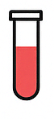

Seven years longitudinal measurements of TTV in lung transplant recipients
Background
Torque tenovirus (TTV) is a DNA virus which causes no known human disease, and which is endemic with up to 90% - 100% of tested subjects having detectable TTV in blood
From studies in solid organ transplantation (SOT), it has become accepted that an elevated TTV viral load is an indication of over immunosuppression, while a low TTV viral load is an indication the patient is under immunosuppressed
No long-term longitudinal studies exist investigating TTV loads for longer than 3 years after SOT
Aim
To retrospectively examine TTV dynamics in lung transplantation recipients (LTR), over a period of up to 7 year
To analyze the relationship between TTV, all cause mortality, acute and chronic lung allograft dysfunction (CLAD), and infectious risk
Methods
n=88 patients that received a lung transplantation between January 2015 and December 2017
Plasma taken within 2 weeks after transplantation, and at routine outpatient visits, approximately every 3 months during the first year, every 6 months during the second and third year, and once per year thereafter
DNA extracted from thawed plasma samples using the eMAG Nucleic Acid Extraction System, and tested for TTV using the RGene kit (bioMérieux, France)
Data analyses performed using SPSS 23.0
Gore E. et al., ESOT Congress 2025 (Abstract 2023)
Notes:
Abbreviations: TTV, Torque tenovirus; LTR, Lung transplantation recipients; CLAD, Chronic lung allograft dysfunction; SOT, Solid organ transplantation.
Reference Number: 2023
Seven years longitudinal measurements of TTV in lung transplant recipients
Edmund J. Gore¹, Judith Vonk^{2,3}, Lilli Rurenga-Gard¹, Hubert Niesters¹, Erik A.M. Verschuuren⁴, Coretta Van Leer-Buter¹
¹UMCG, Medical Microbiology and Infection Prevention, Groningen, Netherlands Antilles, ²UMCG, Epidemiology, Groningen, The Netherlands, ³UMCG, Groningen Research Institute for Asthma and COPD (GRIAC), Groningen, The Netherlands, ⁴UMCG, Pulmonary Diseases, Groningen, The Netherlands
Background: Torque tenovirus (TTV) is a DNA virus which causes no known human disease, and which is endemic with up to 90% - 100% of tested subjects having detectable TTV in blood. From studies in solid organ transplantation (SOT), it has become accepted that an elevated TTV viral load is an indication of over immunosuppression, while a low TTV viral load is an indication the patient is under immunosuppressed. So far no long term longitudinal studies exist investigating TTV loads for longer than 3 years after SOT. In this study we retrospectively examine TTV dynamics in lung transplantation recipients (LTR), over a period of up to 7 years. We further analyze the relationship between TTV, all cause mortality, acute and chronic lung allograft dysfunction (CLAD), and infectious risk.
Methods: 88 patients that received a lung transplantation between January 2015 and December 2017 were included. Plasma was taken within 2 weeks after transplantation, and at routine outpatient visits, approximately every 3 months during the first year, every 6 months during the second and third year, and once per year thereafter. All samples were stored at −80 ◦C, until analysis. DNA was extracted from thawed plasma samples using the eMAG Nucleic Acid Extraction System, and tested for TTV using the RGene kit (bioMérieux, France). Data analyses were performed using SPSS 23.0.
Results: Following transplantation a rapid increase in TTV load was observed in nearly all patients, reaching a peak TTV load of 7.7 log (+/-2.77) in 90 % of cases. Peak levels occurred between 90 and 120 days after transplantation and was followed by a gradual decrease. During the study period, 23 patients died, of whom 13 died of infections, and 26 developed CLAD. Both death and CLAD occurred significantly more in patients whose TTV load was above the mean value for that time after transplantation during their most recent out-patient visit (fig.1).
Conclusions: This retrospective study, which investigates TTV loads over a period of 7 years after lung transplantation, suggests that sustained high TTV loads are associated with increased mortality and allograft dysfunction. Figure 1: Scatterplot of all TTV measurements. TTV measurement immediately prior to death (black dots), acute rejection episodes (red dots), and diagnosis of CLAD (green dots) are indicated.

Slide 8
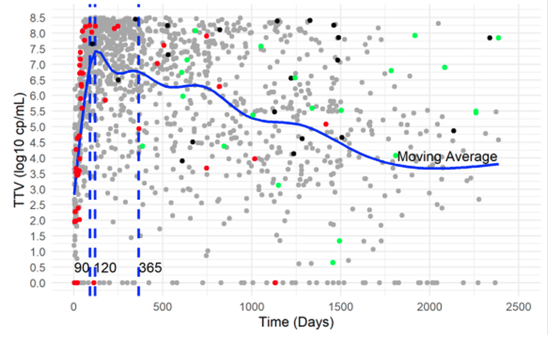
Seven years longitudinal measurements of TTV in lung transplant recipients
Results
Following transplantation, rapid increase in TTV load in nearly all patients, reaching a peak TTV load of 7.7 log (+/-2.77)
Peak levels occurred between 90 and 120 days after transplantation and was followed by a gradual decrease, to 3.7 log copies/ml after 7 years
During the study period, 23 patients died, of whom 11 died of infections, and 26 developed CLAD
Both death and CLAD occurred significantly more in patients whose TTV load was above the mean value for that time after transplantation during their most recent out-patient visit (Fig. 1). Recipients who died of infections (n=11) and malignancy (n=2) had higher TTV loads at the last out-patient visit 7.86 (7.13-8.25) and 8.11 and 8.24 respectively), than those who died of cardiovascular disease (n=6) and other/unknown causes (4.75 (4.5-7.04) and 4.99 (4.05- 7.66) respectively)
Conclusions
Investigation of TTV loads over a period of 7 years after lung transplantation suggests that sustained high TTV loads are associated with increased mortality and allograft dysfunction
Figure 1: Scatterplot of all TTV measurements. TTV measurement immediately prior to death (black dots), acute rejection episodes (red dots), and diagnosis of CLAD (green dots) are indicated.
Gore E. et al., ESOT Congress 2025 (Abstract 2023)
Notes:
Abbreviations: TTV, Torque tenovirus; LTR, Lung transplantation recipients; CLAD, Chronic lung allograft dysfunction; SOT, Solid organ transplantation.
Reference Number: 2023
Seven years longitudinal measurements of TTV in lung transplant recipients
Edmund J. Gore¹, Judith Vonk^{2,3}, Lilli Rurenga-Gard¹, Hubert Niesters¹, Erik A.M. Verschuuren⁴, Coretta Van Leer-Buter¹
¹UMCG, Medical Microbiology and Infection Prevention, Groningen, Netherlands Antilles, ²UMCG, Epidemiology, Groningen, The Netherlands, ³UMCG, Groningen Research Institute for Asthma and COPD (GRIAC), Groningen, The Netherlands, ⁴UMCG, Pulmonary Diseases, Groningen, The Netherlands
Background: Torque tenovirus (TTV) is a DNA virus which causes no known human disease, and which is endemic with up to 90% - 100% of tested subjects having detectable TTV in blood. From studies in solid organ transplantation (SOT), it has become accepted that an elevated TTV viral load is an indication of over immunosuppression, while a low TTV viral load is an indication the patient is under immunosuppressed. So far no long term longitudinal studies exist investigating TTV loads for longer than 3 years after SOT. In this study we retrospectively examine TTV dynamics in lung transplantation recipients (LTR), over a period of up to 7 years. We further analyze the relationship between TTV, all cause mortality, acute and chronic lung allograft dysfunction (CLAD), and infectious risk.
Methods: 88 patients that received a lung transplantation between January 2015 and December 2017 were included. Plasma was taken within 2 weeks after transplantation, and at routine outpatient visits, approximately every 3 months during the first year, every 6 months during the second and third year, and once per year thereafter. All samples were stored at −80 ◦C, until analysis. DNA was extracted from thawed plasma samples using the eMAG Nucleic Acid Extraction System, and tested for TTV using the RGene kit (bioMérieux, France). Data analyses were performed using SPSS 23.0.
Results: Following transplantation a rapid increase in TTV load was observed in nearly all patients, reaching a peak TTV load of 7.7 log (+/-2.77) in 90 % of cases. Peak levels occurred between 90 and 120 days after transplantation and was followed by a gradual decrease. During the study period, 23 patients died, of whom 13 died of infections, and 26 developed CLAD. Both death and CLAD occurred significantly more in patients whose TTV load was above the mean value for that time after transplantation during their most recent out-patient visit (fig.1).
Conclusions: This retrospective study, which investigates TTV loads over a period of 7 years after lung transplantation, suggests that sustained high TTV loads are associated with increased mortality and allograft dysfunction. Figure 1: Scatterplot of all TTV measurements. TTV measurement immediately prior to death (black dots), acute rejection episodes (red dots), and diagnosis of CLAD (green dots) are indicated.

Slide 9
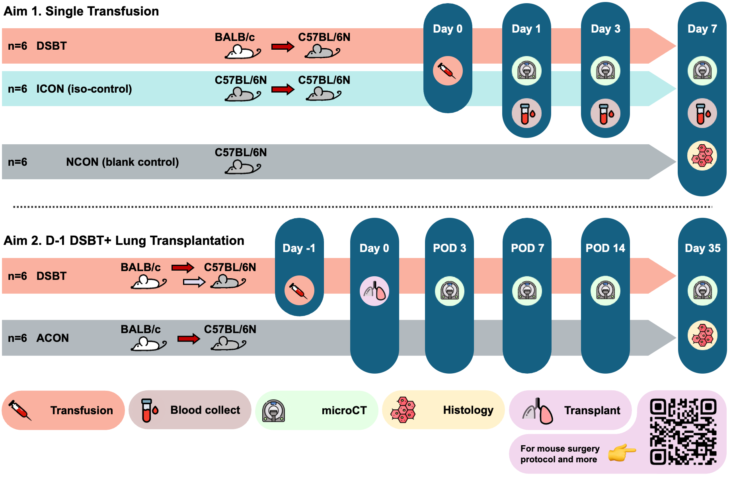
Donor-specific blood transfusion delays rejection development in a mice lung transplantation model
Background
Lung transplantation lung transplantation is still hindered by a high rate of chronic rejection, necessitating profound immunosuppression with associated complications
Donor-specific blood transfusion (DSBT) is a pre-transplant strategy aimed at improving graft acceptance
Limited attention has been given to its application in lung transplantation, and the precise mechanisms underlying DSBT-induced tolerance remain incompletely understood
Aim
To establish the first DSBT animal model for lung transplantation and evaluate its safety and efficacy in improving lung allograft rejection
Methods
Jin X. et al., ESOT Congress 2025 (Abstract 615)
Notes:
Abbreviations: LTx, Lung transplantation; DSBT, Donor-specific blood transfusion; ICON, Iso-transfusion control; NCON, Negative control; ACON, Allograft Control; CT, computed tomography.
Reference Number: 615
DONOR-SPECIFIC BLOOD TRANSFUSION DELAYS REJECTION DEVELOPMENT IN A MICE LUNG TRANSPLANTATION MODEL
Xin Jin^{1,2}, Jacques Pirenne^{3,4}, Robin Vos^{2,5}, Charlotte Hooft², Jan Van Slambrouck^{1,2}, Janne Kaes², Greetje Vande Velde⁶, Karen Moermans⁷, Bart Vanaudenaerde², Laurens J. Ceulemans^{1,2}
¹UZ Leuven, Department of Thoracic Surgery, Leuven, Belgium, ²KU Leuven, Department CHROMETA, Lab of Respiratory Diseases and Thoracic Surgery, Leuven, Belgium, ³UZ Leuven, Department of Abdominal Transplantation, Leuven, Belgium, ⁴KU Leuven, Department of Microbiology, Immunology and Transplantation, Lab of Abdominal Transplantation, Leuven, Belgium, ⁵UZ Leuven, Department of Respiratory Diseases, Leuven, Belgium, ⁶KU Leuven, Department of Imaging & Pathology, Leuven, Belgium, ⁷KU Leuven, Department CHROMETA, Clinical and Experimental Endocrinology, Leuven, Belgium
Background: Lung transplantation (LTx) is still hindered by a high rate of chronic rejection, necessitating profound immunosuppression with associated complications. Donor-specific blood transfusion (DSBT) is a pre-transplant strategy aimed at improving graft acceptance. Limited attention has been given to its application in LTx, and the precise mechanisms underlying DSBT-induced tolerance remain incompletely understood. This study aimed to establish the first DSBT animal model for LTx and evaluate its safety and efficacy in improving lung allograft rejection.
Methods: Aim 1: The blood donor mice were BALB/c (DSBT, n=6) or C57BL/6N [iso-transfusion control (ICON), n=6], and the recipient mice were all C57BL/6N. 0.2 ml of heparinized whole blood was collected from the donor’s inferior caval vein and injected within one hour through the recipient’s tail vein. Data from non-transfused C57BL/6N mice (NCON, n=6) were recorded as the baseline. Complete blood counts were conducted using hematology analyzer, along with microCT scans on D1, 3 and 7. All mice were sacrificed on D7 for left lung Hematoxylin and Eosin staining. Aim 2: DSBT (BALB/c to C57BL/6N n=5) was performed approximately 24 hours before LTx. Non-transfused allograft transplantation mice [BALB/c to C57BL/6N (ACON) n=5] were set as the control group. MicroCT scan was conducted on D7, 14 and 35. All mice were sacrificed on D35 for left lung Masson's Trichrome staining.
Results: Aim 1 (Fig 1): All mice maintained stable weight after transfusion. No signs of transfusion related hemolysis, histological injury or organ dysfunction were observed in any group. White blood cell counts, primarily lymphocytes, decreased significantly on D1 and began to recover on D3. On D7, lymphocyte and monocyte counts stabilized in the DSBT group but decreased in the ICON group. Lymphocyte percentages (Lym%) decreased following allo-transfusion. Aim 2 (Fig 2): More left lung airways remained open in the DSBT group compared to the ACON group until D14. However, the rejection level was comparable between the DSBT and ACON groups by D35.
Conclusions: DSBT was feasible and safe in the mice LTx model. Lymphocytes and monocytes evolved differently following allo- or iso-transfusion. DSBT delayed rejection development in the short term but did not improve long-term outcomes after LTx.

Slide 10
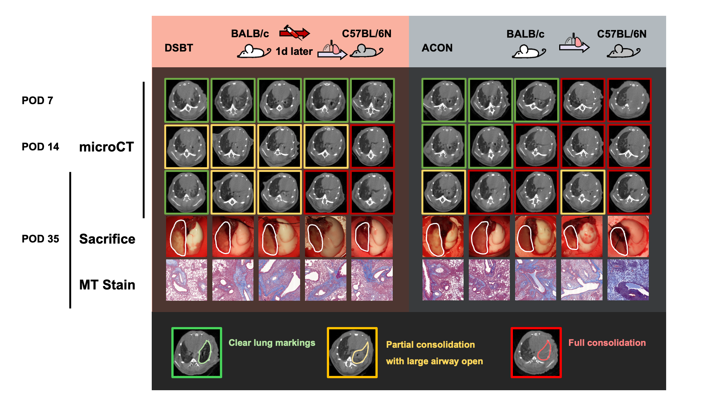
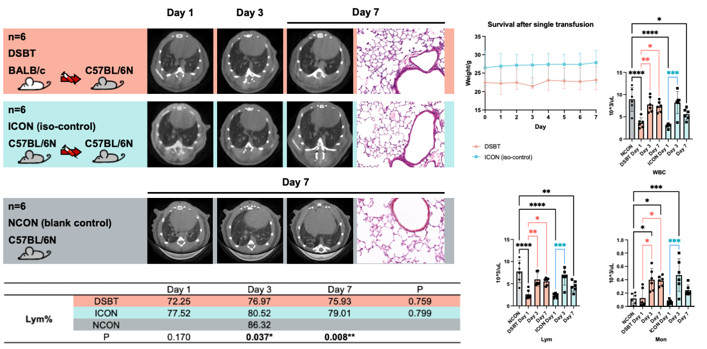
Donor-specific blood transfusion delays rejection development in a mice lung transplantation model
Results
Fig. 1: Longitudinal follow-up after whole blood transfusion in mice model
Fig. 2: Longitudinal follow-up after allograft lung transplantation in mice DSBT model
Aim 1: All mice maintained stable weight after transfusion. No signs of transfusion related hemolysis, histological injury or organ dysfunction were observed in any group. White blood cell counts (WBC), primarily lymphocytes (Lym), decreased significantly on Day 1 and began to recover on Day 3. On Day 7, lymphocyte and monocyte (Mon) counts stabilized in the DSBT group but decreased in the ICON group. Lymphocyte percentages (Lym%) decreased following DSBT
Aim 2: More left lung airways remained open in DSBT group compared to ACON group until D14. However, the rejection level was comparable between the DSBT and ACON groups by D35
Conclusions
DSBT was feasible and safe in the mice lung transplantation model. Lymphocytes and monocytes evolved differently following allo- or iso-transfusion. DSBT delayed rejection development in the short term but did not improve long-term outcomes after lung transplantation
Jin X. et al., ESOT Congress 2025 (Abstract 615)
Notes:
Abbreviations: LTx, Lung transplantation; DSBT, Donor-specific blood transfusion; ICON, Iso-transfusion control; NCON, Negative control; ACON, Allograft Control; CT, computed tomography.
Reference Number: 615
DONOR-SPECIFIC BLOOD TRANSFUSION DELAYS REJECTION DEVELOPMENT IN A MICE LUNG TRANSPLANTATION MODEL
Xin Jin^{1,2}, Jacques Pirenne^{3,4}, Robin Vos^{2,5}, Charlotte Hooft², Jan Van Slambrouck^{1,2}, Janne Kaes², Greetje Vande Velde⁶, Karen Moermans⁷, Bart Vanaudenaerde², Laurens J. Ceulemans^{1,2}
¹UZ Leuven, Department of Thoracic Surgery, Leuven, Belgium, ²KU Leuven, Department CHROMETA, Lab of Respiratory Diseases and Thoracic Surgery, Leuven, Belgium, ³UZ Leuven, Department of Abdominal Transplantation, Leuven, Belgium, ⁴KU Leuven, Department of Microbiology, Immunology and Transplantation, Lab of Abdominal Transplantation, Leuven, Belgium, ⁵UZ Leuven, Department of Respiratory Diseases, Leuven, Belgium, ⁶KU Leuven, Department of Imaging & Pathology, Leuven, Belgium, ⁷KU Leuven, Department CHROMETA, Clinical and Experimental Endocrinology, Leuven, Belgium
Background: Lung transplantation (LTx) is still hindered by a high rate of chronic rejection, necessitating profound immunosuppression with associated complications. Donor-specific blood transfusion (DSBT) is a pre-transplant strategy aimed at improving graft acceptance. Limited attention has been given to its application in LTx, and the precise mechanisms underlying DSBT-induced tolerance remain incompletely understood. This study aimed to establish the first DSBT animal model for LTx and evaluate its safety and efficacy in improving lung allograft rejection.
Methods: Aim 1: The blood donor mice were BALB/c (DSBT, n=6) or C57BL/6N [iso-transfusion control (ICON), n=6], and the recipient mice were all C57BL/6N. 0.2 ml of heparinized whole blood was collected from the donor’s inferior caval vein and injected within one hour through the recipient’s tail vein. Data from non-transfused C57BL/6N mice (NCON, n=6) were recorded as the baseline. Complete blood counts were conducted using hematology analyzer, along with microCT scans on D1, 3 and 7. All mice were sacrificed on D7 for left lung Hematoxylin and Eosin staining. Aim 2: DSBT (BALB/c to C57BL/6N n=5) was performed approximately 24 hours before LTx. Non-transfused allograft transplantation mice [BALB/c to C57BL/6N (ACON) n=5] were set as the control group. MicroCT scan was conducted on D7, 14 and 35. All mice were sacrificed on D35 for left lung Masson's Trichrome staining.
Results: Aim 1 (Fig 1): All mice maintained stable weight after transfusion. No signs of transfusion related hemolysis, histological injury or organ dysfunction were observed in any group. White blood cell counts, primarily lymphocytes, decreased significantly on D1 and began to recover on D3. On D7, lymphocyte and monocyte counts stabilized in the DSBT group but decreased in the ICON group. Lymphocyte percentages (Lym%) decreased following allo-transfusion. Aim 2 (Fig 2): More left lung airways remained open in the DSBT group compared to the ACON group until D14. However, the rejection level was comparable between the DSBT and ACON groups by D35.
Conclusions: DSBT was feasible and safe in the mice LTx model. Lymphocytes and monocytes evolved differently following allo- or iso-transfusion. DSBT delayed rejection development in the short term but did not improve long-term outcomes after LTx.

Slide 11
Donor-derived cell-free mitochondrial DNA in lung transplantation, its relationship with primary graft dysfunction
Background:
Donor-derived cell-free DNA (dd-cfDNA) is a key biomarker for allograft rejection or infection, in lung transplantation.
Cell-free DNA consists of nuclear DNA (cfnDNA) and mitochondrial DNA (cf-mtDNA), with mtDNA being highly efficient at inducing damage-associated molecular patterns (DAMPs).
However, the detectability and role of dd-cf-mtDNA in lung transplant recipients remain unclear
Aim:
To introduce a novel technique for dd-cf-mtDNA detection, analyze its post-transplant evolution, and correlate it with donor type and primary graft dysfunction (PGD) incidence
Methods
Study:
Prospective, multicenter with recipients from n=40 brain-dead (DBD) & n=39 cardiac-dead (cDCD) donors across four Spanish transplant centers
Blood samples collected from donors pre- (E0) and post-retrieval (E1), and from recipient's pre-implantation (R-1), post reperfusion (R0), and 72 hours post-transplant (R72)
Serum cf-mtDNA levels quantified using real-time qPCR, while donor and recipient mtDNA percentages determined by deep sequencing of mtDNA hypervariable regions
dd-cf-mtDNA calculated at R0 and R72, and its association with PGD analyzed
Bello I. et al., ESOT Congress 2025 (Abstract 2311)
Notes:
Abbreviations: dd-cfDNA, Donor-derived cell-free DNA; cfnDNA, Cell-free nuclear DNA; cf-mtDNA, Cell free mitochondrial DNA; DAMPs, Damage-associated molecular patterns; PGD, Primary graft dysfunction; cDCD, Controlled Donation after Circulatory Death; DBD, Donation after brain-dead; IQR, Interquartile Range.
Reference Number: 2311
DONOR-DERIVED CELL-FREE MITOCHONDRIAL DNA IN LUNG TRANSPLANTATION, ITS RELATIONSHIP WITH PRIMARY GRAFT DYSFUNCTION
Irene Bello^{1, 2, 3}, Ramon Martí⁴, Javier Francisco Ramon⁴, Silvana Crowley⁵, Maria Jesús Melià⁴, Elena García-Arumí⁴, Sara Naranjo⁶, Eva Fieira⁷, Marina Pérez Redondo⁵, Aroa Gomez Brey⁸, Victor Mora⁶, María de Los Ángeles Ballesteros⁶, Fernando Mosteiro⁷, Alberto Sandiumenge⁴, ⁸
¹Hospital Clínic de Barcelona , Thoracic Surgery Department, Barcelona , Spain, ²IDIBAPS, Barcelona, Spain, ³Universitat de Barcelona, Surgery Department, Barcelona, Spain, ⁴VHIR, Barcelona, Spain, ⁵Hospital Puerta de Hierro de Majadahonda, Majadahonda, Spain, ⁶Hospital Marqués de Vadecilla, Santander, Spain, ⁷Complejo Hospitalario Universitario A Coruña, A Coruña, Spain, ⁸Hospital Vall d'Hebron, Barcelona, Spain
Background: Donor-derived cell-free DNA (dd-cfDNA) is a key biomarker for allograft rejection or infection, in lung transplantation. Cell-free DNA consists of nuclear DNA (cfnDNA) and mitochondrial DNA (cf-mtDNA), with mtDNA being highly efficient at inducing damage-associated molecular patterns (DAMPs). However, the detectability and role of dd-cf-mtDNA in lung transplant recipients remain unclear. This study introduces a novel technique for dd-cf-mtDNA detection, analyzes its post-transplant evolution, and correlates it with donor type and primary graft dysfunction (PGD) incidence.
Methods: This prospective, multicenter study included recipients from 40 brain-dead (DBD) and 39 cardiac-dead (cDCD) donors across four Spanish transplant centers. Blood samples were collected from donors pre- (E0) and post-retrieval (E1), and from recipients pre-implantation (R-1), post reperfusion (R0), and 72 hours post-transplant (R72). Serum cf-mtDNA levels were quantified using real-time qPCR, while donor and recipient mtDNA percentages were determined by deep sequencing of mtDNA hypervariable regions. %dd-cf-mtDNA was calculated at R0 and R72, and its association with PGD was analyzed.
Results: Median cf-mtDNA levels remained stable (R0: 11593.75 [IQR 33958.84], R72: 11218.75 [IQR 41617.19]). Conversely, %dd-cf-mtDNA levels declined from R0 (5 [IQR 1.2]) to R72 (0.8 [IQR 1.2]). The recipients with PGD showed and increased %dd-cfmtDNA showing a towards tendence to statistically significance (5.8 vs 3.8, p=0.10). (Table 1)
Conclusions: %dd-cf-mtDNA can be reliably detected post-lung transplantation and behaves differently from cf-mtDNA. While cf-mtDNA remains stable, %dd-cf-mtDNA decreases within three days. Elevated dd-cf-mtDNA levels may serve as a specific biomarker for graft damage and PGD, highlighting its potential for monitoring transplant outcomes.

Slide 12
Donor-derived cell-free mitochondrial DNA in lung transplantation, its relationship with primary graft dysfunction
Results
Median cf-mtDNA levels remained stable (R0: 11593.75 [IQR 33958.84], R72: 11218.75 [IQR 41617.19])
Conversely, %dd-cf-mtDNA levels declined from R0 (5 [IQR 1.2]) to R72 (0.8 [IQR 1.2])
The recipients with PGD showed and increased %dd-cfmtDNA showing a towards tendence to statistically significance (5.8 vs 3.8, p=0.10) (Table 1)
Conclusions
%dd-cf-mtDNA can be reliably detected post-lung transplantation and behaves differently from cf-mtDNA
While cf-mtDNA remains stable, %dd-cf-mtDNA decreases within three days
Elevated dd-cf-mtDNA levels may serve as a specific biomarker for graft damage and PGD, highlighting its potential for monitoring transplant outcomes
 |  | %dd-cf-mtDNA R0 | %dd-cf-mtDNA R72
Donor
 | DBD | 5.2 (2.8, 14.1) | 0.7 (0.3, 1.5)
 | cDCD | 5.0 (1.7, 10.4) | 1.0 (0.5, 1.0)
P |  | 0.484 | 0.709
PGD
 | DBD | 3.8 (1.9, 8.9) | 1.0 (0.5, 2.0)
 | cDCD | 5.8 (2.6, 13.3) | 0.8 (0.3, 1.4)
P |  | 0.184 | 0.431
PGDIII
 | DBD | 5.0 (2.0, 11.3) | 0.8 (0.3, 1.9)
 | cDCD | 5.1 (2.8, 10.5) | 0.9 (0.6, 1.1)
P |  | 0.982 | 0.988
Bello I. et al., ESOT Congress 2025 (Abstract 2311)
Notes:
Abbreviations: dd-cfDNA, Donor-derived cell-free DNA; cfnDNA, Cell-free nuclear DNA; cf-mtDNA, Cell free mitochondrial DNA; DAMPs, Damage-associated molecular patterns; PGD, Primary graft dysfunction; cDCD, Controlled Donation after Circulatory Death; DBD, Donation after brain-dead; IQR, Interquartile Range.
Reference Number: 2311
DONOR-DERIVED CELL-FREE MITOCHONDRIAL DNA IN LUNG TRANSPLANATION, ITS RELATIONSHIP WITH PRIMARY GRAFT DYSFUNCTION
Irene Bello^{1, 2, 3}, Ramon Martí⁴, Javier Francisco Ramon⁴, Silvana Crowley⁵, Maria Jesús Melià⁴, Elena García-Arumí⁴, Sara Naranjo⁶, Eva Fieira⁷, Marina Pérez Redondo⁵, Aroa Gomez Brey⁸, Victor Mora⁶, María de Los Ángeles Ballesteros⁶, Fernando Mosteiro⁷, Alberto Sandiumenge⁴, ⁸
¹Hospital Clínic de Barcelona , Thoracic Surgery Department, Barcelona , Spain, ²IDIBAPS, Barcelona, Spain, ³Universitat de Barcelona, Surgery Department, Barcelona, Spain, ⁴VHIR, Barcelona, Spain, ⁵Hospital Puerta de Hierro de Majadahonda, Majadahonda, Spain, ⁶Hospital Marqués de Vadecilla, Santander, Spain, ⁷Complejo Hospitalario Universitario A Coruña, A Coruña, Spain, ⁸Hospital Vall d'Hebron, Barcelona, Spain
Background: Donor-derived cell-free DNA (dd-cfDNA) is a key biomarker for allograft rejection or infection, in lung transplantation. Cell-free DNA consists of nuclear DNA (cfnDNA) and mitochondrial DNA (cf-mtDNA), with mtDNA being highly efficient at inducing damage-associated molecular patterns (DAMPs). However, the detectability and role of dd-cf-mtDNA in lung transplant recipients remain unclear. This study introduces a novel technique for dd-cf-mtDNA detection, analyzes its post-transplant evolution, and correlates it with donor type and primary graft dysfunction (PGD) incidence.
Methods: This prospective, multicenter study included recipients from 40 brain-dead (DBD) and 39 cardiac-dead (cDCD) donors across four Spanish transplant centers. Blood samples were collected from donors pre- (E0) and post-retrieval (E1), and from recipients pre-implantation (R-1), post reperfusion (R0), and 72 hours post-transplant (R72). Serum cf-mtDNA levels were quantified using real-time qPCR, while donor and recipient mtDNA percentages were determined by deep sequencing of mtDNA hypervariable regions. %dd-cf-mtDNA was calculated at R0 and R72, and its association with PGD was analyzed.
Results: Median cf-mtDNA levels remained stable (R0: 11593.75 [IQR 33958.84], R72: 11218.75 [IQR 41617.19]). Conversely, %dd-cf-mtDNA levels declined from R0 (5 [IQR 1.2]) to R72 (0.8 [IQR 1.2]). The recipients with PGD showed and increased %dd-cfmtDNA showing a towards tendence to statistically significance (5.8 vs 3.8, p=0.10). (Table 1)
Conclusions: %dd-cf-mtDNA can be reliably detected post-lung transplantation and behaves differently from cf-mtDNA. While cf-mtDNA remains stable, %dd-cf-mtDNA decreases within three days. Elevated dd-cf-mtDNA levels may serve as a specific biomarker for graft damage and PGD, highlighting its potential for monitoring transplant outcomes.

Slide 13
Predictive value of absolute levels of donor-derived cell-free DNA in early detection of lung allograft dysfunction
Background
Monitoring donor-derived cell-free DNA (dd-cfDNA) in peripheral blood is a promising non-invasive method for assessing lung allograft health after transplantation
However, fluctuations in the total amount of circulating cell-free DNA may affect the measured plasma dd-cfDNA fraction
Aim
To investigate the association between both the fractional (%dd-cfDNA) and absolute quantities of dd-cfDNA (dd-cfDNA_AQ) and lung allograft function
Methods
Study:
Inclusion criteria: patients who underwent bilateral lung transplantation (LuTx) between May 2022 and September 2023
Primary outcome:
Samples for dd-cfDNA analyses prospectively collected between the 3rd and 24th month post-transplant
Assessment of the associations between estimated %dd-cfDNA, dd-cfDNA_AQ, and pulmonary function tests (FEV1% and FVC% predicted) (1) at the same time point
(2) between prior dd-cfDNA levels and subsequent lung function to evaluate the predictive value of dd-cfDNA
Statistical analysis:
Linear mixed-effects models
Alkhouri M. et al., ESOT Congress 2025 (Abstract 2220)
Notes:
Abbreviations: dd-cfDNA, Donor-derived cell-free DNA; AQ, Absolute quantity; LuTx, Lung transplantation; FEV1, Forced Expiratory Volume in 1 second ; FVC, Forced Vital Capacity.
Reference Number: 2220
PREDICTIVE VALUE OF ABSOLUTE LEVELS OF DONOR-DERIVED CELL-FREE DNA IN EARLY DETECTION OF LUNG ALLOGRAFT DYSFUNCTION
Majd Alkhouri^{1,2}, Jan Havlin³, Andrea Zajacova^{1,2}, Alzbeta Dutkova⁴, Jan Balko⁵, Dmitry Rakita⁴, Libor Fila^{2,3}, Robert Lischke³, Tereza Kotowski¹, Kristyna Vyskocilova¹
¹University Hospital Motol, Prague Lung Transplant Program, Department of Pneumology, Prague, Czech Republic, ²Charles University Second Faculty of Medicine, Prague, Czech Republic, ³University Hospital Motol, Prague Lung Transplant Program, 3rd Department of Surgery, Prague, Czech Republic, ⁴University Hospital Motol, Department of Pneumology, Prague, Czech Republic, ⁵University Hospital Motol, Department of Pathology, Prague, Czech Republic
Background: Monitoring donor-derived cell-free DNA (dd-cfDNA) in peripheral blood is a promising non-invasive method for assessing lung allograft health after transplantation. However, fluctuations in the total amount of circulating cell-free DNA may affect the measured plasma dd-cfDNA fraction. This study aimed to investigate the association between both the fractional (%dd-cfDNA) and absolute quantities of dd-cfDNA (dd-cfDNA_AQ) and lung allograft function
Methods: Patients who underwent bilateral lung transplantation (LuTx) between May 2022 and September 2023 with follow-up at our center were considered for inclusion. Samples for dd-cfDNA analyses were prospectively collected between the 3rd and 24th month post-transplant. Associations between estimated %dd-cfDNA, dd-cfDNA_AQ, and pulmonary function tests (FEV1% and FVC% predicted) were assessed (1) at the same time point and (2) between prior dd-cfDNA levels and subsequent lung function to evaluate the predictive value of dd-cfDNA. Linear mixed-effects models were used for statistical analysis.
Results: A total of 414 samples from 41 lung transplant (LuTx) recipients were included (mean 9.7 samples per patient). A significant negative association was observed between concurrently measured dd-cfDNA_AQ and FEV1% (p = 0.003), while %dd-cfDNA showed non-significant association (p = 0.310). Prior dd-cfDNA_AQ levels were significantly associated with a subsequent FEV1% decline (p = 0.029), suggesting predictive potential, whereas %dd-cfDNA remained non significant (p = 0.107). No significant association was found between dd-cfDNA levels and FVC% at either concurrent or prior measurements. The mean interval between measurements was 1.8 months (SD ± 1.1 months).
Conclusions: An increase in absolute dd-cfDNA levels, in contrast to the dd-cfDNA fraction, was significantly associated with a decline in pulmonary function, suggesting that the absolute quantity of dd-cfDNA may be more reliable biomarker for early detection of lung allograft dysfunction and timely clinical intervention. Further investigation is required.

Slide 14
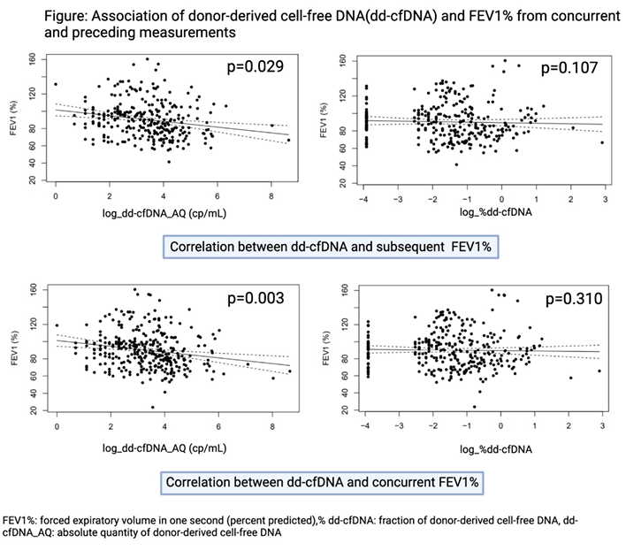
Predictive value of absolute levels of donor-derived cell-free DNA in early detection of lung allograft dysfunction
Results
Prior dd-cfDNA_AQ levels were significantly associated with a subsequent FEV1% decline (p=0.029), suggesting predictive potential, whereas %dd-cfDNA remained non-significant (p=0.107)
No significant association was found between dd-cfDNA levels and FVC% at either concurrent or prior measurements. The mean interval between measurements was 1.8 months (SD ± 1.1 months)
Inclusion of 414 samples from 41 lung transplant (LuTx) recipients (mean 9.7 samples per patient)
Conclusions
An increase in absolute dd-cfDNA levels, in contrast to the dd-cfDNA fraction, was significantly associated with a decline in pulmonary function, suggesting that the absolute quantity of dd-cfDNA may be more reliable biomarker for early detection of lung allograft dysfunction and timely clinical intervention
A significant negative association was observed between concurrently measured dd-cfDNA_AQ and FEV1% (p=0.003), while %dd-cfDNA showed non-significant association (p=0.310)
Alkhouri M. et al., ESOT Congress 2025 (Abstract 2220)
Notes:
Abbreviations: dd-cfDNA, Donor-derived cell-free DNA; AQ, Absolute quantity; LuTx, Lung transplantation; FEV1, Forced Expiratory Volume in 1 second ; FVC, Forced Vital Capacity.
Reference Number: 2220
PREDICTIVE VALUE OF ABSOLUTE LEVELS OF DONOR-DERIVED CELL-FREE DNA IN EARLY DETECTION OF LUNG ALLOGRAFT DYSFUNCTION
Majd Alkhouri^{1,2}, Jan Havlin³, Andrea Zajacova^{1,2}, Alzbeta Dutkova⁴, Jan Balko⁵, Dmitry Rakita⁴, Libor Fila^{2,3}, Robert Lischke³, Tereza Kotowski¹, Kristyna Vyskocilova¹
¹University Hospital Motol, Prague Lung Transplant Program, Department of Pneumology, Prague, Czech Republic, ²Charles University Second Faculty of Medicine, Prague, Czech Republic, ³University Hospital Motol, Prague Lung Transplant Program, 3rd Department of Surgery, Prague, Czech Republic, ⁴University Hospital Motol, Department of Pneumology, Prague, Czech Republic, ⁵University Hospital Motol, Department of Pathology, Prague, Czech Republic
Background: Monitoring donor-derived cell-free DNA (dd-cfDNA) in peripheral blood is a promising non-invasive method for assessing lung allograft health after transplantation. However, fluctuations in the total amount of circulating cell-free DNA may affect the measured plasma dd-cfDNA fraction. This study aimed to investigate the association between both the fractional (%dd-cfDNA) and absolute quantities of dd-cfDNA (dd-cfDNA_AQ) and lung allograft function
Methods: Patients who underwent bilateral lung transplantation (LuTx) between May 2022 and September 2023 with follow-up at our center were considered for inclusion. Samples for dd-cfDNA analyses were prospectively collected between the 3rd and 24th month post-transplant. Associations between estimated %dd-cfDNA, dd-cfDNA_AQ, and pulmonary function tests (FEV1% and FVC% predicted) were assessed (1) at the same time point and (2) between prior dd-cfDNA levels and subsequent lung function to evaluate the predictive value of dd-cfDNA. Linear mixed-effects models were used for statistical analysis.
Results: A total of 414 samples from 41 lung transplant (LuTx) recipients were included (mean 9.7 samples per patient). A significant negative association was observed between concurrently measured dd-cfDNA_AQ and FEV1% (p = 0.003), while %dd-cfDNA showed non-significant association (p = 0.310). Prior dd-cfDNA_AQ levels were significantly associated with a subsequent FEV1% decline (p = 0.029), suggesting predictive potential, whereas %dd-cfDNA remained non significant (p = 0.107). No significant association was found between dd-cfDNA levels and FVC% at either concurrent or prior measurements. The mean interval between measurements was 1.8 months (SD ± 1.1 months).
Conclusions: An increase in absolute dd-cfDNA levels, in contrast to the dd-cfDNA fraction, was significantly associated with a decline in pulmonary function, suggesting that the absolute quantity of dd-cfDNA may be more reliable biomarker for early detection of lung allograft dysfunction and timely clinical intervention. Further investigation is required.

Slide 15
Identifying leukocyte populations as biomarkers for chronic lung allograft dysfunction
Background
Lung transplantation (LT) is the last option for end-stage respiratory diseases, but long-term survival is limited by chronic lung allograft dysfunction (CLAD)
Early CLAD detection is crucial to prevent irreversible damage. Identifying biomarkers can reduce diagnostic subjectivity an improve understanding of underlying mechanisms. This will help LT patients through timely detection and management
Aim
To determine which leukocyte populations in peripheral blood are altered in CLAD after LT
Methods
Case-control study n=68 clinically well-defined lung transplant patients
Stable control
n=29
CLAD follow-up
n=28
de novo CLAD
n=11
Leukocyte subpopulations in peripheral blood were analyzed by flow cytometry using five DuraClone panels (Beckman Coulter, Germany): IM Phenotyping Basic, IM TCRs, IM Treg, IM Granulocytes, and IM Dendritic Cell
Absolute cell counts were determined using Flow-Count following the manufacturer’s instructions
Gómez-Ollés S. et al., ESOT Congress 2025 (Abstract 1479)
Notes:
Abbreviations: LT, Lung transplantation; CLAD, Chronic lung allograft dysfunction; HLA, Human Leukocyte Antigen; Nkreg, Natural killer cells.
Reference Number: 1479
Identifying leukocyte populations as biomarkers for chronic lung allograft dysfunction
Susana Gómez-Ollés¹, Meritxell Boada Pérez², Victoria Ruiz de Miguel², Oriol Grau Bosch², Eva Revilla-López³, Carles Bravo Masgoret³, Berta Saez Gimenez³, Marta Zapata-Ortega³, Manuel López Meseguer³, Roser Escobar³, Victor Monforte Torres³, Cristina Berastegui García³
¹Vall d'Hebron Research Institute and CIBERES, Pulmonology, Barcelona, Spain, ²Vall d'Hebron Research Institute, Pulmonology, Barcelona, Spain, ³Vall d'Hebron University Hospital, Lung Transplantation Unit, Barcelona, Spain
Background: Lung transplantation (LT) is the last option for end-stage respiratory diseases, but long-term survival is limited by chronic lung allograft dysfunction (CLAD). Early CLAD detection is crucial to avoid irreversible damage. Identifying biomarkers to reduce subjectivity in CLAD diagnosis by understanding its biological mechanisms is beneficial for LT patients. This study aims to determine which leukocyte populations in peripheral blood are altered in CLAD after LT.
Methods: This case-control study included 68 clinically well-defined lung transplant patients, divided into three groups: stable control (N=29), CLAD follow-up (N=28), and de novo CLAD (N=11). Leukocyte subpopulations in peripheral blood were analyzed using flow cytometry and five DuraClone panels: IMPhenotyping Basic, IM TCRs, IM Treg, IM Granulocytes, and IM Dendritic Cell (Beckman Coulter, Germany). Flow-Count fluorospheres were used for absolute cell count quantification following the manufacturer’s protocol.
Results: Five leukocyte subpopulations showed significant differences in absolute cell counts among the patient groups. Plasmacytoid dendritic cells (HLA-DR+Lin- CD123+ CD11c-) (Fig. 1a) and myeloid dendritic cells (HLA-DR+ Lin- CD123- CD11c+ CD16- Clec9A+) (Fig. 1b) were significantly reduced in the de novo CLAD group compared to both the follow-up CLAD and stable groups. NKreg cells (CD56high CD16-) were also lower in the de novo CLAD group versus the stable group (Fig. 1c). Significant differences were also observed in the low frequency TCRγδ+ Vδ2+ and Treg Helios+ CD39- populations.
Conclusions: These findings provide valuable insights into the leukocyte populations involved in CLAD onset. Specifically, de novo CLAD patients exhibited reduced levels of plasmacytoid dendritic cells, MDC1, and NKreg cells, all of which are key regulatory cell types.

Slide 16
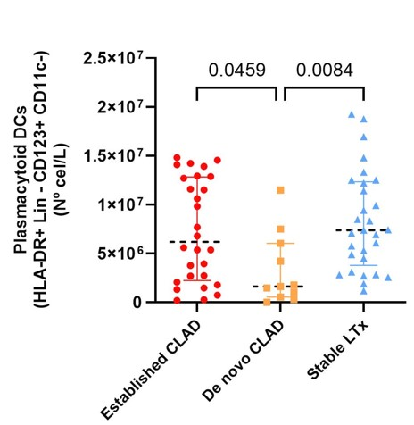
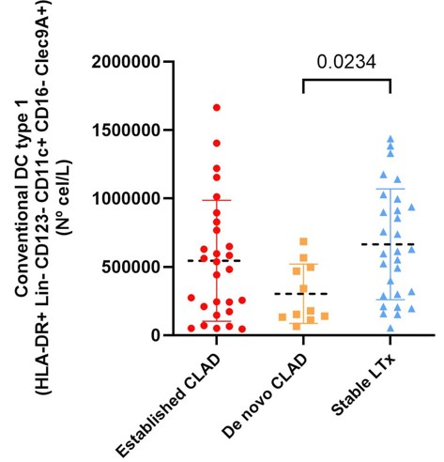
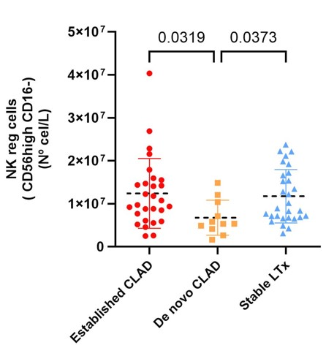
Identifying leukocyte populations as biomarkers for chronic lung allograft dysfunction
Results
Conventional dendritic cells type 1 (HLA-DR+ Lin- CD123- CD11c+ CD16- Clec9A+) were also lower in the de novo CLAD group versus the stable group (Fig. 1c)
Significant differences were also observed in the low frequency TCRγδ+ Vδ2+ and Treg Helios+ CD39- populations
A
B
C
Conclusions
These findings provide valuable insights into the leukocyte populations involved in CLAD onset
Specifically, de novo CLAD patients exhibited reduced levels of plasmacytoid dendritic cells, cDC1, and NKreg cells, all of which are key regulatory cell types
Five leukocyte subpopulations showed significant differences in absolute cell counts among the patient groups
Plasmacytoid dendritic cells (HLA-DR+Lin- CD123+ CD11c-) (Fig. 1a) and NKreg cells (CD56high CD16-) (Fig. 1b) were significantly reduced in the de novo CLAD group compared to both the follow-up CLAD and stable groups
Gómez-Ollés S. et al., ESOT Congress 2025 (Abstract 1479)
Notes:
Abbreviations: LT, Lung transplantation; CLAD, Chronic lung allograft dysfunction; HLA, Human Leukocyte Antigen; Nkreg, Natural killer cells.
Reference Number: 1479
Identifying leukocyte populations as biomarkers for chronic lung allograft dysfunction
Susana Gómez-Ollés¹, Meritxell Boada Pérez², Victoria Ruiz de Miguel², Oriol Grau Bosch², Eva Revilla-López³, Carles Bravo Masgoret³, Berta Saez Gimenez³, Marta Zapata-Ortega³, Manuel López Meseguer³, Roser Escobar³, Victor Monforte Torres³, Cristina Berastegui García³
¹Vall d'Hebron Research Institute and CIBERES, Pulmonology, Barcelona, Spain, ²Vall d'Hebron Research Institute, Pulmonology, Barcelona, Spain, ³Vall d'Hebron University Hospital, Lung Transplantation Unit, Barcelona, Spain
Background: Lung transplantation (LT) is the last option for end-stage respiratory diseases, but long-term survival is limited by chronic lung allograft dysfunction (CLAD). Early CLAD detection is crucial to avoid irreversible damage. Identifying biomarkers to reduce subjectivity in CLAD diagnosis by understanding its biological mechanisms is beneficial for LT patients. This study aims to determine which leukocyte populations in peripheral blood are altered in CLAD after LT.
Methods: This case-control study included 68 clinically well-defined lung transplant patients, divided into three groups: stable control (N=29), CLAD follow-up (N=28), and de novo CLAD (N=11). Leukocyte subpopulations in peripheral blood were analyzed using flow cytometry and five DuraClone panels: IMPhenotyping Basic, IM TCRs, IM Treg, IM Granulocytes, and IM Dendritic Cell (Beckman Coulter, Germany). Flow-Count fluorospheres were used for absolute cell count quantification following the manufacturer’s protocol.
Results: Five leukocyte subpopulations showed significant differences in absolute cell counts among the patient groups. Plasmacytoid dendritic cells (HLA-DR+Lin- CD123+ CD11c-) (Fig. 1a) and myeloid dendritic cells (HLA-DR+ Lin- CD123- CD11c+ CD16- Clec9A+) (Fig. 1b) were significantly reduced in the de novo CLAD group compared to both the follow-up CLAD and stable groups. NKreg cells (CD56high CD16-) were also lower in the de novo CLAD group versus the stable group (Fig. 1c). Significant differences were also observed in the low frequency TCRγδ+ Vδ2+ and Treg Helios+ CD39- populations.
Conclusions: These findings provide valuable insights into the leukocyte populations involved in CLAD onset. Specifically, de novo CLAD patients exhibited reduced levels of plasmacytoid dendritic cells, MDC1, and NKreg cells, all of which are key regulatory cell types.

Slide 17
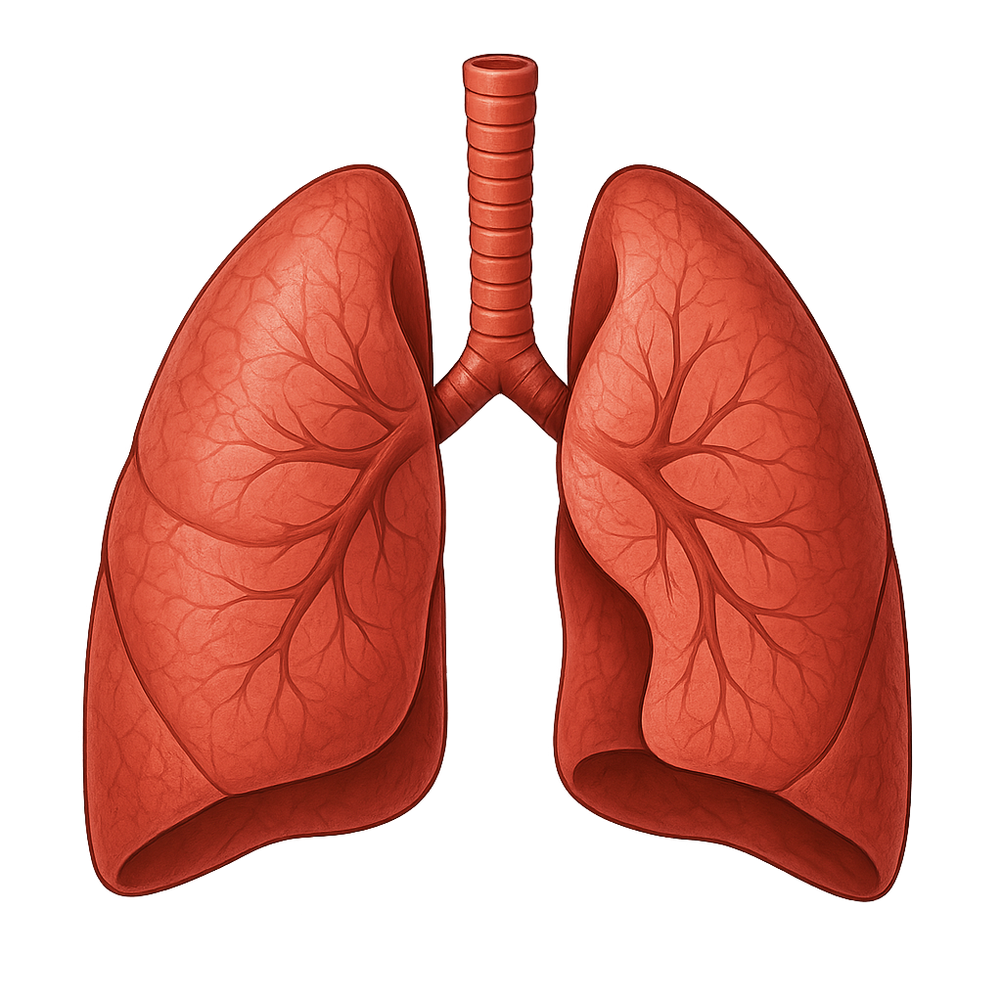
First genome-wide association study of chronic lung allograft dysfunction
Methods
Background
Lung graft survival remains insufficient with only 50.6% survival at 5 years post transplantation
The greatest limitation to long-term survival is chronic lung allograft dysfunction (CLAD)
Aim
To understand the molecular mechanisms underlying CLAD which is critical for improving outcomes
To perform the first genome-wide association study (GWAS) investigating donor and recipient’s genetic factors associated with CLAD
Definition of CLAD
>=20% decline in forced expiratory volume (FEV)
>3 months post-transplant
Absence of infection or another identifiable cause
392 European donor-recipient pairs from the multicentric COLT cohort (Cohort in Lung Transplantation)
Study population
Genotyping method:
Affymetrix Axiom PRMA microarray
After quality controls and SNP imputation, test of 7 million SNPs for association with CLAD
Statistical analysis:
Multivariable logistic regression models corrected for age, sex, initial disease and genetic ancestry
GWAS performed at three levels:
Donors-only,
Recipients-only
Donor-recipient mismatches
Brocard S. et al., ESOT Congress 2025 (Abstract 1831)
Notes:
Abbreviations: CLAD, chronic lung allograft dysfunction; GWAS, genome-wide association study; COLT, Cohort in Lung Transplantation; OR, Odds ratio; SNPs, Single Nucleotide Polymorphisms.
Reference Number: 1831
FIRST GENOME-WIDE ASSOCIATION STUDY OF CHRONIC LUNG ALLOGRAFT DYSFUNCTION
Simon Brocard¹, Martin Morin¹, Leo Boussamet¹, Axelle Durand¹, Nayane Dos Santos Brito Silva¹, Vincent Mauduit¹, Benjamin Renaud-Picard², Benjamin Coiffard³, Xavier Demant⁴, Loïc Falque⁵, Jerôme Le Pavec⁶, Antoine Roux⁷, Thomas Villeneuve⁸, Christiane Knoop⁹, Jean-François Mornex¹⁰, Mathilde Salpin¹¹, Véronique Boussaud¹², Antoine Magnan¹³, Pierre-Antoine Gourraud¹, Mario Sudholt¹⁴, Laureline Berthelot¹, Nicolas Vince¹, Adrien Tissot¹, Sophie Limou1¹
¹Nantes Université, CHU Nantes, Centrale Nantes, Inserm, Center for Research in Transplantation and Translational Immunology, UMR 1064, Nantes, France, ²Strasbourg University Hospital, Pneumology department, Strasbourg, France, ³Aix Marseille University, APHM, Hôpital Nord, Department of Respiratory Medicine and Lung Transplantation, Marseille, France, ⁴University hospital of Bordeaux, Pneumology department, Pessac, France, ⁵Grenoble University Hospital, Grenoble, France, ⁶Paris-Saclay University, Le Kremlin Bicêtre hospital, Department of Pneumology and Lung transplantation, UMR_S 999, Le Plessis-Robinson, France, ⁷Foch hospital, Department of Pneumology, Adult Cystic Fibrosis Center and Lung Transplantation Department , Université de Versailles Saint Quentin Paris-Saclay, INRAe UMR 0892, Suresnes, France, ⁸University of Toulouse III-Paul Sabatier, Toulouse University hospital, Pneumology department, Toulouse, France, ⁹Erasme University Hospital, Pneumology department, Bruxelles, Belgium, ¹⁰Lyon University, Hospices civils de Lyon, Pneumology department, Lyon, France, ¹¹APHP, Bichat hospital, Pneumology and lung transplantation department, University Paris Cité, PHERE UMRS 1152, Paris, France, ¹²APHP, Cochin hospital, Pneumology department, Paris, France, ¹³Foch hospital, University Versailles Saint Quentin Paris Saclay, INRAe UMR 0892, Paris, France, ¹⁴IMT Atlantique, LS2N, DAPI department, STACK team, Nantes, France
Background: Lung graft survival remains insufficient with only 50.6% survival at 5 years post transplantation. The greatest limitation to long-term survival is chronic lung allograft dysfunction (CLAD). Understanding the molecular mechanisms underlying CLAD is critical for improving outcomes. Here, we performed the first genome-wide association study (GWAS) investigating donor and recipient’s genetic factors associated with CLAD.
Methods: CLAD is defined by a >=20% decline in measured forced expiratory volume from the baseline level (3 months after transplant in the absence of infection or another identifiable cause). We genotyped a subset of 392 European donor-recipient pairs from the multicentric COLT cohort (Cohort in Lung Transplantation) using the Affymetrix Axiom PRMA microarray. After quality controls and SNP imputation, we tested 7 million SNPs for association with CLAD using multivariate logistic regression models corrected for age, sex, initial disease and genetic ancestry. The GWAS was performed at three levels: (1) donors-only, (2) recipients-only, and (3) donor-recipient mismatches.
Results: We did not observe any significant association between the donors’ genotypes or the donor-recipient mismatches and CLAD. However, we identified 13 SNPs from the recipients significantly associated with CLAD (P<5x10⁻⁸). Our top signals (34% in CLAD vs 66% in non CLAD recipients, P=2.18x10-9, OR=0.39) encompassed the PLXDC2 gene, that encodes a protein previously associated with the risk for bronchopulmonary dysplasia. Importantly, we demonstrated with scRNAseq data from lung explants (n=4) that PLXDC2 was mostly expressed in monocytes and strongly down-regulated in CLAD vs healthy controls (P=2.22x10 16).
Conclusions: Here, we unveiled the first GWAS conducted in lung transplantation, displaying a biologically relevant candidate gene from the recipient’s genome. Further functional investigations could provide valuable insights into CLAD pathogenesis and potential therapeutic targets. Our study calls for larger genomic initiatives in lung transplantation to increase the power of signal discovery.

Slide 18
First genome-wide association study of chronic lung allograft dysfunction
Results
No significant association between the donors’ genotypes or the donor-recipient mismatches and CLAD
13 SNPs from the recipients significantly associated with CLAD (P<5x10⁻⁸)
scRNAseq data from lung explants (n=4)
PLXDC2 mostly expressed in monocytes and strongly down-regulated in CLAD vs healthy controls (P=2.22x10⁻¹⁶)
Conclusions
Here, we unveiled the first GWAS conducted in lung transplantation, displaying a biologically relevant candidate gene from the recipient’s genome
Further functional investigations could provide valuable insights into CLAD pathogenesis and potential therapeutic targets
Our study calls for larger genomic initiatives in lung transplantation to increase the power of signal discovery
Top signals
66%
34%
non CLAD
CLAD
P=2.18x10⁻⁹, OR=0.39
Encompass the PLXDC2 gene encoding a protein previously associated with the risk for bronchopulmonary dysplasia
Brocard S. et al., ESOT Congress 2025 (Abstract 1831)
Notes:
Abbreviations: CLAD, chronic lung allograft dysfunction; GWAS, genome-wide association study; COLT, Cohort in Lung Transplantation; OR, Odds ratio; SNPs, Single Nucleotide Polymorphisms.
Reference Number: 1831
FIRST GENOME-WIDE ASSOCIATION STUDY OF CHRONIC LUNG ALLOGRAFT DYSFUNCTION
Simon Brocard¹, Martin Morin¹, Leo Boussamet¹, Axelle Durand¹, Nayane Dos Santos Brito Silva¹, Vincent Mauduit¹, Benjamin Renaud-Picard², Benjamin Coiffard³, Xavier Demant⁴, Loïc Falque⁵, Jerôme Le Pavec⁶, Antoine Roux⁷, Thomas Villeneuve⁸, Christiane Knoop⁹, Jean-François Mornex¹⁰, Mathilde Salpin¹¹, Véronique Boussaud¹², Antoine Magnan¹³, Pierre-Antoine Gourraud¹, Mario Sudholt¹⁴, Laureline Berthelot¹, Nicolas Vince¹, Adrien Tissot¹, Sophie Limou1¹
¹Nantes Université, CHU Nantes, Centrale Nantes, Inserm, Center for Research in Transplantation and Translational Immunology, UMR 1064, Nantes, France, ²Strasbourg University Hospital, Pneumology department, Strasbourg, France, ³Aix Marseille University, APHM, Hôpital Nord, Department of Respiratory Medicine and Lung Transplantation, Marseille, France, ⁴University hospital of Bordeaux, Pneumology department, Pessac, France, ⁵Grenoble University Hospital, Grenoble, France, ⁶Paris-Saclay University, Le Kremlin Bicêtre hospital, Department of Pneumology and Lung transplantation, UMR_S 999, Le Plessis-Robinson, France, ⁷Foch hospital, Department of Pneumology, Adult Cystic Fibrosis Center and Lung Transplantation Department , Université de Versailles Saint Quentin Paris-Saclay, INRAe UMR 0892, Suresnes, France, ⁸University of Toulouse III-Paul Sabatier, Toulouse University hospital, Pneumology department, Toulouse, France, ⁹Erasme University Hospital, Pneumology department, Bruxelles, Belgium, ¹⁰Lyon University, Hospices civils de Lyon, Pneumology department, Lyon, France, ¹¹APHP, Bichat hospital, Pneumology and lung transplantation department, University Paris Cité, PHERE UMRS 1152, Paris, France, ¹²APHP, Cochin hospital, Pneumology department, Paris, France, ¹³Foch hospital, University Versailles Saint Quentin Paris Saclay, INRAe UMR 0892, Paris, France, ¹⁴IMT Atlantique, LS2N, DAPI department, STACK team, Nantes, France
Background: Lung graft survival remains insufficient with only 50.6% survival at 5 years post transplantation. The greatest limitation to long-term survival is chronic lung allograft dysfunction (CLAD). Understanding the molecular mechanisms underlying CLAD is critical for improving outcomes. Here, we performed the first genome-wide association study (GWAS) investigating donor and recipient’s genetic factors associated with CLAD.
Methods: CLAD is defined by a >=20% decline in measured forced expiratory volume from the baseline level (3 months after transplant in the absence of infection or another identifiable cause). We genotyped a subset of 392 European donor-recipient pairs from the multicentric COLT cohort (Cohort in Lung Transplantation) using the Affymetrix Axiom PRMA microarray. After quality controls and SNP imputation, we tested 7 million SNPs for association with CLAD using multivariate logistic regression models corrected for age, sex, initial disease and genetic ancestry. The GWAS was performed at three levels: (1) donors-only, (2) recipients-only, and (3) donor-recipient mismatches.
Results: We did not observe any significant association between the donors’ genotypes or the donor-recipient mismatches and CLAD. However, we identified 13 SNPs from the recipients significantly associated with CLAD (P<5x10⁻⁸). Our top signals (34% in CLAD vs 66% in non CLAD recipients, P=2.18x10-9, OR=0.39) encompassed the PLXDC2 gene, that encodes a protein previously associated with the risk for bronchopulmonary dysplasia. Importantly, we demonstrated with scRNAseq data from lung explants (n=4) that PLXDC2 was mostly expressed in monocytes and strongly down-regulated in CLAD vs healthy controls (P=2.22x10 16).
Conclusions: Here, we unveiled the first GWAS conducted in lung transplantation, displaying a biologically relevant candidate gene from the recipient’s genome. Further functional investigations could provide valuable insights into CLAD pathogenesis and potential therapeutic targets. Our study calls for larger genomic initiatives in lung transplantation to increase the power of signal discovery.

Slide 19
Immuno-guided prophylaxis for the prevention of CMV disease in low-risk lung transplant recipients
Background
The standard prophylaxis treatment for CMV disease in CMV-seropositive lung transplant recipients is associated with adverse events and risk of resistance
The current study aims to demonstrate that immuno-guided prophylaxis is effective and safe in seropositive lung transplant recipients
Methods
Phase III, multicentre, randomized, open-label, noninferiority clinical trial conducted in adult lung transplant recipients
Patients randomized (1:1) to:
(1) immuno-guided prophylaxis (IP), 3 months of universal prophylaxis followed by CMV-specific cell-mediated immunity guided discontinuation
(2) standard prophylaxis (SP), 6 months of prophylaxis followed by pre-emptive therapy, both for a total of 12 months
Primary and secondary efficacy endpoints:
CMV disease
Asymptomatic CMV replication at month 18
Primary and secondary safety endpoints:
Incidence of neutropenia (neutrophil count < 1500 cells/μL)
Incidence of rejection
Number of days of valganciclovir prophylaxis
Inclusion of a post-hoc composite efficacy/safety endpoint (CMV disease plus neutropenia)
This trial was registered in EudraCT (2018-003300-39) and ClinicalTrials.gov (NCT03699254)
Paéz Vega A. et al., ESOT Congress 2025 (Abstract 1045)
Notes:
Abbreviations: CMV, Cytomegalovirus; IP, immunoguided prophylaxis; SP, standard prophylaxis; RD, Risk difference; CI, Confidence interval.
Reference Number: 1045
IMMUNOGUIDED PROPHYLAXIS FOR THE PREVENTION OF CMV DISEASE IN LOW RISK LUNG TRANSPLANT RECIPIENTS
Aurora Paéz Vega¹, Jose Manuel Vaquero Barrios², Elisa Ruiz-Arabi³, David Iturbe Fernández⁴, Rodrigo Alonso⁵, Piedad Ussetti-Gil⁶, Victor Monforte Torres⁷, Amparo Pastor⁸, Raquel Fernandez Moreno¹, Victor Mora⁴, Marta Erro-Iribarren⁶, Carlos A Quezada⁵, Cristina Berastegui García⁷, Jose Cifrian Martinez⁴, Angela Cano³, Juan Jose Caston⁶, Isabel MacHuca³, Maria Angeles Lobo-Acosta⁸, Belen Gutierrez Gutierrez⁹, Sara Cantisan¹⁰, Julian de la Torre-Cisneros³
¹Maimónides Institute for Biomedical Research of Córdoba (IMIBIC)/Reina Sofía University Hospital/University of Córdoba (UCO), Córdoba, Spain, Cordoba, Spain, ²Maimónides Institute for Biomedical Research of Córdoba (IMIBIC)/Reina Sofía University Hospital/University of Córdoba (UCO), Córdoba, Spain, Lung Transplantation Unit, Cordoba, Spain, ³Maimónides Institute for Biomedical Research of Córdoba (IMIBIC)/Reina Sofía University Hospital/University of Córdoba (UCO), Córdoba, Spain, Centro de Investigación Biomédica en Red de Enfermedades Infecciosas (CIBERINFEC), Instituto de Salud Carlos III, Madrid, Spain., Infectious Diseases, Cordoba, Spain, ⁴Marques de Valdecilla University Hospital, Santander, Spain, Lung Transplantation Unit, Santander, Spain, ⁵i+12 Research Institute, 12 de Octubre Hospital, Madrid, Spain, Lung Transplantation Unit, Madrid, Spain, ⁶Puerta de Hierro Hospital, Madrid, Spain, Pulmonology Service, Lung Transplant Unit, Madrid, Spain, ⁷Hospital Universitari Vall d'Hebron, Barcelona, Spain. CIBER de Enfermedades Respiratorias, Instituto de Salud Carlos III, Madrid, Spain. , Neumology, Lung Transplantation Unit, Barcelona, Spain, ⁸Virgen del Rocío University Hospital (CTU-HUVR), Sevilla, Spain, Clinical Trials Unit, Seville, Spain, ⁹Virgen Macarena University Hospital/ University of Seville, Biomedicine Institute of Seville (IBIS), Seville, Spain, Centro de Investigación Biomédica en Red de Enfermedades Infecciosas (CIBERINFEC), Instituto de Salud Carlos III, Madrid, Spain, Infectious Diseases Service, Seville, Spain, ¹⁰Maimónides Institute for Biomedical Research of Córdoba (IMIBIC)/Reina Sofía University Hospital/University of Córdoba (UCO), Córdoba, Spain, Centro de Investigación Biomédica en Red de Enfermedades Infecciosas (CIBERINFEC), Instituto de Salud Carlos III, Madrid, Spain., Immunology Service,, Cordoba, Spain
Background: The standard prophylaxis treatment for CMV disease in CMV-seropositive lung transplant recipients is associated with adverse events and risk of resistance. The current study aims to demonstrate that immunoguided prophylaxis is effective and safe in seropositive lung transplant recipients.
Methods: Phase III, multicentre, randomized, open-label, noninferiority clinical trial conducted in adult lung transplant recipients. Patients were randomized (1:1) to: (1) immunoguided prophylaxis (IP), consisting of 3 months of universal prophylaxis followed by CMV-specific cell-mediated immunity guided discontinuation, or (2) standard prophylaxis (SP), consisting of 6 months of prophylaxis followed by pre-emptive therapy, both for a total of 12 months. The primary and secondary efficacy endpoints were CMV disease and asymptomatic CMV replication at month 18. The primary and secondary safety endpoints were the incidence of neutropenia (neutrophil count < 1500 cells/μL), incidence of rejection, and number of days of valganciclovir prophylaxis. A post-hoc composite efficacy/safety endpoint (CMV disease plus neutropenia) was included. This trial was registered in EudraCT (2018-003300-39) and ClinicalTrials.gov (NCT03699254).
Results: A total of 150 patients were randomized. Incidence of CMV disease at month 18 did not differ among groups (18.7% vs. 16%; risk difference [RD] -0.03 [95% CI -0.15% to 0.06%]; P=0.62). The proportion of patients who developed CMV disease at ≤ 180 days after transplant was higher in the IP group compared with the SP group (8% vs. 0%; RD -0.08 [95% CI -0.14 to -0.02; P=0.009]). Asymptomatic CMV replication was reduced in the IP group (4% vs. 16%; adjusted RD 0.12 [95% CI 0.03-0.21; P=0.009]). A total of 30 patients (40%) in the IP group did not require prophylaxis from month 4 to 12. No significant difference was observed in the proportion of patients with neutropenia during months 4 to 7 (14.7% vs. 25.3%; RD 0.11 [95% CI -0.02 to 0.23]; P=0.09) or rejection (33.3% [25 patients] vs. 30.7% [23 patients]; RD -0.03 [95% CI -0.18 to 0.12; P=0.690]). The median days of valganciclovir was lower in the IP group than in the SP group (137 vs. 198; P < 0.001).
Conclusions: Immunoguided prophylaxis was noninferior to the standard of care in preventing CMV disease in lung transplant recipients.

Slide 20

Immuno-guided prophylaxis for the prevention of CMV disease in low-risk lung transplant recipients
Results
A total of 30 patients (40%) in the IP group did not require prophylaxis from month 4 to 12
Incidence of CMV disease at month 18
% patients who developed CMV disease at ≤ 180 days after transplant
% patients with rejection
33.3%
% patients with neutropenia during months 4 to 7
30.7%
18.7%
16%
25.3%
8%
14.7%
0%
IP
SP
IP
SP
IP
Risk difference:
RD -0.03 [95% CI -0.15% to 0.06%]
p=0.62 (No significant difference)
IP
SP
SP
RD 0.11 [95% CI -0.02 to 0.23]
p=0.09 (No significant difference)
RD -0.08 [95% CI -0.14 to -0.02]
p=0.009 (Higher in IP vs SP)
RD -0.03 [95% CI -0.18 to 0.12]
p=0.690 (No significant difference)
198
Conclusions
Immuno-guided prophylaxis was noninferior to the standard of care in preventing CMV disease in lung transplant recipients
Asymptomatic CMV replication
Median days of valganciclovir
137
16%
4%
IP
SP
IP
SP
RD 0.12 [95% CI 0.03-0.21]
p=0.009 (Reduced in IP vs SP)
Lower in the IP vs SP group (p<0.001)
Paéz Vega A. et al., ESOT Congress 2025 (Abstract 1045)
Notes:
Abbreviations: CMV, Cytomegalovirus; IP, immunoguided prophylaxis; SP, standard prophylaxis; RD, Risk difference; CI, Confidence interval.
Reference Number: 1045
IMMUNO-GUIDED PROPHYLAXIS FOR THE PREVENTION OF CMV DISEASE IN LOW RISK LUNG TRANSPLANT RECIPIENTS
Aurora Paéz Vega¹, Jose Manuel Vaquero Barrios², Elisa Ruiz-Arabi³, David Iturbe Fernández⁴, Rodrigo Alonso⁵, Piedad Ussetti-Gil⁶, Victor Monforte Torres⁷, Amparo Pastor⁸, Raquel Fernandez Moreno¹, Victor Mora⁴, Marta Erro-Iribarren⁶, Carlos A Quezada⁵, Cristina Berastegui García⁷, Jose Cifrian Martinez⁴, Angela Cano³, Juan Jose Caston⁶, Isabel MacHuca³, Maria Angeles Lobo-Acosta⁸, Belen Gutierrez Gutierrez⁹, Sara Cantisan¹⁰, Julian de la Torre-Cisneros³
¹Maimónides Institute for Biomedical Research of Córdoba (IMIBIC)/Reina Sofía University Hospital/University of Córdoba (UCO), Córdoba, Spain, Cordoba, Spain, ²Maimónides Institute for Biomedical Research of Córdoba (IMIBIC)/Reina Sofía University Hospital/University of Córdoba (UCO), Córdoba, Spain, Lung Transplantation Unit, Cordoba, Spain, ³Maimónides Institute for Biomedical Research of Córdoba (IMIBIC)/Reina Sofía University Hospital/University of Córdoba (UCO), Córdoba, Spain, Centro de Investigación Biomédica en Red de Enfermedades Infecciosas (CIBERINFEC), Instituto de Salud Carlos III, Madrid, Spain., Infectious Diseases, Cordoba, Spain, ⁴Marques de Valdecilla University Hospital, Santander, Spain, Lung Transplantation Unit, Santander, Spain, ⁵i+12 Research Institute, 12 de Octubre Hospital, Madrid, Spain, Lung Transplantation Unit, Madrid, Spain, ⁶Puerta de Hierro Hospital, Madrid, Spain, Pulmonology Service, Lung Transplant Unit, Madrid, Spain, ⁷Hospital Universitari Vall d'Hebron, Barcelona, Spain. CIBER de Enfermedades Respiratorias, Instituto de Salud Carlos III, Madrid, Spain. , Neumology, Lung Transplantation Unit, Barcelona, Spain, ⁸Virgen del Rocío University Hospital (CTU-HUVR), Sevilla, Spain, Clinical Trials Unit, Seville, Spain, ⁹Virgen Macarena University Hospital/ University of Seville, Biomedicine Institute of Seville (IBIS), Seville, Spain, Centro de Investigación Biomédica en Red de Enfermedades Infecciosas (CIBERINFEC), Instituto de Salud Carlos III, Madrid, Spain, Infectious Diseases Service, Seville, Spain, ¹⁰Maimónides Institute for Biomedical Research of Córdoba (IMIBIC)/Reina Sofía University Hospital/University of Córdoba (UCO), Córdoba, Spain, Centro de Investigación Biomédica en Red de Enfermedades Infecciosas (CIBERINFEC), Instituto de Salud Carlos III, Madrid, Spain., Immunology Service,, Cordoba, Spain
Background: The standard prophylaxis treatment for CMV disease in CMV-seropositive lung transplant recipients is associated with adverse events and risk of resistance. The current study aims to demonstrate that immunoguided prophylaxis is effective and safe in seropositive lung transplant recipients.
Methods: Phase III, multicentre, randomized, open-label, noninferiority clinical trial conducted in adult lung transplant recipients. Patients were randomized (1:1) to: (1) immunoguided prophylaxis (IP), consisting of 3 months of universal prophylaxis followed by CMV-specific cell-mediated immunity guided discontinuation, or (2) standard prophylaxis (SP), consisting of 6 months of prophylaxis followed by pre-emptive therapy, both for a total of 12 months. The primary and secondary efficacy endpoints were CMV disease and asymptomatic CMV replication at month 18. The primary and secondary safety endpoints were the incidence of neutropenia (neutrophil count < 1500 cells/μL), incidence of rejection, and number of days of valganciclovir prophylaxis. A post-hoc composite efficacy/safety endpoint (CMV disease plus neutropenia) was included. This trial was registered in EudraCT (2018-003300-39) and ClinicalTrials.gov (NCT03699254).
Results: A total of 150 patients were randomized. Incidence of CMV disease at month 18 did not differ among groups (18.7% vs. 16%; risk difference [RD] -0.03 [95% CI -0.15% to 0.06%]; P=0.62). The proportion of patients who developed CMV disease at ≤ 180 days after transplant was higher in the IP group compared with the SP group (8% vs. 0%; RD -0.08 [95% CI -0.14 to -0.02; P=0.009]). Asymptomatic CMV replication was reduced in the IP group (4% vs. 16%; adjusted RD 0.12 [95% CI 0.03-0.21; P=0.009]). A total of 30 patients (40%) in the IP group did not require prophylaxis from month 4 to 12. No significant difference was observed in the proportion of patients with neutropenia during months 4 to 7 (14.7% vs. 25.3%; RD 0.11 [95% CI -0.02 to 0.23]; P=0.09) or rejection (33.3% [25 patients] vs. 30.7% [23 patients]; RD -0.03 [95% CI -0.18 to 0.12; P=0.690]). The median days of valganciclovir was lower in the IP group than in the SP group (137 vs. 198; P < 0.001).
Conclusions: Immunoguided prophylaxis was noninferior to the standard of care in preventing CMV disease in lung transplant recipients.

Slide 21
Trajectories of FEV1 after lung transplantation and patient outcomes
Methods
Study:
Adult patients with a bilateral lung transplantation from 15 centers in France, Belgium, Austria and the US, between 2010 and 2021
Background
The forced expiratory volume in one second (FEV1) is the standard measure for monitoring lung allograft function
However, little is known about FEV1 trajectories and their associations with clinical outcomes
All centers performed routine spirometry measurements post lung transplantation at regular intervals commencing shortly after lung transplantation and continuing at regular intervals of maximum three months afterwards.
Collection of recipient, donor and transplant characteristics for each patient
Statistical analysis:
Latent class mixed models were used to identify FEV1 trajectories
Raynaud M. et al., ESOT Congress 2025 (Abstract 1818)
Notes:
Abbreviations: FEV1, forced expiratory volume in one second; IQR, Interquartile Range.
Reference Number: 1818
ABSTRACT TITLE: TRAJECTORIES OF FEV1 AFTER LUNG TRANSPLANTATION AND PATIENT OUTCOMES
Marc Raynaud¹, Natalia Belousova², Matthieu Glorion², Clément Picard², Caroline Hillebrand³, Zehra Dhanani⁴, Laurence Beaumont², Sylvie Colin de Verdière², Edouard Sage², Jonathan Messika², Vincent Bunel⁵, Adrien Tissot⁶, Deborah J. Levine⁷, Jerôme Le Pavec⁸, Julie MacEy⁹, Benjamin Coiffard¹⁰, Thomas Villeneuve¹¹, Benjamin Renaud-Picard¹², Loïc Falque¹³, Nicolas Carlier¹⁴, Claire Merveilleux¹⁵, Fatima Anjum⁴, Alberto Benazzo³, Alexandre Loupy¹, Antoine Roux²
¹Paris Institute for Transplantation and Organ Regeneration, Paris, France, ²Foch hospital, Suresnes, France, ³Medical University of Vienna, Vienna, Austria, ⁴Temple University- Lewis Katz School of Medicine, Philadelphia, United States, ⁵Bichat hospital, Paris, France, ⁶Nantes hospital, Nantes, France, ⁷Stanford University, Stanford, United States, ⁸Marie-Lannelongue hospital, Le Plessis-Robinson, France, ⁹Bordeaux hospital, Bordeaux, France, ¹⁰Marseille hospital, Marseille, France, ¹¹Toulouse hospital, Toulouse, France, ¹²Strasbourg hospital, Strasbourg, France, ¹³Grenoble hospital, Grenoble, France, ¹⁴Cochin Hospital, Paris, France, ¹⁵Lyon hospital, Lyon, France
Background: The forced expiratory volume in one second (FEV1) is the standard measure for monitoring lung allograft function. However, little is known about FEV1 trajectories and their associations with clinical outcomes.
Methods: Adult patients who received a bilateral lung transplantation were included from 15 centers in France, Belgium, Austria and the US, between 2010 and 2021. All centers performed routine spirometry measurements post lung transplantation at regular intervals. All centers performed routine spirometry measurements commencing shortly after lung transplantation and continuing at regular intervals of maximum three months afterwards. Recipient, donor and transplant characteristics were collected for each patient. Latent class mixed models were used to identify FEV1 trajectories.
Results: A total of 2,305 patients were included with 59,034 FEV1 measurements performed. The median follow up post-transplantation was 6.5 years (IQR 4.0-9.0). In the development cohort, the best latent class mixed model identified seven clinically meaningful FEV1 trajectories (Figure). Trajectory #1 (24.7%) was characterized by patients with moderate and stable lung function (5-years patient survival = 79.1%); trajectory #2 (23.4%) and #3 (28.3%) were characterized by patients with moderate/high and stable lung function (5-years patient survival = 94.2% and 90.7% respectively) ; trajectory #4 (3.6%) was characterized by patients with increasing lung function (5-years patient survival = 72.7%) ; trajectory #5 (3.6%) was characterized by patients with a slow decline (5-years patient survival = 68.9%) ; and trajectory #6 (3.1%) and #7 (4.3%) were characterized by patients with accelerated decline (5-years patient survival = 21.1% and 42.3 % respectively). Similar FEV1 trajectories and patient outcomes were identified in the external validation cohorts on the basis of independent analyses. The trajectories were also confirmed in a series of subpopulations. Last, FEV1 value and slope assessed at 1 year post transplant were strongly associated with FEV1 trajectories. Conclusions: We identified FEV1 trajectories that capture different clinical scenarios associated with lung recipients outcomes. Our results provide the basis for a trajectory-based assessment of lung transplant patients.

Slide 22
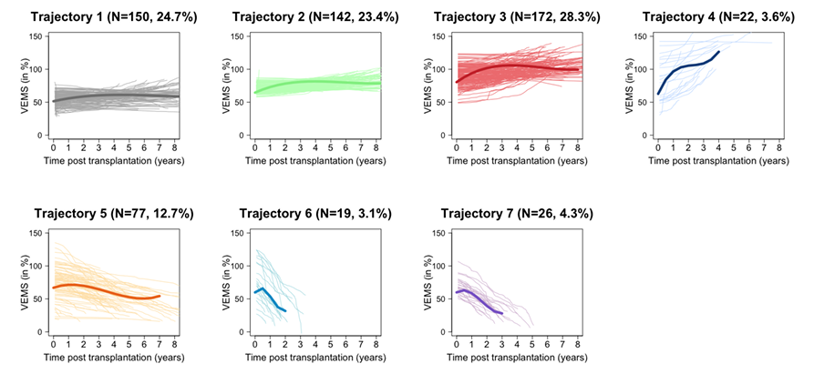
Trajectories of FEV1 after lung transplantation and patient outcomes
Trajectory #1 (24.7%) : patients with moderate and stable lung function (5-years patient survival = 79.1%)
Trajectory #2 (23.4%) and #3 (28.3%) : patients with moderate/high and stable lung function (5-years patient survival = 94.2% and 90.7% respectively)
Trajectory #4 (3.6%) : patients with increasing lung function (5-years patient survival = 72.7%)
Trajectory #5 (3.6%) : patients with a slow decline (5-years patient survival = 68.9%) ; and trajectory #6 (3.1%) and #7 (4.3%) : patients with accelerated decline (5-years patient survival = 21.1% and 42.3 % respectively)
Similar FEV1 trajectories and patient outcomes were identified in the external validation cohorts on the basis of independent analyses. The trajectories were also confirmed in a series of subpopulations
FEV1 value and slope assessed at 1 year post transplant were strongly associated with FEV1 trajectories
Results
n=2,305 patients included with 59,034 FEV1 measurements performed.
The median follow up post-transplantation was 6.5 years (IQR 4.0-9.0)
In the development cohort, the best latent class mixed model identified seven clinically meaningful FEV1 trajectories (see Figure below)
Conclusions
We identified FEV1 trajectories that capture different clinical scenarios associated with lung recipients' outcomes. Our results provide the basis for a trajectory-based assessment of lung transplant patients
Raynaud M. et al., ESOT Congress 2025 (Abstract 1818)
Notes:
Abbreviations: FEV1, forced expiratory volume in one second; IQR, Interquartile Range.
Reference Number: 1818
ABSTRACT TITLE: TRAJECTORIES OF FEV1 AFTER LUNG TRANSPLANTATION AND PATIENT OUTCOMES
Marc Raynaud¹, Natalia Belousova², Matthieu Glorion², Clément Picard², Caroline Hillebrand³, Zehra Dhanani⁴, Laurence Beaumont², Sylvie Colin de Verdière², Edouard Sage², Jonathan Messika², Vincent Bunel⁵, Adrien Tissot⁶, Deborah J. Levine⁷, Jerôme Le Pavec⁸, Julie MacEy⁹, Benjamin Coiffard¹⁰, Thomas Villeneuve¹¹, Benjamin Renaud-Picard¹², Loïc Falque¹³, Nicolas Carlier¹⁴, Claire Merveilleux¹⁵, Fatima Anjum⁴, Alberto Benazzo³, Alexandre Loupy¹, Antoine Roux²
¹Paris Institute for Transplantation and Organ Regeneration, Paris, France, ²Foch hospital, Suresnes, France, ³Medical University of Vienna, Vienna, Austria, ⁴Temple University- Lewis Katz School of Medicine, Philadelphia, United States, ⁵Bichat hospital, Paris, France, ⁶Nantes hospital, Nantes, France, ⁷Stanford University, Stanford, United States, ⁸Marie-Lannelongue hospital, Le Plessis-Robinson, France, ⁹Bordeaux hospital, Bordeaux, France, ¹⁰Marseille hospital, Marseille, France, ¹¹Toulouse hospital, Toulouse, France, ¹²Strasbourg hospital, Strasbourg, France, ¹³Grenoble hospital, Grenoble, France, ¹⁴Cochin Hospital, Paris, France, ¹⁵Lyon hospital, Lyon, France
Background: The forced expiratory volume in one second (FEV1) is the standard measure for monitoring lung allograft function. However, little is known about FEV1 trajectories and their associations with clinical outcomes.
Methods: Adult patients who received a bilateral lung transplantation were included from 15 centers in France, Belgium, Austria and the US, between 2010 and 2021. All centers performed routine spirometry measurements post lung transplantation at regular intervals. All centers performed routine spirometry measurements commencing shortly after lung transplantation and continuing at regular intervals of maximum three months afterwards. Recipient, donor and transplant characteristics were collected for each patient. Latent class mixed models were used to identify FEV1 trajectories.
Results: A total of 2,305 patients were included with 59,034 FEV1 measurements performed. The median follow up post-transplantation was 6.5 years (IQR 4.0-9.0). In the development cohort, the best latent class mixed model identified seven clinically meaningful FEV1 trajectories (Figure). Trajectory #1 (24.7%) was characterized by patients with moderate and stable lung function (5-years patient survival = 79.1%); trajectory #2 (23.4%) and #3 (28.3%) were characterized by patients with moderate/high and stable lung function (5-years patient survival = 94.2% and 90.7% respectively) ; trajectory #4 (3.6%) was characterized by patients with increasing lung function (5-years patient survival = 72.7%) ; trajectory #5 (3.6%) was characterized by patients with a slow decline (5-years patient survival = 68.9%) ; and trajectory #6 (3.1%) and #7 (4.3%) were characterized by patients with accelerated decline (5-years patient survival = 21.1% and 42.3 % respectively). Similar FEV1 trajectories and patient outcomes were identified in the external validation cohorts on the basis of independent analyses. The trajectories were also confirmed in a series of subpopulations. Last, FEV1 value and slope assessed at 1 year post transplant were strongly associated with FEV1 trajectories. Conclusions: We identified FEV1 trajectories that capture different clinical scenarios associated with lung recipients outcomes. Our results provide the basis for a trajectory-based assessment of lung transplant patients.

Slide 23
CMV-IVIG modulates CD8 DR+ level and anti-CMV responses in organ recipients with difficult to control CMV infection
Background
CMV immunoglobulin (CMV-IVIG) has been reported to decrease overactivation status of CD4+ and CD8+ T-cells in high risk heart recipients (D+/R-) when used as adjunctive therapy for prophylaxis of clinical manifestations of CMV infection
In vitro studies have demonstrated that it can also increase CD8+ anti CMV specific responses
Aim
To assess if CMV-IVIG is associated with immunomodulatory changes in vivo by looking for a rational for the use of CMV-IVIG in the setting of difficult to control CMV infection (DCCMV) we performed an immunophenotypic evaluation
Method
Study: Prospective, observational, multicenter
27 Solid organ transplant recipients with DCCMV
  - 13 received Standard of Care (SOC)
  - 14 received SOC + CMV-IVIG
17 Transplant controls (no infection in first 3 months post-transplant)
Immunophenotyping (Flow Cytometry)
CD4⁺, CD8⁺, CD19⁺ lymphocyte subsets
Immunological study timepoints:
At diagnosis of DCCMV
After completion of therapy
Functional Activity Assay (CD8⁺ T cells)
Stimulated with CMV IE1 peptide
Measured IFN-γ production
T Cell Overactivation Analysis
Coexpression of HLA-DR and CD38 by CD4 or CD8+ T-cells
Inclusion Criteria:
Refractory, recurrent or resistant CMV infection
presence of neutropenia secondary to antivirals
Severe hypogammaglobulinemia (IgG < 4 g/L)
Alonso R. et al., ESOT Congress 2025 (Abstract 2672)
Notes:
Abbreviations: CMV, Cytomegalovirus; CMV-IVIG, Cytomegalovirus-specific Intravenous Immunoglobulin; DDCMV, difficulty to control CMV infection; SOC, Standard of Care; IFN-γ, Interferon-gamma; HLA, Human Leukocyte Antigen.
Reference Number: 2672
CMV-IVIG MODULATES CD8 DR+ LEVEL AND ANTI-CMV RESPONSES IN ORGAN RECIPIENTS WITH DIFFICULT TO CONTROL CMV INFECTION
Rocio Alonso¹, Elizabeth Sarmiento², Carlos Ortiz-Bautista³, Rosalia Laporta⁴, Magdalena Salcedo⁵, Maria Luisa Rodriguez Ferrero⁶, Javier Carbone^{1,2,7,8}
¹Instituto de Investigación Sanitaria Puerta de Hierro Segovia de Arana, Grupo de Biomarcadores Inmunitarios e Inmunoterapia, Madrid, Spain, ²Hospital General Universitario Gregorio Marañón, Immunology, Madrid, Spain, ³Hospital General Universitario Gregorio Marañón, Cardiology, Madrid, Spain, ⁴Hospital Universitario Puerta de Hierro Majadahonda, Pneumology, Madrid, Spain, ⁵Hospital Universitario Puerta de Hierro Majadahonda, Gastroenterology, Madrid, Spain, ⁶Hospital Universitario Puerta de Hierro Majadahonda, Nephrology, Madrid, Spain, ⁷Autonoma University, Internal Medicine, Madrid, Spain, ⁸Hospital Universitario Puerta de Hierro Majadahonda, Immunology, Madrid, Spain
Background: CMV immunoglobulin (CMV-IVIG) has been reported to decrease overactivation status of CD4+ and CD8+ T-cells in high risk heart recipients (D+/R-) when used as adjunctive therapy for prophylaxis of clinical manifestations of CMV infection. In vitro studies have demonstrated that it can also increase CD8+ anti CMV specific responses. Looking for a rational for the use of CMV-IVIG in the setting of difficult to control CMV infection (DCCMV) we performed an immunophenotypic evaluation to assess if CMV-IVIG is associated with immunomodulatory changes in vivo.
Methods: In a prospective observational multicenter study, the immunophenotype of CD4+, CD8+ and CD19+ subsets was evaluated in patients at the time of detection of DCCMV in solid organ recipients (n=27). 17 transplant controls without infections during the first 3 months after transplantation were evaluated. The functional activity of CD8+ T cells that produce IFN-gamma was evaluated after stimulation with CMV IE1 peptide. Overactivation status of CD4 and CD8 T cells was evaluated by analyzing coexpression of HLA-DR or CD38 markers by flow cytometry. Inclusion criteria: Refractory, recurrent or resistant CMV infection; presence of neutropenia secondary to antivirals; severe IgG hypogammaglobulinemia (IgG < 4 g/L). 13 solid organ recipients who developed DCCMV were treated with standard of care therapy (SOC) and 14 with SOC + CMV-IVIG. The immunological study was performed at the time of diagnose of DCCMV and after completion of therapy.
Results: DCCMV patients showed lower percentages of CD8+IFNgamma+ T cells to CMV IE1 antigen (0.27 vs 0.56%, p=0.02) and significantly higher percentages of CD8+DR+ T cells (64.9 vs 39.9%, p=0.00026) vs transplant controls. CMV-IVIG was associated with a significant decrease of CD8+DR+ cells (p=0.048) and a significant increase of CD8+IFN gamma+ T cells (p=0.022) while no differences were observed in solid organ recipients using SOC (p=0.36 and p=0.83, respectively).
Conclusions: Overactivation of CD8+ and lower anti-CD8 cellular specific immunity was demonstrated at the time of DCCMV in SOT recipients. Interestingly, CMV-IVIG demonstrated to modulate both components. These observations warrants further evaluation in a randomized clinical trial.

Slide 24
CMV-IVIG modulates CD8 DR+ level and anti-CMV responses in organ recipients with difficult to control CMV infection
Results
Conclusions
Overactivation of CD8+ and lower anti-CD8 cellular specific immunity was demonstrated at the time of DCCMV in SOC recipients
CMV-IVIG demonstrated to modulate both components
These observations warrants further evaluation in a randomized clinical trial
Immune profile of DCCMV
0.56%
64.9%
CD8+IFNgamma+ T cells to CMV IE1 antigen
0.27%
CD8+DR+ T cells to CMV E1 antigen
39.9%
DCCMV patients
Transplant controls
DCCMV patients
Transplant controls
p=0.02
p=0.00026
Immunemodulation by CMVIG
CMV-IVIG associated with a significant decrease of CD8+DR+ cells (p=0.048) and a significant increase of CD8+IFN gamma+ T cells (p=0.022)
No differences observed in solid organ recipients using SOC (p=0.36 and p=0.83, respectively)
Alonso R. et al., ESOT Congress 2025 (Abstract 2672)
Notes:
Abbreviations: CMV, Cytomegalovirus; CMV-IVIG, Cytomegalovirus-specific Intravenous Immunoglobulin; DDCMV, difficulty to control CMV infection; SOC, Standard of Care; IFN-γ, Interferon-gamma; HLA, Human Leukocyte Antigen.
Reference Number: 2672
CMV-IVIG MODULATES CD8 DR+ LEVEL AND ANTI-CMV RESPONSES IN ORGAN RECIPIENTS WITH DIFFICULT TO CONTROL CMV INFECTION
Rocio Alonso¹, Elizabeth Sarmiento², Carlos Ortiz-Bautista³, Rosalia Laporta⁴, Magdalena Salcedo⁵, Maria Luisa Rodriguez Ferrero⁶, Javier Carbone^{1,2,7,8}
¹Instituto de Investigación Sanitaria Puerta de Hierro Segovia de Arana, Grupo de Biomarcadores Inmunitarios e Inmunoterapia, Madrid, Spain, ²Hospital General Universitario Gregorio Marañón, Immunology, Madrid, Spain, ³Hospital General Universitario Gregorio Marañón, Cardiology, Madrid, Spain, ⁴Hospital Universitario Puerta de Hierro Majadahonda, Pneumology, Madrid, Spain, ⁵Hospital Universitario Puerta de Hierro Majadahonda, Gastroenterology, Madrid, Spain, ⁶Hospital Universitario Puerta de Hierro Majadahonda, Nephrology, Madrid, Spain, ⁷Autonoma University, Internal Medicine, Madrid, Spain, ⁸Hospital Universitario Puerta de Hierro Majadahonda, Immunology, Madrid, Spain
Background: CMV immunoglobulin (CMV-IVIG) has been reported to decrease overactivation status of CD4+ and CD8+ T-cells in high risk heart recipients (D+/R-) when used as adjunctive therapy for prophylaxis of clinical manifestations of CMV infection. In vitro studies have demonstrated that it can also increase CD8+ anti CMV specific responses. Looking for a rational for the use of CMV-IVIG in the setting of difficult to control CMV infection (DCCMV) we performed an immunophenotypic evaluation to assess if CMV-IVIG is associated with immunomodulatory changes in vivo.
Methods: In a prospective observational multicenter study, the immunophenotype of CD4+, CD8+ and CD19+ subsets was evaluated in patients at the time of detection of DCCMV in solid organ recipients (n=27). 17 transplant controls without infections during the first 3 months after transplantation were evaluated. The functional activity of CD8+ T cells that produce IFN-gamma was evaluated after stimulation with CMV IE1 peptide. Overactivation status of CD4 and CD8 T cells was evaluated by analyzing coexpression of HLA-DR or CD38 markers by flow cytometry. Inclusion criteria: Refractory, recurrent or resistant CMV infection; presence of neutropenia secondary to antivirals; severe IgG hypogammaglobulinemia (IgG < 4 g/L). 13 solid organ recipients who developed DCCMV were treated with standard of care therapy (SOC) and 14 with SOC + CMV-IVIG. The immunological study was performed at the time of diagnose of DCCMV and after completion of therapy.
Results: DCCMV patients showed lower percentages of CD8+IFNgamma+ T cells to CMV IE1 antigen (0.27 vs 0.56%, p=0.02) and significantly higher percentages of CD8+DR+ T cells (64.9 vs 39.9%, p=0.00026) vs transplant controls. CMV-IVIG was associated with a significant decrease of CD8+DR+ cells (p=0.048) and a significant increase of CD8+IFN gamma+ T cells (p=0.022) while no differences were observed in solid organ recipients using SOC (p=0.36 and p=0.83, respectively).
Conclusions: Overactivation of CD8+ and lower anti-CD8 cellular specific immunity was demonstrated at the time of DCCMV in SOT recipients. Interestingly, CMV-IVIG demonstrated to modulate both components. These observations warrants further evaluation in a randomized clinical trial.

Slide 25
How aggressive is too aggressive:
Navigating reflux and rejection after lung transplantation
Background
Gastroesophageal reflux (GER) is a common challenge after lung transplant (Tx), linked to inferior outcomes
This case highlights the pitfalls of management of GER in a rejection-prone Tx recipient
Case report
.
A 21-years old female was indicated for Tx due to end-stage cystic fibrosis
2 Years & 9 Months Post-Tx
Indication: End-Stage Cystic Fibrosis
9 Months Post-Tx
1 Year After Fundoplication
  Bilateral lung transplantation (Tx)
  Uneventful perioperative period
  Acute cellular rejection (ACR) grade A2
  No clear cause, unresponsive to standard anti-rejection treatment
  pH-metry confirmed gastroesophageal reflux (GER)
  Escalation of anti-reflux + 2nd line of anti-rejection treatment
  Full clinical response
  Sudden decline in lung function
  ACR grade A3 + de novo donor specific antibodies, unresponsive to 1st, 2nd, and 3rd line of therapy
  Repeated pH-metry confirmed worsening of GER
  Nissen Fundoplication performed
  Follow-up: pH-metry negative along with lung function stabilisation
  Re-Transplantation (re-Tx) due to end-stage CLAD
  Favourable post-operative course
  Surveillance: persistent GER
  Re-Fundoplication as a Preventive Measure
  Lung function remain stable
Ferrão G. et al., ESOT Congress 2025 (Abstract 1462)
Notes:
Abbreviations: GER, Gastroesophageal reflux; ACR, acute cellular rejection; Tx, Transplantation; CLAD, chronic lung allograft dysfunction.
Reference Number: 1462
HOW AGGRESSIVE IS TOO AGGRESSIVE: NAVIGATING REFLUX AND REJECTION AFTER LUNG TRANSPLANTATION
Gonçalo Ferrão¹, Miray Guney¹, Majd Alkhouri², Eliška Dvořáčková³, Libor Fila², Jan Havlin⁴, Robert Lischke⁴, Andrea Zajacova²
¹Second Faculty of Medicine, Charles University, Prague, Czech Republic, ²Prague Lung Transplant Program, Department of Pulmonology, Second Faculty of Medicine, Charles University, Motol University Hospital, Prague, Czech Republic, ³Institute of Pharmacology, First Faculty of Medicine, Charles University, Prague, Czech Republic, ⁴Prague Lung Transplant Program, 3rd Department of Surgery, First Faculty of Medicine, Charles University, Motol University Hospital, Prague, Czech Republic
Background: Gastroesophageal reflux (GER) is a common challenge after lung transplant (Tx), linked to inferior outcomes. This case highlights the pitfalls of management of GER in a rejection-prone Tx recipient.
Case report: A 21-year old female was indicated for Tx due to end-stage cystic fibrosis. Patient was immunologically uncomplicated and received bilateral Tx, followed by an uneventful perioperative period. At 9 months post-Tx, the patient experienced A2 grade acute cellular rejection (ACR) without clear etiology. The rejection did not respond to initial anti-rejection treatment, raising suspicion of GER as the underlying cause, confirmed via pH-metry. This prompted escalation of anti-reflux therapy along with further anti-rejection treatment, resulting in a clinical response. Two years later, the patient presented a significant drop in lung function. Biopsy showed ACR grade A3, followed by de novo donor specific antibodies. Despite therapy, the patient developed rapidly progressive chronic lung allograft dysfunction (CLAD). Repeated pH-metry confirmed worsening GER and led to a Nissen fundoplication. Following pHmetry afterward was negative. A year after fundoplication, re-Tx was performed due to end-stade CLAD. Post re-Tx course was favourable, with no rejection complications. However, surveillance pH-metry showed persistent GER despite status after fundoplication. Given the patient’s history of rejection associated with GER, a second Nissen fundoplication was performed as a preventive measure. Following this intervention, the patient remains rejection-free. Interestingly, no bile acids in bronchoalveolar lavage or GER symptoms were present through the entire course.
Conclusions: This case highlights a link between GER and rejection, ultimately necessitating re transplantation. The role of fundoplication as a preventive versus curative strategy warrants further study, emphasizing the need for comprehensive GER management guidelines in lung transplant patients.

Slide 26
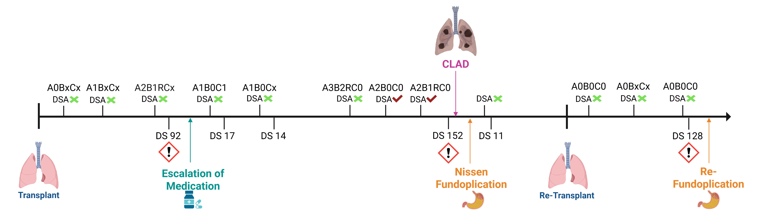
Interestingly, no bile acids in bronchoalveolar lavage or GER symptoms were present through the entire course
How aggressive is too aggressive:
Navigating reflux and rejection after lung transplantation
Figure: Timeline of patient’s post-transplant course. Above the timeline are depicted performed biopsies and donor-specific antibodies (DSA), below DeMeester Scores (DS) of performed pH-metries.
Conclusions
This case highlights a link between GER and rejection, ultimately necessitating re-transplantation
The role of fundoplication as a preventive versus curative strategy warrants further study, emphasizing the need for comprehensive GER management guidelines in lung transplant patients
Ferrão G. et al., ESOT Congress 2025 (Abstract 1462)
Notes:
Abbreviations: GER, Gastroesophageal reflux; ACR, acute cellular rejection; Tx, Transplantation; CLAD, chronic lung allograft dysfunction.
Reference Number: 1462
HOW AGGRESSIVE IS TOO AGGRESSIVE: NAVIGATING REFLUX AND REJECTION AFTER LUNG TRANSPLANTATION
Gonçalo Ferrão¹, Miray Guney¹, Majd Alkhouri², Eliška Dvořáčková³, Libor Fila², Jan Havlin⁴, Robert Lischke⁴, Andrea Zajacova²
¹Second Faculty of Medicine, Charles University, Prague, Czech Republic, ²Prague Lung Transplant Program, Department of Pulmonology, Second Faculty of Medicine, Charles University, Motol University Hospital, Prague, Czech Republic, ³Institute of Pharmacology, First Faculty of Medicine, Charles University, Prague, Czech Republic, ⁴Prague Lung Transplant Program, 3rd Department of Surgery, First Faculty of Medicine, Charles University, Motol University Hospital, Prague, Czech Republic
Background: Gastroesophageal reflux (GER) is a common challenge after lung transplant (Tx), linked to inferior outcomes. This case highlights the pitfalls of management of GER in a rejection-prone Tx recipient.
Case report: A 21-year old female was indicated for Tx due to end-stage cystic fibrosis. Patient was immunologically uncomplicated and received bilateral Tx, followed by an uneventful perioperative period. At 9 months post-Tx, the patient experienced A2 grade acute cellular rejection (ACR) without clear etiology. The rejection did not respond to initial anti-rejection treatment, raising suspicion of GER as the underlying cause, confirmed via pH-metry. This prompted escalation of anti-reflux therapy along with further anti-rejection treatment, resulting in a clinical response. Two years later, the patient presented a significant drop in lung function. Biopsy showed ACR grade A3, followed by de novo donor specific antibodies. Despite therapy, the patient developed rapidly progressive chronic lung allograft dysfunction (CLAD). Repeated pH-metry confirmed worsening GER and led to a Nissen fundoplication. Following pHmetry afterward was negative. A year after fundoplication, re-Tx was performed due to end-stade CLAD. Post re-Tx course was favourable, with no rejection complications. However, surveillance pH-metry showed persistent GER despite status after fundoplication. Given the patient’s history of rejection associated with GER, a second Nissen fundoplication was performed as a preventive measure. Following this intervention, the patient remains rejection-free. Interestingly, no bile acids in bronchoalveolar lavage or GER symptoms were present through the entire course.
Conclusions: This case highlights a link between GER and rejection, ultimately necessitating re transplantation. The role of fundoplication as a preventive versus curative strategy warrants further study, emphasizing the need for comprehensive GER management guidelines in lung transplant patients.

