Slide 1
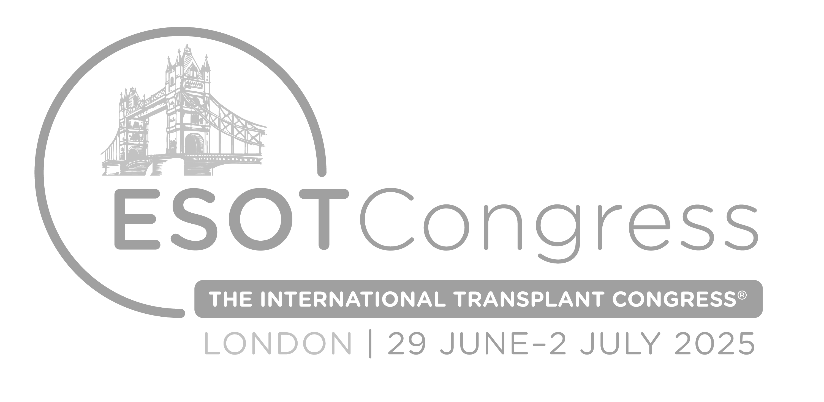

Best of
ESOT Congress 2025
Liver & Pancreas/Islets

Slide 2
Disclaimer
This slide deck is designed for personal educational purposes only and should not be utilised for making patient management decisions. It is important to verify all information provided before treating patients or applying any therapies mentioned in these materials.

Slide 3
Information
This slide deck showcases the latest data presented at the ESOT Congress 2025.
All abbreviations displayed in these slides, along with a complete copy of the
original abstract text, can be found in the slide notes.
3. Click on the symbol to return to the contents page.

Slide 4
Content
LIVER & PANCREAS/ISLETS
441.
A cfChIP- seq liquid biopsy for the diagnosis of cellular rejection following liver transplantation
807.
Understanding the impact of obesity on liver transplant outcomes: A comprehensive analysis
421.
Living with a transplanted liver is associated with airflow limitation: A nationwide cohort study
2593.
Outcome of split-liver transplantation with extended right grafts within Scandiatransplant
2138.
Monitoring of dd-cfDNA and miRNA for early detection of graft dysfunction in adult liver transplant recipients
1726.
Mitochondrial therapy during machine perfusion restores DCD livers: A cross-circulation assessment of transplantability
2314.
Impact of transplant program on the probability of conversion after immunotherapy for hepatocellular carcinoma
2229.
Pancreatic beta cell heterogeneity in adult human islets: Insight from single-islet transcriptomic profiling using DisCo
62.
Impact of islets transplantation on diabetic complications / mortality in type 1 diabetes recipients
1749.
Long term outcomes of pancreas transplantation alone from donation after circulatory death
404.
Listing patients with hepatocellular carcinoma for liver transplantation: Ontario & revised criteria
1841.
Pregnancy outcomes following pancreas transplantation: A single center experience

Slide 5
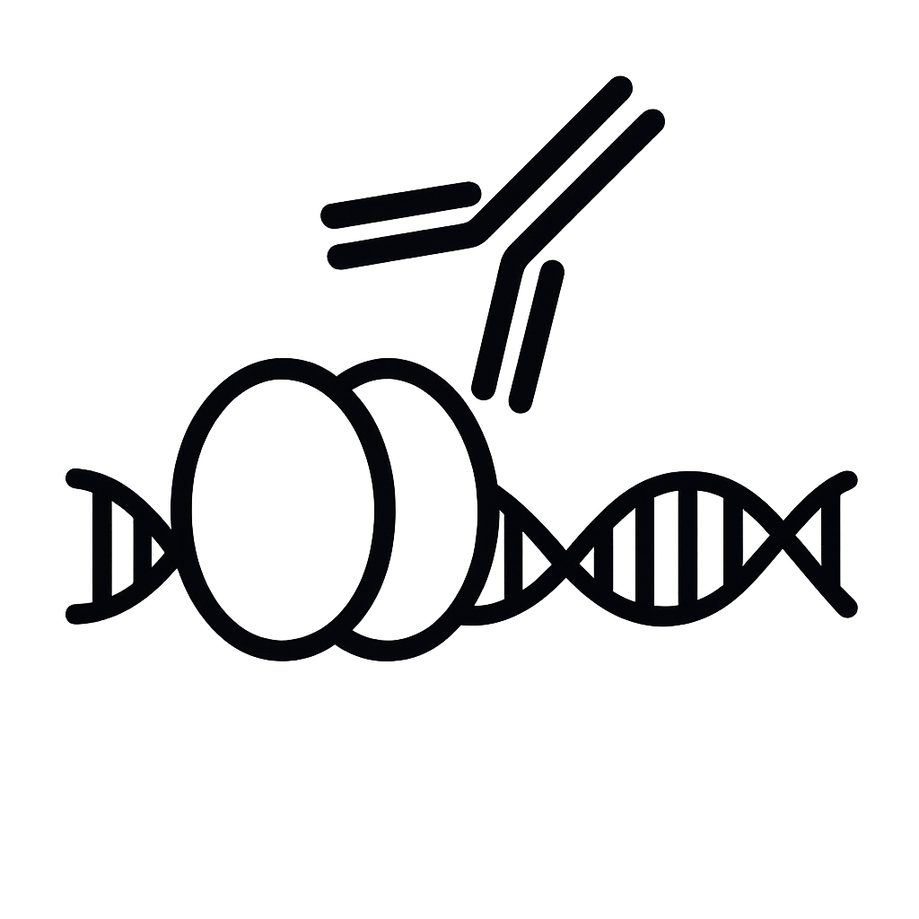
A cfChIP- seq liquid biopsy for the diagnosis of cellular rejection following liver transplantation
Background
Liver transplantation (LTx) is a vital treatment option for patients with end stage liver diseases
Acute cellular rejection (ACR) is a significant clinical diagnostic and therapeutic challenge at the post-transplant period
The clinical challenge lies in distinguishing ACR from other acute events, such as infections, vascular events, drug toxicity and biliary damage, which necessitates very different therapeutic modalities
Current diagnostic standards require liver biopsy for ACR diagnosis
This leads to a delay in diagnosis, is invasive, and with potentially complications
There is an urgent need for a simple, reliable, and reproducible non-invasive diagnostic test, which could be performed on daily basis, for monitoring post LTx patients and diagnosing ACR
Methods
Cell-free chromatin immunoprecipitation
Sequencing (cfChIP-seq)
Epigenetic-based liquid biopsy assay to profile circulating cfDNA originating from active genes in plasma samples (Sadeh et al, Nat. Biotech 2001)
This assay:
Allows for interrogation of gene activity in the cell of origin
Provides insights into the extent of liver damage and the molecular states of dying liver cells and immune cells
Imam A. et al., ESOT Congress 2025 (Abstract 441)
Notes:
Abbreviations: LTx, Liver transplantation ; ACR, Acute cellular rejection; ALT, Alanine Aminotransferase; AST, Aspartate Aminotransferase; AUC, Area Under the Curve.
Reference Number: 441
A CFCHIP- SEQ LIQUID BIOPSY FOR THE DIAGNOSIS OF CELLULAR REJECTION FOLLOWING LIVER TRANSPLANTATION
Ashraf Imam¹, Jenia Gutin², Ronen Sadeh², Gavriel Fialkoff², Israa Sharkia², Rifaat Safadi³, Yael Milgrom³, Zohar Shemuelian², Naomi Gorelin⁴, Dashash Abata⁴, Esther Harpenas², Eithan Galun⁴, Nir Friedman², Abed Khalaileh¹
¹Department of surgery and organ transplantation unit, Hadassah-Hebrew university hospital, jerusalem, Israel, ²The Rachel and Selim Benin School of Computer Science and Engineering, The Hebrew University of Jerusalem, Institute for Medical Research Israel-Canada, The Hebrew University-Hadassah Medical School, Jerusalem, Israel, Jerusalem, Israel, ³The Liver Unit Institute of Gastroenterology and Liver Diseases, Hadassah-Hebrew University Medical Center, jerusalem, Israel, ⁴The Goldyne Savad Institute for Gene Therapy, Hadassah-Hebrew University Medical Center,, jerusalem, Israel
Background: Liver transplantation (LTx) is a vital treatment option for patients with endstage liver diseases. Acute cellular rejection (ACR) is a significant clinical diagnostic and therapeutic challenge at the post-transplant period. The clinical challenge lies in distinguishing ACR from other acute events, such as infections, vascular events, drug toxicity and biliary damage, which necessitates very different therapeutic modalities. Current diagnostic standards require liver biopsy for ACR diagnosis. This leads to a delay in diagnosis, is invasive, and with potentially complications. There is an urgent need for a simple, reliable, and reproducible non-invasive diagnostic test, which could be performed on daily basis, for monitoring post LTx patients and diagnosing ACR.
Methods: We utilized cell-free chromatin immunoprecipitation followed by sequencing (cfChIP-seq), a novel epigenetic-based liquid biopsy assay we recently introduced (Sadeh et al, Nat. Biotech 2001), to profile circulating cfDNA originating from active genes in plasma samples. The assay allows for interrogation of gene activity in the cell of origin. It provides insights into the extent of liver damage and the molecular states of dying liver cells and immune cells.
Results: We enrolled a cohort of >150 LTx patients and prospectively collected >4000 blood samples through their post-transplant hospitalization. We collected blood samples during 15 biopsy verified ACR events and 14 non-ACT acute events for 20 patients. We developed a cfChIP seq signature of genes that distinguish ACR samples from other acute liver damage events. We show that this signature allows the classification of ACR events with AUC of 0.94. This signature provides superior diagnostic performance compared to blood assay of liver enzymes (AUC of 0.75 for ALT and 0.48 for AST). We validated this signature in a follow-up LTx cohort.
Conclusions: We developed an ACR blood test using a cfDNA signature with high accuracy in patients post-LTx. The assay is highly reproducible and robust, suggesting a path toward non invasive detection, monitoring, and diagnosis of post-LTx ACR.

Slide 6

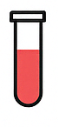
A cfChIP- seq liquid biopsy for the diagnosis of cellular rejection following liver transplantation
Results
Conclusions
We developed an ACR blood test using a cfDNA signature with high accuracy in patients post-LTx
The assay is highly reproducible and robust, suggesting a path toward non-invasive detection, monitoring, and diagnosis of post-LTx ACR
Cohort n>150 LTx patients
>4000 blood samples through their post-transplant hospitalization
Collection of blood samples during 15 biopsy verified ACR events and 14 non-ACR acute events for 20 patients
Development of a cfChIP seq signature of genes that distinguish ACR samples from other acute liver damage events
This signature allows the classification of ACR events with AUC of 0.94
This signature provides superior diagnostic performance compared to blood assay of liver enzymes (AUC of 0.75 for ALT and 0.48 for AST)
Validation of this signature in a follow-up LTx cohort
Imam A. et al., ESOT Congress 2025 (Abstract 441)
Notes:
Abbreviations: LTx, Liver transplantation ; ACR, Acute cellular rejection; ALT, Alanine Aminotransferase; AST, Aspartate Aminotransferase; AUC, Area Under the Curve.
Reference Number: 441
A CFCHIP- SEQ LIQUID BIOPSY FOR THE DIAGNOSIS OF CELLULAR REJECTION FOLLOWING LIVER TRANSPLANTATION
Ashraf Imam¹, Jenia Gutin², Ronen Sadeh², Gavriel Fialkoff², Israa Sharkia², Rifaat Safadi³, Yael Milgrom³, Zohar Shemuelian², Naomi Gorelin⁴, Dashash Abata⁴, Esther Harpenas², Eithan Galun⁴, Nir Friedman², Abed Khalaileh¹
¹Department of surgery and organ transplantation unit, Hadassah-Hebrew university hospital, jerusalem, Israel, ²The Rachel and Selim Benin School of Computer Science and Engineering, The Hebrew University of Jerusalem, Institute for Medical Research Israel-Canada, The Hebrew University-Hadassah Medical School, Jerusalem, Israel, Jerusalem, Israel, ³The Liver Unit Institute of Gastroenterology and Liver Diseases, Hadassah-Hebrew University Medical Center, jerusalem, Israel, ⁴The Goldyne Savad Institute for Gene Therapy, Hadassah-Hebrew University Medical Center,, jerusalem, Israel
Background: Liver transplantation (LTx) is a vital treatment option for patients with endstage liver diseases. Acute cellular rejection (ACR) is a significant clinical diagnostic and therapeutic challenge at the post-transplant period. The clinical challenge lies in distinguishing ACR from other acute events, such as infections, vascular events, drug toxicity and biliary damage, which necessitates very different therapeutic modalities. Current diagnostic standards require liver biopsy for ACR diagnosis. This leads to a delay in diagnosis, is invasive, and with potentially complications. There is an urgent need for a simple, reliable, and reproducible non-invasive diagnostic test, which could be performed on daily basis, for monitoring post LTx patients and diagnosing ACR.
Methods: We utilized cell-free chromatin immunoprecipitation followed by sequencing (cfChIP-seq), a novel epigenetic-based liquid biopsy assay we recently introduced (Sadeh et al, Nat. Biotech 2001), to profile circulating cfDNA originating from active genes in plasma samples. The assay allows for interrogation of gene activity in the cell of origin. It provides insights into the extent of liver damage and the molecular states of dying liver cells and immune cells.
Results: We enrolled a cohort of >150 LTx patients and prospectively collected >4000 blood samples through their post-transplant hospitalization. We collected blood samples during 15 biopsy verified ACR events and 14 non-ACT acute events for 20 patients. We developed a cfChIP seq signature of genes that distinguish ACR samples from other acute liver damage events. We show that this signature allows the classification of ACR events with AUC of 0.94. This signature provides superior diagnostic performance compared to blood assay of liver enzymes (AUC of 0.75 for ALT and 0.48 for AST). We validated this signature in a follow-up LTx cohort.
Conclusions: We developed an ACR blood test using a cfDNA signature with high accuracy in patients post-LTx. The assay is highly reproducible and robust, suggesting a path toward non invasive detection, monitoring, and diagnosis of post-LTx ACR.

Slide 7
Living with a transplanted liver is associated with airflow limitation: A nationwide cohort study
1
2
Background
There is a close interaction between the liver and the lungs.
However, the burden of pulmonary diseases with airflow limitation in liver transplant recipients is unknown as their assessment does not include routine pulmonary function tests
This study investigated lung function measured by spirometry in liver transplant recipients and in age- and sex matched controls from the general population
The study determined the association between living with a transplanted liver and airflow limitation as well as forced expiratory volume in one second (FEV₁) and forced vital capacity (FVC)
Risk factors associated with airflow limitation was also investigated
Methods
 | LT recipients (n=512) | Controls (n=2010) | p-value
Characteristics
Sex (male), n (%) | 287 (56.1) | 1119 (55.6) | 0.88
Age, years, median (IQR) | 55.0 (44.9-63.6) | 55.1 (45.0-63.9) | 0,78
Ethnicity |  |  | <0.001
- Caucasian | 493 (96.3) | 2003 (99.7)
- Other | 19 (3.7) | 7 (1.4)
Height, cm, median (IQR) | 172.5 (166.0-179.6) | 174.0 (167.0-180.5) | 0.04
Weight, kg, median (IQR) | 80.2 (69.6-91.2) | 78.6 (68.3-88.7) | 0,05
Body mass index, median (IQR) | 26.6 (23.6-29.9) | 25.6 (23.3-28.5) | 0,68
Educational status |  |  | <0.001
- No education | 60 (11.7) | 146 (7.3)
- Short (<3 years) | 42 (8.2) | 169 (8.4)
- Vocational (1-3 years) | 185 (36.1) | 558 (27.8)
- Middle length (3 years e.g. Nurse or teacher) | 116 (22.7) | 557 (27.7)
- University degree | 91 (17.8) | 559 (27.8)
Smoking and self-reporting respiratory morbidity
Smoking status |  |  | 0.10
Smoking status - Current, n (%) | 55 (10.7) | 213 (10.6)
Smoking status - Previous, n (%) | 165 (32) | 762 (37.9)
Smoking status - Never, n (%) | 272 (52.9) | 997 (49.6)
Smoking history, pack-years, median (IQR) | 11.0 (4.5-20.4) | 12.5 (5.0-26.3) | 0,7
Self-reported asthma, n (%) | 34 (6.6) | 144 (7.2) | 0,77
Self-reported COPD, n (%) | 9 (1.8) | 39 (1.9) | >0.99
Use of inhalation medicine for asthma or bronchitis at baseline, n (%) | 31 (6.1) | 109 (5.4) | 0.66
1: From The Danish Comorbidity in Liver Transplant Recipients (DACOLT) study
2: Age and sex matched controls from The Copenhagen General Population Study (CGPS)
Airflow limitation was defined as FEV₁/FVC <0.7 and predicted FEV₁ <80% as recommended by The Global Initiative for Chronic Obstructive Lung Disease
Arentoft N. et al., ESOT Congress 2025 (Abstract 421)
Notes:
Abbreviations: FEV₁, Forced expiratory volume in one second ; FVC, Forced vital capacity ; IQR, Interquartile Range; CI, Confidence interval; aOR, adjusted odds ratio.
Reference Number: 421
Living with a transplanted liver is associated with airflow limitation: A nationwide cohort study
Nicoline Arentoft¹, Shoaib Afzal^{2,3}, Hans-Christian Pommergaard^{4,5}, Safura-Luise Heidari¹, Rebekka Faber Thudium¹, Paul Suno Krohn⁶, Jens-Ulrik Stæhr Jensen⁷, Ask Bock¹, Jesper Rømhild Davidsen⁸, Niels Kristian Muff Aagaard⁹, Børge Grønne Nordestgaard^{2,10}, Michael Perch^{10,11}, Allan Rasmussen⁶, Annette Dam Fialla¹², Susanne Dam Nielsen^{1,10}
¹Copenhagen University Hospital - Rigshospitalet, Department of Infectious Diseases, Copenhagen, Denmark, ²Copenhagen University Hospital - Herlev and Gentofte, Department of Clinical Biochemistry, Herlev, Denmark, ³University of Copenhagen, Department of Clnical Medicine, Copenhagen, Denmark, ⁴Copenhagen University Hospital - Rigshospitalet, Department of Surgery and Transplantation, Hepatic Malignancy Surgical Research Unit (HEPSURU), Copenhagen, Denmark, ⁵Copenhagen University, Department of Clinical Biochemistry, Copenhagen, ⁶Copenhagen University Hospital - Rigshospitalet, Department of Surgery and Transplantation, Copenhagen, Denmark, ⁷Copenhagen University Hospital - Herlev and Gentofte, Department of Respiratory Medicine, Gentofte, Denmark, ⁸Odense University Hospital, Department of Respiratory Medicine, South Danish Center for Interstitial Lung Diseases (SCILS), Odense, Denmark, ⁹Aarhus University Hospital, Department of Hepatology and Gastroenterology, Aarhus, Denmark, ¹⁰University of Copenhagen, Department of Clinical Medicine, Copenhagen, Denmark, ¹¹Copenhagen University Hospital - Rigshospitalet, Department of Cardiology, Heart and Lung Transplant Unit, Copenhagen, Denmark, ¹²Odense University Hospital, Department of Gastroenterology, Odense, Denmark
Background: There is a close interaction between the liver and the lungs. However, the burden of pulmonary diseases with airflow limitation in liver transplant recipients is unknown as their assessment does not include routine pulmonary function tests. This study investigated lung function measured by spirometry in liver transplant recipients and in age- and sex matched controls from the general population. The study determined the association between living with a transplanted liver and airflow limitation as well as forced expiratory volume in one second (FEV1) and forced vital capacity (FVC). Risk factors associated with airflow limitation was also investigated.
Methods: Spirometry was performed in 512 adult liver transplant recipients from The Danish Comorbidity in Liver Transplant Recipients (DACOLT) study and 2010 age and sex matched controls from The Copenhagen General Population Study (CGPS). Airflow limitation was defined as FEV₁/FVC <0.7and predicted FEV₁ <80% as recommended by The Global Initiative for Chronic Obstructive Lung Disease.
Results: Liver transplant recipients had higher prevalence of airflow limitation than controls (10.7% vs. 7.1%, p=0.01). When adjusted for age, sex, ethnicity, cumulated smoking, and educational status, living with a transplanted liver was associated with airflow limitation with an adjusted odds ratio (aOR) of 2.06 (95% confidence interval (CI) 1.4-3.0 p<0.001). Liver transplant recipients had 363 mL (95% CI 297-430 mL, p<0.001) lower FEV1 and 549 mL (95% CI 467-632 mL, p<0.001) lower FVC than controls. Previous pulmonary infection was associated with airflow limitation in liver transplant recipients (aOR 2.23 [95% CI 1.0-4.7], p=0.03).
Conclusions: Living with a transplanted liver is independently associated with airflow limitation, lower FEV1 and FVC. Previous pulmonary infection increased the risk of airflow limitation. Increased awareness of pulmonary comorbidities in liver transplant recipients may be warranted.

Slide 8
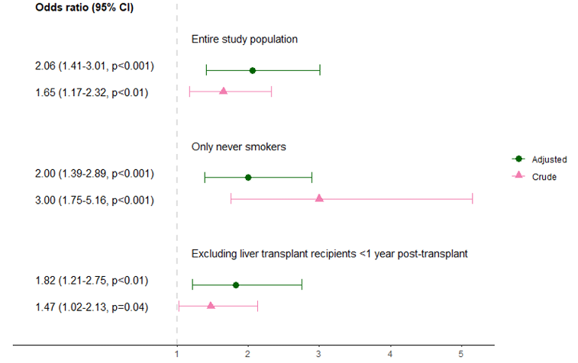
Living with a transplanted liver is associated with airflow limitation: A nationwide cohort study
Results
When adjusted for age, sex, ethnicity, cumulated smoking, and educational status, living with a transplanted liver was associated with airflow limitation with an adjusted odds ratio (aOR) of 2.06 (95% CI 1.4-3.0 p<0.001)
Liver transplant recipients had 363 mL (95% CI 297-430 mL, p<0.001) lower FEV₁ and 549 mL (95% CI 467-632 mL, p<0.001) lower FVC than controls
Previous pulmonary infection was associated with airflow limitation in liver transplant recipients (aOR 2.23 [95% CI 1.0-4.7], p=0.03)
Conclusions
Living with a transplanted liver is independently associated with airflow limitation, lower FEV₁ and FVC
Previous pulmonary infection increased the risk of airflow limitation
Increased awareness of pulmonary comorbidities in liver transplant recipients may be warranted
Figure 1. Association between living with a transplanted liver and airflow limitation. Results are shown for main analysis including the entire study population and for sensitivity analyses i) including only never smoking participants and ii) excluding liver transplant recipients <1-year post-transplantation. Adjusted odds ratios were adjusted for sex, age, ethnicity, cumulated smoking in pack years, and educational status.
Liver transplant recipients had higher prevalence of airflow limitation than controls (10.7% vs. 7.1%, p=0.01)
Arentoft N. et al., ESOT Congress 2025 (Abstract 421)
Notes:
Abbreviations: FEV₁, Forced expiratory volume in one second ; FVC, Forced vital capacity ; IQR, Interquartile Range; CI, Confidence interval; aOR, adjusted odds ratio.
Reference Number: 421
Living with a transplanted liver is associated with airflow limitation: A nationwide cohort study
Nicoline Arentoft¹, Shoaib Afzal^{2,3}, Hans-Christian Pommergaard^{4,5}, Safura-Luise Heidari¹, Rebekka Faber Thudium¹, Paul Suno Krohn⁶, Jens-Ulrik Stæhr Jensen⁷, Ask Bock¹, Jesper Rømhild Davidsen⁸, Niels Kristian Muff Aagaard⁹, Børge Grønne Nordestgaard^{2,10}, Michael Perch^{10,11}, Allan Rasmussen⁶, Annette Dam Fialla¹², Susanne Dam Nielsen^{1,10}
¹Copenhagen University Hospital - Rigshospitalet, Department of Infectious Diseases, Copenhagen, Denmark, ²Copenhagen University Hospital - Herlev and Gentofte, Department of Clinical Biochemistry, Herlev, Denmark, ³University of Copenhagen, Department of Clnical Medicine, Copenhagen, Denmark, ⁴Copenhagen University Hospital - Rigshospitalet, Department of Surgery and Transplantation, Hepatic Malignancy Surgical Research Unit (HEPSURU), Copenhagen, Denmark, ⁵Copenhagen University, Department of Clinical Biochemistry, Copenhagen, ⁶Copenhagen University Hospital - Rigshospitalet, Department of Surgery and Transplantation, Copenhagen, Denmark, ⁷Copenhagen University Hospital - Herlev and Gentofte, Department of Respiratory Medicine, Gentofte, Denmark, ⁸Odense University Hospital, Department of Respiratory Medicine, South Danish Center for Interstitial Lung Diseases (SCILS), Odense, Denmark, ⁹Aarhus University Hospital, Department of Hepatology and Gastroenterology, Aarhus, Denmark, ¹⁰University of Copenhagen, Department of Clinical Medicine, Copenhagen, Denmark, ¹¹Copenhagen University Hospital - Rigshospitalet, Department of Cardiology, Heart and Lung Transplant Unit, Copenhagen, Denmark, ¹²Odense University Hospital, Department of Gastroenterology, Odense, Denmark
Background: There is a close interaction between the liver and the lungs. However, the burden of pulmonary diseases with airflow limitation in liver transplant recipients is unknown as their assessment does not include routine pulmonary function tests. This study investigated lung function measured by spirometry in liver transplant recipients and in age- and sex matched controls from the general population. The study determined the association between living with a transplanted liver and airflow limitation as well as forced expiratory volume in one second (FEV1) and forced vital capacity (FVC). Risk factors associated with airflow limitation was also investigated.
Methods: Spirometry was performed in 512 adult liver transplant recipients from The Danish Comorbidity in Liver Transplant Recipients (DACOLT) study and 2010 age and sex matched controls from The Copenhagen General Population Study (CGPS). Airflow limitation was defined as FEV₁/FVC <0.7and predicted FEV₁ <80% as recommended by The Global Initiative for Chronic Obstructive Lung Disease.
Results: Liver transplant recipients had higher prevalence of airflow limitation than controls (10.7% vs. 7.1%, p=0.01). When adjusted for age, sex, ethnicity, cumulated smoking, and educational status, living with a transplanted liver was associated with airflow limitation with an adjusted odds ratio (aOR) of 2.06 (95% confidence interval (CI) 1.4-3.0 p<0.001). Liver transplant recipients had 363 mL (95% CI 297-430 mL, p<0.001) lower FEV1 and 549 mL (95% CI 467-632 mL, p<0.001) lower FVC than controls. Previous pulmonary infection was associated with airflow limitation in liver transplant recipients (aOR 2.23 [95% CI 1.0-4.7], p=0.03).
Conclusions: Living with a transplanted liver is independently associated with airflow limitation, lower FEV1 and FVC. Previous pulmonary infection increased the risk of airflow limitation. Increased awareness of pulmonary comorbidities in liver transplant recipients may be warranted.

Slide 9
Monitoring of dd-cfDNA and miRNA for early detection of graft dysfunction in adult liver transplant recipients
Methods
Background
The diagnosis of graft dysfunction (GD) remains a challenge in liver transplantation (LT), necessitating the identification of reliable non-invasive biomarkers
Donor-derived cell-free DNA (dd-cfDNA) has emerged as a promising biomarker for this purpose
Additionally, microRNAs (miRNA), particularly miR-155, miR-181, and miR-122, have been identified as potential biomarkers for GD by our group
This study aims to evaluate the combination of both biomarkers
Study: Prospective, observational
n=70 patients followed during the 1st year after liver transplantation
Liver function tests
Pharmacokinetic monitoring
miRNA analysis
dd-cfDNA analysis
Performed on predetermined time points
Quantification: - dd-cfDNA by multiplex PCR
- miRNAs by qPCR
Julián J. et al., ESOT Congress 2025 (Abstract 2138)
Notes:
Abbreviations: GD, Graft dysfunction; LT, Liver transplantation; dd-cfDNA, Donor-derived cell-free DNA; miRNAs, microRNAs; CMV, Cytomegalovirus; CP, Copies per mL; IRI, Ischemia reperfusion injuries; AUROC, Area under the receiver operating characteristic curve; CI, Confidence interval.
Reference Number: 2138
MONITORING OF DD-CFDNA AND MIRNA FOR EARLY DETECTION OF GRAFT DYSFUNCTION IN ADULT LIVER TRANSPLANT
Judit Julián¹, Olga Millán², Pablo Ruiz³, Esther Titos⁴, Alba Díaz⁵, Yiliam Fundora Suárez⁶, Jordi Colmenero³, Constantino Fondevila⁷, Joan Anton Puig⁴, Mercè Brunet⁸
¹Biochemistry and Molecular Genetics, Biomedical Diagnostic Center, Hospital Clínic, Barcelona, ²Liver and Digestive Diseases Networking Biomedical Research Centre (CIBERehd), Pharmacology and Toxicology, Biomedical Diagnostic Center , Hospital Clínic Barcelona, IDIBAPS, University of Barcelona, Barcelona, ³Liver Unit, Hospital Clinic, IDIBAPS, CIBERehd, University of Barcelona, Barcelona, ⁴Molecular Biology CORE Laboratory, Biomedical Diagnostic Centre , Hospital Clínic, Barcelona, ⁵Pathological Anatomy, Biomedical Diagnostic Centre , Hospital Clínic, Barcelona, ⁶Department of General and Digestive Surgery , Hospital Clínic, IDIBAPS, University of Barcelona, Barcelona, ⁷General & Digestive Surgery Service, Hospital Universitario La Paz, IdiPAZ, CIBERehd, Madrid, ⁸Pharmacology and Toxicology, Biomedical Diagnostic Center , Hospital Clínic Barcelona, IDIBAPS, CIBERehd, University of Barcelona, Barcelona
Background: The diagnosis of graft dysfunction (GD) remains a challenge in liver transplantation (LT), necessitating the identification of reliable non-invasive biomarkers. Donor-derived cell-free DNA (dd-cfDNA) has emerged as a promising biomarker for this purpose. Additionally, microRNAs (miRNA), particularly miR-155, miR-181, and miR-122, have been identified as potential biomarkers for GD by our group. This study aims to evaluate the combination of both biomarkers
Methods: Prospective, observational study conducted in a cohort of 70 patients followed during the 1st year after LT. Liver function tests, pharmacokinetic monitoring, miRNA and dd-cfDNA analysis were performed on predetermined time points. dd-cfDNA was quantified by multiplex PCR and miRNAs by qPCR
Results: A total of 437 patient samples were analyzed for miRNA signature and dd-cfDNA levels. During follow up, 46 episodes of GD were identified, with biopsies confirming 14 acute rejection (8 moderate, 6 mild). Other diagnoses included 15 cases of cholestasis, 9 active CMV infections (>1000 cp), 5 ischemia reperfusion injuries (IRI), and 3 non-specific inflammatory responses. Clinical characteristics did not differ significantly across groups. dd-cfDNA levels exhibited a decreasing trend after IRI, with significant differences observed between stable patients and those at risk for rejection after the 2nd week, demonstrating higher dd-cfDNA levels (p<0.01) in the second group. The optimal dd-cfDNA cut-off for diagnosing rejection was 9.88%, with a sensitivity of 1, specificity of 0.67, positive predictive value of 17.5%, negative predictive value of 100%, and an area under the receiver operating characteristic curve (AUROC) of 0.812 (95% CI 0.757 0.868). Notably, cholestasis patients also exhibited a significant increase dd-cfDNA levels, suggesting its potential role in diagnosing this condition. In this cohort, we confirmed the predictive and diagnostic capacity of the miRNA signature previously studied by our group.
Conclusions: The combination of dd-cfDNA and miRNA offers a promising approach for diagnosing GD in LT. miRNAs are effective in detecting rejection early, particularly within the first weeks post-transplant, while dd-cfDNA becomes more useful for ongoing monitoring and late rejection or cholestasis detection.

Slide 10
Monitoring of dd-cfDNA and miRNA for early detection of graft dysfunction in adult liver transplant recipients
Results
n=437 patient samples analyzed for miRNA signature and dd-cfDNA levels
During follow up, 46 episodes of graft dysfunction with biopsies confirming 14 acute rejection (8 moderate, 6 mild)
Other diagnoses included:
15 cases of cholestasis
9 active CMV infections (>1000 cp)
5 ischemia reperfusion injuries (IRI)
3 non-specific inflammatory responses
Clinical characteristics did not differ significantly across groups
dd-cfDNA: ↓ ↓ after IRI, with significant differences observed between stable patients and those at risk for rejection after the 2nd week, demonstrating higher dd-cfDNA levels (p<0.01) in the second group
The optimal dd-cfDNA cut-off for diagnosing rejection was 9.88%, with a sensitivity of 1, specificity of 0.67, positive predictive value of 17.5%, negative predictive value of 100%, and an area under the receiver operating characteristic curve (AUROC) of 0.812 (95% CI 0.757-0.868)
Notably, cholestasis patients also exhibited a significant increase dd-cfDNA levels, suggesting its potential role in diagnosing this condition
In this cohort, the predictive and diagnostic capacity of the miRNA signature was confirmed
Conclusions
The combination of dd-cfDNA and miRNA offers a promising approach for diagnosing GD in LT
miRNAs are effective in detecting rejection early, particularly within the first week's post-transplant, while dd-cfDNA becomes more useful for ongoing monitoring and late rejection or cholestasis detection
Julián J. et al., ESOT Congress 2025 (Abstract 2138)
Notes:
Abbreviations: GD, Graft dysfunction; LT, Liver transplantation; dd-cfDNA, Donor-derived cell-free DNA; miRNAs, microRNAs; CMV, Cytomegalovirus; CP, Copies per mL; IRI, Ischemia reperfusion injuries; AUROC, Area under the receiver operating characteristic curve; CI, Confidence interval.
Reference Number: 2138
MONITORING OF DD-CFDNA AND MIRNA FOR EARLY DETECTION OF GRAFT DYSFUNCTION IN ADULT LIVER TRANSPLANT
Judit Julián¹, Olga Millán², Pablo Ruiz³, Esther Titos⁴, Alba Díaz⁵, Yiliam Fundora Suárez⁶, Jordi Colmenero³, Constantino Fondevila⁷, Joan Anton Puig⁴, Mercè Brunet⁸
¹Biochemistry and Molecular Genetics, Biomedical Diagnostic Center, Hospital Clínic, Barcelona, ²Liver and Digestive Diseases Networking Biomedical Research Centre (CIBERehd), Pharmacology and Toxicology, Biomedical Diagnostic Center , Hospital Clínic Barcelona, IDIBAPS, University of Barcelona, Barcelona, ³Liver Unit, Hospital Clinic, IDIBAPS, CIBERehd, University of Barcelona, Barcelona, ⁴Molecular Biology CORE Laboratory, Biomedical Diagnostic Centre , Hospital Clínic, Barcelona, ⁵Pathological Anatomy, Biomedical Diagnostic Centre , Hospital Clínic, Barcelona, ⁶Department of General and Digestive Surgery , Hospital Clínic, IDIBAPS, University of Barcelona, Barcelona, ⁷General & Digestive Surgery Service, Hospital Universitario La Paz, IdiPAZ, CIBERehd, Madrid, ⁸Pharmacology and Toxicology, Biomedical Diagnostic Center , Hospital Clínic Barcelona, IDIBAPS, CIBERehd, University of Barcelona, Barcelona
Background: The diagnosis of graft dysfunction (GD) remains a challenge in liver transplantation (LT), necessitating the identification of reliable non-invasive biomarkers. Donor-derived cell-free DNA (dd-cfDNA) has emerged as a promising biomarker for this purpose. Additionally, microRNAs (miRNA), particularly miR-155, miR-181, and miR-122, have been identified as potential biomarkers for GD by our group. This study aims to evaluate the combination of both biomarkers
Methods: Prospective, observational study conducted in a cohort of 70 patients followed during the 1st year after LT. Liver function tests, pharmacokinetic monitoring, miRNA and dd-cfDNA analysis were performed on predetermined time points. dd-cfDNA was quantified by multiplex PCR and miRNAs by qPCR
Results: A total of 437 patient samples were analyzed for miRNA signature and dd-cfDNA levels. During follow up, 46 episodes of GD were identified, with biopsies confirming 14 acute rejection (8 moderate, 6 mild). Other diagnoses included 15 cases of cholestasis, 9 active CMV infections (>1000 cp), 5 ischemia reperfusion injuries (IRI), and 3 non-specific inflammatory responses. Clinical characteristics did not differ significantly across groups. dd-cfDNA levels exhibited a decreasing trend after IRI, with significant differences observed between stable patients and those at risk for rejection after the 2nd week, demonstrating higher dd-cfDNA levels (p<0.01) in the second group. The optimal dd-cfDNA cut-off for diagnosing rejection was 9.88%, with a sensitivity of 1, specificity of 0.67, positive predictive value of 17.5%, negative predictive value of 100%, and an area under the receiver operating characteristic curve (AUROC) of 0.812 (95% CI 0.757 0.868). Notably, cholestasis patients also exhibited a significant increase dd-cfDNA levels, suggesting its potential role in diagnosing this condition. In this cohort, we confirmed the predictive and diagnostic capacity of the miRNA signature previously studied by our group.
Conclusions: The combination of dd-cfDNA and miRNA offers a promising approach for diagnosing GD in LT. miRNAs are effective in detecting rejection early, particularly within the first weeks post-transplant, while dd-cfDNA becomes more useful for ongoing monitoring and late rejection or cholestasis detection.

Slide 11
Impact of transplant program on the probability of conversion after immunotherapy for hepatocellular carcinoma
Methods
Study:
Patients with HCC receiving first-line Atezolizumab plus Bevacizumab (AB) between 2019 and 2023 using centre-level aggregate data from a large international consortium
Background
The ability of noncurative intent systemic immunotherapy to convert patients with hepatocellular carcinoma (HCC) to curative treatments (curative conversion) remains controversial
This study aimed to take a reliable epidemiological snapshot of response patterns to Atezolizumab plus Bevacizumab (AB) therapy, focusing on curative conversion rates
Primary end-point: Curative conversion rate distinguishing potential conversion (PC) - when objective response (OR) resulted in a consistent decrease of tumour burden and alpha-fetoprotein levels - from actual conversion (AC) when OR resulted in curative treatment
Under-conversion (UC) = rates
PC - AC
OR
Use of meta-analytic approach to analyse aggregate data
Vitale A. et al., ESOT Congress 2025 (Abstract 2314)
Notes:
Abbreviations: HCC, Hepatocellular carcinoma; AB, Atezolizumab plus Bevacizumab; PC, Potential conversion; OR, objective response; AC, Actual conversion; UC, Under-conversion.
Reference Number: 2314
IMPACT OF TRANSPLANT PROGRAM ON THE PROBABILITY OF CONVERSION AFTER IMMUNOTHERAPY FOR HEPATOCELLULAR CARCINOMA
Alessandro Vitale¹, Giuseppe Cabibbo², Andrea Casadei-Gardini³, Massimo Iavarone⁴, Lorenza Rimassa⁵, Francesca Romana Ponziani⁶, Francesco Tovoli⁷, Alessandro Furlanetto¹, Umberto Cillo¹
¹Padova University Hospital, Hepato-bilio-pancreatic Surgery and Liver Transplantation Unit, Padova, Italy, ²University of Palermo, Department of Health Promotion, Mother and Child Care, Internal Medicine and Medical Specialties PROMISE, Section of Gastroenterology and Hepatology, Palermo, Italy, ³IRCCS San Raffaele Scientific Institute Hospital, Department of Oncology, Vita-Salute San Raffaele University, Milan, Italy, ⁴Foundation IRCCS Ca’ Granda Ospedale Maggiore Policlinico, Division of Gastroenterology and Hepatology, Milan, Italy, ⁵IRCCS Humanitas Research Hospital, Humanitas Cancer Center, Rozzano, Italy, ⁶Fondazione Policlinico Universitario Gemelli IRCCS, Liver Unit, CEMAD Centro Malattie dell’Apparato Digerente, Medicina Interna e Gastroenterologia, Rome, Italy, ⁷IRCCS Azienda Ospedaliero-Universitaria di Bologna, Unit of Internal Medicine, Hepatobiliary and Immunoallergic Diseases, Bologna, Italy
Background: The ability of noncurative intent systemic immunotherapy to convert patients with hepatocellular carcinoma (HCC) to curative treatments (curative conversion) remains controversial. This study aimed to take a reliable epidemiological snapshot of response patterns to Atezolizumab plus Bevacizumab (AB) therapy, focusing on curative conversion rates. Methods: Patients with HCC receiving first-line Atezolizumab plus Bevacizumab (AB) between 2019 and 2023 were included using centre-level aggregate data from a large international consortium. The primary end-point was the curative conversion rate, distinguishing potential conversion (PC) - when objective response (OR) resulted in a consistent decrease of tumour burden and alpha-fetoprotein levels - from actual conversion (AC) when OR resulted in curative treatment. Under-conversion (UC) was defined as PC - AC]/OR) rates. A meta-analytic approach was used to analyse aggregate data.
Results: Data from 46 international centres encompassing 1,413 patients treated with AB were analysed. A significant discrepancy was observed between PC (16%, 95% CI 13-20) and AC rates (3%, 95% CI 1-5). For patients treated with AB, the presence of a liver transplant program, as well as the proportion of patients >70 years old or with metastases, significantly influenced AC rates. UC rates were consequently high (40%, 95% CI 28-52) despite high OR rates (29%, 95% CI 24-34). The presence of a transplant program consistently decreased the risk of UC in AB patients. Diabetes and ALBI> 1 were additional factors affecting UC risk
Conclusions: Despite promising advances, actual conversion rates remain low, underscoring a worrisome UC phenomenon in real-world practice, even with novel immunotherapy-based combinations. The significant role of transplant programs in improving conversion rates highlights the critical importance of referring patients to expert centres, where multidisciplinary teams can evaluate complex cases using a multiparametric approach to optimise outcomes.

Slide 12
Impact of transplant program on the probability of conversion after immunotherapy for hepatocellular carcinoma
Results
The presence of a transplant program consistently decreased the risk of UC in AB patients
Diabetes and ALBI > 1 were additional factors affecting UC risk
n=1,413 patients treated with AB from 46 international centres
Rates in %
Significant discrepancy between PC and AC rates
Conclusions
Despite promising advances, actual conversion rates remain low, underscoring a worrisome UC phenomenon in real-world practice, even with novel immunotherapy-based combinations
The significant role of transplant programs in improving conversion rates highlights the critical importance of referring patients to expert centres, where multidisciplinary teams can evaluate complex cases using a multiparametric approach to optimise outcomes
For patients treated with AB, the presence of a liver transplant program, as well as the proportion of patients >70 years old or with metastases, significantly influenced AC rates
PC
AC
Rates in %
High UC rates despite high OR rates
OR
UC
Vitale A. et al., ESOT Congress 2025 (Abstract 2314)
Notes:
Abbreviations: HCC, Hepatocellular carcinoma; AB, Atezolizumab plus Bevacizumab; PC, Potential conversion; OR, Objective response; AC, Actual conversion; UC, Under-conversion.
Reference Number: 2314
IMPACT OF TRANSPLANT PROGRAM ON THE PROBABILITY OF CONVERSION AFTER IMMUNOTHERAPY FOR HEPATOCELLULAR CARCINOMA
Alessandro Vitale¹, Giuseppe Cabibbo², Andrea Casadei-Gardini³, Massimo Iavarone⁴, Lorenza Rimassa⁵, Francesca Romana Ponziani⁶, Francesco Tovoli⁷, Alessandro Furlanetto¹, Umberto Cillo¹
¹Padova University Hospital, Hepato-bilio-pancreatic Surgery and Liver Transplantation Unit, Padova, Italy, ²University of Palermo, Department of Health Promotion, Mother and Child Care, Internal Medicine and Medical Specialties PROMISE, Section of Gastroenterology and Hepatology, Palermo, Italy, ³IRCCS San Raffaele Scientific Institute Hospital, Department of Oncology, Vita-Salute San Raffaele University, Milan, Italy, ⁴Foundation IRCCS Ca’ Granda Ospedale Maggiore Policlinico, Division of Gastroenterology and Hepatology, Milan, Italy, ⁵IRCCS Humanitas Research Hospital, Humanitas Cancer Center, Rozzano, Italy, ⁶Fondazione Policlinico Universitario Gemelli IRCCS, Liver Unit, CEMAD Centro Malattie dell’Apparato Digerente, Medicina Interna e Gastroenterologia, Rome, Italy, ⁷IRCCS Azienda Ospedaliero-Universitaria di Bologna, Unit of Internal Medicine, Hepatobiliary and Immunoallergic Diseases, Bologna, Italy
Background: The ability of noncurative intent systemic immunotherapy to convert patients with hepatocellular carcinoma (HCC) to curative treatments (curative conversion) remains controversial. This study aimed to take a reliable epidemiological snapshot of response patterns to Atezolizumab plus Bevacizumab (AB) therapy, focusing on curative conversion rates. Methods: Patients with HCC receiving first-line Atezolizumab plus Bevacizumab (AB) between 2019 and 2023 were included using centre-level aggregate data from a large international consortium. The primary end-point was the curative conversion rate, distinguishing potential conversion (PC) - when objective response (OR) resulted in a consistent decrease of tumour burden and alpha-fetoprotein levels - from actual conversion (AC) when OR resulted in curative treatment. Under-conversion (UC) was defined as PC - AC]/OR) rates. A meta-analytic approach was used to analyse aggregate data.
Results: Data from 46 international centres encompassing 1,413 patients treated with AB were analysed. A significant discrepancy was observed between PC (16%, 95% CI 13-20) and AC rates (3%, 95% CI 1-5). For patients treated with AB, the presence of a liver transplant program, as well as the proportion of patients >70 years old or with metastases, significantly influenced AC rates. UC rates were consequently high (40%, 95% CI 28-52) despite high OR rates (29%, 95% CI 24-34). The presence of a transplant program consistently decreased the risk of UC in AB patients. Diabetes and ALBI> 1 were additional factors affecting UC risk
Conclusions: Despite promising advances, actual conversion rates remain low, underscoring a worrisome UC phenomenon in real-world practice, even with novel immunotherapy-based combinations. The significant role of transplant programs in improving conversion rates highlights the critical importance of referring patients to expert centres, where multidisciplinary teams can evaluate complex cases using a multiparametric approach to optimise outcomes.

Slide 13
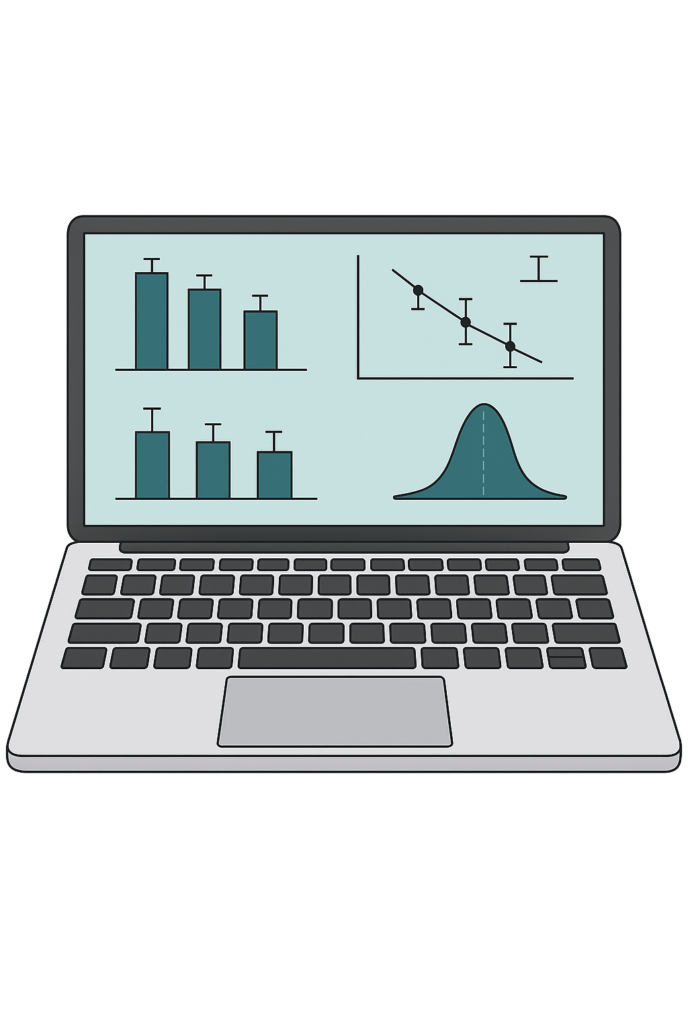
Impact of islets transplantation on diabetic complications / mortality in type 1 diabetes recipients
Methods
Study: Retrospective, multicentre cohort
Patients from:
GRAGIL/TRIMECO trials (intervention group)
The French Healthcare database (SNDS) (synthetic control group)
Background
Islet transplantation (IT) emerges as a promising intervention for the treatment of patients with unstable type 1 diabetes (T1D)
If IT metabolic outcomes are well described, evidence is lacking regarding its impact on long-term diabetic complications and long-term safety
The objective is to evaluate the impact of IT on diabetic complications and cancer incidence
IT after kidney transplantation (IAK) matched with T1D patients
propensity score as 1:1
IT alone (ITA)
matched with T1D patients
propensity score 1:10
Primary outcome:
Composite criterion including death, dialysis, amputation, non-fatal stroke, non-fatal myocardial infarction and transient ischemic attack
Secondary outcome:
Cancer
Hazard Ratio (HR) and p-values were obtained with Cox proportional hazards analysis and log-ranktest respectively
Perrier Q. et al., ESOT Congress 2025 (Abstract 62)
Notes:
Abbreviations: IT, Islet transplantation; T1D, type 1 diabetes; IAK, IT after kidney transplantation; HR, Hazard ratio; Ci, Confidence interval.
Reference Number: 62
Impact of islets transplantation on diabetic complications / mortality in type 1 diabetes
Quentin Perrier¹, Clément Jambon-Barbara², Laurence Kessler³, Orianne Villard⁴, Fanny Burron⁵, Bruno Guerci⁶, Sophie Borot⁷, Matthieu Roustit⁸, Ekaterine Berishvilli⁹, Luc Rakotoarisoa³, Marie-Christine Vantyghem¹⁰, Emmanuel Morelon⁵, Eric Renard⁴, Camille Besch³, Thierry Berney^{5,9}, Pierre-Yves Benhamou¹¹, Sandrine Lablanche¹¹
¹Univ. Grenoble Alpes, Inserm U1055, Department of pharmacy, Grenoble Alpes University Hospital, LBFA, Grenoble, France, ²Univ. Grenoble Alpes, Inserm U1300 – HP2, Pharmacovigilance Unit, Grenoble Alpes University Hospital, HP2, Grenoble, France, ³Univ. Strasbourg, Inserm UMR 1260, Department of endocrinology and diabetology, University hospital of Strasbourg, Regenerative nanomedicine federation of translational medicine, Strasbourg, France, ⁴Univ. Montpellier, Inserm U1191, CNRS UMR5203, Department of endocrinology and diabetes, University hospital of Montpellier, Montpellier, France, ⁵Univ. Lyon, Department of nephrology, immunology and transplantation, Hospices civils de Lyon, Lyon, France, ⁶Univ. Lorraine, Department of endocrinology, diabetology and nutrition, Brabois adult hospital, Nancy, France, ⁷Univ. Besancon, Department of endocrinology, Besançon university hospital, Bensaçon, France, ⁸Univ. Grenoble Alpes, Inserm, U1300 - HP2, CIC1406, Grenoble Alpes University Hospital, Grenoble, France, ⁹Univ. Geneva, Cell isolation and transplantation center, Department of surgery, Geneva University Hospitals, Geneva, Switzerland, ¹⁰Univ. Lille, Inserm UMR 1190, Department of endocrine, diabetology, metabolism and nutrition, University hospital of Lille, Translational research in diabetes, Lille, France, ¹¹Univ. Grenoble Alpes, Inserm U1055, Department of Diabetology, Endocrinology and Nutrition, Grenoble Alpes University Hospital, LBFA, Grenoble, France
Background: Islet transplantation (IT) emerges as a promising intervention for the treatment of patients with unstable type 1 diabetes (T1D). If IT metabolic outcomes are well described, evidence is lacking regarding its impact on long-term diabetic complications and long-term safety. The objective was to evaluate the impact of IT on diabetic complications and cancer incidence.
Methods: This was a retrospective, multicentre, cohort study including patients from GRAGIL/TRIMECO trials (intervention group) and from the French Healthcare database (SNDS) (synthetic control group). Two distinct cohorts of IT recipients were analysed: IT after kidney transplantation (IAK) and IT alone (ITA). They were matched with T1D patients from the SNDS using a propensity score as 1:1 for IAK and 1:10 for ITA. The primary outcome was a composite criterion including death, dialysis, amputation, non-fatal stroke, non-fatal myocardial infarction and transient ischemic attack. Secondary outcome was cancer. Hazard Ratio (HR) and p-values were obtained with Cox proportional hazards analysis and log-rank test respectively.
Results: The study included 61 ITA matched to 610 T1D controls and 45 IAK matched to 45 T1D controls, over a median follow-up period of more than 10 years. Compared with T1D control subjects, ITA and IAK recipients had a significantly lower composite outcome risk (HR, 0.39 [95% CI, 0.21-0.71]; p=0.002 and HR, 0.52 [0.30-0.88]; p=0.014 respectively), seem driven by reduced mortality (HR, 0.22 [0.09-0.54], p<0.001) for ITA and reduced dialysis (HR, 0.19 [0.07-0.50], p<0.001) for IAK. Both groups showed no significant changes in cancer risk.
Conclusions: This study suggests long-term benefits of IT on diabetes-related outcomes. Furthermore, despite the use of immunosuppressive drugs following IT, we observed no significant increase in the risk of cancer. Altogether, these findings highlight a favourable risk-benefit ratio of IT in managing patients with unstable T1D.

Slide 14
Impact of islets transplantation on diabetic complications / mortality in type 1 diabetes recipients
Results
Conclusion
This study suggests long-term benefits of IT on diabetes-related outcomes
Furthermore, despite the use of immunosuppressive drugs following IT, we observed no significant increase in the risk of cancer
Altogether, these findings highlight a favourable risk-benefit ratio of IT in managing patients with unstable T1D
61 ITA matched to 610 T1D controls and 45 IAK matched to 45 T1D over a median follow-up period of more than 10 years
 | Hazard ratio | 95% CI | p value
Composite Outcome (vs. T1D Controls)
ITA | 0.39 | 0.21-0.71 | p=0.002
IAK | 0.52 | 0.30-0.88 | p=0.014
Mortality
ITA | 0.22 | 0.09-0.24 | p<0.01
Dialysis
IAK | 0.1 | 0.07-0.50 | p<0.01
ITA recipients significantly lower composite outcome risk vs controls probably by reduced mortality
IAK recipients significantly lower composite outcome risk vs controls probably by reduced dialysis
Both groups showed no significant changes in cancer risk
Perrier Q. et al., ESOT Congress 2025 (Abstract 62)
Notes:
Abbreviations: IT, Islet transplantation; T1D, type 1 diabetes; IAK, IT after kidney transplantation; HR, Hazard ratio; Ci, Confidence interval.
Reference Number: 62
Impact of islets transplantation on diabetic complications / mortality in type 1 diabetes
Quentin Perrier¹, Clément Jambon-Barbara², Laurence Kessler³, Orianne Villard⁴, Fanny Burron⁵, Bruno Guerci⁶, Sophie Borot⁷, Matthieu Roustit⁸, Ekaterine Berishvilli⁹, Luc Rakotoarisoa³, Marie-Christine Vantyghem¹⁰, Emmanuel Morelon⁵, Eric Renard⁴, Camille Besch³, Thierry Berney^{5,9}, Pierre-Yves Benhamou¹¹, Sandrine Lablanche¹¹
¹Univ. Grenoble Alpes, Inserm U1055, Department of pharmacy, Grenoble Alpes University Hospital, LBFA, Grenoble, France, ²Univ. Grenoble Alpes, Inserm U1300 – HP2, Pharmacovigilance Unit, Grenoble Alpes University Hospital, HP2, Grenoble, France, ³Univ. Strasbourg, Inserm UMR 1260, Department of endocrinology and diabetology, University hospital of Strasbourg, Regenerative nanomedicine federation of translational medicine, Strasbourg, France, ⁴Univ. Montpellier, Inserm U1191, CNRS UMR5203, Department of endocrinology and diabetes, University hospital of Montpellier, Montpellier, France, ⁵Univ. Lyon, Department of nephrology, immunology and transplantation, Hospices civils de Lyon, Lyon, France, ⁶Univ. Lorraine, Department of endocrinology, diabetology and nutrition, Brabois adult hospital, Nancy, France, ⁷Univ. Besancon, Department of endocrinology, Besançon university hospital, Bensaçon, France, ⁸Univ. Grenoble Alpes, Inserm, U1300 - HP2, CIC1406, Grenoble Alpes University Hospital, Grenoble, France, ⁹Univ. Geneva, Cell isolation and transplantation center, Department of surgery, Geneva University Hospitals, Geneva, Switzerland, ¹⁰Univ. Lille, Inserm UMR 1190, Department of endocrine, diabetology, metabolism and nutrition, University hospital of Lille, Translational research in diabetes, Lille, France, ¹¹Univ. Grenoble Alpes, Inserm U1055, Department of Diabetology, Endocrinology and Nutrition, Grenoble Alpes University Hospital, LBFA, Grenoble, France
Background: Islet transplantation (IT) emerges as a promising intervention for the treatment of patients with unstable type 1 diabetes (T1D). If IT metabolic outcomes are well described, evidence is lacking regarding its impact on long-term diabetic complications and long-term safety. The objective was to evaluate the impact of IT on diabetic complications and cancer incidence.
Methods: This was a retrospective, multicentre, cohort study including patients from GRAGIL/TRIMECO trials (intervention group) and from the French Healthcare database (SNDS) (synthetic control group). Two distinct cohorts of IT recipients were analysed: IT after kidney transplantation (IAK) and IT alone (ITA). They were matched with T1D patients from the SNDS using a propensity score as 1:1 for IAK and 1:10 for ITA. The primary outcome was a composite criterion including death, dialysis, amputation, non-fatal stroke, non-fatal myocardial infarction and transient ischemic attack. Secondary outcome was cancer. Hazard Ratio (HR) and p-values were obtained with Cox proportional hazards analysis and log-rank test respectively.
Results: The study included 61 ITA matched to 610 T1D controls and 45 IAK matched to 45 T1D controls, over a median follow-up period of more than 10 years. Compared with T1D control subjects, ITA and IAK recipients had a significantly lower composite outcome risk (HR, 0.39 [95% CI, 0.21-0.71]; p=0.002 and HR, 0.52 [0.30-0.88]; p=0.014 respectively), seem driven by reduced mortality (HR, 0.22 [0.09-0.54], p<0.001) for ITA and reduced dialysis (HR, 0.19 [0.07-0.50], p<0.001) for IAK. Both groups showed no significant changes in cancer risk.
Conclusions: This study suggests long-term benefits of IT on diabetes-related outcomes. Furthermore, despite the use of immunosuppressive drugs following IT, we observed no significant increase in the risk of cancer. Altogether, these findings highlight a favourable risk-benefit ratio of IT in managing patients with unstable T1D.

Slide 15
Listing patients with hepatocellular carcinoma for liver transplantation: Ontario & revised criteria
Background
Liver transplantation (LT) is a curative treatment option for hepatocellular carcinoma (HCC)
This study aims to validate the existing waitlisting exception points of the Ontario criteria (OC) (total tumour volume [TTV] ≤ 145cm3, alpha fetoprotein [AFP] ≤ 1 000ug/L, no macrovascular invasion, no extrahepatic spread), and to re-assess the parameters cutoff values
Methods
Results
n=6783 females
(23%)
Median age= 60 years (IQR: 55, 64)
Median Model of End-stage Liver Disease score of 10 (IQR: 8, 14)
n=22 303 males (77%)
Compared to traditional Milan Criteria, this cohort encompassed a net of +380 (1.3%) patients classified as within OC
Patients within OC reached a 5-year OS of 76% (95%CI: 75,76), median OS 13.5 years (95%CI: 13.2, 13.9)
Being within OC compared to beyond OC significantly decreases the risk of HCC-related deaths (SHR 0.43; 95%CI: 0.36, 0.53)
Patients with HCC selected from the United Network for Organ Sharing registry, with complete tumour variables at waitlisting
Overall survival (OS) analysis
Using estimates (% and median OS) and effect sizes
Competing risk for HCC-related deaths
Evaluated with sub-distribution hazard rate (SHR)
Multivariable a priori Cox proportional hazard regression modelling used to account for potential confounders
Magyar C. et al., ESOT Congress 2025 (Abstract 404)
Notes:
Abbreviations: LT, Liver transplantation; HCC, hepatocellular carcinoma; TTV, Total tumour volume; OS, Overall survival; SHR, Subdistribution hazard rate; IQR, Interquartile Range; CI, Confidence interval; OC, Ontariocriteria; AFP, Alpha fetoprotein.
Reference Number: 404
LISTING PATIENTS WITH HEPATOCELLULAR CARCINOMA FOR LIVER TRANSPLANTATION: ONTARIO & REVISED
Christian Magyar^{1,2}, Laia Aceituno², Anudari Zorigtbaatar², Woo Jin Choi², Owen Jones², Arndt Vogel^{3,4,5}, Grainne O'kane^{4,5,6}, Erin Winter², Nazia Selzner², Blayne Sayed², Markus Selzner², Ian McGilvray², Chaya Shwaartz², Trevor Reichman², Anand Ghanekar², Mark Cattral², Gonzalo Sapisochin²
¹Department of Visceral Surgery and Medicine, Inselspital, Bern University Hospital, Bern, Switzerland, ²HBP & Multi-Organ Transplant Program, University Health Network, Toronto, Canada, ³Department of Hepatology, Gastroenterology, Endocrinology & Infectious Diseases, Hannover Medical School, Hannover, Germany, ⁴Princess Margaret Cancer Center, University Health Network, Toronto, Canada, ⁵University of Toronto, Toronto, Canada, ⁶St. Vincent's University Hospital and University College Dublin, Dublin, Ireland
Background: Liver transplantation (LT) is a curative treatment option for hepatocellular carcinoma (HCC). We aim to validate the existing waitlisting exception points of the Ontario criteria (OC) (total tumour volume [TTV] ≤ 145cm3, alpha fetoprotein [AFP] ≤ 1 000ug/L, no macrovascular invasion, no extrahepatic spread), and to re-assess the parameters cutoff values.
Methods: Patients with HCC were selected from the United Network for Organ Sharing registry, with complete tumor variables at waitlisting. Overall survival (OS) analysis was performed and assessed using estimates (% and median OS) and effect sizes. Multivariable a priori Cox proportional hazard regression modelling was employed to account for potential confounders. Competing risk for HCC-related deaths was evaluated with subdistribution hazard rate (SHR).
Results: The 29 086 patients had a median age of 60 years (IQR: 55,, 64), 22 303 (77%) were male, with a median Model of End-stage Liver Disease score of 10 (IQR: 8, 14). Compared to traditional Milan Criteria, this cohort encompassed a net of +380 (1.3%) patients classified as within OC. Patients within OC reached a 5-year OS of 76% (95%CI: 75, 76), median OS 13.5 years (95%CI: 13.2, 13.9). Being within OC compared to beyond OC significantly decreases the risk of HCC-related deaths (SHR 0.43; 95%CI: 0.36, 0.53). To reassess TTV and AFP cutoffs in patients transplanted between 2013 and 2016 (contemporary era) ; (n=6 592), a multivariable prediction of 5-year OS was performed and presented in contour survival plots (Figure 1). Modelled acceptable outcome (5-year OS > 60%) was reached in four categories: small tumors (TTV 0 - 85 cm3 & AFP ≤1 500 ng/mL), moderate tumors (TTV 86 – 160 cm3 & AFP ≤ 1 000 ng/mL), large tumors: (TTV 161 – 250 cm3 & AFP ≤ 750 ng/mL), and very large tumors (TTV 251 – 415 cm3 & AFP ≤ 500 ng/mL). These revised Ontario criteria were associated with an observed 5-years OS of 76% (95%CI: 75, 76).
Conclusions: The patients within OC have excellent outcomes. Extension of these criteria are feasible in statistical models. Incorporating AFP allows for improved risk stratification, compared to morphometric cutoffs alone.

Slide 16
Listing patients with hepatocellular carcinoma for liver transplantation: Ontario & revised criteria
To reassess TTV and AFP cutoffs in patients transplanted between 2013 and 2016 (contemporary era) ; (n=6 592), a multivariable prediction of 5-year OS was performed and presented in contour survival plots:
Modelled acceptable outcome (5-year OS >60%) was reached in four categories:
Small tumours (TTV 0 - 85 cm3 & AFP ≤1 500 ng/mL)
Moderate tumours (TTV 86 – 160 cm3 & AFP ≤ 1 000 ng/mL)
Large tumours (TTV 161 – 250 cm3 & AFP ≤ 750 ng/mL)
Very large tumours (TTV 251 – 415 cm3 & AFP ≤ 500 ng/mL)
These revised Ontario criteria were associated with an observed 5-years OS of 76% (95%CI:75, 76)
Conclusions
The patients within OC have excellent outcomes. Extension of these criteria are feasible in statistical models
Incorporating AFP allows for improved risk stratification, compared to morphometric cutoffs alone
Magyar C. et al., ESOT Congress 2025 (Abstract 404)
Notes:
Abbreviations: LT, Liver transplantation; HCC, hepatocellular carcinoma; TTV, Total tumour volume; OS, Overall survival; SHR, Subdistribution hazard rate; IQR, Interquartile Range; CI, Confidence interval; OC, Ontariocriteria; AFP, Alpha fetoprotein.
Reference Number: 404
LISTING PATIENTS WITH HEPATOCELLULAR CARCINOMA FOR LIVER TRANSPLANTATION: ONTARIO & REVISED
Christian Magyar^{1,2}, Laia Aceituno², Anudari Zorigtbaatar², Woo Jin Choi², Owen Jones², Arndt Vogel^{3,4,5}, Grainne O'kane^{4,5,6}, Erin Winter², Nazia Selzner², Blayne Sayed², Markus Selzner², Ian McGilvray², Chaya Shwaartz², Trevor Reichman², Anand Ghanekar², Mark Cattral², Gonzalo Sapisochin²
¹Department of Visceral Surgery and Medicine, Inselspital, Bern University Hospital, Bern, Switzerland, ²HBP & Multi-Organ Transplant Program, University Health Network, Toronto, Canada, ³Department of Hepatology, Gastroenterology, Endocrinology & Infectious Diseases, Hannover Medical School, Hannover, Germany, ⁴Princess Margaret Cancer Center, University Health Network, Toronto, Canada, ⁵University of Toronto, Toronto, Canada, ⁶St. Vincent's University Hospital and University College Dublin, Dublin, Ireland
Background: Liver transplantation (LT) is a curative treatment option for hepatocellular carcinoma (HCC). We aim to validate the existing waitlisting exception points of the Ontario criteria (OC) (total tumour volume [TTV] ≤ 145cm3, alpha fetoprotein [AFP] ≤ 1 000ug/L, no macrovascular invasion, no extrahepatic spread), and to re-assess the parameters cutoff values.
Methods: Patients with HCC were selected from the United Network for Organ Sharing registry, with complete tumor variables at waitlisting. Overall survival (OS) analysis was performed and assessed using estimates (% and median OS) and effect sizes. Multivariable a priori Cox proportional hazard regression modelling was employed to account for potential confounders. Competing risk for HCC-related deaths was evaluated with subdistribution hazard rate (SHR).
Results: The 29 086 patients had a median age of 60 years (IQR: 55,, 64), 22 303 (77%) were male, with a median Model of End-stage Liver Disease score of 10 (IQR: 8, 14). Compared to traditional Milan Criteria, this cohort encompassed a net of +380 (1.3%) patients classified as within OC. Patients within OC reached a 5-year OS of 76% (95%CI: 75, 76), median OS 13.5 years (95%CI: 13.2, 13.9). Being within OC compared to beyond OC significantly decreases the risk of HCC-related deaths (SHR 0.43; 95%CI: 0.36, 0.53). To reassess TTV and AFP cutoffs in patients transplanted between 2013 and 2016 (contemporary era) ; (n=6 592), a multivariable prediction of 5-year OS was performed and presented in contour survival plots (Figure 1). Modelled acceptable outcome (5-year OS > 60%) was reached in four categories: small tumors (TTV 0 - 85 cm3 & AFP ≤1 500 ng/mL), moderate tumors (TTV 86 – 160 cm3 & AFP ≤ 1 000 ng/mL), large tumors: (TTV 161 – 250 cm3 & AFP ≤ 750 ng/mL), and very large tumors (TTV 251 – 415 cm3 & AFP ≤ 500 ng/mL). These revised Ontario criteria were associated with an observed 5-years OS of 76% (95%CI: 75, 76).
Conclusions: The patients within OC have excellent outcomes. Extension of these criteria are feasible in statistical models. Incorporating AFP allows for improved risk stratification, compared to morphometric cutoffs alone.

Slide 17
Understanding the impact of obesity on liver transplant outcomes: A comprehensive analysis
Background
Exclusion criteria for liver transplant (LT) based on obesity vary throughout transplant centers, and morbid obesity is listed as a relative contraindication in many transplant center
The purpose of this investigation is to assess how effective it is to exclude individuals from LT by using BMI as a criterion
Methods
A retrospective longitudinal analysis of liver transplant patient outcomes from January 2001 to May 2020 using the UNOS database
The cohort was categorized into subgroups based on transplant date and body mass index (BMI) of the recipients
Results
n=118486 LT cases, 3 groups
Graft failure causes (% total reported data) | 2001-2010 |  |  | 2011-2020 |  |  | P-valueª | P-value^{b} | P-value^{c}
 | BMM≤35 (n=8002) | 35≤BMM≤40 (n=647) | BMM≥40 (n=288) | BMM≤35 (n=2572) | 35≤BMM≤40 (n=345) | BMM≥40 (n=178)
Primary graft failure | 1973 (24.6%) | 169 (26.1%) | 88 (30.6%) | 352 (13.7%) | 108 (31.4%) | 57 (32%) | <0.0001 | 0.08 | 0.73
Recurrent disease | 1434 (17.9%) | 105 (16.7%) | 37 (12.8%) | 341 (13.3%) | 36 (10.4%) | 10 (5.6%) | <0.0001 | 0.01 | 0.01
Infection | 1041 (13.1%) | 90 (13.9%) | 44 (15.3%) | 417 (16.2%) | 57 (16.5%) | 32 (18%) | <0.0001 | 0.28 | 0.44
Vascular thrombosis | 1158 (14.6%) | 83 (12.8%) | 41 (14.2%) | 296 (11.5%) | 32 (9.3%) | 9 (5%) | 0.0001 | 0.10 | 0.002
Chronic rejection | 863 (10.7%) | 69 (10.8%) | 31 (10.8%) | 287 (11.1%) | 39 (11.3%) | 15 (8.4%) | 0.57 | 0.75 | 0.41
Biliary complications | 731 (9.1%) | 68 (10.5%) | 25 (8.7%) | 139 (5.4%) | 8 (2.3%) | 8 (4.5%) | <0.0001 | <0.0001 | 0.09
Acute rejection | 486 (6.2%) | 40 (6.2%) | 1.5 (5.2%) | 250 (9.7%) | 28 (8.1%) | 23 (12.9%) | <0.0001 | 0.76 | 0.04
Hepatic artery thrombosis | 82 (1%) | 2 (0.3%) | 0 (0%) | 452 (17.6%) | 34 (9.9%) | 20 (11.3%) | <0.0001 | 0.0001 | 0.02
Patient non-compliance | 226 (2.8%) | 21 (3.2%) | 7 (2.4%) | 39 (1.5%) | 1 (0.8%) | 4 (2.3%) | 0.0003 | 0.03 | 0.89
Moein M. et al., ESOT Congress 2025 (Abstract 807)
Notes:
Abbreviations: LT, Liver transplantation; BMI, Body mass index.
Reference Number: 807
ABSTRACT TITLE: UNDERSTANDING THE IMPACT OF OBESITY ON LIVER TRANSPLANT OUTCOMES: A COMPREHENSIVE ANALYSIS
Mahmoudreza Moein¹, Stephen Baio¹, Robert Contento¹, Tasiyah Essop¹, Amin Bahreini¹, Mahsa Abedini², Marjan Abedini¹, Matin Moallem Shahri¹, Abolfazl Jamshidi¹, Reza Saidi¹
¹SUNY Upstate Medical University, Surgery/Division of Transplant Services, Syracuse, United States, ²Alma Mater Studiorum - Università di Bologna, Department of Medical and Serological Sciences, Bologna, Italy
Background: Exclusion criteria for liver transplant (LT) based on obesity vary throughout transplant centers, and morbid obesity is listed as a relative contraindication in many transplant centers. The purpose of this investigation is to assess how effective it is to exclude individuals from LT by using BMI as a criterion.
Methods: A retrospective longitudinal analysis of liver transplant patient outcomes from January 2001 to May 2020 was conducted using the UNOS database. The cohort was categorized into subgroups based on transplant date and body mass index (BMI) of the recipients.
Results: A total of 118486 LT cases included in the study. Based on their BMI, patients were split into three groups: BMI<35 kg/m2, 35≤BMM≤40 kg/m2, and BMI≥40 kg/m2. The data analysis revealed a significant improvement in 10-year graft survival in the 2011-2020 group compared to the 2001-2010 group (Mean 70% vs. 53%, P<0.001). Interestingly, BMI above 35 kg/m2 did not have a significant effect on the graft survival and in both time frames, there was no clinically significant difference between the recipients of different BMI spectrum. The patient's survival was also characterized by the same pattern. Primary graft failure was the most significant cause of allograft transplant failure in all the BMI spectrum, except recipients with a BMI<35 kg/m2, in 2011-2020 group.
Conclusions: The long-term outcome of liver transplants in obese patients has been promising, particularly in the last decade. The outcomes of LT in patients requiring a LT are not significantly affected by BMI, considering the advancements in surgical techniques and post-operation improvements and excluding obese patients based on BMI alone would be inappropriate.

Slide 18
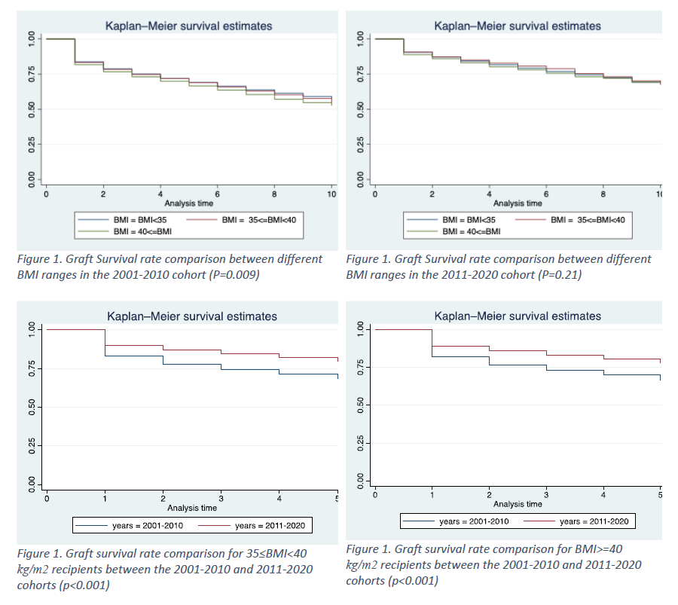
Understanding the impact of obesity on liver transplant outcomes: A comprehensive analysis
Results (cont.)
The patient's survival was also characterized by the same pattern
Primary graft failure was the most significant cause of allograft transplant failure in all the BMI spectrum, except recipients with a BMI <35 kg/m2, in 2011-2020 group
Conclusions
The long-term outcome of liver transplants in obese patients has been promising, particularly in the last decade
The outcomes of LT in patients requiring a LT are not significantly affected by BMI, considering the advancements in surgical techniques and post-operation improvements and excluding obese patients based on BMI alone would be inappropriate
Significant improvement in 10-year graft survival in the 2011-2020 group compared to the 2001-2010 group (Mean 70% vs. 53%, p<0.001)
BMI above 35 kg/m2 did not have a significant effect on the graft survival and in both time frames, there was no clinically significant difference between the recipients of different BMI spectrum
Moein M. et al., ESOT Congress 2025 (Abstract 807)
Notes:
Abbreviations: LT, Liver transplantation; BMI, Body mass index.
Reference Number: 807
ABSTRACT TITLE: UNDERSTANDING THE IMPACT OF OBESITY ON LIVER TRANSPLANT OUTCOMES: A COMPREHENSIVE ANALYSIS
Mahmoudreza Moein¹, Stephen Baio¹, Robert Contento¹, Tasiyah Essop¹, Amin Bahreini¹, Mahsa Abedini², Marjan Abedini¹, Matin Moallem Shahri¹, Abolfazl Jamshidi¹, Reza Saidi¹
¹SUNY Upstate Medical University, Surgery/Division of Transplant Services, Syracuse, United States, ²Alma Mater Studiorum - Università di Bologna, Department of Medical and Serological Sciences, Bologna, Italy
Background: Exclusion criteria for liver transplant (LT) based on obesity vary throughout transplant centers, and morbid obesity is listed as a relative contraindication in many transplant centers. The purpose of this investigation is to assess how effective it is to exclude individuals from LT by using BMI as a criterion.
Methods: A retrospective longitudinal analysis of liver transplant patient outcomes from January 2001 to May 2020 was conducted using the UNOS database. The cohort was categorized into subgroups based on transplant date and body mass index (BMI) of the recipients.
Results: A total of 118486 LT cases included in the study. Based on their BMI, patients were split into three groups: BMI<35 kg/m2, 35≤BMM≤40 kg/m2, and BMI≥40 kg/m2. The data analysis revealed a significant improvement in 10-year graft survival in the 2011-2020 group compared to the 2001-2010 group (Mean 70% vs. 53%, P<0.001). Interestingly, BMI above 35 kg/m2 did not have a significant effect on the graft survival and in both time frames, there was no clinically significant difference between the recipients of different BMI spectrum. The patient's survival was also characterized by the same pattern. Primary graft failure was the most significant cause of allograft transplant failure in all the BMI spectrum, except recipients with a BMI<35 kg/m2, in 2011-2020 group.
Conclusions: The long-term outcome of liver transplants in obese patients has been promising, particularly in the last decade. The outcomes of LT in patients requiring a LT are not significantly affected by BMI, considering the advancements in surgical techniques and post-operation improvements and excluding obese patients based on BMI alone would be inappropriate.

Slide 19
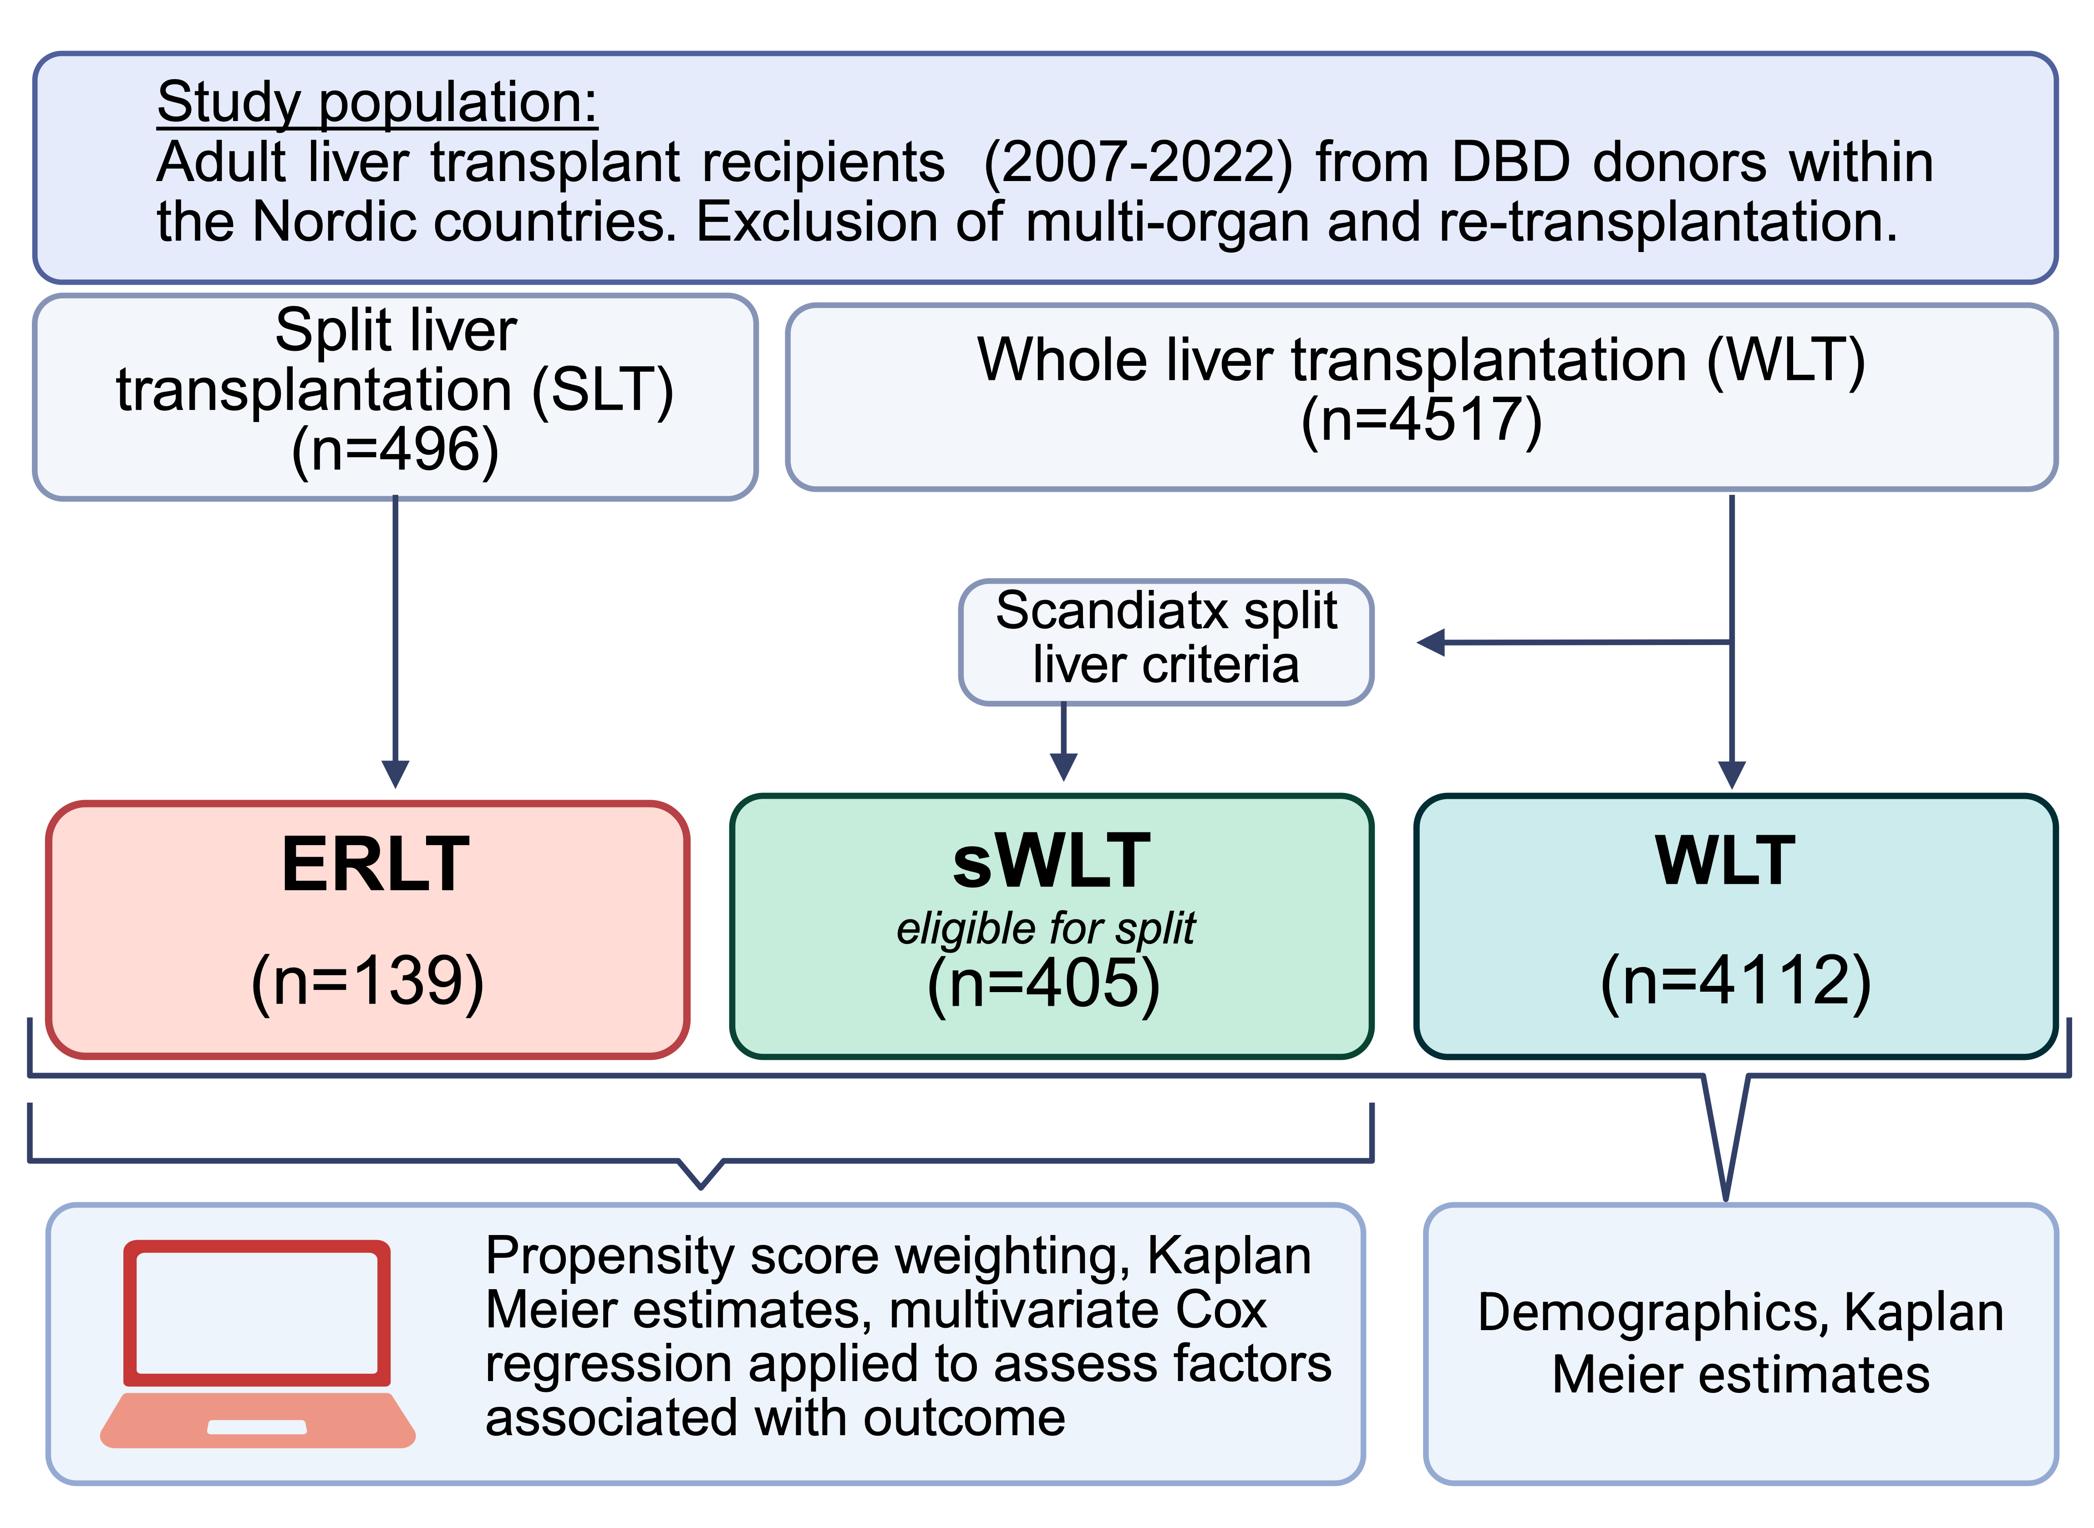
Outcome of split-liver transplantation with extended right grafts within Scandiatransplant
Background
Aim: Evaluate survival and complications amongst extended right lobe liver grafts compared with whole graft transplantation in a Nordic population
Results
Females were more likely to receive an ERLT graft, and malignancy was a more frequent indication for LT amongst ERLT recipients.
Cold ischemic time (CIT) was significantly longer in ERLT (p<0.001)
In-situ ERLT splitting frequency was 43.7%
Methods
 | ERLT N = 139¹ | sWLT N = 405¹ | p-value²
MEAF | 6.93 (1.40) | 5.79 (1.47) | <0.001
Severe complications | 56.2% | 39.7% | 0.002
Biliary complications | 41.1% | 14.2% | <0.001
Biliary anastomotic stricture | Similar | Similar | –
Biliary anastomotic leakage | 13.4% | 7.0% | 0.031
Non-anastomotic stricture | 10.1% | 1.7% | <0.001
Cut-surface biliary leakage | 23.6% | – | –
Hepatic artery thrombosis | 9.4% | 3.2% | 0.007
Graft loss <12 months | 19.4% | 7.2% | <0.001
¹ Mean (SD); n (%) ² Design-based KruskalWallis test; Pearson’s X^2: Rao & Scott adjustment
Nilsén V. et al., ESOT Congress 2025 (Abstract 2593)
Notes:
Abbreviations: SLT, Split liver transplantation; ERLT, extended right lobe transplantation; NLTR, Nordic Liver Transplant Registry; WLT, Whole liver transplantation.
Reference Number: 2593
Outcome of split-liver transplantation with extended right grafts within Scandiatransplant
Vera Nilsén^{1,2}, Emil Bluhme^{1,2}, Ilse Duus Weinreich³, Espen Melum⁴, Morten Hagness⁴, Lise Katrine Engsaeter⁴, Bastian Pedersen⁴, William Bennet⁵, Fredrik Rorsman⁶, Delal Akdag⁷, Andreas Arendtsen Rostved⁷, Hans-Christian Pommergaard^{7,8,9}, Nicolai Aagaard Schultz⁷, Allan Rasmussen⁷, Pål-Dag Line⁴, Andres Tein¹⁰, Arno Nordin¹¹, Christina Villard^{2,12}, Carl Jorns^{1,2}
¹Karolinska Institutet, Department of Clinical Science, Intervention and Technology, CLINTEC, Stockholm, Sweden, ²Karolinska University Hospital Huddinge, Department of Transplantation Surgery, Stockholm, Sweden, ³Aarhus University Hospital, Scandiatransplant, Aarhus, Denmark, ⁴Oslo University Hospital Rikshospitalet, Division of Surgery and Specialized Medicine, Oslo, Norway, ⁵Sahlgrenska University Hospital, Transplant Institute, Gothenburg, Sweden, ⁶Uppsala University Hospital, Department of Gastroenterology and Hepatology, Uppsala, Sweden, ⁷Copenhagen University Hospital, Rigshospitalet, Department of Surgery and Transplantation, Copenhagen, Denmark, ⁸Centre for Cancer and Organ Diseases, Rigshospitalet, Hepatic Malignancy Surgical Research Unit (HEPSURU), Department of Surgery and Transplantation, Copenhagen, Denmark, ⁹University of Copenhagen, Department of Clinical Medicine, Copenhagen, Denmark, ¹⁰University of Tartu, Department of Surgery (ARKI), Tartu, Estonia, ¹¹Helsinki University Hospital and University of Helsinki, Transplantation and Liver Surgery, Helsinki, Finland, 12Karolinska Institutet, Department of Medicine Huddinge, Stockholm, Sweden
Background: Split liver transplantation (SLT) addresses organ shortages by dividing one liver for two recipients, benefiting pediatric patients with size-matched grafts while preserving the adult donor pool. Since Scandiatransplant implemented a split liver policy and shared pediatric waiting list in 2015, pediatric waiting times have improved. However, extended right lobe transplantation (ERLT) outcomes remain debated due to higher reported complication rates and inferior graft survival compared to whole liver transplantation (WLT). This study evaluates deceased donor ERLT outcomes in Scandiatransplant.
Methods: Adult liver transplant recipients from 2007 to 2022 across six countries and seven centers were retrospectively identified using the Nordic Liver Transplant Registry (NLTR). Multi-organ and re-transplantations were excluded. ERLT (n=139) was compared to WLT (n=4516) for patient and graft survival. Additionally, WLT cases eligible for SLT (sWLT, n=406) were matched with ERLT for further analysis. Propensity score matching, Kaplan Meier survival estimates, and multivariable Cox regression were applied to assess donor and recipient factors influencing outcomes.
Results: ERLT recipients were more likely to be women (49.6% vs. 39.7%, p=0.05) and have malignancy as an indication (37.2% vs. 25.1%, p=0.003). While waiting times and MELD scores were similar, ERLT had longer cold ischemia times (p<0.001). ERLT was associated with higher rates of hepatic artery thrombosis (7.9% vs. 3.0%, p=0.033), biliary leakage (25.2% vs. 5.9%, p<0.001), and non-anastomotic biliary strictures (5.8% vs. 0.7%, p=0.002) compared to sWLT. Severe complications (Clavien-Dindo ≥3b) were also more frequent in ERLT (56.7% vs. 39.9%, p<0.002). Patient survival at 1, 3, and 5 years was similar (ERLT 90.6/86.3/80.9 vs. sWLT 94.6/90.0/86.9, p=0.49). However, ERLT graft survival was lower (ERLT 82.0/76.2/70.2 vs. sWLT 93.3/88.5/85.4, p=0.005). In-situ splitting had better graft survival than ex-situ (p=0.05).
Conclusions: SLT in Scandiatransplant has expanded the donor pool and maintained excellent patient survival. However, ERLT is linked to higher complication rates and lower graft survival, particularly with ex-situ techniques. Improving modifiable factors may enhance outcomes.

Slide 20
Outcome of split-liver transplantation with extended right grafts within Scandiatransplant
Overall patient survival
Results (cont.)
Kaplan Meier estimates showed inferior graft survival for ERLT compared to WLT and sWLT (figure), with similar results comparing ERLT and sWLT after weighting
In weighted multivariate cox regression, ERLT was associated with a 2-fold higher risk
of first- year graft loss after adjustment
Subgroup analysis for In-situ and Ex-situ ERLT showed Kaplan Meier estimates with superior patient- and graft survival for In-situ ERLT (p=0.046, and p=0.017, respectively). In multivariate cox regression, Ex-situ ERLT alone was associated with increased risk of first-year graft loss after adjustment. Complication rates were similar, yet cause of early graft loss suggests more severe complications for Ex-situ ERLT
Patient survival 12 months overall
ERLT vs WLT 0.26 p=0.99
ERLT vs sWLT 0.26 p=0.06
Overall graft survival
Conclusions
SLT in Scandiatransplant has expanded the donor pool and maintained excellent patient survival. ERLT showed equal patient survival, but inferior graft survival compared to WLT and sWLT
Postoperative complications, especially HAT and biliary complications were more frequent in ERLT
In-situ ERLT was associated with significantly better patient – and graft survival
Graft survival 12 months overall
ERLT vs WLT p <0.001 p=0.076
ERLT vs sWLT p<0.001 <0.001
Nilsén V. et al., ESOT Congress 2025 (Abstract 2593)
Notes:
Abbreviations: SLT, Split liver transplantation; ERLT, extended right lobe transplantation; NLTR, Nordic Liver Transplant Registry; WLT, Whole liver transplantation.
Reference Number: 2593
Outcome of split-liver transplantation with extended right grafts within Scandiatransplant
Vera Nilsén^{1,2}, Emil Bluhme^{1,2}, Ilse Duus Weinreich³, Espen Melum⁴, Morten Hagness⁴, Lise Katrine Engsaeter⁴, Bastian Pedersen⁴, William Bennet⁵, Fredrik Rorsman⁶, Delal Akdag⁷, Andreas Arendtsen Rostved⁷, Hans-Christian Pommergaard^{7,8,9}, Nicolai Aagaard Schultz⁷, Allan Rasmussen⁷, Pål-Dag Line⁴, Andres Tein¹⁰, Arno Nordin¹¹, Christina Villard^{2,12}, Carl Jorns^{1,2}
¹Karolinska Institutet, Department of Clinical Science, Intervention and Technology, CLINTEC, Stockholm, Sweden, ²Karolinska University Hospital Huddinge, Department of Transplantation Surgery, Stockholm, Sweden, ³Aarhus University Hospital, Scandiatransplant, Aarhus, Denmark, ⁴Oslo University Hospital Rikshospitalet, Division of Surgery and Specialized Medicine, Oslo, Norway, ⁵Sahlgrenska University Hospital, Transplant Institute, Gothenburg, Sweden, ⁶Uppsala University Hospital, Department of Gastroenterology and Hepatology, Uppsala, Sweden, ⁷Copenhagen University Hospital, Rigshospitalet, Department of Surgery and Transplantation, Copenhagen, Denmark, ⁸Centre for Cancer and Organ Diseases, Rigshospitalet, Hepatic Malignancy Surgical Research Unit (HEPSURU), Department of Surgery and Transplantation, Copenhagen, Denmark, ⁹University of Copenhagen, Department of Clinical Medicine, Copenhagen, Denmark, ¹⁰University of Tartu, Department of Surgery (ARKI), Tartu, Estonia, ¹¹Helsinki University Hospital and University of Helsinki, Transplantation and Liver Surgery, Helsinki, Finland, 12Karolinska Institutet, Department of Medicine Huddinge, Stockholm, Sweden
Background: Split liver transplantation (SLT) addresses organ shortages by dividing one liver for two recipients, benefiting pediatric patients with size-matched grafts while preserving the adult donor pool. Since Scandiatransplant implemented a split liver policy and shared pediatric waiting list in 2015, pediatric waiting times have improved. However, extended right lobe transplantation (ERLT) outcomes remain debated due to higher reported complication rates and inferior graft survival compared to whole liver transplantation (WLT). This study evaluates deceased donor ERLT outcomes in Scandiatransplant.
Methods: Adult liver transplant recipients from 2007 to 2022 across six countries and seven centers were retrospectively identified using the Nordic Liver Transplant Registry (NLTR). Multi-organ and re-transplantations were excluded. ERLT (n=139) was compared to WLT (n=4516) for patient and graft survival. Additionally, WLT cases eligible for SLT (sWLT, n=406) were matched with ERLT for further analysis. Propensity score matching, Kaplan Meier survival estimates, and multivariable Cox regression were applied to assess donor and recipient factors influencing outcomes.
Results: ERLT recipients were more likely to be women (49.6% vs. 39.7%, p=0.05) and have malignancy as an indication (37.2% vs. 25.1%, p=0.003). While waiting times and MELD scores were similar, ERLT had longer cold ischemia times (p<0.001). ERLT was associated with higher rates of hepatic artery thrombosis (7.9% vs. 3.0%, p=0.033), biliary leakage (25.2% vs. 5.9%, p<0.001), and non-anastomotic biliary strictures (5.8% vs. 0.7%, p=0.002) compared to sWLT. Severe complications (Clavien-Dindo ≥3b) were also more frequent in ERLT (56.7% vs. 39.9%, p<0.002). Patient survival at 1, 3, and 5 years was similar (ERLT 90.6/86.3/80.9 vs. sWLT 94.6/90.0/86.9, p=0.49). However, ERLT graft survival was lower (ERLT 82.0/76.2/70.2 vs. sWLT 93.3/88.5/85.4, p=0.005). In-situ splitting had better graft survival than ex-situ (p=0.05).
Conclusions: SLT in Scandiatransplant has expanded the donor pool and maintained excellent patient survival. However, ERLT is linked to higher complication rates and lower graft survival, particularly with ex-situ techniques. Improving modifiable factors may enhance outcomes.

Slide 21
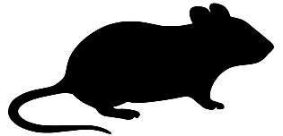


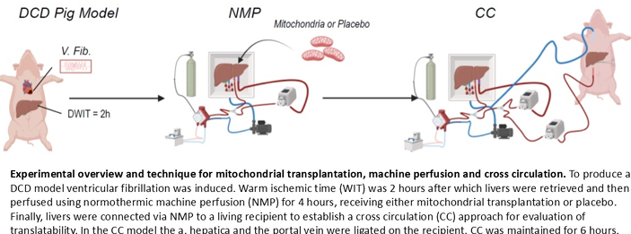
Mitochondrial therapy during machine perfusion restores DCD livers: A cross-circulation assessment of transplantability
Background
Machine perfusion technology has improved DCD liver utilization, but with little expansion in the duration of acceptable warm ischemic time (WIT)
To use livers with prolonged WIT, new strategies must be developed
Mitochondrial transplantation is such an innovative strategy
Results
After DCD donation, cell lysates exhibit a two-fold reduction in ATP levels, suggesting a loss of endogenous mitochondria
When exogenous mitochondria were added to healthy and ischemia reperfusion injury (IRI) exposed hepatocytes in vitro, only the IRI cells took up the mitochondria, confirmed by the change in ATP from baseline and through live single cell imaging
In vitro findings
Methods
Mitochondria isolation
In/ex vivo findings
C57BL/6
Condition / Group | Findings / Outcomes
NMP Treated Livers (4 hours) | - Significant increase in bile production
 | - Improved bile quality
 | - Restored cytoarchitecture
CC Untreated Livers (6 hours) | - Became edematous
 | - Marked cellular degeneration
 | - Near-complete loss of Kupffer cells and CK19+ cholangiocytes
 | - Twenty-fold increase in TUNEL+ cells
Mitochondria Treated Livers | - Maintained function
 | - Comparable to healthy controls
Proteomic Profiles (NMP vs Placebo) | - Distinct differences in expression between treated and placebo groups in bile and liver tissue during NMP (significantly pronounced following CC)
5x10⁹ xenogeneic mitochondria n=6
Placebo n=6
Comparison of DCD cohort to healthy control animals n=9
Lindstedt S. et al., ESOT Congress 2025 (Abstract 1726)
Notes:
Abbreviations: DCD, Donation after Circulatory Death, WIT, Warm ischemic time; NMP, Normothermic machine perfusion; CC, Cross circulation; IRI, ischemia reperfusion injury; ATP, Adenosine triphosphate.
Reference Number: 1726
MITOCHONDRIAL THERAPY DURING MACHINE PERFUSION RESTORES DCD LIVERS: A CROSS-CIRCULATION ASSESSMENT OF TRANSPLANTABILITY
Sandra Lindstedt¹, Nicholas B. Bechet¹, Aybuke Celik¹, Niklas Sterner², Tibor Huzevka², Margareta Mittendorfer², Qi Wang², Embla Boden¹, Runchuan Gu¹, Fanny Severeus², Gabriel Hirdman¹, Franziska Olm¹, Gabriel Oniscu³
¹Lund University, Lund, Sweden, ²Lund University Hospital, Lund, Sweden, ³Karolinska Institute, Stockholm, Sweden
Background: Machine perfusion technology has improved DCD liver utilization, but with little expansion in the duration of acceptable warm ischemic time (WIT). To use livers with prolonged WIT, new strategies must be developed. Mitochondrial transplantation is such an innovative strategy.
Methods: Mitochondria were isolated from liver tissue of the C57BL/6 mice. In a porcine DCD model, following a 2 hour WIT, explanted livers were connected to normothermic machine perfusion (NMP) for 4 hours (n=12), and randomized to receive 5x109 xenogeneic mitochondria(n=6) or placebo(n=12). Upon completion of NMP, three livers from each group were connected to cross circulation (CC) (n=6) to test transplantability. The DCD cohort was compared to healthy control animals (n=9).
Results: After DCD donation, cell lysates exhibit a two-fold reduction in ATP levels, suggesting a loss of endogenous mitochondria. When exogenous mitochondria were added to healthy and ischemia reperfusion injury (IRI) exposed hepatocytes in vitro, only the IRI cells took up the mitochondria, confirmed by the change in ATP from baseline and through live single cell imaging. After 4 hours of NMP, treated livers demonstrated a significant increase in bile production, improved bile quality, and restored cytoarchitecture. After 6 hours of CC, untreated livers became edematous, and showed marked cellular degeneration, and near-complete loss of Kupffer cells and CK19+ cholangiocytes. In contrast, mitochondria treated livers maintained function and were comparable to healthy controls. There was a twenty-fold increase in TUNEL+ cells in the untreated livers. The proteomic profiles of bile and liver tissue revealed distinct differences in expression between treated and placebo groups during NMP. These differences became significantly pronounced following CC. Ultra high-plex spatial imaging using MACsima™ found differential populations of CD3, CD4, HH3, PCNA, Ki67, CD45, vimentin, IBA1, CD163 and LEA positive cells between both NMP cohorts and the treated CC cohort with very few viable cells in the non-treated CC samples. Conclusions: These data confirm that NMP alone cannot restore a DCD liver with extended WIT. Mitochondrial transplantation restores function in these livers, presenting a promising approach to further expand the donor pool.

Slide 22
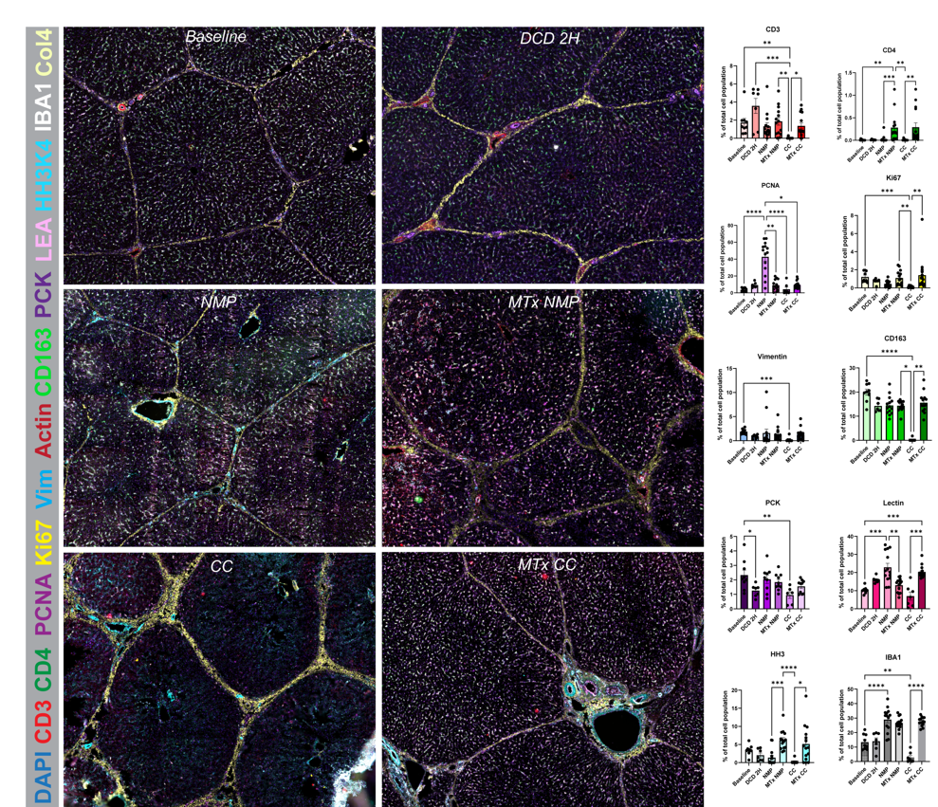
Mitochondrial therapy during machine perfusion restores DCD livers: A cross-circulation assessment of transplantability
Ultra high-plex spatial imaging using MACsima™ found differential populations of CD3, CD4, HH3, PCNA, Ki67, CD45, vimentin, IBA1, CD163 and LEA positive cells between both NMP cohorts and the treated CC cohort with very few viable cells in the non-treated CC samples
Conclusions
These data confirm that NMP alone cannot restore a DCD liver with extended WIT
Mitochondrial transplantation restores function in these livers, presenting a promising approach to further expand the donor pool
Lindstedt S. et al., ESOT Congress 2025 (Abstract 1726)
Notes:
Abbreviations: DCD, Donation after Circulatory Death, WIT, Warm ischemic time; NMP, Normothermic machine perfusion; CC, Cross circulation; IRI, ischemia reperfusion injury; ATP, Adenosine triphosphate.
Reference Number: 1726
MITOCHONDRIAL THERAPY DURING MACHINE PERFUSION RESTORES DCD LIVERS: A CROSS-CIRCULATION ASSESSMENT OF TRANSPLANTABILITY
Sandra Lindstedt¹, Nicholas B. Bechet¹, Aybuke Celik¹, Niklas Sterner², Tibor Huzevka², Margareta Mittendorfer², Qi Wang², Embla Boden¹, Runchuan Gu¹, Fanny Severeus², Gabriel Hirdman¹, Franziska Olm¹, Gabriel Oniscu³
¹Lund University, Lund, Sweden, ²Lund University Hospital, Lund, Sweden, ³Karolinska Institute, Stockholm, Sweden
Background: Machine perfusion technology has improved DCD liver utilization, but with little expansion in the duration of acceptable warm ischemic time (WIT). To use livers with prolonged WIT, new strategies must be developed. Mitochondrial transplantation is such an innovative strategy.
Methods: Mitochondria were isolated from liver tissue of the C57BL/6 mice. In a porcine DCD model, following a 2 hour WIT, explanted livers were connected to normothermic machine perfusion (NMP) for 4 hours (n=12), and randomized to receive 5x109 xenogeneic mitochondria(n=6) or placebo(n=12). Upon completion of NMP, three livers from each group were connected to cross circulation (CC) (n=6) to test transplantability. The DCD cohort was compared to healthy control animals (n=9).
Results: After DCD donation, cell lysates exhibit a two-fold reduction in ATP levels, suggesting a loss of endogenous mitochondria. When exogenous mitochondria were added to healthy and ischemia reperfusion injury (IRI) exposed hepatocytes in vitro, only the IRI cells took up the mitochondria, confirmed by the change in ATP from baseline and through live single cell imaging. After 4 hours of NMP, treated livers demonstrated a significant increase in bile production, improved bile quality, and restored cytoarchitecture. After 6 hours of CC, untreated livers became edematous, and showed marked cellular degeneration, and near-complete loss of Kupffer cells and CK19+ cholangiocytes. In contrast, mitochondria treated livers maintained function and were comparable to healthy controls. There was a twenty-fold increase in TUNEL+ cells in the untreated livers. The proteomic profiles of bile and liver tissue revealed distinct differences in expression between treated and placebo groups during NMP. These differences became significantly pronounced following CC. Ultra high-plex spatial imaging using MACsima™ found differential populations of CD3, CD4, HH3, PCNA, Ki67, CD45, vimentin, IBA1, CD163 and LEA positive cells between both NMP cohorts and the treated CC cohort with very few viable cells in the non-treated CC samples. Conclusions: These data confirm that NMP alone cannot restore a DCD liver with extended WIT. Mitochondrial transplantation restores function in these livers, presenting a promising approach to further expand the donor pool.

Slide 23
Pancreatic beta cell heterogeneity in adult human islets: Insight from single-islet transcriptomic profiling using DisCo
Methods
Deterministic mRNA-capture bead and cell co-encapsulation system (DisCo), developed by Bart Deplancke’s group at EPFL
Background
Pancreatic β-cell heterogeneity within adult human islets plays a critical role in maintaining glucose homeostasis and has profound implications for diabetes pathophysiology and therapeutic development
Conventional single-cell RNA sequencing (scRNA-seq) methods often require pooling multiple islets, potentially obscuring intra-islet variability
DisCo:
Optimized for low-input samples
Achieving >70% capture efficiency
Processing up to 350 cells per hour
Ideal for: single-islet, single-cell transcriptomic analyses
Analyse of dissociated islet cells from n=2 human donors
Cells co-encapsulated with mRNA-capture beads in microfluidic droplets for immediate lysis and mRNA hybridization, ensuring high capture efficiency with minimal technical variability
Captured mRNA was reverse-transcribed, amplified, and sequenced, enabling comprehensive profiling of individual β-cell populations
Bignard J. et al., ESOT Congress 2025 (Abstract 2229)
Notes:
Abbreviations: scRNA-seq, single-cell RNA sequencing.
Reference Number: 2229
Pancreatic beta cell heterogeneity in adult human islets: Insight from single-islet transcriptomic profiling using DisCo
Juliette Bignard¹, Reine Hanna¹, Antoine Marteyn¹, Caroline Rouget², Philippe Compagnon², Ekaterine Berishvili^{1,2}
¹University of Geneva, Surgery, Geneve, Switzerland, ²Hospital of Geneva, Department of Surgery, Geneve, Switzerland
Background: Pancreatic β-cell heterogeneity within adult human islets plays a critical role in maintaining glucose homeostasis and has profound implications for diabetes pathophysiology and therapeutic development. Conventional single-cell RNA sequencing (scRNA-seq) methods often require pooling multiple islets, potentially obscuring intra-islet variability.
Methods: To overcome this limitation, we employed the deterministic mRNA-capture bead and cell co-encapsulation system (DisCo), developed by Bart Deplancke’s group at EPFL. DisCo is optimized for low-input samples, achieving >70% capture efficiency and processing up to 350 cells per hour, making it ideal for single-islet, single-cell transcriptomic analyses. Using DisCo, we analyzed dissociated islet cells from three human donors. Cells were co-encapsulated with mRNA-capture beads in microfluidic droplets for immediate lysis and mRNA hybridization, ensuring high capture efficiency with minimal technical variability. Captured mRNA was reverse-transcribed, amplified, and sequenced, enabling comprehensive profiling of individual β-cell populations.
Results: Our analysis revealed significant intra- and inter-islet heterogeneity, with variations in gene expression related to insulin secretion, cellular stress responses, and β-cell maturation states. Notably, distinct β-cell subpopulations were identified within islets from the same donor, underscoring the limitations of bulk transcriptomic approaches. By preserving individual islet compositions, DisCo provided a more accurate and detailed representation of β-cell diversity.
Conclusions: These findings offer critical insights into the functional heterogeneity of β-cells, advancing our understanding of islet biology and informing the development of targeted, personalized therapies for diabetes. The DisCo system represents a significant step forward in diabetes research by enabling high-resolution transcriptomic analyses of single islets, paving the way for innovations in β-cell replacement and regenerative medicine strategies.

Slide 24
Pancreatic beta cell heterogeneity in adult human islets: Insight from single-islet transcriptomic profiling using DisCo
Results
Significant intra- and inter-islet heterogeneity, with variations in gene expression related to insulin secretion, cellular stress responses, and β-cell maturation states
Distinct α-cell subpopulations were identified within islets from the same donor, underscoring the limitations of bulk transcriptomic approaches
By preserving individual islet compositions, DisCo provided a more accurate and detailed representation of cell diversity
Conclusions
These findings offer critical insights into the functional heterogeneity of cells, advancing our understanding of islet biology and informing the development of targeted, personalized therapies for diabetes.
The DisCo system represents a significant step forward in diabetes research by enabling high-resolution transcriptomic analyses of single islets, paving the way for innovations in β-cell replacement and regenerative medicine strategies
Bignard J. et al., ESOT Congress 2025 (Abstract 2229)
Notes:
Abbreviations: scRNA-seq, single-cell RNA sequencing.
Reference Number: 2229
Pancreatic beta cell heterogeneity in adult human islets: Insight from single-islet transcriptomic profiling using DisCo
Juliette Bignard¹, Reine Hanna¹, Antoine Marteyn¹, Caroline Rouget², Philippe Compagnon², Ekaterine Berishvili^{1,2}
¹University of Geneva, Surgery, Geneve, Switzerland, ²Hospital of Geneva, Department of Surgery, Geneve, Switzerland
Background: Pancreatic β-cell heterogeneity within adult human islets plays a critical role in maintaining glucose homeostasis and has profound implications for diabetes pathophysiology and therapeutic development. Conventional single-cell RNA sequencing (scRNA-seq) methods often require pooling multiple islets, potentially obscuring intra-islet variability.
Methods: To overcome this limitation, we employed the deterministic mRNA-capture bead and cell co-encapsulation system (DisCo), developed by Bart Deplancke’s group at EPFL. DisCo is optimized for low-input samples, achieving >70% capture efficiency and processing up to 350 cells per hour, making it ideal for single-islet, single-cell transcriptomic analyses. Using DisCo, we analyzed dissociated islet cells from three human donors. Cells were co-encapsulated with mRNA-capture beads in microfluidic droplets for immediate lysis and mRNA hybridization, ensuring high capture efficiency with minimal technical variability. Captured mRNA was reverse-transcribed, amplified, and sequenced, enabling comprehensive profiling of individual β-cell populations.
Results: Our analysis revealed significant intra- and inter-islet heterogeneity, with variations in gene expression related to insulin secretion, cellular stress responses, and β-cell maturation states. Notably, distinct β-cell subpopulations were identified within islets from the same donor, underscoring the limitations of bulk transcriptomic approaches. By preserving individual islet compositions, DisCo provided a more accurate and detailed representation of β-cell diversity.
Conclusions: These findings offer critical insights into the functional heterogeneity of β-cells, advancing our understanding of islet biology and informing the development of targeted, personalized therapies for diabetes. The DisCo system represents a significant step forward in diabetes research by enabling high-resolution transcriptomic analyses of single islets, paving the way for innovations in β-cell replacement and regenerative medicine strategies.

Slide 25
Long term outcomes of pancreas transplantation alone from donation after circulatory death
Background
Decreased graft survival and increased risk of postoperative complications are key factors contributing to the infrequent use of donation after circulatory death (DCD) in pancreas transplantation worldwide, due to assumed higher risk
This study aims to compare the outcomes associated with DCD and donation after brain death (DBD) in the context of pancreas transplantation alone (PTA) within a large, single-centre cohort
Results
223 PTA were performed during the study period, of which 20 cases were excluded due to early graft loss in the first 30 postoperative days
203 PTA were included in the analysis: 53 (26.1%) from DCD and 143 (73.9%) from DBD
Demographic data for recipients, postoperative complications and length of hospital stay showed no statistical difference
Donor BMI was statistically lower in the DBD group (25.97 vs. 24.68 kg/m2, p=0.035)
Cold ischemia time (CIT) was not significantly different (705 vs. 674 min, p=0.27)
Methods
Study:
PTA recipients prospectively maintained database for the period from July 2004 to December 2024
Primary outcomes:
Comparison of DBD and DCD cohorts for demographic and transplant variables
Statistical analysis:
Kaplan-Meier and Cox regression for analysis of graft survival and associated risk factors
Adlard F. et al., ESOT Congress 2025 (Abstract 1749)
Notes:
Abbreviations: DCD, Donation after circulatory death; DBD, Donation after brain death; PTA, Pancreas transplantation alone; BMI, Body mass index; CIT, Cold ischemia time.
Abstract Title: Long term outcomes of pancreas transplantation alone from donation after circulatory death
Reference Number: 1749
Francess Adlard¹, 2, Rumyana Smilevska^{2, 3}, Edward Sharples², Irene Mosca², Srikanth Reddy², Isabel Quiroga-Giraldez², Sushma Shankar^{2, 3}, Emilio Canovai², Sanjay Sinha², Rutger Ploeg^{2, 3}, Peter Friend^{2, 3}, Simon Knight^{2, 3}
¹University of Oxford, School of Medicine and Biomedical Sciences, Oxford, United Kingdom, ²Oxford Transplant Centre, Oxford, United Kingdom, ³University of Oxford, Nuffield Department of Surgical Sciences, Oxford, United Kingdom
Background: Decreased graft survival and increased risk of postoperative complications are key factors contributing to the infrequent use of donation after circulatory death (DCD) in pancreas transplantation worldwide, due to assumed higher risk. This study aims to compare the outcomes associated with DCD and donation after brain death (DBD) in the context of pancreas transplantation alone (PTA) within a large, single-centre cohort.
Methods: PTA recipients’ prospectively maintained database was analysed for the period from July 2004 to December 2024. The DBD and DCD cohorts were compared for demographic and transplant variables. Kaplan-Meier and Cox regression were used for analysis of graft survival and associated risk factors.
Results: 223 PTA were performed during the study period, of which 20 cases were excluded due to early graft loss in the first 30 postoperative days. 203 PTA were included in the analysis: 53 (26.1%) from DCD and 143 (73.9%) from DBD. Demographic data for recipients, postoperative complications and length of hospital stay showed no statistical difference. Donor BMI was statistically lower in the DBD group (25.97 vs 24.68kg/m2, p=0.035). Cold ischemia time (CIT) was not significantly different (705 vs 674 min, p=0.27). There was no significant difference in 5-year and 10-year patient and pancreas graft survival (Table 1). Cox regression analysis identified age at transplant, recipient body mass index (BMI), and CIT as significant risk factors for graft failure, while donor category was not found to be a significant predictor.
Conclusions: The findings of this study support that DCD should be considered a safe alternative for PTA without compromising long-term outcomes. Recipient selection and minimising CIT are essential for optimising graft survival.

Slide 26
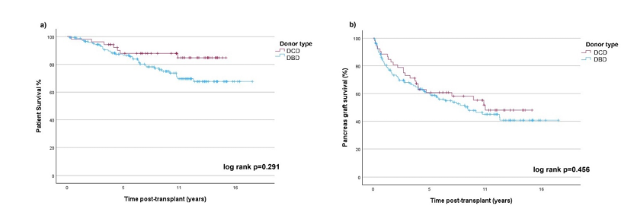
Long term outcomes of pancreas transplantation alone from donation after circulatory death
Results (cont.)
There was no significant difference in 5-year and 10-year patient and pancreas graft survival (Table 1)
Cox regression analysis identified age at transplant, recipient body mass index (BMI), and CIT as significant risk factors for graft failure, while donor category was not found to be a significant predictor
Patient survival %
Pancreas graft survival %
Figure 1: Patient (a) and pancreas graft survival (b) for PTA
Colonne1 | Coefficient | p-value | HR | 95% CI
Recipient age | -0,039 | 0,002 | 0,962 | 0.939 – 0.985
Recipient BMI | -0,057 | 0,04 | 0,944 | 0.894 – 0.997
Donor age | 0,012 | 0,186 | 1,012 | 0.994 – 1.029
Donor BMI | -0,021 | 0,59 | 0,979 | 0.905 – 1.058
Donor category (DBD/DCD) | -0,246 | 0,339 | 0,782 | 0.473 – 1.295
CIT | 0,002 | 0,011 | 1,002 | 1.000 – 1.003
Conclusions
The findings of this study support that DCD should be considered a safe alternative for PTA without compromising long-term outcomes
Recipient selection and minimising CIT are essential for optimising graft survival
Table 1. Cox regression analysis for risk factors for graft survival
Adlard F. et al., ESOT Congress 2025 (Abstract 1749)
Notes:
Abbreviations: DCD, Donation after circulatory death; DBD, Donation after brain death; PTA, Pancreas transplantation alone; BMI, Body mass index; CIT, Cold ischemia time.
Abstract Title: Long term outcomes of pancreas transplantation alone from donation after circulatory death
Reference Number: 1749
Francess Adlard¹, 2, Rumyana Smilevska^{2, 3}, Edward Sharples², Irene Mosca², Srikanth Reddy², Isabel Quiroga-Giraldez², Sushma Shankar^{2, 3}, Emilio Canovai², Sanjay Sinha², Rutger Ploeg^{2, 3}, Peter Friend^{2, 3}, Simon Knight^{2, 3}
¹University of Oxford, School of Medicine and Biomedical Sciences, Oxford, United Kingdom, ²Oxford Transplant Centre, Oxford, United Kingdom, ³University of Oxford, Nuffield Department of Surgical Sciences, Oxford, United Kingdom
Background: Decreased graft survival and increased risk of postoperative complications are key factors contributing to the infrequent use of donation after circulatory death (DCD) in pancreas transplantation worldwide, due to assumed higher risk. This study aims to compare the outcomes associated with DCD and donation after brain death (DBD) in the context of pancreas transplantation alone (PTA) within a large, single-centre cohort.
Methods: PTA recipients’ prospectively maintained database was analysed for the period from July 2004 to December 2024. The DBD and DCD cohorts were compared for demographic and transplant variables. Kaplan-Meier and Cox regression were used for analysis of graft survival and associated risk factors.
Results: 223 PTA were performed during the study period, of which 20 cases were excluded due to early graft loss in the first 30 postoperative days. 203 PTA were included in the analysis: 53 (26.1%) from DCD and 143 (73.9%) from DBD. Demographic data for recipients, postoperative complications and length of hospital stay showed no statistical difference. Donor BMI was statistically lower in the DBD group (25.97 vs 24.68kg/m2, p=0.035). Cold ischemia time (CIT) was not significantly different (705 vs 674 min, p=0.27). There was no significant difference in 5-year and 10-year patient and pancreas graft survival (Table 1). Cox regression analysis identified age at transplant, recipient body mass index (BMI), and CIT as significant risk factors for graft failure, while donor category was not found to be a significant predictor.
Conclusions: The findings of this study support that DCD should be considered a safe alternative for PTA without compromising long-term outcomes. Recipient selection and minimising CIT are essential for optimising graft survival.

Slide 27
Pregnancy outcomes following pancreas transplantation: A single center experience
Background
Pregnancy in diabetic patients presents unique challenges due to glycemic control difficulties, increased maternal health risks, fetal complications, and higher adverse pregnancy outcome rates
Diabetes mellitus (DM), a leading cause of end-stage renal disease (ESRD), often results in menstrual irregularities and infertility
This study evaluates pregnancy outcomes in pancreas transplant recipients at a single center
Methods
Retrospectively analysis:
32 pregnancies in 23 pancreas transplant recipients among 501 recipients (268 women, 208 of childbearing age)
Collection and analysis of maternal, fetal, and graft outcomes
Pre-conception immunosuppressive regimens were adjusted, primarily replacing or discontinuing mycophenolate mofetil with azathioprine in combination with tacrolimus
Jung J. H. et al., ESOT Congress 2025 (Abstract 1841)
Notes:
Abbreviations: DM, Diabetes mellitus ; ESRD, End-stage renal disease; SPK, simultaneous pancreas-kidney transplant.
Reference Number: 1841
PREGNANCY OUTCOMES FOLLOWING PANCREAS TRANSPLANTATION: A SINGLE CENTER EXPERIENCE
Joo Hee Jung¹, Young Hoon Kim²
¹Asan Medical Center, Department of Nursing, Division of Kidney and Pancreas transplantation, Seoul, South Korea, ²Asan Medical Center, Department of Surgery, Division of Kidney and Pancreas transplantation, Seoul, South Korea
Background: Pregnancy in diabetic patients presents unique challenges due to glycemic control difficulties, increased maternal health risks, fetal complications, and higher adverse pregnancy outcome rates. Diabetes mellitus (DM), a leading cause of end-stage renal disease (ESRD), often results in menstrual irregularities and infertility. This study evaluates pregnancy outcomes in pancreas transplant recipients at a single center. Methods: We retrospectively analyzed 32 pregnancies in 23 pancreas transplant recipients among 501 recipients (268 women, 208 of childbearing age). Maternal, fetal, and graft outcomes were collected and analyzed. Pre-conception immunosuppressive regimens were adjusted, primarily replacing or discontinuing mycophenolate mofetil with azathioprine in combination with tacrolimus.
Results: Of 32 pregnancies in 23 recipients, there were 11 miscarriages and 21 live births among 20 recipients. The mean age at transplantation was 28.6 years, with an average interval between transplantation and pregnancy of 65.3 months (range: 18-146). The mean gestational age was 35.0±4.2 weeks, with an average birth weight of 2326.2 g. Among 21 live births (11 male, 10 female), 6 required neonatal intensive care. Preterm delivery occurred in 10 cases, 5 due to preeclampsia. One case of pancreas graft failure occurred during pregnancy, and 4 recipients experienced rejection episodes (2 kidney, 2 pancreas) within the first postpartum year. At median follow-up of 84 months (range, 15~158 months) post-childbirth, 15 recipients maintained graft function, 5 resumed insulin therapy (including 1 who underwent pancreas re-transplantation), and 2 SPK (simultaneous pancreas-kidney transplant) recipients required kidney re-transplantation.
Conclusions: Pregnancy following pancreas transplantation is feasible but carries significant risks, including miscarriage, preterm delivery, fetal complications, and graft dysfunction. Successful maternal and fetal outcomes necessitate close monitoring and coordinated multidisciplinary care involving nephrologists, obstetricians, endocrinologists, and pediatricians.

Slide 28
Pregnancy outcomes following pancreas transplantation: A single center experience
Results
One case of pancreas graft failure occurred during pregnancy, and 4 recipients experienced rejection episodes (2 kidney, 2 pancreas) within the first postpartum year
32
21
11
At median follow-up of 84 months (range, 15~158 months) post-childbirth, 15 recipients maintained graft function, 5 resumed insulin therapy (including 1 who underwent pancreas re-transplantation), and 2 SPK (simultaneous pancreas-kidney transplant) recipients required kidney re-transplantation
Pregnancies
(23 recipients)
Miscarriages
Live births
(20 recipients)
The mean age at transplantation was 28.6 years, with an average interval between transplantation and pregnancy of 65.3 months (range: 18-146)
The mean gestational age was 35.0±4.2 weeks, with an average birth weight of 2326.2 g
Conclusions
Pregnancy following pancreas transplantation is feasible but carries significant risks, including miscarriage, preterm delivery, fetal complications, and graft dysfunction
Successful maternal and fetal outcomes necessitate close monitoring and coordinated multidisciplinary care involving nephrologists, obstetricians, endocrinologists, and pediatricians
21 live births: (11 ♂, 10 ♀)
10
5 due to preeclampsia
6
Neonatal intensive care admission
Preterm delivery
Jung J. H. et al., ESOT Congress 2025 (Abstract 1841)
Notes:
Abbreviations: DM, Diabetes mellitus ; ESRD, End-stage renal disease; SPK, simultaneous pancreas-kidney transplant.
Reference Number: 1841
PREGNANCY OUTCOMES FOLLOWING PANCREAS TRANSPLANTATION: A SINGLE CENTER EXPERIENCE
Joo Hee Jung¹, Young Hoon Kim²
¹Asan Medical Center, Department of Nursing, Division of Kidney and Pancreas transplantation, Seoul, South Korea, ²Asan Medical Center, Department of Surgery, Division of Kidney and Pancreas transplantation, Seoul, South Korea
Background: Pregnancy in diabetic patients presents unique challenges due to glycemic control difficulties, increased maternal health risks, fetal complications, and higher adverse pregnancy outcome rates. Diabetes mellitus (DM), a leading cause of end-stage renal disease (ESRD), often results in menstrual irregularities and infertility. This study evaluates pregnancy outcomes in pancreas transplant recipients at a single center. Methods: We retrospectively analyzed 32 pregnancies in 23 pancreas transplant recipients among 501 recipients (268 women, 208 of childbearing age). Maternal, fetal, and graft outcomes were collected and analyzed. Pre-conception immunosuppressive regimens were adjusted, primarily replacing or discontinuing mycophenolate mofetil with azathioprine in combination with tacrolimus.
Results: Of 32 pregnancies in 23 recipients, there were 11 miscarriages and 21 live births among 20 recipients. The mean age at transplantation was 28.6 years, with an average interval between transplantation and pregnancy of 65.3 months (range: 18-146). The mean gestational age was 35.0±4.2 weeks, with an average birth weight of 2326.2 g. Among 21 live births (11 male, 10 female), 6 required neonatal intensive care. Preterm delivery occurred in 10 cases, 5 due to preeclampsia. One case of pancreas graft failure occurred during pregnancy, and 4 recipients experienced rejection episodes (2 kidney, 2 pancreas) within the first postpartum year. At median follow-up of 84 months (range, 15~158 months) post-childbirth, 15 recipients maintained graft function, 5 resumed insulin therapy (including 1 who underwent pancreas re-transplantation), and 2 SPK (simultaneous pancreas-kidney transplant) recipients required kidney re-transplantation.
Conclusions: Pregnancy following pancreas transplantation is feasible but carries significant risks, including miscarriage, preterm delivery, fetal complications, and graft dysfunction. Successful maternal and fetal outcomes necessitate close monitoring and coordinated multidisciplinary care involving nephrologists, obstetricians, endocrinologists, and pediatricians.

