Slide 1


Best of
ESOT Congress 2025
Heart

Slide 2
Disclaimer
This slide deck is designed for personal educational purposes only and should not be utilised for making patient management decisions. It is important to verify all information provided before treating patients or applying any therapies mentioned in these materials.

Slide 3
Information
This slide deck showcases the latest data presented at the ESOT Congress 2025.
All abbreviations displayed in these slides, along with a complete copy of the
original abstract text, can be found in the slide notes.
3. Click on the symbol to return to the contents page.

Slide 4
Content
HEART
1072.
Selective in-vivo expansion of regulatory T cells leads to long-term tolerance of heart allografts
1533.
Monitoring of cytomegalovirus-specific cell-mediated immunity in heart transplant recipients
1643.
Molecular classification system for cardiac allograft rejection positively correlates with rejection pathology severity
1183.
Effect of extracorporeal photopheresis on graft intimal hyperplasia in the first year after heart transplantation
378.
Lawsone induces cardiac allograft tolerance by suppressing Th1 differentiation in mice
2155.
Electronic nose for detecting impaired glucose metabolism in heart transplant recipients
743.
The relationship between C1q positive donor-specific antibodies and heart transplant outcomes
293.
Enhancing utility of antibody testing with donor-derived cell-free DNA post-heart transplantation
2414.
Levels of circulating microvesicles in patients with cardiac transplant rejection
2349.
Analysis of clinical and immunological risk factors in heart transplant recipients with malignancy
1671.
Molecular diagnostic classification of heart allograft rejection: a calibrated and validated system
606.
Management of multi-drug resistant Acinetobacter baumannii infection in heart transplant recipients

Slide 5
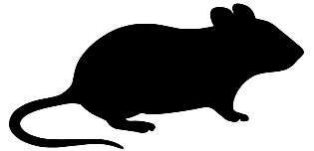

Selective in-vivo expansion of regulatory T cells leads to long-term tolerance of heart allografts
Background
Chronic antibody-mediated rejection (ABMR) and cardiac allograft vasculopathy (CAV) are key causes of late graft failure in heart transplant recipients, with few effective treatments available
Regulatory T cells (Tregs) are essential for immune tolerance, suppressing both autoimmune and alloimmune responses
A promising approach to expand Tregs in vivo involves an interleukin-2 (IL-2) complex with an anti-IL-2 antibody (IL-2cplx), which boosts Treg proliferation
This study examines the potential of IL 2cplx-based immunomodulation in a murine heart allograft model
Method
Fully mismatched BALB/c hearts
Female C57BL/6
Treatment:
IL-2/anti IL-2 (1µg/5µg) and rapamycin (1µg/gBW) on days -3/-2/-1 and thrice a week until day 29
Short-term anti-IL-6 (600µg d-1; 300µg days 4/6)
-> Cardiac allograft survival monitoring
Flow-cytometric crossmatch to detect donor-specific antibodies
Mixed lymphocyte reaction assays to assess donor specific T-cell reaction
Histological analysis according to the ISHLT grading
Efficacy assessed in Tmem-enriched mice (receiving T-cell transfer from donor type skin challenged mice) prior to HTX
Wolner L. et al., ESOT Congress 2025 (Abstract 1072)
Notes:
Abbreviations: ABMR, Chronic antibody-mediated rejection; CAV, cardiac allograft vasculopathy; Tregs, Regulatory T cells; IL-2, Interleukin-2; DSA, donor-specific antibodies; HTX, Heart transplantation.
Reference Number: 1072
SELECTIVE IN-VIVO EXPANSION OF REGULATORY T CELLS LEADS TO LONG-TERM TOLERANCE OF HEART ALLOGRAFTS TOPIC: IMMUNOSUPPRESSIVE AGENTS
Laurenz Wolner¹, Romy Steiner¹, Victoria Österreicher¹, Attila Kiss¹, Andreas Zuckermann², Bruno Podesser¹, Nina Pilat^{1, 2}
¹Center for Biomedical Research and Translational Surgery, Medical University of Vienna, Austria, Vienna, ²Department of Cardiac Surgery, Medical University of Vienna, Austria, Vienna
Background: Chronic antibody-mediated rejection (ABMR) and cardiac allograft vasculopathy (CAV) are key causes of late graft failure in heart transplant recipients, with few effective treatments available. Regulatory T cells (Tregs) are essential for immune tolerance, suppressing both autoimmune and alloimmune responses. A promising approach to expand Tregs in vivo involves an interleukin-2 (IL-2) complex with an anti-IL-2 antibody (IL-2cplx), which boosts Treg proliferation. This study examines the potential of IL 2cplx-based immunomodulation in a murine heart allograft model.
Methods: Female C57BL/6 mice were transplanted with fully mismatched BALB/c hearts and treated with IL-2/anti IL-2 (1µg/5µg) and rapamycin (1µg/gBW) administered on d-3/-2/-1 and thrice a week until d29, and short-term anti-IL-6 (600µg d-1; 300µg d4/6). Cardiac allograft survival was monitored. Flow-cytometric crossmatch was performed to detect donor-specific antibodies (DSA). Mixed lymphocyte reaction essays were performed to assess donor specific T-cell reaction and histological analysis was performed according to the ISHLT grading. Additionally, efficacy of this protocol was assessed in Tmem enriched mice (receiving T-cell transfer from donor type skin challenged mice) prior to HTX.
Results: IL-2cplx protocol treatment led to indefinite survival (>150 d) compared to untreated controls (MST=7.5d). Furthermore, IL-2cplx-based treatment significantly reduced formation of donor-specific IgG1 and IgG2ab. CD4+ and CD8+ cell proliferation against donor antigen was comparable between naïve and treated mice, indicating no donor specific T-cell hyperresponsiveness. Histologic grading revealed low rejection scores even at the end of follow up. We found less necrosis (p=0.02) compared to untreated controls. Even in presensitized mice, survival of the graft was significantly prolonged (> 70 d).
Conclusions: We demonstrated that selective in vivo expansion of Tregs using IL-2cplx, combined with rapamycin and short-term anti-IL-6mAb treatment, leads to operational tolerance in a clinically relevant model of cardiac transplantation, as evidenced by indefinite survival in the absence of continuous immunosuppression. Moreover, the potency of this approach is preserved in the presence of alloreactive memory.

Slide 6
Selective in-vivo expansion of regulatory T cells leads to long-term tolerance of heart allografts
Results
Less necrosis (p=0.02) was observed compared to untreated controls
Even in presensitized mice, survival of the graft was significantly prolonged
IL-2cplx protocol treatment led to indefinite survival (>150 d) compared to untreated controls
IL-2cplx-based treatment significantly reduced formation of donor-specific IgG1 and IgG2ab
Histologic grading revealed low rejection scores even at the end of follow up
Conclusions
Selective in vivo expansion of Tregs using IL-2cplx, combined with rapamycin and short-term anti-IL-6mAb treatment, leads to operational tolerance in a clinically relevant model of cardiac transplantation, as evidenced by indefinite survival in the absence of continuous immunosuppression
Moreover, the potency of this approach is preserved in the presence of alloreactive memory
CD4+ and CD8+ cell proliferation against donor antigen was comparable between naïve and treated mice indicating no donor specific T-cell hyperresponsiveness
CD8+
CD4+
Wolner L. et al., ESOT Congress 2025 (Abstract 1072)
Notes:
Abbreviations: ABMR, Chronic antibody-mediated rejection; CAV, cardiac allograft vasculopathy; Tregs, Regulatory T cells; IL-2, Interleukin-2; DSA, donor-specific antibodies; HTX, Heart transplantation.
Reference Number: 1072
SELECTIVE IN-VIVO EXPANSION OF REGULATORY T CELLS LEADS TO LONG-TERM TOLERANCE OF HEART ALLOGRAFTS TOPIC: IMMUNOSUPPRESSIVE AGENTS
Laurenz Wolner¹, Romy Steiner¹, Victoria Österreicher¹, Attila Kiss¹, Andreas Zuckermann², Bruno Podesser¹, Nina Pilat^{1, 2}
¹Center for Biomedical Research and Translational Surgery, Medical University of Vienna, Austria, Vienna, ²Department of Cardiac Surgery, Medical University of Vienna, Austria, Vienna
Background: Chronic antibody-mediated rejection (ABMR) and cardiac allograft vasculopathy (CAV) are key causes of late graft failure in heart transplant recipients, with few effective treatments available. Regulatory T cells (Tregs) are essential for immune tolerance, suppressing both autoimmune and alloimmune responses. A promising approach to expand Tregs in vivo involves an interleukin-2 (IL-2) complex with an anti-IL-2 antibody (IL-2cplx), which boosts Treg proliferation. This study examines the potential of IL 2cplx-based immunomodulation in a murine heart allograft model.
Methods: Female C57BL/6 mice were transplanted with fully mismatched BALB/c hearts and treated with IL-2/anti IL-2 (1µg/5µg) and rapamycin (1µg/gBW) administered on d-3/-2/-1 and thrice a week until d29, and short-term anti-IL-6 (600µg d-1; 300µg d4/6). Cardiac allograft survival was monitored. Flow-cytometric crossmatch was performed to detect donor-specific antibodies (DSA). Mixed lymphocyte reaction essays were performed to assess donor specific T-cell reaction and histological analysis was performed according to the ISHLT grading. Additionally, efficacy of this protocol was assessed in Tmem enriched mice (receiving T-cell transfer from donor type skin challenged mice) prior to HTX.
Results: IL-2cplx protocol treatment led to indefinite survival (>150 d) compared to untreated controls (MST=7.5d). Furthermore, IL-2cplx-based treatment significantly reduced formation of donor-specific IgG1 and IgG2ab. CD4+ and CD8+ cell proliferation against donor antigen was comparable between naïve and treated mice, indicating no donor specific T-cell hyperresponsiveness. Histologic grading revealed low rejection scores even at the end of follow up. We found less necrosis (p=0.02) compared to untreated controls. Even in presensitized mice, survival of the graft was significantly prolonged (> 70 d).
Conclusions: We demonstrated that selective in vivo expansion of Tregs using IL-2cplx, combined with rapamycin and short-term anti-IL-6mAb treatment, leads to operational tolerance in a clinically relevant model of cardiac transplantation, as evidenced by indefinite survival in the absence of continuous immunosuppression. Moreover, the potency of this approach is preserved in the presence of alloreactive memory.

Slide 7
Molecular classification system for cardiac allograft rejection positively correlates with rejection pathology severity
Methods
Multicenter cohort of 591 FFPE-EMBs collected from four international centers between 2011 and 2021
Background
Targeted molecular profiling combined with reproducible formalin-fixed paraffin-embedded (FFPE) EMB-based technology has the potential to support cardiac rejection diagnosis
The aim of this study is to develop and validate targeted gene expression diagnostic models of cardiac rejection and show their association with ISHLT pathological grades
Biopsies were graded according to the ISHLT working formulations, including:
188 AMR cases
289 ACR cases
114 non-rejection cases
Randomly split in a derivation (n=475) and a validation cohort (n=116)
Tissue gene expression analyzed on FFPE-EMB using the Banff Human Organ Transplant gene set
Molecular classifiers for AMR and ACR were built using a supervised mode
Association between molecular scores and pathology severity of rejection were analyzed in both derivation and validation set
Giarraputo A. et al., ESOT Congress 2025 (Abstract 1643)
Notes:
Abbreviations: FFPE, formalin-fixed paraffin-embedded; ISHLT, International Society for Heart and Lung Transplantation; AMR, Antibody-Mediated Rejection; ACR, Acute Cellular Rejection.
Reference Number: 1643
MOLECULAR CLASSIFICATION SYSTEM FOR CARDIAC ALLOGRAFT REJECTION POSITIVELY CORRELATES WITH REJECTION PATHOLOGY SEVERITY
Alessia Giarraputo¹, Guillaume Coutance², Jignesh Patel³, Marny Fedrigo⁴, Olivier Aubert⁵, Shaida Varnous⁶, Ilaria Barison⁷, Chiara Castellani⁸, Jessy Dagobert⁹, Fariza Mezine¹⁰, Philippe Rouvier¹¹, Leprince Pascal⁶, Jean-Paul Duong van Huyen¹², Patrick Bruneval¹³, Annalisa Angelini¹⁴, Jon Kobashigawa³, Alexandre Loupy¹⁵
¹Paris Institute for Transplantation and Organ Regeneration, ²Pitié-Salpêtrière Hospital; Heart Transplantation, ³Cedars-Sinai Medical Center
⁴University of Padova, ⁵Necker Hospital; Necker Hospital; ⁶Pitié-Salpêtrière Hospital, Assistance Publique des Hôpitaux de Paris (Ap-Hp), ⁷Dctv
⁸Cardiovascular Pathology, Department of Cardiac, Thoracic, Vascular Sciences, University of Padua, ⁹Paris Translational Research Centre for Organ Transplantation, ¹⁰Paris Tranplant Group – Inserm, ¹¹Pitié-Salpêtrière, ¹²Necker - Enfants Malades Hospital; Necker Hospital; Pathology
¹³Paris Transplant Group, ¹⁴2. Cardiovascular Pathology, Department of Cardiac, Thoracic, Vascular Sciences, University of Padua, ¹⁵Paris Transplant Group; Paris Institute for Transplantation and Organ Regeneration (Pitor), Paris, France
Background: Targeted molecular profiling combined with reproducible formalin-fixed paraffin-embedded (FFPE) EMB-based technology has the potential to support cardiac rejection diagnosis. We aimed to develop and validate targeted gene expression diagnostic models of cardiac rejection and show their association with ISHLT pathological grades.
Methods: We built a multicenter cohort of 591 FFPE-EMBs collected from four international centers between 2011 and 2021. Biopsies were graded according to the ISHLT working formulations, including 188 AMR cases, 289 ACR cases, and 114 non-rejection cases, randomly split in a derivation (n = 475) and a validation cohort (n = 116). Tissue gene expression was analyzed on FFPE-EMB using the Banff Human Organ Transplant gene set. Molecular classifiers for AMR and ACR were built using a supervised model. Association between molecular scores and pathology severity of rejection were analyzed in both derivation and validation set.
Results: The derivation included a total of 151 AMR (pAMR1H+: n = 46, pAMR1I+: n = 36, pAMR2-3: n = 69), 232 ACR (ACR 1R: n = 143, ACR 2-3R: n = 89) and 92 non-rejection cases. The validation set included a total of 37 AMR (pAMR1H+: n = 12, pAMR1I+: n = 15, pAMR2-3: n = 10), 57 ACR (ACR 1R: n = 31, ACR 2-3R: n = 26) and 22 non-rejection cases. Median AMR scores in AMR, ACR and non-rejection cases were 0.655 (IQR = 0.316), 0.217 (IQR = 0.254) and 0.140 (IQR = 0.209), respectively. Median ACR scores in ACR, AMR and non-rejection cases were 0.678 (IQR = 0.347), 0.263 (IQR = 0.364) and 0.302 (IQR = 270), respectively. AMR and ACR molecular scores were strongly associated with the pathology assessment of severity of rejection according to AMR and ACR international working formulations, respectively (derivation set: ACR: p for trend = 1.017E-46, AMR: p for trend = 2.911E-52; validation set: ACR: p for trend = 1.827E-13, AMR: p for trend = 5.174E-10, Figure). Molecular AMR score was not associated with ACR severity; neither was the ACR molecular score with AMR severity.
Conclusions: Tissue-based molecular diagnostic system developed closely aligned with histological grading of cardiac allograft rejection, enhancing diagnostic precision, and offering a reliable companion tool for routine practice.

Slide 8
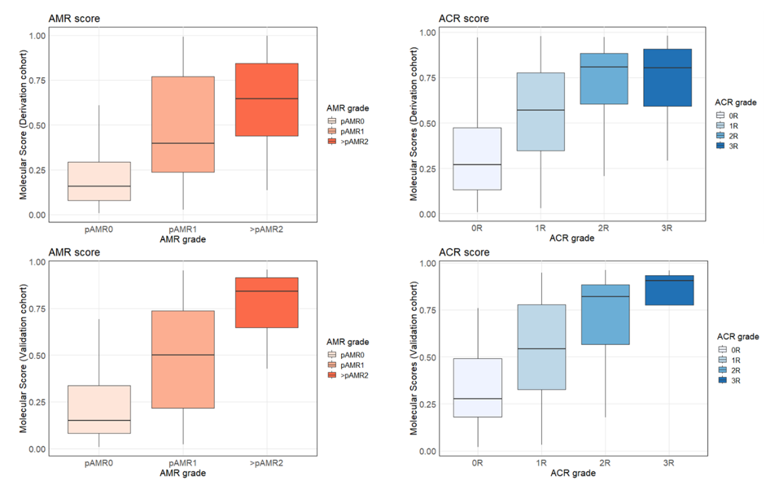
Molecular classification system for cardiac allograft rejection positively correlates with rejection pathology severity
Results
AMR and ACR molecular scores strongly associated with the pathology assessment of severity of rejection according to AMR and ACR international working formulations, respectively (derivation set: ACR: p for trend = 1.017x10⁻⁴⁶, AMR: p for trend = 2.911x10⁻⁵²; validation set: ACR: p for trend = 1.827x10⁻¹³, AMR: p for trend = 5.174x10⁻¹⁰, (Figure)
 | Subcategory | Derivation Set | Validation Set
AMR | pAMR1H+ | 46 | 12
AMR | pAMR1I+ | 36 | 15
AMR | pAMR2-3 | 69 | 10
ACR | ACR 1R | 143 | 31
ACR | ACR 2-3R | 89 | 26
Non-rejection |  | 92 | 22
Score Type | Group | Median | IQR
AMR Score | AMR | 0.655 | 0.316
 | ACR | 0.217 | 0.254
 | Non-rejection | 0.14 | 0.209
ACR Score | ACR | 0.678 | 0.347
 | AMR | 0.263 | 0.364
 | Non-rejection | 0.302 | 0.27
Molecular AMR score was not associated with ACR severity; neither was the ACR molecular score with AMR severity
Conclusions
Tissue-based molecular diagnostic system developed closely aligned with histological grading of cardiac allograft rejection, enhancing diagnostic precision, and offering a reliable companion tool for routine practice
Giarraputo A. et al., ESOT Congress 2025 (Abstract 1643)
Notes:
Abbreviations: FFPE, formalin-fixed paraffin-embedded; ISHLT, International Society for Heart and Lung Transplantation; AMR, Antibody-Mediated Rejection; ACR, Acute Cellular Rejection.
Reference Number: 1643
MOLECULAR CLASSIFICATION SYSTEM FOR CARDIAC ALLOGRAFT REJECTION POSITIVELY CORRELATES WITH REJECTION PATHOLOGY SEVERITY
Alessia Giarraputo¹, Guillaume Coutance², Jignesh Patel³, Marny Fedrigo⁴, Olivier Aubert⁵, Shaida Varnous⁶, Ilaria Barison⁷, Chiara Castellani⁸, Jessy Dagobert⁹, Fariza Mezine¹⁰, Philippe Rouvier¹¹, Leprince Pascal⁶, Jean-Paul Duong van Huyen¹², Patrick Bruneval¹³, Annalisa Angelini¹⁴, Jon Kobashigawa³, Alexandre Loupy¹⁵
¹Paris Institute for Transplantation and Organ Regeneration, ²Pitié-Salpêtrière Hospital; Heart Transplantation, ³Cedars-Sinai Medical Center
⁴University of Padova, ⁵Necker Hospital; Necker Hospital; ⁶Pitié-Salpêtrière Hospital, Assistance Publique des Hôpitaux de Paris (Ap-Hp), ⁷Dctv
⁸Cardiovascular Pathology, Department of Cardiac, Thoracic, Vascular Sciences, University of Padua, ⁹Paris Translational Research Centre for Organ Transplantation, ¹⁰Paris Tranplant Group – Inserm, ¹¹Pitié-Salpêtrière, ¹²Necker - Enfants Malades Hospital; Necker Hospital; Pathology ¹³Paris Transplant Group, ¹⁴2. Cardiovascular Pathology, Department of Cardiac, Thoracic, Vascular Sciences, University of Padua, ¹⁵Paris Transplant Group; Paris Institute for Transplantation and Organ Regeneration (Pitor), Paris, France
Background: Targeted molecular profiling combined with reproducible formalin-fixed paraffin-embedded (FFPE) EMB-based technology has the potential to support cardiac rejection diagnosis. We aimed to develop and validate targeted gene expression diagnostic models of cardiac rejection and show their association with ISHLT pathological grades.
Methods: We built a multicenter cohort of 591 FFPE-EMBs collected from four international centers between 2011 and 2021. Biopsies were graded according to the ISHLT working formulations, including 188 AMR cases, 289 ACR cases, and 114 non-rejection cases, randomly split in a derivation (n = 475) and a validation cohort (n = 116). Tissue gene expression was analyzed on FFPE-EMB using the Banff Human Organ Transplant gene set. Molecular classifiers for AMR and ACR were built using a supervised model. Association between molecular scores and pathology severity of rejection were analyzed in both derivation and validation set.
Results: The derivation included a total of 151 AMR (pAMR1H+: n = 46, pAMR1I+: n = 36, pAMR2-3: n = 69), 232 ACR (ACR 1R: n = 143, ACR 2-3R: n = 89) and 92 non-rejection cases. The validation set included a total of 37 AMR (pAMR1H+: n = 12, pAMR1I+: n = 15, pAMR2-3: n = 10), 57 ACR (ACR 1R: n = 31, ACR 2-3R: n = 26) and 22 non-rejection cases. Median AMR scores in AMR, ACR and non-rejection cases were 0.655 (IQR = 0.316), 0.217 (IQR = 0.254) and 0.140 (IQR = 0.209), respectively. Median ACR scores in ACR, AMR and non-rejection cases were 0.678 (IQR = 0.347), 0.263 (IQR = 0.364) and 0.302 (IQR =0.270), respectively. AMR and ACR molecular scores were strongly associated with the pathology assessment of severity of rejection according to AMR and ACR international working formulations, respectively (derivation set: ACR: p for trend = 1.017E-46, AMR: p for trend = 2.911E-52; validation set: ACR: p for trend = 1.827E-13, AMR: p for trend = 5.174E⁻¹⁰, Figure). Molecular AMR score was not associated with ACR severity; neither was the ACR molecular score with AMR severity.
Conclusions: Tissue-based molecular diagnostic system developed closely aligned with histological grading of cardiac allograft rejection, enhancing diagnostic precision, and offering a reliable companion tool for routine practice.

Slide 9
Lawsone induces cardiac allograft tolerance by suppressing Th1 differentiation in mice
Background
Lawsone is a natural compound that demonstrates diverse biological properties
However, the potential of lawsone in organ transplant remains unknown
This study aims to evaluate the application of lawsone in fully MHC-mismatched murine cardiac transplantation
Methods
Heterotopically transplanted
Donor C57 mice
abdomen of recipient C3H mice
Lawsone administered intragastrically to recipients
Use of allografts to observe the survival, pathological changes and immune cells infiltration
Lawsone treatment
Vehicle treatment
- CFSE labeled T cells proliferation measured by flow cytometry
- Isolation of bone marrow cells, induced to differentiate into bone marrow derived dendritic cells (BMDCs), and subsequently co-cultured with T cells
- Th1 cell differentiation induced by culturing naïve CD4+ T cells
- Inflammatory cytokines detected via ELISA, while RNA-seq and WB used to investigate the underlying mechanisms
Huang W. et al., ESOT Congress 2025 (Abstract 378)
Notes:
Abbreviations: MHC, Major Histocompatibility Complex; BMDCs, bone marrow derived dendritic cells; GO, Gene ontology; KEGG, Kyoto Encyclopedia of Genes and Genomes; IFN-γ, Interferon gamma; IL-10, Interleukin 10; Th1, T-helper 1.
Reference Number: 378
LAWSONE INDUCES CARDIAC ALLOGRAFT TOLERANCE BY SUPPRESSING TH1 DIFFERENTIATION IN MICE
Wenxin Huang¹, Weitao Que², Jifu Ge³
¹KU Leuven, Leuven , Belgium, ²shanghai jiaotong university, shanghai , China, ³boston children's hospital, boston, United States
Background: Lawsone a natural compound demonstrates diverse biological properties. However, the potential of lawsone in organ transplant remains unknown. We aim to evaluate the application of lawsone in fully MHC-mismatched murine cardiac transplantation.
Methods: Hearts from donor C57 mice were heterotopically transplanted to the abdomen of recipient C3H mice. Lawsone was administered intragastrically to recipients. The allografts were used to observe the survival, pathological changes and immune cells infiltration. CFSE labeled T cells were treated with lawsone or vehicle, and the proliferation was measured by flow cytometry. Bone marrow cells were isolated, induced to differentiate into bone marrow derived dendritic cells (BMDCs), and subsequently co-cultured with T cells in the presence of lawsone or vehicle control. Th1 cell differentiation was induced by culturing naïve CD4+ T cells with lawsone or vehicle. Additionally, inflammatory cytokines were detected via ELISA, while RNA-seq and WB were used to investigate the underlying mechanisms.
Results: Lawsone resulted in long-term graft survival in the transplant model(median survival time >100 days). Notably, recipients exhibited reduced T cells in both grafts and spleens 7 days post operation. Similarly, lawsone suppressed the proliferation of CD4+ and CD8+ T cells in vitro, and inhibited the antigen-presenting capability of BMDCs by suppressing their maturation. The levels of the pro-inflammatory cytokine IFN-γ were lower and the levels of the anti-inflammatory cytokine IL-10 were higher in the serum of lawsone-treated groups. Lawsone-treated group demonstrated declined expression of IFN-γ both in vitro and in vivo, indicating lawsone suppressed Th1 cells differentiation. GO and KEGG pathway enrichment revealed a correlation between lawsone treatment and T cell-related pathways, and STAT signaling pathways. Western blot analysis demonstrated down-regulated levels of phosphorylated STAT3 in the lawsone-treated Th1 cells.
Conclusions: We revealed the protective effect of lawsone in murine transplant model. In vitro experiments revealed lawsone against rejection presumably via suppressing IFN-γ/p STAT3 signaling. Our data suggest that lawsone could be a novel therapeutic approach in solid organ transplantation.

Slide 10
Lawsone induces cardiac allograft tolerance by suppressing Th1 differentiation in mice
Results
Lawsone resulted in long-term graft survival in the transplant model (median survival time >100 days)
Observation | Effect of Lawsone
T cell presence in graft and spleen | ↓ Reduced CD4⁺ and CD8⁺ T cells (7 days post operation)
CD4+ and CD8+ T cell proliferation (in vitro) | ↓ Suppressed proliferation
BMDCs antigen-presenting capacity | ↓ Inhibited via suppression of maturation
Cytokines in serum | ↓ IFN-γ (pro-inflammatory), ↑ IL-10 (anti-inflammatory)
Th1 differentiation | ↓ Suppressed (in vitro & in vivo)
IFN-γ expression | ↓ Declined (correlating with reduced Th1 activity)
Pathway analysis (GO & KEGG) | Affected T cell-related and STAT signaling pathways
Western blot (Th1 cells) | ↓ Phosphorylated STAT3
Conclusions
This study demonstrates the protective effect of lawsone in murine transplant model
In vitro experiments revealed that lawsone may prevent rejection presumably via suppressing IFN-γ/pSTAT3 signaling
These data suggest that lawsone could be a novel therapeutic approach in solid organ transplantation
Huang W. et al., ESOT Congress 2025 (Abstract 378)
Notes:
Abbreviations: MHC, Major Histocompatibility Complex; BMDCs, bone marrow derived dendritic cells; GO, Gene ontology; KEGG, Kyoto Encyclopedia of Genes and Genomes; IFN-γ, Interferon gamma; IL-10, Interleukin 10; Th1, T-helper 1.
Reference Number: 378
LAWSONE INDUCES CARDIAC ALLOGRAFT TOLERANCE BY SUPPRESSING TH1 DIFFERENTIATION IN MICE
Wenxin Huang¹, Weitao Que², Jifu Ge³
¹KU Leuven, Leuven , Belgium, ²shanghai jiaotong university, shanghai , China, ³boston children's hospital, boston, United States
Background: Lawsone a natural compound demonstrates diverse biological properties. However, the potential of lawsone in organ transplant remains unknown. We aim to evaluate the application of lawsone in fully MHC-mismatched murine cardiac transplantation.
Methods: Hearts from donor C57 mice were heterotopically transplanted to the abdomen of recipient C3H mice. Lawsone was administered intragastrically to recipients. The allografts were used to observe the survival, pathological changes and immune cells infiltration. CFSE labeled T cells were treated with lawsone or vehicle, and the proliferation was measured by flow cytometry. Bone marrow cells were isolated, induced to differentiate into bone marrow derived dendritic cells(BMDCs), and subsequently co-cultured with T cells in the presence of lawsone or vehicle control. Th1 cell differentiation was induced by culturing naïve CD4+ T cells with lawsone or vehicle. Additionally, inflammatory cytokines were detected via ELISA, while RNA-seq and WB were used to investigate the underlying mechanisms.
Results: Lawsone resulted in long-term graft survival in the transplant model(median survival time >100 days). Notably, recipients exhibited reduced T cells in both grafts and spleens 7 days post operation. Similarly, lawsone suppressed the proliferation of CD4+ and CD8+ T cells in vitro, and inhibited the antigen-presenting capability of BMDCs by suppressing their maturation. The levels of the pro-inflammatory cytokine IFN-γ were lower and the levels of the anti-inflammatory cytokine IL-10 were higher in the serum of lawsone-treated groups. Lawsone-treated group demonstrated declined expression of IFN-γ both in vitro and in vivo, indicating lawsone suppressed Th1 cells differentiation. GO and KEGG pathway enrichment revealed a correlation between lawsone treatment and T cell-related pathways, and STAT signaling pathways. Western blot analysis demonstrated down-regulated levels of phosphorylated STAT3 in the lawsone-treated Th1 cells.
Conclusions: We revealed the protective effect of lawsone in murine transplant model. In vitro experiments revealed lawsone against rejection presumably via suppressing IFN-γ/p STAT3 signaling. Our data suggest that lawsone could be a novel therapeutic approach in solid organ transplantation.

Slide 11
The relationship between C1q positive donor-specific antibodies and heart transplant outcomes
Methods
Among 861 HTx recipients n=126 (14.6%) developed dnDSA (DSA first detected >3 months post-HTx) between 2010 and 2021
Division via the Luminex assay
Background
De novo donor-specific antibodies (dnDSA) following heart transplantation (HTx) have been associated with worse outcomes including increased incidence of antibody mediated rejection (AMR), cardiac allograft vasculopathy (CAV), graft dysfunction, and mortality
It is unknown whether complement binding ability on Luminex (C1q+) identifies a more virulent DSA phenotype
C1q+ DSA
cohort
C1q- DSA
cohort
Primary outcome:
All-cause mortality
Secondary outcomes: (includes)
CAV, AMR (pAMR >1)
Acute cellular rejection (ACR) >2R
Graft dysfunction (left ventricular ejection fraction (LVEF) ≤40%)
Non-fatal major adverse cardiovascular events (NF-MACE)
Baseline characteristics and outcomes compared utilizing t-tests for continuous variables and chi-square analysis for categorical variable
Logistic regression was used to identify independent associations between C1q status and outcomes
Aiken A. et al., ESOT Congress 2025 (Abstract 743)
Notes:
Abbreviations: dnDSA, De novo donor-specific antibodies; HTx, heart transplantation; AMR, antibody mediated rejection; CAV, Cardiac allograft vasculopathy; DSA, donor-specific antibodies; LVEF, Left ventricular ejection fraction; ACR, Acute cellular rejection; NF-MACE, Non-fatal major adverse cardiovascular events.
Reference Number: 743
THE RELATIONSHIP BETWEEN C1Q POSITIVE DONOR-SPECIFIC ANTIBODIES AND HEART TRANSPLANT OUTCOMES
Achilles Aiken¹, Andriana Nikolova¹, Avani Kanungo¹, Nayana Bhatnagar¹, Mason Lee¹, Peter Deckerman¹, David Chang¹, Michelle Kittleson¹, Evan Kransdorf¹, Jon Kobashigawa¹
¹Cedars-Sinai Smidt Heart Institute, Los Angeles, United States
Background: De novo donor-specific antibodies (dnDSA) following heart transplantation (HTx) have been associated with worse outcomes including increased incidence of antibody mediated rejection (AMR), cardiac allograft vasculopathy (CAV), graft dysfunction, and mortality. It is unknown whether complement binding ability on Luminex (C1q+) identifies a more virulent DSA phenotype.
Methods: Between 2010 and 2021, we identified 126 out of 861 HTx recipients who developed dnDSA (14.6%), defined as DSA that were first detected >3 months post-HTx. These patients were divided into C1q+ DSA and C1q- DSA cohorts via the Luminex assay. The primary outcome was all-cause mortality. Secondary outcomes included CAV, AMR (pAMR >1), acute cellular rejection (ACR) >2R, graft dysfunction (left ventricular ejection fraction (LVEF) ≤40%), and non-fatal major adverse cardiovascular events (NF-MACE) including stroke, coronary revascularization, heart failure, and defibrillator or pacemaker implantation. Baseline characteristics and outcomes were compared utilizing t-tests for continuous variables and chi-square analysis for categorical variables. Logistic regression analysis was used to evaluate for independent associations between C1q status and outcome variables.
Results: There were 40 C1q+ DSA and 86 C1q- DSA patients identified with a mean follow up of 5.8 years. The mean time to DSA appearance was 2.3 years post-HTx in both cohorts. Mean LVEF at time of DSA identification was lower in the C1q+ vs C1q- cohort (50.8% vs 57.9%, p =<0.001). The primary outcome was higher in the C1q+ cohort (40.0% vs 20.9%, p = 0.025) with a mean time to event of 4 years. AMR was more frequent in the C1q+ cohort (25.0% vs 10.6%, p = 0.036). Causes of cardiovascular mortality in the C1q+ compared to the C1q- group included sudden death (25% vs 11.1%), CAV (18.8% vs 22.2%), acute rejection (25% vs 5.6%), and stroke (6.3% vs 5.6%). There were similar rates of CAV, ACR, graft dysfunction, and NF-MACE between the C1q+ and C1q- cohorts.
Conclusions: C1q+ DSA are associated with increased AMR rates, worse graft function, and higher mortality when compared to C1q- DSA at a mean follow-up of over 5 years. Larger prospective studies are needed to validate those findings and identify potential therapeutic interventions that can improve outcomes.

Slide 12
The relationship between C1q positive donor-specific antibodies and heart transplant outcomes
Results
Similar rates of CAV, ACR, graft dysfunction, and NF-MACE between the C1q+ and C1q- cohorts
n=40 C1q+ DSA
Mean follow up of 5.8 years
Mean time to DSA appearance:
2.3 years post-HTx in both cohorts
n= 86 C1q- DSA
Conclusions
C1q+ DSA are associated with increased AMR rates, worse graft function, and higher mortality when compared to C1q- DSA at a mean follow-up of over 5 years
Larger prospective studies are needed to validate those findings and identify potential therapeutic interventions that can improve outcomes
 | C1q+ Cohort | C1q– Cohort | p-value
Mean LVEF at time of DSA identification | 50.8% | 57.9% | <0.001
Primary outcome (mean time to event of 4 years) | 40.0% | 20.9% | 0.025
AMR frequency | 25.0% | 10.6% | 0.036
Causes of cardiovascular mortality:
Sudden death | 25% | 11.1%
CAV | 18.8% | 22.2%
Acute rejection | 25% | 5.6%
Stroke | 6.3% | 5.6%
Aiken A. et al., ESOT Congress 2025 (Abstract 743)
Notes:
Abbreviations: dnDSA, De novo donor-specific antibodies; HTx, heart transplantation; AMR, antibody mediated rejection; CAV, Cardiac allograft vasculopathy; DSA, donor-specific antibodies; LVEF, Left ventricular ejection fraction; ACR, Acute cellular rejection; NF-MACE, Non-fatal major adverse cardiovascular events.
Reference Number: 743
THE RELATIONSHIP BETWEEN C1Q POSITIVE DONOR-SPECIFIC ANTIBODIES AND HEART TRANSPLANT OUTCOMES
Achilles Aiken¹, Andriana Nikolova¹, Avani Kanungo¹, Nayana Bhatnagar¹, Mason Lee¹, Peter Deckerman¹, David Chang¹, Michelle Kittleson¹, Evan Kransdorf¹, Jon Kobashigawa¹
¹Cedars-Sinai Smidt Heart Institute, Los Angeles, United States
Background: De novo donor-specific antibodies (dnDSA) following heart transplantation (HTx) have been associated with worse outcomes including increased incidence of antibody mediated rejection (AMR), cardiac allograft vasculopathy (CAV), graft dysfunction, and mortality. It is unknown whether complement binding ability on Luminex (C1q+) identifies a more virulent DSA phenotype.
Methods: Between 2010 and 2021, we identified 126 out of 861 HTx recipients who developed dnDSA (14.6%), defined as DSA that were first detected >3 months post-HTx. These patients were divided into C1q+ DSA and C1q- DSA cohorts via the Luminex assay. The primary outcome was all-cause mortality. Secondary outcomes included CAV, AMR (pAMR >1), acute cellular rejection (ACR) >2R, graft dysfunction (left ventricular ejection fraction (LVEF) ≤40%), and non-fatal major adverse cardiovascular events (NF-MACE) including stroke, coronary revascularization, heart failure, and defibrillator or pacemaker implantation. Baseline characteristics and outcomes were compared utilizing t-tests for continuous variables and chi-square analysis for categorical variables. Logistic regression analysis was used to evaluate for independent associations between C1q status and outcome variables.
Results: There were 40 C1q+ DSA and 86 C1q- DSA patients identified with a mean follow up of 5.8 years. The mean time to DSA appearance was 2.3 years post-HTx in both cohorts. Mean LVEF at time of DSA identification was lower in the C1q+ vs C1q- cohort (50.8% vs 57.9%, p =<0.001). The primary outcome was higher in the C1q+ cohort (40.0% vs 20.9%, p = 0.025) with a mean time to event of 4 years. AMR was more frequent in the C1q+ cohort (25.0% vs 10.6%, p = 0.036). Causes of cardiovascular mortality in the C1q+ compared to the C1q- group included sudden death (25% vs 11.1%), CAV (18.8% vs 22.2%), acute rejection (25% vs 5.6%), and stroke (6.3% vs 5.6%). There were similar rates of CAV, ACR, graft dysfunction, and NF-MACE between the C1q+ and C1q- cohorts.
Conclusions: C1q+ DSA are associated with increased AMR rates, worse graft function, and higher mortality when compared to C1q- DSA at a mean follow-up of over 5 years. Larger prospective studies are needed to validate those findings and identify potential therapeutic interventions that can improve outcomes.

Slide 13
Levels of circulating microvesicles in patients with cardiac transplant rejection
Background
Endomyocardial biopsy (EMB) is the "gold" standard for diagnosing cardiac allograft rejection
There is a high demand for non-invasive methods to exclude rejection
This study aimed to determine the relationship between the level and composition of microvesicles (MVs) and the presence of rejection
Methods
Study:
n=43 heart transplant patients (74%, n=32 - male)
from January 2022 to December 2024
EMB results
Group №1
without rejection 47%,n=20
Group №2
with acute rejection 53%, n=23
Standard immunosuppressive therapy: (to all)
Tacrolimus, Mycophenolic acid and steroids; in long-term
Mycophenolic acid was switched to Everolimus if developing complications (i.e. allograft vasculopathy and cancer development)
Peripheral blood sampling for MVs analysis in all patients
Nanoparticle trajectory analysis to assess the size and concentration of extracellular vesicles in the blood plasma
Fluorescently labeled antibodies and highly sensitive flow laser cytometry to perform phenotyping
The study was supported by a grant from the RSF № 24-15-20016 and by a grant from the SPbSF (№ 24-15-20016 by 24 May 2024)
Korneva L. et al., ESOT Congress 2025 (Abstract 2414)
Notes:
Abbreviations: EMB, Endomyocardial biopsy; MVs, microvesicles; HTx, Heart transplantation.
Reference Number: 2414
LEVELS OF CIRCULATING MICROVESICLES IN PATIENTS WITH CARDIAC TRANSPLANT REJECTION
Lubov Korneva¹, Maria Osipova¹, Maria Simonenko¹, Maria Bortsova¹, Bulgun Musaeva¹, Arthur Akino¹, Aleksei Golovkin¹, Maria Sitnikova¹, Petr Fedotov¹
¹V.A. Almazov National Medical Research Centre, St. Petersburg, Russian Federation
Background: Endomyocardial biopsy (EMB) is the "gold" standard for diagnosing cardiac allograft rejection. There is a high demand for non-invasive methods to exclude rejection. The aim was to determine the relationship between the level and composition of microvesicles (MVs) and the presence of rejection.
Methods: From January 2022 to December 2024 43 heart transplant patients (74%, n=32 - male) were enrolled in the study and based on the EMB results they were divided into 2 groups: group №1 – without rejection (47%, n=20), group №2 – with acute rejection (53%, n=23). Recipients from the 1st group were 47±12-year-old and were 1429 [726;1967] days after heart transplantation (HTx), p>0.05. Those included in the group №2 were 53±11-year-old with 1651 [604; 2418] days after HTx. Standard immunosuppressive therapy was prescribed to all of them: Tacrolimus, Mycophenolic acid and steroids; in long-term Mycophenolic acid was switched to Everolimus in case of developing complications (i.e. allograft vasculopathy and cancer development). Peripheral blood sampling for MVs analysis was performed in all patients, the size and concentration of extracellular vesicles in the blood plasma were assessed by nanoparticle trajectory analysis on a NanoSight NS3000 device (Malvern, UK), and phenotyping was performed using fluorescently labeled antibodies and highly sensitive flow laser cytometry on a Cytoflex S flow laser cytometer (Beckman Coulter, USA). The study was supported by a grant from the RSF № 24-15-20016 and by a grant from the SPbSF (№ 24-15-20016 by 24 May 2024).
Results: Both groups did not differ significantly in age, sex, causes of heart failure and time of follow-up after heart transplantation, comorbidities, results of biochemical blood test parameters and transthoracic echocardiography. When assessing MVs positive for tetraspanin, platelet and endothelial markers, a significant increase (p=0.009) in the level of CD90+ MVs was revealed in the group №1 compared to the 2nd: 2017.5 [8.0; 14225.0] events/ml and 3.4 [0.5; 181.1] events/ml, respectively.
Conclusion. Long-term after HTx high levels of CD90+ MVs in the peripheral blood of heart recipients are associated with the absence of allograft rejection. The level of CD90+ MVs may be a potential marker for non-invasive assessment of acute heart transplant rejection.

Slide 14
Levels of circulating microvesicles in patients with cardiac transplant rejection
Results
Long-term after HTx high levels of CD90+ MVs in the peripheral blood of heart recipients are associated with the absence of allograft rejection
The level of CD90+ MVs may be a potential marker for non-invasive assessment of acute heart transplant rejection
Group №1
47±12-year-old
1429 [726;1967] days after HTx, p>0.05
Group №2
53±11-year-old 1651 [604; 2418] days after HTx
Both groups did not differ significantly in:
Age and sex
Causes of heart failure and time of follow-up after heart transplantation
Comorbidities
Results of biochemical blood test parameters and transthoracic echocardiography
Assessment of MVs positive for tetraspanin, platelet and endothelial markers:
CD90+ levels in MVs:
- Group 1 -> 2017.5 [8.0; 14225.0] events/ml
- Group 2 -> 3.4 [0.5; 181.1] events/ml
(p=0.009)
Conclusions
The molecular diagnostic system demonstrated robustness and reliability in identifying cardiac rejection events
This system can complement standard pathology, reduce diagnostic uncertainty, and serve as a practical companion tool in the clinical management of heart transplant patients
Korneva L. et al., ESOT Congress 2025 (Abstract 2414)
Notes:
Abbreviations: EMB, Endomyocardial biopsy; MVs, microvesicles; HTx, Heart transplantation.
Reference Number: 2414
LEVELS OF CIRCULATING MICROVESICLES IN PATIENTS WITH CARDIAC TRANSPLANT REJECTION
Lubov Korneva¹, Maria Osipova¹, Maria Simonenko¹, Maria Bortsova¹, Bulgun Musaeva¹, Arthur Akino¹, Aleksei Golovkin¹, Maria Sitnikova¹, Petr Fedotov¹
¹V.A. Almazov National Medical Research Centre, St. Petersburg, Russian Federation
Background: Endomyocardial biopsy (EMB) is the "gold" standard for diagnosing cardiac allograft rejection. There is a high demand for non-invasive methods to exclude rejection. The aim was to determine the relationship between the level and composition of microvesicles (MVs) and the presence of rejection.
Methods: From January 2022 to December 2024 43 heart transplant patients (74%, n=32 - male) were enrolled in the study and based on the EMB results they were divided into 2 groups: group №1 – without rejection (47%, n=20), group №2 – with acute rejection (53%, n=23). Recipients from the 1st group were 47±12-year-old and were 1429 [726;1967] days after heart transplantation (HTx), p>0.05. Those included in the group №2 were 53±11-year-old with 1651 [604; 2418] days after HTx. Standard immunosuppressive therapy was prescribed to all of them: Tacrolimus, Mycophenolic acid and steroids; in long-term Mycophenolic acid was switched to Everolimus in case of developing complications (i.e. allograft vasculopathy and cancer development). Peripheral blood sampling for MVs analysis was performed in all patients, the size and concentration of extracellular vesicles in the blood plasma were assessed by nanoparticle trajectory analysis on a NanoSight NS3000 device (Malvern, UK), and phenotyping was performed using fluorescently labeled antibodies and highly sensitive flow laser cytometry on a Cytoflex S flow laser cytometer (Beckman Coulter, USA). The study was supported by a grant from the RSF № 24-15-20016 and by a grant from the SPbSF (№ 24-15-20016 by 24 May 2024).
Results: Both groups did not differ significantly in age, sex, causes of heart failure and time of follow-up after heart transplantation, comorbidities, results of biochemical blood test parameters and transthoracic echocardiography. When assessing MVs positive for tetraspanin, platelet and endothelial markers, a significant increase (p=0.009) in the level of CD90+ MVs was revealed in the group №1 compared to the 2nd: 2017.5 [8.0; 14225.0] events/ml and 3.4 [0.5; 181.1] events/ml, respectively.
Conclusion. Long-term after HTx high levels of CD90+ MVs in the peripheral blood of heart recipients are associated with the absence of allograft rejection. The level of CD90+ MVs may be a potential marker for non-invasive assessment of acute heart transplant rejection.

Slide 15

Molecular diagnostic classification of heart allograft rejection: a calibrated and validated system
Background
Endomyocardial biopsies (EMB) gene expression profiling is a promising companion tool for rejection diagnosis
However, novel molecular diagnostic systems need to be properly tested and validated to support diagnosis post heart transplantation
Results
In the validation cohort (n=116), the molecular classifiers demonstrated strong diagnostic performance:
AMR detection achieved 81.89% accuracy
(ROC-AUC=0.831, Brier score=0.143, F1 score=0.70)
ACR detection achieved 77.58% accuracy
(ROC AUC=0.812, Brier score=0.176, F1 score=0.76)
Models’ stabilization was reached around 400 samples, confirming sufficient statistical power for reliable predictions
Calibration curves resulted adequate for AMR and ACR models sets, reflecting the reliability of the probabilistic predictions (see Figure next slide)
Methods
Multicenter, retrospective study (NCT06436027)
n=591 FFPE-EMBs between 2011 and 2021 representative of the landscape of rejection
n=188 antibody mediated rejection-AMR
n=289 acute cellular rejection-ACR
n=114 non-rejection
Molecular classifiers for AMR and ACR built using a supervised model, assessing thoroughly the performance
Models’ calibration was optimized, and discrepancies analyzed in derivation and validation set
Tissue gene expression analyzed using the consensus Banff Human Organ Transplant gene panel
Giarraputo A. et al., ESOT Congress 2025 (Abstract 1671)
Notes:
Abbreviations: EMB, Endomyocardial biopsies; AMR, antibody mediated rejection; ROC, Receiver Operating Characteristic; AUC, Area Under the Curve; ACR, Acute Cellular Rejection.
Reference Number: 1671
MOLECULAR DIAGNOSTIC CLASSIFICATION OF HEART ALLOGRAFT REJECTION: A CALIBRATED AND VALIDATED SYSTEM
Alessia Giarraputo¹, Guillaume Coutance¹, Jignesh Patel², Marny Fedrigo³, Olivier Aubert¹, Shaida Varnous⁴, Ilaria Barison³, Chiara Castellani³, Jessy Dagobert¹, Fariza Mezine¹, Philippe Rouvier⁵, Leprince Pascal⁴, Jean-Paul Duong van Huyen⁶, Patrick Bruneval¹, Annalisa Angelini³, Jon Kobashigawa², Alexandre Loupy¹
¹Paris Institute for Transplantation and Organ Regeneration (PITOR), Paris, France, ²Department of Cardiology, Smidt Heart Institute, Cedars-Sinai Medical Center, Los Angeles, United States, ³Cardiovascular Pathology, Department of Cardiac, Thoracic, Vascular Sciences and Public Health, University of Padua , Padua, Italy, ⁴Department of Cardiac and Thoracic Surgery, Cardiology Institute, Pitié Salpêtrière Hospital, Assistance Publique-Hôpitaux de Paris (AP-HP). Sorbonne University Medical School, Paris, France, ⁵Department of Pathology, Pitié Salpêtrière Hospital, Assistance Publique-Hôpitaux de Paris (AP-HP). Sorbonne University Medical School, Paris, France, ⁶Pathology Department, Hôpital Necker, AP-HP and Paris Cité University, Paris, France
Background: Endomyocardial biopsies (EMB) gene expression profiling is a promising companion tool for rejection diagnosis. However, novel molecular diagnostic systems need to be properly tested and validated to support diagnosis post heart transplantation.
Methods: We performed a multicenter, retrospective study (NCT06436027), collecting 591 FFPE-EMBs between 2011 and 2021 representative of the landscape of rejection (antibody mediated rejection-AMR, n=188; acute cellular rejection-ACR, n=289; non-rejection, n=114). Tissue gene expression was analyzed using the consensus Banff Human Organ Transplant gene panel. Molecular classifiers for AMR and ACR were built using a supervised model, assessing thoroughly the performance. Models’ calibration was optimized, and discrepancies were analyzed in derivation and validation set.
Results: In the validation cohort (n=116), the molecular classifiers demonstrated strong diagnostic performance: AMR detection achieved an accuracy of 81.89% (ROC-AUC=0.831, Brier score=0.143, F1 score=0.70), while ACR detection achieved 77.58% accuracy (ROC AUC=0.812, Brier score=0.176, F1 score=0.76). Models’ stabilization was reached around 400 samples, confirming sufficient statistical power for reliable predictions. Calibration curves resulted adequate for AMR and ACR models sets, reflecting the reliability of the probabilistic predictions (Figure). In the derivation cohort, the predicted probabilities closely followed the ideal trend for both rejection-specifics models, indicating minimal bias. In the validation cohort, the mean absolute error was 0.031 for the AMR model and 0.014 for the ACR model respectively, suggesting excellent calibration. Minor deviations from the ideal line were observed at sub-clinical probability levels. Overall, the calibration curves support the reliability of the models for predicting rejection events in both cohorts.
Conclusions: The molecular diagnostic system demonstrated robustness and reliability in identifying cardiac rejection events. This system can complement standard pathology, reduce diagnostic uncertainty, and serve as a practical companion tool in the clinical management of heart transplant patients.

Slide 16
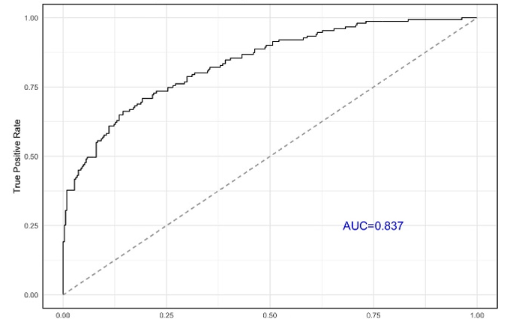
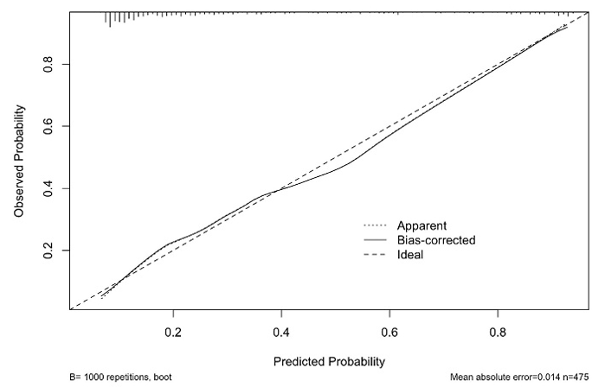
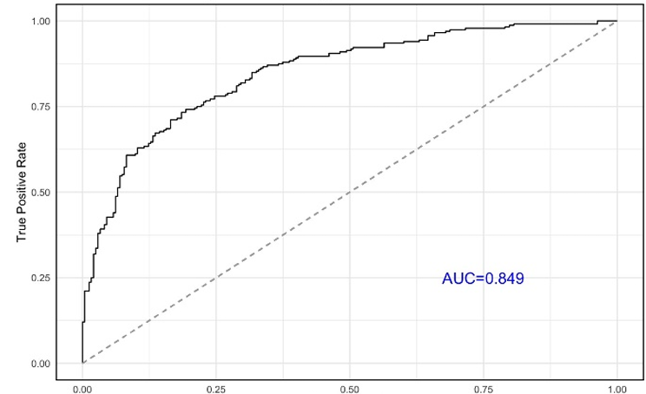
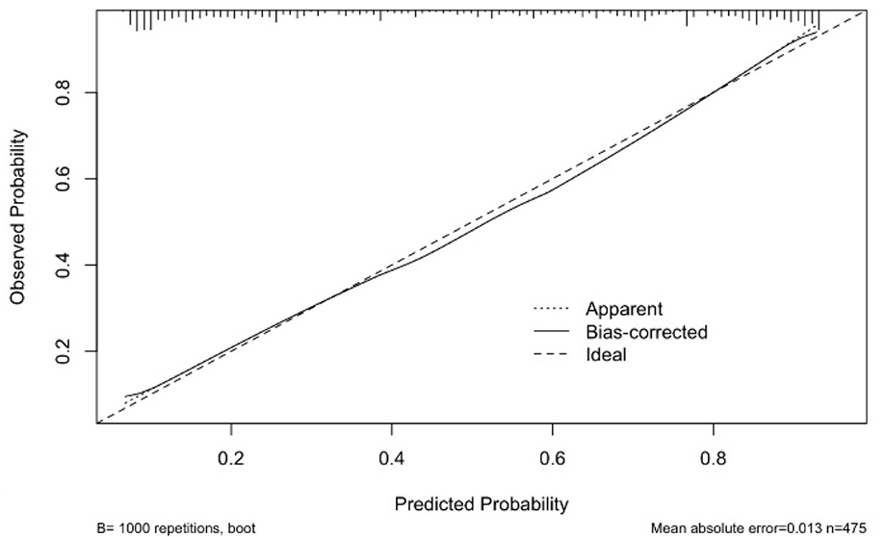
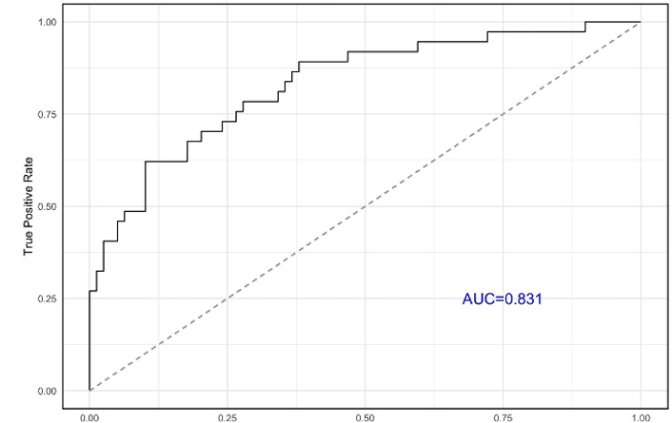
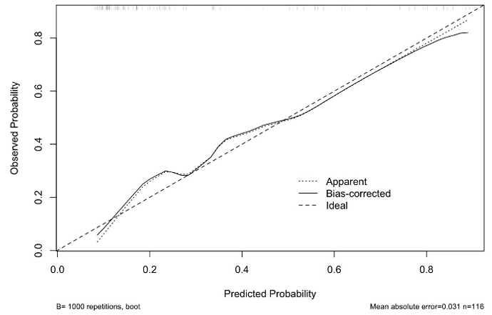
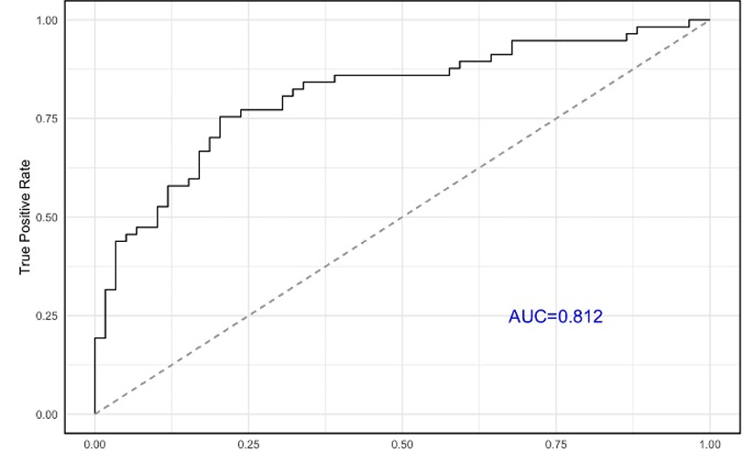
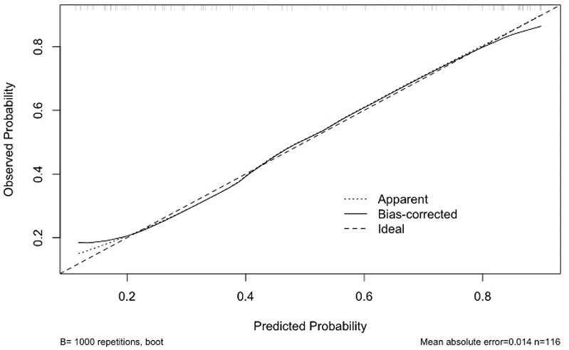
Molecular diagnostic classification of heart allograft rejection: a calibrated and validated system
AMR model ROC-AUC (Derivative cohort)
ACR model ROC-AUC (Derivation cohort)
Calibration curve (Derivative cohort)
Calibration curve (Derivative cohort)
Calibration curve (Derivative cohort)
False positive Rate
False positive Rate
AMR model ROC-AUC (Validation cohort)
ACR model ROC-AUC (Validation cohort)
Calibration curve (Validation cohort)
Calibration curve (Validation cohort)
False positive Rate
False positive Rate
Conclusions
The molecular diagnostic system demonstrated robustness and reliability in identifying cardiac rejection events
This system can complement standard pathology, reduce diagnostic uncertainty, and serve as a practical companion tool in the clinical management of heart transplant patients
In the derivation cohort, the predicted probabilities closely followed the ideal trend for both rejection-specifics models, indicating minimal bias
In the validation cohort, mean absolute error=0.031 for the AMR model and 0.014 for the ACR model respectively, suggesting excellent calibration
Minor deviations from the ideal line were observed at sub-clinical probability levels. Overall, the calibration curves support the reliability of the models for predicting rejection events in both cohorts
Giarraputo A. et al., ESOT Congress 2025 (Abstract 1671)
Notes:
Abbreviations: EMB, Endomyocardial biopsies; AMR, antibody mediated rejection; ROC, Receiver Operating Characteristic; AUC, Area Under the Curve; ACR, Acute Cellular Rejection.
Reference Number: 1671
MOLECULAR DIAGNOSTIC CLASSIFICATION OF HEART ALLOGRAFT REJECTION: A CALIBRATED AND VALIDATED SYSTEM
Alessia Giarraputo¹, Guillaume Coutance¹, Jignesh Patel², Marny Fedrigo³, Olivier Aubert¹, Shaida Varnous⁴, Ilaria Barison³, Chiara Castellani³, Jessy Dagobert¹, Fariza Mezine¹, Philippe Rouvier⁵, Leprince Pascal⁴, Jean-Paul Duong van Huyen⁶, Patrick Bruneval¹, Annalisa Angelini³, Jon Kobashigawa², Alexandre Loupy¹
¹Paris Institute for Transplantation and Organ Regeneration (PITOR), Paris, France, ²Department of Cardiology, Smidt Heart Institute, Cedars-Sinai Medical Center, Los Angeles, United States, ³Cardiovascular Pathology, Department of Cardiac, Thoracic, Vascular Sciences and Public Health, University of Padua , Padua, Italy, ⁴Department of Cardiac and Thoracic Surgery, Cardiology Institute, Pitié Salpêtrière Hospital, Assistance Publique-Hôpitaux de Paris (AP-HP). Sorbonne University Medical School, Paris, France, ⁵Department of Pathology, Pitié Salpêtrière Hospital, Assistance Publique-Hôpitaux de Paris (AP-HP). Sorbonne University Medical School, Paris, France, ⁶Pathology Department, Hôpital Necker, AP-HP and Paris Cité University, Paris, France
Background: Endomyocardial biopsies (EMB) gene expression profiling is a promising companion tool for rejection diagnosis. However, novel molecular diagnostic systems need to be properly tested and validated to support diagnosis post heart transplantation.
Methods: We performed a multicenter, retrospective study (NCT06436027), collecting 591 FFPE-EMBs between 2011 and 2021 representative of the landscape of rejection (antibody mediated rejection-AMR, n=188; acute cellular rejection-ACR, n=289; non-rejection, n=114). Tissue gene expression was analyzed using the consensus Banff Human Organ Transplant gene panel. Molecular classifiers for AMR and ACR were built using a supervised model, assessing thoroughly the performance. Models’ calibration was optimized, and discrepancies were analyzed in derivation and validation set.
Results: In the validation cohort (n=116), the molecular classifiers demonstrated strong diagnostic performance: AMR detection achieved an accuracy of 81.89% (ROC-AUC=0.831, Brier score=0.143, F1 score=0.70), while ACR detection achieved 77.58% accuracy (ROC AUC=0.812, Brier score=0.176, F1 score=0.76). Models’ stabilization was reached around 400 samples, confirming sufficient statistical power for reliable predictions. Calibration curves resulted adequate for AMR and ACR models sets, reflecting the reliability of the probabilistic predictions (Figure). In the derivation cohort, the predicted probabilities closely followed the ideal trend for both rejection-specifics models, indicating minimal bias. In the validation cohort, the mean absolute error was 0.031 for the AMR model and 0.014 for the ACR model respectively, suggesting excellent calibration. Minor deviations from the ideal line were observed at sub-clinical probability levels. Overall, the calibration curves support the reliability of the models for predicting rejection events in both cohorts.
Conclusions: The molecular diagnostic system demonstrated robustness and reliability in identifying cardiac rejection events. This system can complement standard pathology, reduce diagnostic uncertainty, and serve as a practical companion tool in the clinical management of heart transplant patients.

Slide 17
Monitoring of cytomegalovirus-specific cell-mediated immunity in heart transplant recipients
Background
Valganciclovir prophylaxis is recommended for solid organ transplant recipients to prevent cytomegalovirus (CMV) infection but is frequently associated with leukopenia
Assays measuring CMV-specific T cell-mediated immunity may individualize the duration of antiviral prophylaxis after heart transplantation
Data remain scarce in heart transplant recipients
Methods
Study:
Prospective, observational, single-center
Inclusion of all CMV-seropositive adults who underwent heart transplantation at our center between January 2021 and January 2023
All patients received primary valganciclovir prophylaxis for 90 days
QuantiFERON®-CMV assays were performed at 3, 6, and 12 months post-transplant
Primary outcomes:
Assessment of CMV immunity restoration and the ability of the QuantiFERON®-CMV assay to predict a protective immune status against CMV infection
Fleuriet J. et al., ESOT Congress 2025 (Abstract 1533)
Notes:
Abbreviation: CMV, Cytomegalovirus.
Reference Number:1533
MONITORING OF CYTOMEGALOVIRUS-SPECIFIC CELL-MEDIATED IMMUNITY IN HEART TRANSPLANT RECIPIENTS
Jules Fleuriet¹, Kevin Sermet², Celine Goéminne², Mouna Lazrek², Sophie Alain³, Julie Demaret², Fanny Vuotto⁴
¹Chu Lille; Infectious Disease,²Chu Lille, ³Chu Limoges, ⁴Service des Maladies Infectieuses et Tropicales, Chu Lille
Background: Valganciclovir prophylaxis is recommended for solid organ transplant recipients to prevent cytomegalovirus (CMV) infection but is frequently associated with leukopenia. Assays measuring CMV-specific T cell-mediated immunity may individualize the duration of antiviral prophylaxis after heart transplantation. Data remain scarce in heart transplant recipients.
Methods: This prospective, observational, single-center study included all CMV-seropositive adults who underwent heart transplantation at our center between January 2021 and January 2023. All patients received primary valganciclovir prophylaxis for 90 days. QuantiFERON®-CMV assays were performed at 3, 6, and 12 months post-transplant. The primary outcomes were the assessment of CMV immunity restoration and the ability of the QuantiFERON®-CMV assay to predict a protective immune status against CMV infection.
Results: We included 11 adult heart transplant recipients CMV-seropositive, most of whom had received antithymoglobulin (ATG)-based induction therapy. At 3, 6 and 12 months post-transplant, the QuantiFERON®-CMV assay was positive in 8 patients (73%) and negative in 3 patients (27%). Results remained stable throughout the follow-up period. Eight patients experienced significant CMV infections during the follow-up, including 7 with a positive QuantiFERON®-CMV assay and only 1 patient with a negative assay.
Conclusions: The QuantiFERON®-CMV assay may not accurately predict CMV infection and would not have contributed to refining the duration of primary prophylaxis in this study.

Slide 18
Monitoring of cytomegalovirus-specific cell-mediated immunity in heart transplant recipients
Results
n=11 adult heart transplant recipients CMV-seropositive
Most of whom had received antithymoglobulin (ATG)-based induction therapy
Results remained stable throughout the follow-up period
CMV infections during the follow-up
n=8 patients experienced significant CMV infections
n=1 patient with negative QuantiFERON®-CMV assay
12,5%
At 3, 6 and 12 months post-transplant QuantiFERON®-CMV assay
87,5%
n=7 patients with positive QuantiFERON®-CMV
assay
n=3 patients
Negative
27%
Conclusions
The QuantiFERON®-CMV assay may not accurately predict CMV infection and would not have contributed to refining the duration of primary prophylaxis in this study
73%
n=8 patients
positive
Fleuriet J. et al., ESOT Congress 2025 (Abstract 1533)
Notes:
Abbreviation: CMV, Cytomegalovirus.
Reference Number:1533
MONITORING OF CYTOMEGALOVIRUS-SPECIFIC CELL-MEDIATED IMMUNITY IN HEART TRANSPLANT RECIPIENTS
Jules Fleuriet¹, Kevin Sermet², Celine Goéminne², Mouna Lazrek², Sophie Alain³, Julie Demaret², Fanny Vuotto⁴
¹Chu Lille; Infectious Disease,²Chu Lille, ³Chu Limoges, ⁴Service des Maladies Infectieuses et Tropicales, Chu Lille
Background: Valganciclovir prophylaxis is recommended for solid organ transplant recipients to prevent cytomegalovirus (CMV) infection but is frequently associated with leukopenia. Assays measuring CMV-specific T cell-mediated immunity may individualize the duration of antiviral prophylaxis after heart transplantation. Data remain scarce in heart transplant recipients.
Methods: This prospective, observational, single-center study included all CMV-seropositive adults who underwent heart transplantation at our center between January 2021 and January 2023. All patients received primary valganciclovir prophylaxis for 90 days. QuantiFERON®-CMV assays were performed at 3, 6, and 12 months post-transplant. The primary outcomes were the assessment of CMV immunity restoration and the ability of the QuantiFERON®-CMV assay to predict a protective immune status against CMV infection.
Results: We included 11 adult heart transplant recipients CMV-seropositive, most of whom had received antithymoglobulin (ATG)-based induction therapy. At 3, 6 and 12 months post-transplant, the QuantiFERON®-CMV assay was positive in 8 patients (73%) and negative in 3 patients (27%). Results remained stable throughout the follow-up period. Eight patients experienced significant CMV infections during the follow-up, including 7 with a positive QuantiFERON®-CMV assay and only 1 patient with a negative assay.
Conclusions: The QuantiFERON®-CMV assay may not accurately predict CMV infection and would not have contributed to refining the duration of primary prophylaxis in this study.

Slide 19
Effect of extracorporeal photopheresis on graft intimal hyperplasia in the first year after heart transplantation
Background
Cardiac allograft vasculopathy (CAV) is a major cause of long-term mortality after heart transplantation (HTx) but prevention measures are still limited
Coronary intimal thickening that occurs during the first post-HTx year is an early sign of CAV
So far only one study has reported of decreased intimal thickening in HTx recipients who received prophylactic extracorporeal photopheresis (ECP) in addition to maintenance immunosuppressive therapy (IST) consisting of cyclosporine, azathioprine, and steroid
The aim of this study is to evaluate the effect of prophylactic ECP on intimal thickening during the first post-HTx year as assessed by optical coherence tomography (OCT) in light of modern IST which includes mycophenolate mofetil, proven to have advantages over azathioprine in CAV prevention
Methods
Study:
Pilot, prospective, randomized, open-label
n=38 consecutive patients randomized into two arms
10 cycles of ECP treatment in addition to standard IST
Standard IST alone
Assessment of intimal thickening:
OCT images from baseline and one year recorded for the matched coronary segments and compared
Primary endpoint:
Change in normalized total intimal volume, i.e. volume index (intimal volume/length)
Skoric B. et al., ESOT Congress 2025 (Abstract 1183)
Notes:
Abbreviations: CAV, Cardiac allograft vasculopathy; HTx, heart transplantation; ECP, Extracorporeal photopheresis; IST, Immunosuppressive therapy; OCT, Optical coherence tomography.
Reference Number: 1183
EFFECT OF EXTRACORPOREAL PHOTOPHERESIS ON GRAFT INTIMAL HYPERPLASIA IN THE FIRST YEAR AFTER HEART TRANSPLANTATION
Bosko Skoric¹, Mia Dubravcic Dosen², Marijan Pasalic², Hrvoje Jurin², Branka Golubic Cepulic¹, Ines Bojanic¹, Sanja Mazic², Marija Doronjga², Ivo Planinc², Dora Fabijanovic², Jure Samardzic¹, Maja Cikes¹, Josko Bulum¹, Kristina Maric Besic¹, Hrvoje Gasparovic¹, Davor Milicic¹
¹School of Medicine, University of Zagreb, Zagreb, Croatia, ²University Hospital Centre Zagreb, Zagreb, Croatia
Background: Cardiac allograft vasculopathy (CAV) is a major cause of long-term mortality after heart transplantation (HTx) but prevention measures are still limited. Coronary intimal thickening that occurs during the first post-HTx year is an early sign of CAV. To our knowledge, only one study has reported of decreased intimal thickening in HTx recipients who received prophylactic extracorporeal photopheresis (ECP) in addition to maintenance immunosuppressive therapy (IST) consisting of cyclosporine, azathioprine, and steroid. The aim of this study was to evaluate the effect of prophylactic ECP on intimal thickening during the first post-HTx year as assessed by optical coherence tomography (OCT) in light of modern IST which includes mycophenolate mofetil, proven to have advantages over azathioprine in CAV prevention.
Methods: This is a pilot, prospective, randomized, open-label study. A total of 38 consecutive patients were randomized into two arms to receive either 10 cycles of ECP treatment in addition to standard IST or standard IST alone. OCT images from baseline and one year were recorded for the matched coronary segments and compared to assess intimal thickening. The primary endpoint was defined as the change in normalized total intimal volume, i.e. volume index (intimal volume/length).
Results: Follow-up was completed in 27 patients (13 in control and 14 in ECP group). The mean increase in volume index at 1-yr follow-up was significantly lower in the ECP group compared with the control group (1.054±1.756 mm3/mm vs. 0.040±0.753 mm3/mm, p=0.013).
Conclusions: This is the first prospective study that evaluated the effect of prophylactic ECP on intimal thickening in HTx recipients in the context of modern IST. Our study demonstrated significantly decreased intimal thickening in the first post-HTx year in patients receiving prophylactic ECP. The study is limited by a relatively small population size. The larger-scaled study is warranted to confirm our observation.

Slide 20
Effect of extracorporeal photopheresis on graft intimal hyperplasia in the first year after heart transplantation
Results
Follow-up completed in n=27 patients
The mean increase in volume index at 1-yr follow-up was significantly lower in the ECP group compared with the control group:
1.054±1.756 mm3/mm vs. 0.040±0.753 mm3/mm, p=0.013
Conclusions
This is the first prospective study that evaluates the effect of prophylactic ECP on intimal thickening in HTx recipients in the context of modern IST
This study demonstrates significantly decreased intimal thickening in the first post-HTx year in patients receiving prophylactic ECP
The study is limited by a relatively small population size
The larger-scaled study is warranted to confirm our observation
n=13 in control
n=14 in ECP group
Skoric B. et al., ESOT Congress 2025 (Abstract 1183)
Notes:
Abbreviations: CAV, Cardiac allograft vasculopathy; HTx, heart transplantation; ECP, Extracorporeal photopheresis; IST, Immunosuppressive therapy; OCT, Optical coherence tomography.
Reference Number: 1183
EFFECT OF EXTRACORPOREAL PHOTOPHERESIS ON GRAFT INTIMAL HYPERPLASIA IN THE FIRST YEAR AFTER HEART TRANSPLANTATION
Bosko Skoric¹, Mia Dubravcic Dosen², Marijan Pasalic², Hrvoje Jurin², Branka Golubic Cepulic¹, Ines Bojanic¹, Sanja Mazic², Marija Doronjga², Ivo Planinc², Dora Fabijanovic², Jure Samardzic¹, Maja Cikes¹, Josko Bulum¹, Kristina Maric Besic¹, Hrvoje Gasparovic¹, Davor Milicic¹
¹School of Medicine, University of Zagreb, Zagreb, Croatia, ²University Hospital Centre Zagreb, Zagreb, Croatia
Background: Cardiac allograft vasculopathy (CAV) is a major cause of long-term mortality after heart transplantation (HTx) but prevention measures are still limited. Coronary intimal thickening that occurs during the first post-HTx year is an early sign of CAV. To our knowledge, only one study has reported of decreased intimal thickening in HTx recipients who received prophylactic extracorporeal photopheresis (ECP) in addition to maintenance immunosuppressive therapy (IST) consisting of cyclosporine, azathioprine, and steroid. The aim of this study was to evaluate the effect of prophylactic ECP on intimal thickening during the first post-HTx year as assessed by optical coherence tomography (OCT) in light of modern IST which includes mycophenolate mofetil, proven to have advantages over azathioprine in CAV prevention.
Methods: This is a pilot, prospective, randomized, open-label study. A total of 38 consecutive patients were randomized into two arms to receive either 10 cycles of ECP treatment in addition to standard IST or standard IST alone. OCT images from baseline and one year were recorded for the matched coronary segments and compared to assess intimal thickening. The primary endpoint was defined as the change in normalized total intimal volume, i.e. volume index (intimal volume/length).
Results: Follow-up was completed in 27 patients (13 in control and 14 in ECP group). The mean increase in volume index at 1-yr follow-up was significantly lower in the ECP group compared with the control group (1.054±1.756 mm3/mm vs. 0.040±0.753 mm3/mm, p=0.013).
Conclusions: This is the first prospective study that evaluated the effect of prophylactic ECP on intimal thickening in HTx recipients in the context of modern IST. Our study demonstrated significantly decreased intimal thickening in the first post-HTx year in patients receiving prophylactic ECP. The study is limited by a relatively small population size. The larger-scaled study is warranted to confirm our observation.

Slide 21
Electronic nose for detecting impaired glucose metabolism in heart transplant recipients
Background
Post-transplant diabetes mellitus (PTDM) affects 34% of heart transplant recipients (HTR) within 5 years and increases the risk of adverse outcomes
While the oral glucose tolerance test (OGTT) is the preferred screening method for prediabetes and diabetes, it is time intensive and burdensome
This study evaluates the diagnostic accuracy of exhaled breath analysis using an electronic nose (eNose) as a potential alternative to detect impaired glucose tolerance (IGT)
Methods
Study:
n=76 HTR >1-year post-transplant who underwent OGTT screening (29% female, median age 56 [range 19–77] years, median post-transplant time 7.8 [1.5–26.5] years), along with a positive control group of fasting diabetic HTR
Exhaled breath analysis performed using an eNose (SpiroNose) pre-glucose loading
eNose parameters combined with clinically relevant parameters for:
PTDM (time after HTx (years)
Fasting glucose level (mmol/L)
Prednisolon use
Weight (kg))
in a multivariate logistic regression model to assess the accuracy in assessing IGT
Wijbenga N. et al., ESOT Congress 2025 (Abstract 2155)
Notes:
Abbreviations: PTDM, Post-transplant diabetes mellitus; HTR, Heart transplant recipients; OGTT, Oral glucose tolerance test; IGT, Impaired glucose tolerance; HTX, Heart transplantation; AUROC, Area Under the Receiver Operating Characteristic curve; PPV, Positive Predictive Value; NPV, Negative Predictive Value.
Reference Number: 2155
ELECTRONIC NOSE FOR DETECTING IMPAIRED GLUCOSE METABOLISM IN HEART TRANSPLANT RECIPIENTS
Nynke Wijbenga^{1, 2, 3}, Annelot Muntinga^{1, 3}, Marleen Goedendorp-Sluimer^{2, 3}, Britt C.J. van Dijk^{2, 3}, Stefan Roest^{2, 3}, Jasper J. Brugts^{2, 3}, Kadir Caliskan^{2, 3}, Alina A. Constantinescu^{2, 3}, Daniel Bos^{4, 5}, Merel Hellemons^{1, 3}, Olivier Manintveld^{2, 3}
¹Erasmus University Medical Center, Respiratory Medicine, Rotterdam, ²Erasmus University Medical Center, Department of Cardiology, Rotterdam, ³Erasmus University Medical Center, Erasmus MC Transplant Institute, Rotterdam, ⁴Erasmus University Medical Center, Department of Radiology & Nuclear Medicine, Rotterdam, ⁵Erasmus University Medical Center, Department of Epidemiology, Rotterdam
Background: Post-transplant diabetes mellitus (PTDM) affects 34% of heart transplant recipients (HTR) within 5 years and increases the risk of adverse outcomes. While the oral glucose tolerance test (OGTT) is the preferred screening method for prediabetes and diabetes, it is time intensive and burdensome. We evaluated the diagnostic accuracy of exhaled breath analysis using an electronic nose (eNose) as a potential alternative to detect impaired glucose tolerance (IGT).
Methods: HTR >1 year post-transplant who underwent OGTT screening were included, along with a positive control group of fasting diabetic HTR. Exhaled breath analysis was performed using an eNose (SpiroNose) pre-glucose loading. eNose parameters were combined with clinically relevant parameters for PTDM (time after HTx (years), fasting glucose level (mmol/L), Prednisolon use, weight (kg)) in a multivariate logistic regression model to assess the accuracy in assessing IGT.
Results: A total of 76 HTR were included (29% female, median age 56 [range 19–77] years, median post-transplant time 7.8 [1.5–26.5] years). Among them, 18 had normal glucose tolerance (fasting glucose 5.3 [4.3–5.8] mmol/L, HbA1c 35 [29–39] mmol/mol), 33 prediabetes (fasting glucose 5.9 [4.6–7] mmol/L, HbA1c 40 [32–50] mmol/mol), and 25 PTDM (fasting glucose 7.8 [4.4–17] mmol/L, HbA1c 58 [35–96] mmol/mol). Overall, 58 (76%) exhibited IGT. Pre-glucose loading eNose distinguished normal from IGT with AUROC 0.70 (95% CI 0.57–0.83; Fig 1), 68% accuracy, 69% sensitivity, 67% specificity, 40% negative predictive value (NPV), and 87% positive predictive value (PPV). Adding clinical parameters improved AUROC to 0.88 (95% CI 0.81–0.96; Fig 1), 78% accuracy, 71% sensitivity, 100% specificity, 51% NPV, and 100% PPV.
Conclusions: Impaired glucose metabolism is a frequent finding in HTR. Exhaled breath analysis using eNose technology has the potential to non-invasively monitor and identify patients at risk for IGT in addition to clinical parameters and may serve as an alternative for OGTT given its high PPV and specificity. Additionally, eNose technology’s rapid point-of-care application allows for subsequent OGTT testing if its results are inconclusive. However, further validation in larger cohorts is necessary to confirm its effectiveness as a replacement screening tool for OGTT.

Slide 22
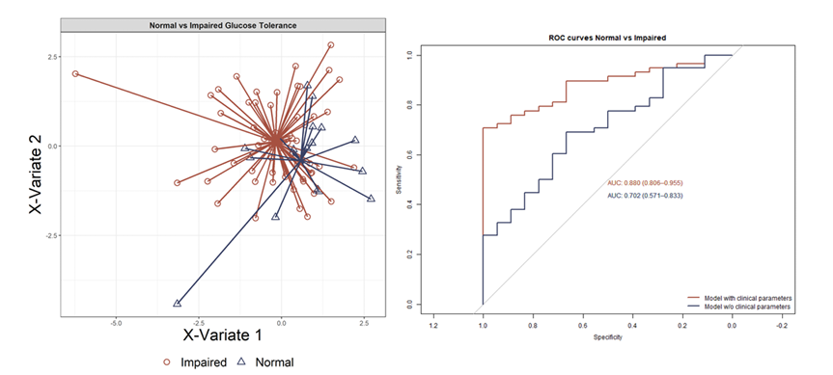
Electronic nose for detecting impaired glucose metabolism in heart transplant recipients
Results
18 had normal glucose tolerance (fasting glucose 5.3 [4.3–5.8] mmol/L, HbA1c 35 [29–39] mmol/mol)
33 prediabetes (fasting glucose 5.9 [4.6–7] mmol/L, HbA1c 40 [32–50] mmol/mol),
25 PTDM (fasting glucose 7.8 [4.4–17] mmol/L, HbA1c 58 [35–96] mmol/mol)
Overall, 58 (76%) exhibited IGT
Pre-glucose loading eNose distinguished normal from IGT with AUROC 0.70 (95% CI 0.57–0.83; Fig. 1), 68% accuracy, 69% sensitivity, 67% specificity, 40% NPV, and 87% PPV
Adding clinical parameters improved AUROC to 0.88 (95% CI 0.81–0.96; Fig. 1), 78% accuracy, 71% sensitivity, 100% specificity, 51% NPV, and 100% PPV
Conclusions
Impaired glucose metabolism is a frequent finding in HTR
Exhaled breath analysis using eNose technology has the potential to non-invasively monitor and identify patients at risk for IGT in addition to clinical parameters and may serve as an alternative for OGTT given its high PPV and specificity
Additionally, eNose technology’s rapid point-of-care application allows for subsequent OGTT testing if its results are inconclusive
However, further validation in larger cohorts is necessary to confirm its effectiveness as a replacement screening tool for OGTT
Figure 1: Discrimination between HTR with normal and impaired glucose tolerance using the SpiroNose. On the left, discrimination between normal and impaired glucose tolerance using the SpiroNose, using the first two latent variables obtained by PLS-DA is shown. Each point is a measured patient. In short, PLS-DA is a modelling technique for data reduction, creating new latent variables containing as much information as possible of the complete dataset. On the right, the corresponding ROC curves for both the eNose only and eNose with clinical parameters model are shown.
Wijbenga N. et al., ESOT Congress 2025 (Abstract 2155)
Notes:
Abbreviations: PTDM, Post-transplant diabetes mellitus; HTR, Heart transplant recipients; OGTT, Oral glucose tolerance test; IGT, Impaired glucose tolerance; HTX, Heart transplantation; AUROC, Area Under the Receiver Operating Characteristic curve; PPV, Positive Predictive Value; NPV, Negative Predictive Value.
Reference Number: 2155
Electronic Nose for Detecting Impaired Glucose Metabolism in Heart Transplant Recipients
Nynke Wijbenga^{1, 2, 3}, Annelot Muntinga^{1, 3}, Marleen Goedendorp-Sluimer^{2, 3}, Britt C.J. van Dijk^{2, 3}, Stefan Roest^{2, 3}, Jasper J. Brugts^{2, 3}, Kadir Caliskan^{2, 3}, Alina A. Constantinescu^{2, 3}, Daniel Bos^{4, 5}, Merel Hellemons^{1, 3}, Olivier Manintveld^{2, 3}
¹Erasmus University Medical Center, Respiratory Medicine, Rotterdam, ²Erasmus University Medical Center, Department of Cardiology, Rotterdam, ³Erasmus University Medical Center, Erasmus MC Transplant Institute, Rotterdam, ⁴Erasmus University Medical Center, Department of Radiology & Nuclear Medicine, Rotterdam, ⁵Erasmus University Medical Center, Department of Epidemiology, Rotterdam
Background: Post-transplant diabetes mellitus (PTDM) affects 34% of heart transplant recipients (HTR) within 5 years and increases the risk of adverse outcomes. While the oral glucose tolerance test (OGTT) is the preferred screening method for prediabetes and diabetes, it is time intensive and burdensome. We evaluated the diagnostic accuracy of exhaled breath analysis using an electronic nose (eNose) as a potential alternative to detect impaired glucose tolerance (IGT).
Methods: HTR >1 year post-transplant who underwent OGTT screening were included, along with a positive control group of fasting diabetic HTR. Exhaled breath analysis was performed using an eNose (SpiroNose) pre-glucose loading. eNose parameters were combined with clinically relevant parameters for PTDM (time after HTx (years), fasting glucose level (mmol/L), Prednisolon use, weight (kg)) in a multivariate logistic regression model to assess the accuracy in assessing IGT.
Results: A total of 76 HTR were included (29% female, median age 56 [range 19–77] years, median post-transplant time 7.8 [1.5–26.5] years). Among them, 18 had normal glucose tolerance (fasting glucose 5.3 [4.3–5.8] mmol/L, HbA1c 35 [29–39] mmol/mol), 33 prediabetes (fasting glucose 5.9 [4.6–7] mmol/L, HbA1c 40 [32–50] mmol/mol), and 25 PTDM (fasting glucose 7.8 [4.4–17] mmol/L, HbA1c 58 [35–96] mmol/mol). Overall, 58 (76%) exhibited IGT. Pre-glucose loading eNose distinguished normal from IGT with AUROC 0.70 (95% CI 0.57–0.83; Fig 1), 68% accuracy, 69% sensitivity, 67% specificity, 40% negative predictive value (NPV), and 87% positive predictive value (PPV). Adding clinical parameters improved AUROC to 0.88 (95% CI 0.81–0.96; Fig 1), 78% accuracy, 71% sensitivity, 100% specificity, 51% NPV, and 100% PPV.
Conclusions: Impaired glucose metabolism is a frequent finding in HTR. Exhaled breath analysis using eNose technology has the potential to non-invasively monitor and identify patients at risk for IGT in addition to clinical parameters and may serve as an alternative for OGTT given its high PPV and specificity. Additionally, eNose technology’s rapid point-of-care application allows for subsequent OGTT testing if its results are inconclusive. However, further validation in larger cohorts is necessary to confirm its effectiveness as a replacement screening tool for OGTT.

Slide 23
Enhancing utility of antibody testing with donor-derived cell-free DNA post-heart transplantation
Background
Donor-specific antibodies (DSA) are routinely assessed after heart transplant (HT) with sensitive immunoassays
However, not all detected DSAs are associated with adverse events (AE), and conversely, not all episodes of antibody-mediated rejection (AMR) are associated with the presence of DSAs
Donor-derived cell-free DNA (dd-cfDNA) is a noninvasive biomarker of allograft injury
We hypothesize that dd-cfDNA can be used to delineate clinically meaningful DSAs and detect patients at risk for AE in the absence of DSA
Methods
Retrospective study of adult HT patients at Ohio State University where routine post-transplant monitoring includes both DSA and dd-cfDNA (the Prospera™ test, Natera Inc., Austin, TX)
Pts were categorized into four groups based on dd-cfDNA%
(positive if ≥0.15%) and DSA status (positive if any DSA ≥2,000 MFI)
Kaplan-Meier curves were plotted, for each group, for freedom from all of the following adverse events:
Treated rejection
Biopsy-proven rejection (ACR ≥2R and/or AMR≥1)
Graft dysfunction (LVEF ≤ 40)
Cardiac allograft vasculopathy (ISHLT grade >0)
Re-transplantation
Death
Bole I. et al., ESOT Congress 2025 (Abstract 293)
Notes:
Abbreviations: DSA, Donor-specific antibodies; HT, heart transplant; AE, Adverse events; AMR, Antibody-mediated rejection; dd-cfDNA, Donor-derived cell-free DNA.
Reference Number: 293
ENHANCING UTILITY OF ANTIBODY TESTING WITH DONOR-DERIVED CELL-FREE DNA POST-HEART TRANSPLANTATION
Indra Bole¹, Mason Mocarski¹, Ayesha Hasan¹, Garrie Haas¹, Rami Kahwash¹, Ajay Vallakati¹, Veronica Franco¹, Vaiibhav Patel¹, Beth Foreman¹, Michael Olymbios², Sandra Carey², Kathryn Crabtree², Madeleine Armer-Cabral², Zhiji Zhang², Brent Lampert¹
¹Wexner Medical Center, Ohio State University, ²Natera, Inc.
Background: Donor-specific antibodies (DSA) are routinely assessed after heart transplant (HT) with sensitive immunoassays. However, not all detected DSAs are associated with adverse events (AE), and conversely, not all episodes of antibody-mediated rejection (AMR) are associated with the presence of DSAs. Donor-derived cell-free DNA (dd-cfDNA) is a noninvasive biomarker of allograft injury. We hypothesize that dd-cfDNA can be used to delineate clinically meaningful DSAs and detect patients at risk for AE in the absence of DSA.
Methods: We conducted a retrospective study of adult HT patients (pts) at Ohio State University, where routine post-transplant monitoring includes both DSA and dd-cfDNA (the Prospera™ test, Natera Inc., Austin, TX). Pts were categorized into four groups based on dd-cfDNA% (positive if ≥0.15%) and DSA status (positive if any DSA ≥2,000 MFI). Kaplan-Meier curves were plotted, for each group, for freedom from all of the following AE: treated rejection, biopsy-proven rejection (ACR ≥2R and/or AMR≥1), graft dysfunction (LVEF ≤ 40), cardiac allograft vasculopathy (ISHLT grade >0), re-transplantation, and death.
Results: 898 paired dd-cfDNA and DSA tests from 170 pts, transplanted from 2006 to 2023, were included in this analysis. Pts were followed for a median of 32 and a maximum of 126 months from transplant. Results are shown in Figure 1. dd-cfDNA%-neg and DSA-neg pts exhibited the greatest freedom from AE, while dd-cfDNA%-pos and DSA-neg pts had the least freedom from AE, followed by pts who were both dd-cfDNA%-pos and DSA-pos.
Conclusions: These data suggest that the presence of DSA alone may not necessarily lead to AE, and dd-cfDNA aids in risk stratification for patients beyond DSA. We also find that dd-cfDNA% rises during AMR episodes without DSA. These preliminary results indicate the potential value of integrating dd-cfDNA into the interpretation of DSA results in clinical care. Further exploration in larger cohorts is warranted.

Slide 24
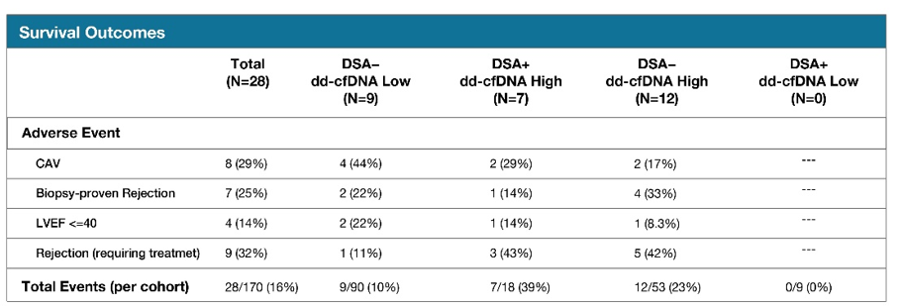
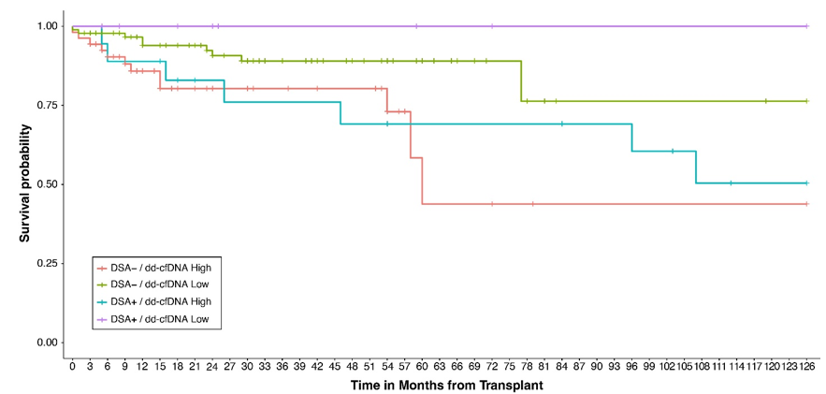
Enhancing utility of antibody testing with donor-derived cell-free DNA post-heart transplantation
Results
n=898 paired dd-cfDNA and DSA tests from 170 patients (Pts) transplanted from 2006 to 2023
Pts were followed for a median of 32 and a maximum of 126 months from transplant. Results are shown in Figure 1
dd-cfDNA%-neg and DSA-neg pts exhibited the greatest freedom from AE, while dd-cfDNA%-pos and DSA-neg pts had the least freedom from AE, followed by pts who were both dd-cfDNA%-pos and DSA-pos
Outcomes for DSA Positive and DSA Negative Heart Transplant Patients Stratified by High and Low dd-cfDNA Levels
Conclusions
These data suggest that the presence of DSA alone may not necessarily lead to AE, and dd-cfDNA aids in risk stratification for patients beyond DSA
dd-cfDNA% rises during AMR episodes without DSA
These preliminary results indicate the potential value of integrating dd-cfDNA into the interpretation of DSA results in clinical care
Further exploration in larger cohorts is warranted
Bole I. et al., ESOT Congress 2025 (Abstract 293)
Notes:
Abbreviations: DSA, Donor-specific antibodies; HT, heart transplant; AE, Adverse events; AMR, Antibody-mediated rejection; dd-cfDNA, Donor-derived cell-free DNA.
Reference Number: 293
ENHANCING UTILITY OF ANTIBODY TESTING WITH DONOR-DERIVED CELL-FREE DNA POST-HEART TRANSPLANTATION
Indra Bole¹, Mason Mocarski¹, Ayesha Hasan¹, Garrie Haas¹, Rami Kahwash¹, Ajay Vallakati¹, Veronica Franco¹, Vaiibhav Patel¹, Beth Foreman¹, Michael Olymbios², Sandra Carey², Kathryn Crabtree², Madeleine Armer-Cabral², Zhiji Zhang², Brent Lampert¹
¹Wexner Medical Center, Ohio State University, ²Natera, Inc.
Background: Donor-specific antibodies (DSA) are routinely assessed after heart transplant (HT) with sensitive immunoassays. However, not all detected DSAs are associated with adverse events (AE), and conversely, not all episodes of antibody-mediated rejection (AMR) are associated with the presence of DSAs. Donor-derived cell-free DNA (dd-cfDNA) is a noninvasive biomarker of allograft injury. We hypothesize that dd-cfDNA can be used to delineate clinically meaningful DSAs and detect patients at risk for AE in the absence of DSA.
Methods: We conducted a retrospective study of adult HT patients (pts) at Ohio State University, where routine post-transplant monitoring includes both DSA and dd-cfDNA (the Prospera™ test, Natera Inc., Austin, TX). Pts were categorized into four groups based on dd-cfDNA% (positive if ≥0.15%) and DSA status (positive if any DSA ≥2,000 MFI). Kaplan-Meier curves were plotted, for each group, for freedom from all of the following AE: treated rejection, biopsy-proven rejection (ACR ≥2R and/or AMR≥1), graft dysfunction (LVEF ≤ 40), cardiac allograft vasculopathy (ISHLT grade >0), re-transplantation, and death.
Results: 898 paired dd-cfDNA and DSA tests from 170 pts, transplanted from 2006 to 2023, were included in this analysis. Pts were followed for a median of 32 and a maximum of 126 months from transplant. Results are shown in Figure 1. dd-cfDNA%-neg and DSA-neg pts exhibited the greatest freedom from AE, while dd-cfDNA%-pos and DSA-neg pts had the least freedom from AE, followed by pts who were both dd-cfDNA%-pos and DSA-pos.
Conclusions: These data suggest that the presence of DSA alone may not necessarily lead to AE, and dd-cfDNA aids in risk stratification for patients beyond DSA. We also find that dd-cfDNA% rises during AMR episodes without DSA. These preliminary results indicate the potential value of integrating dd-cfDNA into the interpretation of DSA results in clinical care. Further exploration in larger cohorts is warranted.

Slide 25
Analysis of clinical and immunological risk factors in heart transplant recipients with malignancy
Background
Long-term prognosis after heart transplantation is influenced by complications of immunosuppressive therapy, including malignancies
This study aimed to identify clinical risk factors influencing 5-year survival after cancer diagnosis
Results
n=50 patients diagnosed with 112 malignancies:
83
Methods
Study:
n=242 heart transplant recipients from 2008 to 2020
24
5
Data collection:
on neoplasm diagnosis, immunosuppressive therapy at diagnosis, and main clinical data
Non-melanoma skin cancers
Post-transplant lymphoproliferative disorder (PTLD)
Solid tumors
Outcome:
5-year survival assessment
Giovannini L. et al., ESOT Congress 2025 (Abstract 2349)
Notes:
Abbreviation: PTLD, PTLD-Post-transplant lymphoproliferative disorder.
Reference Number: 2349
ANALYSIS OF CLINICAL AND IMMUNOLOGICAL RISK FACTORS IN HEART TRANSPLANT RECIPIENTS WITH MALIGNANCY
Laura Giovannini¹, Marco Masetti¹, Laura Borgese¹, Greta Zagni¹, Sofia Martin Suarez¹, Antonio Russo¹, Marco Silenzi¹, Celeste Valeria Ricupero¹, Luciano Potena¹
¹IRCCS Azienda Ospedaliero-Universitaria di Bologna, Heart Failure and Transplant Unit , Bologna, Italy
Background: Long-term prognosis after heart transplantation is influenced by complications of immunosuppressive therapy, including malignancies. This study aimed to identify clinical risk factors influencing 5-year survival after cancer diagnosis.
Methods: We included 242 heart transplant recipients from 2008 to 2020 at our center; we collected data on neoplasm diagnosis, immunosuppressive therapy at diagnosis, and main clinical data. As an outcome, we assessed 5-year survival.
Results: Among the patients we included in our study, 50 were diagnosed with 112 malignancies; 24 solid tumors, 83 non-melanoma skin cancers, and 5 hematologic malignancies (PTLD-Post-transplant lymphoproliferative disorder). Patients with solid tumors had a significantly worse 5-year prognosis compared to other types (47.3±14.2% vs 66.6±27.2% PTLD vs 100% skin cancers; P=0.01). Among patients with solid tumors, as expected, the absence of metastases and the possibility of surgical resection influenced the outcome (65.3±15.8% vs 0% and 80.0±11.2% vs 33.3±19.2%, respectively); the choice of a surgical approach was not influenced by the presence or absence of metastases at diagnosis. No cardiovascular complications related to surgical or oncological therapies were observed. Patients who were not on mycophenolate therapy (yes 62.0±15.7% vs no 30.0±23.9%) due to leukopenia, likely an expression of greater immunosuppression, had a worse prognosis. Finally, recipients from donors older than 55 years showed a trend towards a worse prognosis at one year, with similar prevalence of metastatic disease, suggesting a possible role of donor immunosenescence.
Conclusions: Our data, in addition to showing the effect of tumor stage and the possibility of surgical treatment, suggest a potential role of immunosuppression and donor-related immunosenescence. These hypotheses should be confirmed by studies with molecular biology and immunogenetic methods involving both recipient and donor.

Slide 26
Analysis of clinical and immunological risk factors in heart transplant recipients with malignancy
Results (cont.)
No cardiovascular complications related to surgical or oncological therapies were observed
Patients who were not on mycophenolate therapy (yes 62.0±15.7% vs no 30.0±23.9%) due to leukopenia, likely an expression of greater immunosuppression, had a worse prognosis
Recipients from donors older than 55 years showed a trend towards a worse prognosis at one year, with similar prevalence of metastatic disease, suggesting a possible role of donor immunosenescence
Patients with solid tumors had a significantly worse 5-year prognosis:
100
5-year Survival rate
66.6
P=0.01
47.3
Solid tumors
Skin cancers
PTLD
Among patients with solid tumors, absence of metastases and possibility of surgical resection influence the outcome:
Conclusions
These data, in addition to showing the effect of tumor stage and the possibility of surgical treatment, suggest a potential role of immunosuppression and donor-related immunosenescence
These hypotheses should be confirmed by studies with molecular biology and immunogenetic methods involving both recipient and donor
80
5-year Survival rate
65,3
No
metastases
Surgical resection
No surgical resection
Metastases
Choice of a surgical approach not influenced by the presence or absence of metastases at diagnosis
Giovannini L. et al., ESOT Congress 2025 (Abstract 2349)
Notes:
Abbreviation: PTLD, PTLD-Post-transplant lymphoproliferative disorder.
Reference Number: 2349
ANALYSIS OF CLINICAL AND IMMUNOLOGICAL RISK FACTORS IN HEART TRANSPLANT RECIPIENTS WITH MALIGNANCY
Laura Giovannini¹, Marco Masetti¹, Laura Borgese¹, Greta Zagni¹, Sofia Martin Suarez¹, Antonio Russo¹, Marco Silenzi¹, Celeste Valeria Ricupero¹, Luciano Potena¹
¹IRCCS Azienda Ospedaliero-Universitaria di Bologna, Heart Failure and Transplant Unit , Bologna, Italy
Background: Long-term prognosis after heart transplantation is influenced by complications of immunosuppressive therapy, including malignancies. This study aimed to identify clinical risk factors influencing 5-year survival after cancer diagnosis.
Methods: We included 242 heart transplant recipients from 2008 to 2020 at our center; we collected data on neoplasm diagnosis, immunosuppressive therapy at diagnosis, and main clinical data. As an outcome, we assessed 5-year survival.
Results: Among the patients we included in our study, 50 were diagnosed with 112 malignancies; 24 solid tumors, 83 non-melanoma skin cancers, and 5 hematologic malignancies (PTLD-Post-transplant lymphoproliferative disorder). Patients with solid tumors had a significantly worse 5-year prognosis compared to other types (47.3±14.2% vs 66.6±27.2% PTLD vs 100% skin cancers; P=0.01). Among patients with solid tumors, as expected, the absence of metastases and the possibility of surgical resection influenced the outcome (65.3±15.8% vs 0% and 80.0±11.2% vs 33.3±19.2%, respectively); the choice of a surgical approach was not influenced by the presence or absence of metastases at diagnosis. No cardiovascular complications related to surgical or oncological therapies were observed. Patients who were not on mycophenolate therapy (yes 62.0±15.7% vs no 30.0±23.9%) due to leukopenia, likely an expression of greater immunosuppression, had a worse prognosis. Finally, recipients from donors older than 55 years showed a trend towards a worse prognosis at one year, with similar prevalence of metastatic disease, suggesting a possible role of donor immunosenescence.
Conclusions: Our data, in addition to showing the effect of tumor stage and the possibility of surgical treatment, suggest a potential role of immunosuppression and donor-related immunosenescence. These hypotheses should be confirmed by studies with molecular biology and immunogenetic methods involving both recipient and donor.

Slide 27
Management of multi-drug resistant Acinetobacter baumannii infection in heart transplant recipients
Antibiotherapy:
7 patients were already on antibiotics; the antibiotic protocol was antibiogram-based
Endotoxin blood level (Endotoxin Activity assay):
If high (≥ 0.6 units) a cycle of Polymyxin B Hemoperfusion was performed; 6 patients were treated with iv Pentaglobin 0,25 g/Kg at 12 mL/h for 3 days, a solution containing 95 % immunoglobulins (IgG, IgM and IgA)
Hematology:
5 patients developed pancytopenia; we administered subcutaneous Filgrastim 48 MU for 3 days, an originator recombinant human granulocyte colony stimulating factor
Immunosuppression:
Based on low dose of corticosteroids and tacrolimus serum levels were reduced to the lowest acceptable
Background
Acinetobacter baumannii (AB) is a Gram-negative, multi-drug resistant (MDR), nosocomial pathogen that causes ventilator-associated and bloodstream infections
It is particularly challenging in the early post-operative stages of heart transplants for intense immunosuppressant protocols and fragile condition
We report the experience of our center in treating nosocomial MDR AB that provoked pneumonia and septic shock
Methods
Patients: n=8 heart transplant (7 males, 1 female; 46 ± 21 years, m ± SD) with positive hemocultures
4 in the ICU
3 patients on mechanically ventilation, 1 required intubation
3 patients were on extracorporeal membrane oxygenation (ECMO)
4 patients on continuous renal replacement therapy, 1 required it afterwards
Parigino D. et al., ESOT Congress 2025 (Abstract 606)
Notes:
Abbreviations: AB, Acinetobacter baumannii ; MDR, Multi-drug resistant; ICU, Intensive Care Unit; ECMO, Extracorporeal membrane oxygenation; MU, Million Units.
Reference Number: 606
MANAGEMENT OF MULTI-DRUG RESISTANT ACINETOBACTER BAUMANNII INFECTION IN HEART TRANSPLANT RECIPIENTS.
Domenico Parigino¹, Lorenzo Giovannico¹, Giuseppe Fischetti¹, Luca Savino¹, Federica Mazzone¹, Claudia Leo¹, Giuseppe Cristiano¹, Nicola Di Bari¹, Massimo Padalino¹, Aldo Milano¹, Tomaso Bottio¹
¹University of Bari, Cardiac Surgery, Bari, Italy
Background: Acinetobacter baumannii (AB) is a Gram-negative, multi-drug resistant (MDR), nosocomial pathogen that causes ventilator-associated and bloodstream infections. It is particularly challenging in the early post-operative stages of heart transplants for intense immunosuppressant protocols and fragile conditions. We report the experience of our center in treating nosocomial MDR AB that provoked pneumonia and septic shock.
Methods: Eight heart transplant patients (7 males, 1 female; 46 ± 21 years, m ± SD) with positive hemocultures were included; 4 were in the ICU; 3 patients on mechanically ventilation, 1 required intubation; 3 patients were on extracorporeal membrane oxygenation (ECMO); 4 patients on continuous renal replacement therapy, 1 required it afterwards. 7 patients were already on antibiotics; the antibiotic protocol was antibiogram-based. Endotoxin blood level was measured with the Endotoxin Activity assay; if high (≥ 0.6 units) a cycle of Polymyxin B Hemoperfusion was performed; 6 patients were treated with iv Pentaglobin 0,25 g/Kg at 12 mL/h for 3 days, a solution containing 95 % immunoglobulins (IgG, IgM and IgA). 5 patients developed pancytopenia; we administered subcutaneous Filgrastim 48 MU for 3 days, an originator recombinant human granulocyte colony stimulating factor. Immunosuppression was based on low dose of corticosteroids and tacrolimus serum levels were reduced to the lowest acceptable.
Results: Negative cultures were obtained after 14-45 days of therapy in all cases; antibiotics were suspended 20-30 days later. In every case we obtained normalization of leukocytes and flogosis, ECMO removal, independence from inotropes, respiratory weaning (3 patients after tracheostomy), recovering of renal function (no permanent treatment required). All patients are reported fine, leading an autonomous life 16 to 57 months after the events.
Conclusions: Management of MDR-AB is particularly challenging in heart transplant patients because of concomitant factors of fragility, such as recovering hemodynamics of the early transplant stages, and intense immunosuppressive strategies. The combined use of antibiogram-guided therapy, blood purification methods and modulation of immunosuppressants proved successful in managing these clinical scenarios.

Slide 28

Management of multi-drug resistant Acinetobacter baumannii infection in heart transplant recipients
Results
Negative cultures were obtained after 14-45 days of therapy in all cases; antibiotics were suspended 20-30 days later
In every case normalization of leukocytes and flogosis was obtained, ECMO removal, independence from inotropes, respiratory weaning (3 patients after tracheostomy), recovering of renal function (no permanent treatment required)
All patients are reported fine, leading an autonomous life 16 to 57 months after the events
Conclusions
Management of MDR-AB is particularly challenging in heart transplant patients because of concomitant factors of fragility, such as recovering hemodynamics of the early transplant stages, and intense immunosuppressive strategies
The combined use of antibiogram-guided therapy, blood purification methods and modulation of immunosuppressants proved successful in managing these clinical scenarios
Parigino D. et al., ESOT Congress 2025 (Abstract 606)
Notes:
Abbreviations: AB, Acinetobacter baumannii ; MDR, Multi-drug resistant; ICU, Intensive Care Unit; ECMO, Extracorporeal membrane oxygenation; MU, Million Units.
Reference Number: 606
MANAGEMENT OF MULTI-DRUG RESISTANT ACINETOBACTER BAUMANNII INFECTION IN HEART TRANSPLANT RECIPIENTS.
Domenico Parigino¹, Lorenzo Giovannico¹, Giuseppe Fischetti¹, Luca Savino¹, Federica Mazzone¹, Claudia Leo¹, Giuseppe Cristiano¹, Nicola Di Bari¹, Massimo Padalino¹, Aldo Milano¹, Tomaso Bottio¹
¹University of Bari, Cardiac Surgery, Bari, Italy
Background: Acinetobacter baumannii (AB) is a Gram-negative, multi-drug resistant (MDR), nosocomial pathogen that causes ventilator-associated and bloodstream infections. It is particularly challenging in the early post-operative stages of heart transplants for intense immunosuppressant protocols and fragile conditions. We report the experience of our center in treating nosocomial MDR AB that provoked pneumonia and septic shock.
Methods: Eight heart transplant patients (7 males, 1 female; 46 ± 21 years, m ± SD) with positive hemocultures were included; 4 were in the ICU; 3 patients on mechanically ventilation, 1 required intubation; 3 patients were on extracorporeal membrane oxygenation (ECMO); 4 patients on continuous renal replacement therapy, 1 required it afterwards. 7 patients were already on antibiotics; the antibiotic protocol was antibiogram-based. Endotoxin blood level was measured with the Endotoxin Activity assay; if high (≥ 0.6 units) a cycle of Polymyxin B Hemoperfusion was performed; 6 patients were treated with iv Pentaglobin 0,25 g/Kg at 12 mL/h for 3 days, a solution containing 95 % immunoglobulins (IgG, IgM and IgA). 5 patients developed pancytopenia; we administered subcutaneous Filgrastim 48 MU for 3 days, an originator recombinant human granulocyte colony stimulating factor. Immunosuppression was based on low dose of corticosteroids and tacrolimus serum levels were reduced to the lowest acceptable.
Results: Negative cultures were obtained after 14-45 days of therapy in all cases; antibiotics were suspended 20-30 days later. In every case we obtained normalization of leukocytes and flogosis, ECMO removal, independence from inotropes, respiratory weaning (3 patients after tracheostomy), recovering of renal function (no permanent treatment required). All patients are reported fine, leading an autonomous life 16 to 57 months after the events.
Conclusions: Management of MDR-AB is particularly challenging in heart transplant patients because of concomitant factors of fragility, such as recovering hemodynamics of the early transplant stages, and intense immunosuppressive strategies. The combined use of antibiogram-guided therapy, blood purification methods and modulation of immunosuppressants proved successful in managing these clinical scenarios.

