Slide 1

Best of
ESOT Congress 2025
Basic science

Slide 2
Disclaimer
This slide deck is designed for personal educational purposes only and should not be utilised for making patient management decisions. It is important to verify all information provided before treating patients or applying any therapies mentioned in these materials.

Slide 3
Information
This slide deck showcases the latest data presented at the ESOT Congress 2025.
All abbreviations displayed in these slides, along with a complete copy of the
original abstract text, can be found in the slide notes.
3. Click on the symbol to return to the contents page.

Slide 4
Content
BASIC SCIENCE
1783.
Iguratimod upregulated PTPN22 and inhibits B cells activation in ABMR after renal transplant
1986.
Soluble CD46 as a marker of hepatic steatosis in prospective living liver donors
1068.
Loss of regulation of antigen specific IFNγ-producing T cells precedes the appearance of de novo DSA post transplant
2091.
Circulating sphingosine, sphingosine-1-phosphate and long-term mortality in kidney transplant recipients
1284.
Pre-sensitization disrupts tolerance by driving Treg dysfunction in murine kidney transplant models
971.
The pro-inflammatory role of EVs in chronic lung rejection: NF-kappa-B signaling as a possible target
1550.
Metabolic reprogramming in macrophages: PP2A's crucial role in kidney transplant rejection dynamic
1091.
Optimal timing of anti-CD3F(ab')2 treatment in sensitized model of heart transplantation
1558.
Use of a hepatocyte-specific chimeric antigen receptor enhances recruitment of regulatory T cells to liver
812.
Recovery of rat hearts after cold storage with acid sensing ion channel inhibitor Hi1a varies by sex
951.
Spatial insights into CLAD reveal differential modulation of immune checkpoints in obstructive vs restrictive phenotype
2072.
Islet beta cell cell-free DNA and trypsinogen for diagnosis of rejection in pancreas transplantation; The EMPAR study

Slide 5
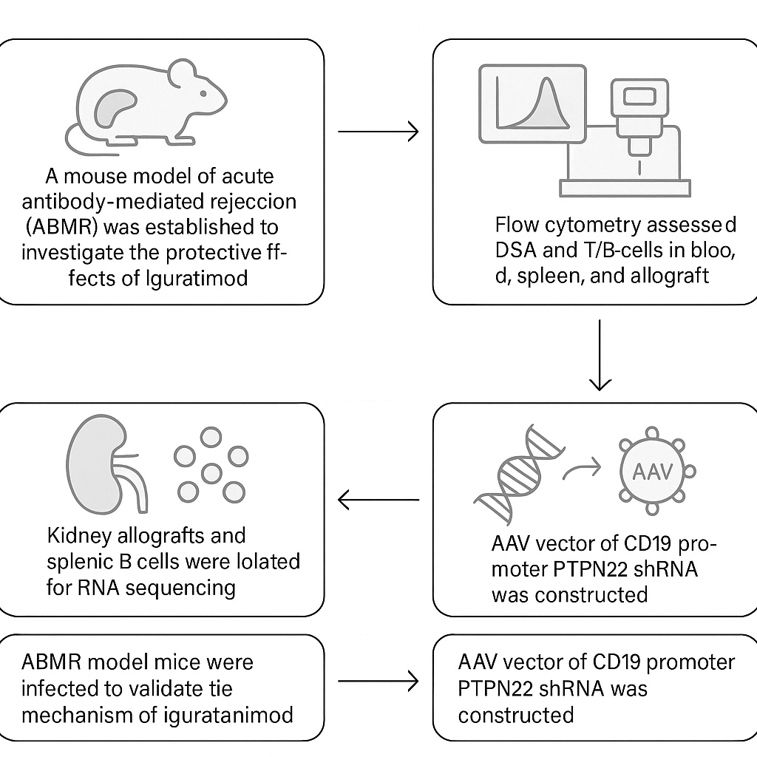
Iguratimod upregulates PTPN22 and inhibits B cells activation in ABMR after renal transplant
Method
Acute antibody-mediated rejection (ABMR) mouse model to investigate the protective effects of Iguratimod
Background
Iguratimod is a novel small-molecule anti-rheumatic drug that has demonstrated potential immunosuppressive effects in clinical applications for rheumatoid arthritis
Previous research in renal transplant recipients has indicated that Iguratimod may effectively decrease de novo donor-specific antibody (DSA) levels alongside population response antibody (PRA) levels, leading to a notable reduction in kidney allograft rejection with a favorable safety profile
Flow cytometry to assess changes in donor-specific antibodies (DSA) and T/B cell subtypes in peripheral blood, spleen, and kidney allograft following Iguratimod administration
Isolation of kidney allografts and B cells from the spleens of transplanted using magnetic beads and subjected to RNA sequencing
Adeno associated virus vector of CD19 specific promoter of PTPN22 shRNA to infect ABMR model mice to validate the mechanism of Iguratimod
Zheng M. et al., ESOT Congress 2025 (Abstract 1783)
Notes:
Abbreviations: ABMR, acute antibody-mediated rejection; PTPN22, Protein Tyrosine Phosphatase Non-receptor 22; DSA, donor-specific antibodies; PRA, population response antibody
Reference Number: 1783
IGURATIMOD UPREGULATED PTPN22 AND INHIBITED B CELLS ACTIVATION IN ABMR AFTER RENAL TRANSPLANT
Ming Zheng¹, Min Gu¹, Zijie Wang¹
¹the Second Affiliated Hospital of Nanjing Medical University, Nanjing, China
Background: Iguratimod, a novel small molecule anti-rheumatic drug, has demonstrated potential immunosuppressive effects in clinical applications for rheumatoid arthritis. Our previous research in renal transplant recipients has indicated that Iguratimod may effectively decrease de novo donor-specific antibody (DSA) levels, alongside population response antibody (PRA) levels, leading to a notable reduction in kidney allograft rejection with a favorable safety profile.
Methods: A mouse model of acute antibody-mediated rejection (ABMR) was established to investigate the protective effects of Iguratimod through allograft survival analysis and pathology. Flow cytometry was employed to assess changes in donor-specific antibodies (DSA) and T/B cell subtypes in peripheral blood, spleen, and kidney allograft following Iguratimod administration. Kidney allografts and B cells from the spleens of transplanted mice were isolated using magnetic beads and subjected to RNA sequencing. Notably, gene PTPN22 (Protein Tyrosine Phosphatase Non-receptor 22) emerged and then we constructed adeno associated virus vector of CD19 specific promoter of PTPN22 shRNA to infect ABMR model mice to validate the mechanism of Iguratimod.
Results: Iguratimod exhibited the ability to reduce DSA levels, significantly mitigate pathological injuries, and extend allograft survival in a mouse acute ABMR model. Flow cytometry analysis revealed a decrease in the CD4/CD8 ratio in peripheral blood, a reduction in activated B cells in the spleen, and a decline in plasma cells in peripheral blood following Iguratimod administration. Transcript sequencing suggested that Iguratimod might exert a pronounced effect by upregulating PTPN22. Finally, mice infected with an adeno-associated virus vector containing the CD19-specific promoter for PTPN22 shRNA confirmed the potential mechanism of Iguratimod, highlighting its ability to inhibit PI3K/AKT/mTOR.
Conclusions: Iguratimod could mitigate acute antibody-mediated rejection and extend renal graft survival by upregulating PTPN22, subsequently inhibiting B cell activation in a mouse kidney transplant model through the suppression of the PI3K/AKT/mTOR signaling pathway.

Slide 6
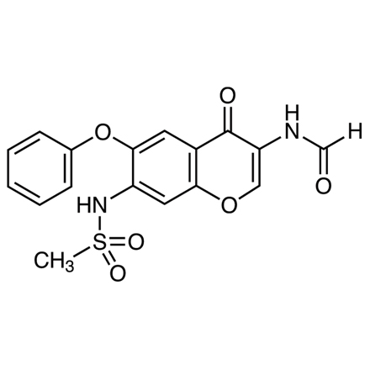
Iguratimod upregulates PTPN22 and inhibits B cells activation in ABMR after renal transplant
Results
Iguratimod exhibits the ability to:
Reduce DSA levels
Significantly mitigate pathological injuries
Extend allograft survival in a mouse acute ABMR model
Flow cytometry analysis reveals:
Decrease in the CD4/CD8 ratio in peripheral blood
Reduction in activated B cells in the spleen
Decline in plasma cells in peripheral blood following Iguratimod administration
Transcript sequencing suggests that Iguratimod might exert a pronounced effect by upregulating PTPN22
Mice infected with an adeno-associated virus vector containing the CD19-specific promoter for PTPN22 shRNA confirm the potential mechanism of Iguratimod, highlighting its ability to inhibit PI3K/AKT/mTOR
Conclusions
Iguratimod could mitigate acute antibody-mediated rejection and extend renal graft survival by upregulating PTPN22, subsequently inhibiting B cell activation in a mouse kidney transplant model through the suppression of the PI3K/AKT/mTOR signaling pathway
↑
↑
PTPN22
↑
Iguratimod
PI3K
AKT
mTOR
B-cell activation
Zheng M. et al., ESOT Congress 2025 (Abstract 1783)
Notes:
Abbreviations: ABMR, acute antibody-mediated rejection; PTPN22, Protein Tyrosine Phosphatase Non-receptor 22; DSA, donor-specific antibodies; PRA, population response antibody
Reference Number: 1783
IGURATIMOD UPREGULATED PTPN22 AND INHIBITED B CELLS ACTIVATION IN ABMR AFTER RENAL TRANSPLANT
Ming Zheng¹, Min Gu¹, Zijie Wang¹
¹the Second Affiliated Hospital of Nanjing Medical University, Nanjing, China
Background: Iguratimod, a novel small molecule anti-rheumatic drug, has demonstrated potential immunosuppressive effects in clinical applications for rheumatoid arthritis. Our previous research in renal transplant recipients has indicated that Iguratimod may effectively decrease de novo donor-specific antibody (DSA) levels, alongside population response antibody (PRA) levels, leading to a notable reduction in kidney allograft rejection with a favorable safety profile.
Methods: A mouse model of acute antibody-mediated rejection (ABMR) was established to investigate the protective effects of Iguratimod through allograft survival analysis and pathology. Flow cytometry was employed to assess changes in donor-specific antibodies (DSA) and T/B cell subtypes in peripheral blood, spleen, and kidney allograft following Iguratimod administration. Kidney allografts and B cells from the spleens of transplanted mice were isolated using magnetic beads and subjected to RNA sequencing. Notably, gene PTPN22 (Protein Tyrosine Phosphatase Non-receptor 22) emerged and then we constructed adeno associated virus vector of CD19 specific promoter of PTPN22 shRNA to infect ABMR model mice to validate the mechanism of Iguratimod.
Results: Iguratimod exhibited the ability to reduce DSA levels, significantly mitigate pathological injuries, and extend allograft survival in a mouse acute ABMR model. Flow cytometry analysis revealed a decrease in the CD4/CD8 ratio in peripheral blood, a reduction in activated B cells in the spleen, and a decline in plasma cells in peripheral blood following Iguratimod administration. Transcript sequencing suggested that Iguratimod might exert a pronounced effect by upregulating PTPN22. Finally, mice infected with an adeno-associated virus vector containing the CD19-specific promoter for PTPN22 shRNA confirmed the potential mechanism of Iguratimod, highlighting its ability to inhibit PI3K/AKT/mTOR.
Conclusions: Iguratimod could mitigate acute antibody-mediated rejection and extend renal graft survival by upregulating PTPN22, subsequently inhibiting B cell activation in a mouse kidney transplant model through the suppression of the PI3K/AKT/mTOR signaling pathway.

Slide 7

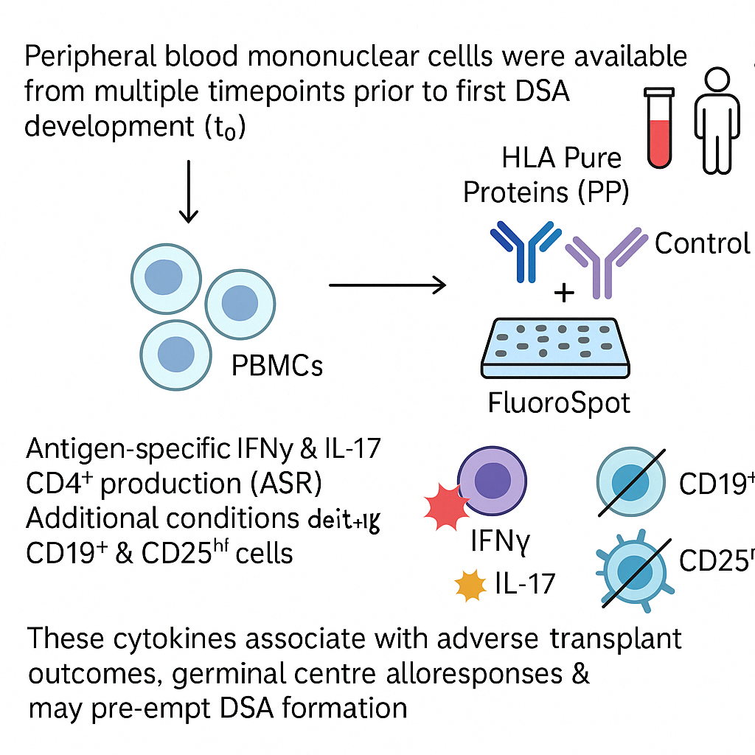
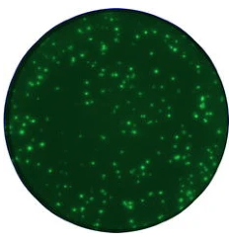
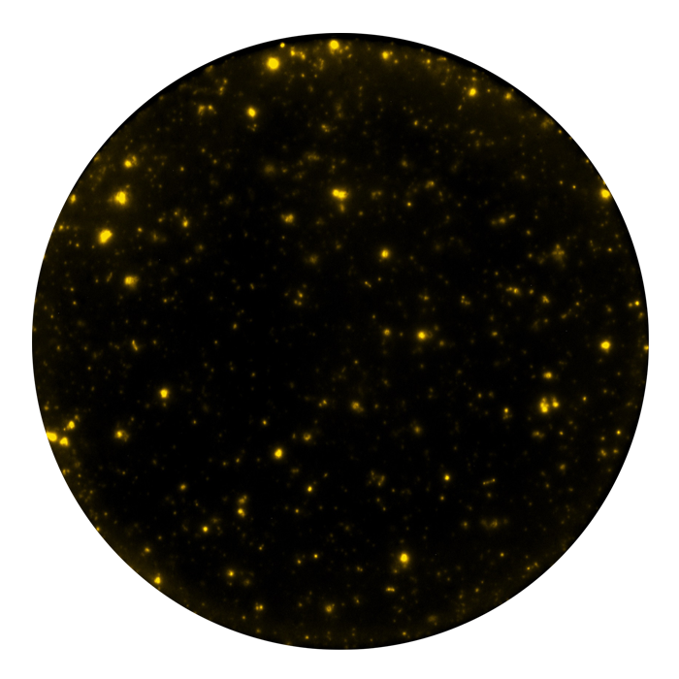
Loss of regulation of antigen specific IFNγ-producing T cells precedes the appearance of de novo DSA post transplant
Method
n=52 samples from 82 patients initially DSA negative but developed dnDSA during the trial
Background
While de novo donor specific antibodies (dnDSA) associate with graft loss in the OuTSMART trial, optimised immunosuppression post-DSA does not improve transplant survival.
It is unknown why only some patients develop dnDSA.
The longitudinal analysis of OuTSMART samples provides a unique opportunity to understand whether loss of regulation of allo-responses is a prerequisite for dnDSA formation.
Peripheral blood mononuclear cells from multiple timepoints prior to first DSA development (t0)
HLA Pure Proteins (PP) representing either DSA or control donor antigens to stimulate CD8 depleted PBMC to evaluate indirect alloresponses
FluoroSpot Assay:
Comparison of antigen specific IFNγ & IL17 CD4+ production (ASR) including additional conditions depleting CD19+ & CD25hi cells.
These cytokines associate with adverse transplant outcomes, germinal centre alloresponses & may pre-empt DSA formation
Basu S. et al., ESOT Congress 2025 (Abstract 1068)
Notes:
Abbreviations: dnDSA, de novo donor specific antibodies; DSA, Donor specific antibodies; HLA PP, Human Leukocyte Antigen Pure protein; PBMC, Peripheral Blood Mononuclear Cells; ASR, Antigen-Specific Response.
Reference Number: 1068
LOSS OF REGULATION OF ANTIGEN SPECIFIC IFNG-PRODUCING T CELLS PRECEDES THE APPEARANCE OF DE NOVO DSA POST
Sumoyee Basu¹, Dominic Stringer¹, Elli Tham¹, Chloe Martin², Olivia Shaw², Giovanna Lombardi¹, Anthony Dorling¹
¹King's College London Guy's Campus, London, United Kingdom, ²Clinical Transplantation Laboratory at Guy's Hospital, London, United Kingdom
Background While de novo donor specific antibodies (dnDSA) associated with graft loss in the OuTSMART trial, optimised immunosuppression post-DSA did not improve transplant survival. Furthermore it is unknown why only some patients develop dnDSA. The longitudinal analysis of OuTSMART samples provided a unique opportunity to understand whether loss of regulation of alloresponses was a prerequisite for dnDSA formation.
Methods Peripheral blood mononuclear cells were available from multiple timepoints prior to first DSA development (t0) from 52/82 patients; initially DSA- but developed dnDSA during the trial. HLA Pure Proteins (PP) representing either DSA or control donor antigens were used to stimulate CD8 depleted PBMC to evaluate indirect alloresponses. Using FluoroSpot, antigen specific IFNγ & IL17 CD4+ production (ASR) were compared, including additional conditions depleting CD19+ & CD25hi cells. These cytokines associate with adverse transplant outcomes, germinal centre alloresponses & may pre-empt DSA formation.
Results ASR were detectable to either control/DSA PP in 66.7% (80/120) of IFNy assays & 42.5% (51/120) for IL17. Notably ASR were measurable in >50% of samples even up to 32 months at all timepoints prior to t0. Fig 1a) indicates overall ASR to control mismatches were more regulated 32/39 (82.1%) than to DSA protein 28/41 (68.3%) but was not statistically significant. Fig 1b) demonstrates similar proportions of regulated IFNy responses to both control & DSA PP until 8 months prior to t0. However from -4 months, unregulated IFNy responses to DSA predominated. This differed from the control protein where regulated responses were maintained. No similar patterns were discerned in responses to IL-17. A concomitant 36-colour flow cytometry panel highlights which regulatory cell subsets associate with ASR regulation & their changes prior to dnDSA.
Conclusions This is the first systematic study of clinical samples prior to dnDSA. ASR were detectable even 32 months prior to DSA formation in >50% samples. There was differential loss of regulation of IFNy production to DSA PP just prior to dnDSA detection. Conversely regulated control ASR responses predominated at all timepoints. This highlights a window of detectable T cell sensitisation prior to dnDSA potentially amenable to specific Treg cell therapy.

Slide 8
Loss of regulation of antigen specific IFNγ-producing T cells precedes the appearance of de novo DSA post transplant
Results
A concomitant 36-colour flow cytometry panel highlights which regulatory cell subsets associate with ASR regulation and their changes prior to dnDSA
Conclusions
This is the first systematic study of clinical samples prior to dnDSA
ASR were detectable even 32 months prior to DSA formation in >50% samples
There was differential loss of regulation of IFNγ production to DSA PP just prior to dnDSA detection
Conversely, regulated control ASR responses predominated at all timepoints
This highlights a window of detectable T cell sensitisation prior to dnDSA potentially amenable to specific Treg cell therapy
Overall antigen specific responses (ASR) to control mismatches were more regulated 32/39 (82.1%) than to DSA proteins 28/41 (68.3%) but was not statistically significant
Months relative to DSA first detected
Longitudinal analysis of antigen specific IFNγ in response to pure protein relative to DSA first appearing (t0)
Regulated IFNγ responses to control and DSA PP similar until 8 months prior to t0
From -4 months, unregulated IFNγ responses to DSA predominated, unlike control responses which remained regulated
No similar patterns were discerned in responses to IL17-A
Basu S. et al., ESOT Congress 2025 (Abstract 1068)
Notes:
Abbreviations: dnDSA, de novo donor specific antibodies; DSA, Donor specific antibodies; HLA PP, Human Leukocyte Antigen Pure protein; PBMC, Peripheral Blood Mononuclear Cells; ASR, Antigen-Specific Response.
Reference Number: 1068
LOSS OF REGULATION OF ANTIGEN SPECIFIC IFNG-PRODUCING T CELLS PRECEDES THE APPEARANCE OF DE NOVO DSA POST
Sumoyee Basu¹, Dominic Stringer¹, Elli Tham¹, Chloe Martin², Olivia Shaw², Giovanna Lombardi¹, Anthony Dorling¹
¹King's College London Guy's Campus, London, United Kingdom, ²Clinical Transplantation Laboratory at Guy's Hospital, London, United Kingdom
Background While de novo donor specific antibodies (dnDSA) associated with graft loss in the OuTSMART trial, optimised immunosuppression post-DSA did not improve transplant survival. Furthermore it is unknown why only some patients develop dnDSA. The longitudinal analysis of OuTSMART samples provided a unique opportunity to understand whether loss of regulation of alloresponses was a prerequisite for dnDSA formation.
Methods Peripheral blood mononuclear cells were available from multiple timepoints prior to first DSA development (t0) from 52/82 patients; initially DSA- but developed dnDSA during the trial. HLA Pure Proteins (PP) representing either DSA or control donor antigens were used to stimulate CD8 depleted PBMC to evaluate indirect alloresponses. Using FluoroSpot, antigen specific IFNγ & IL17 CD4+ production (ASR) were compared, including additional conditions depleting CD19+ & CD25hi cells. These cytokines associate with adverse transplant outcomes, germinal centre alloresponses & may pre-empt DSA formation.
Results ASR were detectable to either control/DSA PP in 66.7% (80/120) of IFNy assays & 42.5% (51/120) for IL17. Notably ASR were measurable in >50% of samples even up to 32 months at all timepoints prior to t0. Fig 1a) indicates overall ASR to control mismatches were more regulated 32/39 (82.1%) than to DSA protein 28/41 (68.3%) but was not statistically significant. Fig 1b) demonstrates similar proportions of regulated IFNy responses to both control & DSA PP until 8 months prior to t0. However from -4 months, unregulated IFNy responses to DSA predominated. This differed from the control protein where regulated responses were maintained. No similar patterns were discerned in responses to IL-17. A concomitant 36-colour flow cytometry panel highlights which regulatory cell subsets associate with ASR regulation & their changes prior to dnDSA.
Conclusions This is the first systematic study of clinical samples prior to dnDSA. ASR were detectable even 32 months prior to DSA formation in >50% samples. There was differential loss of regulation of IFNy production to DSA PP just prior to dnDSA detection. Conversely regulated control ASR responses predominated at all timepoints. This highlights a window of detectable T cell sensitisation prior to dnDSA potentially amenable to specific Treg cell therapy.

Slide 9
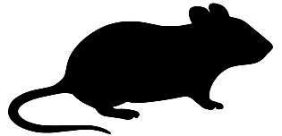
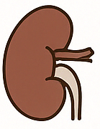

Pre-sensitization disrupts tolerance by driving Treg dysfunction in murine kidney transplant models
Background
Inducing tolerance is the goal of solid organ transplantation, yet immune activation, particularly pre-sensitization enhancing memory T cell responses, often disrupts it
Understanding how pre-sensitization impairs Treg function in murine kidney transplant models is crucial for developing tolerance-inducing strategies
Results
Skin graft-induced pre-sensitization markedly impaired renal allograft tolerance, reducing graft survival by 94.5%
Tolerant grafts showed increased proliferating Treg1 cells (Ccr4^{low}, Irf4^{high}), while pre-sensitized acute rejection grafts had fewer Tregs and upregulated immune checkpoints PD1, TIM3, LAG3
SCENIC analyses revealed upregulated Tbx21-regulon activity in Tregs from pre-sensitized graft linked to increased regulation of type I inflammatory chemokines
Trajectory analysis demonstrated progressive changes in Treg subsets including decrease of Mki67, and increase of Ctla4, Ikzf2, Ifngr1, Pdcd1
PD1+ Tregs in undermined tolerant microenvironment mainly received PD-L1 and stronger inflammatory signals (Tnf-Tnfrsf1b) from inflammatory macrophages, but weaker MHC-TCR/Cd4 and Cd86-Ctla4 signals
Pre-sensitization mediated type I immune signal induces Treg dysfunction by
increasing T-bet regulon activity and PD1 expression
Method
Kidney transplant tolerance models
Pre-sensitization
By syngeneic skin grafts five days before kidney transplantation
C3H (H2k) donors
BALB/c(H2d) recipients
Renal allografts harvested 5 days post-surgery
Isolation of CD45+ immune cells
Single-cell transcriptomics
TCR sequencing
Chen Y. et al., ESOT Congress 2025 (Abstract 1284)
Notes:
Abbreviations: TCR, T Cell Receptor; Treg, Regulatory T cell; PD-1, Programmed cell Death protein 1; PD-L1, Programmed Death-Ligand 1; CCR4, C-C chemokine receptor type 4; Interferon Regulatory Factor 4; TIM-3, T-cell immunoglobulin and mucin-domain containing-3; LAG3, Lymphocyte Activation Gene-3; MHC, Major Histocompatibility Complex.
Reference Number: 1284
PRE-SENSITIZATION DISRUPTS TOLERANCE BY DRIVING TREG DYSFUNCTION IN MURINE KIDNEY TRANSPLANT MODELS
Yanxu Chen¹, Qiang Zhang¹, Longshan Liu¹, Changxi Wang¹
¹the first affiliated hospital of sun yat-sen university, Guangzhou
Background: Inducing tolerance is the goal of solid organ transplantation, yet immune activation, particularly pre-sensitization enhancing memory T cell responses, often disrupts it. Understanding how pre-sensitization impairs Treg function in murine kidney transplant models is crucial for developing tolerance-inducing strategies.
Methods: Kidney transplant tolerance models were established using C3H (H2k) donors and BALB/c(H2d) recipients. Pre-sensitization was induced by syngeneic skin grafts five days before kidney transplantation. Renal allografts were harvested 5 days post-surgery, and CD45+ immune cells were isolated for single-cell transcriptomics and TCR sequencing.
Results: Renal allograft tolerance models were disrupted by pre-sensitization with skin grafting, reducing overall survival by 94.5%. Tolerant grafts exhibited increased Treg infiltration, particularly proliferating Treg1 subsets, characterized by low Ccr4 and high Irf4 expression. Pre-sensitized acute rejection grafts exhibited reduced Treg proportions and upregulation of immune checkpoints (PD1, TIM3, LAG3). SCENIC analysis revealed higher Tbx21-regulon activity in Treg from pre-sensitized graft, linked to increased regulation of type I inflammatory chemokines. Trajectory analysis demonstrated progressive changes in Treg subsets, including downregulation of Mki67 and upregulation of Ctla4, Ikzf2, Ifngr1 and Pdcd1. In the disrupted tolerance microenvironment, PD1+Tregs predominantly received PD-L1 signals from pro-inflammatory macrophages, which also provided stronger inflammatory signals (Tnf Tnfrsf1b), but weaker MHC-TCR/Cd4 and Cd86-Ctla4 signals. We propose that macrophage-mediated type I immune microenvironment induced Treg dysfunction by increasing T-bet regulon activity and PD1 expression.
Conclusions: Our findings highlight the crucial role of Tregs in maintaining graft tolerance. Pre-sensitization triggers stronger type I immune signals, which upregulate T-bet transcriptional regulation and PD1 expression in Tregs. This ultimately impairs Treg immune regulatory function and disrupts the tolerance balance within the graft.

Slide 10
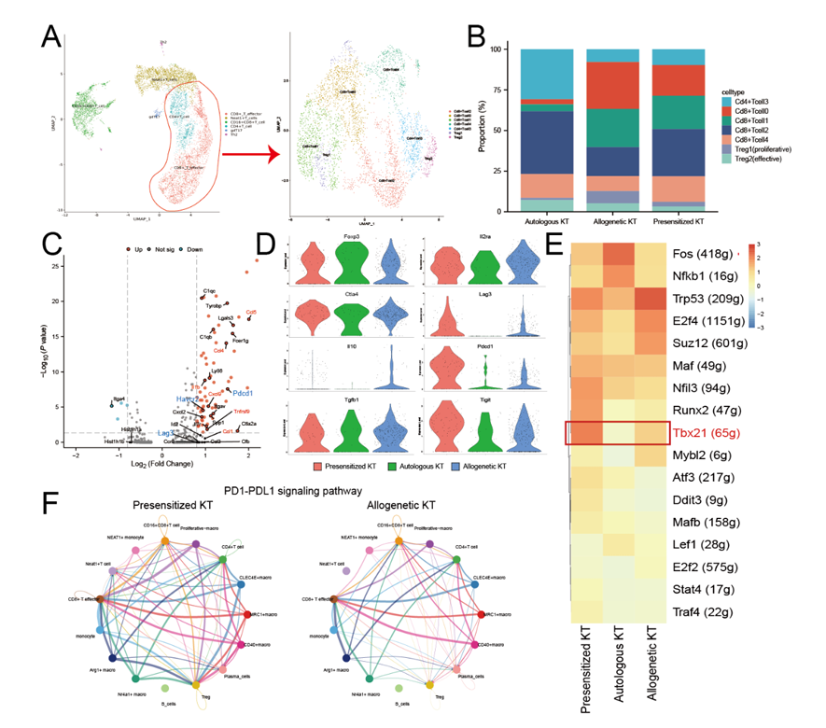
Pre-sensitization disrupts tolerance by driving Treg dysfunction in murine kidney transplant models
Results (cont.)
Conclusions
These findings highlight the crucial role of Tregs in maintaining graft tolerance
Pre-sensitization triggers stronger type I immune signals, which upregulate T-bet transcriptional regulation and PD1 expression in Tregs
This ultimately impairs Treg immune regulatory function and disrupts the tolerance balance within the graft
Chen Y. et al., ESOT Congress 2025 (Abstract 1284)
Notes:
Abbreviations: TCR, T Cell Receptor; Treg, Regulatory T cell; PD-1, Programmed cell Death protein 1; PD-L1, Programmed Death-Ligand 1; CCR4, C-C chemokine receptor type 4; Interferon Regulatory Factor 4; TIM-3, T-cell immunoglobulin and mucin-domain containing-3; LAG3, Lymphocyte Activation Gene-3; MHC, Major Histocompatibility Complex.
Reference Number: 1284
PRE-SENSITIZATION DISRUPTS TOLERANCE BY DRIVING TREG DYSFUNCTION IN MURINE KIDNEY TRANSPLANT MODELS
Yanxu Chen¹, Qiang Zhang¹, Longshan Liu¹, Changxi Wang¹
¹the first affiliated hospital of sun yat-sen university, Guangzhou
Background: Inducing tolerance is the goal of solid organ transplantation, yet immune activation, particularly pre-sensitization enhancing memory T cell responses, often disrupts it. Understanding how pre-sensitization impairs Treg function in murine kidney transplant models is crucial for developing tolerance-inducing strategies.
Methods: Kidney transplant tolerance models were established using C3H (H2k) donors and BALB/c(H2d) recipients. Pre-sensitization was induced by syngeneic skin grafts five days before kidney transplantation. Renal allografts were harvested 5 days post-surgery, and CD45+ immune cells were isolated for single-cell transcriptomics and TCR sequencing.
Results: Renal allograft tolerance models were disrupted by pre-sensitization with skin grafting, reducing overall survival by 94.5%. Tolerant grafts exhibited increased Treg infiltration, particularly proliferating Treg1 subsets, characterized by low Ccr4 and high Irf4 expression. Pre-sensitized acute rejection grafts exhibited reduced Treg proportions and upregulation of immune checkpoints (PD1, TIM3, LAG3). SCENIC analysis revealed higher Tbx21-regulon activity in Treg from pre-sensitized graft, linked to increased regulation of type I inflammatory chemokines. Trajectory analysis demonstrated progressive changes in Treg subsets, including downregulation of Mki67 and upregulation of Ctla4, Ikzf2, Ifngr1 and Pdcd1. In the disrupted tolerance microenvironment, PD1+Tregs predominantly received PD-L1 signals from pro-inflammatory macrophages, which also provided stronger inflammatory signals (Tnf Tnfrsf1b), but weaker MHC-TCR/Cd4 and Cd86-Ctla4 signals. We propose that macrophage-mediated type I immune microenvironment induced Treg dysfunction by increasing T-bet regulon activity and PD1 expression.
Conclusions: Our findings highlight the crucial role of Tregs in maintaining graft tolerance. Pre-sensitization triggers stronger type I immune signals, which upregulate T-bet transcriptional regulation and PD1 expression in Tregs. This ultimately impairs Treg immune regulatory function and disrupts the tolerance balance within the graft.

Slide 11


Metabolic reprogramming in macrophages: PP2A's crucial role in kidney transplant rejection dynamic
Background
This study aims to investigate the role and mechanism of Protein Phosphatase 2A (PP2A) in antibody-mediated rejection (ABMR) of renal allogeneic transplantation
Methods
Conditional macrophage PP2A knockout mice
Mouse model of acute ABMR
Techniques
Histological staining
Immunohistochemistry
Flow cytometry
Immunofluorescence staining
qRT-PCR
Western blot
Assessment
Renal transplantation injury
Macrophage polarization markers
Glycolysis markers
Fatty acid synthesis markers.
RNA sequencing classification of macrophages infiltrating the transplanted kidney via magnetic beads
PP2A
?
Metabolic reprogramming
Xu J. et al., ESOT Congress 2025 (Abstract 1550)
Notes:
Abbreviations:PP2A, Protein Phosphatase 2A; ABMR, Antibody-mediated rejection; BMDMs, Bone marrow derived macrophages.
Reference Number: 1550
METABOLIC REPROGRAMMING IN MACROPHAGES: PP2A'S CRUCIAL ROLE IN KIDNEY TRANSPLANT REJECTION DYNAMIC
Jie Xu¹, Min Gu¹, Zijie Wang¹
¹the Second Affiliated Hospital of Nanjing Medical University, Nanjing, China
Background: This study aims to investigate the role and mechanism of Protein Phosphatase 2A (PP2A) in antibody-mediated rejection (ABMR) of renal allogeneic transplantation.
Methods: Conditional macrophage PP2A knockout mice were employed to establish a mouse model of acute ABMR. Various techniques, including histological staining, immunohistochemistry, flow cytometry, immunofluorescence staining, quantitative reverse transcription polymerase chain reaction (qRT-PCR), and Western blotting, were utilized to assess renal transplantation injury, macrophage polarization markers, glycolysis markers, and fatty acid synthesis markers in ABMR mice. Additionally, magnetic beads facilitated RNA sequencing classification of macrophages infiltrating the transplanted kidney to elucidate the molecular mechanism by which PP2A regulates macrophage metabolic reprogramming in ABMR.
Results: Our findings revealed that both macrophage infiltration and pro-inflammatory macrophage polarization were significantly elevated in the renal tissues of ABMR patients and animal models. We subsequently generated conditional macrophage PP2A knockout mice and established an acute ABMR model using these mice. Compared to the control group, gene knockout enhanced the polarization of pro-inflammatory macrophages and exacerbated the pathological damage to renal grafts. Furthermore, PP2A deficiency in primary bone marrow derived macrophages (BMDMs) promoted pro-inflammatory macrophage polarization, stimulated macrophage glycolysis, and increased fatty acid synthesis. Mechanistically, PP2A may mitigate pro-inflammatory macrophage activation and ameliorate the progression of ABMR in allogeneic kidney transplantation by modulating macrophage metabolic reprogramming. Conclusions: An acute antibody-mediated rejection (ABMR) model in mice was successfully established and characterized. Protein phosphatase 2A (PP2A) appears to mitigate pro-inflammatory macrophage activation and enhance the progression of ABMR in allogeneic kidney transplantation by modulating macrophage metabolic reprogramming. This finding may offer new insights into the PP2A pathway as a potential therapeutic target for ABMR.

Slide 12
Metabolic reprogramming in macrophages: PP2A's crucial role in kidney transplant rejection dynamic
Results
Both macrophage infiltration and pro-inflammatory macrophage polarization are significantly elevated in the renal tissues of ABMR patients and animal models
PP2A knockout enhances the polarization of pro-inflammatory macrophages and exacerbates the pathological damage to renal grafts
PP2A deficiency in primary bone marrow derived macrophages (BMDMs) promotes pro-inflammatory macrophage polarization, stimulates macrophage glycolysis, and increases fatty acid synthesis
PP2A may mitigate pro-inflammatory macrophage activation and ameliorate the progression of ABMR in allogeneic kidney transplantation by modulating macrophage metabolic reprogramming
Conclusions
An acute antibody-mediated rejection (ABMR) model in mice was successfully established and characterized
Protein phosphatase 2A (PP2A) appears to mitigate pro-inflammatory macrophage activation and enhance the progression of ABMR in allogeneic kidney transplantation by modulating macrophage metabolic reprogramming
This finding may offer new insights into the PP2A pathway as a potential therapeutic target for ABMR
Xu J. et al., ESOT Congress 2025 (Abstract 1550)
Notes:
Abbreviations:PP2A, Protein Phosphatase 2A; ABMR, Antibody-mediated rejection; BMDMs, Bone marrow derived macrophages.
Reference Number: 1550
METABOLIC REPROGRAMMING IN MACROPHAGES: PP2A'S CRUCIAL ROLE IN KIDNEY TRANSPLANT REJECTION DYNAMIC
Jie Xu¹, Min Gu¹, Zijie Wang¹
¹the Second Affiliated Hospital of Nanjing Medical University, Nanjing, China
Background: This study aims to investigate the role and mechanism of Protein Phosphatase 2A (PP2A) in antibody-mediated rejection (ABMR) of renal allogeneic transplantation.
Methods: Conditional macrophage PP2A knockout mice were employed to establish a mouse model of acute ABMR. Various techniques, including histological staining, immunohistochemistry, flow cytometry, immunofluorescence staining, quantitative reverse transcription polymerase chain reaction (qRT-PCR), and Western blotting, were utilized to assess renal transplantation injury, macrophage polarization markers, glycolysis markers, and fatty acid synthesis markers in ABMR mice. Additionally, magnetic beads facilitated RNA sequencing classification of macrophages infiltrating the transplanted kidney to elucidate the molecular mechanism by which PP2A regulates macrophage metabolic reprogramming in ABMR.
Results: Our findings revealed that both macrophage infiltration and pro-inflammatory macrophage polarization were significantly elevated in the renal tissues of ABMR patients and animal models. We subsequently generated conditional macrophage PP2A knockout mice and established an acute ABMR model using these mice. Compared to the control group, gene knockout enhanced the polarization of pro-inflammatory macrophages and exacerbated the pathological damage to renal grafts. Furthermore, PP2A deficiency in primary bone marrow derived macrophages (BMDMs) promoted pro-inflammatory macrophage polarization, stimulated macrophage glycolysis, and increased fatty acid synthesis. Mechanistically, PP2A may mitigate pro-inflammatory macrophage activation and ameliorate the progression of ABMR in allogeneic kidney transplantation by modulating macrophage metabolic reprogramming. Conclusions: An acute antibody-mediated rejection (ABMR) model in mice was successfully established and characterized. Protein phosphatase 2A (PP2A) appears to mitigate pro-inflammatory macrophage activation and enhance the progression of ABMR in allogeneic kidney transplantation by modulating macrophage metabolic reprogramming. This finding may offer new insights into the PP2A pathway as a potential therapeutic target for ABMR.

Slide 13

Use of a hepatocyte-specific chimeric antigen receptor enhances recruitment of regulatory T cells to liver
Background
Regulatory T cells (Tregs) are being explored as therapies for autoimmunity and transplantation due to their immunomodulatory properties
Their activation depends on TCR-mediated antigen engagement
Preclinical data show that antigen-specific Tregs migrate to and persist at inflammation sites, enhancing localized immunosuppression
Using CAR technology, Tregs can be engineered to target specific antigens; here, we hypothesize that CAR-Tregs recognizing a hepatocyte-specific antigen will selectively migrate to the liver
Methods
Design and synthesis of several second-generation CAR constructs incorporating single-chain antibody fragments recognizing asialoglycoprotein receptor 1 (ASGPR) and different transmembrane and hinge domains
Initial screening for specificity and functionality using a Jurkat NFAT-reporter cell line stimulated with recombinant proteins and/or ASGPR-expressing cells
Specificity and functionality assesment
Activation in vitro assay
Proliferation in vitro assay
Suppression in vitro assay
CD4+CD25+CD127– Tregs
transduced, using lentiviral vectors
Evaluation of tissue homing and persistence of liver-specific CAR-Tregs in vivo in immunocompromised NSG mice under homeostatic conditions
Kurt A. et al., ESOT Congress 2025 (Abstract 1558)
Notes:
Abbreviations:Tregs, Regulatory T cells; CAR, Chimeric antigen receptor ; ASGPR, Asialoglycoprotein receptor 1.
Reference Number: 1558
USE OF A HEPATOCYTE-SPECIFIC CHIMERIC ANTIGEN RECEPTOR ENHANCES RECRUITMENT OF REGULATORY T CELLS TO LIVER
Ada Kurt¹, Elisavet Kodela¹, Emmanuelle Landmann¹, Paula Ruiz¹, Marwa Elgosbi¹, Maegen Fleming¹, Louisa Tang², Anna Koi², Eva Bugallo Blanco², Sim Tung², Daniela Penston², Marc Martinez-Llordella², Alberto Sanchez-Fueyo²
¹RW Institute of Liver Studies, King’s College London University and King’s College Hospital, London, UK, London, United Kingdom, ²Quell Therapeutics, London, United Kingdom
Background: Regulatory T cells (Tregs), known for their powerful immunomodulatory properties, are being evaluated as a therapeutic strategy to ameliorate immunopathology and re-establish immunological tolerance in autoimmunity and transplantation. Treg activation requires T cell receptor (TCR)-mediated cognate antigen engagement. In pre-clinical studies, Tregs with specificity for antigens expressed at the site of inflammation preferentially traffic and persist in these sites, resulting in more powerful compartmentalized immunosuppression. The antigen specificity of Tregs can be artificially modified using the synthetic chimeric antigen receptors (CARs) technology. We hypothesized that by engineering Tregs to express a CAR recognizing a hepatocyte-specific antigen, we would promote their selective migration to the liver.
Methods: We designed and synthesized several second-generation CAR constructs incorporating single-chain antibody fragments recognizing asialoglycoprotein receptor 1 (ASGPR) and different transmembrane and hinge domains. Initial screening for specificity and functionality was performed using a Jurkat NFAT-reporter cell line stimulated with recombinant proteins and/or ASGPR-expressing cells. Human CD4+CD25+CD127– Tregs were then transduced, using lentiviral vectors, and their specificity and functionality was assessed through activation, proliferation, and suppression in vitro assays. The tissue homing and persistence of liver-specific CAR-Tregs were evaluated in vivo in immunocompromised NSG mice under homeostatic conditions.
Results: CARs were selected based on their specificity for ASGPR and activation profile following antigen recognition. As compared to untransduced polyclonal Tregs, ASGPR-specific CAR-Tregs exhibited enhanced activation, proliferation and suppressive function in vitro. Following infusion into NSG mice, CAR-Tregs preferentially homed and persisted in the liver. Conclusions: Organ-specific CAR targeting is a promising strategy to improve outcomes in transplantation and inflammatory liver diseases by enhancing Treg recruitment to the target organ.

Slide 14

Use of a hepatocyte-specific chimeric antigen receptor enhances recruitment of regulatory T cells to liver
Results
CARs were selected based on their specificity for ASGPR and activation profile following antigen recognition
As compared to untransduced polyclonal Tregs, ASGPR-specific CAR-Tregs exhibited enhanced activation, proliferation and suppressive function in vitro
Following infusion into NSG mice, CAR-Tregs preferentially homed and persisted in the liver
Conclusions
Organ-specific CAR targeting is a promising strategy to improve outcomes in transplantation and inflammatory liver diseases by enhancing Treg recruitment to the target organ
Liver
CAR Treg
Kurt A. et al., ESOT Congress 2025 (Abstract 1558)
Notes:
Abbreviations:Tregs, Regulatory T cells; CAR, Chimeric antigen receptor ; ASGPR, Asialoglycoprotein receptor 1.
Reference Number: 1558
USE OF A HEPATOCYTE-SPECIFIC CHIMERIC ANTIGEN RECEPTOR ENHANCES RECRUITMENT OF REGULATORY T CELLS TO LIVER
Ada Kurt¹, Elisavet Kodela¹, Emmanuelle Landmann¹, Paula Ruiz¹, Marwa Elgosbi¹, Maegen Fleming¹, Louisa Tang², Anna Koi², Eva Bugallo Blanco², Sim Tung², Daniela Penston², Marc Martinez-Llordella², Alberto Sanchez-Fueyo²
¹RW Institute of Liver Studies, King’s College London University and King’s College Hospital, London, UK, London, United Kingdom, ²Quell Therapeutics, London, United Kingdom
Background: Regulatory T cells (Tregs), known for their powerful immunomodulatory properties, are being evaluated as a therapeutic strategy to ameliorate immunopathology and re-establish immunological tolerance in autoimmunity and transplantation. Treg activation requires T cell receptor (TCR)-mediated cognate antigen engagement. In pre-clinical studies, Tregs with specificity for antigens expressed at the site of inflammation preferentially traffic and persist in these sites, resulting in more powerful compartmentalized immunosuppression. The antigen specificity of Tregs can be artificially modified using the synthetic chimeric antigen receptors (CARs) technology. We hypothesized that by engineering Tregs to express a CAR recognizing a hepatocyte-specific antigen, we would promote their selective migration to the liver.
Methods: We designed and synthesized several second-generation CAR constructs incorporating single-chain antibody fragments recognizing asialoglycoprotein receptor 1 (ASGPR) and different transmembrane and hinge domains. Initial screening for specificity and functionality was performed using a Jurkat NFAT-reporter cell line stimulated with recombinant proteins and/or ASGPR-expressing cells. Human CD4+CD25+CD127– Tregs were then transduced, using lentiviral vectors, and their specificity and functionality was assessed through activation, proliferation, and suppression in vitro assays. The tissue homing and persistence of liver-specific CAR-Tregs were evaluated in vivo in immunocompromised NSG mice under homeostatic conditions.
Results: CARs were selected based on their specificity for ASGPR and activation profile following antigen recognition. As compared to untransduced polyclonal Tregs, ASGPR-specific CAR-Tregs exhibited enhanced activation, proliferation and suppressive function in vitro. Following infusion into NSG mice, CAR-Tregs preferentially homed and persisted in the liver. Conclusions: Organ-specific CAR targeting is a promising strategy to improve outcomes in transplantation and inflammatory liver diseases by enhancing Treg recruitment to the target organ.

Slide 15
Spatial insights into CLAD reveal differential modulation of immune checkpoints in obstructive vs. restrictive phenotype
Methods:
Patient Samples
8 lung tissue blocks from n=8 patients
All underwent re-transplantation for CLAD:
4 BOS-CLAD
4 RAS-CLAD
Background
Chronic lung allograft rejection (CLAD) is the leading cause of morbidity and mortality in lung transplantation, and there is still a gap of knowledge about immune-mediated rejection mechanisms
Therefore, this study aims to investigate panels of immune- and cell-signaling proteins at the spatial level in CLAD lungs
Spatial proteomics (Platform: GeoMX)
CD4, CD8, CD68, panCK, and CD20-positive cells and protein modules for immune cell profiling, immune checkpoints, cell death, PI3K/AKT and MAPK signaling
(n=72 proteins)
in both fibrotic and endoalveolar regions (ROI; CD4 and CD8)
in peri-bronchial area (CD20)
in endoalveolar space (panCK and CD68)
Vaira V. et al., ESOT Congress 2025 (Abstract 951)
Notes:
Abbreviations: CLAD, Chronic lung allograft rejection; BOS, Bronchiolitis obliterans syndrome; RAS, Restrictive allograft syndrome.
Reference Number: 951
SPATIAL INSIGHTS INTO CLAD REVEAL DIFFERENTIAL MODULATION OF IMMUNE CHECKPOINTS IN OBSTRUCTIVE VS RESTRICTIVE PHENOTYPE
Valentina Vaira¹, Ilaria Righi², Lorenzo Rosso³, Nadia Mansour⁴, Maria Rosaria De Filippo⁴, Gianluca Lopez⁵, Andrea Vingiani⁶, daniele lorenzini⁶, giancarlo pruneri⁶, Silvia Brich⁷, Alessandra Maria Storaci⁸, Sara Franzi⁹, Letizia Corinna Morlacchi¹⁰, Valeria Rossetti¹¹, Francesco Blasi¹², Daria Trabattoni¹³, Mario Nosotti¹⁴, Silvano Bosari⁶, Mario Clerici⁶
¹University of Milan, Department of Pathophysiology and Transplantation; Department of Pathophysiology and Transplantation, ²Fondazione Irccs Ca’ Granda – Ospedale Maggiore Policlinico di Milano; Fondazione Irccs Ca' Granda; Thoracic Surgery and Lung Transplantation Unit, ³Fondazione Irccs Ca' Granda Policlinico; Fondazione Irccs Ca' Granda; Thoracic Surgery and Lung Transplantation, ⁴Fondazione Irccs Ca' Granda - Ospedale Maggiore Policlinico, Milan, Italy, ⁵Fondazione Irccs Ca' Granda, ⁶University of Milan, ⁷Fondazione Irccs Istitut, Nazionale Dei Tumori, ⁸University of Milan, Milan, Italy; Department of Pathophysiology and Transplantation, ⁹Fondazione Irccs Ca' Granda - Ospedale Maggiore Policlinico, Milan, Italy; Department of Cardio-Thoraco-Vascular Diseases, ¹⁰Fondazione Irccs Ca’ Granda – Ospedale Maggiore Policlinico di Milano; Respiratory Unit and Cystic Fibrosis Center; Department of Pathophysiology and Transplantation, Università Degli Studi di Milano, ¹¹Fondazione Irccs Ca'granda - Ospedale Maggiore Policlinico; Internal Medicine Department, Respiratory Unit and Cystic Fibrosis Adult Centre, ¹²Fondazione Irccs Ca’ Granda Ospedale Maggiore Policlinico di Milano, Università Degli Studi di Milano, ¹³University of Milan; Department of Biomedical and Clinical Sciences, ¹⁴Fondazione Irccs Ca' Granda Ospedale Maggiore Policlinico; Dipartimento di Fisiopatologia Medico-Chirurgica e Dei Trapianti
Background:Chronic lung allograft rejection (CLAD) is the leading cause of morbidity and mortality in lung transplantation, and there is still a gap of knowledge about immune-mediated rejection mechanisms. Therefore, we investigated panels of immune- and cell-signaling proteins at the spatial level in CLAD lungs.
Methods:Eight representative lung tissue blocks from 8 patients who underwent re-transplantation for CLAD, were retrieved. Four had BOS- and four had RAS-CLAD. Spatial proteomics of CD4, CD8, CD68, panCK, and CD20-pos cells was performed using the GeoMX platform and protein modules for immune cell profiling, immune checkpoints, cell death, PI3K/AKT and MAPK signaling (n=72 proteins) in both fibrotic and endoalveolar regions (ROI; CD4 and CD8), in peri-bronchial area (CD20), or in endoalveolar space (panCK and CD68).
Results:At unsupervised level, lung epithelial cells from BOS and RAS CLAD showed distinct regulation of proteins belonging to the MAPK, PI3K/Akt and Immune checkpoint families; specifically, epithelial cells in BOS upregulate phospho−MEK1, phospho−p38 MAPK, phospho−JNK and phospho−AKT1 whereas in RAS we could detected upregulation of immune checkpoints, namely PDL1, PDL2 and VISTA. Further, a higher quota of proliferating cells (Ki67pos) was detected in BOS lungs. Differential expression of immune checkpoints between BOS and RAS was evident for immune cell populations. CD4pos T cells from fibrotic ROI in RAS overexpressed OX40L, CD14 and IDO1, while in BOS there was a predominant overexpression of known repressors of the T cells function, such as PDL1/ 2, B7-H3, Tim3, VISTA and Lag-3. A similar trend was observed in CD8pos and CD68pos immune cells. B-cell (CD20pos) was the histotype with less dissimilarities between BOS and RAS for all the protein modules.
Conclusions:Our spatially resolved approach reveals the involvement of innate immune response in RAS, and this is specifically evident in fibrotic areas. On the other side, BOS lungs show predominant expression of immune checkpoints with a suppressive function both in T-lymphocytes and in monocyte cells within endoalveolar space. These profound immunological differences between the two phenotypes of CLAD support the need of a differentiated medical approach for patients with either forms of chronic rejection.

Slide 16
Spatial insights into CLAD reveal differential modulation of immune checkpoints in obstructive vs. restrictive phenotype
Results
 | BOS-CLAD | RAS-CLAD
Lung epithelial cells at unsupervised level | Upregulation of phospho-MEK1, phospho-p38 MAPK, phospho-JNK, phospho-AKT1 | Upregulation of immune checkpoints: PDL1, PDL2, VISTA
Proliferation (Ki67⁺ cells) | Higher proportion | Lower proportion
CD4⁺ T cell from fibrotic ROI | Overexpression of PDL1, PDL2, B7-H3, Tim3, VISTA, Lag-3 (T cell repressors) | Overexpression of OX40L, CD14, IDO1
CD8⁺ and CD68⁺ immune cells | Similar trend | Similar trend
CD20⁺ B cells | Least differential expression between BOS and RAS across all the protein modules
Conclusions
This spatially resolved approach reveals the involvement of innate immune response in RAS, and this is specifically evident in fibrotic areas
On the other side, BOS lungs show predominant expression of immune checkpoints with a suppressive function both in T-lymphocytes and in monocyte cells within endoalveolar space
These profound immunological differences between the two phenotypes of CLAD support the need of a differentiated medical approach for patients with either forms of chronic rejection
Vaira V. et al., ESOT Congress 2025 (Abstract 951)
Notes:
Abbreviations: CLAD, Chronic lung allograft rejection; BOS, Bronchiolitis obliterans syndrome; RAS, Restrictive allograft syndrome.
Reference Number: 951
SPATIAL INSIGHTS INTO CLAD REVEAL DIFFERENTIAL MODULATION OF IMMUNE CHECKPOINTS IN OBSTRUCTIVE VS RESTRICTIVE PHENOTYPE
Valentina Vaira¹, Ilaria Righi², Lorenzo Rosso³, Nadia Mansour⁴, Maria Rosaria De Filippo⁴, Gianluca Lopez⁵, Andrea Vingiani⁶, daniele lorenzini⁶, giancarlo pruneri⁶, Silvia Brich⁷, Alessandra Maria Storaci⁸, Sara Franzi⁹, Letizia Corinna Morlacchi¹⁰, Valeria Rossetti¹¹, Francesco Blasi¹², Daria Trabattoni¹³, Mario Nosotti¹⁴, Silvano Bosari⁶, Mario Clerici⁶
¹University of Milan, Department of Pathophysiology and Transplantation; Department of Pathophysiology and Transplantation, ²Fondazione Irccs Ca’ Granda – Ospedale Maggiore Policlinico di Milano; Fondazione Irccs Ca' Granda; Thoracic Surgery and Lung Transplantation Unit, ³Fondazione Irccs Ca' Granda Policlinico; Fondazione Irccs Ca' Granda; Thoracic Surgery and Lung Transplantation, ⁴Fondazione Irccs Ca' Granda - Ospedale Maggiore Policlinico, Milan, Italy, ⁵Fondazione Irccs Ca' Granda, ⁶University of Milan, ⁷Fondazione Irccs Istitut, Nazionale Dei Tumori, ⁸University of Milan, Milan, Italy; Department of Pathophysiology and Transplantation, ⁹Fondazione Irccs Ca' Granda - Ospedale Maggiore Policlinico, Milan, Italy; Department of Cardio-Thoraco-Vascular Diseases, ¹⁰Fondazione Irccs Ca’ Granda – Ospedale Maggiore Policlinico di Milano; Respiratory Unit and Cystic Fibrosis Center; Department of Pathophysiology and Transplantation, Università Degli Studi di Milano, ¹¹Fondazione Irccs Ca'granda - Ospedale Maggiore Policlinico; Internal Medicine Department, Respiratory Unit and Cystic Fibrosis Adult Centre, ¹²Fondazione Irccs Ca’ Granda Ospedale Maggiore Policlinico di Milano, Università Degli Studi di Milano, ¹³University of Milan; Department of Biomedical and Clinical Sciences, ¹⁴Fondazione Irccs Ca' Granda Ospedale Maggiore Policlinico; Dipartimento di Fisiopatologia Medico-Chirurgica e Dei Trapianti
Background:Chronic lung allograft rejection (CLAD) is the leading cause of morbidity and mortality in lung transplantation, and there is still a gap of knowledge about immune-mediated rejection mechanisms. Therefore, we investigated panels of immune- and cell-signaling proteins at the spatial level in CLAD lungs.
Methods:Eight representative lung tissue blocks from 8 patients who underwent re-transplantation for CLAD, were retrieved. Four had BOS- and four had RAS-CLAD. Spatial proteomics of CD4, CD8, CD68, panCK, and CD20-pos cells was performed using the GeoMX platform and protein modules for immune cell profiling, immune checkpoints, cell death, PI3K/AKT and MAPK signaling (n=72 proteins) in both fibrotic and endoalveolar regions (ROI; CD4 and CD8), in peri-bronchial area (CD20), or in endoalveolar space (panCK and CD68).
Results:At unsupervised level, lung epithelial cells from BOS and RAS CLAD showed distinct regulation of proteins belonging to the MAPK, PI3K/Akt and Immune checkpoint families; specifically, epithelial cells in BOS upregulate phospho−MEK1, phospho−p38 MAPK, phospho−JNK and phospho−AKT1 whereas in RAS we could detected upregulation of immune checkpoints, namely PDL1, PDL2 and VISTA. Further, a higher quota of proliferating cells (Ki67pos) was detected in BOS lungs. Differential expression of immune checkpoints between BOS and RAS was evident for immune cell populations. CD4pos T cells from fibrotic ROI in RAS overexpressed OX40L, CD14 and IDO1, while in BOS there was a predominant overexpression of known repressors of the T cells function, such as PDL1/ 2, B7-H3, Tim3, VISTA and Lag-3. A similar trend was observed in CD8pos and CD68pos immune cells. B-cell (CD20pos) was the histotype with less dissimilarities between BOS and RAS for all the protein modules.
Conclusions:Our spatially resolved approach reveals the involvement of innate immune response in RAS, and this is specifically evident in fibrotic areas. On the other side, BOS lungs show predominant expression of immune checkpoints with a suppressive function both in T-lymphocytes and in monocyte cells within endoalveolar space. These profound immunological differences between the two phenotypes of CLAD support the need of a differentiated medical approach for patients with either forms of chronic rejection.

Slide 17
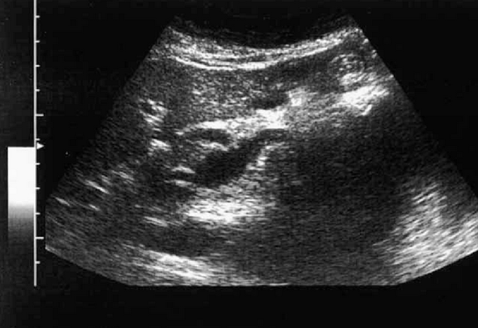

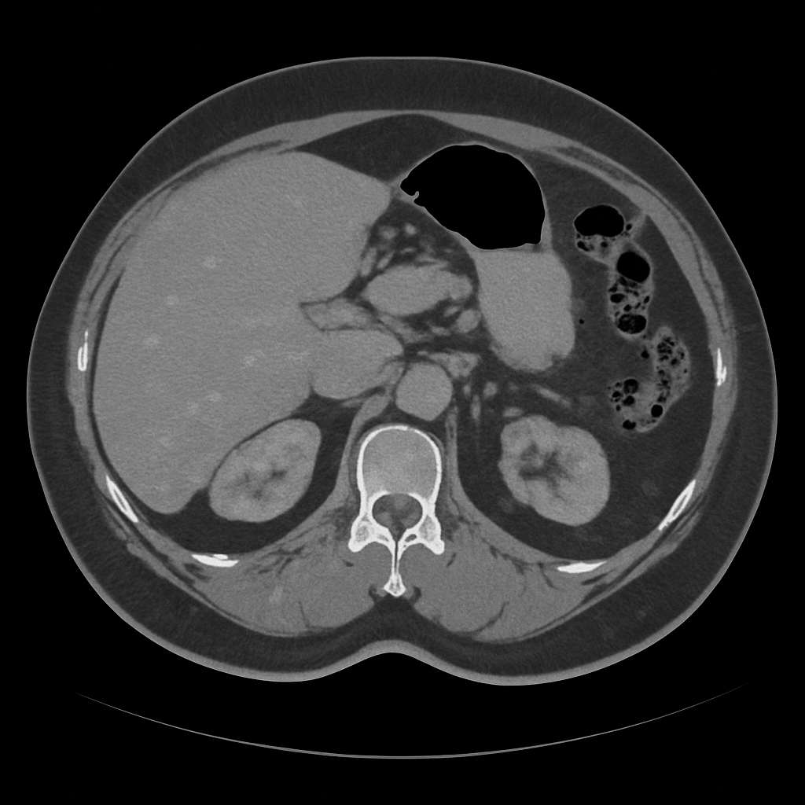
Soluble CD46 as a marker of hepatic steatosis in prospective living liver donors
Background
Interleukin-4-secreting (IL-4⁺) iNKT cells are over-represented in steatotic livers
This is attributed to stress-induction of matrix metalloproteases (MMP) in hepatocytes, which leads to indiscriminate cleavage of immune receptors
Loss of cell-surface CD46 results in unrepressed differentiation of IL-4⁺ iNKT cells
Soluble CD46 (sCD46) levels accurately classified oncological patients undergoing liver resection according to histological steatosis grade
This study investigates whether sCD46 levels predict steatosis in prospective living liver donors
Methods
n=156 prospective living liver donors
Measurement of sCD46 in stored plasma
Steatosis assessment by upper abdominal ultrasonography using the ratio of echogenicity in liver and kidney
Clinical data collected from hospital records
Waist circumference measured from abdominal CT images
Significance tests and receiver operating characteristic (ROC) curve analyses performed in R (4.3.3) Comparison of ROC curves with the DeLong test
Kupke P. et al., ESOT Congress 2025 (Abstract 1986)
Notes:
Abbreviations: MMP, Matrix metalloproteases; iNKT, iNKT cells, immature Natural killer cells; CT, Computed tomography; ROC, Receiver operating characteristic; CCR, correct classification rate; PPV, positive predictive value; NPV, Negative predictive value; FLI, Fatty Liver Index.
Reference Number: 1986
SOLUBLE CD46 AS A MARKER OF HEPATIC STEATOSIS IN PROSPECTIVE LIVING LIVER DONORS
Paul Kupke¹, Florian Bitterer¹, Akinbami Adenugba¹, Katja Evert¹, Gunther Glehr¹, Paloma Riquelme¹, Lena Scheibert¹, Giulia Preverin¹, Christina Böhm¹, Matthias Hornung¹, Hans J. Schlitt¹, Jürgen J. Wenzel¹, Edward K. Geissler¹, Niloufar Safinia², James A. Hutchinson¹, Jens M. Werner¹
¹University Hospital Regensburg, Regensburg, Germany, ²King's College London, London, United Kingdom
Background: We recently discovered that interleukin-4-secreting (IL-4+) iNKT cells are over represented in steatotic liver. This was attributed to stress-induction of matrix metalloproteases (MMP) in hepatocytes, which led to indiscriminate cleavage of immune receptors. Loss of cell-surface CD46 resulted in unrepressed differentiation of IL-4+ iNKT cells. Soluble CD46 (sCD46) levels accurately classified oncological patients undergoing liver resection according to histological steatosis grade. Here, we asked whether sCD46 levels predict steatosis in prospective living liver donors.
Methods: sCD46 was measured in stored plasma from 156 prospective living liver donors. Steatosis was assessed by upper abdominal ultrasonography using the ratio of echogenicity in liver and kidney. Clinical data were collected from hospital records. Waist circumference was measured from abdominal CT images. Significance tests and receiver operating characteristic (ROC) curve analyses were performed in R (4.3.3). ROC curves were compared with the DeLong test.
Results: Prospective living liver transplant donors with moderate or severe steatosis had higher sCD46 levels than those without (Figure A). After stratified random assignment of cases to a training (n=52) or validation (n=104) set, we found that sCD46 performed well in classifying steatotic donors (Figure B). Training data were used to fix a cut-off for sCD46 of 26.91 ng/ml. In the validation set, the correct classification rate (CCR) was 78.8 %, positive predictive value (PPV) was 61.8 % and negative predictive value (NPV) was 87.1 % (Figure C). We further demonstrated sCD46 was superior to Fatty Liver Index (FLI) in classifying steatotic donors (Figure D).
Conclusions: sCD46 is a reliable diagnostic marker of hepatic steatosis, which can be conveniently and non-invasively measured in plasma samples. Our work raises the possibility of using sCD46 as a biochemical screening tool for evaluating prospective living liver donors.

Slide 18
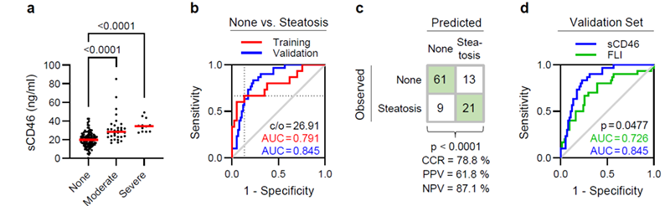
Soluble CD46 as a marker of hepatic steatosis in prospective living liver donors
Results
Conclusions
sCD46 is a reliable diagnostic marker of hepatic steatosis, which can be conveniently and non-invasively measured in plasma samples
This work raises the possibility of using sCD46 as a biochemical screening tool for evaluating prospective living liver donors
Figure a: Prospective living liver transplant donors with moderate or severe steatosis had higher sCD46 levels than those without
Figure b After stratified random assignment of cases to a training (n=52) or validation (n=104) set, sCD46 performed well in classifying steatotis
Figure c: Training data were used to fix a cut-off for sCD46 of 26.91 ng/ml.
In the validation set, the correct classification rate (CCR) was 78.8 %, positive predictive value (PPV) was 61.8 % and negative predictive value (NPV) was 87.1 %
Figure d: sCD46 is superior to Fatty Liver Index (FLI) in classifying steatotic donors
Kupke P. et al., ESOT Congress 2025 (Abstract 1986)
Notes:
Abbreviations: MMP, Matrix metalloproteases; iNKT, iNKT cells, immature Natural killer cells; CT, Computed tomography; ROC, Receiver operating characteristic; CCR, correct classification rate; PPV, positive predictive value; NPV, Negative predictive value; FLI, Fatty Liver Index.
Reference Number: 1986
SOLUBLE CD46 AS A MARKER OF HEPATIC STEATOSIS IN PROSPECTIVE LIVING LIVER DONORS
Paul Kupke¹, Florian Bitterer¹, Akinbami Adenugba¹, Katja Evert¹, Gunther Glehr¹, Paloma Riquelme¹, Lena Scheibert¹, Giulia Preverin¹, Christina Böhm¹, Matthias Hornung¹, Hans J. Schlitt¹, Jürgen J. Wenzel¹, Edward K. Geissler¹, Niloufar Safinia², James A. Hutchinson¹, Jens M. Werner¹
¹University Hospital Regensburg, Regensburg, Germany, ²King's College London, London, United Kingdom
Background: We recently discovered that interleukin-4-secreting (IL-4+) iNKT cells are over represented in steatotic liver. This was attributed to stress-induction of matrix metalloproteases (MMP) in hepatocytes, which led to indiscriminate cleavage of immune receptors. Loss of cell-surface CD46 resulted in unrepressed differentiation of IL-4+ iNKT cells. Soluble CD46 (sCD46) levels accurately classified oncological patients undergoing liver resection according to histological steatosis grade. Here, we asked whether sCD46 levels predict steatosis in prospective living liver donors.
Methods: sCD46 was measured in stored plasma from 156 prospective living liver donors. Steatosis was assessed by upper abdominal ultrasonography using the ratio of echogenicity in liver and kidney. Clinical data were collected from hospital records. Waist circumference was measured from abdominal CT images. Significance tests and receiver operating characteristic (ROC) curve analyses were performed in R (4.3.3). ROC curves were compared with the DeLong test.
Results: Prospective living liver transplant donors with moderate or severe steatosis had higher sCD46 levels than those without (Figure A). After stratified random assignment of cases to a training (n=52) or validation (n=104) set, we found that sCD46 performed well in classifying steatotic donors (Figure B). Training data were used to fix a cut-off for sCD46 of 26.91 ng/ml. In the validation set, the correct classification rate (CCR) was 78.8 %, positive predictive value (PPV) was 61.8 % and negative predictive value (NPV) was 87.1 % (Figure C). We further demonstrated sCD46 was superior to Fatty Liver Index (FLI) in classifying steatotic donors (Figure D).
Conclusions: sCD46 is a reliable diagnostic marker of hepatic steatosis, which can be conveniently and non-invasively measured in plasma samples. Our work raises the possibility of using sCD46 as a biochemical screening tool for evaluating prospective living liver donors.

Slide 19
Circulating sphingosine, sphingosine-1-phosphate and long-term mortality in kidney transplant recipients
Background
Kidney transplant recipients (KTR) still face high mortality rates, often due to lethal infections
Sphingosine-1-phosphate (S1P), derived from sphingosine, plays a crucial role in inflammation regulation and cell survival
Elevated circulating S1P levels are linked to reduced severity of infections
Circulating very long-chain saturated fatty acids (VLSFA), which are positively associated with peanut intake and inversely associated with infectious disease mortality in KTR, might contribute to circulating S1P levels
This study aimed to explore associations between plasma sphingosine, S1P, VLSFA, and long-term mortality in KTR
Method
n=680 outpatient KTR with a functional graft of 1 year
Liquid chromatography–mass spectrometry (LC–MS)
Plasma sphingosine and S1P
Gas chromatography coupled with a flame ionization detector
VLSFA
Assessment of the association between sphingosine, S1P and potential determinants by univariate and multivariable linear regression analyses
Use of cox regression analyses to prospectively study the associations of sphingosine and S1P with all-cause and cause specific mortality
Vogelpohl F. A. et al., ESOT Congress 2025 (Abstract 2091)
Notes:
Abbreviations: KTR, Kidney transplant recipients; S1P, Sphingosine-1-phosphate; VLSFA, very long-chain saturated fatty acids; LC–MS, Liquid chromatography–mass spectrometry; HR, hazard ratio; CI, Confidence interval.
Reference Number: 2091
CIRCULATING SPHINGOSINE, SPHINGOSINE-1-PHOSPHATE AND LONG-TERM MORTALITY IN KIDNEY TRANSPLANT
Fabian A. Vogelpohl¹, António W. Gomes Neto¹, M. Rebecca Heiner-Fokkema², Hjlamar P. Permentier³, Stefan P. Berger¹, Ido Kema², Gerjan Navis¹, Stephan J.L. Bakker¹
¹University Medical Center Groningen, Department of Internal Medicine, Groningen, The Netherlands, ²University Medical Center Groningen, Department of Laboratory Medicine, Groningen, The Netherlands, ³University of Groningen, Department of Analytical Biochemistry and Interfaculty Mass Spectrometry Center, Groningen, The Netherlands
Background: Kidney transplant recipients (KTR) still face high mortality rates, often due to lethal infections. Sphingosine-1-phosphate (S1P), derived from sphingosine, plays a crucial role in inflammation regulation and cell survival. Elevated circulating S1P levels are linked to reduced severity of infections. Circulating very long-chain saturated fatty acids (VLSFA), which are positively associated with peanut intake and inversely associated with infectious disease mortality in KTR, might contribute to circulating S1P levels. This study aimed to explore associations between plasma sphingosine, S1P, VLSFA, and long-term mortality in KTR.
Methods: The study included 680 outpatient KTR with a functional graft of 1 year. Plasma sphingosine and S1P were measured with liquid chromatography–mass spectrometry. VLSFA were measured with gas chromatography coupled with a flame ionization detector. Univariate and multivariable linear regression analyses were used to assess the association between sphingosine, S1P and potential determinants. Cox regression analyses were used to prospectively study the associations of sphingosine and S1P with all-cause and cause specific mortality.
Results: VLSFA were among the top predictors of S1P (std. beta=0.13, p=0.001 in multivariable adjusted analyses). During a median (interquartile range) follow-up of 5.4 (4.8–6.1) years, 141 (21%) KTR died with 39 (28%) deaths due to severe infections. Circulating sphingosine was positively associated with infectious disease mortality, with a hazard ratio (HR) (95% confidence interval) per doubling of 1.63 (1.08–2.47), p=0.02, while S1P was inversely associated with all-cause and infectious disease mortality, with a HR per doubling of 0.54 (0.31–0.93), p=0.03 and 0.17 (0.06–0.48), p<0.001, respectively, all independent of adjustment for potential confounders. S1P mediated 12% (p<0.01) of the association
between VLSFA and infectious disease mortality.
Conclusions: Circulating sphingosine was positively associated with infectious disease mortality. S1P was positively associated with VLSFA and inversely associated with all-cause and infectious disease mortality. Further studies are needed to assess the effect of VLSFA-containing foods on circulating S1P and on the risk of (fatal) infections in KTR.

Slide 20
Circulating sphingosine, sphingosine-1-phosphate and long-term mortality in kidney transplant recipients
Results
VLSFA among the top predictors of S1P (std. beta=0.13, p=0.001 in multivariable adjusted analyses)
During a median (interquartile range) follow-up of 5.4 (4.8–6.1) years:
Positive association between circulating sphingosine with infectious disease mortality, HR per doubling of 1.63 95% CI (1.08–2.47), p=0.02
S1P inversely associated with all-cause and infectious disease mortality, with a HR per doubling of 0.54 (0.31–0.93), p=0.03 and 0.17 (0.06–0.48) p<0.001, respectively, all independent of adjustment for potential confounders
S1P mediated 12% (p<0.01) of the association between VLSFA and infectious disease mortality
Conclusions
Circulating sphingosine was positively associated with infectious disease mortality
S1P was positively associated with VLSFA and inversely associated with all-cause and infectious disease mortality
Further studies are needed to assess the effect of VLSFA-containing foods on circulating S1P and on the risk of (fatal) infections in KTR
n=141
KTR died
n=102
other causes
21%
72%
n=539
survived
79%
n=39 deaths
due to
severe infections
28%
Vogelpohl F. A. et al., ESOT Congress 2025 (Abstract 2091)
Notes:
Abbreviations: KTR, Kidney transplant recipients; S1P, Sphingosine-1-phosphate; VLSFA, very long-chain saturated fatty acids; LC–MS, Liquid chromatography–mass spectrometry; HR, hazard ratio; CI, Confidence interval.
Reference Number: 2091
CIRCULATING SPHINGOSINE, SPHINGOSINE-1-PHOSPHATE AND LONG-TERM MORTALITY IN KIDNEY TRANSPLANT
Fabian A. Vogelpohl¹, António W. Gomes Neto¹, M. Rebecca Heiner-Fokkema², Hjlamar P. Permentier³, Stefan P. Berger¹, Ido Kema², Gerjan Navis¹, Stephan J.L. Bakker¹
¹University Medical Center Groningen, Department of Internal Medicine, Groningen, The Netherlands, ²University Medical Center Groningen, Department of Laboratory Medicine, Groningen, The Netherlands, ³University of Groningen, Department of Analytical Biochemistry and Interfaculty Mass Spectrometry Center, Groningen, The Netherlands
Background: Kidney transplant recipients (KTR) still face high mortality rates, often due to lethal infections. Sphingosine-1-phosphate (S1P), derived from sphingosine, plays a crucial role in inflammation regulation and cell survival. Elevated circulating S1P levels are linked to reduced severity of infections. Circulating very long-chain saturated fatty acids (VLSFA), which are positively associated with peanut intake and inversely associated with infectious disease mortality in KTR, might contribute to circulating S1P levels. This study aimed to explore associations between plasma sphingosine, S1P, VLSFA, and long-term mortality in KTR.
Methods: The study included 680 outpatient KTR with a functional graft of 1 year. Plasma sphingosine and S1P were measured with liquid chromatography–mass spectrometry. VLSFA were measured with gas chromatography coupled with a flame ionization detector. Univariate and multivariable linear regression analyses were used to assess the association between sphingosine, S1P and potential determinants. Cox regression analyses were used to prospectively study the associations of sphingosine and S1P with all-cause and cause specific mortality.
Results: VLSFA were among the top predictors of S1P (std. beta=0.13, p=0.001 in multivariable adjusted analyses). During a median (interquartile range) follow-up of 5.4 (4.8–6.1) years, 141 (21%) KTR died with 39 (28%) deaths due to severe infections. Circulating sphingosine was positively associated with infectious disease mortality, with a hazard ratio (HR) (95% confidence interval) per doubling of 1.63 (1.08–2.47), p=0.02, while S1P was inversely associated with all-cause and infectious disease mortality, with a HR per doubling of 0.54 (0.31–0.93), p=0.03 and 0.17 (0.06–0.48), p<0.001, respectively, all independent of adjustment for potential confounders. S1P mediated 12% (p<0.01) of the association
between VLSFA and infectious disease mortality.
Conclusions: Circulating sphingosine was positively associated with infectious disease mortality. S1P was positively associated with VLSFA and inversely associated with all-cause and infectious disease mortality. Further studies are needed to assess the effect of VLSFA-containing foods on circulating S1P and on the risk of (fatal) infections in KTR.

Slide 21
The pro-inflammatory role of EVs in chronic lung rejection: NF-kappa-B signaling as a possible target
Background
Methods
Chronic lung allograft rejection (CLAD) is the leading cause of morbidity and mortality following lung transplantation (LT)
Although much progress has been made, little is known about the pathogenic mechanisms underlying chronic rejection
This study explores CLAD in the lung microenvironment by characterizing and profiling LT patients’ extracellular vesicles (EVs) from bronchoalveolar lavage (BAL)
Extracellular vesicles from the BALs extraction
CLAD (n=10)
patients
Non-rejecting (CTR, n=10)
patients
EVs characterization for specific markers (CD63, TSG101)
Phenotyping using Nanoparticle Tracking Analyses (NTA) and the Leprechaun platform
EVs were co-cultured with a human bronchial epithelium cell line HBEpC cells for 48/72 h, followed by transcriptomic (nCounter Nanostring) and protein expression profiling
Franzi S. et al., ESOT Congress 2025 (Abstract 971)
Notes:
Abbreviations: CLAD, Chronic lung allograft rejection; LT, lung transplantation; EVs, Extracellular vesicles; BAL, bronchoalveolar lavage; NTA, Nanoparticle Tracking Analyses.
Reference Number: 971
THE PRO-INFLAMMATORY ROLE OF EVS IN CHRONIC LUNG REJECTION: NFKB SIGNALLING AS A POSSIBLE TARGET.
Sara Franzi¹, Alessandra Maria Storaci², Maria Rosaria De Filippo³, Maria Molisso³, Nadia Mansour³, Cristina Banfi⁴, Gianluca Lopez³, Giulia Garulli³, Letizia Corinna Morlacchi⁵, Valeria Rossetti⁶, Francesco Blasi⁷, Mario Nosotti⁸, Stefano Ferrero⁹, Alessandro Palleschi¹⁰, Valentina Vaira¹¹
¹Fondazione Irccs Ca' Granda - Ospedale Maggiore Policlinico, Milan, Italy; Department of Cardio-Thoraco-Vascular Diseases, ²University of Milan, Milan, Italy; Department of Pathophysiology and Transplantation, ³Fondazione Irccs Ca' Granda - Ospedale Maggiore Policlinico, Milan, Italy, ⁴Centro Cardiologico Monzino Irccs, 20138, Milan, Italy, ⁵Fondazione Irccs Ca’ Granda – Ospedale Maggiore Policlinico di Milano; Respiratory Unit and Cystic Fibrosis Center; Department of Pathophysiology and Transplantation, Università Degli Studi di Milano, ⁶Fondazione Irccs Ca'granda - Ospedale Maggiore Policlinico; Internal Medicine Department, Respiratory Unit and Cystic Fibrosis Adult Centre, ⁷Fondazione Irccs Ca’ Granda Ospedale Maggiore Policlinico di Milano, Università Degli Studi di Milano, ⁸Fondazione Irccs Ca' Granda Ospedale Maggiore Policlinico; Dipartimento di Fisiopatologia Medico-Chirurgica e Dei Trapianti, ⁹Università Degli Studi di Milano, ¹⁰University of Milan; Fondazione Irccs Cà Granda Ospedale Maggiore Policlinico di Milano; Thoracic Surgery and Lung Transplant Unit, ¹¹University of Milan, Department of Pathophysiology and Transplantation; Department of Pathophysiology and Transplantation
Background: Chronic lung allograft rejection (CLAD) is the leading cause of morbidity and mortality following lung transplantation (LT). Although much progress has been made, little is known about the pathogenic mechanisms underlying chronic rejection. We explored CLAD in the lung microenvironment by characterising and profiling LT patients’ extracellular vesicles (EVs) from bronchoalveolar lavage (BAL).
Methods: We extracted EVs from the BALs of CLAD (n=10) and non-rejecting (CTR, n=10) patients. We characterised EVs for specific markers (CD63, TSG101) and phenotyped them using Nanoparticle Tracking Analyses (NTA) and the Leprechaun platform. By co-culturing the EVs with a human bronchial epithelium cell line (HBEpC) for 48/72h, we profiled them for transcriptome by nCounter Nanostring and protein expression.
Results: The LT patients were stratified into stable and severe based on lung function after CLAD. The immunophenotypic characterisation confirmed the leucocytic origin of EVs, given the positivity for the CD45 marker. The HBEpC co-cultured with CLAD-EVs showed transcriptional up-regulation of REL and CHUCK (both involved in the NF-kB signalling) and the downregulation of CXCL8, a neutrophil-attracting chemokine. Proteomic analysis showed the up-regulation of CCL25, chemotactic for macrophages and dendritic cells, and DNER. The pathways analysis revealed the up-regulation of TRAF6-mediated transcription factor NF-kB pathway and the MAPK mediated by MAP3K8.
Conclusions: Our results suggest the involvement of the NF-kB pathway as a possible immunological scenario associated with severe CLAD, with the activation of chemotaxis and the recruitment of macrophages and dendritic cells. The mediator TRAF6 also indicates a possible canonical pathway of NF-kB signalling and the involvement of Toll-like receptors that are even expressed by macrophages. CCL25 and NF-kB might be therapeutic targets to limit chronic graft rejection.

Slide 22
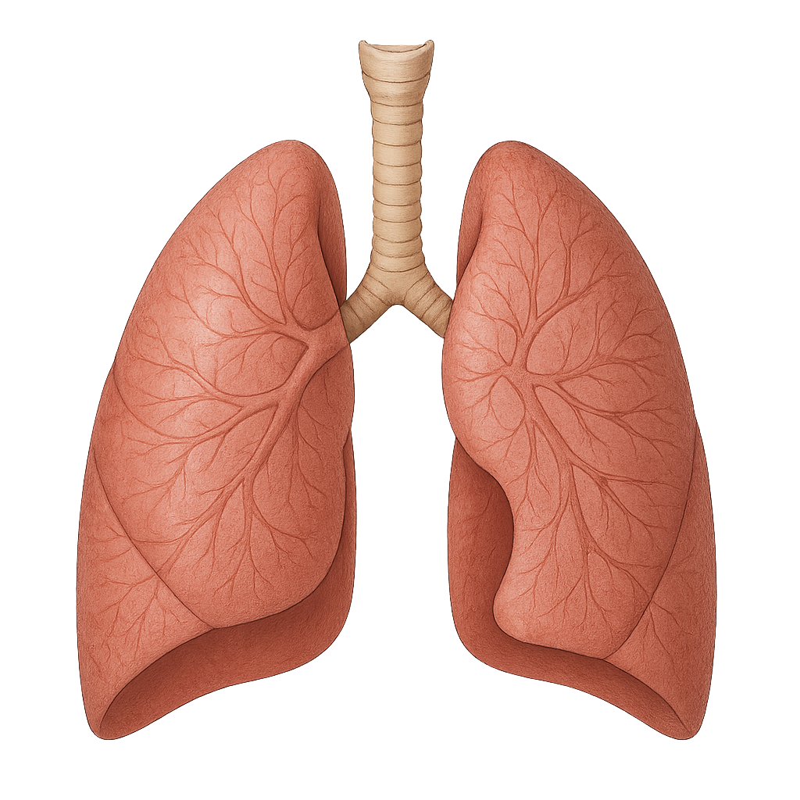
The pro-inflammatory role of EVs in chronic lung rejection: NF-kappa-B signaling as a possible target
Results
Conclusions
These results suggest the involvement of the NF-kB pathway as a possible immunological scenario associated with severe CLAD, with the activation of chemotaxis and the recruitment of macrophages and dendritic cells
The mediator TRAF6 also indicates a possible canonical pathway of NF-kB signaling and the involvement of Toll-like receptors that are even expressed by macrophages
CCL25 and NF-kB might be therapeutic targets to limit chronic graft rejection
LT patients stratified into stable and severe based on lung function after CLAD
The immunophenotypic characterization confirmed the leucocytic origin of EVs
CD45 marker +
HBEpC co-cultured with CLAD-Evs
Transcriptional analysis:
↑ ↑ REL and CHUCK (NF-kappa-B signaling)
and ↓ ↓ CXCL8, a neutrophil-attracting chemokine
Proteomic analysis:
↑ ↑ CCL25, chemotactic for macrophages and dendritic cells, and DNER.
Pathways analysis:
↑ ↑ TRAF6-mediated transcription factor NF-kB pathway and the MAPK signaling mediated by MAP3K8
Franzi S. et al., ESOT Congress 2025 (Abstract 971)
Notes:
Abbreviations: CLAD, Chronic lung allograft rejection; LT, lung transplantation; EVs, Extracellular vesicles; BAL, bronchoalveolar lavage; NTA, Nanoparticle Tracking Analyses.
Reference Number: 971
THE PRO-INFLAMMATORY ROLE OF EVS IN CHRONIC LUNG REJECTION: NFKB SIGNALLING AS A POSSIBLE TARGET.
Sara Franzi¹, Alessandra Maria Storaci², Maria Rosaria De Filippo³, Maria Molisso³, Nadia Mansour³, Cristina Banfi⁴, Gianluca Lopez³, Giulia Garulli³, Letizia Corinna Morlacchi⁵, Valeria Rossetti⁶, Francesco Blasi⁷, Mario Nosotti⁸, Stefano Ferrero⁹, Alessandro Palleschi¹⁰, Valentina Vaira¹¹
¹Fondazione Irccs Ca' Granda - Ospedale Maggiore Policlinico, Milan, Italy; Department of Cardio-Thoraco-Vascular Diseases, ²University of Milan, Milan, Italy; Department of Pathophysiology and Transplantation, ³Fondazione Irccs Ca' Granda - Ospedale Maggiore Policlinico, Milan, Italy, ⁴Centro Cardiologico Monzino Irccs, 20138, Milan, Italy, ⁵Fondazione Irccs Ca’ Granda – Ospedale Maggiore Policlinico di Milano; Respiratory Unit and Cystic Fibrosis Center; Department of Pathophysiology and Transplantation, Università Degli Studi di Milano, ⁶Fondazione Irccs Ca'granda - Ospedale Maggiore Policlinico; Internal Medicine Department, Respiratory Unit and Cystic Fibrosis Adult Centre, ⁷Fondazione Irccs Ca’ Granda Ospedale Maggiore Policlinico di Milano, Università Degli Studi di Milano, ⁸Fondazione Irccs Ca' Granda Ospedale Maggiore Policlinico; Dipartimento di Fisiopatologia Medico-Chirurgica e Dei Trapianti, ⁹Università Degli Studi di Milano, ¹⁰University of Milan; Fondazione Irccs Cà Granda Ospedale Maggiore Policlinico di Milano; Thoracic Surgery and Lung Transplant Unit, ¹¹University of Milan, Department of Pathophysiology and Transplantation; Department of Pathophysiology and Transplantation
Background: Chronic lung allograft rejection (CLAD) is the leading cause of morbidity and mortality following lung transplantation (LT). Although much progress has been made, little is known about the pathogenic mechanisms underlying chronic rejection. We explored CLAD in the lung microenvironment by characterising and profiling LT patients’ extracellular vesicles (EVs) from bronchoalveolar lavage (BAL).
Methods: We extracted EVs from the BALs of CLAD (n=10) and non-rejecting (CTR, n=10) patients. We characterised EVs for specific markers (CD63, TSG101) and phenotyped them using Nanoparticle Tracking Analyses (NTA) and the Leprechaun platform. By co-culturing the EVs with a human bronchial epithelium cell line (HBEpC) for 48/72h, we profiled them for transcriptome by nCounter Nanostring and protein expression.
Results: The LT patients were stratified into stable and severe based on lung function after CLAD. The immunophenotypic characterisation confirmed the leucocytic origin of EVs, given the positivity for the CD45 marker. The HBEpC co-cultured with CLAD-EVs showed transcriptional up-regulation of REL and CHUCK (both involved in the NF-kB signalling) and the downregulation of CXCL8, a neutrophil-attracting chemokine. Proteomic analysis showed the up-regulation of CCL25, chemotactic for macrophages and dendritic cells, and DNER. The pathways analysis revealed the up-regulation of TRAF6-mediated transcription factor NF-kB pathway and the MAPK mediated by MAP3K8.
Conclusions: Our results suggest the involvement of the NF-kB pathway as a possible immunological scenario associated with severe CLAD, with the activation of chemotaxis and the recruitment of macrophages and dendritic cells. The mediator TRAF6 also indicates a possible canonical pathway of NF-kB signalling and the involvement of Toll-like receptors that are even expressed by macrophages. CCL25 and NF-kB might be therapeutic targets to limit chronic graft rejection.

Slide 23

Optimal timing of anti-CD3F(ab')2 treatment in sensitized model of heart transplantation
Background
Previous studies have demonstrated a unique effect of the non-Fc binding anti-CD3 antibody
(aCD3F(ab')2), where delayed timing of treatment effectively promotes transplant tolerance in a mouse model
With the recent clinical use of humanized Fc-engineered CD3 antibodies, determining the optimal treatment strategy, including appropriate timing of use, has become crucial for organ transplantation
Method
Sensitized with BALB/c tail skin grafts
BALB/c heart
transplantation 8-12 weeks later
C57BL/6 mice
Three aCD3F(ab')2 treatment protocols (50μg daily for 5 consecutive days) as follows:
Early (day-1 to day 3 post-transplantation)
Delayed (day 3 to day 7)
Revised delayed (day 1 to day 5)
Flow cytometry:
To assess Intragraft lymphocytes
Ota T. et al., ESOT Congress 2025 (Abstract 1091)
Notes:
Abbreviations: MST, Median Survival Time.
Reference Number: 1091
OPTIMAL TIMING OF ANTI-CD3F(AB')2 TREATMENT IN SENSITIZED MODEL OF HEART TRANSPLANTATION
Takuji Ota¹, Ryoichi Goto¹, Takuya Harada¹, Agustina Forgioni¹, Norio Kawamura¹, Masaaki Watanabe², Tsuyoshi Shimamura³, Akinobu Taketomi^{1, 2}
¹Hokkaido University, Gastroenterological Surgery I, Sapporo, Japan, ²Hokkaido University, Transplant of Surgery, Sapporo, Japan, ³Hokkaido University Hospital, Division of Organ Transplantation, Sapporo, Japan
Background: Previous studies have demonstrated a unique effect of the non-Fc binding anti-CD3 antibody (aCD3F(ab')2), where delayed timing of treatment effectively promotes transplant tolerance in a mouse model. With the recent clinical use of humanized Fc-engineered CD3 antibodies, determining the optimal treatment strategy, including appropriate timing of use, has become crucial for organ transplantation.
Methods: C57BL/6 mice were sensitized with BALB/c tail skin grafts, followed by BALB/c heart transplantation 8-12 weeks later. Three aCD3F(ab')2 treatment protocols (50μg daily for 5 consecutive days) were as follows: early (day-1 to day 3 post-transplantation), delayed (day 3 to day 7), revised delayed (day 1 to day 5). Intragraft lymphocytes were assessed by flow cytometry.
Results: The early treatment protocol of aCD3F(ab')2 significantly prolonged graft survival in the BALB/c to C57BL/6 heart transplant model (n=5, MST =38 days). Notably, the delayed protocol promoted long-term graft acceptance (MST >100 days). A significantly higher percentage of ly108+ TCF1high PD-1+ CD8+ T cells was observed in the graft treated with the delayed protocol. However, in a sensitized situation, the delayed protocol failed to prevent rejection (MST=5 days), with an increase in intragraft granzyme B+ CD8+ T cells by day 3. The revised delayed protocol, starting from day 1 post-transplantation, significantly prolonged graft survival (MST=18 days, p=0.0018 vs. MST=10 days in early protocol) even under sensitized situation (Figure. A). Additionally, significantly higher percentages of Foxp3+ CD25+ CD4+ T cell and ly108+ TCF1high PD-1+ CD8+ T cell were observed in the graft treated with the revised delayed protocol (Figure. B).
Conclusions: Optimal timing of aCD3F(ab')2 treatment is critical in sensitized situation. Ly108+ TCF1high PD 1+ CD8+ T cells play a key role in maintaining immune balance within the graft.

Slide 24
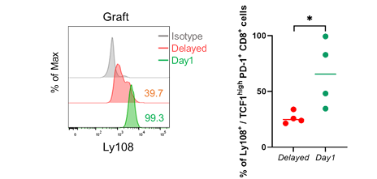
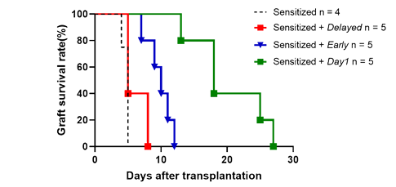
Optimal timing of anti-CD3F(ab')2 treatment in sensitized model of heart transplantation
Results
The early treatment protocol of aCD3F(ab')2 significantly prolonged graft survival in the BALB/c to C57BL/6 heart transplant model (n=5, MST =38 days)
The delayed protocol promoted long-term graft acceptance (MST >100 days)
A significantly higher percentage of ly108+ TCF1high PD-1+ CD8+ T cells was observed in the graft treated with the delayed protocol
In a sensitized situation, the delayed protocol failed to prevent rejection (MST=5 days), with an increase in intragraft granzyme B+ CD8+ T cells by day 3
The revised delayed protocol, starting from day 1 post-transplantation, significantly prolonged graft survival (MST=18 days, p=0.0018 vs. MST=10 days in early protocol) even under sensitized situation (Fig. A)
Additionally, significantly higher percentages of Foxp3+ CD25+ CD4+ T cell and ly108+ TCF1high PD-1+ CD8+ T cell were observed in the graft treated with the revised delayed protocol (Fig. B)
4 independent experiments
Figure. B : The percentage of Ly108⁺ TCF-1^{high} PD-1⁺ CD8⁺ T cells in the sensitized group treated with aCD3F(ab’)2
Conclusions
Optimal timing of aCD3F(ab')2 treatment is critical in sensitized situation. Ly108+ TCF1high PD 1+ CD8+ T cells play a key role in maintaining immune balance within the graft
5 independent experiments
Figure. A : Heart allograft survival rates in skin-sensitized recipient mice treated with anti-CD3F(ab')2
Ota T. et al., ESOT Congress 2025 (Abstract 1091)
Notes:
Abbreviations: MST, Median Survival Time.
Reference Number: 1091
OPTIMAL TIMING OF ANTI-CD3F(AB')2 TREATMENT IN SENSITIZED MODEL OF HEART TRANSPLANTATION
Takuji Ota¹, Ryoichi Goto¹, Takuya Harada¹, Agustina Forgioni¹, Norio Kawamura¹, Masaaki Watanabe², Tsuyoshi Shimamura³, Akinobu Taketomi^{1, 2}
¹Hokkaido University, Gastroenterological Surgery I, Sapporo, Japan, ²Hokkaido University, Transplant of Surgery, Sapporo, Japan, ³Hokkaido University Hospital, Division of Organ Transplantation, Sapporo, Japan
Background: Previous studies have demonstrated a unique effect of the non-Fc binding anti-CD3 antibody (aCD3F(ab')2), where delayed timing of treatment effectively promotes transplant tolerance in a mouse model. With the recent clinical use of humanized Fc-engineered CD3 antibodies, determining the optimal treatment strategy, including appropriate timing of use, has become crucial for organ transplantation.
Methods: C57BL/6 mice were sensitized with BALB/c tail skin grafts, followed by BALB/c heart transplantation 8-12 weeks later. Three aCD3F(ab')2 treatment protocols (50μg daily for 5 consecutive days) were as follows: early (day-1 to day 3 post-transplantation), delayed (day 3 to day 7), revised delayed (day 1 to day 5). Intragraft lymphocytes were assessed by flow cytometry.
Results: The early treatment protocol of aCD3F(ab')2 significantly prolonged graft survival in the BALB/c to C57BL/6 heart transplant model (n=5, MST =38 days). Notably, the delayed protocol promoted long-term graft acceptance (MST >100 days). A significantly higher percentage of ly108+ TCF1high PD-1+ CD8+ T cells was observed in the graft treated with the delayed protocol. However, in a sensitized situation, the delayed protocol failed to prevent rejection (MST=5 days), with an increase in intragraft granzyme B+ CD8+ T cells by day 3. The revised delayed protocol, starting from day 1 post-transplantation, significantly prolonged graft survival (MST=18 days, p=0.0018 vs. MST=10 days in early protocol) even under sensitized situation (Figure. A). Additionally, significantly higher percentages of Foxp3+ CD25+ CD4+ T cell and ly108+ TCF1high PD-1+ CD8+ T cell were observed in the graft treated with the revised delayed protocol (Figure. B).
Conclusions: Optimal timing of aCD3F(ab')2 treatment is critical in sensitized situation. Ly108+ TCF1high PD 1+ CD8+ T cells play a key role in maintaining immune balance within the graft.

Slide 25

Recovery of rat hearts after cold storage with acid sensing ion channel inhibitor Hi1a varies by sex
Background
Most heart transplants rely on cardioplegia and cold static storage (CSS) for preservation, however long ischaemic times result in poor outcomes
Supplementation of cardioplegia improves post-transplant organ function and Hi1a, an acid sensing ion channel (ASIC) 1a inhibitor derived from funnel web spider venom, reduces ischaemia-reperfusion injury
Women are underrepresented in cardiovascular research, and oestrogen has been shown to decrease ASIC1a expression in other tissue types
This study investigates if the cardiac functional recovery following CSS with cardioplegia supplemented with Hi1a differed based on sex
Methods
- Hearts isolated from male (M) and female (F) Wistar rats
(300-570g, n = 6-10/group) perfused ex-vivo with Krebs-Henseleit buffer at 37°C
- Baseline haemodynamic measurements of aortic flow (AF)
Hearts arrested with Celsior (Cel) cardioplegia either alone or supplemented with 10nM Hi1a
Following 6-hour CSS (4°C), hearts were re-perfused ex-vivo.
Following 6-hour CSS (4°C), hearts were re-perfused ex-vivo
Haemodynamic measurements were obtained, and recovery expressed as percentage of pre-storage baseline (mean ± SEM)
Dutta S. et al., ESOT Congress 2025 (Abstract 812)
Notes:
Abbreviations: CSS, cold static storage; ASIC, acid sensing ion channel; AF, Aortic flow; Cel; Celsior.
Reference Number: 812
RECOVERY OF RAT HEARTS AFTER COLD STORAGE WITH ACID SENSING ION CHANNEL INHIBITOR HI1A VARIES BY SEX
Sanjay Dutta^{1, 2, 3}, Jeanette Villanueva^{1, 2}, Ling Gao¹, Aoife Doyle¹, Nathan Palpant^{4, 5}, Glenn King^{4, 5}, Peter MacDonald^{1, 2, 3, 4}
¹Victor Chang Cardiac Research Institute, Cardiac Transplantation Laboratory, Sydney, Australia, ²The University of New South Wales, School of Clinical Medicine, Faculty of Medicine and Health, Sydney, Australia, ³St Vincent's Hospital Sydney, Department of Heart and Lung Transplantation, Darlinghurst, Australia, ⁴Infensa Bioscience Pty Ltd, Brisbane, Australia, 5The University of Queensland, Institute for Molecular Bioscience, Brisbane, Australia
Background: Most heart transplants rely on cardioplegia and cold static storage (CSS) for preservation, however long ischaemic times result in poor outcomes. Supplementation of cardioplegia improves post-transplant organ function and Hi1a, an acid sensing ion channel (ASIC) 1a inhibitor derived from funnel web spider venom, reduces ischaemia-reperfusion injury. Women are underrepresented in cardiovascular research, and oestrogen has been shown to decrease ASIC1a expression in other tissue types. We investigated if the cardiac functional recovery following CSS with cardioplegia supplemented with Hi1a differed based on sex.
Methods: Hearts were isolated from male (M) and female (F) Wistar rats (300-570g, n = 6-10/group) perfused ex-vivo with Krebs-Henseleit buffer at 37°C, and baseline haemodynamic measurements of aortic flow (AF) were obtained. Hearts were arrested with Celsior (Cel) cardioplegia either alone, or supplemented with 10nm Hi1a. Following 6-hour CSS (4°C), hearts were re-perfused ex-vivo. Haemodynamic measurements were obtained, and recovery expressed as percentage of pre-storage baseline (mean ± SEM).
Results: Compared to unsupplemented Celsior (AF 14± 5.0%), male hearts stored in Celsior supplemented with 10nM Hi1a had significantly improved recovery (AF 55± 10%, P = 0.026). Female rat hearts stored in unsupplemented Celsior (AF 24±5.8%) had improved recovery compared to male hearts, however supplementation with 10nM Hi1a did not significantly improve recovery (AF 31±9.8%, P = 0.89). Two-way ANOVA revealed significant interaction between supplementation with Hi1a and sex (P = 0.047), with supplementation resulting in improved recovery overall (P = 0.007) with no significant impact of sex (P = 0.412).
Conclusions: Supplementation of Celsior with Hi1a improves cardiac recovery following 6 hours CSS in male but not female rats, showing that its benefit as a preconditioning agent is influenced by sex. Further work is needed to examine reasons for differing efficacy between sexes. ASIC1a inhibitors may improve acceptable ischaemic times for organ transplantation however sex of donors may need to be considered.

Slide 26
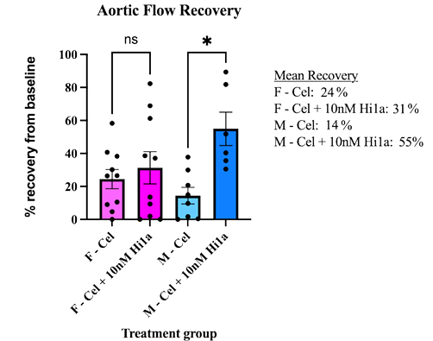
Recovery of rat hearts after cold storage with acid sensing ion channel inhibitor Hi1a varies by sex
Results
Compared to unsupplemented Celsior (AF 14± 5.0%), male hearts stored in Celsior supplemented with 10nM Hi1a had significantly improved recovery (AF 55± 10%, P = 0.026)
Female rat hearts stored in unsupplemented Celsior (AF 24 ±5.8%) had improved recovery compared to male hearts, however supplementation with 10nM Hi1a did not significantly improve recovery (AF 31 ±9.8%, P = 0.89)
Two-way ANOVA revealed significant interaction between supplementation with Hi1a and sex (P=0.047), with supplementation resulting in improved recovery overall (P=0.007) with no significant impact of sex (P=0.412)
Conclusions
Supplementation of Celsior with Hi1a improves cardiac recovery following 6 hours CSS in male but not female rats, showing that its benefit as a preconditioning agent is influenced by sex
Further work is needed to examine reasons for differing efficacy between sexes
ASIC1a inhibitors may improve acceptable ischaemic times for organ transplantation however sex of donors may need to be considered
Treatment group
Figure 1: Mean myocardial functional recovery following 6hrs CSS, expressed as a percentage of baseline aortic flow. Error bar represents standard error of the mean
Dutta S. et al., ESOT Congress 2025 (Abstract 812)
Notes:
Abbreviations: CSS, cold static storage; ASIC, acid sensing ion channel; AF, Aortic flow; Cel; Celsior.
Reference Number: 812
RECOVERY OF RAT HEARTS AFTER COLD STORAGE WITH ACID SENSING ION CHANNEL INHIBITOR HI1A VARIES BY SEX
Sanjay Dutta^{1, 2, 3}, Jeanette Villanueva^{1, 2}, Ling Gao¹, Aoife Doyle¹, Nathan Palpant^{4, 5}, Glenn King^{4, 5}, Peter MacDonald^{1, 2, 3, 4}
¹Victor Chang Cardiac Research Institute, Cardiac Transplantation Laboratory, Sydney, Australia, ²The University of New South Wales, School of Clinical Medicine, Faculty of Medicine and Health, Sydney, Australia, ³St Vincent's Hospital Sydney, Department of Heart and Lung Transplantation, Darlinghurst, Australia, ⁴Infensa Bioscience Pty Ltd, Brisbane, Australia, 5The University of Queensland, Institute for Molecular Bioscience, Brisbane, Australia
Background: Most heart transplants rely on cardioplegia and cold static storage (CSS) for preservation, however long ischaemic times result in poor outcomes. Supplementation of cardioplegia improves post-transplant organ function and Hi1a, an acid sensing ion channel (ASIC) 1a inhibitor derived from funnel web spider venom, reduces ischaemia-reperfusion injury. Women are underrepresented in cardiovascular research, and oestrogen has been shown to decrease ASIC1a expression in other tissue types. We investigated if the cardiac functional recovery following CSS with cardioplegia supplemented with Hi1a differed based on sex.
Methods: Hearts were isolated from male (M) and female (F) Wistar rats (300-570g, n = 6-10/group) perfused ex-vivo with Krebs-Henseleit buffer at 37°C, and baseline haemodynamic measurements of aortic flow (AF) were obtained. Hearts were arrested with Celsior (Cel) cardioplegia either alone, or supplemented with 10nM Hi1a. Following 6-hour CSS (4°C), hearts were re-perfused ex-vivo. Haemodynamic measurements were obtained, and recovery expressed as percentage of pre-storage baseline (mean ± SEM).
Results: Compared to unsupplemented Celsior (AF 14± 5.0%), male hearts stored in Celsior supplemented with 10nM Hi1a had significantly improved recovery (AF 55± 10%, P = 0.026). Female rat hearts stored in unsupplemented Celsior (AF 24±5.8%) had improved recovery compared to male hearts, however supplementation with 10nM Hi1a did not significantly improve recovery (AF 31±9.8%, P = 0.89). Two-way ANOVA revealed significant interaction between supplementation with Hi1a and sex (P = 0.047), with supplementation resulting in improved recovery overall (P = 0.007) with no significant impact of sex (P = 0.412).
Conclusions: Supplementation of Celsior with Hi1a improves cardiac recovery following 6 hours CSS in male but not female rats, showing that its benefit as a preconditioning agent is influenced by sex. Further work is needed to examine reasons for differing efficacy between sexes. ASIC1a inhibitors may improve acceptable ischaemic times for organ transplantation however sex of donors may need to be considered.

Slide 27
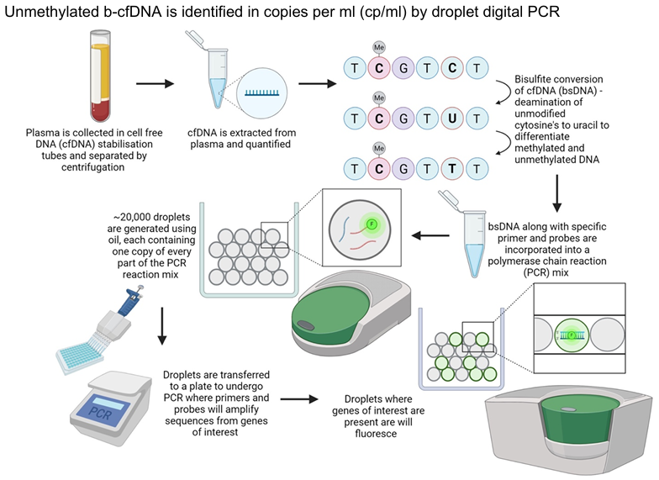
Islet beta cell cell-free DNA and trypsinogen for diagnosis of rejection in pancreas transplantation; The EMPAR study
Background
Pancreas transplant rejection diagnosis remains difficult
In SPK often relies on the diagnosis of kidney rejection or the rise of amylase/lipase to prompt a biopsy
20-30% of cases show discordance between the kidney and pancreas rejection whilst amylase exhibits a transient rise that is not sensitive enough
Methods
EMPAR is the first prospective study examining the role of a combination of novel biomarkers for pancreas rejection including islet beta cell specific cell free DNA (b-cfDNA), trypsinogen, and micro RNAs
n=10 patients with new SPK transplant and 9 admitted with pancreas dysfunction or any infection
New transplants were sampled pretransplant, post perfusion, at discharge, and monthly thereafter whereas admitted patients on admission, treatment (if they had a biopsy confirmed rejection) and monthly after discharge
Results in admitted patients were associated with the presence of biopsy proven rejection or an alternative diagnosis
Tteralli N. et al., ESOT Congress 2025 (Abstract 2072)
Notes:
Abbreviations: SPK, Simultaneous Pancreas-Kidney; b-cfDNA, beta cell specific cell-free DNA.
Reference Number: 2072
ISLET BETA CELL CELL-FREE DNA AND TRYPSINOGEN FOR DIAGNOSIS OF REJECTION IN PANCREAS TRANSPLANTATION; THE EMPAR STUDY
Nikos Tteralli^{1,2}, Georgina Mortimer³, Laszlo Szabo¹, Kathleen Gillespie³, Chantal Colmont⁴, Ioannis Karniadakis¹, Aida Martinez Sanchez⁵, Colin Dayan⁴, Argiris Asderakis^{1,2}
¹University Hospital of Wales, Cardiff Transplant Unit, Cardiff, United Kingdom, ²Cardiff University, Infection and Immunity, Cardiff, United Kingdom, ³Bristol Medical School, Diabetes and Metabolism, Bristol, United Kingdom, ⁴Cardiff University, Diabetes and Metabolism, Cardiff, United Kingdom, ⁵Imperial College London, Section of Cell Biology and Functional Genomics, London, United Kingdom
Background: Pancreas transplant rejection diagnosis remains difficult. In SPK often relies on the diagnosis of kidney rejection or the rise of amylase/lipase to prompt a biopsy. 20-30% of cases show discordance between the kidney and pancreas rejection whilst amylase exhibits a transient rise that is not sensitive enough.
Methods: EMPAR is the first prospective study examining the role of a combination of novel biomarkers for pancreas rejection including islet beta cell specific cell free DNA (b-cfDNA), trypsinogen, and micro RNAs. 10 patients with new SPK transplant and 9 admitted with pancreas dysfunction or any infection have been recruited so far. New transplants were sampled pretransplant, post perfusion, at discharge, and monthly thereafter whereas admitted patients on admission, treatment (if they had a biopsy confirmed rejection) and monthly after discharge.
Results in admitted patients were associated with the presence of biopsy proven rejection or an alternative diagnosis Unmethylated b-cfDNA is identified in copies per ml (cp/ml) by droplet digital PCR Trypsinogen was measured with an adapted Delfia Neonatal IRT kit Results We present the preliminary results for b-cfDNA and trypsinogen in these patients. The baseline pre-perfusion median trypsinogen level was 109 ng/ml (66-223) and raised to 450 post-perfusion; at 3 months post-transplant was 41 (18-88). In the 7 patients with rejection trypsinogen was 122 (11-320) which was increased compared to 3 months post-transplant in stable patients but with some overlapping values. The baseline median pre-perfusion b-cfDNA was 79 cp/ml, and 223 cp/ml post-perfusion; at 2 months post-transplant was 115 cp/ml. In 7 patients with rejection b-cfDNA raised to median of 318 (172-1044) cp/ml on the admission pre-biopsy day and was 126 cp/ml following rejection treatment. This compared to 55 cp/ml in admitted patients without rejection and 115 cp/ml seen in patients 2 months post transplant. Given the small number of admitted non rejectors no formal statistical testing is presented.
Conclusions: EMPAR is the first human study investigating the role of beta cell specific cfDNA as a marker of acute pancreas rejection. Preliminary results show that it is a promising marker of rejection (both sensitive and specific). The role of trypsinogen requires further analysis.

Slide 28
Islet beta cell cell-free DNA and trypsinogen for diagnosis of rejection in pancreas transplantation; The EMPAR study
Results
The baseline pre-perfusion median trypsinogen level was 109 ng/ml (66-223) and raised to 450 post-perfusion; at 3 months post-transplant was 41 (18-88)
In the 7 patients with rejection trypsinogen was 122 (11-320) which was increased compared to 3 months post-transplant in stable patients but with some overlapping values
Given the small number of admitted non rejectors no formal statistical testing is presented
Preliminary results for trypsinogen and b-cfDNA in these patients:
Trypsinogen
Conclusions
EMPAR is the first human study investigating the role of beta cell specific cfDNA as a marker of acute pancreas rejection and challenges the notion the b cells reject late in the process of pancreas rejection
Preliminary results show that it is a promising marker of rejection (both sensitive and specific). The role of trypsinogen requires further analysis
B-cfDNA
The baseline median pre-perfusion b-cfDNA was 79 cp/ml, and 223 cp/ml post-perfusion; at 2 months post-transplant was 115 cp/ml
In 7 patients with rejection b-cfDNA raised to median of 318 (172-1044) cp/ml on the admission pre-biopsy day and was 126 cp/ml following rejection treatment
This compared to 55 cp/ml in admitted patients without rejection and 115 cp/ml seen in patients 2 months post transplant
Tteralli N. et al., ESOT Congress 2025 (Abstract 2072)
Notes:
Abbreviations: SPK, Simultaneous Pancreas-Kidney; b-cfDNA, beta cell specific cell-free DNA.
Reference Number: 2072
ISLET BETA CELL CELL-FREE DNA AND TRYPSINOGEN FOR DIAGNOSIS OF REJECTION IN PANCREAS TRANSPLANTATION; THE EMPAR STUDY
Nikos Tteralli^{1,2}, Georgina Mortimer³, Laszlo Szabo¹, Kathleen Gillespie³, Chantal Colmont⁴, Ioannis Karniadakis¹, Aida Martinez Sanchez⁵, Colin Dayan⁴, Argiris Asderakis^{1,2}
¹University Hospital of Wales, Cardiff Transplant Unit, Cardiff, United Kingdom, ²Cardiff University, Infection and Immunity, Cardiff, United Kingdom, ³Bristol Medical School, Diabetes and Metabolism, Bristol, United Kingdom, ⁴Cardiff University, Diabetes and Metabolism, Cardiff, United Kingdom, ⁵Imperial College London, Section of Cell Biology and Functional Genomics, London, United Kingdom
Background: Pancreas transplant rejection diagnosis remains difficult. In SPK often relies on the diagnosis of kidney rejection or the rise of amylase/lipase to prompt a biopsy. 20-30% of cases show discordance between the kidney and pancreas rejection whilst amylase exhibits a transient rise that is not sensitive enough.
Methods: EMPAR is the first prospective study examining the role of a combination of novel biomarkers for pancreas rejection including islet beta cell specific cell free DNA (b-cfDNA), trypsinogen, and micro RNAs. 10 patients with new SPK transplant and 9 admitted with pancreas dysfunction or any infection have been recruited so far. New transplants were sampled pretransplant, post perfusion, at discharge, and monthly thereafter whereas admitted patients on admission, treatment (if they had a biopsy confirmed rejection) and monthly after discharge.
Results in admitted patients were associated with the presence of biopsy proven rejection or an alternative diagnosis Unmethylated b-cfDNA is identified in copies per ml (cp/ml) by droplet digital PCR Trypsinogen was measured with an adapted Delfia Neonatal IRT kit Results We present the preliminary results for b-cfDNA and trypsinogen in these patients. The baseline pre-perfusion median trypsinogen level was 109 ng/ml (66-223) and raised to 450 post-perfusion; at 3 months post-transplant was 41 (18-88). In the 7 patients with rejection trypsinogen was 122 (11-320) which was increased compared to 3 months post-transplant in stable patients but with some overlapping values. The baseline median pre-perfusion b-cfDNA was 79 cp/ml, and 223 cp/ml post-perfusion; at 2 months post-transplant was 115 cp/ml. In 7 patients with rejection b-cfDNA raised to median of 318 (172-1044) cp/ml on the admission pre-biopsy day and was 126 cp/ml following rejection treatment. This compared to 55 cp/ml in admitted patients without rejection and 115 cp/ml seen in patients 2 months post transplant. Given the small number of admitted non rejectors no formal statistical testing is presented.
Conclusions: EMPAR is the first human study investigating the role of beta cell specific cfDNA as a marker of acute pancreas rejection. Preliminary results show that it is a promising marker of rejection (both sensitive and specific). The role of trypsinogen requires further analysis.

