Slide 1


Best of
ESOT Congress 2025
Kidney

Slide 2
Disclaimer
This slide deck is designed for personal educational purposes only and should not be utilised for making patient management decisions. It is important to verify all information provided before treating patients or applying any therapies mentioned in these materials.

Slide 3
Information
This slide deck showcases the latest data presented at the ESOT Congress 2025.
All abbreviations displayed in these slides, along with a complete copy of the
original abstract text, can be found in the slide notes.
3. Click on the symbol to return to the contents page.

Slide 4
Content
KIDNEY
1408.
MIF Modulation of Macrophage Polarization through IRF1 in Renal Allograft Rejection
2279.
Development and validation of a novel risk prediction model for kidney transplant outcomes in the European population
1566.
Association of donor-derived cell-free DNA with microvascular inflammation phenotypes in kidney allografts
1834.
HLA eplet matching as a prognostic biomarker of kidney transplant outcomes
2056.
Investigating inequalities in access to paediatric kidney transplantation
714.
One-year outcome of HMP(O2)-perfused kidneys after the implementation of a national machine perfusion service
1803.
Trends in factors affecting access to kidney transplantation and graft survival (Collaborative Transplant Study)
1095.
Rescuing donor kidneys for transplantation at a dedicated normothermic perfusion center
604.
Delivery of mRNA therapeutics during machine perfusion of donor kidneys
1588.
Is living kidney donation with expanded criteria safe for the donor? long-term follow-up from the Catalan registry
2251.
Evolution of transcriptomic signatures associated with donor´s diabetes in normoglycemic transplant recipients
1466.
Development of a magnetic resonance imaging protocol for ex-vivo assessment of deceased donor human kidneys

Slide 5
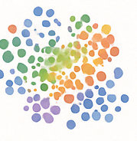
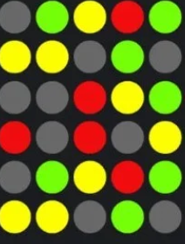

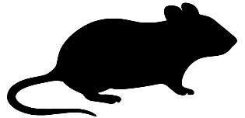
MIF Modulation of Macrophage Polarization through IRF1 in Renal Allograft Rejection
Background
Rejection is a major cause of kidney transplant failure
While research has primarily focused on lymphocytes, recent studies emphasize myeloid cells, particularly macrophages
Understanding the phenotypic diversity of infiltrating macrophages in different rejection types provides insights into the mechanisms of rejection
This study aims to investigate the roles of the cytokine MIF and the transcription factor IRF1 in macrophages during renal allograft rejection
Methods
Single-cell RNA sequencing was conducted to investigate macrophage phenotypes across different rejections
Integration of renal allograft biopsy microarrays to confirm the roles of MIF and IRF1 in macrophages
siRNA interference in THP-1 cells to assess the role of IRF1 in MIF-induced polarization
Use of mouse skin and heart transplant models to examine how MIF signaling blockade with ISO-1 alleviates rejection
Chen Y. et al., ESOT Congress 2025 (Abstract 1408)
Notes:
Abbreviations: MIF, Macrophage Migration Inhibitory Factor; IRF1, Interferon Regulatory Factor 1; CXCR4, C-X-C chemokine receptor type 4.
Reference Number: 1408
MIF MODULATION OF MACROPHAGE POLARIZATION THROUGH IRF1 IN RENAL ALLOGRAFT REJECTION
Yanxu Chen¹, Longshan Liu¹, Changxi Wang¹
¹the first affiliated hospital of sun yat-sen university, Guangzhou
Background: Rejection is a major cause of kidney transplant failure. While research has primarily focused on lymphocytes, recent studies emphasize myeloid cells, particularly macrophages. Understanding the phenotypic diversity of infiltrating macrophages in different rejection types provides insights into the mechanisms of rejection.
Methods: Single-cell RNA sequencing was conducted to investigate macrophage phenotypes across different rejections. Renal allograft biopsy microarrays were integrated to confirm the roles of MIF and IRF1 in macrophages. siRNA interference in THP-1 cells assessed the role of IRF1 in MIF-induced polarization. Mouse skin and heart transplant models were utilized to examine how MIF signaling blockade with ISO-1 alleviates rejection. Results: Macrophages showed significant changes in quantity, functionality, and signal networks. SCENIC analysis revealed a notable upregulation of IRF1 expression in macrophages, accompanied by higher activity of the IRF1 regulon during rejection. Further clustering identified three macrophage subtypes. Pseudotime trajectory elucidating the transition from M2 to M1 states, concomitant with the progressive upregulation of IRF1. In renal allografts, macrophages received stronger MIF signals from the rejection microenvironment. In vitro experiments corroborated the requirement of IRF1 for MIF's ability to induce macrophage polarization towards the M1 phenotype, triggering a positive feedback response by elevating the expression of CXCR4, the MIF receptor. Comparative scRNA-seq and immunohistochemistry showed reduced MIF and IRF1+ macrophages after effective treatment. In murine heart and skin transplant models treated with ISO-1, the MIF antagonist, immune cell infiltration and inflammation in the allograft were reduced, confirming its therapeutic potential in rejection.
Conclusions: This study delves into the pivotal role of the MIF signal and IRF1-mediated transcriptional regulation in macrophages during renal allograft rejection. MIF induces M1 polarization in an IRF1-dependent manner, and antagonizing the MIF signal effectively mitigates the progression of rejection. These findings provide key insights into the immunologic mechanisms of rejection and inform potential therapeutic strategies.

Slide 6
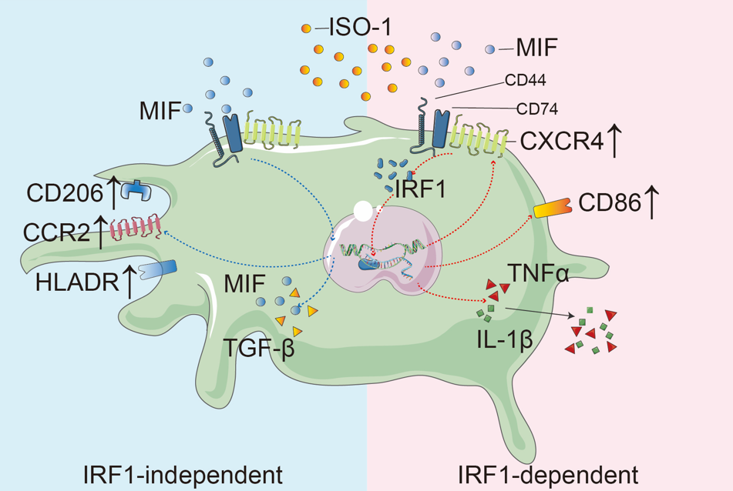
MIF Modulation of Macrophage Polarization through IRF1 in Renal Allograft Rejection
Results
Macrophages showed significant changes in quantity, functionality, and intracellular networks
IRF-1 was significantly upregulated in macrophages from the rejection group, with enhanced transcriptional activity
Pseudotime trajectory revealed a continuous upregulation of IRF-1 along the macrophage differentiation
Macrophages in rejected allograft received enhanced MIF to CD74/CXCR4 signaling, which was predominantly in recipient-derived macrophages
MIF-induced polarization occurred via:
IRF-1–dependent: ↑ TNF, CD86, NOS2, inflammatory cytokines
IRF-1–independent: ↑ CCR2, HLA-DR, TGF-β
A MIF–CXCR4–IRF-1 feedback loop amplified inflammatory responses
In murine heart and skin transplant models treated with ISO-1, the MIF antagonist, immune cell infiltration and inflammation in the allograft were alleviated, confirming its therapeutic potential in rejection
Conclusions
This study delves into the pivotal role of the MIF signal and IRF1-mediated transcriptional regulation in macrophages during renal allograft rejection
MIF induces M1 polarization in an IRF1-dependent manner, with positive feedback loop amplifying inflammation
Targeting the MIF pathway offers a promising strategy for managing transplant rejection
Chen Y. et al., ESOT Congress 2025 (Abstract 1408)
Notes:
Abbreviations: MIF, Macrophage Migration Inhibitory Factor; IRF1, Interferon Regulatory Factor 1; CXCR4, C-X-C chemokine receptor type 4.
Reference Number: 1408
MIF MODULATION OF MACROPHAGE POLARIZATION THROUGH IRF1 IN RENAL ALLOGRAFT REJECTION
Yanxu Chen¹, Longshan Liu¹, Changxi Wang¹
¹the first affiliated hospital of sun yat-sen university, Guangzhou
Background: Rejection is a major cause of kidney transplant failure. While research has primarily focused on lymphocytes, recent studies emphasize myeloid cells, particularly macrophages. Understanding the phenotypic diversity of infiltrating macrophages in different rejection types provides insights into the mechanisms of rejection.
Methods: Single-cell RNA sequencing was conducted to investigate macrophage phenotypes across different rejections. Renal allograft biopsy microarrays were integrated to confirm the roles of MIF and IRF1 in macrophages. siRNA interference in THP-1 cells assessed the role of IRF1 in MIF-induced polarization. Mouse skin and heart transplant models were utilized to examine how MIF signaling blockade with ISO-1 alleviates rejection. Results: Macrophages showed significant changes in quantity, functionality, and signal networks. SCENIC analysis revealed a notable upregulation of IRF1 expression in macrophages, accompanied by higher activity of the IRF1 regulon during rejection. Further clustering identified three macrophage subtypes. Pseudotime trajectory elucidating the transition from M2 to M1 states, concomitant with the progressive upregulation of IRF1. In renal allografts, macrophages received stronger MIF signals from the rejection microenvironment. In vitro experiments corroborated the requirement of IRF1 for MIF's ability to induce macrophage polarization towards the M1 phenotype, triggering a positive feedback response by elevating the expression of CXCR4, the MIF receptor. Comparative scRNA-seq and immunohistochemistry showed reduced MIF and IRF1+ macrophages after effective treatment. In murine heart and skin transplant models treated with ISO-1, the MIF antagonist, immune cell infiltration and inflammation in the allograft were reduced, confirming its therapeutic potential in rejection.
Conclusions: This study delves into the pivotal role of the MIF signal and IRF1-mediated transcriptional regulation in macrophages during renal allograft rejection. MIF induces M1 polarization in an IRF1-dependent manner, and antagonizing the MIF signal effectively mitigates the progression of rejection. These findings provide key insights into the immunologic mechanisms of rejection and inform potential therapeutic strategies.

Slide 7
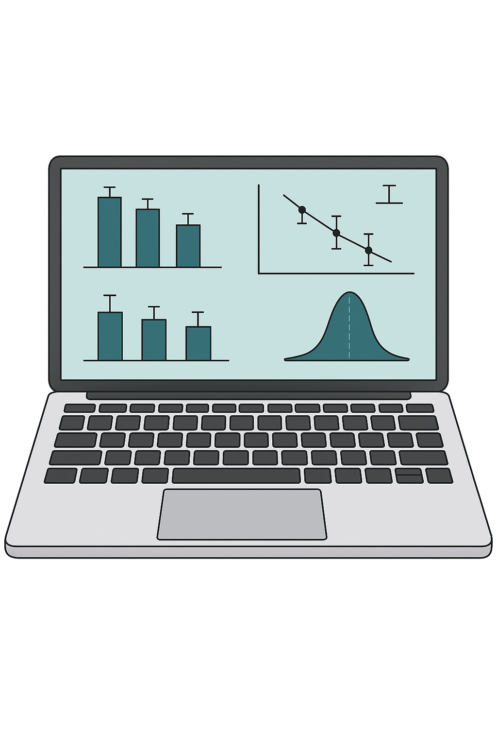
Association of donor-derived cell-free DNA with microvascular inflammation phenotypes in kidney allografts
Methods
n=3,175 paediatric and adult kidney transplant recipients from 20
transplant centers between September 2011 and October 2024, who underwent allograft biopsy with concurrent assessment of:
dd-cfDNA
anti-HLA donor-specific antibodies (DSA)
functional parameters
Background
Donor-derived cell-free DNA (dd-cfDNA) has shown to improve the detection of kidney allograft rejection
However, its ability to identify the recently defined microvascular inflammation (MVI) phenotypes in the Banff 2022 Classification remains unclear
Integration of clinical and pathological data to classify biopsies according to the Banff 2022 Classification
Statistical analysis:
Uni- and multivariable logistic regressions to determine the independent association between dd-cfDNA and microvascular inflammation phenotypes
Sablik M. et al., ESOT Congress 2025 (Abstract 1566)
Notes:
Abbreviations: dd-cfDNA, Donor-derived cell-free DNA; MVI, microvascular inflammation; HLA, Human Leukocyte Antigen; DSA , Donor-Specific Antibodies; CI, Confidence interval; OR, odds ratio; aOR, adjusted odd ratio; AMR, Antibody-Mediated Rejection; IFTA, Interstitial Fibrosis and Tubular Atrophy; PVN, polyomavirus-associated nephropathy.
Reference Number: 1566
ASSOCIATION OF DONOR-DERIVED CELL-FREE DNA WITH MICROVASCULAR INFLAMMATION PHENOTYPES IN KIDNEY ALLOGRAFTS
Marta Sablik¹, Romain Brousse¹, Maud Racape¹, Anais Certain¹, Jessica Bastian¹, Renata Ponsirenas¹, Marc Raynaud¹, Oriol Bestard², Klemens Budde³, Fabian Halleck³, Miklos Molnar⁴, Edmund Huang⁵, Stanley Jordan⁵, Kenneth Chavin⁶, Gaurav Gupt⁷, Dhiren Kumar⁷, Tarek Alhamad⁸, Sanjiv Anand⁹, Jorge Sanchez- Garcia⁹, Basmah Abdalla¹⁰, Julien Hogan¹¹, Rouba Garro¹², Darshana Dadhania¹³, Pranjal Jain¹⁴, Didier Mandelbrot¹⁵, Maarten Naesens¹⁶, Raja Dandamudi¹⁷, Vikas Dharnidharka¹⁷, Dany Anglicheau¹⁸, Carmen Lefaucheur^{1,19}, Olivier Aubert^{1,18}, Alexandre Loupy^{1,18}
¹Paris Institute for Transplantation and Organ Regeneration (PITOR), Paris, France, ²Department of Nephrology and Kidney Transplantation, Vall d’Hebrón University Hospital, Barcelona, Spain, ³Department of Nephrology and Critical Care Medicine, Charité– Universitätsmedizin Berlin, Freie Universität Berlin, Berlin Institute of Health, Berlin, Germany, ⁴Department of Internal Medicine, Division of Nephrology & Hypertension, University of Utah, Spencer Fox Eccles School of Medicine, Salt Lake City, UT, United States, ⁵Department of Medicine, Division of Nephrology, Comprehensive Transplant Center, Cedars Sinai Medical Center, Los Angeles, CA, United States, ⁶Division of Abdominal Organ Transplant, Department of Surgery, Temple University Hospital, Philadelphia, PA, United States, ⁷Division of Nephrology, Virginia Commonwealth University,, Richmond, VA, United States, ⁸Division of Nephrology, Department of Internal Medicine, Washington University School of Medicine, St. Louis, MO, United States, ⁹Intermountain Medical Center, Transplant Services, Murray, UT, United States, ¹⁰Division of Nephrology, Department of Medicine, David Geffen School of Medicine at UCLA, Los Angeles, CA, United States, ¹¹Department of Pediatric Nephrology, Robert Debré Hospital, Paris Cité University, Paris, France, ¹²Pediatric Nephrology Department, Children Healthcare of Atlanta, Emory University, Atlanta, GA, United States, ¹³Weill Cornell Medicine – New York Presbyterian Hospital, New York, NY, United States, ¹⁴Department of Nephrology, Tampa General Hospital,, Tampa, FL, United States, ¹⁵Department of Medicine, Division of Nephrology, University of Wisconsin School of Medicine and Public Health, Madison, WI, United States, ¹⁶Department of Nephrology and Renal Transplantation, University Hospitals Leuven, Leuven, Belgium, ¹⁷Department of Pediatrics, Washington University School of Medicine, St. Louis, MO, United States, ¹⁸Department of Kidney Transplantation, Necker Hospital, Assistance Publique - Hôpitaux de Paris, Paris, France, ¹⁹Kidney Transplant Department, Saint-Louis Hospital, Assistance Publique - Hôpitaux de Paris, Paris, France
Background: Donor-derived cell-free DNA (dd-cfDNA) has shown to improve the detection of kidney allograft rejection. However, its ability to identify the recently defined microvascular inflammation (MVI) phenotypes in the Banff 2022 Classification remains unclear.
Methods: We included 3,175 pediatric and adult kidney transplant recipients from 20 transplant centers, who underwent allograft biopsy with concurrent assessment of dd-cfDNA, anti-HLA DSA, and functional parameters between September 2011 and October 2024. Clinical and pathological data were integrated to classify biopsies according to the Banff 2022 Classification. We performed uni- and multivariable logistic regressions to determine the independent association between dd-cfDNA and microvascular inflammation phenotypes.
Results: Among the 4,181 allograft biopsies, mild to moderate MVI was diagnosed in 695 (16,6%) cases, including 115 MVI, DSA-negative C4d-negative (MVI, DSA-C4d-), 72 probable AMR (mild MVI with DSA-positivity), 398 AMR and 110 mixed cases. We observed an incremental increase of dd-cfDNA levels from probable AMR (0.67  0.11%) to MVI, DSA-C4d- cases (1.22 ±0.12%), with highest levels seen in AMR (1.73 ± 0.11%) and mixed rejection (3.69 ± 0.37%) (Figure). Dd-cfDNA (OR 2.12, 95% CI 1.83-2.45, p <0.001), proteinuria (OR 1.32, 95% CI 1.14-1.52, p<0.001), and history of rejection (OR 5.18, 95% CI 3.52-7.53, p<0.001) were associated with MVI, DSA-C4d- in univariate analysis. In multivariable analysis, dd-cfDNA remained independently associated with MVI, DSA- C4d- (adjusted OR 1.68, 95% CI 1.40-2.02, p<0.001). Dd-cfDNA was significantly associated with probable AMR in univariate analysis (OR 1.34, 95% CI 1.08-1.66, p=0.007), and remained independently associated with probable AMR after adjusting for functional parameters and history of rejection (p=0.041).
Conclusions: In this large multicenter prospective kidney transplant cohort, we demonstrated that dd-cfDNA was independently associated with MVI, DSA-negative, C4d-negative, as well as probable AMR (mild MVI with DSA-positivity), highlighting its promising role in diagnosing and guiding treatment for these phenotypes.

Slide 8
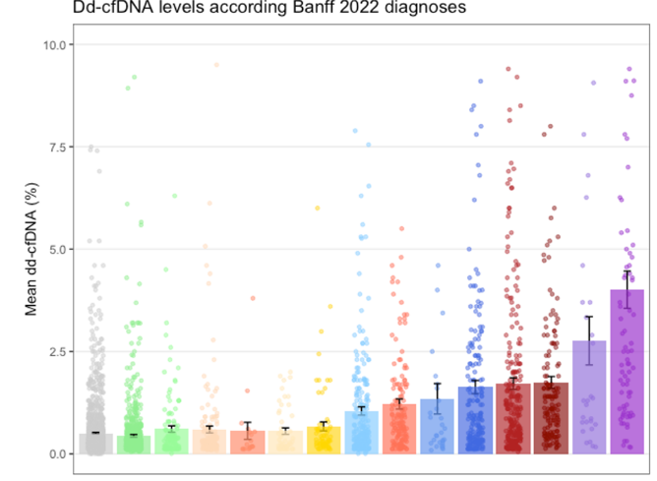
Association of donor-derived cell-free DNA with microvascular inflammation phenotypes in kidney allografts
Results
n=4,181 allograft biopsies
Mild to moderate MVI:
n=695 (16,6%) cases
MVI
DSA (-)
C4d (-)
Dd-cfDNA OR=2.12 [95% CI 1.83-2.45] p <0.001
proteinuria OR=1.32 [95% CI 1.14-1.52] p<0.001
History of rejection OR=5.18 [95% CI 3.52-7.53]
p<0.001
In multivariable analysis, dd-cfDNA remained independently associated with MVI, DSA- C4d- (aOR=1.68 [95% CI 1.40-2.02] p<0.001)
Dd-cfDNA significantly associated with probable AMR in univariate analysis (OR=1.34 [95% CI 1.08-1.66] p=0.007), and remained independently associated with probable AMR after adjusting for functional parameters and history of rejection (p=0.041)
Mixed cases
Associated with MVI, DSA-C4d- in univariate analysis
115
110
probable AMR
mild MVI DSA (+)
72
398
AMR
Incremental increase of dd-cfDNA levels from probable AMR (0.67±0.11%) to MVI, DSA-C4d-cases (1.22±0.12%), with highest levels in AMR (1.73±0.11%) and mixed rejection (3.69±0.37%)
No specific lesions
IFTA
PVN
C4d Staining Without Evidence of Rejection
Chronic AMR
Glomerulitis without rejection
Probable AMR
Borderline
MVI, DSA-negative C4d-negative
Chronic active TCMR
Acute TCMR
Active AMR
Chronic active AMR
(c)aTCMR + MVI, DSA (-) C4d (-)
Mixed
Conclusions
This study demonstrates that dd-cfDNA is independently associated with MVI, DSA-negative, C4d-negative, as well as probable AMR (mild MVI with DSA-positivity), highlighting its promising role in diagnosing and guiding treatment for these phenotypes
Figure. Mean level of dd-cfDNA according to the Banff 2022 Classification. Each bar corresponds to one histological diagnosis with its mean dd-cfDNA value. Each dot corresponds to an individual dd-cfDNA value. Data are presented as mean ± SEM. IFTA, Interstitial Fibrosis and Tubular Atrophy; PVN, polyomavirus-associated nephropathy
Sablik M. et al., ESOT Congress 2025 (Abstract 1566)
Notes:
Abbreviations: dd-cfDNA, Donor-derived cell-free DNA; MVI, microvascular inflammation; HLA, Human Leukocyte Antigen; DSA , Donor-Specific Antibodies; CI, Confidence interval; OR, odds ratio; aOR, adjusted odd ratio; AMR, Antibody-Mediated Rejection; IFTA, Interstitial Fibrosis and Tubular Atrophy; PVN, polyomavirus-associated nephropathy.
Reference Number: 1566
ASSOCIATION OF DONOR-DERIVED CELL-FREE DNA WITH MICROVASCULAR INFLAMMATION PHENOTYPES IN KIDNEY ALLOGRAFTS
Marta Sablik¹, Romain Brousse¹, Maud Racape¹, Anais Certain¹, Jessica Bastian¹, Renata Ponsirenas¹, Marc Raynaud¹, Oriol Bestard², Klemens Budde³, Fabian Halleck³, Miklos Molnar⁴, Edmund Huang⁵, Stanley Jordan⁵, Kenneth Chavin⁶, Gaurav Gupt⁷, Dhiren Kumar⁷, Tarek Alhamad⁸, Sanjiv Anand⁹, Jorge Sanchez- Garcia⁹, Basmah Abdalla¹⁰, Julien Hogan¹¹, Rouba Garro¹², Darshana Dadhania¹³, Pranjal Jain¹⁴, Didier Mandelbrot¹⁵, Maarten Naesens¹⁶, Raja Dandamudi¹⁷, Vikas Dharnidharka¹⁷, Dany Anglicheau¹⁸, Carmen Lefaucheur^{1,19}, Olivier Aubert^{1,18}, Alexandre Loupy^{1,18}
¹Paris Institute for Transplantation and Organ Regeneration (PITOR), Paris, France, ²Department of Nephrology and Kidney Transplantation, Vall d’Hebrón University Hospital, Barcelona, Spain, ³Department of Nephrology and Critical Care Medicine, Charité– Universitätsmedizin Berlin, Freie Universität Berlin, Berlin Institute of Health, Berlin, Germany, ⁴Department of Internal Medicine, Division of Nephrology & Hypertension, University of Utah, Spencer Fox Eccles School of Medicine, Salt Lake City, UT, United States, ⁵Department of Medicine, Division of Nephrology, Comprehensive Transplant Center, Cedars Sinai Medical Center, Los Angeles, CA, United States, ⁶Division of Abdominal Organ Transplant, Department of Surgery, Temple University Hospital, Philadelphia, PA, United States, ⁷Division of Nephrology, Virginia Commonwealth University,, Richmond, VA, United States, ⁸Division of Nephrology, Department of Internal Medicine, Washington University School of Medicine, St. Louis, MO, United States, ⁹Intermountain Medical Center, Transplant Services, Murray, UT, United States, ¹⁰Division of Nephrology, Department of Medicine, David Geffen School of Medicine at UCLA, Los Angeles, CA, United States, ¹¹Department of Pediatric Nephrology, Robert Debré Hospital, Paris Cité University, Paris, France, ¹²Pediatric Nephrology Department, Children Healthcare of Atlanta, Emory University, Atlanta, GA, United States, ¹³Weill Cornell Medicine – New York Presbyterian Hospital, New York, NY, United States, ¹⁴Department of Nephrology, Tampa General Hospital,, Tampa, FL, United States, ¹⁵Department of Medicine, Division of Nephrology, University of Wisconsin School of Medicine and Public Health, Madison, WI, United States, ¹⁶Department of Nephrology and Renal Transplantation, University Hospitals Leuven, Leuven, Belgium, ¹⁷Department of Pediatrics, Washington University School of Medicine, St. Louis, MO, United States, ¹⁸Department of Kidney Transplantation, Necker Hospital, Assistance Publique - Hôpitaux de Paris, Paris, France, ¹⁹Kidney Transplant Department, Saint-Louis Hospital, Assistance Publique - Hôpitaux de Paris, Paris, France
Background: Donor-derived cell-free DNA (dd-cfDNA) has shown to improve the detection of kidney allograft rejection. However, its ability to identify the recently defined microvascular inflammation (MVI) phenotypes in the Banff 2022 Classification remains unclear.
Methods: We included 3,175 pediatric and adult kidney transplant recipients from 20 transplant centers, who underwent allograft biopsy with concurrent assessment of dd-cfDNA, anti-HLA DSA, and functional parameters between September 2011 and October 2024. Clinical and pathological data were integrated to classify biopsies according to the Banff 2022 Classification. We performed uni- and multivariable logistic regressions to determine the independent association between dd-cfDNA and microvascular inflammation phenotypes.
Results: Among the 4,181 allograft biopsies, mild to moderate MVI was diagnosed in 695 (16,6%) cases, including 115 MVI, DSA-negative C4d-negative (MVI, DSA-C4d-), 72 probable AMR (mild MVI with DSA-positivity), 398 AMR and 110 mixed cases. We observed an incremental increase of dd-cfDNA levels from probable AMR (0.67  0.11%) to MVI, DSA-C4d- cases (1.22 ±0.12%), with highest levels seen in AMR (1.73 ± 0.11%) and mixed rejection (3.69 ± 0.37%) (Figure). Dd-cfDNA (OR 2.12, 95% CI 1.83-2.45, p <0.001), proteinuria (OR 1.32, 95% CI 1.14-1.52, p<0.001), and history of rejection (OR 5.18, 95% CI 3.52-7.53, p<0.001) were associated with MVI, DSA-C4d- in univariate analysis. In multivariable analysis, dd-cfDNA remained independently associated with MVI, DSA- C4d- (adjusted OR 1.68, 95% CI 1.40-2.02, p<0.001). Dd-cfDNA was significantly associated with probable AMR in univariate analysis (OR 1.34, 95% CI 1.08-1.66, p=0.007), and remained independently associated with probable AMR after adjusting for functional parameters and history of rejection (p=0.041).
Conclusions: In this large multicenter prospective kidney transplant cohort, we demonstrated that dd-cfDNA was independently associated with MVI, DSA-negative, C4d-negative, as well as probable AMR (mild MVI with DSA-positivity), highlighting its promising role in diagnosing and guiding treatment for these phenotypes.

Slide 9


Investigating inequalities in access to paediatric kidney transplantation
Background
Our understanding of whether access to kidney transplantation inequities exist for UK children is lacking
To date, socioeconomic and ethnic inequities in access to pre-emptive kidney transplantation have been described, but no research has investigated associations with access to waitlist activation or transplantation in general
Methods
Analysis:
UK Renal Registry and NHS Blood & Transplant data
Study:
Population comprised incident patients <18 years starting kidney replacement therapies (KRT) in the UK between 1/1/96-31/12/20
Statistical analysis:
Multivariable logistic regression and Cox proportional hazards models used to determine associations between exposures (ethnicity, socioeconomic deprivation (SED) and sex)
Outcomes:
1) waitlist activation for deceased donor kidney transplantation; receipt of 2) any 3) deceased donor 4) living donor kidney transplant
James A. et al., ESOT Congress 2025 (Abstract 2056)
Notes:
Abbreviations: UK, United kingdom; NHS, National Health Service; SED, socioeconomic deprivation; KRT, kidney replacement therapies; HZ, hazard ratio; aOR, adjusted odds ratio; CI, Confidence Interval.
Reference Number: 2056
INVESTIGATING INEQUALITIES IN ACCESS TO PAEDIATRIC KIDNEY TRANSPLANTATION
Alice James¹, Pippa Bailey¹, Lucy Plumb¹
¹University of Bristol , Bristol , United Kingdom
Background: Our understanding of whether access to kidney transplantation inequities exist for UK children is lacking. To date, socioeconomic and ethnic inequities in access to pre-emptive kidney transplantation have been described, but no research has investigated associations with access to waitlist activation or transplantation in general.
Methods: We performed an analysis of UK Renal Registry and NHS Blood & Transplant data. The study population comprised incident patients <18 years starting kidney replacement therapies (KRT) in the UK between 1/1/96-31/12/20. Multivariable logistic regression and Cox proportional hazards models were used to determine associations between exposures (ethnicity, socioeconomic deprivation (SED) and sex) and outcomes: 1) waitlist activation for deceased donor kidney transplantation; receipt of 2) any 3) deceased donor 4) living donor kidney transplant.
Results: Adjusted Cox regression results show lower hazard of being waitlisted for females (HR 0.88, 95% CI 0.81, 0.95) compared to males; for those in the most deprived SED group (HR 0.67, 95% CI 0.59, 0.76) compared to the least deprived; and those from a Black ethnic background (HR 0.81, 95% CI 0.65, 0.99) compared to children of White ethnicity. Once waitlisted, associations with sex and SED were attenuated. However, lower hazards remained for children of Black ethnicity (HR 0.74, 95% CI 0.56, 0.97) compared to children of White ethnicity. Adjusted odds of receiving a living donor transplant within two years of starting KRT were lower for those in the most deprived SED group (OR 0.28, 95% CI 0.21, 0.26) compared to least deprived, and children of Black or Asian ethnicity (OR 0.40, 95% CI 0.24, 0.65; OR 0.47, 95% CI 0.37, 0.60) compared to children of White ethnicity.
Conclusions: Higher relative area-level deprivation and Black ethnicity are associated with lower access to waitlisting and living donor transplantation; reassuringly, variations in access to transplant are attenuated once waitlisted, suggesting interventions equitably supporting timely consideration and preparation for waitlisting are needed. Similar SED and ethnicity associations were noted for living kidney donor transplant access.

Slide 10
Investigating inequalities in access to paediatric kidney transplantation
Results
Conclusions
Higher relative area-level deprivation and Black ethnicity are associated with lower access to waitlisting and living donor transplantation; reassuringly, variations in access to transplant are attenuated once waitlisted, suggesting interventions equitably supporting timely consideration and preparation for waitlisting are needed
Similar SED and ethnicity associations were noted for living kidney donor transplant access
Hazard Ratios (HR) - likelihood of being waitlisted or transplanted:
Comparison | Context | Adjusted HR (95% CI)
Female vs Male | Waitlist | 0.88 (0.81–0.95)
Most vs Least Deprived | Waitlist | 0.67 (0.59–0.76)
Black vs. White | Waitlist | 0.81 (0.65–0.99)
Black vs. White | Post-Waitlist | 0.74 (0.56–0.97)
Once waitlisted, associations with sex and SED were attenuated
Adjusted odds (OR) - likelihood of receiving a living donor transplant within two years of starting KRT:
Comparison | Context | Adjusted OR (95% CI)
Most vs Least Deprived | Living Donor | 0.28 (0.21–0.36)
Black vs White | Living Donor | 0.40 (0.24–0.65)
Asian vs White | Living Donor | 0.47 (0.37–0.60)
James A. et al., ESOT Congress 2025 (Abstract 2056)
Notes:
Abbreviations: UK, United kingdom; NHS, National Health Service; SED, socioeconomic deprivation; KRT, kidney replacement therapies; HZ, hazard ratio; aOR, adjusted odds ratio; CI, Confidence Interval.
Reference Number: 2056
INVESTIGATING INEQUALITIES IN ACCESS TO PAEDIATRIC KIDNEY TRANSPLANTATION
Alice James¹, Pippa Bailey¹, Lucy Plumb¹
¹University of Bristol , Bristol , United Kingdom
Background: Our understanding of whether access to kidney transplantation inequities exist for UK children is lacking. To date, socioeconomic and ethnic inequities in access to pre-emptive kidney transplantation have been described, but no research has investigated associations with access to waitlist activation or transplantation in general.
Methods: We performed an analysis of UK Renal Registry and NHS Blood & Transplant data. The study population comprised incident patients <18 years starting kidney replacement therapies (KRT) in the UK between 1/1/96-31/12/20. Multivariable logistic regression and Cox proportional hazards models were used to determine associations between exposures (ethnicity, socioeconomic deprivation (SED) and sex) and outcomes: 1) waitlist activation for deceased donor kidney transplantation; receipt of 2) any 3) deceased donor 4) living donor kidney transplant.
Results: Adjusted Cox regression results show lower hazard of being waitlisted for females (HR 0.88, 95% CI 0.81, 0.95) compared to males; for those in the most deprived SED group (HR 0.67, 95% CI 0.59, 0.76) compared to the least deprived; and those from a Black ethnic background (HR 0.81, 95% CI 0.65, 0.99) compared to children of White ethnicity. Once waitlisted, associations with sex and SED were attenuated. However, lower hazards remained for children of Black ethnicity (HR 0.74, 95% CI 0.56, 0.97) compared to children of White ethnicity. Adjusted odds of receiving a living donor transplant within two years of starting KRT were lower for those in the most deprived SED group (OR 0.28, 95% CI 0.21, 0.26) compared to least deprived, and children of Black or Asian ethnicity (OR 0.40, 95% CI 0.24, 0.65; OR 0.47, 95% CI 0.37, 0.60) compared to children of White ethnicity.
Conclusions: Higher relative area-level deprivation and Black ethnicity are associated with lower access to waitlisting and living donor transplantation; reassuringly, variations in access to transplant are attenuated once waitlisted, suggesting interventions equitably supporting timely consideration and preparation for waitlisting are needed. Similar SED and ethnicity associations were noted for living kidney donor transplant access.

Slide 11
Trends in factors affecting access to kidney transplantation and graft survival (Collaborative Transplant Study)
Background
Univariate Kaplan-Meier analysis of the CTS data shows that graft survival for kidney transplant recipients improved steadily over 20 years before the SARS-CoV-2 pandemic
Three-year overall graft survival rates were 83.4% for patients transplanted 2000–2004, increasing to 83.5%, 84.4%, and 85.5% in the subsequent five-year periods
This study aimed to assess trends in commonly known confounding factors during this time
Methods
Study:
Analysis of first deceased-donor kidney-only transplants in Europe from 2000 to 2019 (162 transplant centers; n=126,172 transplants), stratified into four periods: 2000–2004, 2005–2009, 2010–2014, and 2015–2019
Statistical analysis:
Kaplan-Meier analysis was used for univariate survival, Cox regression for multivariable three-year overall graft loss, chi-squared test for categorical variables, and Kruskal-Wallis test for continuous confounders
Acknowledgments
We sincerely thank all the transplant centers from around the world that have participated in the CTS over the last 43 years and are particularly grateful to the 162 transplant centers that provided the data used for this analysis.
Unterrainer C. et al., ESOT Congress 2025 (Abstract 1803)
Notes:
Abbreviations: CTS, Collaborative Transplant Study; HR, Hazard ratios; HLA, Human Leukocyte Antigen; CDC, Complement-Dependent Cytotoxicity; PRA, Panel Reactive Antibody.
Reference Number: 1803
TRENDS IN FACTORS AFFECTING ACCESS TO KIDNEY TRANSPLANTATION AND GRAFT SURVIVAL (COLLABORATIVE TRANSPLANT STUDY)
Christian Unterrainer¹, Christian Morath², Klemens Budde³, Axel Roers¹, Thuong Hien Tran¹
¹Heidelberg University Hospital, Institute of Immunology, Heidelberg, Germany, ²Heidelberg University Hospital, The Heidelberg Kidney Center, Heidelberg, Germany, ³Charité Berlin, Department of Nephrology, Berlin, Germany
Background: Univariate Kaplan-Meier analysis of the CTS data shows that graft survival for kidney transplant recipients improved steadily over 20 years before the SARS-CoV-2 pandemic. Three-year overall graft survival rates were 83.4% for patients transplanted 2000–2004, increasing to 83.5%, 84.4%, and 85.5% in the subsequent five-year periods. We aimed to assess trends in commonly known confounding factors during this time.
Methods: We analyzed first deceased-donor kidney-only transplants in Europe from 2000 to 2019 (162 transplant centers; 126,172 transplants), stratified into four periods: 2000–2004, 2005–2009, 2010–2014, and 2015–2019. Kaplan-Meier analysis was used for univariate survival, Cox regression for multivariable three-year overall graft loss, chi-squared test for categorical variables, and Kruskal-Wallis test for continuous confounders.
Results: As shown in Table 1, comparing the first to the last period, mean donor age increased by eight years and recipient age by six years - factors typically associated with lower graft survival. However, cold ischemia time decreased by four hours and patients receiving induction therapy increased - trends reported to favor graft survival. Also, steroid usage among recipients decreased. Other analyzed factors did not show clear trends. Figure 1 presents the hazard ratios (HR) for 3-year overall graft loss. While the number of HLA mismatches increased, their negative impact remained constant over time with HRs between 1.07 and 1.08 (1A). In contrast, the risk of graft loss with pre-transplant panel-reactive antibodies (CDC PRA) decreased steadily, with hazard ratios dropping from HR=1.32 in the first to HR=1.07 in the last period (1B).
Conclusions: The average number of HLA mismatches increased, but their negative impact on graft survival remains significant with similar hazard ratio. On the other hand, the detrimental effect of HLA pre-sensitization has decreased probably due to refined antibody detection methods with more specific exclusion of incompatible antigens and to wider use of induction therapy.

Slide 12
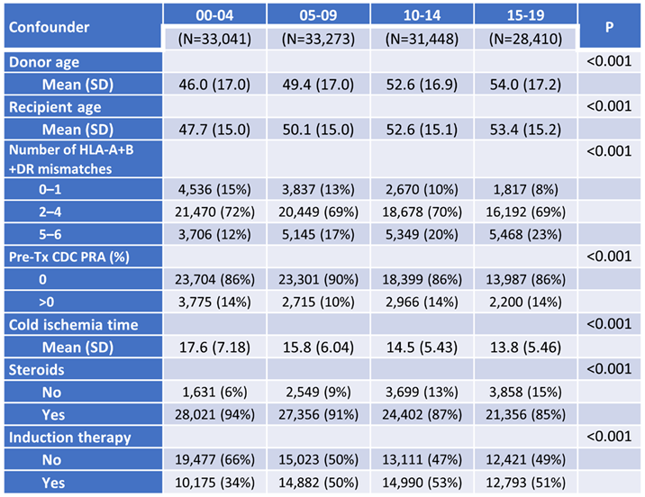
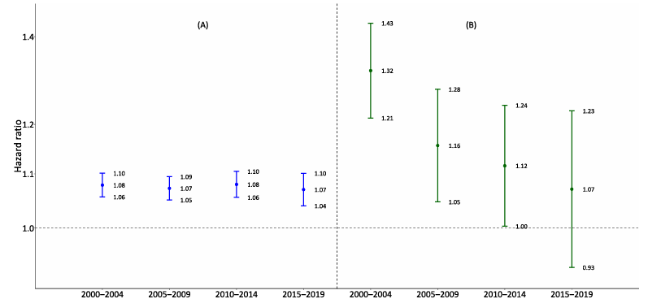
Trends in factors affecting access to kidney transplantation and graft survival (Collaborative Transplant Study)
Results
Figure 1. Hazard ratios (HR) for 3-year overall graft loss
Table 1. Demographics
(A) HLA-A+B+DR MM
(B) CDC PRA (>0% vs 0%)
While the number of HLA mismatches increased, their negative impact remained constant over time with HRs between 1.07 and 1.08 (1A)
In contrast, the risk of graft loss with pre-transplant panel-reactive antibodies (CDC PRA) decreased steadily, with hazard ratios dropping from HR=1.32 in the first to HR=1.07 in the last period (1B)
Conclusions
The average number of HLA mismatches increased, but their negative impact on graft survival remains significant with similar hazard ratio
On the other hand, the detrimental effect of HLA pre-sensitization has decreased probably due to refined antibody detection methods with more specific exclusion of incompatible antigens and to wider use of induction therapy
From the first to the last period, donor age rose by 8 years and recipient age by 6 - factors typically associated with lower graft survival
Cold ischemia time decreased by 4 hours and patients receiving induction therapy increased - trends reported to favor graft survival
Steroid usage among recipients decreased
Other analyzed factors did not show clear trends
Unterrainer C. et al., ESOT Congress 2025 (Abstract 1803)
Notes:
Abbreviations: CTS, Collaborative Transplant Study; HR, Hazard ratios; HLA, Human Leukocyte Antigen; CDC, Complement-Dependent Cytotoxicity; PRA, Panel Reactive Antibody.
Reference Number: 1803
TRENDS IN FACTORS AFFECTING ACCESS TO KIDNEY TRANSPLANTATION AND GRAFT SURVIVAL (COLLABORATIVE TRANSPLANT STUDY)
Christian Unterrainer¹, Christian Morath², Klemens Budde³, Axel Roers¹, Thuong Hien Tran¹
¹Heidelberg University Hospital, Institute of Immunology, Heidelberg, Germany, ²Heidelberg University Hospital, The Heidelberg Kidney Center, Heidelberg, Germany, ³Charité Berlin, Department of Nephrology, Berlin, Germany
Background: Univariate Kaplan-Meier analysis of the CTS data shows that graft survival for kidney transplant recipients improved steadily over 20 years before the SARS-CoV-2 pandemic. Three-year overall graft survival rates were 83.4% for patients transplanted 2000–2004, increasing to 83.5%, 84.4%, and 85.5% in the subsequent five-year periods. We aimed to assess trends in commonly known confounding factors during this time.
Methods: We analyzed first deceased-donor kidney-only transplants in Europe from 2000 to 2019 (162 transplant centers; 126,172 transplants), stratified into four periods: 2000–2004, 2005–2009, 2010–2014, and 2015–2019. Kaplan-Meier analysis was used for univariate survival, Cox regression for multivariable three-year overall graft loss, chi-squared test for categorical variables, and Kruskal-Wallis test for continuous confounders.
Results: As shown in Table 1, comparing the first to the last period, mean donor age increased by eight years and recipient age by six years - factors typically associated with lower graft survival. However, cold ischemia time decreased by four hours and patients receiving induction therapy increased - trends reported to favor graft survival. Also, steroid usage among recipients decreased. Other analyzed factors did not show clear trends. Figure 1 presents the hazard ratios (HR) for 3-year overall graft loss. While the number of HLA mismatches increased, their negative impact remained constant over time with HRs between 1.07 and 1.08 (1A). In contrast, the risk of graft loss with pre-transplant panel-reactive antibodies (CDC PRA) decreased steadily, with hazard ratios dropping from HR=1.32 in the first to HR=1.07 in the last period (1B).
Conclusions: The average number of HLA mismatches increased, but their negative impact on graft survival remains significant with similar hazard ratio. On the other hand, the detrimental effect of HLA pre-sensitization has decreased probably due to refined antibody detection methods with more specific exclusion of incompatible antigens and to wider use of induction therapy.

Slide 13

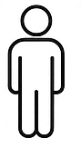

Delivery of mRNA therapeutics during machine perfusion of donor kidneys
Background
Development of post-transplant kidney fibrosis significantly reduces graft function
Preventing fibrosis can impact the quality of life of transplanted patients
Normothermic machine perfusion (NMP) of donor organs before transplantation enables targeted delivery of therapeutics, minimizing systemic effects
Synthetic messenger RNA (mRNA) encoding therapeutic proteins is promising due to its cost-effectiveness, favorable safety profile and capacity for controllable and transient expression of therapeutic proteins
This study assesses the feasibility of mRNA therapy during kidney-NMP
Methods
mRNAs encoding a secretive protein (human erythropoietin, hEPO) and an intracellular protein (mCherry) used as proof-of-concept
Porcine kidneys (n=15)
Human donor kidneys (n=7)
Perfusion on NMP using an erythrocyte or acellular-based perfusate for 6-12 hours at 37ºC
After 30 minutes of NMP, kidneys infused with either DSPE or TPGS based lipid nanoparticles (LNPs) carrying 150 μg mRNA into the renal artery
Perfusate, urine and tissue samples obtained during NMP
Initial safety and pharmacokinetics tested through porcine auto transplantation with one week follow-up (n=3)
Ballester Bergada C. et al., ESOT Congress 2025 (Abstract 604)
Notes:
Abbreviations: NMP, Normothermic machine perfusion; hEPO, human erythropoietin; DSPE, 1,2-Distearoyl-sn-glycero 3-phosphoethanolamine; TPGS, D-alpha-tocopheryl polyethylene glycol 1000 succinate; LNPs, lipid nanoparticles.
Reference Number: 604
DELIVERY OF MRNA THERAPEUTICS DURING MACHINE PERFUSION OF DONOR KIDNEYS
Cristina Ballester Bergada¹, Ping Song², Katerina Knudsen¹, Victor Ramon Llorente¹, L. Annick van Furth³, Marc Weiss¹, Yazan Fh Rawashdeh⁴, Chris Jaynes^{3,5}, Anna Krarup Keller⁴, Henri Leuvenink^{3,5}, Bente Jespersen¹, Jørgen Kjems², Marco Eijken¹
¹Aarhus University, Department of Clinical Medicine, Aarhus, Denmark, ²Aarhus University, Interdisciplinary Nanoscience Center (iNANO), Aarhus, Denmark, ³University Medical Center Groningen (UMCG), Department of Surgery, Groningen, The Netherlands, ⁴Aarhus University Hospital, Department of Urology, Aarhus, Denmark, ⁵34Lives, Public Benefit Company, West Lafayette, Indiana, Denmark
Background: Development of post-transplant kidney fibrosis significantly reduces graft function. Preventing fibrosis can impact the quality of life of transplanted patients. Normothermic machine perfusion (NMP) of donor organs before transplantation enables targeted delivery of therapeutics, minimizing systemic effects. Synthetic messenger RNA (mRNA) encoding therapeutic proteins is promising due to its cost-effectiveness, favorable safety profile and capacity for controllable and transient expression of therapeutic proteins. This study assesses the feasibility of mRNA therapy during kidney-NMP.
Methods: mRNAs encoding a secretive protein (human erythropoietin, hEPO) and an intracellular protein (mCherry) were used as proof-of-concept. Porcine kidneys (n=15) were perfused on NMP using an erythrocyte or acellular-based perfusate for 6-12 hours at 37ºC. After 30 minutes of NMP, kidneys were infused with either DSPE (1,2-Distearoyl-sn-glycero 3-phosphoethanolamine) or TPGS (D-alpha-tocopheryl polyethylene glycol 1000 succinate) based lipid nanoparticles (LNPs) carrying 150 μg mRNA into the renal artery. Perfusate, urine and tissue samples were obtained during NMP. The same protocol was used in human donor kidneys (n=7). Initial safety and pharmacokinetics were tested through porcine auto transplantation with one week follow-up (n=3).
Results: mRNA treatment did not alter perfusion characteristics or post-transplant kidney function. Porcine kidneys exhibited elevated hEPO protein levels in perfusate and urine 1 hour after hEPO mRNA delivery, with levels increasing through NMP. mCherry protein was detected in cortex and medulla tissue in both human and porcine kidneys during and at the end of NMP. Notably, mCherry was observed in the glomeruli and tubules alike. mRNA delivery was successful using both erythrocyte and acellular-based perfusates. mRNA delivery by TPGS LNPs resulted in higher protein expression compared to DSPE-LNPs.
Conclusions: Expression of therapeutic proteins was achieved during NMP paving the way for ex-vivo mRNA therapy of kidney grafts, in which production of therapeutic proteins in the kidney will persist after transplantation. Ongoing studies are testing the delivery of mRNAs encoding tissue-regenerating proteins to limit post-transplant fibrosis.

Slide 14
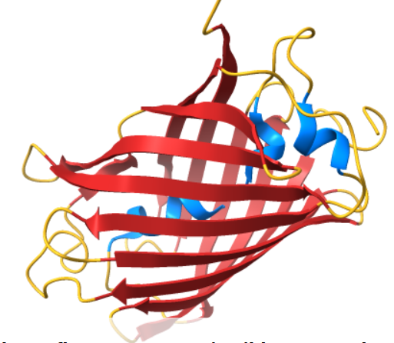
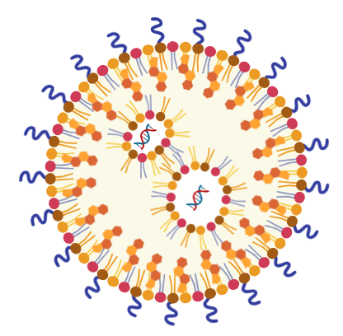
Delivery of mRNA therapeutics during machine perfusion of donor kidneys
Results
mRNA treatment did not alter perfusion characteristics or post-transplant kidney function
mRNA delivery was successful using both erythrocyte and acellular-based perfusates
Porcine kidneys exhibited elevated hEPO protein levels in perfusate and urine 1 hour after hEPO mRNA delivery, with levels increasing through NMP
  mCherry protein was detected in cortex and medulla tissue in both human and porcine kidneys during and at the end of NMP
mCherry was observed in the glomeruli and tubules alike
mRNA delivery by TPGS LNPs resulted in higher protein expression compared to DSPE LNPs
Conclusions
Expression of therapeutic proteins was achieved during NMP paving the way for ex-vivo mRNA therapy of kidney grafts, in which production of therapeutic proteins in the kidney will persist after transplantation
Ongoing studies are testing the delivery of mRNAs encoding tissue-regenerating proteins to limit post-transplant fibrosis
Ballester Bergada C. et al., ESOT Congress 2025 (Abstract 604)
Notes:
Abbreviations: NMP, Normothermic machine perfusion; hEPO, human erythropoietin; DSPE, 1,2-Distearoyl-sn-glycero 3-phosphoethanolamine; TPGS, D-alpha-tocopheryl polyethylene glycol 1000 succinate; LNPs, lipid nanoparticles.
Reference Number: 604
DELIVERY OF MRNA THERAPEUTICS DURING MACHINE PERFUSION OF DONOR KIDNEYS
Cristina Ballester Bergada¹, Ping Song², Katerina Knudsen¹, Victor Ramon Llorente¹, L. Annick van Furth³, Marc Weiss¹, Yazan Fh Rawashdeh⁴, Chris Jaynes^{3,5}, Anna Krarup Keller⁴, Henri Leuvenink^{3,5}, Bente Jespersen¹, Jørgen Kjems², Marco Eijken¹
¹Aarhus University, Department of Clinical Medicine, Aarhus, Denmark, ²Aarhus University, Interdisciplinary Nanoscience Center (iNANO), Aarhus, Denmark, ³University Medical Center Groningen (UMCG), Department of Surgery, Groningen, The Netherlands, ⁴Aarhus University Hospital, Department of Urology, Aarhus, Denmark, ⁵34Lives, Public Benefit Company, West Lafayette, Indiana, Denmark
Background: Development of post-transplant kidney fibrosis significantly reduces graft function. Preventing fibrosis can impact the quality of life of transplanted patients. Normothermic machine perfusion (NMP) of donor organs before transplantation enables targeted delivery of therapeutics, minimizing systemic effects. Synthetic messenger RNA (mRNA) encoding therapeutic proteins is promising due to its cost-effectiveness, favorable safety profile and capacity for controllable and transient expression of therapeutic proteins. This study assesses the feasibility of mRNA therapy during kidney-NMP.
Methods: mRNAs encoding a secretive protein (human erythropoietin, hEPO) and an intracellular protein (mCherry) were used as proof-of-concept. Porcine kidneys (n=15) were perfused on NMP using an erythrocyte or acellular-based perfusate for 6-12 hours at 37ºC. After 30 minutes of NMP, kidneys were infused with either DSPE (1,2-Distearoyl-sn-glycero 3-phosphoethanolamine) or TPGS (D-alpha-tocopheryl polyethylene glycol 1000 succinate) based lipid nanoparticles (LNPs) carrying 150 μg mRNA into the renal artery. Perfusate, urine and tissue samples were obtained during NMP. The same protocol was used in human donor kidneys (n=7). Initial safety and pharmacokinetics were tested through porcine auto transplantation with one week follow-up (n=3).
Results: mRNA treatment did not alter perfusion characteristics or post-transplant kidney function. Porcine kidneys exhibited elevated hEPO protein levels in perfusate and urine 1 hour after hEPO mRNA delivery, with levels increasing through NMP. mCherry protein was detected in cortex and medulla tissue in both human and porcine kidneys during and at the end of NMP. Notably, mCherry was observed in the glomeruli and tubules alike. mRNA delivery was successful using both erythrocyte and acellular-based perfusates. mRNA delivery by TPGS LNPs resulted in higher protein expression compared to DSPE-LNPs.
Conclusions: Expression of therapeutic proteins was achieved during NMP paving the way for ex-vivo mRNA therapy of kidney grafts, in which production of therapeutic proteins in the kidney will persist after transplantation. Ongoing studies are testing the delivery of mRNAs encoding tissue-regenerating proteins to limit post-transplant fibrosis.

Slide 15
Evolution of transcriptomic signatures associated with donor´s diabetes in normoglycemic transplant recipients
Background
Deceased donors with diabetes are considered being suitable for kidney transplant recipients without diabetes, as long-term outcomes have generally been favorable; however, little is known about mechanisms supporting this approach
The assessment of zero-hour transplant biopsies, including transcriptomic analysis, represents an innovative tool to study molecular signatures associated with diabetes and their evolution in subjects with different glycemic control
Methods
n=288 deceased donor zero-hour kidney biopsies prospectively collected in 2021-2022 and stored in RNAlater
®
Transcriptomic profiles in biopsies of diabetic donors (n=43) and matched non-diabetic controls (n=86) were compared by microarray to identify diabetes-associated transcripts
Evolution of intrarenal transcriptome from zero-hour donor biopsy to 3-month protocol kidney graft biopsy assessed by paired analysis in 50 diabetic and non-diabetic kidney transplant donors and recipients: Dd+/Rd-(n=13), Dd-/Rd+(n=11), Dd-/Rd-(n=26)
Girman P. et al., ESOT Congress 2025 (Abstract 2251)
Notes:
Abbreviations: Dd, Diabetic donor; Rd, Diabetic recipient.
Reference Number: 2251
EVOLUTION OF TRANSCRIPTOMIC SIGNATURES ASSOCIATED WITH DONOR´S DIABETES IN NORMOGLYCEMIC TRANSPLANT RECIPIENTS
Peter Girman¹, Petra Hruba², Eva Girmanova³, Petra Mrazova², Lucie Capkova², Ludek Voska⁴, Roman Keleman⁵, Katarina Jakubov⁶, Jiri Klema⁷, Jiri Fronek⁸, Ondrej Viklicky⁶
¹Institute of Clinical and Experimental Medicine, Diabetes Department, Prague, Czech Republic, ²Institute of Clinical and Experimental Medicine, Transplant Laboratory , Prague, Czech Republic, ³Institute of Clinical and Experimental Medicine, Transplantation Center , Nephrology Department, Prague, Czech Republic, ⁴Institute of Clinical and Experimental Medicine, Department of Clinical and Transplant Pathology, Prague, Czech Republic, ⁵Institute of Clinical and Experimental Medicine, Department of Transplant Coordinators, Prague, Czech Republic, ⁶Institute of Clinical and Experimental Medicine, Transplantation Center , Department of Nephrology, Prague, Czech Republic, ⁷Faculty of Electrical Engineering CTU in Prague, Prague, Czech Republic, ⁸Institute of Clinical and Experimental Medicine, Department of Transplantation Surgery, Prague, Czech
Background: Deceased donors with diabetes are considered being suitable for kidney transplant recipients without diabetes, as long-term outcomes have generally been favorable however little is known about mechanisms supporting this approach. The assessment of zero-hour transplant biopsies, including transcriptomic analysis, represents an innovative tool to study molecular signatures associated with diabetes and their evolution in subjects with different glycemic control.
Methods: 288 deceased donor zero-hour kidney biopsies were prospectively collected in 2021-2022 and stored in RNAlater®. Transcriptomic profiles in biopsies of diabetic donors (n=43) and matched non-diabetic controls (n=86) were compared by microarray to identify diabetes-associated transcripts. Next, evolution of intrarenal transcriptome from zero-hour donor biopsy to 3-month protocol kidney graft biopsy was assessed by paired analysis in 50 diabetic and non-diabetic kidney transplant donors and recipients: Dd+/Rd-(n=13), Dd-/Rd+(n=11), Dd-/Rd-(n=26).
Results: Among the 47 upregulated (corresponding to 39 genes) transcripts discriminating diabetic donor kidneys from non-diabetic donor kidneys were aldo-ketoreductases (AKR1C2, AKR1B10 and AKR1B15) and transcripts associated with fibrosis (VNN1, VCAN, CXCL6 and IGHM, IGHA1, JCHAIN). Of 11 downregulated transcripts, three were from the kallikrein-kinin system (KLK1, KNG1, and SERPINF2). Assessments of transcriptome evolution from zero hour biopsy to 3-months protocol biopsy in Dd+/Rd- revealed decrease in expression of aldo ketoreductases (AKR1C2, AKR1B10) and NQO1 (NAD(P)H quinone dehydrogenase 1) and increase of SERPINF2 (serpin family F member 2), however there were no detected changes in the transcriptomic profiles in controls (Dd-/Rd-, Dd-/Rd+).
Conclusions: We identified four intrarenal transcripts associated with donor diabetes whose deregulated expression were normalized after successful kidney transplantation in non-diabetic recipients. Support:Ministry of Health of the Czech Republic Grants NU21-06-00021 and by the project National Institute for Research of Metabolic and Cardiovascular Diseases (Programme EXCELES, Project No. LX22NPO5104) - funded by the European Union - Next Generation EU.

Slide 16
Evolution of transcriptomic signatures associated with donor´s diabetes in normoglycemic transplant recipients
Results
Assessments of transcriptome evolution from zero hour biopsy to 3-months protocol biopsy in Dd+/Rd-:
aldo ketoreductases AKR1C2 AKR1B10 and NQO1
SERPINF2
Upregulated Transcripts in Diabetic Donor (Dd+) Kidneys:
Total Upregulated: 47 transcripts (corresponding to 39 genes)
Key Genes:
  Aldo-ketoreductases:
  Transcripts associated with fibrosis
↑ ↑
↑ ↑
AKR1C2
AKR1B10
AKR1B15
No detected changes in the transcriptomic profiles in controls (Dd-/Rd-, Dd-/Rd+)
VNN1
VCAN
CXCL6
Conclusions
This study identified four intrarenal transcripts associated with donor diabetes whose deregulated expression were normalized after successful kidney transplantation in non-diabetic recipients
IGHM
IGHA1
JCHAIN
Downregulated Transcripts in Dd+ Kidneys:
Total Downregulated: 11 transcripts
Key Genes:
Kallikrein-kinin system
KNG1
SERPINF2
KLK1
Girman P. et al., ESOT Congress 2025 (Abstract 2251)
Notes:
Abbreviations: Dd, Diabetic donor; Rd, Diabetic recipient.
Reference Number: 2251
EVOLUTION OF TRANSCRIPTOMIC SIGNATURES ASSOCIATED WITH DONOR´S DIABETES IN NORMOGLYCEMIC TRANSPLANT RECIPIENTS
Peter Girman¹, Petra Hruba², Eva Girmanova³, Petra Mrazova², Lucie Capkova², Ludek Voska⁴, Roman Keleman⁵, Katarina Jakubov⁶, Jiri Klema⁷, Jiri Fronek⁸, Ondrej Viklicky⁶
¹Institute of Clinical and Experimental Medicine, Diabetes Department, Prague, Czech Republic, ²Institute of Clinical and Experimental Medicine, Transplant Laboratory , Prague, Czech Republic, ³Institute of Clinical and Experimental Medicine, Transplantation Center , Nephrology Department, Prague, Czech Republic, ⁴Institute of Clinical and Experimental Medicine, Department of Clinical and Transplant Pathology, Prague, Czech Republic, ⁵Institute of Clinical and Experimental Medicine, Department of Transplant Coordinators, Prague, Czech Republic, ⁶Institute of Clinical and Experimental Medicine, Transplantation Center , Department of Nephrology, Prague, Czech Republic, ⁷Faculty of Electrical Engineering CTU in Prague, Prague, Czech Republic, ⁸Institute of Clinical and Experimental Medicine, Department of Transplantation Surgery, Prague, Czech
Background: Deceased donors with diabetes are considered being suitable for kidney transplant recipients without diabetes, as long-term outcomes have generally been favorable however little is known about mechanisms supporting this approach. The assessment of zero-hour transplant biopsies, including transcriptomic analysis, represents an innovative tool to study molecular signatures associated with diabetes and their evolution in subjects with different glycemic control.
Methods: 288 deceased donor zero-hour kidney biopsies were prospectively collected in 2021-2022 and stored in RNAlater®. Transcriptomic profiles in biopsies of diabetic donors (n=43) and matched non-diabetic controls (n=86) were compared by microarray to identify diabetes-associated transcripts. Next, evolution of intrarenal transcriptome from zero-hour donor biopsy to 3-month protocol kidney graft biopsy was assessed by paired analysis in 50 diabetic and non-diabetic kidney transplant donors and recipients: Dd+/Rd-(n=13), Dd-/Rd+(n=11), Dd-/Rd-(n=26).
Results: Among the 47 upregulated (corresponding to 39 genes) transcripts discriminating diabetic donor kidneys from non-diabetic donor kidneys were aldo-ketoreductases (AKR1C2, AKR1B10 and AKR1B15) and transcripts associated with fibrosis (VNN1, VCAN, CXCL6 and IGHM, IGHA1, JCHAIN). Of 11 downregulated transcripts, three were from the kallikrein-kinin system (KLK1, KNG1, and SERPINF2). Assessments of transcriptome evolution from zero hour biopsy to 3-months protocol biopsy in Dd+/Rd- revealed decrease in expression of aldo ketoreductases (AKR1C2, AKR1B10) and NQO1 (NAD(P)H quinone dehydrogenase 1) and increase of SERPINF2 (serpin family F member 2), however there were no detected changes in the transcriptomic profiles in controls (Dd-/Rd-, Dd-/Rd+).
Conclusions: We identified four intrarenal transcripts associated with donor diabetes whose deregulated expression were normalized after successful kidney transplantation in non-diabetic recipients. Support:Ministry of Health of the Czech Republic Grants NU21-06-00021 and by the project National Institute for Research of Metabolic and Cardiovascular Diseases (Programme EXCELES, Project No. LX22NPO5104) - funded by the European Union - Next Generation EU.

Slide 17
Development and validation of a novel risk prediction model for kidney transplant outcomes in the European population
Background
Living and deceased donor kidney transplantation (LDKT and DDKT) require clinicians to select the optimal donor for recipients
When no compatible living donor is available, alternatives such as kidney exchange programs or ABO/HLA-incompatible LDKT may be considered
Tools like the KDPI and LKDPI donor risk index are essential for predicting transplant outcomes and have been widely used to support decision-makin
However, these models were developed based on US transplant populations, and their applicability in Europe may be influenced by differences in donor demographics, transplantation practices, and recipient characteristics
This study aimed to develop the (Living donor) European Kidney Transplant Risk Assessment ((L)EKTRA) models tailored to European populations
Methods
Study:
Analysis of all adult-to-adult LDKT and DDKT performed in the UK (2007–2023)
Statistical analysis:
EKTRA and LEKTRA scores developed using Cox proportional hazards models with pre-transplant variables, excluding incomplete cases
LEKTRA coefficients scaled relative to EKTRA
Validation conducted using bootstrap resampling and an external Dutch cohort
Predictive performance assessed with time-dependent ROC analysis up to 10 years
Van de Laar S. et al., ESOT Congress 2025 (Abstract 2279)
Notes:
Abbreviations: LDKT, Living donor kidney transplantation ; DDKT, Deceased donor kidney transplantation; KDPI, Kidney Donor Profile Index; LKDPI, Living Kidney Donor Profile Index; (L)EKTRA, Living donor European Kidney Transplant Risk Assessment; UK, united kingdom; ROC, Receiver Operating Characteristic; AUC, Area Under the Curve.
Reference Number: 2279
DEVELOPMENT AND VALIDATION OF A NOVEL RISK PREDICTION MODEL FOR KIDNEY TRANSPLANT OUTCOMES IN THE EUROPEAN POPULATION
Stijn C. van de Laar¹, Matthew Robb², Hidde de Heus¹, Robert Porte¹, Robert C. Minnee¹, Frank J.M.F. Dor¹
¹Erasmus MC, Rotterdam, The Netherlands, ²NHS Blood and Transplant, Bristol, United Kingdom; KDPI, Kidney Donor Profile Index; LKDPI, Living Kidney Donor Profile Index;
Background: Living and deceased donor kidney transplantation (LDKT and DDKT) require clinicians to select the optimal donor for recipients. When no compatible living donor is available, alternatives such as kidney exchange programs or ABO/HLA-incompatible LDKT may be considered. Tools like the KDPI and LKDPI donor risk index are essential for predicting transplant outcomes and have been widely used to support decision-making. However, these models were developed based on US transplant populations, and their applicability in Europe may be influenced by differences in donor demographics, transplantation practices, and recipient characteristics. This study aimed to develop the (Living donor) European Kidney Transplant Risk Assessment ((L)EKTRA) models tailored to European populations. Methods: All adult-to-adult LDKT and DDKT performed in the UK (2007–2023) were analyzed. EKTRA and LEKTRA scores were developed using Cox proportional hazards models with pre-transplant variables, excluding incomplete cases. LEKTRA coefficients were scaled relative to EKTRA. Validation was conducted using bootstrap resampling and an external Dutch cohort. Predictive performance was assessed with time-dependent ROC analysis up to 10 years.
Results: This study analyzed 38,940 transplants (14,508 LDKT, 24,432 DDKT). The KDPI demonstrated an AUC of 0.59 at 10 years, while EKTRA achieved 0.66. LEKTRA showed strong predictive performance, with a C-index of 0.69 and AUCs of 0.74, 0.71, and 0.70 at 1, 5, and 10 years, outperforming LKDPI (C-index = 0.59). Kaplan-Meier curves demonstrated significant graft survival stratification by LEKTRA risk groups (p < 0.001).
Conclusions: This study validates the utility of the KDPI and LKDPI in European populations and introduces EKTRA and LEKTRA, which are tailored to European DDKT and LDKT contexts. By addressing population-specific differences and optimizing predictive variables, EKTRA and LEKTRA provide robust tools to complement existing models. These models enhance donor risk quantification, graft survival predictions, and donor selection in kidney exchange programs. Integrating them into European transplant registries and guidelines could further standardize decision-making, improve donor matching, and optimize transplant outcomes.

Slide 18
Development and validation of a novel risk prediction model for kidney transplant outcomes in the European population
Results
n=38,940 transplants
Conclusions
This study validates the utility of the KDPI and LKDPI in European populations and introduces EKTRA and LEKTRA, which are tailored to European DDKT and LDKT contexts
By addressing population-specific differences and optimizing predictive variables, EKTRA and LEKTRA provide robust tools to complement existing models
These models enhance donor risk quantification, graft survival predictions, and donor selection in kidney exchange programs
Integrating them into European transplant registries and guidelines could further standardize decision-making, improve donor matching, and optimize transplant outcomes
n=14,508 LDKT
37,3%
n=24,5432 DDKT
72,7%
AUC at 10 years
KDPI 0.59
EKTRA 0.66
LEKTRA showed strong predictive performance, with a C-index of 0.69 and AUCs of 0.74, 0.71, and 0.70 at 1, 5, and 10 years, outperforming LKDPI (C-index = 0.59)
Kaplan-Meier curves demonstrated significant graft survival stratification by LEKTRA risk groups (p < 0.001)
Van de Laar S. et al., ESOT Congress 2025 (Abstract 2279)
Notes:
Abbreviations: LDKT, Living donor kidney transplantation ; DDKT, Deceased donor kidney transplantation; KDPI, Kidney Donor Profile Index; LKDPI, Living Kidney Donor Profile Index; (L)EKTRA, Living donor European Kidney Transplant Risk Assessment; UK, united kingdom; ROC, Receiver Operating Characteristic; AUC, Area Under the Curve.
Reference Number: 2279
DEVELOPMENT AND VALIDATION OF A NOVEL RISK PREDICTION MODEL FOR KIDNEY TRANSPLANT OUTCOMES IN THE EUROPEAN POPULATION
Stijn C. van de Laar¹, Matthew Robb², Hidde de Heus¹, Robert Porte¹, Robert C. Minnee¹, Frank J.M.F. Dor¹
¹Erasmus MC, Rotterdam, The Netherlands, ²NHS Blood and Transplant, Bristol, United Kingdom; KDPI, Kidney Donor Profile Index; LKDPI, Living Kidney Donor Profile Index;
Background: Living and deceased donor kidney transplantation (LDKT and DDKT) require clinicians to select the optimal donor for recipients. When no compatible living donor is available, alternatives such as kidney exchange programs or ABO/HLA-incompatible LDKT may be considered. Tools like the KDPI and LKDPI donor risk index are essential for predicting transplant outcomes and have been widely used to support decision-making. However, these models were developed based on US transplant populations, and their applicability in Europe may be influenced by differences in donor demographics, transplantation practices, and recipient characteristics. This study aimed to develop the (Living donor) European Kidney Transplant Risk Assessment ((L)EKTRA) models tailored to European populations. Methods: All adult-to-adult LDKT and DDKT performed in the UK (2007–2023) were analyzed. EKTRA and LEKTRA scores were developed using Cox proportional hazards models with pre-transplant variables, excluding incomplete cases. LEKTRA coefficients were scaled relative to EKTRA. Validation was conducted using bootstrap resampling and an external Dutch cohort. Predictive performance was assessed with time-dependent ROC analysis up to 10 years.
Results: This study analyzed 38,940 transplants (14,508 LDKT, 24,432 DDKT). The KDPI demonstrated an AUC of 0.59 at 10 years, while EKTRA achieved 0.66. LEKTRA showed strong predictive performance, with a C-index of 0.69 and AUCs of 0.74, 0.71, and 0.70 at 1, 5, and 10 years, outperforming LKDPI (C-index = 0.59). Kaplan-Meier curves demonstrated significant graft survival stratification by LEKTRA risk groups (p < 0.001).
Conclusions: This study validates the utility of the KDPI and LKDPI in European populations and introduces EKTRA and LEKTRA, which are tailored to European DDKT and LDKT contexts. By addressing population-specific differences and optimizing predictive variables, EKTRA and LEKTRA provide robust tools to complement existing models. These models enhance donor risk quantification, graft survival predictions, and donor selection in kidney exchange programs. Integrating them into European transplant registries and guidelines could further standardize decision-making, improve donor matching, and optimize transplant outcomes.

Slide 19
HLA eplet matching as a prognostic biomarker of kidney transplant outcomes
Methods
Paris Transplant Group qualified cohort (NCT03474003)
n=3,612 deeply phenotyped adult patients, prospectively enrolled at the time of transplantation in four French centers
Background
HLA eplet matching has emerged as a potential biomarker for optimising organ allocation and improving patient management
However, its clinical relevance in terms of prognostic value is not demonstrated
The aim of this study is to investigate the association between HLA eplet mismatches and long-term allograft failure, and its additional value beyond standard of care parameters
The HLA eplet class I and II mismatch scores calculated through high-resolution HLA typing, which encompasses the identification of specific configurations of epitopes (eplets) on both donor and recipient HLA molecules (HLAMatchmaker)
Clinical, functional, histological and immunological parameters collected for each patient
The iBox prediction system used to evaluate the ability of HLA eplet mismatches to predict the long-term allograft survival beyond standard of care parameters
Raynaud M. et al., ESOT Congress 2025 (Abstract 1834)
Notes:
Abbreviations: HLA, Human Leukocyte Antigen; IQR, Interquartile Range; HR, Hazard Ratio; CI, Confidence Interval.
Reference Number: 1834
HLA EPLET MATCHING AS A PROGNOSTIC BIOMARKER OF KIDNEY TRANSPLANT OUTCOMES
Marc Raynaud¹, Zeynep Demir¹, Kevin Louis¹, Agathe Truchot¹, Solaf Alawadhi², Renata Ponsirenas³, Roslyn Mannon⁴, Anat Tambur⁵, Carmen Lefaucheur¹, Alexandre Loupy¹
¹Paris Institute for Transplantation and Organ Regeneration, Paris, France, ²Houston Methodist Hospital, Houston, United States, ³Hospital Universitario Cajuru, Curitiba, Brazil, ⁴Department of Internal Medicine, Omaha, United States, ⁵Feinberg School of Medicine, Northwestern University, Chicago, United States
Background: HLA eplet matching has emerged as a potential biomarker for optimising organ allocation and improving patient management. However, its clinical relevance in terms of prognostic value is not demonstrated. We aimed to investigate the association between HLA eplet mismatches and long-term allograft failure, and its additional value beyond standard of care parameters.
Methods: The Paris Transplant Group qualified cohort (NCT03474003) consisted of 3,612 deeply phenotyped adult patients, prospectively enrolled at the time of transplantation in four french centers. The HLA eplet class I and II mismatch scores were calculated through high-resolution HLA typing, which encompasses the identification of specific configurations of epitopes (eplets) on both donor and recipient HLA molecules (HLAMatchmaker). Clinical, functional, histological and immunological parameters were collected for each patient. The iBox prediction system was used to evaluate the ability of HLA eplet mismatches to predict the long-term allograft survival beyond standard of care parameters.
Results: The median follow-up post transplantation was 8.8 years (IQR 6.0-11.9), with 510 (14.1%) allograft failures occuring during the follow-up. The median number of HLA eplet class I and II mismatches were respectively 16 (IQR 10-21) and 11 (IQR 5-17). When stratifying the population according to the quartiles of the HLA eplet class I and II mismatches, no differences were observed in terms of long-term allograft failure (log-rank test for class I and II mismatches: p=0.365 and 0.920 respectively). The HLA eplet class I and II mismatches were not independently associated with long term allograft failure, with HR=1.00 (CI 0.99-1.01, p=0.856) and HR=1.00 (CI 0.99-1.01, p=0.863), respectively. Last, addition of HLA eplet class I and II mismatches to a standard of care (iBox) model did not increase its performance (c=statistics 0.796 vs 0.796 for the standard of care iBox model respectively. Similarly, the addition of HLA eplet mismatches to the standard of care iBox model did not improve the model’s calibration.
Conclusions: Our study shows in a large, deeply phenotyped population of kidney recipients, that HLA eplet matching does not add value to standard of care parameter for prognostication of long-term allograft outcome.

Slide 20
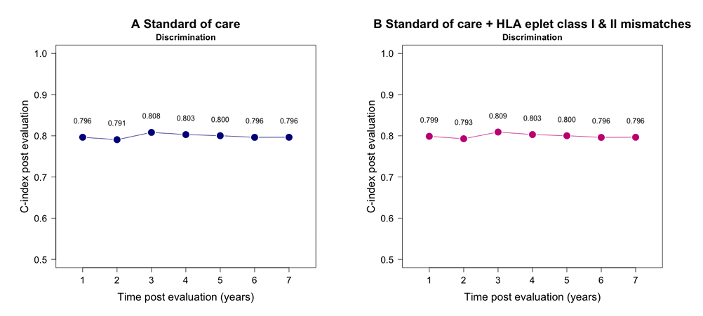
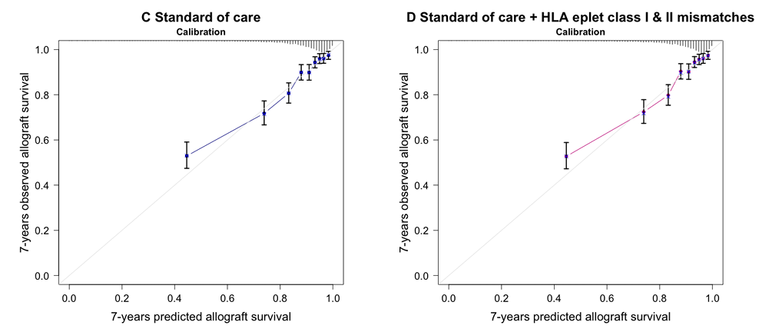
HLA eplet matching as a prognostic biomarker of kidney transplant outcomes
Results
Median follow-up post transplantation = 8.8 years (IQR 6.0-11.9), with 510 (14.1%) allograft failures during the follow-up
Median number of HLA eplet class I and II mismatches: respectively 16 (IQR 10-21) and 11 (IQR 5-17)
When stratifying the population according to the quartiles of the HLA eplet class I and II mismatches, no differences observed in terms of long-term allograft failure (log-rank test for class I and II mismatches: p=0.365 and 0.920 respectively)
The HLA eplet class I and II mismatches were not independently associated with long term allograft failure, with HR=1.00 (CI 0.99-1.01, p=0.856) and HR=1.00 (CI 0.99-1.01, p=0.863), respectively
Addition of HLA eplet class I and II mismatches to a standard of care (iBox) model did not increase its performance (c=statistics 0.796 vs 0.796 for the standard of care iBox model respectively
Similarly, the addition of HLA eplet mismatches to the standard of care iBox model did not improve the model’s calibration
Conclusions
This study shows in a large, deeply phenotyped population of kidney recipients, that HLA eplet matching does not add value to standard of care parameter for prognostication of long-term allograft outcome
Raynaud M. et al., ESOT Congress 2025 (Abstract 1834)
Notes:
Abbreviations: HLA, Human Leukocyte Antigen; IQR, Interquartile Range; HR, Hazard Ratio; CI, Confidence Interval.
Reference Number: 1834
HLA EPLET MATCHING AS A PROGNOSTIC BIOMARKER OF KIDNEY TRANSPLANT OUTCOMES
Marc Raynaud¹, Zeynep Demir¹, Kevin Louis¹, Agathe Truchot¹, Solaf Alawadhi², Renata Ponsirenas³, Roslyn Mannon⁴, Anat Tambur⁵, Carmen Lefaucheur¹, Alexandre Loupy¹
¹Paris Institute for Transplantation and Organ Regeneration, Paris, France, ²Houston Methodist Hospital, Houston, United States, ³Hospital Universitario Cajuru, Curitiba, Brazil, ⁴Department of Internal Medicine, Omaha, United States, ⁵Feinberg School of Medicine, Northwestern University, Chicago, United States
Background: HLA eplet matching has emerged as a potential biomarker for optimising organ allocation and improving patient management. However, its clinical relevance in terms of prognostic value is not demonstrated. We aimed to investigate the association between HLA eplet mismatches and long-term allograft failure, and its additional value beyond standard of care parameters.
Methods: The Paris Transplant Group qualified cohort (NCT03474003) consisted of 3,612 deeply phenotyped adult patients, prospectively enrolled at the time of transplantation in four french centers. The HLA eplet class I and II mismatch scores were calculated through high-resolution HLA typing, which encompasses the identification of specific configurations of epitopes (eplets) on both donor and recipient HLA molecules (HLAMatchmaker). Clinical, functional, histological and immunological parameters were collected for each patient. The iBox prediction system was used to evaluate the ability of HLA eplet mismatches to predict the long-term allograft survival beyond standard of care parameters.
Results: The median follow-up post transplantation was 8.8 years (IQR 6.0-11.9), with 510 (14.1%) allograft failures occuring during the follow-up. The median number of HLA eplet class I and II mismatches were respectively 16 (IQR 10-21) and 11 (IQR 5-17). When stratifying the population according to the quartiles of the HLA eplet class I and II mismatches, no differences were observed in terms of long-term allograft failure (log-rank test for class I and II mismatches: p=0.365 and 0.920 respectively). The HLA eplet class I and II mismatches were not independently associated with long term allograft failure, with HR=1.00 (CI 0.99-1.01, p=0.856) and HR=1.00 (CI 0.99-1.01, p=0.863), respectively. Last, addition of HLA eplet class I and II mismatches to a standard of care (iBox) model did not increase its performance (c=statistics 0.796 vs 0.796 for the standard of care iBox model respectively. Similarly, the addition of HLA eplet mismatches to the standard of care iBox model did not improve the model’s calibration.
Conclusions: Our study shows in a large, deeply phenotyped population of kidney recipients, that HLA eplet matching does not add value to standard of care parameter for prognostication of long-term allograft outcome.

Slide 21
One-year outcome of HMP(O2)-perfused kidneys after the implementation of a national machine perfusion service
Methods
Study:
Retrospective analysis, n=242 HMP-perfused kidney transplantations (DBD+DCD) between 1/10/2022 and 30/09/2023
49 from ECD (defined as a DBD donor between 50-60yrs old with 2/3 following criteria (arterial hypertension, serum creatinine>1.5mg/dl and death due to cerebrovascular accident) or a donor> 60yrs)
193 from DCD donors
Background
In October 2022, a national hypothermic machine perfusion (HMP) service was implemented for all kidneys from expanded criteria donors (ECD) and kidneys donated after circulatory death (DCD) procured and transplanted in Belgium
The aim of this study is to evaluate the functional one-year outcome of these kidneys continuously perfused with HMP
®
The LifePort Kidney Transporter ( Organ Recovery Systems) used for all MP procedures
Active oxygenation realized by preceding bubble O2 of the perfusate and continuous surface O2 during HMP applied to all DCD>50yrs and in study context in 14 DCD≤50yrs
Donor demographics and functional outcome analyzed
Darius T. et al., ESOT Congress 2025 (Abstract 714)
Notes:
Abbreviations: HMP, hypothermic machine perfusion; ECD, Expanded criteria donors; DCD, Donated after circulatory death; DBD, Donation after Brain Death.
Reference Number: 714
ONE-YEAR OUTCOME OF HMP(O2)-PERFUSED KIDNEYS AFTER THE IMPLEMENTATION OF A NATIONAL MACHINE PERFUSION SERVICE
Tom Darius¹, Ina Jochmans¹, Maxime Foguenne², Eric Hoste³, Caren Randon⁴, Geert Roeyen⁵, Bart Bracke⁶, Olivier Detry⁷, Laurent Weekers⁸, Daniel Jacob’s-Tulleneers Thevissen⁹, Tineke Bogaerts⁹, Dimitri Mikhalski¹⁰, Jean-Philippe De Wilde¹¹, Jacques Pirenne¹
¹University Hospitals Leuven, Abdominal Transplant Surgery, Leuven, Belgium, ²University Clinics Saint-Luc, Surgery and Abdominal Transplant Unit, Brussels, Belgium, ³Ghent University Hospital, Department of Intensive Care Medicine, Ghent, Belgium, ⁴Ghent University Hospital, Department of Thoracic and Vascular Surgery, Ghent, Belgium, ⁵University Hospital Antwerp, Department of Hepatobiliary Transplantation and Endocrine Surgery, Antwerp, Belgium, ⁶University Hospital of Antwerp, Department of Hepatobiliary Surgery, Antwerp, Belgium, ⁷University of Liège Hospital, Division of Abdominal Surgery and Transplantation, Liège, Belgium, ⁸University of Liège Hospital, Division of Nephrology, Liège, Belgium, ⁹Universitair Ziekenhuis Brussel, Diabetes Research Center, Brussels, Belgium, ¹⁰Hôpital Erasme, Department of Abdominal Surgery and Transplantation, Brussels, Belgium, ¹¹Hôpital Erasme, Department of Vascular Diseases, Brussels, Belgium
Background: In October 2022, a national hypothermic machine perfusion (HMP) service was implemented for all kidneys from expanded criteria donors (ECD) and kidneys donated after circulatory death (DCD) procured and transplanted in Belgium. The aim of this study is to evaluate the functional one-year outcome of these kidneys continuously perfused with HMP.
Methods: A retrospective analysis was performed on 242 HMP-perfused kidney transplantations (DBD+DCD) performed between 1/10/2022 and 30/09/2023 of which 49 from ECD (defined as a DBD donor between 50-60yrs old with 2/3 following criteria (arterial hypertension, serum creatinine>1.5mg/dl and death due to cerebrovascular accident) or a donor> 60yrs) and 193 from DCD donors. The LifePort Kidney Transporter (↓Organ Recovery Systems) was used for all MP procedures. Active oxygenation realized by preceding bubble O2 of the perfusate and continuous surface O2 during HMP was applied to all DCD>50yrs and in study context in 14 DCD≤50yrs$. Donor demographics and functional outcome were analyzed.
Results: The 1-year functional outcome according to donor type is illustrated in Table 1. Donor type Type of kidney preservation (HMP, HMPO2) All (ECD +DCD) HMP(O2) (n=242) DBD ECD HMP (n=49) DCD DCD≤50y DCD>50yrs HMP (n=193) Delayed graft function, % 14.35 9.14 16.67 HMP(O2)$ (n=77) 9.46 HMP(O2) (n=116) 19.64 Mean eGFR @1y, ml/min/1.73m2 Organ rejection @1y, % Death-censored graft survival @1y, % Patient survival @1y, % 54.25 10.05 96.28 98.34 52.03 2.33 100 95.91 54.69 12.82 94.34 98.96 61.10 8.96 97.40 100 49.73 14.00 93.97 98.28 The reasons for graft loss (13/242) were primary nonfunction (n=1), rejection (n=1), donor transmitted infection (n=1), graft infection (n=1), arterial thrombosis (n=1), venous thrombosis (n=2), unknown (n=2) and patient’s death (n=4).
Conclusions: Functional outcome of HMP-preserved kidneys after the introduction of a national HMP program for all ECD and DCD kidneys is excellent and reassures transplant teams in their decision-making process when such higher-risk kidneys are offered for transplantation.

Slide 22
One-year outcome of HMP(O2)-perfused kidneys after the implementation of a national machine perfusion service
Results
Conclusions
Functional outcome of HMP-preserved kidneys after the introduction of a national HMP program for all ECD and DCD kidneys is excellent and reassures transplant teams in their decision-making process when such higher-risk kidneys are offered for transplantation
The 1-year functional outcome according to donor type is illustrated:
 | All (ECD + DCD) | DBD ECD | DCD | DCD≤50y | DCD>50yrs
Type of kidney preservation (HMP, HMP(O₂) | HMP(O₂) (n=242) | HMP (n=49) | HMP (n=193) | HMP(O₂)⁵ (n=77) | HMP(O₂) (n=116)
Delayed graft function, % | 14.35 | 9.14 | 16.67 | 9.46 | 19.64
Mean eGFR @1y, ml/min/1.73m² | 54.25 | 52.03 | 54.69 | 61.10 | 49.73
Organ rejection @1y, % | 10.05 | 2.33 | 12.82 | 8.96 | 14.00
Death-censored graft survival @1y, % | 96.28 | 100 | 94.34 | 97.40 | 93.97
Patient survival @1y, % | 98.34 | 95.91 | 98.96 | 100 | 98.28
The reasons for graft loss (13/242) were primary nonfunction (n=1), rejection (n=1), donor transmitted infection (n=1), graft infection (n=1), arterial thrombosis (n=1), venous thrombosis (n=2), unknown (n=2) and patient’s death (n=4)
Darius T. et al., ESOT Congress 2025 (Abstract 714)
Notes:
Abbreviations: HMP, hypothermic machine perfusion; ECD, Expanded criteria donors; DCD, Donated after circulatory death; DBD, Donation after Brain Death.
Reference Number: 714
ONE-YEAR OUTCOME OF HMP(O2)-PERFUSED KIDNEYS AFTER THE IMPLEMENTATION OF A NATIONAL MACHINE PERFUSION SERVICE
Tom Darius¹, Ina Jochmans¹, Maxime Foguenne², Eric Hoste³, Caren Randon⁴, Geert Roeyen⁵, Bart Bracke⁶, Olivier Detry⁷, Laurent Weekers⁸, Daniel Jacob’s-Tulleneers Thevissen⁹, Tineke Bogaerts⁹, Dimitri Mikhalski¹⁰, Jean-Philippe De Wilde¹¹, Jacques Pirenne¹
¹University Hospitals Leuven, Abdominal Transplant Surgery, Leuven, Belgium, ²University Clinics Saint-Luc, Surgery and Abdominal Transplant Unit, Brussels, Belgium, ³Ghent University Hospital, Department of Intensive Care Medicine, Ghent, Belgium, ⁴Ghent University Hospital, Department of Thoracic and Vascular Surgery, Ghent, Belgium, ⁵University Hospital Antwerp, Department of Hepatobiliary Transplantation and Endocrine Surgery, Antwerp, Belgium, ⁶University Hospital of Antwerp, Department of Hepatobiliary Surgery, Antwerp, Belgium, ⁷University of Liège Hospital, Division of Abdominal Surgery and Transplantation, Liège, Belgium, ⁸University of Liège Hospital, Division of Nephrology, Liège, Belgium, ⁹Universitair Ziekenhuis Brussel, Diabetes Research Center, Brussels, Belgium, ¹⁰Hôpital Erasme, Department of Abdominal Surgery and Transplantation, Brussels, Belgium, ¹¹Hôpital Erasme, Department of Vascular Diseases, Brussels, Belgium
Background: In October 2022, a national hypothermic machine perfusion (HMP) service was implemented for all kidneys from expanded criteria donors (ECD) and kidneys donated after circulatory death (DCD) procured and transplanted in Belgium. The aim of this study is to evaluate the functional one-year outcome of these kidneys continuously perfused with HMP.
Methods: A retrospective analysis was performed on 242 HMP-perfused kidney transplantations (DBD+DCD) performed between 1/10/2022 and 30/09/2023 of which 49 from ECD (defined as a DBD donor between 50-60yrs old with 2/3 following criteria (arterial hypertension, serum creatinine>1.5mg/dl and death due to cerebrovascular accident) or a donor> 60yrs) and 193 from DCD donors. The LifePort Kidney Transporter (↓Organ Recovery Systems) was used for all MP procedures. Active oxygenation realized by preceding bubble O2 of the perfusate and continuous surface O2 during HMP was applied to all DCD>50yrs and in study context in 14 DCD≤50yrs$. Donor demographics and functional outcome were analyzed.
Results: The 1-year functional outcome according to donor type is illustrated in Table 1. Donor type Type of kidney preservation (HMP, HMPO2) All (ECD +DCD) HMP(O2) (n=242) DBD ECD HMP (n=49) DCD DCD≤50y DCD>50yrs HMP (n=193) Delayed graft function, % 14.35 9.14 16.67 HMP(O2)$ (n=77) 9.46 HMP(O2) (n=116) 19.64 Mean eGFR @1y, ml/min/1.73m2 Organ rejection @1y, % Death-censored graft survival @1y, % Patient survival @1y, % 54.25 10.05 96.28 98.34 52.03 2.33 100 95.91 54.69 12.82 94.34 98.96 61.10 8.96 97.40 100 49.73 14.00 93.97 98.28 The reasons for graft loss (13/242) were primary nonfunction (n=1), rejection (n=1), donor transmitted infection (n=1), graft infection (n=1), arterial thrombosis (n=1), venous thrombosis (n=2), unknown (n=2) and patient’s death (n=4).
Conclusions: Functional outcome of HMP-preserved kidneys after the introduction of a national HMP program for all ECD and DCD kidneys is excellent and reassures transplant teams in their decision-making process when such higher-risk kidneys are offered for transplantation.

Slide 23
Rescuing donor kidneys for transplantation at a dedicated normothermic perfusion center
Background
In 2024, 31,677 deceased donor kidneys were recovered in the US with the intent to transplant, however 9,266 (29%) were discarded
Rescue of these organs may be facilitated using normothermic machine perfusion (NMP), which can prolong out of body time and provide additional viability assessment
While NMP has been increasingly used internationally, barriers to adoption of NMP in the US include limited availability, staffing and facility resource limitations, geographic distances between donor and recipient hospitals, blood shortage, and nationwide reliance on hypothermic machine perfusion (HMP)
Organized as an independent public benefit company, this center was constructed to provide NMP as a regional hub-and spoke service to transplant centers and Organ Procurement Organizations (OPOs), offering functional assessment of unused donor kidneys (Table 1):
Renal Biomarker | Ice (4°C) | HMP (4°C) | NMP (35°C)
Renal Flow Rate |  | ✓ | ✓
Renal Pressure |  | ✓ | ✓
Renal Resistance |  | ✓ | ✓
Perfusate pO₂/ pCO₂/ pH |  |  | ✓
Urine pO₂ |  |  | ✓
TCO₂/ HCO₃⁻/ Base Excess |  |  | ✓
Perfusate Na⁺/ K⁺/ Cl⁻ |  |  | ✓
Urine Na⁺/ K⁺/ Cl⁻ |  |  | ✓
Lactate/ Glucose |  |  | ✓
AST (marker of mitochondrial death) |  |  | ✓
Oxygen Consumption |  |  | ✓
Hosgood Transplant Suitability Score |  |  | ✓
Methods
The first regional NMP center for discarded kidneys in West Lafayette, Indiana was established to overcome obstacles to US-based NMP
Jaynes C. et al., ESOT Congress 2025 (Abstract 1095)
Notes:
Abbreviations: NMP, normothermic machine perfusion ; HMP, hypothermic machine perfusion; OPOs, Organ Procurement Organizations; CIT, cold ischemic time; HTTP, Hypertension; NRP, Normothermic Regional Perfusion; KDPI, Kidney Donor Profile Index.
Reference Number: 1095
RESCUING DONOR KIDNEYS FOR TRANSPLANTATION AT A DEDICATED NORMOTHERMIC PERFUSION CENTER
Chris Jaynes^{1,2}, William Goggins³, Matthew Holzner⁴, Jacqueline Garonzik-Wang⁵, Henri Leuvenink^{1,2}
¹University Medical Center Groningen, Department of Surgery, Groningen, The Netherlands, ²34 Lives, Public Benefit Company, West Lafayette, United States, ³Indiana University Health, Department of Surgery, Division of Transplantation, Indianapolis, United States, ⁴The Recanati/Miller Transplantation Institute (RMTI), New York, United States, ⁵University of Wisconsin–Madison, Department of Surgery, Madison, United States
Background: In 2024, 31,677 deceased donor kidneys were recovered in the US with the intent to transplant, however 9,266 (29%) were discarded. Rescue of these organs may be facilitated using normothermic machine perfusion (NMP), which can prolong out of body time and provide additional viability assessment. While NMP has been increasingly used internationally, barriers to adoption of NMP in the US include limited availability, staffing and facility resource limitations, geographic distances between donor and recipient hospitals, blood shortage, and nationwide reliance on hypothermic machine perfusion (HMP).
Methods: To overcome obstacles to US-based NMP, the first regional NMP center for discarded kidneys was established in West Lafayette, Indiana. Organized as an independent public benefit company, this center was constructed to provide NMP as a regional hub-and spoke service to transplant centers and Organ Procurement Organizations (OPOs), offering functional assessment of unused donor kidneys (Table 1). An acellular, human serum albumin- based perfusate was chosen and validated pre-clinically to avoid the need for blood. Additionally, an extended second cold ischemic time was validated during the pre clinical testing to mimic transportation from the central NMP center to the accepting transplant hospital. Central IRB approval was granted in March 2024, and the first kidney was transplanted after NMP on April 20th, 2024 (clinicaltrials.gov: NCT06263023).
Results: To date, 68 unused kidneys were transported to the central NMP center. 59 (87%) of these kidneys were transplanted successfully after NMP by 9 transplant centers. Median initial cold ischemic time (CIT) prior to NMP was 20.3 hours (range 11.5- 30 hrs). Median transport CIT (after NMP and prior to transplant) was 15 hours (range 9- 33 hrs) with median total out of body time (donor cross clamp to recipient reperfusion) of 38.5 hours (range 27.2- 60 hrs). Characteristics of donor kidneys transplanted after NMP can be found in Table 2.
Conclusions: Acellular NMP is feasible when performed by a centralized hub and reduces kidney discard by providing objective viability assessment. Moreover, NMP allows for extended preservation times up to 60 hours, enabling improved logistical planning and broader sharing of deceased donor kidneys.

Slide 24
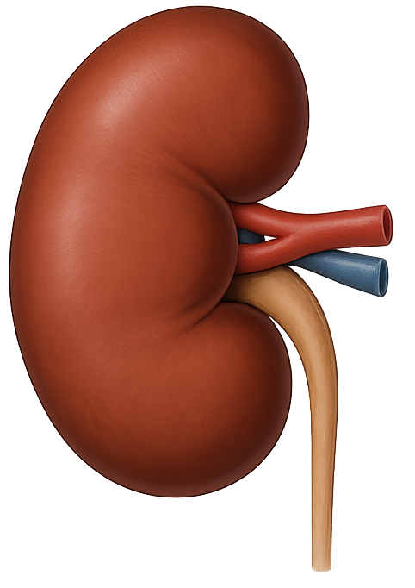
Rescuing donor kidneys for transplantation at a dedicated normothermic perfusion center
Characteristics of donor kidneys transplanted after NMP can be found in Table 2
Methods (cont.)
An acellular, human serum albumin- based perfusate was chosen and validated pre-clinically to avoid the need for blood
Characteristic | Median | Range/Notes
Donor Age (years) | Median: 53 | Range: 15–69
# DCD Donors | 36 (57%) | With NRP: 8 (14%)
# Donors with HTN | 35 (59%)
Glomerular Sclerosis % | Median: 4 | Range: 0–71
Peak sCr (mg/dL) | Median: 1.61 | Range: 0.7–11.09
KDPI % | Median: 64 | Range: 24–98
1st CIT pre-NMP | Median: 20.2 hrs | Range: 11.5–30 hrs
2nd CIT post-NMP | Median: 15 hrs | Range: 9–33 hrs
Total Out Of Body Time | Median: 38.5 hrs | Range: 27.2–60 hrs
Renal Resistance pre-NMP | Median: 0.24 | Range: 0.08–1.03
Renal Resistance post-NMP | Median: 0.14 | Range: 0.05–0.30
An extended second cold ischemic time was validated during the pre-clinical testing to mimic transportation from the central NMP center to the accepting transplant hospital. Central IRB approval was granted in March 2024, and the first kidney was transplanted after NMP on April 20th, 2024 (clinicaltrials.gov: NCT06263023)
Results
Median initial cold ischemic time (CIT) prior to NMP = 20.3 hours (range 11.5- 30 hrs)
Median transport CIT (after NMP and prior to transplant) = 15 hours (range 9- 33 hrs) with median total out of body time (donor cross clamp to recipient reperfusion) of 38.5 hours (range 27.2- 60 hrs)
n=68 unused kidneys
n=59 (87%) transplanted successfully after NMP by 9 transplant centers
Conclusions
Acellular NMP is feasible when performed by a centralized hub and reduces kidney discard by providing objective viability assessment
Moreover, NMP allows for extended preservation times up to 60 hours, enabling improved logistical planning and broader sharing of deceased donor kidneys
Jaynes C. et al., ESOT Congress 2025 (Abstract 1095)
Notes:
Abbreviations: NMP, normothermic machine perfusion ; HMP, hypothermic machine perfusion; OPOs, Organ Procurement Organizations; CIT, cold ischemic time; HTTP, Hypertension; NRP, Normothermic Regional Perfusion; KDPI, Kidney Donor Profile Index.
Reference Number: 1095
RESCUING DONOR KIDNEYS FOR TRANSPLANTATION AT A DEDICATED NORMOTHERMIC PERFUSION CENTER
Chris Jaynes^{1,2}, William Goggins³, Matthew Holzner⁴, Jacqueline Garonzik-Wang⁵, Henri Leuvenink^{1,2}
¹University Medical Center Groningen, Department of Surgery, Groningen, The Netherlands, ²34 Lives, Public Benefit Company, West Lafayette, United States, ³Indiana University Health, Department of Surgery, Division of Transplantation, Indianapolis, United States, ⁴The Recanati/Miller Transplantation Institute (RMTI), New York, United States, ⁵University of Wisconsin–Madison, Department of Surgery, Madison, United States
Background: In 2024, 31,677 deceased donor kidneys were recovered in the US with the intent to transplant, however 9,266 (29%) were discarded. Rescue of these organs may be facilitated using normothermic machine perfusion (NMP), which can prolong out of body time and provide additional viability assessment. While NMP has been increasingly used internationally, barriers to adoption of NMP in the US include limited availability, staffing and facility resource limitations, geographic distances between donor and recipient hospitals, blood shortage, and nationwide reliance on hypothermic machine perfusion (HMP).
Methods: To overcome obstacles to US-based NMP, the first regional NMP center for discarded kidneys was established in West Lafayette, Indiana. Organized as an independent public benefit company, this center was constructed to provide NMP as a regional hub-and spoke service to transplant centers and Organ Procurement Organizations (OPOs), offering functional assessment of unused donor kidneys (Table 1). An acellular, human serum albumin- based perfusate was chosen and validated pre-clinically to avoid the need for blood. Additionally, an extended second cold ischemic time was validated during the pre clinical testing to mimic transportation from the central NMP center to the accepting transplant hospital. Central IRB approval was granted in March 2024, and the first kidney was transplanted after NMP on April 20th, 2024 (clinicaltrials.gov: NCT06263023). Results: To date, 68 unused kidneys were transported to the central NMP center. 59 (87%) of these kidneys were transplanted successfully after NMP by 9 transplant centers. Median initial cold ischemic time (CIT) prior to NMP was 20.3 hours (range 11.5- 30 hrs). Median transport CIT (after NMP and prior to transplant) was 15 hours (range 9- 33 hrs) with median total out of body time (donor cross clamp to recipient reperfusion) of 38.5 hours (range 27.2- 60 hrs). Characteristics of donor kidneys transplanted after NMP can be found in Table 2.
Conclusions: Acellular NMP is feasible when performed by a centralized hub and reduces kidney discard by providing objective viability assessment. Moreover, NMP allows for extended preservation times up to 60 hours, enabling improved logistical planning and broader sharing of deceased donor kidneys.

Slide 25
Is living kidney donation with expanded criteria safe for the donor? Long-term follow-up from the Catalan registry
Background
In order to reduce the waiting list for kidney transplantation, Spain has seen a growing number of living donors with expanded criteria in recent years
This implied a great concern for the safety of the donors regarding survival and evolution of renal function
Results
Initial pre-donation difference in the estimated glomerular filtration rate (eGFR) when the donor is >70 years old compared to those under 70 years old (79.5 ml/min vs. 93.4 ml/min, p70 ml/min)
This difference persists throughout the follow up, with no evidence of progressive long-term eGFR loss in either group
Similarly, the eGFR remains very stable in donors with lower pre-donation CKD-EPI (70 ml/min)
During the follow-up period, 48 living donors died (1.92%)
Just 2 donors required dialysis and were transplanted immediately using deceased donors
Methods
Study:
n=2.510 living donor kidney transplants characteristics using the Catalan Registry of Kidney Living Donors performed in Catalonia between the years 2000 and 2023
Outcome:
Long-term donor’s survival and the evolution of their renal function
Neoplasia
29.2%
Unknown
41.7%
8.3%
Infections
6.2%
14.6%
Other causes
Cardiovascular causes
Alabau Perich R. et al., ESOT Congress 2025 (Abstract 1588)
Notes:
Abbreviations: eGFR, estimated glomerular filtration rate; CKD EPI, Chronic Kidney Disease Epidemiology Collaboration.
Reference Number: 1588
IS LIVING KIDNEY DONATION WITH EXPANDED CRITERIA SAFE FOR THE DONOR? LONG-TERM FOLLOW-UP FROM THE CATALAN REGISTRY
Roger Alabau Perich¹, Lluis Guirado Perich¹, Jordi Comas², Nuria Serra Cabañas¹, Christian Córdoba Herrera¹, Monica Pérez Mir¹, Leonor Fayos de Arizon¹, Jaume Tort², Ignacio Revuelta³, Anna Manonelles⁴, Carme Facundo¹, Francesc Moreso⁵, Marta Crespo⁶, Laura Cañas⁷, Emma Arcos²
¹Fundació Puigvert, Nephrology, Barcelona, Spain, ²Organització Catalana de Trasplantaments, Technical Data, Barcelona, Spain, ³Hospital Clínic i Provincial, Barcelona, Spain, ⁴Hospital de Bellvitge, Barcelona, Spain, ⁵Hospital Vall d'Hebron, Barcelona, Spain, ⁶Hospital del Mar, Barcelona, Spain, ⁷Hospital Germans Trias i Pujol, Barcelona, Spain
Background: In order to reduce the waiting list for kidney transplantation, Spain has seen a growing number of living donors with expanded criteria in recent years. This implied a great concern for the safety of the donors regarding survival and evolution of renal function.
Methods: Using the Catalan Registry of Kidney Living Donors, we describe the characteristics of 2.510 living donor kidney transplants performed in Catalonia between the years 2000 and 2023 in order to observe long-term donor’s survival and the evolution of their renal function.
Results: There is an initial pre-donation difference in the estimated glomerular filtration rate (eGFR) when the donor is >70 years old compared to those under 70 years old (79.5 ml/min vs. 93.4 ml/min, p70 ml/min). During the follow-up period, 48 living donors died (1.92%). The main causes were neoplasia (29.2%), infections (8.3%), cardiovascular causes (6.2%) other causes (14.6%) and unknown (41.7%). Just 2 donors required dialysis and were transplanted immediately using deceased donors. The following table shows the results for our main concern, the long term evolution of the living donors’ renal function according to different characteristics. Living donors CKD EPI ml/min Basal 3rd month 1 year 3y 5y 10y p-value >70 years n=127 78 51.6 51.9 57.1 55.1 54.8 < 70 ml/min n=163 CKD EPI > 70 ml/min n=1903 Proteinuria > 150 mg/24 h n=312 Proteinuria < 150 mg/24 h n=2132 68 95,2 91.7 93.2 51.3 63.1 63.6 62.5 53.3 64.3 63.3 63.4 56.9 67.4 64.9 66.9 56.4 68 64.6 67.5 56.3 68.7 64.3 68 P=0.0000 p>0’05
Conclusions: Throughout the follow-up, we found statistically significant differences in post-donation renal function among living donors based on their age and glomerular filtration rate at the time of donation. However, the glomerular filtration rate measured three months after donation remains very stable over 10 years of follow-up, both in living donors with expanded criteria and those without, ensuring that donation in this type of donor is safe in the long term.

Slide 26
Is living kidney donation with expanded criteria safe for the donor? Long-term follow-up from the Catalan registry
Results (Cont.)
The following table shows the results for the long-term evolution of the living donors’ renal function according to different characteristics:
Living donors CKD EPI ml/min | Basal | 3rd month | 1 year | 3y | 5y | 10y | p-value
>70 years n=127 | 78 | 51,6 | 51,9 | 57,1 | 55,1 | 54,8
<70 years n=1939 | 93 | 62,8 | 64,1 | 67,1 | 67,9 | 68,3
CKD EPI <70 ml/min n=163 | 68 | 51,3 | 53,3 | 56,9 | 56,4 | 56,3
CKD EPI > 70 ml/min n=1903 | 95,2 | 63,1 | 64,3 | 67,4 | 68 | 68,7
Proteinuria > 150 mg/24 h n=312 | 91,7 | 63,6 | 63,3 | 64,9 | 64,6 | 64,3
Proteinuria < 150 mg/24 h n=2132 | 93,2 | 62,5 | 63,4 | 66,9 | 67,5 | 68
P=0.0000
P=0.0000
P>0.05
Conclusions
Throughout the follow-up, statistically significant differences were observed in post-donation renal function among living donors based on their age and glomerular filtration rate at the time of donation
However, the glomerular filtration rate measured three months after donation remains very stable over 10 years of follow-up, both in living donors with expanded criteria and those without, ensuring that donation in this type of donor is safe in the long term
Alabau Perich R. et al., ESOT Congress 2025 (Abstract 1588)
Notes:
Abbreviations: eGFR, estimated glomerular filtration rate; CKD EPI, Chronic Kidney Disease Epidemiology Collaboration.
Reference Number: 1588
IS LIVING KIDNEY DONATION WITH EXPANDED CRITERIA SAFE FOR THE DONOR? LONG-TERM FOLLOW-UP FROM THE CATALAN REGISTRY
Roger Alabau Perich¹, Lluis Guirado Perich¹, Jordi Comas², Nuria Serra Cabañas¹, Christian Córdoba Herrera¹, Monica Pérez Mir¹, Leonor Fayos de Arizon¹, Jaume Tort², Ignacio Revuelta³, Anna Manonelles⁴, Carme Facundo¹, Francesc Moreso⁵, Marta Crespo⁶, Laura Cañas⁷, Emma Arcos²
¹Fundació Puigvert, Nephrology, Barcelona, Spain, ²Organització Catalana de Trasplantaments, Technical Data, Barcelona, Spain, ³Hospital Clínic i Provincial, Barcelona, Spain, ⁴Hospital de Bellvitge, Barcelona, Spain, ⁵Hospital Vall d'Hebron, Barcelona, Spain, ⁶Hospital del Mar, Barcelona, Spain, ⁷Hospital Germans Trias i Pujol, Barcelona, Spain
Background: In order to reduce the waiting list for kidney transplantation, Spain has seen a growing number of living donors with expanded criteria in recent years. This implied a great concern for the safety of the donors regarding survival and evolution of renal function.
Methods: Using the Catalan Registry of Kidney Living Donors, we describe the characteristics of 2.510 living donor kidney transplants performed in Catalonia between the years 2000 and 2023 in order to observe long-term donor’s survival and the evolution of their renal function.
Results: There is an initial pre-donation difference in the estimated glomerular filtration rate (eGFR) when the donor is >70 years old compared to those under 70 years old (79.5 ml/min vs. 93.4 ml/min, p70 ml/min). During the follow-up period, 48 living donors died (1.92%). The main causes were neoplasia (29.2%), infections (8.3%), cardiovascular causes (6.2%) other causes (14.6%) and unknown (41.7%). Just 2 donors required dialysis and were transplanted immediately using deceased donors. The following table shows the results for our main concern, the long term evolution of the living donors’ renal function according to different characteristics. Living donors CKD EPI ml/min Basal 3rd month 1 year 3y 5y 10y p-value >70 years n=127 78 51.6 51.9 57.1 55.1 54.8 < 70 ml/min n=163 CKD EPI > 70 ml/min n=1903 Proteinuria > 150 mg/24 h n=312 Proteinuria < 150 mg/24 h n=2132 68 95,2 91.7 93.2 51.3 63.1 63.6 62.5 53.3 64.3 63.3 63.4 56.9 67.4 64.9 66.9 56.4 68 64.6 67.5 56.3 68.7 64.3 68 P=0.0000 p>0’05
Conclusions: Throughout the follow-up, we found statistically significant differences in post-donation renal function among living donors based on their age and glomerular filtration rate at the time of donation. However, the glomerular filtration rate measured three months after donation remains very stable over 10 years of follow-up, both in living donors with expanded criteria and those without, ensuring that donation in this type of donor is safe in the long term.

Slide 27
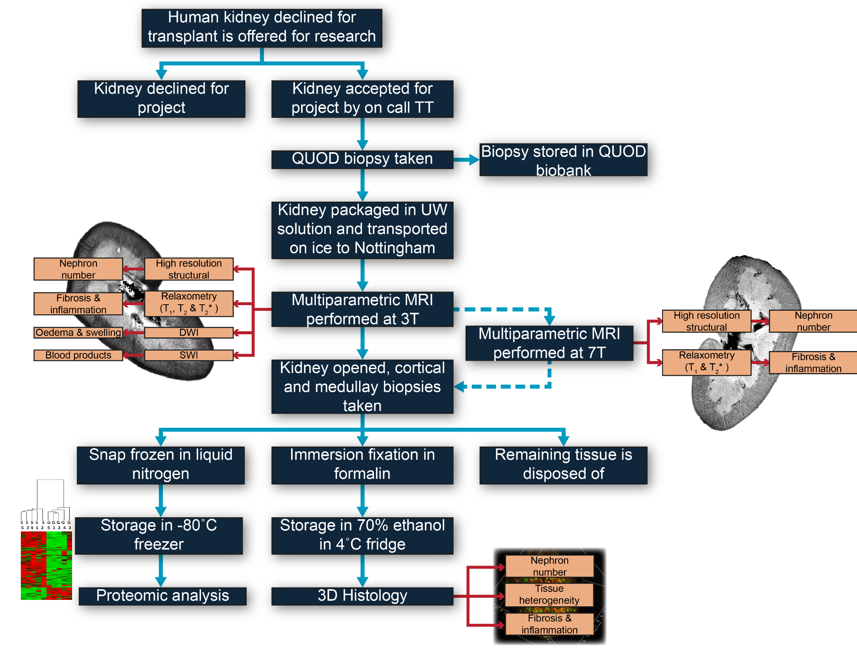
Development of a magnetic resonance imaging protocol for ex-vivo assessment of deceased donor human kidneys
Background
In the UK deceased donor kidney viability is currently assessed using donor age, medical history, and estimated glomerular filtration rate, but these have limited predictive power resulting in potentially viable donor organs not being transplanted
The development of a rapid, non-invasive, assessment method of deceased donor kidney quality, ex-vivo, prior to transplant, would give clinicians confidence in determining the viability of donor kidneys
Here, we outline a Magnetic Resonance Imaging (MRI) protocol to study whole human kidneys that have been declined for transplant, integrating MRI measures with 3D-histology and tissue proteomics to develop an assessment protocol of deceased donor quality
Methods
The research pathway of a declined kidney
Daniel A. et al., ESOT Congress 2025 (Abstract 1466)
Notes:
Abbreviations: MRI, Magnetic Resonance Imaging; QUOD, Quality in Organ Donation; ADC, Apparent Diffusion Coefficient; SWI, Susceptibility-Weighted Imaging; MTR, Magnetisation transfer ratio.
Reference Number: 1466
DEVELOPMENT OF A MAGNETIC RESONANCE IMAGING PROTOCOL FOR EX-VIVO ASSESSMENT OF DECEASED DONOR HUMAN KIDNEYS
Alexander Daniel¹, Sarah Fawaz², Philip Charles³, Mohamed Elzawahry², Jane Grove⁴, David Long⁵, James Hunter², Maria Kaisar², Susan Francis¹
¹University of Nottingham, Sir Peter Mansfield Imaging Centre, Nottingham, United Kingdom, ²University of Oxford, Nuffield Department of Surgical Sciences, Oxford, United Kingdom, ³University of Oxford, Big Data Institute, Oxford, United Kingdom, ⁴Nottingham University Hospitals NHS Trust and the University of Nottingham, NIHR Nottingham Biomedical Research Centre, Nottingham, United Kingdom, ⁵University College London Great Ormond Street Institute of Child Health, Developmental Biology and Cancer Department, London, United Kingdom
Background: In the UK deceased donor kidney viability is currently assessed using donor age, medical history, and estimated glomerular filtration rate, but these have limited predictive power resulting in potentially viable donor organs not being transplanted. The development of a rapid, non-invasive, assessment method of deceased donor kidney quality, ex-vivo, prior to transplant, would give clinicians confidence in determining the viability of donor kidneys. Here, we outline a Magnetic Resonance Imaging (MRI) protocol to study whole human kidneys that have been declined for transplant, integrating MRI measures with 3D-histology and tissue proteomics to develop an assessment protocol of deceased donor quality.
Methods: The research pathway of a declined kidney is shown below. The kidneys are retrieved for transplant but later declined and offered for research through the Quality in Organ Donation (QUOD) programme. Preparation mimics clinical practice; kidneys are flushed to remove any blood, bagged in University of Wisconsin solution and transported on ice. All kidneys are scanned on a 3T MRI system in a head coil. The MRI protocol collects high resolution structural, relaxometry, Apparent Diffusion Coefficient (ADC), Susceptibility-Weighted Imaging (SWI), magnetisation transfer ratio (MTR), fat/water, and field mapping scans. After MRI acquisition, the kidneys are cut lengthwise, and 24 punch biopsies taken from both the cortex and medulla. Half of these are formalin fixed for 3D-histology analysis; the other half are snap frozen for proteomic analysis.
Results: To date, fifteen kidneys have been imaged and biopsies taken. The images acquired from a representative subject are shown above. SWI data is especially effective for detecting any remaining blood products that should have been flushed at retrieval.
Conclusions: An MRI protocol has been developed to allow the assessment of donor kidneys, with samples subsequently being collected for validation via histology and proteomics. This work aims to establish a framework to allow non-invasive, whole kidney, assessment and potentially facilitate future donor kidney evaluations.
Acknowledgements: We acknowledge the funding support of Kidney Research UK (KS_RP_002_20210111), and the support of the NIHR Nottingham Biomedical Research Centre.

Slide 28
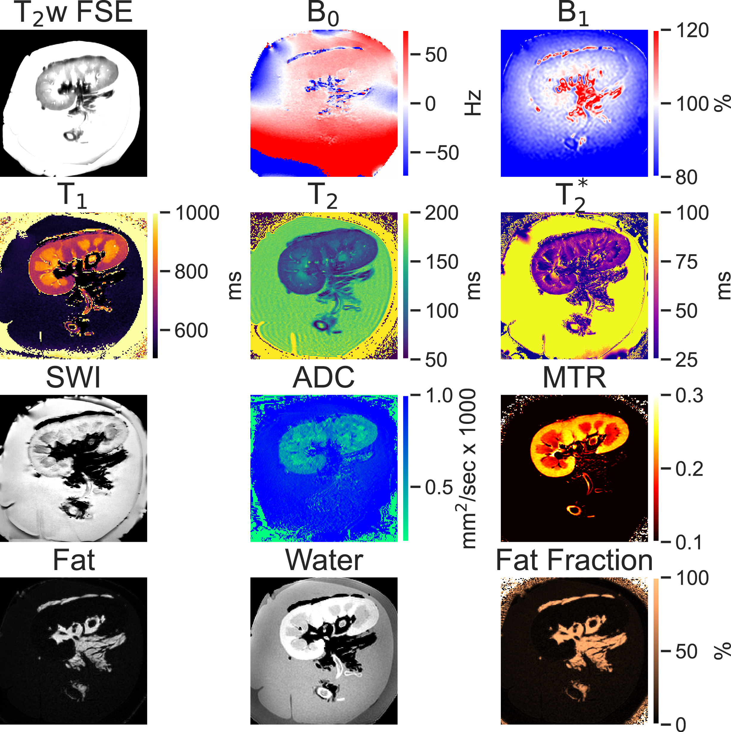
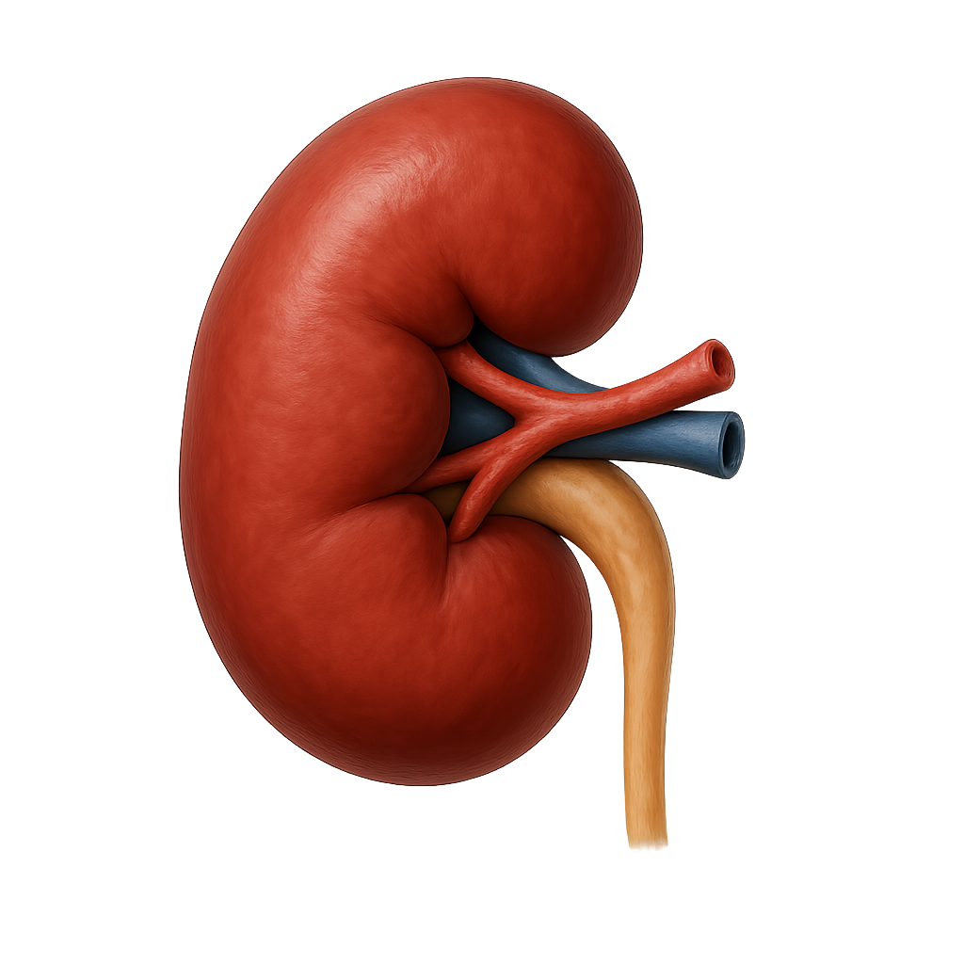
Development of a magnetic resonance imaging protocol for ex-vivo assessment of deceased donor human kidneys
Methods (Cont.)
The kidneys are retrieved for transplant but later declined and offered for research through the Quality in Organ Donation (QUOD) programme
Preparation mimics clinical practice; kidneys are flushed to remove any blood, bagged in University of Wisconsin solution and transported on ice
Results:
To date, n=15 kidneys have been imaged and biopsies taken
The images acquired from a representative subject are shown. SWI data is especially effective for detecting any remaining blood products that should have been flushed at retrieval
All kidneys are scanned on a 3T MRI system in a head coil The MRI protocol collects:
High resolution structural scans
Relaxometry
Apparent Diffusion Coefficient (ADC)
Susceptibility-Weighted Imaging (SWI)
Magnetisation transfer ratio (MTR)
Fat/water
Field mapping scans
Conclusions
An MRI protocol has been developed to allow the assessment of donor kidneys, with samples subsequently being collected for validation via histology and proteomics
This work aims to establish a framework to allow non-invasive, whole kidney, assessment and potentially facilitate future donor kidney evaluations
After MRI acquisition, the kidneys are cut lengthwise, and 24 punch biopsies taken from both the cortex and medulla
Half of these are formalin fixed for 3D-histology analysis; the other half are snap frozen for proteomic analysis
Daniel A. et al., ESOT Congress 2025 (Abstract 1466)
Notes:
Abbreviations: MRI, Magnetic Resonance Imaging; QUOD, Quality in Organ Donation; ADC, Apparent Diffusion Coefficient; SWI, Susceptibility-Weighted Imaging; MTR, Magnetisation transfer ratio.
Reference Number: 1466
DEVELOPMENT OF A MAGNETIC RESONANCE IMAGING PROTOCOL FOR EX-VIVO ASSESSMENT OF DECEASED DONOR HUMAN KIDNEYS
Alexander Daniel¹, Sarah Fawaz², Philip Charles³, Mohamed Elzawahry², Jane Grove⁴, David Long⁵, James Hunter², Maria Kaisar², Susan Francis¹
¹University of Nottingham, Sir Peter Mansfield Imaging Centre, Nottingham, United Kingdom, ²University of Oxford, Nuffield Department of Surgical Sciences, Oxford, United Kingdom, ³University of Oxford, Big Data Institute, Oxford, United Kingdom, ⁴Nottingham University Hospitals NHS Trust and the University of Nottingham, NIHR Nottingham Biomedical Research Centre, Nottingham, United Kingdom, ⁵University College London Great Ormond Street Institute of Child Health, Developmental Biology and Cancer Department, London, United Kingdom
Background: In the UK deceased donor kidney viability is currently assessed using donor age, medical history, and estimated glomerular filtration rate, but these have limited predictive power resulting in potentially viable donor organs not being transplanted. The development of a rapid, non-invasive, assessment method of deceased donor kidney quality, ex-vivo, prior to transplant, would give clinicians confidence in determining the viability of donor kidneys. Here, we outline a Magnetic Resonance Imaging (MRI) protocol to study whole human kidneys that have been declined for transplant, integrating MRI measures with 3D-histology and tissue proteomics to develop an assessment protocol of deceased donor quality.
Methods: The research pathway of a declined kidney is shown below. The kidneys are retrieved for transplant but later declined and offered for research through the Quality in Organ Donation (QUOD) programme. Preparation mimics clinical practice; kidneys are flushed to remove any blood, bagged in University of Wisconsin solution and transported on ice. All kidneys are scanned on a 3T MRI system in a head coil. The MRI protocol collects high resolution structural, relaxometry, Apparent Diffusion Coefficient (ADC), Susceptibility-Weighted Imaging (SWI), magnetisation transfer ratio (MTR), fat/water, and field mapping scans. After MRI acquisition, the kidneys are cut lengthwise, and 24 punch biopsies taken from both the cortex and medulla. Half of these are formalin fixed for 3D-histology analysis; the other half are snap frozen for proteomic analysis.
Results: To date, fifteen kidneys have been imaged and biopsies taken. The images acquired from a representative subject are shown above. SWI data is especially effective for detecting any remaining blood products that should have been flushed at retrieval.
Conclusions: An MRI protocol has been developed to allow the assessment of donor kidneys, with samples subsequently being collected for validation via histology and proteomics. This work aims to establish a framework to allow non-invasive, whole kidney, assessment and potentially facilitate future donor kidney evaluations.
Acknowledgements: We acknowledge the funding support of Kidney Research UK (KS_RP_002_20210111), and the support of the NIHR Nottingham Biomedical Research Centre.

