Slide 1


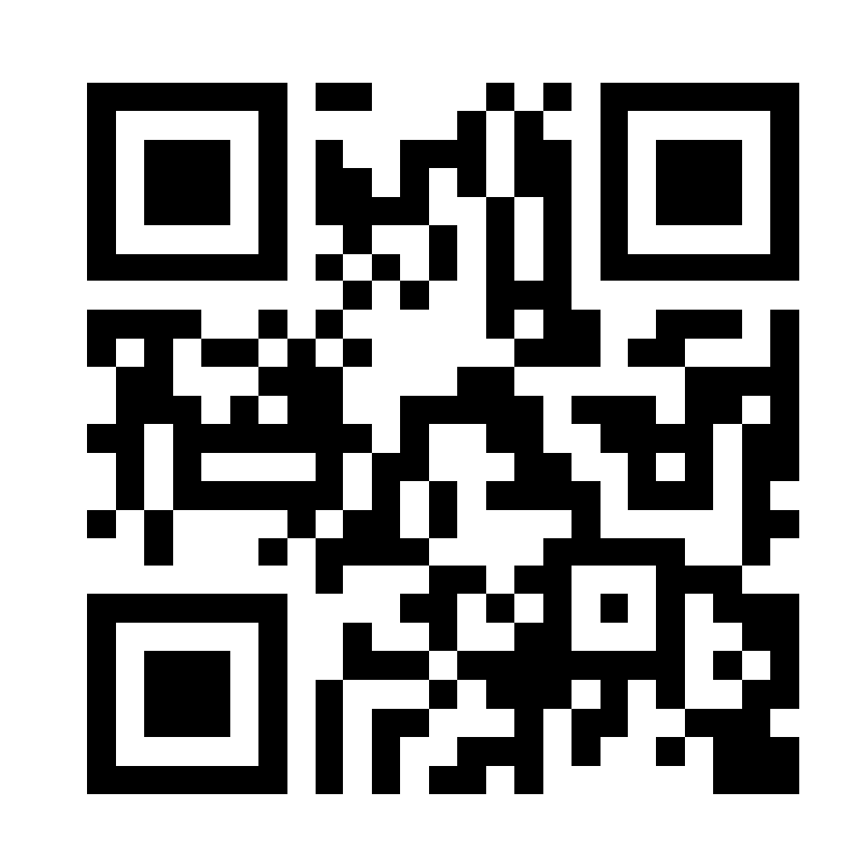

#ELPATcongress
6th ELPAT Congress
Ethical, Legal and Psychosocial Aspects of Transplantation.
New Technologies – Evolving Humanities
9-12 October 2025
Seville, Spain
17 March 2025 – Abstract submissions open
14 April 2025 – Registration opens
19 May 2025 – Abstract submission deadline
Scan the QR code to
get the latest news

Slide 2
Organising Committee
Christina Papachristou
Thessaloniki, Greece
Frederike Ambagtsheer
Rotterdam, The Netherlands
Hannah Maple
London, United Kingdom
David Shaw
Basel, Switzerland
Antonia Cronin
London, United Kingdom
Gregory Moorlock
Warwick, United Kingdom
Joe Brierley
London, United Kingdom
Ines Mega
Lisboa, Portugal
David Rodriguez-Arias
Granada, Spain
Ana Manzano
Leeds, United Kingdom
Follow
#ELPATcongress
for more updates!
Scientific Programme Topics
Human, Organ, Technology Interaction
The future of transplantation
Xenotransplantation
Sustaining transplant workforce
New professions in transplantation
Transplant psychology
Bioartificial organs
Transplant inequalities
End-of-life and organ protection
Global mobility and trade
Ethics and law in transplantation
Cultural considerations
Living donation

