Slide 2
Disclaimer
This slide deck is designed for personal educational purposes only and should not be utilised for making patient management decisions. It is important to verify all information provided before treating patients or applying any therapies mentioned in these materials.

Slide 3
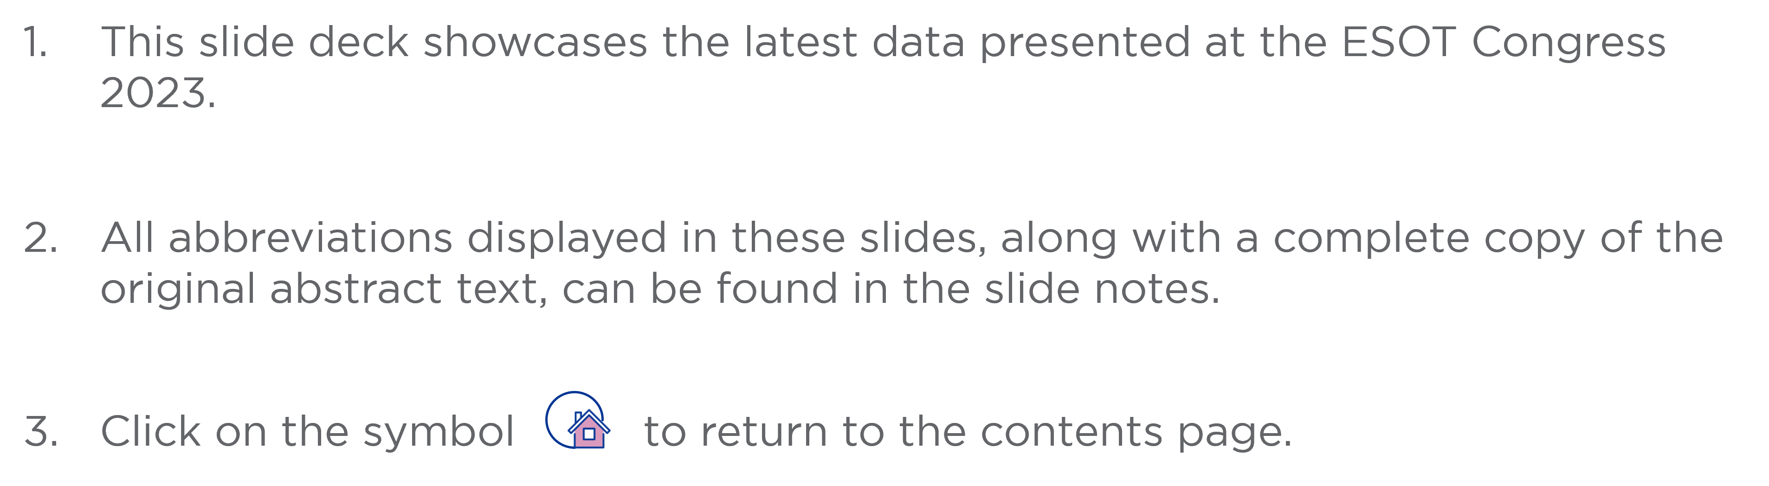
Information

Slide 4
Content
Kidney
LDV4 | Recipient FcγR3A polymorphism influences the prognosis of AMR and the response to IVIg in renal transplantation
OS1_2 | Solvent-accessible amino acid mismatches on donor HLA are associated with kidney graft outcomes; a step towards personalizing post-transplant care?
OS8_8 | The UK living kidney exchange programme – pushing boundaries to optimise transplant possibilities
OS9_8 | Spatial profiling of the kidney allograft unravels a central role of FcyRIII⁺ innate immune cells in rejection
OS10_3 | Early results of attain (ITN090ST): Daratumumab & belatacept for HLA desensitization in kidney transplant candidates with 100% cPRA
OS10_5 | A phase I/IIa trial of autologous regulatory T cell therapy together with donor bone marrow infusion in kidney transplantation
OS11_1 | Assessment of donor-derived cell-free DNA (dd-cfDNA) in kidney transplant recipients with indication biopsy

Slide 5
Content
Kidney
OS11_4 | DSA-negative microvascular inflammation in kidney transplant biopsies: Gene expression comparison with native and transplant kidney controls
OS12_5 | Cancer incidence among Italian kidney transplant recipients over a 25-year period
OS12_7 | Allogeneic immunity helps sustain effective BK-virus immune responses and prevents BK virus-associated nephropathy

Slide 6


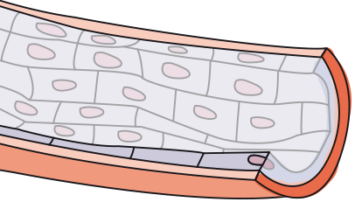

Recipient FcγR3A polymorphism influences the prognosis of AMR and the response to IVIg in renal transplantation
Background
AMR is the first cause of kidney graft failure
The binding of anti-DSA to the surface of graft endothelial cells induces the recruitment of innate immune effectors via their Fcγ receptors for which many SNPs modulating their affinity for IgG Fc have been described (Figure A)
Aim: To determine which polymorphism(s) in recipient FcγRs are associated with poor prognosis at the diagnosis of AMR and the possible therapeutic consequences
Methods
Kidney transplant recipients graft biopsy between 2004 and 2017, n=1682
Diagnosis of AMR and FcγR polymorphisms identification
NK cells
Monocytes
Neutrophils
Global and single-cell transcriptomic analyses of AMR biopsies
FcγR3a
FcγR2a
FcγR3a
DSA
FcγR3b
MHC molecule
Results
135 (8%) of the 1682 kidney transplant recipients were diagnosed with AMR
Only Fcγ RIIIa*559A>C (rs396991; p=0.005) is associated with graft survival (Figure B)
Graft endothelium
Koenig A.. et al., ESOT Congress 2023; LDV4
Notes:
Abbreviations: AMR, antibody-mediated rejection; DSA, donor-specific antibody; FcγRs, Fcγ receptors; IgG, immunoglobulin G; IVIg, intravenous immunoglobulin; NK, natural killer; SNPs, single nucleotide polymorphisms.
LDV4
RECIPIENT FCΓR3A POLYMORPHISM INFLUENCES THE PROGNOSIS OF AMR AND THE RESPONSE TO IVIG IN RENAL TRANSPLANTATION
Alice Koenig*¹, Virginie Mathias², Emmanuel Morelon¹, Beatrice Charreau³, Maud Rabeyrin⁴, Veronique Fremeaux Bacchi⁵, Dany Anglicheau⁵, Nicolas Pallet⁵, Valérie Dubois², Olivier Thaunat¹
¹Lyon University Hospital-INSERM U1111, Lyon, France, ²EFS, Decines, France, ³CHU Nantes, Nantes, France, ⁴Hospices Civils de Lyon, Lyon, France, ⁵APHP, Paris, France
Background: Antibody-mediated rejection (AMR) is the first cause of kidney graft failure but its heterogeneous prognosis makes difficult to assess the risk of graft loss and to choose a therapeutic strategy at the time of diagnosis.
The binding of anti-donor antibodies (DSA) to the surface of graft endothelial cells induces the recruitment of innate immune effectors via their Fcγ receptors (depending on the cell type: FcγR2A, FcγR2B, FcγR2C, FcγR3A and FcγR3B), for which many SNPs modulating their affinity for IgG Fc have been described.
The aim of this translational study was to determine which polymorphism(s) in recipient FcγRs were associated with poor prognosis at the diagnosis of AMR and the possible therapeutic consequences.
Methods and Results: Among 1682 kidney transplant recipients at Lyon University Hospital who underwent graft biopsy between 2004 and 2017, 135 (8%) were diagnosed with AMR. Of the 5 functional FcγR polymorphisms described in the literature, only Fcγ RIIIa*559A>C (rs396991; p=0.005) was statistically associated with graft survival.
Global and single-cell transcriptomic analyses of AMR biopsies demonstrated that non-classical monocytes and NKs are the only innate effectors expressing FcγR3A.
In vitro cocultures between these human purified innate effectors and allogeneic endothelial cells covered with DSA confirmed that effector cells with high-affinity FcγR3A i) activated more strongly and caused more damage to target, but ii) that these same effectors were also more effectively controlled by the addition of IVIg in the culture medium.
The latter in vitro therapeutic results were confirmed in a second independent clinical cohort of kidney transplant patients treated with IVIg.
Conclusions: Our work demonstrates that a single functional polymorphism of FcγR3A influences the severity of AMR and suggests that patients at high risk are also those who respond the best to IVIg treatment.

Slide 7
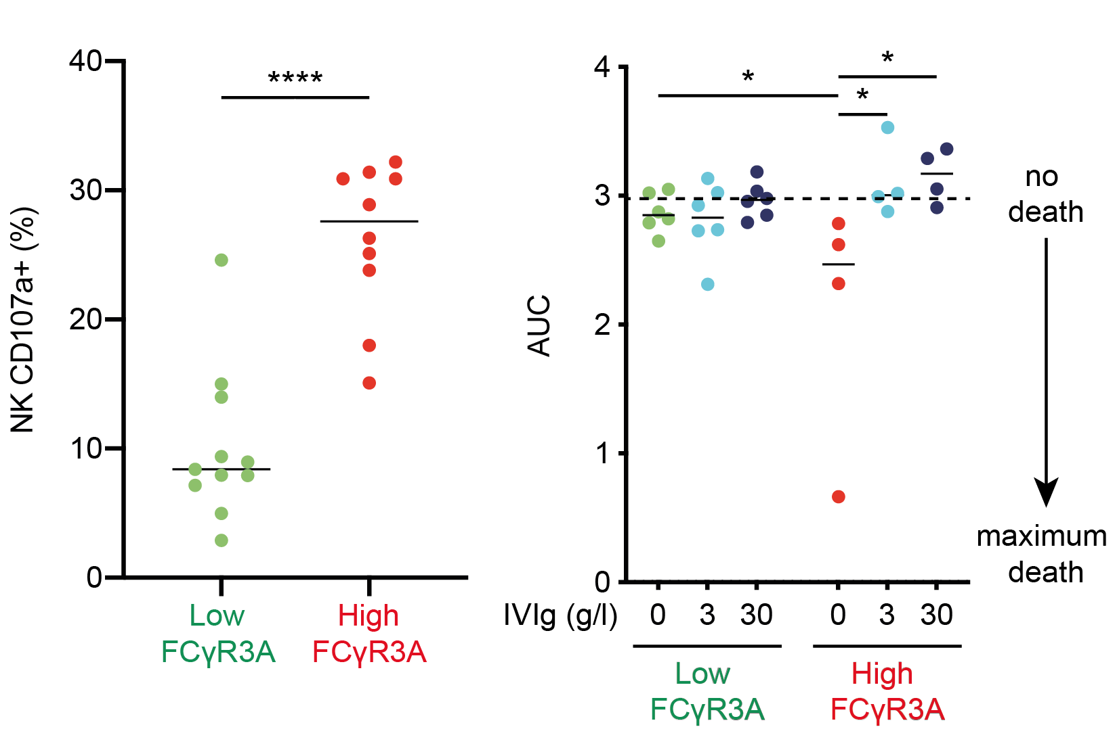
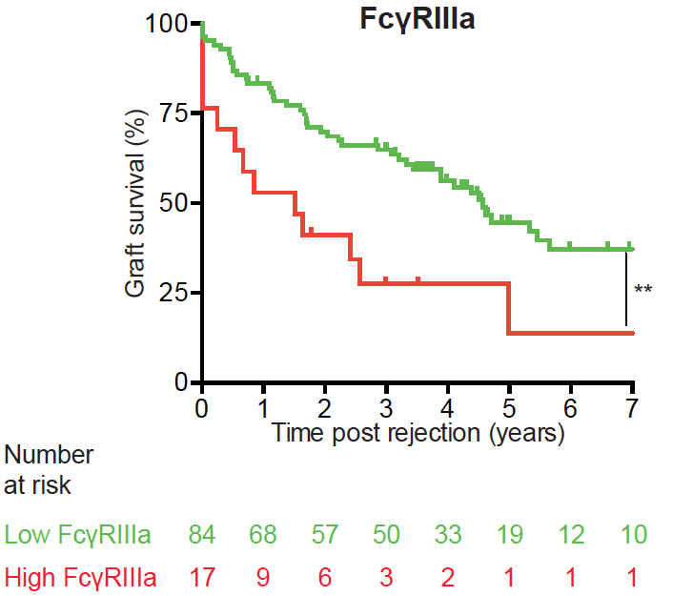
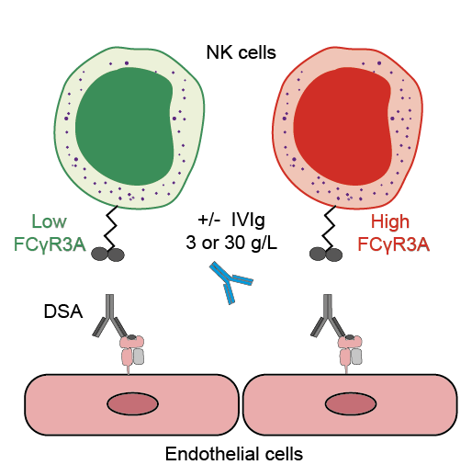
Recipient FcγR3A polymorphism influences the prognosis of AMR and the response to IVIg in renal transplantation
Results (cont.)
In vitro cocultures between human non-classical monocytes and NKs (the only innate effectors expressing FcγR3A in AMR biopsies), and allogeneic endothelial cells covered with DSA (Figure C) confirmed that effector cells with high-affinity FcγR3A:
  High binding FcγR3A NK cells get activated more strongly (Figure D)
  High binding FcγR3A NK cells are more effectively controlled by IVIg (Figure E)
Figure D
Figure E
Figure B
Figure C
Conclusions
A single functional polymorphism of FcγR3A influences the severity of AMR and suggests that patients at high risk are also those who respond the best to IVIg treatment
Koenig A.. et al., ESOT Congress 2023; LDV4
Notes:
Abbreviations: AMR, antibody-mediated rejection; DSA, donor-specific antibody; FcγRs, Fcγ receptors; IgG, immunoglobulin G; IVIg, intravenous immunoglobulin; NK, natural killer; SNPs, single nucleotide polymorphisms.
LDV4
RECIPIENT FCΓR3A POLYMORPHISM INFLUENCES THE PROGNOSIS OF AMR AND THE RESPONSE TO IVIG IN RENAL TRANSPLANTATION
Alice Koenig*¹, Virginie Mathias², Emmanuel Morelon¹, Beatrice Charreau³, Maud Rabeyrin⁴, Veronique Fremeaux Bacchi⁵, Dany Anglicheau⁵, Nicolas Pallet⁵, Valérie Dubois², Olivier Thaunat¹
¹Lyon University Hospital-INSERM U1111, Lyon, France, ²EFS, Decines, France, ³CHU Nantes, Nantes, France, ⁴Hospices Civils de Lyon, Lyon, France, ⁵APHP, Paris, France
Background: Antibody-mediated rejection (AMR) is the first cause of kidney graft failure but its heterogeneous prognosis makes difficult to assess the risk of graft loss and to choose a therapeutic strategy at the time of diagnosis.
The binding of anti-donor antibodies (DSA) to the surface of graft endothelial cells induces the recruitment of innate immune effectors via their Fcγ receptors (depending on the cell type: FcγR2A, FcγR2B, FcγR2C, FcγR3A and FcγR3B), for which many SNPs modulating their affinity for IgG Fc have been described.
The aim of this translational study was to determine which polymorphism(s) in recipient FcγRs were associated with poor prognosis at the diagnosis of AMR and the possible therapeutic consequences.
Methods and Results: Among 1682 kidney transplant recipients at Lyon University Hospital who underwent graft biopsy between 2004 and 2017, 135 (8%) were diagnosed with AMR. Of the 5 functional FcγR polymorphisms described in the literature, only Fcγ RIIIa*559A>C (rs396991; p=0.005) was statistically associated with graft survival.
Global and single-cell transcriptomic analyses of AMR biopsies demonstrated that non-classical monocytes and NKs are the only innate effectors expressing FcγR3A.
In vitro cocultures between these human purified innate effectors and allogeneic endothelial cells covered with DSA confirmed that effector cells with high-affinity FcγR3A i) activated more strongly and caused more damage to target, but ii) that these same effectors were also more effectively controlled by the addition of IVIg in the culture medium.
The latter in vitro therapeutic results were confirmed in a second independent clinical cohort of kidney transplant patients treated with IVIg.
Conclusions: Our work demonstrates that a single functional polymorphism of FcγR3A influences the severity of AMR and suggests that patients at high risk are also those who respond the best to IVIg treatment.

Slide 8
Solvent-accessible amino acid mismatches on donor HLA are associated with kidney graft outcomes; a step towards personalizing post-transplant care?
Background
Current guidelines advise the use of HLA antigenic mismatches to assess the risk of alloimmunity in KTR
HLA-EMMA was developed to quantify saAA mismatches that could interact with B cell receptors responsible for the humoral allo-immune response
Until date, HLA-EMMA has only been associated with graft outcomes in relatively small cohorts with a limited number of events
Aim: To examine the relationship between HLA-EMMA and transplant outcomes in a large and deeply phenotyped, multi-center cohort of 2473 KTR by cox regression analyses
Methods
1
Outcomes of interest
Patient death
DCGF
BPAR
Overall dnDSA development
dnDSA development per HLA locus (A, B, C, DQ, and DR)
2
HR and CI were adjusted for
Type of transplantation
Recipient and donor age/gender
Number of prior transplantations
Pre-transplant DSA’s
Meziyerh S. et al., ESOT Congress 2023; OS1_2
Notes:
Abbreviations: BPAR, biopsy-proven acute rejection; CI, confidence interval; DCGF, death-censored graft failure; dnDSA, de novo donor-specific antibody; KTR, kidney transplant recipients; HLA, human leukocyte antigen; HLA-EMMA, HLA epitope mismatch algorithm; HR, hazard ratio; IQR, interquartile range; saAA, solvent-accessible amino acid.
OS1_2
SOLVENT-ACCESSIBLE AMINO ACID MISMATCHES ON DONOR HLA ARE ASSOCIATED WITH KIDNEY GRAFT OUTCOMES; A STEP TOWARDS PERSONALIZING POST-TRANSPLANT CARE?
Soufian Meziyerh*^{1;2}, Suzanne Bezstarosti^{1;3}, Jesper Kers⁴, Teun van Gelder⁵, Danny van der Helm², Paul van der Boog^{1;2}, Johan de Fijter^{1;2}, Dirk Jan Moes⁵, Dave Roelen³, Geert Haasnoot³, Aiko De Vries^{1;2}, Sebastiaan Heidt³
¹Leiden University Medical Center, Department of Internal Medicine, Division of Nephrology, Leiden, Netherlands, ²LUMC Transplant Center, Leiden, Netherlands, ³Leiden University Medical Center, Department of Immunology, Leiden, Netherlands, ⁴Leiden University Medical Center, Department of Pathology, Leiden, Netherlands, ⁵Leiden University Medical Center, Department of Clinical Pharmacy and Toxicology, Leiden, Netherlands
Background: Current guidelines advise the use of HLA antigenic mismatches to assess the risk of alloimmunity in kidney transplant recipients (KTR). This approach is however too crude to allow personalization of post-transplant care. Recently, the HLA epitope mismatch algorithm (HLA-EMMA) was developed to quantify solvent-accessible amino acid (saAA) mismatches that could interact with B cell receptors responsible for the humoral allo-immune response. Until date, HLA-EMMA has only been associated with graft outcomes in relatively small cohorts with a limited number of events. This observational study aimed to examine the relationship between HLA-EMMA and transplant outcomes in a large and deeply phenotyped cohort of 1580 KTR by cox regression analyses.
Methods: Outcomes of interest were patient death, death-censored graft failure (DCGF), biopsy-proven acute rejection (BPAR), overall de novo donor-specific antibody (dnDSA) development, and dnDSA development per HLA locus (A, B, C, DQ, and DR). Hazard ratios (HR) and confidence intervals (CI) were adjusted for type of transplantation, recipient and donor age/gender, number of prior transplantations, and pre-transplant DSA’s.
Results: During a median follow-up of 5.5 years (IQR: 2.8-9.0), 270 (17%) patients died, 185 (12%) suffered from graft failure, 302 (19%) suffered from BPAR, and 272 (17%) developed dnDSA. dnDSA against HLA-DQ were most common (n=164).
Multivariable analysis showed that HLA-EMMA (total, class I, and class II saAA) mismatch scores were independently and significantly associated with patient death, DCGF, BPAR, overall dnDSA occurrence as well as HLA-specific dnDSA formation as shown in Figure 1. For locus-specific dnDSA, HRs per 10 saAA mismatches were 2.68 (95% CI: 1.93-3.71,p<.001), 2.34 (95% CI:1.34-4.09,p<.001), 3.78 (95% CI: 1.91-7.47,p<.001), 2.13 (95% CI: 1.77-2.55,p<.001), and 2.06 (95% CI: 1.68-2.53,p<.001) for HLA-A, -B, -C, -DQ, and -DR, respectively.
Conclusions: This is the first study to investigate the association between saAA mismatches and kidney transplant outcomes calculated by HLA-EMMA in a large and deeply phenotyped cohort of KTR. These findings suggest that HLA-EMMA may be a useful tool to stratify immunological risk to potentiate personalized surveillance and immunosuppression after transplantation.

Slide 9
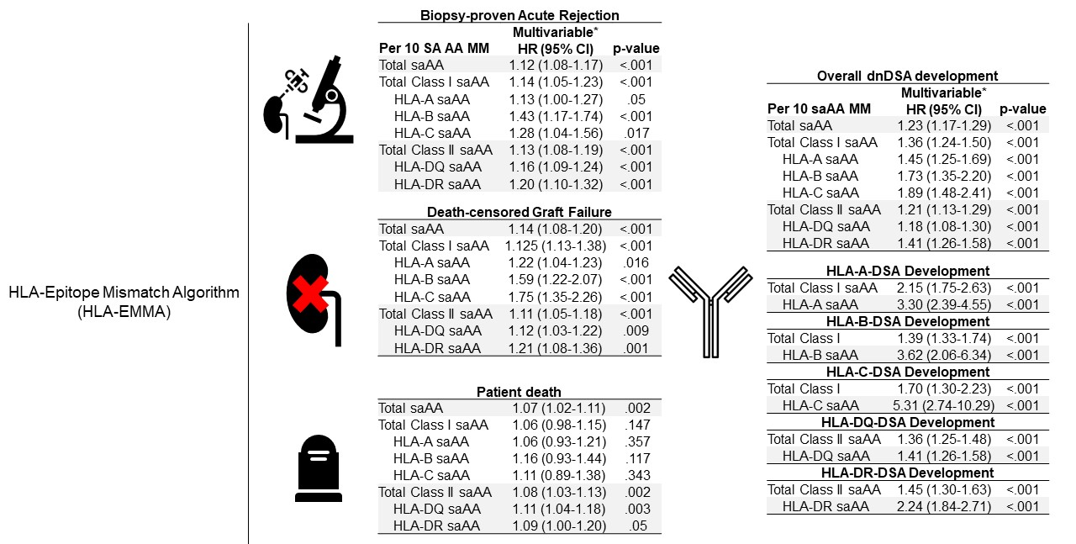
Solvent-accessible amino acid mismatches on donor HLA are associated with kidney graft outcomes; a step towards personalizing post-transplant care?
Results
During a median follow-up of 7 years (IQR: 4-10)
  549 (22%) patients died
  335 (14%) suffered from graft failure
  555 (22%) suffered from BPAR
  315 (13%) developed dnDSA
dnDSA against HLA-DQ were most common (n=188)
Multivariable analysis showed that HLA-EMMA (total, class I, and class II saAA) mismatch scores were independently and significantly associated with:
  Patient death
  DCGF
  BPAR
  Overall dnDSA occurrence
  HLA-specific dnDSA formation (Figure)
* Adjusted for type of transplantation, recipient and donor age/gender, number of prior transplantations and pre-transplant DSA’s
Locus-specific dnDSA | HRs per 10 saAA mismatches | 95% CI | p-value
HLA-A | 3.30 | 2.39-4.55 | <0.001
HLA-B | 3.62 | 2.07-6.34 | <0.001
HLA-C | 5.31 | 2.74-10.29 | <0.001
HLA-DQ | 1.41 | 1.26-1.58 | <0.001
HLA-DR | 2.24 | 1.84-2.71 | <0.001
Conclusions
These findings suggest that HLA-EMMA may be a useful tool to stratify immunological risk to potentiate personalized surveillance and immunosuppression after transplantation
Meziyerh S. et al., ESOT Congress 2023; OS1_2
Notes:
Abbreviations: BPAR, biopsy-proven acute rejection; CI, confidence interval; DCGF, death-censored graft failure; dnDSA, de novo donor-specific antibody; KTR, kidney transplant recipients; HLA, human leukocyte antigen; HLA-EMMA, HLA epitope mismatch algorithm; HR, hazard ratio; IQR, interquartile range; saAA, solvent-accessible amino acid.
OS1_2
SOLVENT-ACCESSIBLE AMINO ACID MISMATCHES ON DONOR HLA ARE ASSOCIATED WITH KIDNEY GRAFT OUTCOMES; A STEP TOWARDS PERSONALIZING POST-TRANSPLANT CARE?
Soufian Meziyerh*^{1;2}, Suzanne Bezstarosti^{1;3}, Jesper Kers⁴, Teun van Gelder⁵, Danny van der Helm², Paul van der Boog^{1;2}, Johan de Fijter^{1;2}, Dirk Jan Moes⁵, Dave Roelen³, Geert Haasnoot³, Aiko De Vries^{1;2}, Sebastiaan Heidt³
¹Leiden University Medical Center, Department of Internal Medicine, Division of Nephrology, Leiden, Netherlands, ²LUMC Transplant Center, Leiden, Netherlands, ³Leiden University Medical Center, Department of Immunology, Leiden, Netherlands, ⁴Leiden University Medical Center, Department of Pathology, Leiden, Netherlands, ⁵Leiden University Medical Center, Department of Clinical Pharmacy and Toxicology, Leiden, Netherlands
Background: Current guidelines advise the use of HLA antigenic mismatches to assess the risk of alloimmunity in kidney transplant recipients (KTR). This approach is however too crude to allow personalization of post-transplant care. Recently, the HLA epitope mismatch algorithm (HLA-EMMA) was developed to quantify solvent-accessible amino acid (saAA) mismatches that could interact with B cell receptors responsible for the humoral allo-immune response. Until date, HLA-EMMA has only been associated with graft outcomes in relatively small cohorts with a limited number of events. This observational study aimed to examine the relationship between HLA-EMMA and transplant outcomes in a large and deeply phenotyped cohort of 1580 KTR by cox regression analyses.
Methods: Outcomes of interest were patient death, death-censored graft failure (DCGF), biopsy-proven acute rejection (BPAR), overall de novo donor-specific antibody (dnDSA) development, and dnDSA development per HLA locus (A, B, C, DQ, and DR). Hazard ratios (HR) and confidence intervals (CI) were adjusted for type of transplantation, recipient and donor age/gender, number of prior transplantations, and pre-transplant DSA’s.
Results: During a median follow-up of 5.5 years (IQR: 2.8-9.0), 270 (17%) patients died, 185 (12%) suffered from graft failure, 302 (19%) suffered from BPAR, and 272 (17%) developed dnDSA. dnDSA against HLA-DQ were most common (n=164).
Multivariable analysis showed that HLA-EMMA (total, class I, and class II saAA) mismatch scores were independently and significantly associated with patient death, DCGF, BPAR, overall dnDSA occurrence as well as HLA-specific dnDSA formation as shown in Figure 1. For locus-specific dnDSA, HRs per 10 saAA mismatches were 2.68 (95% CI: 1.93-3.71,p<.001), 2.34 (95% CI:1.34-4.09,p<.001), 3.78 (95% CI: 1.91-7.47,p<.001), 2.13 (95% CI: 1.77-2.55,p<.001), and 2.06 (95% CI: 1.68-2.53,p<.001) for HLA-A, -B, -C, -DQ, and -DR, respectively.
Conclusions: This is the first study to investigate the association between saAA mismatches and kidney transplant outcomes calculated by HLA-EMMA in a large and deeply phenotyped cohort of KTR. These findings suggest that HLA-EMMA may be a useful tool to stratify immunological risk to potentiate personalized surveillance and immunosuppression after transplantation.

Slide 10
The UK living kidney exchange programme – pushing boundaries to optimise transplant possibilities
Background
NDAD and living kidney exchanges between incompatible pairs first became legal in the UK in 2006, with the first transplants happening in 2007
UKLKSS seeks to find transplants for patients with willing but incompatible living donors
Aim: To highlight the benefits of the UKLKSS
Methods
UKLKSS
2007
2-way exchanges (ie between 2 pairs)
2009
3-way exchanges
NDAD chains giving 2 transplants
+ routinely facilitates both ABOi and HLAi transplant exchanges, permitting registration of modified blood groups and unacceptable antigens to enable incompatible transplantation
2012
2015
NDAD chains giving 3 transplants
The scheme also includes compatible pairs (seeking to improve age gap or HLA mismatch)
Johnson R. et al., ESOT Congress 2023; OS8_8
Notes:
Abbreviations: ABOi, ABO incompatible; HLA, human leukocyte antigen; HLAi, HLA incompatible; LD, living donor; NDAD, non-directed altruistic donation; pmp, per million people; UKLKSS, UK Living Kidney Sharing Scheme.
OS8_8
THE UK LIVING KIDNEY EXCHANGE PROGRAMME – PUSHING BOUNDARIES TO OPTIMISE TRANSPLANT POSSIBILITIES
Rachel Johnson¹, Matthew Robb*¹, Lisa Mumford¹, Lisa Burnapp²
¹NHS Blood and Transplant, Bristol, United Kingdom, ²NHS Blood and Transplant, London, United Kingdom
Background: Non-directed altruistic donation (NDAD) and living kidney exchanges between incompatible pairs first became legal in the UK in 2006, with the first transplants happening in 2007. The UK Living Kidney Sharing Scheme (UKLKSS), which seeks to find transplants for patients with willing but incompatible living donors, has grown incrementally since 2007, to the sophisticated programme that exists today.
Methods: This study highlights the benefits of the UKLKSS, which started by only facilitating 2-way exchanges (ie between 2 pairs), but grew to allow 3-way exchanges (2009), NDAD transplant chains (2012 for chains giving 2 transplants and 2015 for chains giving 3 transplants). Innovatively, the scheme also includes compatible pairs (seeking to improve age gap or HLA mismatch) and routinely facilitates both ABO incompatible (ABOi) and HLA incompatible (HLAi) transplant exchanges. The latter has been possible since 2012 by permitting registration of modified blood groups and unacceptable antigens to enable incompatible transplantation, where safe in the UKLKSS context.
Results: To the end of 2022, the UKLKSS has enabled a total of 1684 living donor (LD) transplants through 188 2-way exchanges (376 transplants, 22%), 185 3-way exchanges (555 transplants, 33%), 177 short chains (354 transplants, 21%) and 133 long chains (399 transplants, 24%). There have been 195 transplants for recipients registered in a compatible pair. There have also been 8 ABOi transplants, 61 HLAi transplants and one both ABOi and HLAi. The recipients of antibody incompatible transplants included 13 who waited over 2 years for a transplant in the UKLKSS. Overall, death-censored graft survival rates for all recipients receiving a transplant via the UKLKSS are 93.1% at 5 years (95%CI 91-95), with a breakdown by pair and transplant compatibility shown in Figure 1.
Conclusions: The UK Living Kidney Sharing Scheme has become one of the most innovative and mature schemes in Europe. In the last 5 years it has contributed 21% (2.6pmp) of the 4311 LD kidney transplants in the UK (12.8pmp). The scheme is continuously reviewed and improvements implemented to maximise the number of transplant opportunities. The scheme is the largest in Europe and its success has led to increasing numbers of LD transplants in the UK with excellent post-transplant outcomes.

Slide 11
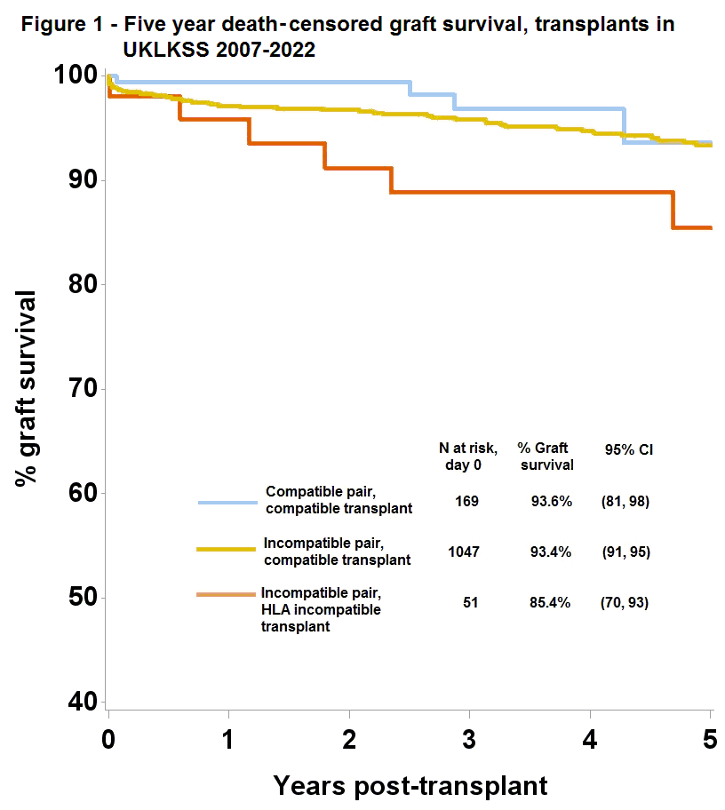
The UK living kidney exchange programme – pushing boundaries to optimise transplant possibilities
Figure. Five years death-censored graft survival, transplants in UKLKSS 2007-2022
Results
UKLKSS | # LD transplants
2-way exchanges | 376 (22%)
3-way exchanges | 555 (33%)
Short chains | 354 (21%)
Long chains | 399 (24%)
TOTAL | 1684 (100%)
UKLKSS | # LD transplants
Compatible pair | 195
ABOi | 8
HLAi | 61
ABOi & HLAi | 1
Including
The recipients of antibody incompatible transplants included 13 who waited over 2 years for a transplant in the UKLKSS
Conclusions
In the last 5 years, it has contributed 21% (2.6pmp) of the 4311 LD kidney transplants in the UK (12.8pmp)
The scheme is continuously reviewed and improvements implemented to maximise the number of transplant opportunities
The scheme is the largest in Europe and its success has led to increasing numbers of LD transplants in the UK with excellent post-transplant outcomes
Johnson R. et al., ESOT Congress 2023; OS8_8
Notes:
Abbreviations: ABOi, ABO incompatible; HLA, human leukocyte antigen; HLAi, HLA incompatible; LD, living donor; NDAD, non-directed altruistic donation; pmp, per million people; UKLKSS, UK Living Kidney Sharing Scheme.
OS8_8
THE UK LIVING KIDNEY EXCHANGE PROGRAMME – PUSHING BOUNDARIES TO OPTIMISE TRANSPLANT POSSIBILITIES
Rachel Johnson¹, Matthew Robb*¹, Lisa Mumford¹, Lisa Burnapp²
¹NHS Blood and Transplant, Bristol, United Kingdom, ²NHS Blood and Transplant, London, United Kingdom
Background: Non-directed altruistic donation (NDAD) and living kidney exchanges between incompatible pairs first became legal in the UK in 2006, with the first transplants happening in 2007. The UK Living Kidney Sharing Scheme (UKLKSS), which seeks to find transplants for patients with willing but incompatible living donors, has grown incrementally since 2007, to the sophisticated programme that exists today.
Methods: This study highlights the benefits of the UKLKSS, which started by only facilitating 2-way exchanges (ie between 2 pairs), but grew to allow 3-way exchanges (2009), NDAD transplant chains (2012 for chains giving 2 transplants and 2015 for chains giving 3 transplants). Innovatively, the scheme also includes compatible pairs (seeking to improve age gap or HLA mismatch) and routinely facilitates both ABO incompatible (ABOi) and HLA incompatible (HLAi) transplant exchanges. The latter has been possible since 2012 by permitting registration of modified blood groups and unacceptable antigens to enable incompatible transplantation, where safe in the UKLKSS context.
Results: To the end of 2022, the UKLKSS has enabled a total of 1684 living donor (LD) transplants through 188 2-way exchanges (376 transplants, 22%), 185 3-way exchanges (555 transplants, 33%), 177 short chains (354 transplants, 21%) and 133 long chains (399 transplants, 24%). There have been 195 transplants for recipients registered in a compatible pair. There have also been 8 ABOi transplants, 61 HLAi transplants and one both ABOi and HLAi. The recipients of antibody incompatible transplants included 13 who waited over 2 years for a transplant in the UKLKSS. Overall, death-censored graft survival rates for all recipients receiving a transplant via the UKLKSS are 93.1% at 5 years (95%CI 91-95), with a breakdown by pair and transplant compatibility shown in Figure 1.
Conclusions: The UK Living Kidney Sharing Scheme has become one of the most innovative and mature schemes in Europe. In the last 5 years it has contributed 21% (2.6pmp) of the 4311 LD kidney transplants in the UK (12.8pmp). The scheme is continuously reviewed and improvements implemented to maximise the number of transplant opportunities. The scheme is the largest in Europe and its success has led to increasing numbers of LD transplants in the UK with excellent post-transplant outcomes.

Slide 12
Spatial profiling of the kidney allograft unravels a central role of FcyRIII⁺ innate immune cells in rejection
Background
How the immune system participates to kidney transplant rejection has not been fully elucidated
Transcriptomics analysis showed that NK cells and monocytes are key players in kidney transplant rejection
Aim: To examine spatial localization and interactions at single-cell resolution between NK cells and monocytes and all other cells present in the graft using multiplex immunofluorescent staining
Methods
MILAN technic on n=18 different transplant biopsies
Antibody-mediated rejection (DSA+ ABMR), n=3
DSA- MVI, n=5
Mixed rejection, n=2
TCMR, n=4
Borderline changes, n=1
Stable cases, n=3
The cell identities were determined using a broad panel of 36 phenotypic markers after digital reconstruction
Lamarthée B. et al., ESOT Congress 2023; OS9_8
Notes:
Abbreviations: ABMR, antibody-mediated rejection; AQP1, aquaporin 1 gene; DC, dendritic cells; DSA, donor-specific antigen; MILAN, multiple iterative labeling by antibody neodeposition; MPO, myeloperoxidase; MVI, microvascular inflammation; NK, natural killer; PanCK, cytokeratin; PT cell, proximal tubule cell; TCMR, T-cell mediated rejection; Teff, effector T cells; Tregs, regulatory T cells.
OS9_8
SPATIAL PROFILING OF THE KIDNEY ALLOGRAFT UNRAVELS A CENTRAL ROLE OF FCYRIII+ INNATE IMMUNE CELLS IN REJECTION
Baptiste Lamarthée*^{1;2}, Jasper Callemeyn¹, Yannick Van Herck³, Asier Antoranz⁴, Priyanka Koshy⁴, Claire Tinel^{1;2}, Francesca Bosisio⁴, Maarten Naesens¹
¹UZ KU Leuven, Department of Microbiology, Immunology and Transplantation, Leuven, Belgium, ²Inserm RIght, Université de Bourgogne Franche Comté, EFS BFC, Transplantation, Autoimmunity and Inflammation, Besançon, France, ³UZ KU Leuven, Department of Oncology, Leuven, Belgium, ⁴UZ KU Leuven, Department of Imaging and Pathology, Leuven, Belgium
Background: How the immune system participates to kidney transplant rejection has not been fully elucidated. Using transcriptomics, we previously reported that NK cells and monocytes are key players in kidney transplant rejection. Here, we examined spatial localization and interactions at single-cell resolution between these two cell types and all other cells present in the graft using multiplex immunofluorescent staining.
Methods: We performed Multiple Iterative Labeling by Antibody Neodeposition (MILAN) technic on 18 different transplant biopsies, with a representative mix of clinicopathological phenotypes: 3 antibody-mediated rejection (DSA+ ABMR), 5 DSA-negative cases with microvascular inflammation (DSA- MVI), 2 mixed rejection, 4 T-cell mediated rejection (TCMR), 1 borderline changes, and 3 stable cases (NR). The cell identities were determined using a broad panel of 36 phenotypic markers after digital reconstruction.
Results: We mapped 555,479 cells to 17 phenotypes including 5 types of renal epithelial cells (PT cells, AQP1+ tubule cells, CD138+ tubule cells, distal tubule cells and AQP1+ PanCK+ tubule cells), 9 immune cell subtypes: 3 myeloid (macrophages, CD1c⁺ dendritic cells [DC] and S100+ DC), 5 lymphoid (B cells, CD4 regulatory T cells (Tregs), FcγRIII⁺ NK cells, CD4 effector T cells (Teff) and CD8 Teff) and an MPO+ neutrophil subtype. Importantly, FcγRIII⁺ NK cells, neutrophils, FcγRIII⁺ monocytes and CD8+ Teff proportions mainly correlated with inflammation associated to transplant rejection. Compartmentalization analysis indicated that FcγRIII⁺ NK cells and FcγRIII⁺ monocytes infiltrate vascular compartment. In addition, neighbourhood analysis unravelled a strong and significant enrichment of FcγRIII⁺ NK cells next to FcγRIII⁺ monocytes in ABMR or mixed rejection biopsies, but not in TCMR or NR biopsies. In contrast, CD14⁺ monocytes were mainly surrounded by CD8 T cells in TCMR.
Conclusions: Our study provides new insights in the role of the different innate immune cell populations and their interactions with the kidney structural cells at the protein level. FcγRIII⁺ and CD14⁺ monocytes act as the dominant “communication hubs” within the allograft, mainly communicating with FcγRIII⁺ NK cells in vascular compartment and CD8 T cells in interstitial compartment, respectively.

Slide 13
Spatial profiling of the kidney allograft unravels a central role of FcyRIII⁺ innate immune cells in rejection
Results
FcγRIII⁺ NK cells, neutrophils, FcγRIII⁺ monocytes and CD8⁺ Teff proportions correlated with inflammation associated to transplant rejection
FcγRIII⁺ NK cells and FcγRIII⁺ monocytes infiltrate vascular compartment
Neighbourhood analysis unravelled a strong and significant enrichment of FcγRIII⁺ NK cells next to FcγRIII⁺ monocytes in ABMR or mixed rejection biopsies, but not in TCMR or NR biopsies
CD14⁺ monocytes were mainly surrounded by CD8 T cells in TCMR
555,479 cells mapped to 17 phenotypes | Subtypes
5 renal epithelial cells | PT cells
 | AQP1⁺ tubule cells
 | CD138⁺ tubule cells
 | Distal tubule cells
 | AQP1⁺ PanCK⁺ tubule cells
3 myeloid | Macrophages
 | CD1c⁺ DC
 | S100⁺ DC
5 lymphoid | B cells
 | CD4 Tregs
 | FcγRIII⁺ NK cells
 | CD4 Teff
 | CD8 Teff
 | MPO⁺ neutrophil
4 others
Conclusions
FcγRIII+ and CD14⁺ monocytes act as the dominant “communication hubs” within the allograft, mainly communicating with FcγRIII⁺ NK cells in vascular compartment and CD8 T cells in interstitial compartment, respectively
Lamarthée B. et al., ESOT Congress 2023; OS9_8
Notes:
Abbreviations: ABMR, antibody-mediated rejection; AQP1, aquaporin 1 gene; DC, dendritic cells; DSA, donor-specific antigen; MILAN, multiple iterative labeling by antibody neodeposition; MPO, myeloperoxidase; MVI, microvascular inflammation; NK, natural killer; PanCK, cytokeratin; PT cell, proximal tubule cell; TCMR, T-cell mediated rejection; Teff, effector T cells; Tregs, regulatory T cells.
OS9_8
SPATIAL PROFILING OF THE KIDNEY ALLOGRAFT UNRAVELS A CENTRAL ROLE OF FCYRIII+ INNATE IMMUNE CELLS IN REJECTION
Baptiste Lamarthée*^{1;2}, Jasper Callemeyn¹, Yannick Van Herck³, Asier Antoranz⁴, Priyanka Koshy⁴, Claire Tinel^{1;2}, Francesca Bosisio⁴, Maarten Naesens¹
¹UZ KU Leuven, Department of Microbiology, Immunology and Transplantation, Leuven, Belgium, ²Inserm RIght, Université de Bourgogne Franche Comté, EFS BFC, Transplantation, Autoimmunity and Inflammation, Besançon, France, ³UZ KU Leuven, Department of Oncology, Leuven, Belgium, ⁴UZ KU Leuven, Department of Imaging and Pathology, Leuven, Belgium
Background: How the immune system participates to kidney transplant rejection has not been fully elucidated. Using transcriptomics, we previously reported that NK cells and monocytes are key players in kidney transplant rejection. Here, we examined spatial localization and interactions at single-cell resolution between these two cell types and all other cells present in the graft using multiplex immunofluorescent staining.
Methods: We performed Multiple Iterative Labeling by Antibody Neodeposition (MILAN) technic on 18 different transplant biopsies, with a representative mix of clinicopathological phenotypes: 3 antibody-mediated rejection (DSA+ ABMR), 5 DSA-negative cases with microvascular inflammation (DSA- MVI), 2 mixed rejection, 4 T-cell mediated rejection (TCMR), 1 borderline changes, and 3 stable cases (NR). The cell identities were determined using a broad panel of 36 phenotypic markers after digital reconstruction.
Results: We mapped 555,479 cells to 17 phenotypes including 5 types of renal epithelial cells (PT cells, AQP1+ tubule cells, CD138+ tubule cells, distal tubule cells and AQP1+ PanCK+ tubule cells), 9 immune cell subtypes: 3 myeloid (macrophages, CD1c⁺ dendritic cells [DC] and S100+ DC), 5 lymphoid (B cells, CD4 regulatory T cells (Tregs), FcγRIII⁺ NK cells, CD4 effector T cells (Teff) and CD8 Teff) and an MPO+ neutrophil subtype. Importantly, FcγRIII⁺ NK cells, neutrophils, FcγRIII⁺ monocytes and CD8+ Teff proportions mainly correlated with inflammation associated to transplant rejection. Compartmentalization analysis indicated that FcγRIII⁺ NK cells and FcγRIII⁺ monocytes infiltrate vascular compartment. In addition, neighbourhood analysis unravelled a strong and significant enrichment of FcγRIII⁺ NK cells next to FcγRIII⁺ monocytes in ABMR or mixed rejection biopsies, but not in TCMR or NR biopsies. In contrast, CD14⁺ monocytes were mainly surrounded by CD8 T cells in TCMR.
Conclusions: Our study provides new insights in the role of the different innate immune cell populations and their interactions with the kidney structural cells at the protein level. FcγRIII⁺ and CD14⁺ monocytes act as the dominant “communication hubs” within the allograft, mainly communicating with FcγRIII⁺ NK cells in vascular compartment and CD8 T cells in interstitial compartment, respectively.

Slide 14


Early results of attain (ITN090ST): Daratumumab & belatacept for HLA desensitization in kidney transplant candidates with 100% cPRA
Background
<10% of kidney transplant candidates with cPRA 100% are able to find a compatible donor
Current HLA desensitization strategies are ineffective due to antibody rebound
Adding costimulation blockade to PC depletion prevents antibody rebound in NHP by countering nodal B cell and Tfh expansion
Aim: To test the hypothesis that a similar approach in humans could improve success with HLA desensitization
Methods
1
ATTAIN
phase I/II trial
Daratumumab
(a CD38 mAb used in multiple myeloma)
Belatacept (a high affinity CTLA4-Ig)
Desensitization kidney transplant candidates with cPRA ≥99.9%
Daratumumab 8 mg/kg
2
W1
W10
Belatacept 10 mg/kg
Blood and bone marrow assessments pre-and post-treatment
3
The primary efficacy endpoint is a composite of (1) elimination of ≥1 HLA antibody specificity, (2) ≥50% reduction in the MFI of ≥3 HLA antibody specificities, or (3) kidney transplant from a previously incompatible donor
Target accrual is 15, enrolled in 2 cohorts (5+10)
4
Vincenti F. et al., ESOT Congress 2023; OS10_3
Notes:
Abbreviations: cPRA, calculated panel reactive antibody ; CTLA4, cytotoxic T-lymphocyte-associated protein 4; HLA, human leukocyte antigen; LLPC, long-lived PC; NHP, non-human primate; mAb, monoclonal antibody; MFI, mean fluorescence intensity; PC, plasma cell ; SLPC, short-lived PC ; Tfh, T follicular helper cell.
OS10_3
EARLY RESULTS OF ATTAIN (ITN090ST): DARATUMUMAB & BELATACEPT FOR HLA DESENSITIZATION IN KIDNEY TRANSPLANT CANDIDATES WITH 100% CPRA
Flavio Vincenti*¹, Sindhu Chandran², Rajalingam Raja³, Thomas Martin³, Stalinraja Maruthamuthu³, Shreya Mall³, Cynthia Breeden⁴, Kristen Mason⁵, Doan Nguyen⁶, Frances Lee⁷, Juliete Silva⁴
¹University of California San Francisco Parnassus Campus, San Francisco, United States, ²Immune Tolerance network, San Francisco, United States, ¹University of California San Francisco Parnassus Campus, San Francisco, United States, ⁴Immune Tolerance Network, Atlanta, United States, ⁵Rho Inc, Chapel Hill, United States, ⁶Emory University, Atlanta, United States, ⁶Emory University, Atlanta, United States
Background: Despite high allocation priority, <10% of kidney transplant candidates with calculated panel reactive antibody (cPRA) 100% are able to find a compatible donor. Current HLA desensitization strategies are ineffective due to antibody rebound. Adding costimulation blockade to plasma cell (PC) depletion prevents antibody rebound in NHP by countering nodal B cell and Tfh expansion. We hypothesized that a similar approach in humans could improve success with HLA desensitization.
Methods: ATTAIN is a pilot, phase I/II trial of daratumumab, a CD38 mAb used in multiple myeloma, plus belatacept, a high affinity CTLA4-Ig, to desensitize kidney transplant candidates with cPRA ≥99.9%. Enrolled subjects receive daratumumab (6 doses: 8 mg/kg) and Belatacept (4 doses: 10 mg/kg) over 10 weeks with blood and bone marrow assessments pre-and post-treatment. The primary efficacy endpoint is a composite of (1) elimination of ≥1 HLA antibody specificity, (2) ≥50% reduction in the MFI of ≥3 HLA antibody specificities, or (3) kidney transplant from a previously incompatible donor. Target accrual is 15, enrolled in 2 cohorts (5+10).
Results: Cohort 1 (n=5, mean age 44, 60% with previous transplant) has been enrolled and treated, with 5-31 weeks follow-up to date. The treatment was tolerated well in all 5 patients. Three of 5 participants met the primary efficacy endpoint and 5 of 5 had >50% bone marrow PC depletion. It was accompanied by decrease of both CD19+CD38hiCD138- short-lived PC (SLPC) and CD19+CD38hiCD138+ PC subsets with maintenance of CD19-CD38+CD138+ PC population which contains the long-lived PC (LLPC) subsets. Moreover, circulating CD19+CD27-IgD+CD38+CD24+ transitional B cells were also decreased all 5 patients. One patient received a kidney transplant from a previously incompatible deceased donor and is doing well at 7 months post-transplant without rejection or rebound of HLA antibodies.
Conclusions: Daratumumab and belatacept may provide effective desensitization for kidney transplant candidates with cPRA 100% by depleting PC from existing marrow and blood PC subsets. ATTAIN (NCT04827979) is a trial conducted by the Immune Tolerance Network and sponsored by NIAID (award UM1AI109565).

Slide 15
Early results of attain (ITN090ST): Daratumumab & belatacept for HLA desensitization in kidney transplant candidates with 100% cPRA
Results
Cohort 1 (n=5, mean age 44, 60% with previous transplant) enrolled and treated, with 5-31 weeks follow-up to date
The treatment well tolerated in all 5 patients
3 of 5 participants met the primary efficacy endpoint and 5 of 5 had >50% bone marrow PC depletion. It was accompanied by decrease of both CD19⁺CD38^{hi}CD138⁻ SLPC and CD19⁺CD38^{hi}CD138⁺ PC subsets with maintenance of CD19⁻CD38⁺CD138⁺ PC population which contains LLPC subsets
Circulating CD19⁺CD27-IgD⁺CD38⁺CD24⁺ transitional B cells were also decreased in all 5 patients
One patient received a kidney transplant from a previously incompatible deceased donor and is doing well at 7 months post-transplant without rejection or rebound of HLA antibodies
Conclusions
Daratumumab and belatacept may provide effective desensitization for kidney transplant candidates with cPRA 100% by depleting PC from existing marrow and blood PC subsets
Vincenti F. et al., ESOT Congress 2023; OS10_3
Notes:
Abbreviations: cPRA, calculated panel reactive antibody ; CTLA4, cytotoxic T-lymphocyte-associated protein 4; HLA, human leukocyte antigen; LLPC, long-lived PC; NHP, non-human primate; mAb, monoclonal antibody; MFI, mean fluorescence intensity; PC, plasma cell ; SLPC, short-lived PC ; Tfh, T follicular helper cell.
OS10_3
EARLY RESULTS OF ATTAIN (ITN090ST): DARATUMUMAB & BELATACEPT FOR HLA DESENSITIZATION IN KIDNEY TRANSPLANT CANDIDATES WITH 100% CPRA
Flavio Vincenti*¹, Sindhu Chandran², Rajalingam Raja³, Thomas Martin³, Stalinraja Maruthamuthu³, Shreya Mall³, Cynthia Breeden⁴, Kristen Mason⁵, Doan Nguyen⁶, Frances Lee⁷, Juliete Silva⁴
¹University of California San Francisco Parnassus Campus, San Francisco, United States, ²Immune Tolerance network, San Francisco, United States, ¹University of California San Francisco Parnassus Campus, San Francisco, United States, ⁴Immune Tolerance Network, Atlanta, United States, ⁵Rho Inc, Chapel Hill, United States, ⁶Emory University, Atlanta, United States, ⁶Emory University, Atlanta, United States
Background: Despite high allocation priority, <10% of kidney transplant candidates with calculated panel reactive antibody (cPRA) 100% are able to find a compatible donor. Current HLA desensitization strategies are ineffective due to antibody rebound. Adding costimulation blockade to plasma cell (PC) depletion prevents antibody rebound in NHP by countering nodal B cell and Tfh expansion. We hypothesized that a similar approach in humans could improve success with HLA desensitization.
Methods: ATTAIN is a pilot, phase I/II trial of daratumumab, a CD38 mAb used in multiple myeloma, plus belatacept, a high affinity CTLA4-Ig, to desensitize kidney transplant candidates with cPRA ≥99.9%. Enrolled subjects receive daratumumab (6 doses: 8 mg/kg) and Belatacept (4 doses: 10 mg/kg) over 10 weeks with blood and bone marrow assessments pre-and post-treatment. The primary efficacy endpoint is a composite of (1) elimination of ≥1 HLA antibody specificity, (2) ≥50% reduction in the MFI of ≥3 HLA antibody specificities, or (3) kidney transplant from a previously incompatible donor. Target accrual is 15, enrolled in 2 cohorts (5+10).
Results: Cohort 1 (n=5, mean age 44, 60% with previous transplant) has been enrolled and treated, with 5-31 weeks follow-up to date. The treatment was tolerated well in all 5 patients. Three of 5 participants met the primary efficacy endpoint and 5 of 5 had >50% bone marrow PC depletion. It was accompanied by decrease of both CD19+CD38hiCD138- short-lived PC (SLPC) and CD19+CD38hiCD138+ PC subsets with maintenance of CD19-CD38+CD138+ PC population which contains the long-lived PC (LLPC) subsets. Moreover, circulating CD19+CD27-IgD+CD38+CD24+ transitional B cells were also decreased all 5 patients. One patient received a kidney transplant from a previously incompatible deceased donor and is doing well at 7 months post-transplant without rejection or rebound of HLA antibodies.
Conclusions: Daratumumab and belatacept may provide effective desensitization for kidney transplant candidates with cPRA 100% by depleting PC from existing marrow and blood PC subsets. ATTAIN (NCT04827979) is a trial conducted by the Immune Tolerance Network and sponsored by NIAID (award UM1AI109565).

Slide 16
A phase I/IIa trial of autologous regulatory T cell therapy together with donor bone marrow infusion in kidney transplantation
Background
In preclinical models combining Treg therapy with donor BM transplantation leads to mixed hematopoietic chimerism and tolerance without myelosuppressive recipient conditioning, avoiding the adverse effects of irradiation or cytotoxic drugs
2
Study group (n=5)
Control group (n=3)
In vitro expanded polyclonal recipient Tregs (1.1-1.5x10⁷ cells/kg) + MNC-separated donor BM cells (0.7-1.9x10⁸ nucleated cells/kg) administration
Transplantation
D0
No Tregs and BM administration
D3
Tocilizumab s.c. injection
W3
IS: Thymoglobulin, belatacept, sirolimus and steroids
IS: Thymoglobulin, belatacept, sirolimus and steroids
Methods
M6
IS: Gradual withdraw of sirolimus and steroids
1
Single center, controlled, first-in-human
phase I/II trial
3
Co-primary endpoints: Total leukocyte donor chimerism and safety
HLA-mismatched living donor kidney transplant recipients
4
Immune monitoring includes:
NGS of the TCR repertoire
Flow cytometric leukocyte subset analysis
scRNAseq and protocol biopsies including transcriptomic analysis (at 6, 12, 24, 36 and 60 months)
Oberbauer R., Wekerle T. et al., ESOT Congress 2023; OS10_5
Notes:
Abbreviations: BM, bone marrow; D, day; GFR, glomerular filtration rate; HLA, human leukocyte antigen; IS, immunosuppression; M, month; MNC, mononuclear cell; NGS, next generation sequencing; s.c., subcutaneous; scRNAseq, single cell RNA sequencing; TCR, T cell receptor; Treg, regulatory T cell; W, week.
OS10_5
A PHASE I/IIA TRIAL OF AUTOLOGOUS REGULATORY T CELL THERAPY TOGETHER WITH DONOR BONE MARROW INFUSION IN KIDNEY TRANSPLANTATION
Rainer Oberbauer¹, Moritz Muckenhuber¹, Jasmin Mucha¹, Roman Reindl-Schwaighofer¹, Andreas Heinzel¹, Gabriela A. Berlakovich¹, Nina Worel¹, Michael Wolzt¹, Thomas Lion², Matthias Edinger³, Thomas Wekerle*¹
¹Medical University of Vienna, Vienna, Austria, ²St. Anna Children’s Cancer Research Institute, Vienna, Austria, ³University Hospital Regensburg, Regensburg, Germany
Background: In preclinical models combining Treg therapy with donor bone marrow (BM) transplantation leads to mixed hematopoietic chimerism and tolerance without myelosuppressive recipient conditioning, avoiding the adverse effects of irradiation or cytotoxic drugs.
Methods: A single center, controlled, first-in-human phase I/IIa trial is conducted in HLA-mismatched living donor kidney transplant recipients. In vitro expanded polyclonal recipient Tregs and MNC-separated donor BM cells are administered within 3 days after transplant, tocilizumab is injected s.c. for the first 3 weeks. No irradiation or cytotoxic drugs are given. Immunosuppression (IS) consists of thymoglobulin, belatacept, sirolimus and steroids. Starting at 6 months, sirolimus and steroids are gradually withdrawn in stable study group patients. A parallel control group receives the same IS, but no Tregs, BM or tocilizumab. Total leukocyte donor chimerism and safety are co-primary endpoints. Immune monitoring accompanying the trial includes NGS of the TCR repertoire, flow cytometric leukocyte subset analysis, scRNAseq and protocol biopsies including transcriptomic analysis (at 6, 12, 24, 36 and 60 months).
Results: Eight patients have been enrolled and treated so far (5 in the study group, 3 in the control group; out of the predetermined sample size of 6 per group). One additional patient was enrolled but not treated as Treg manufacturing failed. Treg (1.1-1.5x10^7 cells/kg) and BM cell (0.7-1.9x10^8 nucleated cells/kg) infusions were well tolerated. The study group developed low levels of total leukocyte donor chimerism (<1%) in the first weeks post-transplant, whereas no chimerism was detectable in the control group. The study group shows a favorable clinical course, with GFRs of 55-74 ml/min/1.72m² at latest follow-up (median follow-up 20 months) and no safety signals were observed. IS reduction has been completed in one patient currently maintained on belatacept monotherapy q8 weeks and is in progress in all other patients. Protocol biopsies at 12 months were clear.
Conclusion: Combined Treg therapy and BM transplantation is safe and feasible in living donor kidney transplantation and induces low-level chimerism. Results from immune monitoring assays will provide insight into the immunomodulatory effect of this protocol.

Slide 17
A phase I/IIa trial of autologous regulatory T cell therapy together with donor bone marrow infusion in kidney transplantation
Results
8 patients have been enrolled and treated so far out of the predetermined sample size of 6 per group
One additional patient was enrolled but not treated as Treg manufacturing failed
Treg and BM cell infusions were well tolerated
The study group developed low levels of total leukocyte donor chimerism (<1%) in the first weeks post-transplant, whereas no chimerism was detectable in the control group
The study group shows a favorable clinical course, with GFRs of 55-74 ml/min/1.72m² at latest follow-up (median follow-up 20 months) and no safety signals were observed
IS reduction has been completed in one patient currently maintained on belatacept monotherapy q8 weeks and is in progress in all other patient protocol biopsies at 12 months were clear
Conclusions
Combined Treg therapy and BM transplantation is safe and feasible in living donor kidney transplantation and induces low-level chimerism
Results from immune monitoring assays will provide insight into the immunomodulatory effect of this protocol
Oberbauer R., Wekerle T. et al., ESOT Congress 2023; OS10_5
Notes:
Abbreviations: BM, bone marrow; D, day; GFR, glomerular filtration rate; HLA, human leukocyte antigen; IS, immunosuppression; M, month; MNC, mononuclear cell; NGS, next generation sequencing; s.c., subcutaneous; scRNAseq, single cell RNA sequencing; TCR, T cell receptor; Treg, regulatory T cell; W, week.
OS10_5
A PHASE I/IIA TRIAL OF AUTOLOGOUS REGULATORY T CELL THERAPY TOGETHER WITH DONOR BONE MARROW INFUSION IN KIDNEY TRANSPLANTATION
Rainer Oberbauer¹, Moritz Muckenhuber¹, Jasmin Mucha¹, Roman Reindl-Schwaighofer¹, Andreas Heinzel¹, Gabriela A. Berlakovich¹, Nina Worel¹, Michael Wolzt¹, Thomas Lion², Matthias Edinger³, Thomas Wekerle*¹
¹Medical University of Vienna, Vienna, Austria, ²St. Anna Children’s Cancer Research Institute, Vienna, Austria, ³University Hospital Regensburg, Regensburg, Germany
Background: In preclinical models combining Treg therapy with donor bone marrow (BM) transplantation leads to mixed hematopoietic chimerism and tolerance without myelosuppressive recipient conditioning, avoiding the adverse effects of irradiation or cytotoxic drugs.
Methods: A single center, controlled, first-in-human phase I/IIa trial is conducted in HLA-mismatched living donor kidney transplant recipients. In vitro expanded polyclonal recipient Tregs and MNC-separated donor BM cells are administered within 3 days after transplant, tocilizumab is injected s.c. for the first 3 weeks. No irradiation or cytotoxic drugs are given. Immunosuppression (IS) consists of thymoglobulin, belatacept, sirolimus and steroids. Starting at 6 months, sirolimus and steroids are gradually withdrawn in stable study group patients. A parallel control group receives the same IS, but no Tregs, BM or tocilizumab. Total leukocyte donor chimerism and safety are co-primary endpoints. Immune monitoring accompanying the trial includes NGS of the TCR repertoire, flow cytometric leukocyte subset analysis, scRNAseq and protocol biopsies including transcriptomic analysis (at 6, 12, 24, 36 and 60 months).
Results: Eight patients have been enrolled and treated so far (5 in the study group, 3 in the control group; out of the predetermined sample size of 6 per group). One additional patient was enrolled but not treated as Treg manufacturing failed. Treg (1.1-1.5x10^7 cells/kg) and BM cell (0.7-1.9x10^8 nucleated cells/kg) infusions were well tolerated. The study group developed low levels of total leukocyte donor chimerism (<1%) in the first weeks post-transplant, whereas no chimerism was detectable in the control group. The study group shows a favorable clinical course, with GFRs of 55-74 ml/min/1.72m² at latest follow-up (median follow-up 20 months) and no safety signals were observed. IS reduction has been completed in one patient currently maintained on belatacept monotherapy q8 weeks and is in progress in all other patients. Protocol biopsies at 12 months were clear.
Conclusion: Combined Treg therapy and BM transplantation is safe and feasible in living donor kidney transplantation and induces low-level chimerism. Results from immune monitoring assays will provide insight into the immunomodulatory effect of this protocol.

Slide 18
Assessment of donor-derived cell-free DNA (dd-cfDNA) in kidney transplant recipients with indication biopsy
Background
dd-cfDNA is released into the circulation upon allograft injury in KTR
Results
325 dd-cfDNA measurements from 100 patients
30% biopsies were graded as different types of rejection
70% biopsies
Methods
5/30 (16.7%) patients showed signs of ABMR
21/30 (70%) borderline changes
4/30 (13.3%) signs of TCMR in the graft
Prospective single-center trial
Biopsy
D0
D7
D30
D90
ABMR or TCMR patients had significantly higher levels of dd-cfDNA than patients without rejection (p<0.001), whereas eGFR did not differ significantly between the two groups (p>0.99, Figure A)
Levels of circulating dd-cfDNA were with a median (IQR) of 2.0% (0.38 – 7.25) highest in patients with ABMR or TCMR, compared to the 0.38% (0.20 – 1.15) in patients with borderline changes and 0.22% (0.11 – 0.52) in patients with no signs of rejection (Figure A)
n= 100
KTR with indication biopsy
Levels of circulating dd-cfDNA are measured using the AlloSeq dd-cfDNA assay
Benning L. et al., ESOT Congress 2023; OS11_1
Notes:
Abbreviations: ABMR, antibody-mediated rejection; D, day; dd-cfDNA, donor-derived cell-free DNA; eGFR, estimated glomerular filtration rate; KTR, kidney transplant recipients; IQR, interquartile range; TCMR, T-cell-mediated rejection.
OS11_1
ASSESSMENT OF DONOR-DERIVED CELL-FREE DNA (DD-CFDNA) IN KIDNEY TRANSPLANT RECIPIENTS WITH INDICATION BIOPSY
Louise Benning*¹, Annette Fink², Markus Rudek¹, Claudius Speer¹, Christian Nußhag¹, Christoph Mahler¹, Florian Kälble¹, Martin Zeier¹, Caner Süsal³, Christian Morath¹, Thuong Hien Tran²
¹University Hospital Heidelberg, Department of Nephrology, Heidelberg, Germany, ²University Hospital Heidelberg, Transplantation Immunology, Heidelberg Institute of Immunology, Heidelberg, Germany, ³Koç University Hospital, Transplant Immunology Research Center of Excellence, Istanbul, Turkey
Background: Donor-derived cell-free DNA (dd-cfDNA) is released into the circulation upon allograft injury in kidney transplant recipients (KTR).
Methods: Starting in November 2020, we enrolled 100 KTR with indication biopsy in this prospective single-center trial to assess dd-cfDNA at time of biopsy as well as 7, 30 and 90 days post biopsy. Levels of circulating dd-cfDNA were measured using the AlloSeq dd-cfDNA assay (CareDx).
Results: The analytic sample included 325 dd-cfDNA measurements from 100 patients. 30/100 (30%) biopsies were graded as different types of rejection, whereof 5/30 (16.7%) patients showed signs of antibody-mediated rejection (ABMR), 21/30 (70%) borderline changes, and 4/30 (13.3%) signs of T-cell-mediated rejection (TCMR) in the graft. At time of biopsy, patients with ABMR or TCMR had significantly higher levels of dd-cfDNA than patients without any signs of rejection in the graft (P<0.001), whereas eGFR did not differ significantly between the two groups (P>0.99, Figure 1A). Levels of circulating dd-cfDNA were with a median (IQR) of 2.0% (0.38 – 7.25) highest in patients with ABMR or TCMR, compared to the 0.38% (0.20 – 1.15) in patients with borderline changes and 0.22% (0.11 – 0.52) in patients with no signs of rejection (Figure 1A). Following anti-rejection treatment, dd-cfDNA decreased in most patients with ABMR or TCRM (pooled slope -0.025, Figure 1B), possibly indicating response to therapy. Patients with Borderline changes and dd-cfDNA levels <1% at time of biopsy showed a trend towards increasing eGFR following corticosteroid pulse therapy whereas patients with higher dd-cfDNA levels (>1%) showed unchanged or even subsequent eGFR decline (Figure 1C).
Conclusions:dd-cfDNA significantly discriminates between KTR with signs of rejection in the graft and KTR with other pathology. Decreasing levels of dd-cfDNA reflect response to anti-rejection treatment. Higher dd-cfDNA levels in patients with borderline changes may help to identify patients at risk that may profit from intensified therapy.

Slide 19
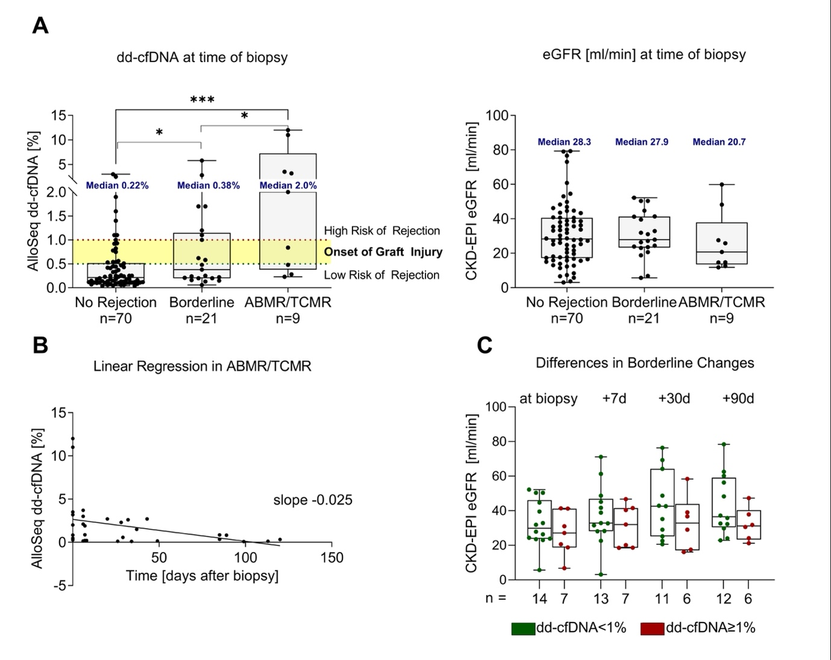
Assessment of donor-derived cell-free DNA (dd-cfDNA) in kidney transplant recipients with indication biopsy
Results (cont.)
Anti-rejection treatment decreased dd-cfDNA in most patients with ABMR or TCRM (pooled slope -0.025, figure B)
Patients with borderline changes and dd-cfDNA levels <1% at time of biopsy showed a trend towards increasing eGFR following corticosteroid pulse therapy whereas patients with higher dd-cfDNA levels (>1%) showed unchanged or even subsequent eGFR decline (figure C)
Conclusions
dd-cfDNA significantly discriminates between KTR with signs of rejection in the graft and KTR with other pathology
Decreasing levels of dd-cfDNA reflect response to anti-rejection treatment
Higher dd-cfDNA levels in patients with borderline changes may help to identify patients at risk that may profit from intensified therapy
Benning L. et al., ESOT Congress 2023; OS11_1
Notes:
Abbreviations: ABMR, antibody-mediated rejection; D, day; dd-cfDNA, donor-derived cell-free DNA; eGFR, estimated glomerular filtration rate; KTR, kidney transplant recipients; IQR, interquartile range; TCMR, T-cell-mediated rejection.
OS11_1
ASSESSMENT OF DONOR-DERIVED CELL-FREE DNA (DD-CFDNA) IN KIDNEY TRANSPLANT RECIPIENTS WITH INDICATION BIOPSY
Louise Benning*¹, Annette Fink², Markus Rudek¹, Claudius Speer¹, Christian Nußhag¹, Christoph Mahler¹, Florian Kälble¹, Martin Zeier¹, Caner Süsal³, Christian Morath¹, Thuong Hien Tran²
¹University Hospital Heidelberg, Department of Nephrology, Heidelberg, Germany, ²University Hospital Heidelberg, Transplantation Immunology, Heidelberg Institute of Immunology, Heidelberg, Germany, ³Koç University Hospital, Transplant Immunology Research Center of Excellence, Istanbul, Turkey
Background: Donor-derived cell-free DNA (dd-cfDNA) is released into the circulation upon allograft injury in kidney transplant recipients (KTR).
Methods: Starting in November 2020, we enrolled 100 KTR with indication biopsy in this prospective single-center trial to assess dd-cfDNA at time of biopsy as well as 7, 30 and 90 days post biopsy. Levels of circulating dd-cfDNA were measured using the AlloSeq dd-cfDNA assay (CareDx).
Results: The analytic sample included 325 dd-cfDNA measurements from 100 patients. 30/100 (30%) biopsies were graded as different types of rejection, whereof 5/30 (16.7%) patients showed signs of antibody-mediated rejection (ABMR), 21/30 (70%) borderline changes, and 4/30 (13.3%) signs of T-cell-mediated rejection (TCMR) in the graft. At time of biopsy, patients with ABMR or TCMR had significantly higher levels of dd-cfDNA than patients without any signs of rejection in the graft (P<0.001), whereas eGFR did not differ significantly between the two groups (P>0.99, Figure 1A). Levels of circulating dd-cfDNA were with a median (IQR) of 2.0% (0.38 – 7.25) highest in patients with ABMR or TCMR, compared to the 0.38% (0.20 – 1.15) in patients with borderline changes and 0.22% (0.11 – 0.52) in patients with no signs of rejection (Figure 1A). Following anti-rejection treatment, dd-cfDNA decreased in most patients with ABMR or TCRM (pooled slope -0.025, Figure 1B), possibly indicating response to therapy. Patients with Borderline changes and dd-cfDNA levels <1% at time of biopsy showed a trend towards increasing eGFR following corticosteroid pulse therapy whereas patients with higher dd-cfDNA levels (>1%) showed unchanged or even subsequent eGFR decline (Figure 1C).
Conclusions:dd-cfDNA significantly discriminates between KTR with signs of rejection in the graft and KTR with other pathology. Decreasing levels of dd-cfDNA reflect response to anti-rejection treatment. Higher dd-cfDNA levels in patients with borderline changes may help to identify patients at risk that may profit from intensified therapy.

Slide 20
DSA-negative microvascular inflammation in kidney transplant biopsies: Gene expression comparison with native and transplant kidney controls
Background
MVI in KT biopsies from patients without detectable anti-HLA DSA presents a diagnostic and therapeutic dilemma
Aim: To understand the significance of these changes by characterizing their molecular phenotype compared to other native and transplant kidney biopsies
Methods
n=195 archival FFPE kidney biopsies from 4 centers
MVI, n=47
MVI (g+ptc>1) but no detectable DSA
ABMR, n=42
Antibody-mediated rejection with DSA
TCMR, n=25
Pure T-cell mediated rejection without DSA
MVI+TCMR, n=47
Mixed MVI and TCMR without DSA
Normal, n=11
Normal implant biopsies
GN, n=12
Native kidney biopsies with endocapillary proliferative glomerulonephritis
MCD, n=11
Native kidney biopsies with minimal change disease
NanoString B-HOT panel (770 genes) to evaluate expression of six literature-derived gene sets, including transcripts previously associated with ABMR, DSA (DSAST), endothelial injury (ENDAT), TCMR, early injury, and late injury
Gene expression compared between groups using principal component and class comparison analyses
Buxeda A. et al., ESOT Congress 2023; OS11_4
Notes:
Abbreviations: ABMR, antibody-mediated rejection; DSA, donor-specific antibodies; FFPE, formalin-fixed paraffin-embedded; g+ptc, glomerulitis + peritubular capillaritis; GN, glomerulonephritis; KT, kidney transplant; HLA, human leukocyte antigen; MCD, minimal change disease; MVI, microvascular inflammation; TCMR, T-cell-mediated rejection.
OS11_4
DSA-NEGATIVE MICROVASCULAR INFLAMMATION IN KIDNEY TRANSPLANT BIOPSIES: GENE EXPRESSION COMPARISON WITH NATIVE AND TRANSPLANT KIDNEY CONTROLS
Anna Buxeda*^{1;2}, Ivy Fixsen¹, Ian Gibson³, Christopher Wiebe⁴, Peter Nickerson⁴, Patricia Campbell¹, Natalia Polanco⁵, Marta Crespo², Benjamin Adam¹, Michael Mengel¹
¹University of Alberta, Laboratory Medicine and Pathology, Edmonton, Canada, ²Hospital del Mar, Nephrology, Barcelona, Spain, ³University of Manitoba, Pathology, Winnipeg, Canada, ⁴University of Manitoba, Internal Medicine, Winnipeg, Canada, ⁵Hospital Universitario 12 de Octubre, Nephrology, Madrid, Spain
Background: Microvascular inflammation (MVI) in kidney transplant (KT) biopsies from patients without detectable anti-HLA donor-specific antibodies (DSA) presents a diagnostic and therapeutic dilemma. This study aimed to further understand the significance of these changes by characterizing their molecular phenotype compared to other native and transplant kidney biopsies.
Methods: The NanoString B-HOT panel (770 genes) was used to measure the expression of six literature-derived gene sets in 195 archival FFPE kidney biopsies from four centers, including transplant biopsies with MVI (g+ptc>1) but no detectable DSA (MVI, n=47), antibody-mediated rejection with DSA (ABMR, n=42), pure T-cell mediated rejection without DSA (TCMR, n=25), mixed MVI and TCMR without DSA (MVI+TCMR, n=47), normal implant biopsies (Normal, n=11), and native kidney biopsies with either endocapillary proliferative glomerulonephritis (GN, n=12) or minimal change disease (MCD, n=11). The evaluated gene sets included transcripts previously associated with ABMR, DSA (DSAST), endothelial injury (ENDAT), TCMR, early injury, and late injury. Gene expression was compared between groups using principal component and class comparison analyses.
Results: Principal component analysis demonstrated significant molecular overlap between sample groups (Figure 1A). However, gene set analysis showed lower expression of ABMR-related, DSAST (Figure 1B), and ENDAT gene sets in DSA-negative MVI compared to ABMR. DSAST and ENDAT gene set expression was similar between MVI, MVI+TCMR, and TCMR groups; but higher than native biopsies (p≤0.002). TCMR and early injury gene set expression was higher in TCMR than all other groups (p≤0.002), except MVI+TCMR. Late injury gene set expression was lower in MVI compared to ABMR, MVI+TCMR, and TCMR groups (p≤0.031); but higher than the Normal and MCD groups (p≥0.016).
Conclusions: These results suggest that DSA-negative MVI displays a lower expression of ABMR-related genes than ABMR, but similar to MVI+TCMR and higher than native kidney biopsies with or without glomerulonephritis. Further work is underway to evaluate the potential role of non-HLA DSA and recognition of missing self in these cases.

Slide 21
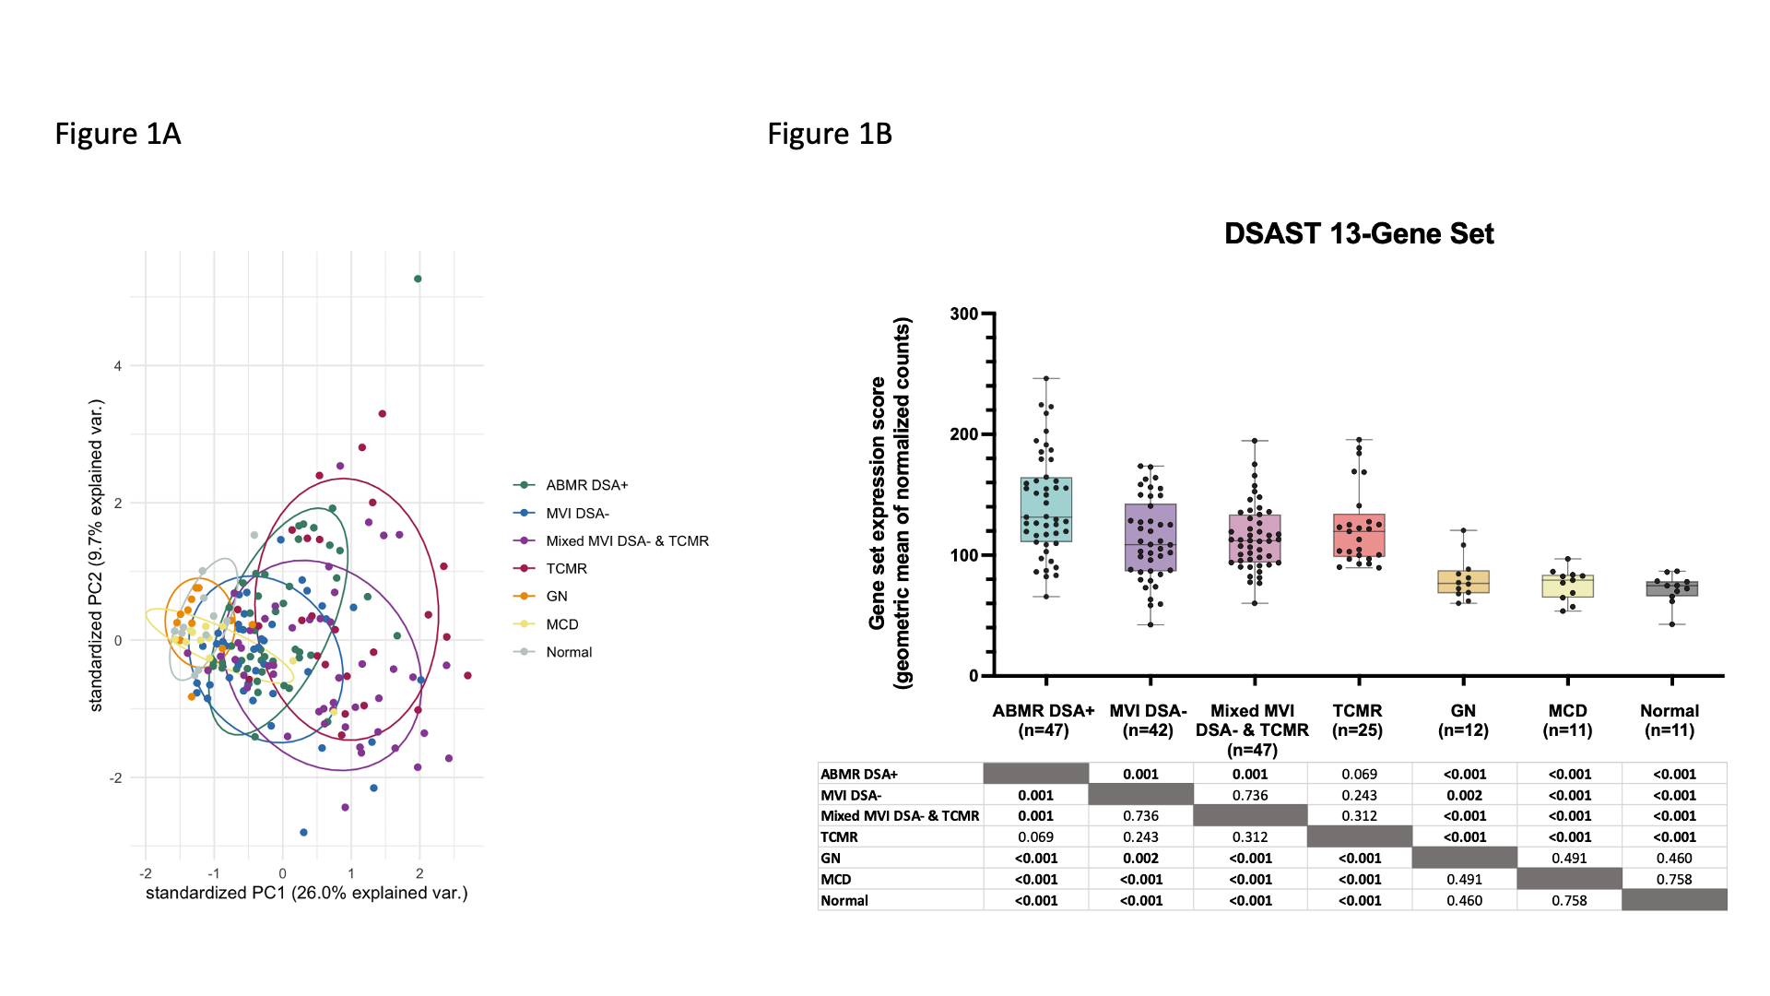
DSA-negative microvascular inflammation in kidney transplant biopsies: Gene expression comparison with native and transplant kidney controls
Results
Principal component analysis demonstrated significant molecular overlap between sample groups (Figure A)
Lower expression of ABMR-related, DSAST (Figure B), and ENDAT gene sets in DSA-negative MVI compared to ABMR
DSAST and ENDAT gene set expression was similar between MVI, MVI+TCMR, and TCMR groups; but higher than native biopsies (p≤0.002)
TCMR and early injury gene set expression was higher in TCMR than all other groups (p≤0.002), except MVI+TCMR
Late injury gene set expression was lower in MVI compared to ABMR, MVI+TCMR, and TCMR groups (p≤0.031); but higher than the Normal and MCD groups (p≥0.016)
Figure A
Figure B
Conclusions
DSA-negative MVI displays a lower expression of ABMR-related genes than ABMR, but similar to MVI+TCMR and higher than native kidney biopsies with or without glomerulonephritis
Buxeda A. et al., ESOT Congress 2023; OS11_4
Notes:
Abbreviations: ABMR, antibody-mediated rejection; DSA, donor-specific antibodies; FFPE, formalin-fixed paraffin-embedded; g+ptc, glomerulitis + peritubular capillaritis; GN, glomerulonephritis; KT, kidney transplant; HLA, human leukocyte antigen; MCD, minimal change disease; MVI, microvascular inflammation; TCMR, T-cell-mediated rejection.
OS11_4
DSA-NEGATIVE MICROVASCULAR INFLAMMATION IN KIDNEY TRANSPLANT BIOPSIES: GENE EXPRESSION COMPARISON WITH NATIVE AND TRANSPLANT KIDNEY CONTROLS
Anna Buxeda*^{1;2}, Ivy Fixsen¹, Ian Gibson³, Christopher Wiebe⁴, Peter Nickerson⁴, Patricia Campbell¹, Natalia Polanco⁵, Marta Crespo², Benjamin Adam¹, Michael Mengel¹
¹University of Alberta, Laboratory Medicine and Pathology, Edmonton, Canada, ²Hospital del Mar, Nephrology, Barcelona, Spain, ³University of Manitoba, Pathology, Winnipeg, Canada, ⁴University of Manitoba, Internal Medicine, Winnipeg, Canada, ⁵Hospital Universitario 12 de Octubre, Nephrology, Madrid, Spain
Background: Microvascular inflammation (MVI) in kidney transplant (KT) biopsies from patients without detectable anti-HLA donor-specific antibodies (DSA) presents a diagnostic and therapeutic dilemma. This study aimed to further understand the significance of these changes by characterizing their molecular phenotype compared to other native and transplant kidney biopsies.
Methods: The NanoString B-HOT panel (770 genes) was used to measure the expression of six literature-derived gene sets in 195 archival FFPE kidney biopsies from four centers, including transplant biopsies with MVI (g+ptc>1) but no detectable DSA (MVI, n=47), antibody-mediated rejection with DSA (ABMR, n=42), pure T-cell mediated rejection without DSA (TCMR, n=25), mixed MVI and TCMR without DSA (MVI+TCMR, n=47), normal implant biopsies (Normal, n=11), and native kidney biopsies with either endocapillary proliferative glomerulonephritis (GN, n=12) or minimal change disease (MCD, n=11). The evaluated gene sets included transcripts previously associated with ABMR, DSA (DSAST), endothelial injury (ENDAT), TCMR, early injury, and late injury. Gene expression was compared between groups using principal component and class comparison analyses.
Results: Principal component analysis demonstrated significant molecular overlap between sample groups (Figure 1A). However, gene set analysis showed lower expression of ABMR-related, DSAST (Figure 1B), and ENDAT gene sets in DSA-negative MVI compared to ABMR. DSAST and ENDAT gene set expression was similar between MVI, MVI+TCMR, and TCMR groups; but higher than native biopsies (p≤0.002). TCMR and early injury gene set expression was higher in TCMR than all other groups (p≤0.002), except MVI+TCMR. Late injury gene set expression was lower in MVI compared to ABMR, MVI+TCMR, and TCMR groups (p≤0.031); but higher than the Normal and MCD groups (p≥0.016).
Conclusions: These results suggest that DSA-negative MVI displays a lower expression of ABMR-related genes than ABMR, but similar to MVI+TCMR and higher than native kidney biopsies with or without glomerulonephritis. Further work is underway to evaluate the potential role of non-HLA DSA and recognition of missing self in these cases.

Slide 22
Cancer incidence among Italian kidney transplant recipients over a 25-year period
Background
Solid organ transplant recipients have an augmented risk of developing several cancers
Aim: To investigate this risk in KT recipients in Italy in the last 25 years (1997-2021)
Results
Overall, out of 85,209 PYs (median follow-up 7.1 years, IQR: 3.9-10.6) 1646 PTM were diagnosed (931 excluding NMSC), with an overall incidence rate/1000 PYs ranging from 15.5 in 1997-2004 to 21.0 in 2013-2021
As compared to the general population, KT recipients have a 2.25-fold increased risk of developing a PTM (95% CI: 2.14-2.36) and SIR=7.16 for NMSC (SIR=1.47 for all cancers but NMSC)
Methods
Cohort study of 11,418 patients undergoing KT in 17 Italian centers
The period at risk (PYs) was calculated from 30 days after KT to date of malignancy, death, return to dialysis or last follow-up
The risk of cancer is compared to the general population of the same age and sex through SIR and relative 95% CI and Poisson regression is used to assess trends over 3 periods 1997‒2004/2005‒2012/2013‒2021
Piselli P. et al., ESOT Congress 2023; OS12_5
Notes:
Abbreviations: CI, confidence interval; KS, Kaposi sarcoma; KT, kidney transplant; NHL, non-Hodgkin lymphoma; NMSC, non-melanoma skin cancer; IQR, interquartile range; obs/exp, observed/expected; PTLD, posttransplant lymphoproliferative diseases; PTM, post-transplant malignancies; PYs, person-years; SIR, standardized incidence ratios.
OS12_5
CANCER INCIDENCE AMONG ITALIAN KIDNEY TRANSPLANT RECIPIENTS OVER A 25-YEAR PERIOD
Pierluca Piselli*¹, Diego Seraino², Claudia Cimaglia¹, Lucrezia Furian³, Luigi Biancone⁴, Ghil Busnach, Nicola Bossini⁵, Paola Todeschini⁶, Maurizio Iaria⁷, Franco Citterio⁸, Maria Rosaria Campise⁹, Massimiliano Veroux¹⁰, Giuseppe Tisone¹¹, Vincenzo Cantaluppi¹², Margherita Mangino¹³, Simona Simone¹⁴, Davide Argiolas¹⁵, Andrea Ambrosini¹⁶, Francesco Pisani¹⁷, Falvia Caputo¹⁸, Martina Taborelli²
¹National Institute of Infectious Diseases "L. Spallanzani" IRCCS, Department of Epidemiology and Pre-Clinical Research, Roma, Italy, ²Centro di Riferimento Oncologico di Aviano (CRO), IRCCS, Unit of Cancer Epidemiology, Aviano, Italy, ³University of Padova, Department of Surgical, Oncological and Gastroenterological Sciences, Padova, Italy, ⁴Azienda Ospedaliero-Universitaria Città della Salute e della Scienza di Torino, Division of Nephrology Dialysis and Transplantation, Renal Transplantation Center "A. Vercellone", , Torino, Italy, ⁵ASST Spedali Civili di Brescia, Unit of Nephrology, Brescia, Italy, ⁶IRCCS S. Orsola Hospital, Department of Experimental Diagnostic and Specialty Medicine (DIMES), Nephrology, Dialysis and Renal Transplant Unit, Bologna, Italy, ⁷Parma University Hospital, Department of General and Specialized Surgery, Division of General Surgery, Transplant Surgery Unit, Parma, Italy, ⁸Università Cattolica Roma, Renal Transplantation , Milano, Italy, ⁹Fondazione IRCCS Ca’ Granda Ospedale Maggiore Policlinico, Unit of Nephrology, Dialysis, and Renal Transplantation, Milano, Italy, ¹⁰University Hospital of Catania, Organ Transplantation Unit, Department of Medical and Surgical Sciences and Advanced Technologies, Catania, Italy, ¹¹Tor Vergata University, UOC Transplant Unit, Department of Surgery, Roma, Italy, ¹²University Hospital Maggiore della Carità, Nephrology and Kidney Transplantation Unit, Department of Translational Medicine, Novara, Italy, ¹³Ospedale Ca’ Foncello, Nephrology, Dialysis, Transplantation Unit, Treviso, Italy, ¹⁴University of Bari, Nephrology, Dialysis and Transplantation Unit, Department of Emergency and Organ Transplantation, Bari, Italy, ¹⁵Azienda Ospedaliera "G. Brotzu", Renal Transplant Unit, Cagliari, Italy, ¹⁶Azienda Ospedaliera Ospedale di Circolo e Fondazione Macchi, Renal Transplant Unit, Varese, Italy, ¹⁷University of L'Aquila, General and Transplant Surgery Department, L'Aquila, Italy, ¹⁸Ospedali Civico Di Cristina Benfratelli, Nephrology Dialysis and Renal Transplant Department, Palermo, Italy
Background: Solid organ transplant recipients have an augmented risk of developing several cancers. We investigated this risk in kidney transplant (KT) recipients in Italy in the last 25 years (1997-2021).
Methods: Cohort study of 11,418 patients undergoing KT in 17 Italian centers. The period at risk (person-years, PYs) was calculated from 30 days after KT to date of malignancy, death, return to dialysis or last follow-up. The risk of cancer was compared to the general population of the same age and sex was through standardized incidence ratios (SIR) and relative 95% confidence intervals (CI) and Poisson regression was used to assess trends over three periods (1997‒2004/2005‒2012/2013‒2021).
Results: Overall, out of 85,209 PYs (median follow-up 7.1 years, IQR: 3.9-10.6) 1646 post-transplant malignancies (PTM) were diagnosed (931 excluding non-melanoma skin cancers – NMSC), with an overall incidence rate/1000 PYs ranging from 15.5 in 1997-2004 to 21.0 in 2013-2021. As compared to the general population, KT recipients have a 2.25-fold increased risk of developing a PTM (95% CI: 2.14-2.36) and SIR=7.16 for NMSC (SIR=1.47 for all cancers but NMSC). Significantly increased SIRs were found for several virus-related malignancies including Kaposi sarcoma (KS - SIR=75.8), non-Hodgkin lymphoma (NHL - SIR=4.4), lip (SIR=21.4), salivary gland (SIR=5.5), while among other virus unrelated cancers, high risks emerged for tumours of the kidney (SIR=5.4), lung (SIR=1.3), testis (SIR=2.6) and melanoma (SIR =1.7). A decreasing magnitude over time of all cancers (SIR=2.54 in 1997‒2004 and SIR=1.99 in 2013‒2021; P_{trend}<0.01) was observed. A decline in SIRs was observed specifically for NHL and KS, though only the KS trend retained statistical significance after adjustment (from 189.2 to 20.2; p<0.01).
Conclusions: Despite decreased KS risk, cancer remains a serious adverse event among KT recipients. Study findings indicate the need to endure and strengthen cancer preventive actions in KT recipients.

Slide 23
Cancer incidence among Italian kidney transplant recipients over a 25-year period
Results (cont.)
Significantly increased SIRs are found for several virus-related malignancies including Kaposi sarcoma (KS-SIR=75.8), non-Hodgkin lymphoma (NHL-SIR=4.4), lip (SIR=21.4), salivary gland (SIR=5.5), while among other virus unrelated cancers, high risks emerged for tumours of the kidney (SIR=5.4), lung (SIR=1.3), testis (SIR=2.6) and melanoma (SIR=1.7)
A decreasing magnitude over time of all cancers (SIR=2.54 in 1997‒2004 and SIR=1.99 in 2013‒2021; P_{trend}<0.01) was observed
A decline in SIRs was observed specifically for NHL and KS, though only the KS trend retained statistical significance after adjustment (from 189.2 to 20.2; p<0.01)
In bold results statistically significant (p<0.05)
Conclusions
Despite decreased KS risk, cancer remains a serious adverse event among KT recipients
Study findings indicate the need to endure and strengthen cancer preventive actions in KT recipients
Piselli P. et al., ESOT Congress 2023; OS12_5
Notes:
Abbreviations: CI, confidence interval; KS, Kaposi sarcoma; KT, kidney transplant; NHL, non-Hodgkin lymphoma; NMSC, non-melanoma skin cancer; IQR, interquartile range; obs/exp, observed/expected; PTLD, posttransplant lymphoproliferative diseases; PTM, post-transplant malignancies; PYs, person-years; SIR, standardized incidence ratios.
OS12_5
CANCER INCIDENCE AMONG ITALIAN KIDNEY TRANSPLANT RECIPIENTS OVER A 25-YEAR PERIOD
Pierluca Piselli*¹, Diego Seraino², Claudia Cimaglia¹, Lucrezia Furian³, Luigi Biancone⁴, Ghil Busnach, Nicola Bossini⁵, Paola Todeschini⁶, Maurizio Iaria⁷, Franco Citterio⁸, Maria Rosaria Campise⁹, Massimiliano Veroux¹⁰, Giuseppe Tisone¹¹, Vincenzo Cantaluppi¹², Margherita Mangino¹³, Simona Simone¹⁴, Davide Argiolas¹⁵, Andrea Ambrosini¹⁶, Francesco Pisani¹⁷, Falvia Caputo¹⁸, Martina Taborelli²
¹National Institute of Infectious Diseases "L. Spallanzani" IRCCS, Department of Epidemiology and Pre-Clinical Research, Roma, Italy, ²Centro di Riferimento Oncologico di Aviano (CRO), IRCCS, Unit of Cancer Epidemiology, Aviano, Italy, ³University of Padova, Department of Surgical, Oncological and Gastroenterological Sciences, Padova, Italy, ⁴Azienda Ospedaliero-Universitaria Città della Salute e della Scienza di Torino, Division of Nephrology Dialysis and Transplantation, Renal Transplantation Center "A. Vercellone", , Torino, Italy, ⁵ASST Spedali Civili di Brescia, Unit of Nephrology, Brescia, Italy, ⁶IRCCS S. Orsola Hospital, Department of Experimental Diagnostic and Specialty Medicine (DIMES), Nephrology, Dialysis and Renal Transplant Unit, Bologna, Italy, ⁷Parma University Hospital, Department of General and Specialized Surgery, Division of General Surgery, Transplant Surgery Unit, Parma, Italy, ⁸Università Cattolica Roma, Renal Transplantation , Milano, Italy, ⁹Fondazione IRCCS Ca’ Granda Ospedale Maggiore Policlinico, Unit of Nephrology, Dialysis, and Renal Transplantation, Milano, Italy, ¹⁰University Hospital of Catania, Organ Transplantation Unit, Department of Medical and Surgical Sciences and Advanced Technologies, Catania, Italy, ¹¹Tor Vergata University, UOC Transplant Unit, Department of Surgery, Roma, Italy, ¹²University Hospital Maggiore della Carità, Nephrology and Kidney Transplantation Unit, Department of Translational Medicine, Novara, Italy, ¹³Ospedale Ca’ Foncello, Nephrology, Dialysis, Transplantation Unit, Treviso, Italy, ¹⁴University of Bari, Nephrology, Dialysis and Transplantation Unit, Department of Emergency and Organ Transplantation, Bari, Italy, ¹⁵Azienda Ospedaliera "G. Brotzu", Renal Transplant Unit, Cagliari, Italy, ¹⁶Azienda Ospedaliera Ospedale di Circolo e Fondazione Macchi, Renal Transplant Unit, Varese, Italy, ¹⁷University of L'Aquila, General and Transplant Surgery Department, L'Aquila, Italy, ¹⁸Ospedali Civico Di Cristina Benfratelli, Nephrology Dialysis and Renal Transplant Department, Palermo, Italy
Background: Solid organ transplant recipients have an augmented risk of developing several cancers. We investigated this risk in kidney transplant (KT) recipients in Italy in the last 25 years (1997-2021).
Methods: Cohort study of 11,418 patients undergoing KT in 17 Italian centers. The period at risk (person-years, PYs) was calculated from 30 days after KT to date of malignancy, death, return to dialysis or last follow-up. The risk of cancer was compared to the general population of the same age and sex was through standardized incidence ratios (SIR) and relative 95% confidence intervals (CI) and Poisson regression was used to assess trends over three periods (1997‒2004/2005‒2012/2013‒2021).
Results: Overall, out of 85,209 PYs (median follow-up 7.1 years, IQR: 3.9-10.6) 1646 post-transplant malignancies (PTM) were diagnosed (931 excluding non-melanoma skin cancers – NMSC), with an overall incidence rate/1000 PYs ranging from 15.5 in 1997-2004 to 21.0 in 2013-2021. As compared to the general population, KT recipients have a 2.25-fold increased risk of developing a PTM (95% CI: 2.14-2.36) and SIR=7.16 for NMSC (SIR=1.47 for all cancers but NMSC). Significantly increased SIRs were found for several virus-related malignancies including Kaposi sarcoma (KS - SIR=75.8), non-Hodgkin lymphoma (NHL - SIR=4.4), lip (SIR=21.4), salivary gland (SIR=5.5), while among other virus unrelated cancers, high risks emerged for tumours of the kidney (SIR=5.4), lung (SIR=1.3), testis (SIR=2.6) and melanoma (SIR =1.7). A decreasing magnitude over time of all cancers (SIR=2.54 in 1997‒2004 and SIR=1.99 in 2013‒2021; P_{trend}<0.01) was observed. A decline in SIRs was observed specifically for NHL and KS, though only the KS trend retained statistical significance after adjustment (from 189.2 to 20.2; p<0.01).
Conclusions: Despite decreased KS risk, cancer remains a serious adverse event among KT recipients. Study findings indicate the need to endure and strengthen cancer preventive actions in KT recipients.

Slide 24
Allogeneic immunity helps sustain effective BK-virus immune responses and prevents BK virus-associated nephropathy
Background
BKvAN emerged as a major complication in renal transplantation, affecting up to 10% of kidney transplant recipients and leading to graft loss in more than 50% of cases
Aim: To identify the mechanisms by which BKv T-cell response controls BKv infection
Results
Patients with BKvAN have a severe impairment of BKv CD8 T-cell functionality, such as proliferative, cytokine and cytotoxic capacities (p<0.05)
Gradual loss of functional BKv T cells according to BKv reactivation levels (p<0.0001)
Inverse correlation between T-cell functionality and plasmatic BKv load
Overexpression of lymphocyte inhibitory receptors (PD1, CTLA4, TIGIT and TIM3) (p<0.05)
This phenotype suggests an exhaustion of BKv T cells in patients with BKvAN
In a context of higher levels of donor-recipient class II HLA divergence, allogeneic CD4 T cells can provide heterospecific help to sustain BKv T-cell responses
Replacement of syngeneic CD4 T cells with allogeneic HLA-mismatched CD4 T cells restores BKv CD8 T-cell responses in vitro
Methods
Prospective characterization of BKv T cells in a cohort of 100 kidney transplant recipients with different BKv reactivation levels
Without BKv
Viruria
Viremia
BKvAN
Dekeyser M. et al., ESOT Congress 2023; OS12_7
Notes:
Abbreviations: BKv, BK-virus; BKvAN, BK-virus associated nephropathy; CTLA4, cytotoxic T-lymphocyte-associated protein 4; HLA, human leukocyte antigen; PD1, programmed cell death protein 1; TIGIT, T cell immunoreceptor with Ig and ITIM domains; TIM3, T-cell immunoglobulin and mucin containing protein-3.
OS12_7
ALLOGENEIC IMMUNITY HELPS SUSTAIN EFFECTIVE BK-VIRUS IMMUNE RESPONSES AND PREVENTS BK VIRUS-ASSOCIATED NEPHROPATHY
Manon Dekeyser*¹, Marie-Ghislaine de Goer de Herve², Houria Chavez², Romain Lhotte³, Emmanuelle Boutin⁴, Florence Herr², Ivan Scriabine², Jean-Luc Taupin⁵, Yassine Taoufik², Antoine Durrbach²
¹Paris-Saclay University - INSERM 1186, Gustave Roussy Institute, Villejuif, France, ¹Paris-Saclay University - INSERM 1186, Gustave Roussy Institute, Villejuif, France, ³Laboratory of Immunology and Histocompatibility, Saint Louis Hospital, Assistance Publique - Hôpitaux de Paris (AP-HP) - INSERM U976, Paris, France, ⁴Unit of Clinical Research, Henri Mondor Hospital, Assistance Publique - Hôpitaux de Paris, Creteil, France, ⁵Laboratory of Immunology and Histocompatibility, Saint Louis Hospital, Assistance Publique - Hôpitaux de Paris (AP-HP) - INSERM U976, PARIS, France
Background: BK-virus (BKv) associated nephropathy (BKvAN) emerged as a major complication in renal transplantation, affecting up to 10% of kidney transplant recipients and leading to graft loss in more than 50% of cases. If BKv T-cell response plays a crucial role in the control of BKv infection, the mechanisms involved remain unknown.
Methods: We prospectively characterized BKv T cells in a cohort of 100 kidney transplant recipients with different BKv reactivation levels (without BKV, viruria, viremia or BKvAN).
Results: Patients with BKvAN had a severe impairment of BKv CD8 T-cell functionality, such as proliferative, cytokine and cytotoxic capacities (p<0.05). We observed a gradual loss of functional BKv T cells according to BKv reactivation levels (p<0.0001), an inverse correlation between T-cell functionality and plasmatic BKv load, and an overexpression of lymphocyte inhibitory receptors (PD1, CTLA4, TIGIT and TIM3) (p<0.05). This phenotype suggested an exhaustion of BKv T cells in patients with BKvAN. This lymphocyte impairment was associated with a low level of donor-recipient class II HLA divergence, suggesting a key role of allogeneic CD4 help. In a context of higher levels of donor-recipient class II HLA divergence, allogeneic CD4 T cells can provide heterospecific help to sustain BKv T-cell responses. In in vitro experiments, the replacement of syngeneic CD4 T cells with allogeneic HLA-mismatched CD4 T cells restores BKv CD8 T-cell responses.
Conclusions: We observed an exhaustion of BKv CD8 T cells in patients with BKvAN. This lymphocyte exhaustion could lead to a defective BKv T-cell response, unable to provide a protective immune response against BKv reactivation. Our results suggest that in kidney transplant recipient, allogeneic CD4 T cells may provide a heterospecific help to maintain an effective BKv CD8 T-cell response in kidney transplant recipients, improving the control of BKv replication in the kidney allograft.

Slide 25
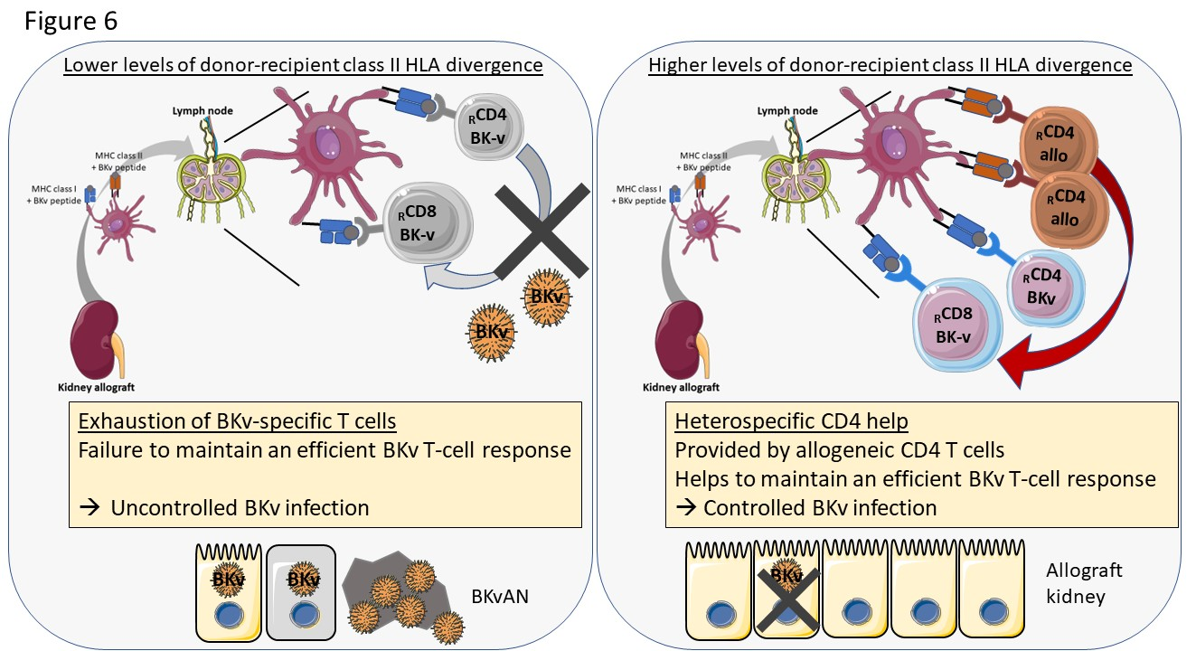
Allogeneic immunity helps sustain effective BK-virus immune responses and prevents BK virus-associated nephropathy
Results (cont.)
Conclusions
Exhaustion of BKv CD8 T cells in patients with BKvAN is observed
This lymphocyte exhaustion could lead to a defective BKv T-cell response, unable to provide a protective immune response against BKv reactivation
These results suggest that in kidney transplant recipient, allogeneic CD4 T cells may provide a heterospecific help to maintain an effective BKv CD8 T-cell response in kidney transplant recipients, improving the control of BKv replication in the kidney allograft
Dekeyser M. et al., ESOT Congress 2023; OS12_7
Notes:
Abbreviations: BKv, BK-virus; BKvAN, BK-virus associated nephropathy; CTLA4, cytotoxic T-lymphocyte-associated protein 4; HLA, human leukocyte antigen; PD1, programmed cell death protein 1; TIGIT, T cell immunoreceptor with Ig and ITIM domains; TIM3, T-cell immunoglobulin and mucin containing protein-3.
OS12_7
ALLOGENEIC IMMUNITY HELPS SUSTAIN EFFECTIVE BK-VIRUS IMMUNE RESPONSES AND PREVENTS BK VIRUS-ASSOCIATED NEPHROPATHY
Manon Dekeyser*¹, Marie-Ghislaine de Goer de Herve², Houria Chavez², Romain Lhotte³, Emmanuelle Boutin⁴, Florence Herr², Ivan Scriabine², Jean-Luc Taupin⁵, Yassine Taoufik², Antoine Durrbach²
¹Paris-Saclay University - INSERM 1186, Gustave Roussy Institute, Villejuif, France, ¹Paris-Saclay University - INSERM 1186, Gustave Roussy Institute, Villejuif, France, ³Laboratory of Immunology and Histocompatibility, Saint Louis Hospital, Assistance Publique - Hôpitaux de Paris (AP-HP) - INSERM U976, Paris, France, ⁴Unit of Clinical Research, Henri Mondor Hospital, Assistance Publique - Hôpitaux de Paris, Creteil, France, ⁵Laboratory of Immunology and Histocompatibility, Saint Louis Hospital, Assistance Publique - Hôpitaux de Paris (AP-HP) - INSERM U976, PARIS, France
Background: BK-virus (BKv) associated nephropathy (BKvAN) emerged as a major complication in renal transplantation, affecting up to 10% of kidney transplant recipients and leading to graft loss in more than 50% of cases. If BKv T-cell response plays a crucial role in the control of BKv infection, the mechanisms involved remain unknown.
Methods: We prospectively characterized BKv T cells in a cohort of 100 kidney transplant recipients with different BKv reactivation levels (without BKV, viruria, viremia or BKvAN).
Results: Patients with BKvAN had a severe impairment of BKv CD8 T-cell functionality, such as proliferative, cytokine and cytotoxic capacities (p<0.05). We observed a gradual loss of functional BKv T cells according to BKv reactivation levels (p<0.0001), an inverse correlation between T-cell functionality and plasmatic BKv load, and an overexpression of lymphocyte inhibitory receptors (PD1, CTLA4, TIGIT and TIM3) (p<0.05). This phenotype suggested an exhaustion of BKv T cells in patients with BKvAN. This lymphocyte impairment was associated with a low level of donor-recipient class II HLA divergence, suggesting a key role of allogeneic CD4 help. In a context of higher levels of donor-recipient class II HLA divergence, allogeneic CD4 T cells can provide heterospecific help to sustain BKv T-cell responses. In in vitro experiments, the replacement of syngeneic CD4 T cells with allogeneic HLA-mismatched CD4 T cells restores BKv CD8 T-cell responses.
Conclusions: We observed an exhaustion of BKv CD8 T cells in patients with BKvAN. This lymphocyte exhaustion could lead to a defective BKv T-cell response, unable to provide a protective immune response against BKv reactivation. Our results suggest that in kidney transplant recipient, allogeneic CD4 T cells may provide a heterospecific help to maintain an effective BKv CD8 T-cell response in kidney transplant recipients, improving the control of BKv replication in the kidney allograft.

