Slide 2
Disclaimer
This slide deck is designed for personal educational purposes only and should not be utilised for making patient management decisions. It is important to verify all information provided before treating patients or applying any therapies mentioned in these materials.

Slide 3
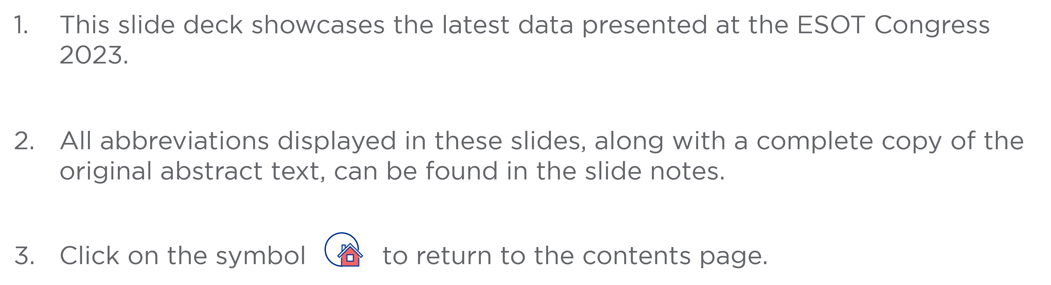
Information

Slide 4
Content
Heart
BOS5_5 | Outcome of heart transplant bridged with veno-arterial extracorporeal membrane oxygenation: A single center experience
BOS5_7 | Heart transplant survival outcomes: Role of donor-transmitted atherosclerosis
BOS5_13 | Development and validation of specific posttransplant risk scores according to the transplant era: A UNOS cohort analysis
BOS5_14 | Graft remodeling after thoracic transplantation: MIR-339 and galectin-3 in the diagnosis of structural changes
FG2_6 | Custodiol-N versus custodiol: Results from a prospective randomized single blind multicenter phase III trial in patients undergoing heart transplantation
FG2_7 | Effects of triiodothyronine and preconditioning on ex vivo rat hearts subjected to normothermic perfusion. Implications for donor heart preservation

Slide 5
Content
Heart
LDV7 | Donor-derived cell free DNA as a surveillance tool for acute cellular rejection in heart transplantation: Results from the free-DNA car study
OS6_1 | 5-year outcome after continuous flow LVAD with full-magnetic vs hybrid levitation system: Results of an all-comers multicenter registry
OS6_2 | Impact of the 2018 French allocation scheme on the profile of heart transplantation candidates and recipients: Insights from a high-volume center
OS6_3 | Results from over 800 transplant recipients enrolled in the guardian-heart registry: Challenging the standard of care
OS6_4 | Heart transplantation from controlled donation after the circulatory determination of death: Our experience
OS6_5 | Molecular diagnostic classification of heart allograft rejection based on the targeted banff human organ transplant gene expression panel

Slide 6
Content
Heart
OS6_6 | Banff human organ transplant consensus gene panel for detecting antibody mediated rejection in heart allograft biopsies
OS6_7 | Pregnancy after heart transplant
OS6_8 | Long-term outcomes of complement inhibition for prevention of antibody-mediated rejection in immunologically high-risk heart transplantation

Slide 7

Outcome of heart transplant bridged with veno-arterial extracorporeal membrane oxygenation: A single center experience
Background
HT remains the gold standard for severe HF
Patients admitted for acute decompensated HF develop CS in about 1% of cases, requiring prompt intervention to reverse hypoperfusion and end-organ damage
VA-ECMO as bridge to transplant gives the highest priority to the patient, reducing waiting list time
Reported data about post-transplant outcome after VA-ECMO bridging is controversial
Aim: To evaluate the follow-up of both patients bridged to transplant with VA-ECMO and patients transplanted electively between 2014 and 2019 at our institution
Methods
Outcome of n=27/181 (15%) HT on VA-ECMO support
Outcome of n=24/181 (13%) HT without support
VS
Matched for:
Sex
Age
Anthropometric characteristics
Results
VA-ECMO bridged patients:
  Less likely to be women
  Had more frequently previous cardiac surgery
  Had higher bilirubin levels
There were no significant differences in age, creatinine levels, mPAP and donor characteristics between the two groups
Statistically significant difference in VA-ECMO patients regarding fewer days on waiting list (Table)
Masciocco G., Varrenti M., Ruzzenenti G. et al., ESOT Congress 2023; BOS5_5
Notes:
Abbreviations: BMI, body mass index; CI, cardiac index; CS, cardiogenic shock; HF, heart failure; HT, heart transplantation; min, minute; mPAP, mean pulmonary arterial pressure; VA-ECMO, veno-arterial extracorporeal membrane oxygenation.
BOS5_5
OUTCOME OF HEART TRANSPLANT BRIDGED WITH VENO-ARTERIAL EXTRACORPOREAL MEMBRANE OXYGENATION: A SINGLE CENTER EXPERIENCE
Gabriella Masciocco¹, Marisa Varrenti¹, Giacomo Ruzzenenti*¹, Nicolina Conti¹, Matteo Palazzini¹, Piero Gentile¹, Andrea Tedeschi¹, Guido Maria Olivieri¹, Elisa Montrasio^{1;2}, Andrea Garascia¹
¹ASST Niguarda, Milan, Italy, ²ASST GOM NIGUARDA, Milan, Italy
Background: despite advances in medical therapy, heart transplantation (HT) remains the gold standard for severe heart failure (HF). Patients admitted for acute decompensated HF develop cardiogenic shock (CS) in about 1% of cases, requiring prompt intervention to reverse hypoperfusion and end-organ damage. Veno-arterial extracorporeal membrane oxygenation (VA-ECMO) as bridge to transplant gives the highest priority to the patient, reducing waiting list time. Reported data about post-transplant outcome after VA-ECMO bridging is controversial.
Methods: we evaluated the follow-up of both patients bridged to transplant with VA-ECMO and patients transplanted electively between 2014 and 2019 at our institution. Of 181 patients who underwent heart transplantation in that period, we compared the outcome of 27 (15%) transplanted on VA-ECMO support to the outcome of 24 (13%, matched for sex, age and anthropometric characteristics) transplanted without support in the same period.
Results: VA-ECMO bridged patients were less likely to be women, had more frequently previous cardiac surgery and had higher bilirubin levels. There were no significant differences in age, creatinine levels, mean pulmonary arterial pressure (mPAP) and donor characteristics between the two groups. We found a statistically significant difference in VA-ECMO patients regarding fewer days on waiting list (Table). The Kaplan-Mayer curves showed no statistically significant differences in event-free survival (Figure).
Conclusions: data from our study suggests that, despite being on worse clinical condition with more hepatic damage at transplant, there are no significant differences in early and medium-term survival between patients on VA-ECMO support and the other group. The shorter time on waiting list in VA-ECMO population may have a protective role in these patients preventing further organ damage and complication related to the mechanical support itself. Larger case series and more in-depth statistical analyses should be carried out in future studies to confirm this result.

Slide 8
Outcome of heart transplant bridged with veno-arterial extracorporeal membrane oxygenation: A single center experience
Results (cont.)
The Kaplan-Mayer curves shows no statistically significant differences in event-free survival (Figure)
 |  | ECMO | No-ECMO | p-value
Age at HT, median (Q1-Q3) | Age at HT, median (Q1-Q3) | 48 (32-56) | 50 (36-50) | 0.4
Female, n (%) | Female, n (%) | 8 (29.6) | 16 (66.6) | 0.01
BMI, median (Q1-Q3) | BMI, median (Q1-Q3) | 22 (21-25) | 22 (21-25) | 0.67
Aetiology | Ischemic, n (%) | 4 | 6 | 0.4
 | Non-ischemic, n (%) | 23 | 18 | 0.5
 | Previous cardiac-surgery, n (%) | 9 (33) | 0 (0) | 0.002
Creatinine, median (Q1-Q3) |  | 1 (0.69-1.69) | 0.9 (0.75-1.19) | 0.5
Bilirubin, median (Q1-Q3) |  | 1.3 (0.79-2.4) | 0.6 (0.42-0.96) | 0.001
mPAP, median (Q1-Q3) |  | 22.5 (15.5-26.7) | 21 (15.2-30) | 0.77
CI, median (Q1-Q3) |  | 2.2 (1.6-2.5) | 1.7 (1.5-1.9) | 0.03
Days on waiting list, median (Q1-Q3) |  | 8 (3-41) | 151 (49-309) | <0.0001
Days on ECMO, median (Q1-Q3) |  | 4 (8-10) | - | -
Age of donor, median (Q1-Q3) |  | 47 (36.5-51.5) | 42.5 (23.5-54.7) | 0.6
BMI of donor, median (Q1-Q3) |  | 24.7 (22.9-27.4) | 23.9 (21-27.3) | 0.7
Time of ischemia, min, median (Q1-Q3) |  | 195 (163-231) | 176.5 (157.8-209.5) | 0.22
Conclusions
No significant differences in early and medium-term survival between patients on VA-ECMO support and the other group
The shorter time on waiting list in VA-ECMO population may have a protective role in these patients preventing further organ damage and complication related to the mechanical support itself
Larger case series and more in-depth statistical analyses should be carried out in future studies to confirm this result
In bold: significant p-value
Masciocco G., Varrenti M., Ruzzenenti G. et al., ESOT Congress 2023; BOS5_5
Notes:
Abbreviations: BMI, body mass index; CI, cardiac index; CS, cardiogenic shock; HF, heart failure; HT, heart transplantation; min, minute; mPAP, mean pulmonary arterial pressure; VA-ECMO, veno-arterial extracorporeal membrane oxygenation.
BOS5_5
OUTCOME OF HEART TRANSPLANT BRIDGED WITH VENO-ARTERIAL EXTRACORPOREAL MEMBRANE OXYGENATION: A SINGLE CENTER EXPERIENCE
Gabriella Masciocco¹, Marisa Varrenti¹, Giacomo Ruzzenenti*¹, Nicolina Conti¹, Matteo Palazzini¹, Piero Gentile¹, Andrea Tedeschi¹, Guido Maria Olivieri¹, Elisa Montrasio^{1;2}, Andrea Garascia¹
¹ASST Niguarda, Milan, Italy, ²ASST GOM NIGUARDA, Milan, Italy
Background: despite advances in medical therapy, heart transplantation (HT) remains the gold standard for severe heart failure (HF). Patients admitted for acute decompensated HF develop cardiogenic shock (CS) in about 1% of cases, requiring prompt intervention to reverse hypoperfusion and end-organ damage. Veno-arterial extracorporeal membrane oxygenation (VA-ECMO) as bridge to transplant gives the highest priority to the patient, reducing waiting list time. Reported data about post-transplant outcome after VA-ECMO bridging is controversial.
Methods: we evaluated the follow-up of both patients bridged to transplant with VA-ECMO and patients transplanted electively between 2014 and 2019 at our institution. Of 181 patients who underwent heart transplantation in that period, we compared the outcome of 27 (15%) transplanted on VA-ECMO support to the outcome of 24 (13%, matched for sex, age and anthropometric characteristics) transplanted without support in the same period.
Results: VA-ECMO bridged patients were less likely to be women, had more frequently previous cardiac surgery and had higher bilirubin levels. There were no significant differences in age, creatinine levels, mean pulmonary arterial pressure (mPAP) and donor characteristics between the two groups. We found a statistically significant difference in VA-ECMO patients regarding fewer days on waiting list (Table). The Kaplan-Mayer curves showed no statistically significant differences in event-free survival (Figure).
Conclusions: data from our study suggests that, despite being on worse clinical condition with more hepatic damage at transplant, there are no significant differences in early and medium-term survival between patients on VA-ECMO support and the other group. The shorter time on waiting list in VA-ECMO population may have a protective role in these patients preventing further organ damage and complication related to the mechanical support itself. Larger case series and more in-depth statistical analyses should be carried out in future studies to confirm this result.

Slide 9
Heart transplant survival outcomes: Role of donor-transmitted atherosclerosis
Background
An increasing number of potential heart recipients with UNOS1 status forces to find solutions for the shortage of donor organs by expanding the criteria for selecting optimal donors
Coronary assessment of a cardiac graft is inaccessible in the pre-transplant period; therefore there exists a risk of transmission of the coronary atherosclerotic from a donor to a recipient
Methods
Retrospective study, n=1155 heart transplant recipients from Shumakov Center (2009-2018)
n=985 men
n=170 women
aged 10 to 74 years
All patients underwent coronary angiography in the early postoperative period
Group I
Recipients with hemodynamically significant lesions of the CA
Group II
Pts. with signs of CA atheromatosis (rough contours or stenoses ≤50%)
Group III
Pts. without signs of CA
Analysis criteria: Sex, age, cause of donor’s brain death, UNOS status
Sakhovskiy S. et al., ESOT Congress 2023; BOS5_7
Notes:
Abbreviations: CA, coronary arteries; pts, patients; UNOS, united network for organ sharing.
BOS5_7
HEART TRANSPLANT SURVIVAL OUTCOMES: ROLE OF DONOR-TRANSMITTED ATHEROSCLEROSIS
Stepan Sakhovskiy*¹, Nadegda Koloskova¹, Ilkhom Muminov¹, Daria Uvarova¹, Anna Goncharova¹, Boris Mironkov¹
¹Shumakov National Medical Research Center of Transplantology and Artificial Organs, Moscow, Russian Federation, Moscow, Schukinskaya street, 1, Russian Federation
Background: An increasing number of potential heart recipients with UNOS1 status forces to find solutions for the shortage of donor organs by expanding the criteria for selecting optimal donors. Coronary assessment of a cardiac graft is inaccessible in the pre-transplant period; therefore there exists a risk of transmission of the coronary atherosclerotic from a donor to a recipient.
Methods: We retrospectively reviewed the medical records of 1155 recipients who underwent Heart transplantation in the Shumakov Center from 2009 to 2018; 985 were men, and 170 women, aged 10 to 74 years. All patients underwent coronary angiography in the early postoperative period and were divided into 3 groups: I - recipients with hemodynamically significant lesions of the coronary arteries (CA), II – pts. with signs of CA atheromatosis (rough contours or stenoses up to 50%), and III – pts. without signs of CA. The analysis included the following criteria: sex, age, cause of donor’s brain death, UNOS status.
Results: In 332 pts. (groups I and II) signs of donor-transmitted atherosclerosis were found. In 130 cases the lesion was assessed as hemodynamically significant and percutaneous coronary intervention was performed. In 823 cases there were no signs of atherosclerosis. In recipients with UNOS status 1A (n=355) and 1B (n=436), transmission of atherosclerosis was detected more often than in recipients with UNOS 2 (60% and 40%, respectively). The age of donors in groups I and II was significantly higher than in groups III (p = 0.0001). No association was found between the frequency of donor-transmitted atherosclerosis and the gender of the donor. Acute cerebrovascular accident as a cause of donor’s brain death in groups was: 90% in I, 84% in II, and 80% in III. Five-year survival in I group was 75.6%, II - 72.5%, and III - 74.6%, no significant difference between groups (I/II p=0,849, I/III p=0,389, II/III p=0,421).
Conclusions: Donor-transmitted atherosclerosis, including hemodynamically significant lesions of the CA, is associated with the age of the donor. Early endovascular correction of hemodynamically significant lesions neutralizes the potentially negative impact of coronary stenosis on the survival of heart transplant recipients.

Slide 10
Heart transplant survival outcomes: Role of donor-transmitted atherosclerosis
Results
n=332 pts. (groups I and II) with donor-transmitted atherosclerosis and n=823 pts. without atherosclerosis
In 130/332 cases, the lesion was assessed as hemodynamically significant and percutaneous coronary intervention was performed
In recipients with UNOS status 1A (n=355) and 1B (n=436), transmission of atherosclerosis was detected more often than in recipients with UNOS 2 (60% and 40%, respectively)
The age of donors in groups I and II was significantly higher than in groups III (p=0.0001)
No association was found between the frequency of donor-transmitted atherosclerosis and the gender of the donor
Acute cerebrovascular accident as a cause of donor’s brain death in groups was: 90% in I, 84% in II, and 80% in III
Five-year survival in I group was 75.6%, II - 72.5%, and III - 74.6%, no significant difference between groups (I/II p=0,849, I/III p=0,389, II/III p=0,421)
Conclusions
Donor-transmitted atherosclerosis, including hemodynamically significant lesions of the CA, is associated with the age of the donor
Early endovascular correction of hemodynamically significant lesions neutralizes the potentially negative impact of coronary stenosis on the survival of heart transplant recipients
Sakhovskiy S. et al., ESOT Congress 2023; BOS5_7
Notes:
Abbreviations: CA, coronary arteries; pts, patients; UNOS, united network for organ sharing.
BOS5_7
HEART TRANSPLANT SURVIVAL OUTCOMES: ROLE OF DONOR-TRANSMITTED ATHEROSCLEROSIS
Stepan Sakhovskiy*¹, Nadegda Koloskova¹, Ilkhom Muminov¹, Daria Uvarova¹, Anna Goncharova¹, Boris Mironkov¹
¹Shumakov National Medical Research Center of Transplantology and Artificial Organs, Moscow, Russian Federation, Moscow, Schukinskaya street, 1, Russian Federation
Background: An increasing number of potential heart recipients with UNOS1 status forces to find solutions for the shortage of donor organs by expanding the criteria for selecting optimal donors. Coronary assessment of a cardiac graft is inaccessible in the pre-transplant period; therefore there exists a risk of transmission of the coronary atherosclerotic from a donor to a recipient.
Methods: We retrospectively reviewed the medical records of 1155 recipients who underwent Heart transplantation in the Shumakov Center from 2009 to 2018; 985 were men, and 170 women, aged 10 to 74 years. All patients underwent coronary angiography in the early postoperative period and were divided into 3 groups: I - recipients with hemodynamically significant lesions of the coronary arteries (CA), II – pts. with signs of CA atheromatosis (rough contours or stenoses up to 50%), and III – pts. without signs of CA. The analysis included the following criteria: sex, age, cause of donor’s brain death, UNOS status.
Results: In 332 pts. (groups I and II) signs of donor-transmitted atherosclerosis were found. In 130 cases the lesion was assessed as hemodynamically significant and percutaneous coronary intervention was performed. In 823 cases there were no signs of atherosclerosis. In recipients with UNOS status 1A (n=355) and 1B (n=436), transmission of atherosclerosis was detected more often than in recipients with UNOS 2 (60% and 40%, respectively). The age of donors in groups I and II was significantly higher than in groups III (p = 0.0001). No association was found between the frequency of donor-transmitted atherosclerosis and the gender of the donor. Acute cerebrovascular accident as a cause of donor’s brain death in groups was: 90% in I, 84% in II, and 80% in III. Five-year survival in I group was 75.6%, II - 72.5%, and III - 74.6%, no significant difference between groups (I/II p=0,849, I/III p=0,389, II/III p=0,421).
Conclusions: Donor-transmitted atherosclerosis, including hemodynamically significant lesions of the CA, is associated with the age of the donor. Early endovascular correction of hemodynamically significant lesions neutralizes the potentially negative impact of coronary stenosis on the survival of heart transplant recipients.

Slide 11
Development and validation of specific posttransplant risk scores according to the transplant era: A UNOS cohort analysis
Background
The clinical use of post-transplant risk scores is limited by their poor statistical performance
Neglecting the dynamic evolution of demographics and risk factors over time may be a key issue
Aim: To test the hypothesis that developing specific prognostic models for each transplant era may improve risk stratification
2
Build (logistic regression, derivation cohort 2/3) and compared (validation cohort 1/3) the statistical performance (discrimination, calibration, reclassification indices) of era-specific models and non-era-specific models (2001-2005, 2006-2010, 2011-2015, 2016-2018)
In a sensitivity analysis, 1,000 bootstrap samples were generated to analyze the variability of specific predictive models and compare era and non-era-specific models
Results
A total of 34,747 patients were included; 3,674 patients (10.6%) met the composite endpoint
Significant improvement in post-transplant outcomes (p<0.001) and an important evolution in baseline characteristics over time
Significant (p<0.01) interaction between time and the effect of the following variables:
  Bilirubin
  Recipient age
  Prior cardiac surgery
Methods
1
Analysis of the UNOS database including first, non-combined heart transplantations with a common allocation scheme (2003-2018)
Endpoint: Death or retransplantation during the first year post-transplant
Coutance G. et al., ESOT Congress 2023; BOS5_13
Notes:
Abbreviations: BMI, body mass index; ECMO, extracorporeal membrane oxygenation; eGFR, estimated glomerular filtration rate; HF, heart failure; UNOS, united network for organ sharing.
BOS5_13
DEVELOPMENT AND VALIDATION OF SPECIFIC POST-TRANSPLANT RISK SCORES ACCORDING TO THE TRANSPLANT ERA: A UNOS COHORT ANALYSIS.
Guillaume Coutance*¹, Mickael Lescroart², Evan Kransdorf³, Jignesh Patel³, Alexandre Loupy¹
¹Paris Transplant Group, Paris, France, ²Pitié-Salpêtrière Hospital, Paris, France, ³Cedars Sinai Medical Center, Los Angeles, United States
Background: The clinical use of post-transplant risk scores is limited by their poor statistical performance. Neglecting the dynamic evolution of demographics and risk factors over time may be a key issue. We hypothesized that developing specific prognostic models for each transplant era may improve risk stratification.
Methods: We analyzed the UNOS database including first, non-combined heart transplantations with a common allocation scheme (2003-2018). The endpoint was death or retransplantation during the first year post-transplant. We analyzed the evolution of post-transplant outcomes, demographics, and odds ratios of major predictive variables over time. Then, we build (logistic regression, derivation cohort 2/3) and compared (validation cohort 1/3) the statistical performance (discrimination, calibration, reclassification indices) of era-specific models and non-era-specific models (2001-2005, 2006-2010, 2011-2015, 2016-2018). In a sensitivity analysis, we randomly generated 1,000 bootstrap samples to analyze the variability of specific predictive models and compare era and non-era-specific models.
Results: A total of 34,747 patients were included; 3,674 patients (10.6%) met the composite endpoint. We observed a significant improvement in post-transplant outcomes (p < 0.001) and an important evolution in baseline characteristics over time. We found a significant interaction between time and the effect of the following variables: bilirubin, recipient age and prior cardiac surgery (p<0.01). Era-specific models differed from each other, both in terms of variables and odds ratios (Figure 1A). Era-specific models outperformed the statistical performance of non-era-specific models in a majority of samples, both in terms of discrimination, calibration (Figure 1B) and reclassification indices.
Conclusions: We found important evolution in post-transplant outcomes, baseline characteristics and predictive models over time. Era-specific models outperformed the statistical performance of non-era-specific models in a majority of samples. This finding suggests the need for a regular update of post-transplant predictive models to account for the evolving demography of candidates and medical practices.

Slide 12
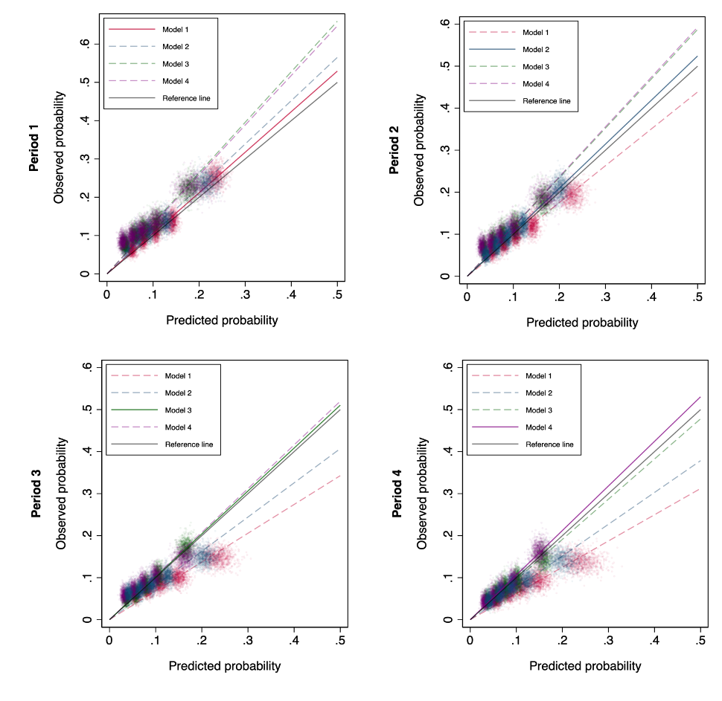
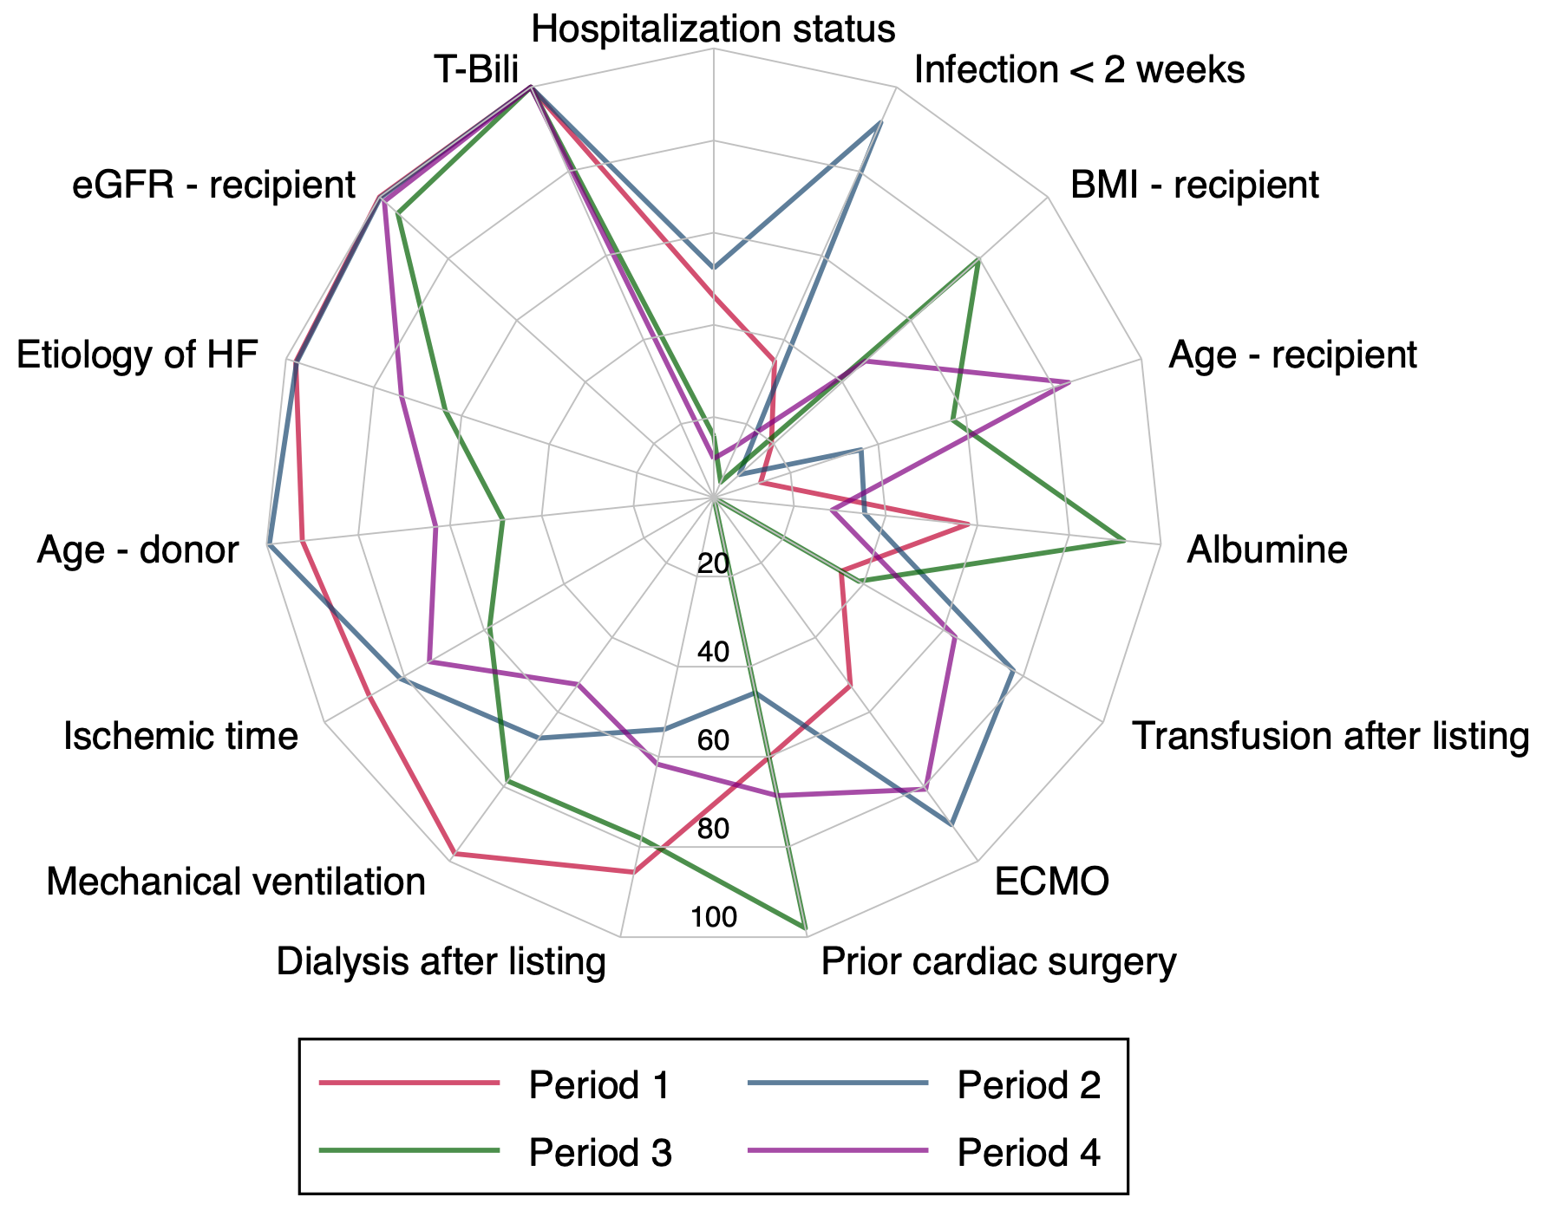
Development and validation of specific posttransplant risk scores according to the transplant era: A UNOS cohort analysis
Figure B
Results
Era-specific models differed from each other, both in terms of variables and odds ratios (Figure A)
Figure A
Era-specific models outperformed the statistical performance of non-era-specific models in a majority of samples, both in terms of discrimination, calibration (Figure B) and reclassification indices
Conclusions
This finding suggests the need for a regular update of post-transplant predictive models to account for the evolving demography of candidates and medical practices
Coutance G. et al., ESOT Congress 2023; BOS5_13
Notes:
Abbreviations: BMI, body mass index; ECMO, extracorporeal membrane oxygenation; eGFR, estimated glomerular filtration rate; HF, heart failure; UNOS, united network for organ sharing.
BOS5_13
DEVELOPMENT AND VALIDATION OF SPECIFIC POST-TRANSPLANT RISK SCORES ACCORDING TO THE TRANSPLANT ERA: A UNOS COHORT ANALYSIS.
Guillaume Coutance*¹, Mickael Lescroart², Evan Kransdorf³, Jignesh Patel³, Alexandre Loupy¹
¹Paris Transplant Group, Paris, France, ²Pitié-Salpêtrière Hospital, Paris, France, ³Cedars Sinai Medical Center, Los Angeles, United States
Background: The clinical use of post-transplant risk scores is limited by their poor statistical performance. Neglecting the dynamic evolution of demographics and risk factors over time may be a key issue. We hypothesized that developing specific prognostic models for each transplant era may improve risk stratification.
Methods: We analyzed the UNOS database including first, non-combined heart transplantations with a common allocation scheme (2003-2018). The endpoint was death or retransplantation during the first year post-transplant. We analyzed the evolution of post-transplant outcomes, demographics, and odds ratios of major predictive variables over time. Then, we build (logistic regression, derivation cohort 2/3) and compared (validation cohort 1/3) the statistical performance (discrimination, calibration, reclassification indices) of era-specific models and non-era-specific models (2001-2005, 2006-2010, 2011-2015, 2016-2018). In a sensitivity analysis, we randomly generated 1,000 bootstrap samples to analyze the variability of specific predictive models and compare era and non-era-specific models.
Results: A total of 34,747 patients were included; 3,674 patients (10.6%) met the composite endpoint. We observed a significant improvement in post-transplant outcomes (p < 0.001) and an important evolution in baseline characteristics over time. We found a significant interaction between time and the effect of the following variables: bilirubin, recipient age and prior cardiac surgery (p<0.01). Era-specific models differed from each other, both in terms of variables and odds ratios (Figure 1A). Era-specific models outperformed the statistical performance of non-era-specific models in a majority of samples, both in terms of discrimination, calibration (Figure 1B) and reclassification indices.
Conclusions: We found important evolution in post-transplant outcomes, baseline characteristics and predictive models over time. Era-specific models outperformed the statistical performance of non-era-specific models in a majority of samples. This finding suggests the need for a regular update of post-transplant predictive models to account for the evolving demography of candidates and medical practices.

Slide 13


Graft remodeling after thoracic transplantation: MIR-339 and galectin-3 in the diagnosis of structural changes
Background
Graft remodelling after HTx and LTx caused by ACR, AMR and fibrosis leads to its dysfunction
Timely and minimally invasive diagnostic methods for graft structural changes detection are required
MiRs are small non-coding regulatory molecules; miR-339 inhibits proliferation of pulmonary artery smooth muscle cell by targeting fibroblast growth factor signalling
Gal-3 is known as a proteomic biomarker of the inflammatory processes, immune response, and fibrosis
Aim: To evaluate the miR-339 and gal-3 plasma levels in patients with graft remodeling – myocardial fibrosis after HTx and airway obstruction after LTx
Methods
n=83 patients (16-70 years) after HTx
n=57 patients (10-74 years) after LTx
MiR-339 plasma levels measured by PCR
Gal-3 plasma levels determined by ELISA
Diagnostic value of biomarkers evaluated by the ROC analysis
Gautier S. et al., ESOT Congress 2023; BOS5_14
Notes:
Abbreviations: ACR, acute cellular rejection; AMR, antibody-mediated rejection; CI, confidence interval; gal-3, galectin-3; HTx heart transplantation, ISHLT, international society for heart and lung transplantation; LTx, lung transplantation; miRs, microRNAs; PCR, polymerase chain reaction; resp., respectively; RR, relative risk; Se, sensitivity; Sp, specificity.
BOS5_14
GRAFT REMODELING AFTER THORACIC TRANSPLANTATION: MIR-339 AND GALECTIN-3 IN THE DIAGNOSIS OF STRUCTURAL CHANGES
Sergey Gautier^{1;2}, Olga Shevchenko^{1;2}, Olga Tsiroulnikova^{1;2}, Sofya Sharapchenko*^{1;1}, Dmitriy Velikiy¹, Olga Gichkun^{1;2}, Ivan Pashkov¹, Maksat Bekov¹, Natalya Mozheiko¹, Alex Shevchenko^{1;2;3}
¹Shumakov National Medical Research Center of Transplantology and Artificial Organs , Moscow , Russian Federation, ²First Moscow State Medical University, Department of transplantology, Moscow, Russian Federation, ³Pirogov Russian National Research Medical University, Moscow, Russian Federation
Background: Graft remodeling after heart (HTx) and lung (LTx) transplantation, caused by ACR, AMR and fibrosis leads to its dysfunction. Timely and minimally invasive diagnostic methods for graft structural changes detection are required. MicroRNAs (miRs) are small non-coding regulatory molecules; miR-339 inhibits proliferation of pulmonary artery smooth muscle cell by targeting fibroblast growth factor signaling. Galectin-3 (gal-3) is known as a proteomic biomarker of the inflammatory processes, immune response, and fibrosis. The aim is to evaluate the miR-339 and gal-3 plasma levels in patients with graft remodeling – myocardial fibrosis after HTx and airway obstruction after LTx.
Methods: The study enrolled 83 patients after HTx, aged 16 to 70 years, and 57 patients after LTx, aged 10 to 74 years. MiR-339 plasma levels were measured by PCR (Qiagen, USA) and are expressed in relative units. Gal-3 levels were determined by ELISA (Bender MedSystems GmbH, Austria). The diagnostic value of biomarkers was evaluated by the ROC analysis.
Results: According to the ISHLT classifications, 48 recipients with myocardial fibrosis, 36 – with ACR, and 2 – with AMR after HTx were detected. MiR-339 and gal-3 levels were significantly higher in heart recipients with fibrosis than without it (p=0.018, p=0.043, resp.). During follow-up 12 lung recipients with non-infectious airway obstruction and 16 – with infections, and 2 – with ACR after LTx were identified. MiR-339 and gal-3 levels in lung recipients with airway obstruction were significantly higher compared to recipients without it (p=0.036 and p=0.014, resp.). MiR-339 and gal-3 threshold levels and diagnostic characteristics for myocardial fibrosis and airway obstruction detection were determined.
Conclusions: MiR-339 and gal-3 have been shown to be promising profibrotic biomarkers whose increasing in duplex tests identifies recipients with graft remodeling after HTx and LTx.

Slide 14
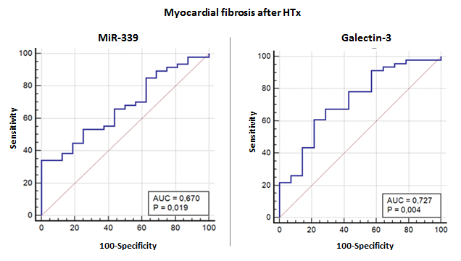
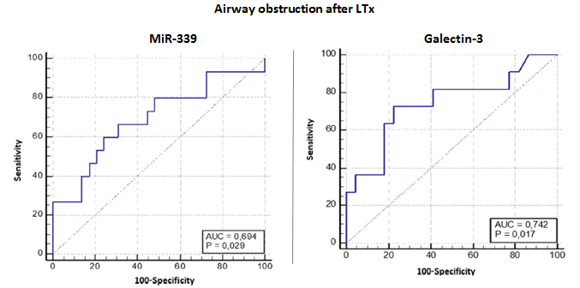
Graft remodeling after thoracic transplantation: MIR-339 and galectin-3 in the diagnosis of structural changes
Results
Detection of post-transplant complications (ISHLT classifications)
In heart transplant recipients:
  48 with myocardial fibrosis;
  36 with ACR;
  2 with AMR
  MiR-339 and gal-3 levels were significantly higher in heart transplant recipients with fibrosis than without it (p=0.018, p=0.043, resp.)
In lung transplant recipients:
  12 recipients with airway obstruction;
  16 recipients with infections;
  2 recipients with ACR
  MiR-339 and gal-3 levels in lung transplant recipients with airway obstruction were significantly higher compared to recipients without it (p=0.036 and p=0.014, resp.)
Diagnostic characteristics of miR-339 and gal-3 for graft remodeling
Biomarker | Myocardial fibrosis after HTx |  |  |  | Airway obstruction after LTx
 | RR | 95% CI | Se | Sp | RR | 95% CI | Se | Sp
miR-339 | 1.31 | 1.02–1.70 | 36.2% | 87.5% | 2.63 | 1.14–6.02 | 60.0% | 75.9%
gal-3 | 1.46 | 1.07–1.98 | 60.9% | 78.6% | 3.62 | 1.16–11.24 | 72.7% | 72.7%
miR-339+gal-3 | 2.00 | 1.08–3.72 | 54.5% | 100.0% | 7.14 | 1.05–48.60 | 83.3% | 81.8%
Conclusions
MiR-339 and gal-3 are promising profibrotic biomarkers whose increasing in duplex tests identifies recipients with graft remodelling after HTx and LTx
Gautier S. et al., ESOT Congress 2023; BOS5_14
Notes:
Abbreviations: ACR, acute cellular rejection; AMR, antibody-mediated rejection; CI, confidence interval; gal-3, galectin-3; HTx heart transplantation, ISHLT, international society for heart and lung transplantation; LTx, lung transplantation; miRs, microRNAs; PCR, polymerase chain reaction; resp., respectively; RR, relative risk; Se, sensitivity; Sp, specificity.
BOS5_14
GRAFT REMODELING AFTER THORACIC TRANSPLANTATION: MIR-339 AND GALECTIN-3 IN THE DIAGNOSIS OF STRUCTURAL CHANGES
Sergey Gautier^{1;2}, Olga Shevchenko^{1;2}, Olga Tsiroulnikova^{1;2}, Sofya Sharapchenko*^{1;1}, Dmitriy Velikiy¹, Olga Gichkun^{1;2}, Ivan Pashkov¹, Maksat Bekov¹, Natalya Mozheiko¹, Alex Shevchenko^{1;2;3}
¹Shumakov National Medical Research Center of Transplantology and Artificial Organs , Moscow , Russian Federation, ²First Moscow State Medical University, Department of transplantology, Moscow, Russian Federation, ³Pirogov Russian National Research Medical University, Moscow, Russian Federation
Background: Graft remodeling after heart (HTx) and lung (LTx) transplantation, caused by ACR, AMR and fibrosis leads to its dysfunction. Timely and minimally invasive diagnostic methods for graft structural changes detection are required. MicroRNAs (miRs) are small non-coding regulatory molecules; miR-339 inhibits proliferation of pulmonary artery smooth muscle cell by targeting fibroblast growth factor signaling. Galectin-3 (gal-3) is known as a proteomic biomarker of the inflammatory processes, immune response, and fibrosis. The aim is to evaluate the miR-339 and gal-3 plasma levels in patients with graft remodeling – myocardial fibrosis after HTx and airway obstruction after LTx.
Methods: The study enrolled 83 patients after HTx, aged 16 to 70 years, and 57 patients after LTx, aged 10 to 74 years. MiR-339 plasma levels were measured by PCR (Qiagen, USA) and are expressed in relative units. Gal-3 levels were determined by ELISA (Bender MedSystems GmbH, Austria). The diagnostic value of biomarkers was evaluated by the ROC analysis.
Results: According to the ISHLT classifications, 48 recipients with myocardial fibrosis, 36 – with ACR, and 2 – with AMR after HTx were detected. MiR-339 and gal-3 levels were significantly higher in heart recipients with fibrosis than without it (p=0.018, p=0.043, resp.). During follow-up 12 lung recipients with non-infectious airway obstruction and 16 – with infections, and 2 – with ACR after LTx were identified. MiR-339 and gal-3 levels in lung recipients with airway obstruction were significantly higher compared to recipients without it (p=0.036 and p=0.014, resp.). MiR-339 and gal-3 threshold levels and diagnostic characteristics for myocardial fibrosis and airway obstruction detection were determined.
Conclusions: MiR-339 and gal-3 have been shown to be promising profibrotic biomarkers whose increasing in duplex tests identifies recipients with graft remodeling after HTx and LTx.

Slide 15
Custodiol-N versus custodiol: Results from a prospective randomized single blind multicenter phase III trial in patients undergoing heart transplantation
Background
HTK is a well-established preservation solution in organ transplantation
HTK-N, is a novel HTK-based solution, which includes iron chelators to reduce oxidative injury, as well as L-arginine, to improve endothelial cell function
Earlier results in coronary artery bypass surgery, showed good cardiac protection without any safety concerns
Aim: To evaluate the safety and ability of Custodiol-N to preserve cardiac grafts for heart transplantation
Methods
Prospective randomised, single blind multicenter non-inferiority trial performed at 3 centers in Austria and Germany, n=105 randomized patients
HTK N, n=53
HTK, n=52
Primary endpoint (analysed in PP population)
CK-MB peak value from 4-168 hours after opening of the aortic cross clamp, with a 30% non-inferiority margin
Secondary efficacy endpoints (analysed in both as treated and PP populations)
Patient and graft survival
Incidence of primary graft failure
Length of intensive care unit stay
Aliabadi-Zuckermann A. et al., ESOT Congress 2023; FG2_6
Notes:
Abbreviations: CK-MB, creatine kinase MB, HTK, histidine-tryptophan-ketoglutarate; HTK-N, modified histidine-tryptophan-ketoglutarate; n.s., not significant; PP, per-protocol; U/L, units per litre; SD, standard deviation.
FG2_6
CUSTODIOL-N VERSUS CUSTODIOL: RESULTS FROM A PROSPECTIVE RANDOMISED SINGLE BLIND MULTICETNER PHASE III TRIAL IN PATIENTS UNDERGOING HEART TRANSPLANTATION
Arezu Aliabadi-Zuckermann¹, Emilio Osorio-Jaramillo¹, Christoph Knosalla², Jan Gummert³, Gabor Szabo⁴, Franziska Wittmann¹, Ruhi Yeter², Rene Schramm³, Johannes Goekler¹, Felix Hennig², Michiel Mershuis³, Andreas Zuckermann*¹
¹Medical University of Vienna, Cardiac Surgery, Vienna, Austria, ²Deutsches Herzzentrum Berlin, Berlin, Germany, ³Herz- und Diabeteszentrum NRW, Bad Oyenhausen, Germany, ⁴Universitätsklinikum Halle , Halle, Germany
Background: HTK is a well-established preservation solution in organ transplantation. HTK-N, is a novel HTK-based solution, which includes iron chelators to reduce oxidative injury, as well as L-arginine, to improve endothelial cell function. Earlier results in coronary artery bypass surgery, showed good cardiac protection without any safety concerns. The aim of this study was to evaluate the safety and ability of Custodiol-N to preserve cardiac grafts for heart transplantation
Methods: This prospective randomised, single blind multicenter non-inferiority trial was performed at three centers in Austria and Germany. 105 patients were randomized to HTK N (n=53) or HTK (n=52) as preservation solution for their donor hearts. The primary endpoint was creatine kinase (CK-MB) peak value from 4-168 hours after opening of the aortic cross clamp, with a 30% non-inferiority margin. Secondary efficacy endpoints were patient and graft survival, incidence of primary graft failure, length of intensive care unit stay. The primary endpoint was analysed in per-protocol (PP) population, whereas other endpoints were analysed in both as treated and PP populations.
Results: Average donor age (39.42±12.73 vs. 45.05±11.62; p=n.s.) and ischemic times (206.33±49.42 vs. 220.6±65.63; p=n.s.) were comparable between HTK-N and HTK groups. For the PP data set, 19 patients (HTK-N n=12, HTK n=7) were excluded due to missing CK-MB values. Average CK-MB peak values 178.17±202.41 U/L in the HTK group compared to 136.29±70,72 U/L in the HTK-N Group (p-value for non-inferiority of HTK-N by 30% <.0001). Patient and graft survival were comparable between groups at 30 days and 1-year post transplantation (HTK-N: 100%, 88,7%; HTK: 98.1%, 90,4%, p=0.83). The incidence of primary graft failure was 21.5% in the HTK and 11.3% in HTK-N group (p=0.19). Median length of intensive care unit stay was 8 days (25%-75%: 5-11 days) in the HTK-N group compared to 11 days in the HTK group (25%-75%: 6-19 days; p=0.13). Safety assessment showed even distributed adverse events with only 7 (HTK:n=4, HTK-N:n=3) possibly related to the preservation solutions.
Conclusions: This study shows that HTK-N is safe and provides similar cardiac protection as the established HTK solution. Both solutions were safe to use in clinical heart transplantation.

Slide 16
Custodiol-N versus custodiol: Results from a prospective randomized single blind multicenter phase III trial in patients undergoing heart transplantation
Results
For the PP data set, 19 patients (HTK-N n=12, HTK n=7) were excluded due to missing CK-MB values
Safety assessment showed even distributed adverse events with only 7 (HTK: n=4, HTK-N: n=3) possibly related to the preservation solutions
Conclusions
HTK-N is safe and provides similar cardiac protection as the established HTK solution
Both solutions were safe to use in clinical heart transplantation
 |  | HTK-N | HTK | p-value
Age (years), average ± SD | Age at HT, median (Q1-Q3) | 39.42 ± 12.73 | 45.05 ± 11.62 | n.s.
Ischemic times (minutes) | Female, n (%) | 206.33 ± 49.42 | 220.6 ± 65.63 | n.s.
Average CK-MB peak values (U/L) | BMI, median (Q1-Q3) | 136.29 ± 0.72 | 178.17 ± 202.41 | <.0001*
Post-transplantation patient and graft survival | at 30 days | 100% | 98.1% | 0.83
 | at 1-year | 88.7% | 90.4% | 0.5
Incidence of primary graft failure |  | 11.3% | 21.5% | 0.19
Intensive care unit stay, median |  | 8 days, (25%-75%: 5-11 days) | 11 days (25%-75%: 6-19 days) | 0.13
*for non-inferiority of HTK-N by 30%
Aliabadi-Zuckermann A. et al., ESOT Congress 2023; FG2_6
Notes:
Abbreviations: CK-MB, creatine kinase MB, HTK, histidine-tryptophan-ketoglutarate; HTK-N, modified histidine-tryptophan-ketoglutarate; n.s., not significant; PP, per-protocol; U/L, units per litre; SD, standard deviation.
FG2_6
CUSTODIOL-N VERSUS CUSTODIOL: RESULTS FROM A PROSPECTIVE RANDOMISED SINGLE BLIND MULTICETNER PHASE III TRIAL IN PATIENTS UNDERGOING HEART TRANSPLANTATION
Arezu Aliabadi-Zuckermann¹, Emilio Osorio-Jaramillo¹, Christoph Knosalla², Jan Gummert³, Gabor Szabo⁴, Franziska Wittmann¹, Ruhi Yeter², Rene Schramm³, Johannes Goekler¹, Felix Hennig², Michiel Mershuis³, Andreas Zuckermann*¹
¹Medical University of Vienna, Cardiac Surgery, Vienna, Austria, ²Deutsches Herzzentrum Berlin, Berlin, Germany, ³Herz- und Diabeteszentrum NRW, Bad Oyenhausen, Germany, ⁴Universitätsklinikum Halle , Halle, Germany
Background: HTK is a well-established preservation solution in organ transplantation. HTK-N, is a novel HTK-based solution, which includes iron chelators to reduce oxidative injury, as well as L-arginine, to improve endothelial cell function. Earlier results in coronary artery bypass surgery, showed good cardiac protection without any safety concerns. The aim of this study was to evaluate the safety and ability of Custodiol-N to preserve cardiac grafts for heart transplantation
Methods: This prospective randomised, single blind multicenter non-inferiority trial was performed at three centers in Austria and Germany. 105 patients were randomized to HTK N (n=53) or HTK (n=52) as preservation solution for their donor hearts. The primary endpoint was creatine kinase (CK-MB) peak value from 4-168 hours after opening of the aortic cross clamp, with a 30% non-inferiority margin. Secondary efficacy endpoints were patient and graft survival, incidence of primary graft failure, length of intensive care unit stay. The primary endpoint was analysed in per-protocol (PP) population, whereas other endpoints were analysed in both as treated and PP populations.
Results: Average donor age (39.42±12.73 vs. 45.05±11.62; p=n.s.) and ischemic times (206.33±49.42 vs. 220.6±65.63; p=n.s.) were comparable between HTK-N and HTK groups. For the PP data set, 19 patients (HTK-N n=12, HTK n=7) were excluded due to missing CK-MB values. Average CK-MB peak values 178.17±202.41 U/L in the HTK group compared to 136.29±70,72 U/L in the HTK-N Group (p-value for non-inferiority of HTK-N by 30% <.0001). Patient and graft survival were comparable between groups at 30 days and 1-year post transplantation (HTK-N: 100%, 88,7%; HTK: 98.1%, 90,4%, p=0.83). The incidence of primary graft failure was 21.5% in the HTK and 11.3% in HTK-N group (p=0.19). Median length of intensive care unit stay was 8 days (25%-75%: 5-11 days) in the HTK-N group compared to 11 days in the HTK group (25%-75%: 6-19 days; p=0.13). Safety assessment showed even distributed adverse events with only 7 (HTK:n=4, HTK-N:n=3) possibly related to the preservation solutions.
Conclusions: This study shows that HTK-N is safe and provides similar cardiac protection as the established HTK solution. Both solutions were safe to use in clinical heart transplantation.

Slide 17


Effects of triiodothyronine and preconditioning on ex vivo rat hearts subjected to normothermic perfusion. Implications for donor heart preservation
Background
Machine perfusion may become a platform for cardioprotective approaches, enabling repair and reconditioning of donor hearts
Ischemic PC is a powerful means of cardioprotection
T3 is repairing the injured myocardium and recently this cardioprotective action was shown in an ex vivo rat heart normothermic perfusion model
Aim: To investigate potential effects of low-flow PC with and without T3 administration in an ex vivo rat heart model
Methods
Rat hearts perfused in Langendorff apparatus with constant flow
Control group: NP with Krebs-Henseleit for 6h (NP, n=9)
Stabilization for 30 min
Perfusion with normal flow for 30 min followed by 5 cycles of PC (40 min of low flow perfusion + 20 min normal flow perfusion)
Vehicle (PC, n=11)
60nM T3 (PC+T3, n=10)
Measurement of:
LVEDP
LVDP
PP
Mourouzis I. et al., ESOT Congress 2023; FG2_7
Notes:
Abbreviations: LVEDP, left ventricular end diastolic pressure; LVDP, left ventricular developed pressure; min, minute; mmHg, millimeter of mercury; nM, nanomole; NP, normothermic perfusion; PC, preconditioning; PP, perfusion pressure; SD, standard deviation; T3, triiodothyronine.
FG2_7
EFFECTS OF TRIIODOTHYRONINE AND PRECONDITIONING ON EX VIVO RAT HEARTS SUBJECTED TO NORMOTHERMIC PERFUSION. IMPLICATIONS FOR DONOR HEART PRESERVATION
Iordanis Mourouzis*¹, Dimitris Anagnostopoulos¹, Vassiliki Brozou¹, Dimitris Kounatidis¹, Dimitris Giannoulis¹, Theodosios Saranteas¹, Constantinos Pantos¹
¹National and Kapodistrian University of Athens, Medical School, Pharmacology, Athens, Greece
Background: Machine perfusion may become a platform for cardioprotective approaches, enabling repair and reconditioning of donor hearts. Ischemic preconditioning (PC) is a powerful means of cardioprotection. Triiodothyronine (T3) is repairs the injured myocardium and recently this cardioprotective action was shown in an ex vivo rat heart normothermic perfusion model (Transplant Int, in press). This study investigated potential effects of low-flow PC with and without T3 administration in an ex vivo rat heart model.
Methods: Rat hearts were perfused in Langendorff apparatus with constant flow. Control hearts were subjected to normothermic perfusion (NP) with Krebs-Henseleit for 6h (NP, n=9). Another group of hearts, after stabilization for 30min, was perfused with normal flow for 30 min followed by 5 cycles of PC (40 min of low flow perfusion and 20 min normal flow perfusion) with either vehicle (PC, n=11) or 60nM T3 (PC+T3, n=10) in the perfusate. T3 or vehicle administration started at the end of stabilization period (30min). Left ventricular end diastolic pressure (LVEDP), left ventricular developed pressure (LVDP), perfusion pressure (PP), as an indirect index of microvascular function and percentage of change of these parameters from the baseline values were measured.
Results: Results are shown in table. Baseline parameters were similar between groups. LVEDP at the end of perfusion was significantly increased from the baseline in both NP and PC groups. The magnitude of this change was significantly less in PC hearts versus NP. In PC+T3 hearts, LVEDP at the end of perfusion was similar to baseline. PP at the end of perfusion was significantly increased from the baseline in all groups, however this increase was significantly less in both PC and PC+T3 hearts versus NP. LVDP at the end of perfusion was significantly reduced from baseline in all groups and no difference between the groups was observed.
Data are presented as Mean (SD)
* p<0.05 vs baseline (30min), paired samples t-test
# p<0.05 vs NP, OneWay ANOVA
Conclusions: PC limits cardiac and microvascular dysfunction and T3 added to PC prevents the increase in LVEDP after prolonged perfusion. These data may have important therapeutic implications. A clinical study is under design to assess effects of T3 and PC in normothermic perfusion of marginal human donor hearts.

Slide 18
Effects of triiodothyronine and preconditioning on ex vivo rat hearts subjected to normothermic perfusion. Implications for donor heart preservation
Results
At the end of perfusion:
  LVEDP was significantly increased from the baseline in both NP and PC groups, but the magnitude was significantly less in PC hearts versus NP
  LVEDP in PC+T3 hearts was similar to baseline
  PP was significantly increased from the baseline in all groups, however this increase was significantly less in both PC and PC+T3 hearts versus NP
  LVDP was significantly reduced from baseline in all groups and no difference between the groups was observed
Conclusions
PC limits cardiac and microvascular dysfunction and T3 added to PC prevents the increase in LVEDP after prolonged perfusion
These data may have important therapeutic implications
 | LVEDP (mmHg) | HTK | p-value | PP (mmHg)
Age (years), average ± XX | End of stabilization (30min) | End of perfusion (360min) | % change | End of stabilization (30min) | End of perfusion (360min) | % change
NP (n=9) | 7.6 (0.3) | 21.8 (7.0)* | 188 (94)% | 69 (5) | 153 (47) | 120 (63)%
PC (n=11) | 7.7 (0.4) | 13.4 (7.8)*# | 73 (98)%# | 68 (6) | 105 (22) *# | 58 (35)%#
PC+T3 (n=10) | 7.6 (0.3) | 8.3 (4.6)# | 8 (58)%# | 66 (4) | 90 (19) *# | 39 (27)%#
Data are presented as mean (SD)
* p<0.05 vs baseline (30min), paired samples t-test
# p<0.05 vs NP, OneWay ANOVA
Mourouzis I. et al., ESOT Congress 2023; FG2_7
Notes:
Abbreviations: LVEDP, left ventricular end diastolic pressure; LVDP, left ventricular developed pressure; min, minute; mmHg, millimeter of mercury; nM, nanomole; NP, normothermic perfusion; PC, preconditioning; PP, perfusion pressure; SD, standard deviation; T3, triiodothyronine.
FG2_7
EFFECTS OF TRIIODOTHYRONINE AND PRECONDITIONING ON EX VIVO RAT HEARTS SUBJECTED TO NORMOTHERMIC PERFUSION. IMPLICATIONS FOR DONOR HEART PRESERVATION
Iordanis Mourouzis*¹, Dimitris Anagnostopoulos¹, Vassiliki Brozou¹, Dimitris Kounatidis¹, Dimitris Giannoulis¹, Theodosios Saranteas¹, Constantinos Pantos¹
¹National and Kapodistrian University of Athens, Medical School, Pharmacology, Athens, Greece
Background: Machine perfusion may become a platform for cardioprotective approaches, enabling repair and reconditioning of donor hearts. Ischemic preconditioning (PC) is a powerful means of cardioprotection. Triiodothyronine (T3) is repairs the injured myocardium and recently this cardioprotective action was shown in an ex vivo rat heart normothermic perfusion model (Transplant Int, in press). This study investigated potential effects of low-flow PC with and without T3 administration in an ex vivo rat heart model.
Methods: Rat hearts were perfused in Langendorff apparatus with constant flow. Control hearts were subjected to normothermic perfusion (NP) with Krebs-Henseleit for 6h (NP, n=9). Another group of hearts, after stabilization for 30min, was perfused with normal flow for 30 min followed by 5 cycles of PC (40 min of low flow perfusion and 20 min normal flow perfusion) with either vehicle (PC, n=11) or 60nM T3 (PC+T3, n=10) in the perfusate. T3 or vehicle administration started at the end of stabilization period (30min). Left ventricular end diastolic pressure (LVEDP), left ventricular developed pressure (LVDP), perfusion pressure (PP), as an indirect index of microvascular function and percentage of change of these parameters from the baseline values were measured.
Results: Results are shown in table. Baseline parameters were similar between groups. LVEDP at the end of perfusion was significantly increased from the baseline in both NP and PC groups. The magnitude of this change was significantly less in PC hearts versus NP. In PC+T3 hearts, LVEDP at the end of perfusion was similar to baseline. PP at the end of perfusion was significantly increased from the baseline in all groups, however this increase was significantly less in both PC and PC+T3 hearts versus NP. LVDP at the end of perfusion was significantly reduced from baseline in all groups and no difference between the groups was observed.
Data are presented as Mean (SD)
* p<0.05 vs baseline (30min), paired samples t-test
# p<0.05 vs NP, OneWay ANOVA
Conclusions: PC limits cardiac and microvascular dysfunction and T3 added to PC prevents the increase in LVEDP after prolonged perfusion. These data may have important therapeutic implications. A clinical study is under design to assess effects of T3 and PC in normothermic perfusion of marginal human donor hearts.

Slide 19

Donor-derived cell free DNA as a surveillance tool for acute cellular rejection in heart transplantation: Results from the free-DNA car study
Background
There is growing interest in the potential utility of dd-cfDNA as a non-invasive biomarker for surveillance of ACR in HT recipients, thus allowing avoidance of repeated EMB
Results
1006 pairs of EMB and dd-cfDNA determinations
ACR was present in 44 EMB (4.4%) and AMR ≥1 in 17 EMB (1.7%)
Median (IQR) dd-cfDNA values for each ACR group were: 0R 0.088% (0.04-0.2), 1R 0.11% (0.045-0.36), 2-3R 0.2% (0.06-0.65). AMR0 and AMR ≥1 median values were 0.1% (0.04-0.24) and 0.2% (0.075-0.7), respectively
Patients with ACR ≥2 had significantly higher dd-cfDNA values than those with ACR 0 or 1, 0.205% (0.06-0.65) vs 0.097% (0.04-0.24), p<0.01 (Figure 1)
A 0.15% dd-cfDNA threshold revealed a NPV of 97%, which could have safely eliminated 61% of routine EMB
Methods
Prospective, multicenter study (12 HT centers, between 2019-2022)
M0.5
M1
M2
M3
M4
M6
M12
n=206 patients
(mean age 54 ± 12 years, 74% male)
HT
dd-cfDNA levels determined prior to each EMB using Next Generation Sequencing technology
Figure 1
p<0.01
Primary endpoint:
Association between dd-cfDNA levels and the presence of ACR ≥2R in EMB
Secondary end-points:
Association between dd-cfDNA and the presence of clinically relevant rejection (defined as ACR ≥2R and/or AMR ≥1)
Correlation between dd-cfDNA and NTproBNP levels
Jimenez-Blanco M. et al., ESOT Congress 2023; LDV7
Notes:
Abbreviations: ACR, acute cellular rejection; AMR, antibody-mediated rejection; CI, confidence interval; dd-cfDNA, donor-derived cell-free DNA; EMB, endomyocardial biopsies; GEE, generalized estimating equation; HT, heart transplant; M, month; NTproBNP, N-terminal pro b-type natriuretic peptide; IQR, interquartile range; OR, odd ratio; pg/ml, picogram per millilitre.
LDV7
DONOR-DERIVED CELL FREE DNA AS A SURVEILLANCE TOOL FOR ACUTE CELLULAR REJECTION IN HEART TRANSPLANTATION: RESULTS FROM THE FREE-DNA CAR STUDY
Marta Jimenez-Blanco*¹, María Generosa Crespo-Leiro², Dolores García Cosío³, Raquel López-Vilella⁴, Carlos Ortiz Bautista⁵, Marta Farrero⁶, Alba Maestro⁷, Beatriz Diaz Molina⁸, Carles Diez Lopez⁹, Diego Rangel Sousa¹⁰, Nahikari Salterain Gonzalez¹¹, Iris Garrido¹², Sara Lozano Jimenez¹, Javier Segovia Cubero¹
¹University Hospital Puerta de Hierro, Madrid, Spain, ²Complexo Hospitalario Universitario A Coruña, A Coruña, Spain, ³University Hospital 12 de octubre, Madrid, Spain, ⁴Hospital La Fe , Valencia, Spain, ⁵University Hospital Gregorio Marañon, Madrid, Spain, ⁶Hospital Clinic de Barcelona, Barcelona, Spain, ⁷Hospital de la Santa Creu i Sant Pau, Barcelona, Spain, ⁸Hospital Universitario Central de Asturias, Oviedo, Spain, ⁹Hospital Universitari de Bellvitge, Barcelona, Spain, ¹⁰University Hospital Virgen del Rocio, Sevilla, Spain, ¹¹Clinica Universitaria de Navarra, Navarra, Spain, ¹²Hospital Virgen de la Arrixaca, Murcia, Spain
Background: There is growing interest in the potential utility of donor-derived cell-free DNA (dd-cfDNA) as a non-invasive biomarker for surveillance of acute cellular rejection (ACR) in heart transplant (HT) recipients, thus allowing avoidance of repeated endomyocardial biopsies (EMB).
Methods: Prospective, multicenter study performed between 2019 and 2022 (NCT 04973943). All patients underwent surveillance EMB at 0.5, 1, 2, 3, 4, 6 and 12 months post-HT. Dd-cfDNA levels were determined prior to each EMB, using Next Generation Sequencing technology (Allonext® assay, Eurofins Genome). The primary end-point was the association between dd-cfDNA levels and the presence of ACR (defined as grade ≥2R) in EMB. The correlation between dd-cfDNA and NTproBNP levels was also studied.
Results: A total of 206 patients from 12 HT centers were included (mean age 54 ± 11 years, 73% male). We analyze here the first 848 pairs of EMB and dd-cfDNA determinations. ACR was present in 35 EMB (4.1%) and AMR ≥1 in 14 EMB (1.7%). Median (IQR) dd-cfDNA values for each ACR group were: 0R 0.088% (0.038-0.22), 1R 0.15% (0.056-0.4), 2R 0.23% (0.06-0.6) and 3R 0.6% (Figure 1A, with %dd-cfDNA logtransformed as log2(x+0.01) in order to reduce the skewness). AMR0 and AMR ≥1 median values were 0.1% (0.04-0.24) and 0.2% (0.075-0.7), respectively.
Using GEE (generalized estimating equation) models, a significant association between %dd-cfDNA and ACR ≥2R was found (OR 1.23, IQR 1.04-1.45, p <0.01) (Figure 1B). A 0.15% dd-cfDNA threshold showed a negative predictive value of 97%.
Median (IQR) NTproBNP values for each ACR group were: 0R 1100 pg/ml (450-2580), 1R 1367 pg/ml (588-3298), 2R 2401 pg/ml (1115-6680) and 3R 4740 pg/ml. A statistically significant correlation between both biomarkers was found (GEE model shown in Figure 1C), with a coefficient of 0.002 ± 0.0006, meaning that for every increase of 100 units of NTproBNP, %dd-cfDNA increased in 0.002 (p <0.001).
Conclusions: Dd-cfDNA appears to be an excellent biomarker to rule out ACR, and shows a good correlation with NTproBNP levels. Further studies are needed in order to determine if the combination of both biomarkers could improve individual performance and increase the number of EMB that may be safely avoided.

Slide 20
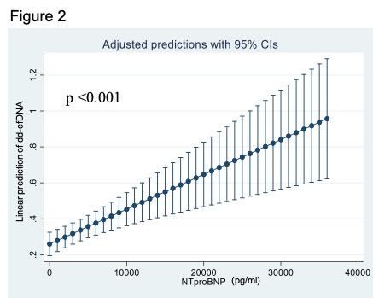
Donor-derived cell free DNA as a surveillance tool for acute cellular rejection in heart transplantation: Results from the free-DNA car study
4
Figure 2. Dd-cfDNA is logtransformed as log2(x+0.01) in order to reduce the skewness
Results
Patients with clinically relevant rejection had dd-cfDNA levels significantly higher than those without, 0.189% (0.058-0.6) vs 0.097% (0.04-0.24), p<0.01 (Figure 2)
Median (IQR) NTproBNP values for each ACR group were: 0R 1067 pg/ml (454-2563), 1R 1300 pg/ml (562-3298) and 2R-3R 1780 pg/ml (943-4880)
Using a GEE approach, a statistically significant correlation between both biomarkers was found, with a coefficient of 0.001 (CI95% 0.0006-0.002), p<0.001 (Figure 3)
In a multivariable analysis, both biomarkers were associated with the risk of acute rejection, with an OR 1.48 (CI95% 1.04-2.11), p=0.03 for dd-cfDNA, and OR 1.007 (CI95% 1.001-1-013) p=0.017 for each additional 100 pg/ml of NTproBNP
p < 0.01
2
2
0
g
o
l
_
A
N
D
2
c
-
f
d
d
4
-
6
-
No rejection
ACR≥ 2 and/or AMR≥ 1
Figure 3. The coefficient of 0.001 means that for every increase of 100 units of NTproBNP, %dd-cfDNA increased in 0.001
Conclusions
dd-cfDNA appears to be an excellent biomarker to rule out ACR and clinically relevant rejection, and shows a good correlation with NTproBNP levels
Jimenez-Blanco M. et al., ESOT Congress 2023; LDV7
Notes:
Abbreviations: ACR, acute cellular rejection; AMR, antibody-mediated rejection; CI, confidence interval; dd-cfDNA, donor-derived cell-free DNA; EMB, endomyocardial biopsies; GEE, generalized estimating equation; HT, heart transplant; M, month; NTproBNP, N-terminal pro b-type natriuretic peptide; IQR, interquartile range; OR, odd ratio; pg/ml, picogram per millilitre.
LDV7
DONOR-DERIVED CELL FREE DNA AS A SURVEILLANCE TOOL FOR ACUTE CELLULAR REJECTION IN HEART TRANSPLANTATION: RESULTS FROM THE FREE-DNA CAR STUDY
Marta Jimenez-Blanco*¹, María Generosa Crespo-Leiro², Dolores García Cosío³, Raquel López-Vilella⁴, Carlos Ortiz Bautista⁵, Marta Farrero⁶, Alba Maestro⁷, Beatriz Diaz Molina⁸, Carles Diez Lopez⁹, Diego Rangel Sousa¹⁰, Nahikari Salterain Gonzalez¹¹, Iris Garrido¹², Sara Lozano Jimenez¹, Javier Segovia Cubero¹
¹University Hospital Puerta de Hierro, Madrid, Spain, ²Complexo Hospitalario Universitario A Coruña, A Coruña, Spain, ³University Hospital 12 de octubre, Madrid, Spain, ⁴Hospital La Fe , Valencia, Spain, ⁵University Hospital Gregorio Marañon, Madrid, Spain, ⁶Hospital Clinic de Barcelona, Barcelona, Spain, ⁷Hospital de la Santa Creu i Sant Pau, Barcelona, Spain, ⁸Hospital Universitario Central de Asturias, Oviedo, Spain, ⁹Hospital Universitari de Bellvitge, Barcelona, Spain, ¹⁰University Hospital Virgen del Rocio, Sevilla, Spain, ¹¹Clinica Universitaria de Navarra, Navarra, Spain, ¹²Hospital Virgen de la Arrixaca, Murcia, Spain
Background: There is growing interest in the potential utility of donor-derived cell-free DNA (dd-cfDNA) as a non-invasive biomarker for surveillance of acute cellular rejection (ACR) in heart transplant (HT) recipients, thus allowing avoidance of repeated endomyocardial biopsies (EMB).
Methods: Prospective, multicenter study performed between 2019 and 2022 (NCT 04973943). All patients underwent surveillance EMB at 0.5, 1, 2, 3, 4, 6 and 12 months post-HT. Dd-cfDNA levels were determined prior to each EMB, using Next Generation Sequencing technology (Allonext® assay, Eurofins Genome). The primary end-point was the association between dd-cfDNA levels and the presence of ACR (defined as grade ≥2R) in EMB. The correlation between dd-cfDNA and NTproBNP levels was also studied.
Results: A total of 206 patients from 12 HT centers were included (mean age 54 ± 11 years, 73% male). We analyze here the first 848 pairs of EMB and dd-cfDNA determinations. ACR was present in 35 EMB (4.1%) and AMR ≥1 in 14 EMB (1.7%). Median (IQR) dd-cfDNA values for each ACR group were: 0R 0.088% (0.038-0.22), 1R 0.15% (0.056-0.4), 2R 0.23% (0.06-0.6) and 3R 0.6% (Figure 1A, with %dd-cfDNA logtransformed as log2(x+0.01) in order to reduce the skewness). AMR0 and AMR ≥1 median values were 0.1% (0.04-0.24) and 0.2% (0.075-0.7), respectively.
Using GEE (generalized estimating equation) models, a significant association between %dd-cfDNA and ACR ≥2R was found (OR 1.23, IQR 1.04-1.45, p <0.01) (Figure 1B). A 0.15% dd-cfDNA threshold showed a negative predictive value of 97%.
Median (IQR) NTproBNP values for each ACR group were: 0R 1100 pg/ml (450-2580), 1R 1367 pg/ml (588-3298), 2R 2401 pg/ml (1115-6680) and 3R 4740 pg/ml. A statistically significant correlation between both biomarkers was found (GEE model shown in Figure 1C), with a coefficient of 0.002 ± 0.0006, meaning that for every increase of 100 units of NTproBNP, %dd-cfDNA increased in 0.002 (p <0.001).
Conclusions: Dd-cfDNA appears to be an excellent biomarker to rule out ACR, and shows a good correlation with NTproBNP levels. Further studies are needed in order to determine if the combination of both biomarkers could improve individual performance and increase the number of EMB that may be safely avoided.

Slide 21
5-year outcome after continuous flow LVAD with full-magnetic vs hybrid levitation system: Results of an all-comers multicenter registry
Background
Despite its withdrawal, hundreds of patients are still supported with HW and a consensus about the long-term management of these patients is still questioned
Published data have focused on short-term outcome
Aim: To analyse mid-term survival and freedom from major complications in a real-world population supported with HW and HM3
Methods
n=447 patients, MIRAMACS Italian registry (2010-2022) from 7 cardiac surgery centers implanted with LVAD because of end-stage heart failure
HM3,
n=214
HW, n=233
Adverse events defined according to INTERMACS definitions
A Cox-regression analysis adjusted for preoperative confounders performed to compare survival and freedom from major adverse events at 5 years of follow-up
Francica A. et al., ESOT Congress 2023; OS6_1
Notes:
Abbreviations: HM3, HeartMate3; HR, hazard ratio; HW, HeartWare; LVAD, left ventricular assist device.
OS6_1
5-YEAR OUTCOME AFTER CONTINUOUS FLOW LVAD WITH FULL-MAGNETIC VS HYBRID LEVITATION SYSTEM:RESULTS OF AN ALL-COMERS MULTICENTER REGISTRY
Alessandra Francica*¹, Antonio Loforte², Matteo Attisani³, Massimo Maiani⁴, Attilio Iacovoni⁵, Teodora Nisi⁶, Marina Comisso⁷, Amedeo Terzi⁵, Michele De Bonis⁶, Igor Vendramin⁴, Massimo Boffini³, Francesco Musumeci⁷, Davide Pacini², Francesco Onorati¹
¹University Hospital of Verona, Division of Cardiac Surgery, Verona, Italy, ²S. Orsola University Hospital, IRCCS Bologna, Division of Cardiac Surgery, Bologna, Italy, ³University of Turin, Division of Cardiac Surgery, Turin, Italy, ⁴Ospedale S. Maria della Misericordia, Division of Cardiac Surgery, Udine, Italy, ⁵Papa Giovanni XXII Hospital of Bergamo, Division of Cardiac Surgery, Bergamo, Italy, ⁶IRCCS San Raffaele Hospital, Vita-Salute San Raffaele University,, Division of Cardiac Surgery, Milan, Italy, ⁷San Camillo Forlanini Hospital, Division of Cardiac Surgery, Rome, Italy
Background: Despite its withdrawal, hundreds of patients are still supported with HeartWare(HW) and a consensus about the long-term management of these patients is still questioned. Published data have focused on short-term outcome. It is the aim of this study to analyse mid-term survival and freedom from major complications in a real-world population supported with HW and HeartMate3 (HM3).
Methods: From 2010 to 2022, the MIRAMACS Italian Registry enrolled all-comer patients requiring third generation LVAD support (HM3 or HW) at seven Cardiac Surgery Centres. Adverse events were defined according to INTERMACS definitions. A Cox-regression analysis adjusted for preoperative confounders was performed to compare survival and freedom from major adverse events at 5 years of follow-up.
Results: A total of 447 patients were implanted with LVAD because of end-stage heart failure: 214 HM3 and 233 HW. The two populations differed in age, heart failure etiology, body surface area, renal and hepatic dysfunctions, degree of pulmonary hypertension. Periprocedural mortality (14% vs 9% for HM3 vs HW; p=0.1) and most of post-operative complications rates were similar between the two groups. The overall survival at 5 years was higher in HM3 patients (64.1% vs 42.6% for HM3 vs HW, p=.004) [Figure]. The Cox-regression analysis adjusted for major confounders showed an almost doubled risk for mortality (HR 1.5 [1.2-1.9]; p=0.031), and a more than doubled risk for both ischemic stroke (HR 2.08 [1.06-4.08]; p=.033) and hemorrhagic stroke (HR 2.6 [1.3-4.9]; p=.005) in patients supported by HW. Moreover, HW patients experienced a higher rate of pump thrombosis (3.9% vs 0.5%; p<.001). Subanalysis in Bridge-to-Transplant reported similar cumulative survival and freedom from adverse events, though time to transplant was shorter in HW (32.2 vs 49.1 months; p=0.001). In Destination Therapy, 5-years cumulative survival (61.8% vs 34.5% p=0.002) and freedom from haemorrhagic stroke was lower in HW (85.5% vs 67.9%; p=0.01).
Conclusions: Although similar post-operative results, patients implanted with HW developed a higher risk of mortality and major cerebrovascular events after 5-year from the implantation when compared to HM3 patients. A consensus should be reached about the future management of all patients still supported by HW.

Slide 22
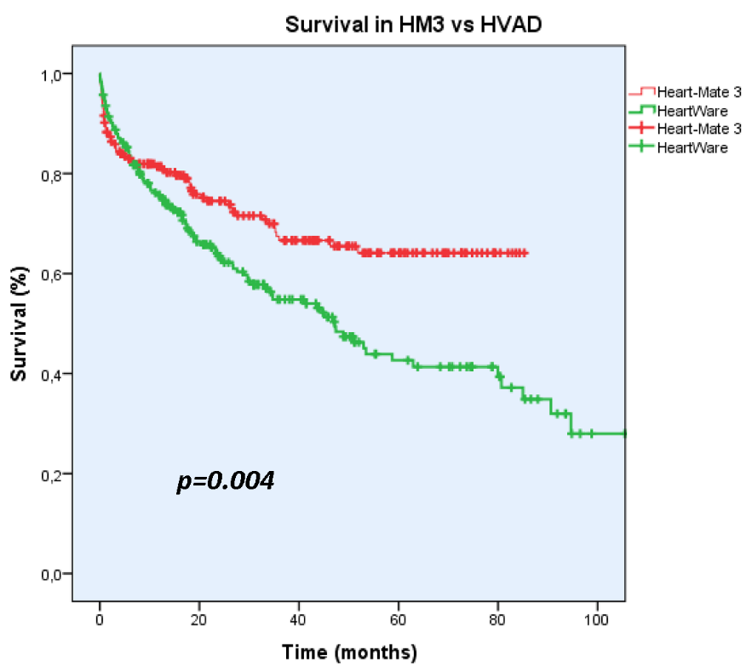
5-year outcome after continuous flow LVAD with full-magnetic vs hybrid levitation system: Results of an all-comers multicenter registry
Results
The two populations differed in age, heart failure etiology, body surface area, renal and hepatic dysfunctions, degree of pulmonary hypertension
Periprocedural mortality (14% vs 9% for HM3 vs HW; p=0.1) and most of post-operative complications rates were similar between the two groups
Overall survival at 5 years was higher in HM3 patients (64.1% vs 42.6% for HM3 vs HW, p=.004, Figure)
The Cox-regression analysis adjusted for major confounders showed an almost doubled risk for mortality (HR 1.5 [1.2-1.9]; p=0.031), and a more than doubled risk for both ischemic stroke (HR 2.08 [1.06-4.08]; p=.033) and hemorrhagic stroke (HR 2.6 [1.3-4.9]; p=.005) in patients supported by HW
HW patients experienced a higher rate of pump thrombosis (3.9% vs 0.5%; p<.001)
Subanalysis in Bridge-to-Transplant reported similar cumulative survival and freedom from adverse events, though time to transplant was shorter in HW (32.2 vs 49.1 months; p=0.001)
In Destination Therapy, 5-years cumulative survival (61.8% vs 34.5% p=0.002) and freedom from haemorrhagic stroke was lower in HW (85.5% vs 67.9%; p=0.01)
Conclusions
Although similar post-operative results, patients implanted with HW developed a higher risk of mortality and major cerebrovascular events after 5-year from the implantation when compared to HM3 patients
Francica A. et al., ESOT Congress 2023; OS6_1
Notes:
Abbreviations: HM3, HeartMate3; HR, hazard ratio; HW, HeartWare; LVAD, left ventricular assist device.
OS6_1
5-YEAR OUTCOME AFTER CONTINUOUS FLOW LVAD WITH FULL-MAGNETIC VS HYBRID LEVITATION SYSTEM:RESULTS OF AN ALL-COMERS MULTICENTER REGISTRY
Alessandra Francica*¹, Antonio Loforte², Matteo Attisani³, Massimo Maiani⁴, Attilio Iacovoni⁵, Teodora Nisi⁶, Marina Comisso⁷, Amedeo Terzi⁵, Michele De Bonis⁶, Igor Vendramin⁴, Massimo Boffini³, Francesco Musumeci⁷, Davide Pacini², Francesco Onorati¹
¹University Hospital of Verona, Division of Cardiac Surgery, Verona, Italy, ²S. Orsola University Hospital, IRCCS Bologna, Division of Cardiac Surgery, Bologna, Italy, ³University of Turin, Division of Cardiac Surgery, Turin, Italy, ⁴Ospedale S. Maria della Misericordia, Division of Cardiac Surgery, Udine, Italy, ⁵Papa Giovanni XXII Hospital of Bergamo, Division of Cardiac Surgery, Bergamo, Italy, ⁶IRCCS San Raffaele Hospital, Vita-Salute San Raffaele University,, Division of Cardiac Surgery, Milan, Italy, ⁷San Camillo Forlanini Hospital, Division of Cardiac Surgery, Rome, Italy
Background: Despite its withdrawal, hundreds of patients are still supported with HeartWare(HW) and a consensus about the long-term management of these patients is still questioned. Published data have focused on short-term outcome. It is the aim of this study to analyse mid-term survival and freedom from major complications in a real-world population supported with HW and HeartMate3 (HM3).
Methods: From 2010 to 2022, the MIRAMACS Italian Registry enrolled all-comer patients requiring third generation LVAD support (HM3 or HW) at seven Cardiac Surgery Centres. Adverse events were defined according to INTERMACS definitions. A Cox-regression analysis adjusted for preoperative confounders was performed to compare survival and freedom from major adverse events at 5 years of follow-up.
Results: A total of 447 patients were implanted with LVAD because of end-stage heart failure: 214 HM3 and 233 HW. The two populations differed in age, heart failure etiology, body surface area, renal and hepatic dysfunctions, degree of pulmonary hypertension. Periprocedural mortality (14% vs 9% for HM3 vs HW; p=0.1) and most of post-operative complications rates were similar between the two groups. The overall survival at 5 years was higher in HM3 patients (64.1% vs 42.6% for HM3 vs HW, p=.004) [Figure]. The Cox-regression analysis adjusted for major confounders showed an almost doubled risk for mortality (HR 1.5 [1.2-1.9]; p=0.031), and a more than doubled risk for both ischemic stroke (HR 2.08 [1.06-4.08]; p=.033) and hemorrhagic stroke (HR 2.6 [1.3-4.9]; p=.005) in patients supported by HW. Moreover, HW patients experienced a higher rate of pump thrombosis (3.9% vs 0.5%; p<.001). Subanalysis in Bridge-to-Transplant reported similar cumulative survival and freedom from adverse events, though time to transplant was shorter in HW (32.2 vs 49.1 months; p=0.001). In Destination Therapy, 5-years cumulative survival (61.8% vs 34.5% p=0.002) and freedom from haemorrhagic stroke was lower in HW (85.5% vs 67.9%; p=0.01).
Conclusions: Although similar post-operative results, patients implanted with HW developed a higher risk of mortality and major cerebrovascular events after 5-year from the implantation when compared to HM3 patients. A consensus should be reached about the future management of all patients still supported by HW.

Slide 23
Impact of the 2018 French allocation scheme on the profile of heart transplantation candidates and recipients: Insights from a high-volume center
Background
In 2018, a new cardiac allograft allocation scheme based on an individual scoring system considering the risk of death both on the waitlist and after HTx, was implemented in France
Aim: To assess the impact of this new scheme on the profile of HTx candidates and recipients
Methods
Single-center retrospective study
Including consecutive patients listed and/or transplanted (01/01/2012 -09/30/2021) at La Pitié-Salpêtrière Hospital
Newly listed HTx candidates,
n=1098
HTx recipients, n=855
Baseline characteristics of patients retrieved from the national CRISTAL registry and compared according to the type of allocation scheme (before or after 2018)
Coutance G. et al., ESOT Congress 2023; OS6_2
Notes:
Abbreviations: ECMO, extracorporeal membrane oxygenation; HTx, heart transplantation.
OS6_2
IMPACT OF THE 2018 FRENCH ALLOCATION SCHEME ON THE PROFILE OF HEART TRANSPLANTATION CANDIDATES AND RECIPIENTS: INSIGHTS FROM A HIGH-VOLUME CENTER.
Guillaume Coutance*¹, Eva Desiré¹, Mickael Lescroart¹, Guillaume Lebreton¹, Shaida Varnous¹, Leprince Pascal¹
¹Pitié-Salpêtrière Hospital, Paris, France
Background: In 2018, a new cardiac allograft allocation scheme based on an individual scoring system considering the risk of death both on the waitlist and after heart transplantation (HTx), was implemented in France. We aimed to assess the impact of this new scheme on the profile of HTx candidates and recipients.
Methods: In this single-center retrospective study, we included consecutive patients listed and/or transplanted between 01/01/2012 and 09/30/2021 at La Pitié-Salpêtrière Hospital. Baseline characteristics of patients were retrieved from the national CRISTAL registry and were compared according to the type of allocation scheme (before or after 2018).
Results: A total of 1098 newly listed HTx candidates and 855 HTx recipients were included. One-year post-listing and post-transplant mortality was 12.4% and 20%, respectively. At listing, the proportion of candidates on inotropes significantly declined following the scheme update (26.3% compared to 20.9%; p = 0.038), reflecting a change in medical practice (Figure 1A). At transplant, recipients had a worse kidney function (estimated glomerular filtration rate ≤ 60 mL/min/1.73 m2: old scheme = 28.6%; new scheme: 45%, p < 0.001), and were more likely to be on ECMO support (33.5% compared to 28.1%, p = 0.080) under the new scheme, reflecting the prioritization of more severe patients (Figure 1B). Post-transplant outcomes were not significantly influenced by the allocation system.
Conclusions: The implementation of the 2018 French allocation scheme had a limited impact on the profiles of HTx candidates but selected more severe patients for HTx without significant impact on post-transplant outcomes.

Slide 24
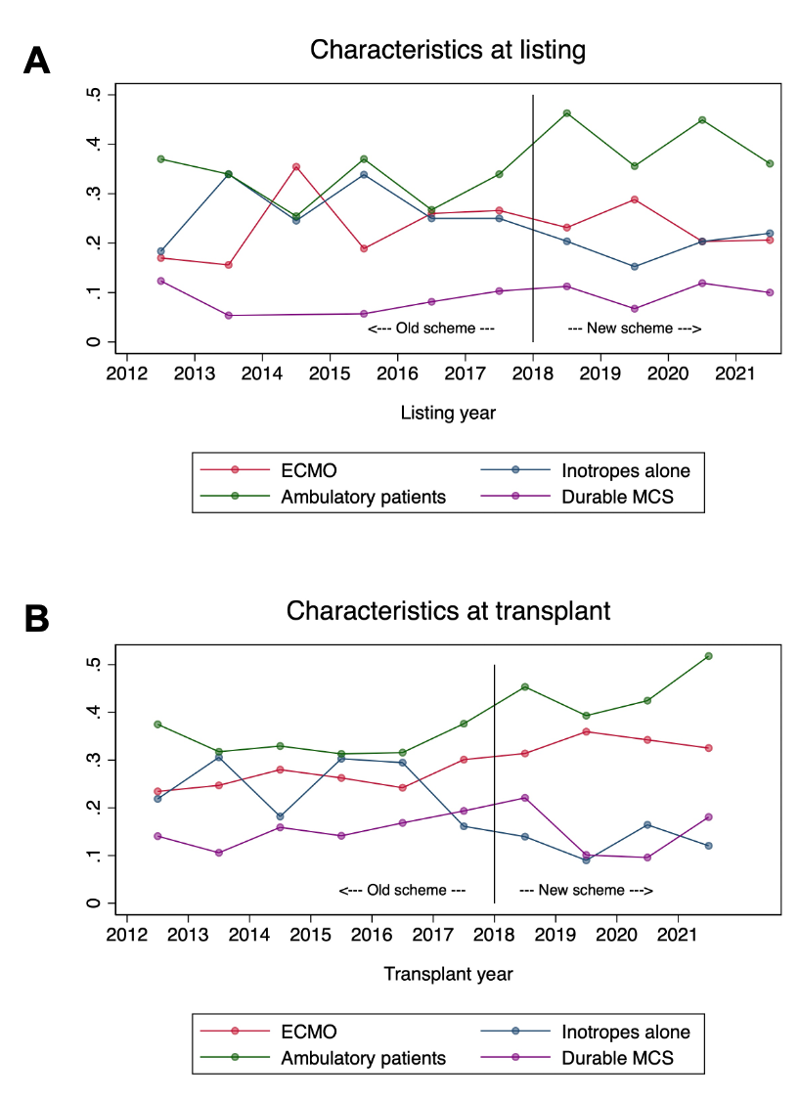
Impact of the 2018 French allocation scheme on the profile of heart transplantation candidates and recipients: Insights from a high-volume center
Results
One-year post-listing and post-transplant mortality was 12.4% (HTx candidates) and 20% (HTx recipients)
At listing, the proportion of candidates on inotropes significantly declined following the scheme update (26.3% compared to 20.9%; p=0.038), reflecting a change in medical practice (Figure A)
At transplant, recipients had a worse kidney function (estimated glomerular filtration rate ≤ 60 mL/min/1.73 m²: old scheme=28.6%; new scheme: 45%, p<0.001), and were more likely to be on ECMO support (33.5% compared to 28.1%, p=0.080) under the new scheme, reflecting the prioritization of more severe patients (Figure B)
Post-transplant outcomes were not significantly influenced by the allocation system
Conclusions
The implementation of the 2018 French allocation scheme had a limited impact on the profiles of HTx candidates but selected more severe patients for HTx without significant impact on post-transplant outcomes
Coutance G. et al., ESOT Congress 2023; OS6_2
Notes:
Abbreviations: ECMO, extracorporeal membrane oxygenation; HTx, heart transplantation.
OS6_2
IMPACT OF THE 2018 FRENCH ALLOCATION SCHEME ON THE PROFILE OF HEART TRANSPLANTATION CANDIDATES AND RECIPIENTS: INSIGHTS FROM A HIGH-VOLUME CENTER.
Guillaume Coutance*¹, Eva Desiré¹, Mickael Lescroart¹, Guillaume Lebreton¹, Shaida Varnous¹, Leprince Pascal¹
¹Pitié-Salpêtrière Hospital, Paris, France
Background: In 2018, a new cardiac allograft allocation scheme based on an individual scoring system considering the risk of death both on the waitlist and after heart transplantation (HTx), was implemented in France. We aimed to assess the impact of this new scheme on the profile of HTx candidates and recipients.
Methods: In this single-center retrospective study, we included consecutive patients listed and/or transplanted between 01/01/2012 and 09/30/2021 at La Pitié-Salpêtrière Hospital. Baseline characteristics of patients were retrieved from the national CRISTAL registry and were compared according to the type of allocation scheme (before or after 2018).
Results: A total of 1098 newly listed HTx candidates and 855 HTx recipients were included. One-year post-listing and post-transplant mortality was 12.4% and 20%, respectively. At listing, the proportion of candidates on inotropes significantly declined following the scheme update (26.3% compared to 20.9%; p = 0.038), reflecting a change in medical practice (Figure 1A). At transplant, recipients had a worse kidney function (estimated glomerular filtration rate ≤ 60 mL/min/1.73 m2: old scheme = 28.6%; new scheme: 45%, p < 0.001), and were more likely to be on ECMO support (33.5% compared to 28.1%, p = 0.080) under the new scheme, reflecting the prioritization of more severe patients (Figure 1B). Post-transplant outcomes were not significantly influenced by the allocation system.
Conclusions: The implementation of the 2018 French allocation scheme had a limited impact on the profiles of HTx candidates but selected more severe patients for HTx without significant impact on post-transplant outcomes.

Slide 25
Results from over 800 transplant recipients enrolled in the guardian-heart registry: Challenging the standard of care
Background
In 2022, almost one in 3 donor hearts in the US were transported in a Paragonix SherpaPak CTS
This controlled hypothermic technology is both FDA approved and CE Marked and has been in clinical use since 2018 preserving organ temperatures between 4 – 8°C
Aim: To evaluate real-world evidence on the clinical benefits of using CTS compared to conventional ICE in the GUARDIAN-Heart Registry to assess whether improved outcomes are achieved with this technology
Methods
Data analysis in the GUARDIAN-Heart registry from n=877 adults at 16 US centres (October 2015-August 2022) receiving donor hearts preserved and transported in
CTS,
n=487
ICE,
n=390
Propensity matching on site, donor age, transplant era, ischemic time, and baseline durable ventricular assist device (VAD) performed to balance baseline differences to further evaluate outcomes between cohorts (Table)
Summary statistics used for comparisons, and Kaplan Meier method used to estimate survival
Zuckermann A. et al., ESOT Congress 2023; OS6_3
Notes:
Abbreviations: BMI, body mass index; CE, Communauté Européenne; CTS, cardiac transport system; ECMO, extracorporeal membrane oxygenation; FDA, U.S. food and drug administration; F/M mismatch, female to male mismatch; IABP, intra-aortic baIloon pump; ICE, ice storage; LVEF, left ventricular ejection fraction; MCS, mechanical circulatory support; PGD, primary graft dysfunction; PHM, predicted heart mass; Tx, transplant; VAD, ventricular assist device.
OS6_3
RESULTS FROM OVER 800 TRANSPLANT RECIPIENTS ENROLLED IN THE GUARDIAN-HEART REGISTRY: CHALLENGING THE STANDARD OF CARE
Andreas Zuckermann*¹, Yasuhiro Shudo², Dan Meyer³, Scott Silvestry⁴, Marzia Leacche⁵, Christopher Sciortino⁶, Maria Rodrigo⁷, Si Pham⁸, Jeffrey Jacobs⁹, Koji Takeda¹⁰, Hannah Copeland¹¹, Andrija Vidic¹², Masashi Kawabori¹³, Jacob Schroder¹⁴, David D'alessandro¹⁵
¹Medical University of Vienna, Cardiac Surgery, Vienna, Austria, ²Stanford University School of Medicine, Stanford, United States, ³Baylor University Medical Center, Dallas, United States, ⁴AdventHealth Transplant Institute, Orlando, United States, ⁵Corewell Health, Grand Rapids, United States, ⁶Sentara Norfolk General Hospital, Norfolk, United States, ⁷MedStar Heart and Vascular Institute, Washington DC, United States, ⁸Mayo Clinic, Jacksonville, United States, ⁹UF Health Shands Hospital, Gainesville, United States, ¹⁰Columbia University, New York, United States, ¹¹Lutheran Health, Fort Wayne, United States, ¹²University of Kansas Medical Center, Kansas City, United States, ¹³Tufts Medical Center, Boston, United States, ¹⁴Duke University Medical Center, Durham, United States, ¹⁵Massachusetts General Hospital, Boston, United States
Background: The decades long gold standard for preservation of donor hearts in ice appears to be rapidly shifting to advanced hypothermic preservation. In 2022, almost one in 3 donor hearts in the US were transported in a Paragonix SherpaPak Cardiac Transport System (CTS). This controlled hypothermic technology is both FDA approved and CE Marked and has been in clinical use since 2018 preserving organ temperatures between 4 – 8°C. Real-world evidence on the clinical benefits of using CTS compared to conventional ice storage (ICE) is evaluated in the GUARDIAN-Heart Registry to assess whether improved outcomes are achieved with this technology.
Methods: Data from 877 adults at 16 US centers receiving donor hearts preserved and transported in either CTS (n=487) or ICE (n=390) between October 2015-August 2022 were analysed in the GUARDIAN-Heart registry. Propensity matching on site, donor age, transplant era, ischemic time, and baseline durable ventricular assist device (VAD) was performed to balance baseline differences to further evaluate outcomes between cohorts (see Table). Summary statistics were used for comparisons, and Kaplan Meier method was used to estimate survival.
Results: The CTS cohort demonstrated reduced severe primary graft dysfunction (PGD) compared to ICE in the unmatched cohort (p=0.08) (Table). When propensity matched, CTS had significantly lowered severe PGD compared to ICE by 60% (10.0% vs 4.0%, p=0.01), and overall MCS utilization by 37% (32.1% vs 20.1%, ICE vs CTS, respectively). Kaplan-Meier survival was similar (one year, ICE = 91.9%, SCTS = 95.6%, p=0.12). Further analysis on a larger dataset with ongoing enrolment in this live registry will be available for presentation.
Conclusions: Utilization of the Paragonix CTS for organ preservation is associated with lower rates of severe PGD. This finding continues to fundamentally challenge the decades-long status quo of using ice for transporting donor hearts.

Slide 26
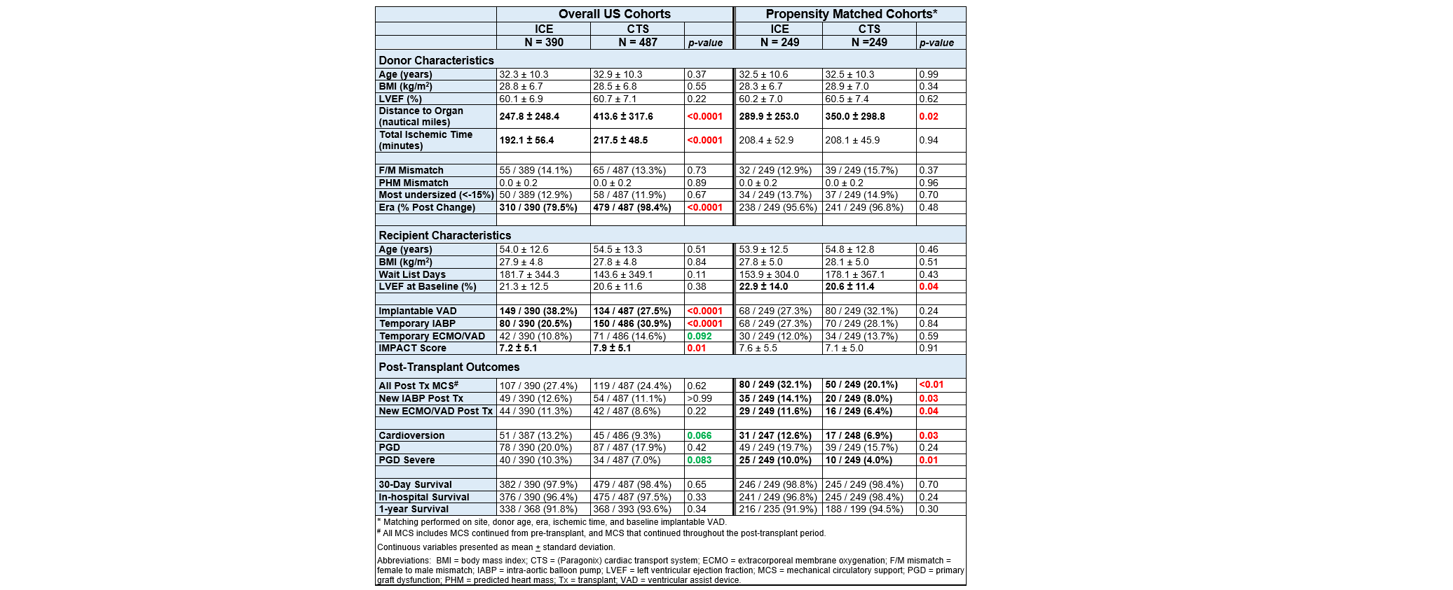
Results from over 800 transplant recipients enrolled in the guardian-heart registry: Challenging the standard of care
Results
The CTS cohort demonstrated reduced severe PGD compared to ICE in the unmatched cohort (p=0.08)
When propensity matched, CTS had significantly lowered severe PGD compared to ICE by 60% (10.0% vs 4.0%, p=0.01), and overall MCS utilization by 37% (32.1% vs 20.1%, ICE vs CTS, respectively)
Kaplan-Meier survival was similar (one year, ICE=91.9%, CTS=95.6%, p=0.12)
Methods
Conclusions
Utilization of the Paragonix CTS for organ preservation is associated with lower rates of severe PGD
Table. Baseline demographics and post-transplant outcomes
*Matching performed on site, donor age, era, ischemic time, and baseline implantable VAD
#All MCS include MCS continued from pre-transplant, and MCS that continued throughout the post-transplant period
Continuous variables presented as mean ± standard deviation
Zuckermann A. et al., ESOT Congress 2023; OS6_3
Notes:
Abbreviations: BMI, body mass index; CE, Communauté Européenne; CTS, cardiac transport system; ECMO, extracorporeal membrane oxygenation; FDA, U.S. food and drug administration; F/M mismatch, female to male mismatch; IABP, intra-aortic baIloon pump; ICE, ice storage; LVEF, left ventricular ejection fraction; MCS, mechanical circulatory support; PGD, primary graft dysfunction; PHM, predicted heart mass; Tx, transplant; VAD, ventricular assist device.
OS6_3
RESULTS FROM OVER 800 TRANSPLANT RECIPIENTS ENROLLED IN THE GUARDIAN-HEART REGISTRY: CHALLENGING THE STANDARD OF CARE
Andreas Zuckermann*¹, Yasuhiro Shudo², Dan Meyer³, Scott Silvestry⁴, Marzia Leacche⁵, Christopher Sciortino⁶, Maria Rodrigo⁷, Si Pham⁸, Jeffrey Jacobs⁹, Koji Takeda¹⁰, Hannah Copeland¹¹, Andrija Vidic¹², Masashi Kawabori¹³, Jacob Schroder¹⁴, David D'alessandro¹⁵
¹Medical University of Vienna, Cardiac Surgery, Vienna, Austria, ²Stanford University School of Medicine, Stanford, United States, ³Baylor University Medical Center, Dallas, United States, ⁴AdventHealth Transplant Institute, Orlando, United States, ⁵Corewell Health, Grand Rapids, United States, ⁶Sentara Norfolk General Hospital, Norfolk, United States, ⁷MedStar Heart and Vascular Institute, Washington DC, United States, ⁸Mayo Clinic, Jacksonville, United States, ⁹UF Health Shands Hospital, Gainesville, United States, ¹⁰Columbia University, New York, United States, ¹¹Lutheran Health, Fort Wayne, United States, ¹²University of Kansas Medical Center, Kansas City, United States, ¹³Tufts Medical Center, Boston, United States, ¹⁴Duke University Medical Center, Durham, United States, ¹⁵Massachusetts General Hospital, Boston, United States
Background: The decades long gold standard for preservation of donor hearts in ice appears to be rapidly shifting to advanced hypothermic preservation. In 2022, almost one in 3 donor hearts in the US were transported in a Paragonix SherpaPak Cardiac Transport System (CTS). This controlled hypothermic technology is both FDA approved and CE Marked and has been in clinical use since 2018 preserving organ temperatures between 4 – 8°C. Real-world evidence on the clinical benefits of using CTS compared to conventional ice storage (ICE) is evaluated in the GUARDIAN-Heart Registry to assess whether improved outcomes are achieved with this technology.
Methods: Data from 877 adults at 16 US centers receiving donor hearts preserved and transported in either CTS (n=487) or ICE (n=390) between October 2015-August 2022 were analysed in the GUARDIAN-Heart registry. Propensity matching on site, donor age, transplant era, ischemic time, and baseline durable ventricular assist device (VAD) was performed to balance baseline differences to further evaluate outcomes between cohorts (see Table). Summary statistics were used for comparisons, and Kaplan Meier method was used to estimate survival.
Results: The CTS cohort demonstrated reduced severe primary graft dysfunction (PGD) compared to ICE in the unmatched cohort (p=0.08) (Table). When propensity matched, CTS had significantly lowered severe PGD compared to ICE by 60% (10.0% vs 4.0%, p=0.01), and overall MCS utilization by 37% (32.1% vs 20.1%, ICE vs CTS, respectively). Kaplan-Meier survival was similar (one year, ICE = 91.9%, SCTS = 95.6%, p=0.12). Further analysis on a larger dataset with ongoing enrolment in this live registry will be available for presentation.
Conclusions: Utilization of the Paragonix CTS for organ preservation is associated with lower rates of severe PGD. This finding continues to fundamentally challenge the decades-long status quo of using ice for transporting donor hearts.

Slide 27
Heart transplantation from controlled donation after the circulatory determination of death: Our experience
Background
Heart transplantation is currently the most effective treatment to improve the prognosis of patients with end-stage heart failure. In recent years, cDCD with TA-NRP has been developed in Spain
Aim: To present the initial experiences in heart transplantation from cDCD donors with TA-NRP at the Hospital Virgen de la Arrixaca in Murcia
Methods
1
cDCD considered in patients under 65 years of age admitted to the ICU in whom the medical team and legal representatives had made the decision for WLST and the donation was accepted
Evaluation:
Donor heart monitoring performed using a Swan-Ganz catheter and continuous TEE
Brain activity monitored using the bispectral index
2
After declaration of death (5 minutes no touch), the 3 aortic arch vessels were clamped to exclude cerebral flow
Simultaneously, the patient was intubated and mechanical ventilation was initiated
The values of troponin I and lactate were monitored during the whole procedure
del Mar Martín Magán M. et al., ESOT Congress 2023; OS6_4
Notes:
Abbreviations: cDCD, donation after circulatory death; ICU, intensive care unit; TA-NRP, thoraco-abdominal normothermic regional perfusion; TEE, transesophageal echocardiography; WLST, withdrawal of life support therapy.
OS6_4
HEART TRANSPLANTATION FROM CONTROLLED DONATION AFTER THE CIRCULATORY DETERMINATION OF DEATH: OUR EXPERIENCE.
María del Mar Martín Magán*¹, Ramón Mula Martínez¹, Marta Mateos Llosa¹, Clara Manso Murcia¹, M Dolores Victoria Rodenas², Maria Granados Madero¹, Nayara López Hernández¹, Paula Rivera Sánchez¹, Marina Asensio Rodríguez¹, Gabriel Vázquez Andres¹, José Moya Sánchez¹
¹Hospital Clínico Universitario Virgen de la Arrixaca , Murcia, Spain, ²Hospital Los Arcos del Mar Menor, Murcia, Spain
Background: Heart transplantation is currently the most effective treatment to improve the prognosis of patients with end-stage heart failure. In recent years, donation after circulatory death (cDCD) with regional normothermic thoracoabdominal perfusion (TA-NRP) has been developed in Spain. We present the initial experiences in heart transplantation from cDCD donors with TA-NRP at the Hospital Virgen de la Arrixaca in Murcia.
Methods: cDCD was considered in patients under 65 years of age admitted to the ICU in whom the medical team and legal representatives had made the decision for withdrawal of life support therapy (WLST) and the donation was accepted. The evaluation was performed as usually. Donor heart monitoring was performed using a Swan-Ganz catheter and continuous transesophageal echocardiography (TEE). Brain activity was monitored using the bispectral index. After declaration of death (5 minutes no touch), the 3 aortic arch vessels were clamped to exclude cerebral flow. Simultaneously, the patient was intubated and mechanical ventilation was initiated. The values of troponin I and lactate were monitored during the whole procedure.
Results: 11 procedures were performed to local recipients with excellent outcome. In all cases the heart reverted to sinus rhythm within 1 minute. Left ventricular ejection fraction at the validation, and 60 minutes after it, was optimal. The recipients had a short ICU stay and were discharged home with an excellent evolution and optimal cardiac index. Only one of them required mechanical support after transplantation, and another one finally died for a local complication, not related with the graft function.
Conclusions: Transplantation from cDCD donors represents an important source of grafts in countries with an adequate legal framework. TA-NRP may become a way to make cDCD donor heart transplantation feasible, reducing the costs of ex situ machine devices by making this procedure economically affordable.

Slide 28
Heart transplantation from controlled donation after the circulatory determination of death: Our experience
Results
11 procedures were performed to local recipients with excellent outcome
In all cases the heart reverted to sinus rhythm within 1 minute
Left ventricular ejection fraction at the validation, and 60 minutes after it, was optimal
The recipients had a short ICU stay and were discharged home with an excellent evolution and optimal cardiac index
Only one of them required mechanical support after transplantation, and another one finally died for a local complication, not related with the graft function
Conclusions
Transplantation from cDCD donors represents an important source of grafts in countries with an adequate legal framework
TA-NRP may become a way to make cDCD donor heart transplantation feasible, reducing the costs of ex situ machine devices by making this procedure economically affordable
del Mar Martín Magán M. et al., ESOT Congress 2023; OS6_4
Notes:
Abbreviations: cDCD, donation after circulatory death; ICU, intensive care unit; TA-NRP, thoraco-abdominal normothermic regional perfusion; TEE, transesophageal echocardiography; WLST, withdrawal of life support therapy.
OS6_4
HEART TRANSPLANTATION FROM CONTROLLED DONATION AFTER THE CIRCULATORY DETERMINATION OF DEATH: OUR EXPERIENCE.
María del Mar Martín Magán*¹, Ramón Mula Martínez¹, Marta Mateos Llosa¹, Clara Manso Murcia¹, M Dolores Victoria Rodenas², Maria Granados Madero¹, Nayara López Hernández¹, Paula Rivera Sánchez¹, Marina Asensio Rodríguez¹, Gabriel Vázquez Andres¹, José Moya Sánchez¹
¹Hospital Clínico Universitario Virgen de la Arrixaca , Murcia, Spain, ²Hospital Los Arcos del Mar Menor, Murcia, Spain
Background: Heart transplantation is currently the most effective treatment to improve the prognosis of patients with end-stage heart failure. In recent years, donation after circulatory death (cDCD) with regional normothermic thoracoabdominal perfusion (TA-NRP) has been developed in Spain. We present the initial experiences in heart transplantation from cDCD donors with TA-NRP at the Hospital Virgen de la Arrixaca in Murcia.
Methods: cDCD was considered in patients under 65 years of age admitted to the ICU in whom the medical team and legal representatives had made the decision for withdrawal of life support therapy (WLST) and the donation was accepted. The evaluation was performed as usually. Donor heart monitoring was performed using a Swan-Ganz catheter and continuous transesophageal echocardiography (TEE). Brain activity was monitored using the bispectral index. After declaration of death (5 minutes no touch), the 3 aortic arch vessels were clamped to exclude cerebral flow. Simultaneously, the patient was intubated and mechanical ventilation was initiated. The values of troponin I and lactate were monitored during the whole procedure.
Results: 11 procedures were performed to local recipients with excellent outcome. In all cases the heart reverted to sinus rhythm within 1 minute. Left ventricular ejection fraction at the validation, and 60 minutes after it, was optimal. The recipients had a short ICU stay and were discharged home with an excellent evolution and optimal cardiac index. Only one of them required mechanical support after transplantation, and another one finally died for a local complication, not related with the graft function.
Conclusions: Transplantation from cDCD donors represents an important source of grafts in countries with an adequate legal framework. TA-NRP may become a way to make cDCD donor heart transplantation feasible, reducing the costs of ex situ machine devices by making this procedure economically affordable.

Slide 29
Molecular diagnostic classification of heart allograft rejection based on the targeted banff human organ transplant gene expression panel
Background
EMB gene expression profiling is a promising companion tool of the pathology diagnosis of rejection
While the routine application of pangenomic approaches is limited, targeted molecular profiling combined with reproducible FFPE EMB-based technology has the potential to change the current paradigm of cardiac rejection diagnosis
Aim: To develop and validate targeted gene expression diagnostic system of cardiac rejection
Methods
Multicenter, retrospective study, building a reference set of 610 FFPE-EMB collected between 2011 and 2021
AMR, n=189
ACR, n=289
Non-rejection, n=114
Tissue gene expression
Nanostring nCounter technology with BHOT panel (consensus-based panel of 770 genes)
Differential expression and elastic net approaches applied to identify key AMR and ACR-related transcripts
A supervised machine learning model was used to build molecular classifiers of AMR and ACR
Their performance was evaluated in an independent validation set (n=117)
Giarraputo A. et al., ESOT Congress 2023; OS6_5
Notes:
Abbreviations: ACR, acute cellular rejection; AMR, antibody-mediated rejection; BHOT, banff human organ transplant; EMB, endomyocardial biopsies; FFPE, formalin-fixed paraffin-embedded; ROC-AUC, area under the receiver operating characteristic curve.
OS6_5
MOLECULAR DIAGNOSTIC CLASSIFICATION OF HEART ALLOGRAFT REJECTION BASED ON THE TARGETED BANFF HUMAN ORGAN TRANSPLANT GENE EXPRESSION PANEL
Alessia Giarraputo*^{1;2}, Guillaume Coutance^{1;3}, Marny Fedrigo², Olivier Aubert¹, Jessy Dagobert¹, Blaise Robin¹, Ilaria Barison², Chiara Castellani², Fariza Mezine¹, Philip Rouvier⁴, Patrick Bruneval¹, Jon Kobashigawa⁵, Jignesh Patel⁵, Jean-Paul Duong van Huyen^{1;6}, Annalisa Angelini², Alexandre Loupy¹
¹Paris Institute for Transplantation and Organ Regeneration, Université Paris Cité, INSERM, U-970, AP-HP, Paris, France, ²Cardiovascular Pathology, Department of Cardiac, Thoracic, Vascular Sciences, University of Padua, Padua, Italy, ³Department of Cardiac and Thoracic Surgery, Cardiology Institute, Pitié Salpêtrière Hospital, Assistance Publique-Hôpitaux de Paris (AP-HP). Sorbonne University Medical School, Paris, France, ⁴Pitié Salpêtrière Hospital, Assistance Publique-Hôpitaux de Paris (AP-HP), Paris, Italy, ⁵Cedars-Sinai Smidt Heart Institute, Los Angeles, United States, ⁶Kidney Transplant Department, Necker Hospital, Assistance Publique - Hôpitaux de Paris, Paris, France
Background: Endomyocardial biopsies (EMB) gene expression profiling is a promising companion tool of the pathology diagnosis of rejection. While the routine application of pangenomic approaches is limited, targeted molecular profiling combined with reproducible formalin-fixed paraffin-embedded (FFPE) EMB-based technology has the potential to change the current paradigm of cardiac rejection diagnosis. We aimed to develop and validate targeted gene expression diagnostic system of cardiac rejection.
Methods: We performed a multicenter, retrospective study, building a reference set of 610 FFPE-EMB collected between 2011 and 2021 and representative of the landscape of rejection (antibody-mediated rejection-AMR, n=189; acute cellular rejection-ACR, n=289; non-rejection, n=114). Nanostring nCounter technology with BHOT panel, a consensus-based panel of 770 genes, was used to analyze tissue gene expression. Differential expression and elastic net approaches were applied to identify key AMR and ACR-related transcripts. A supervised machine learning model was used to build molecular classifiers of AMR and ACR. Their performance was evaluated in an independent validation set (n=117).
Results: Overall, the molecular analysis of 592 (97%) biopsies successfully passed all quality control and normalization steps. The molecular profiles of both ACR and AMR included typical transcripts reflecting the rejection-related pathophysiology. In the validation cohort, the AMR and ACR models accurately identified each type of rejection. The diagnostic accuracy was 81.89% for AMR (ROC-AUC=0.844, Brier score=0.143) and 77.58% for ACR (ROC-AUC=0.812, Brier score=0.176). Principal component analysis based on the molecular scores showed the detection of 72% of variance (Figure) allowing the histo-molecular contextualization of the reference set samples according to the molecular scores.
Conclusions: We developed and validated robust molecular-based models, showing high diagnostic performance to detect heart rejection profiles in transplanted patients. These results support the clinical utility of BHOT-based diagnostic model to improve diagnostic and follow-up procedure in heart transplantation.

Slide 30
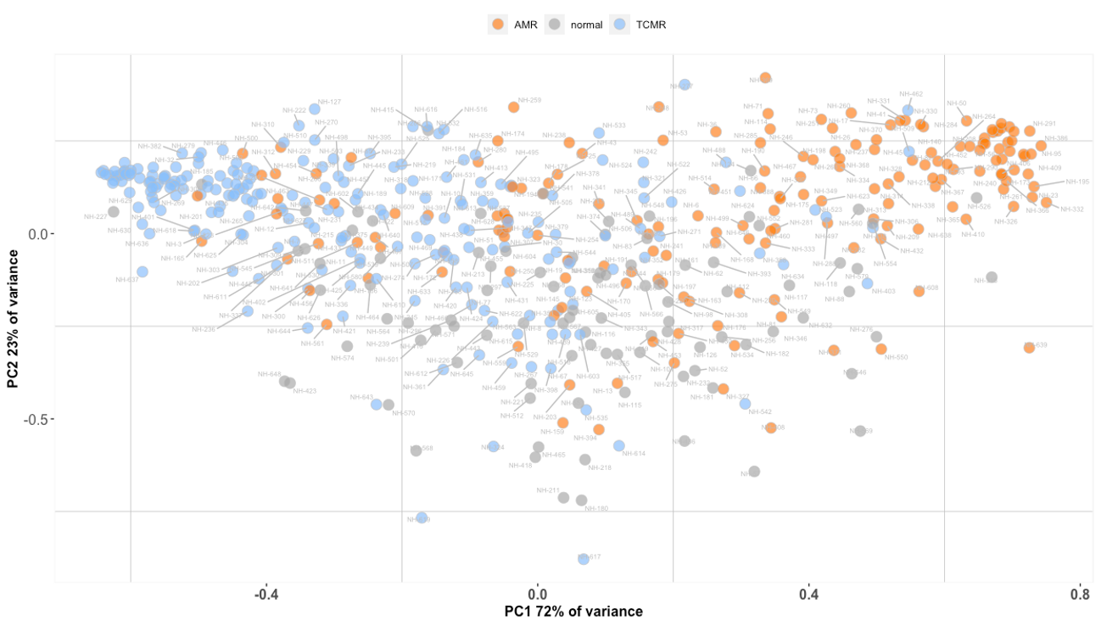
Molecular diagnostic classification of heart allograft rejection based on the targeted banff human organ transplant gene expression panel
Results
Overall, the molecular analysis of 592 (97%) biopsies successfully passed all quality control and normalization steps
The molecular profiles of both ACR and AMR included typical transcripts reflecting the rejection-related pathophysiology
In the validation cohort, the AMR and ACR models accurately identified each type of rejection
The diagnostic accuracy was 81.89% for AMR (ROC-AUC=0.844, Brier score=0.143) and 77.58% for ACR (ROC-AUC=0.812, Brier score=0.176)
Principal component analysis based on the molecular scores showed the detection of 72% of variance (Figure) allowing the histo-molecular contextualization of the reference set samples according to the molecular scores
Conclusions
We developed and validated robust molecular-based models, showing high diagnostic performance to detect heart rejection profiles in transplanted patients
These results support the clinical utility of BHOT-based diagnostic model to improve diagnostic and follow-up procedure in heart transplantation
Giarraputo A. et al., ESOT Congress 2023; OS6_5
Notes:
Abbreviations: ACR, acute cellular rejection; AMR, antibody-mediated rejection; BHOT, banff human organ transplant; EMB, endomyocardial biopsies; FFPE, formalin-fixed paraffin-embedded; ROC-AUC, area under the receiver operating characteristic curve.
OS6_5
MOLECULAR DIAGNOSTIC CLASSIFICATION OF HEART ALLOGRAFT REJECTION BASED ON THE TARGETED BANFF HUMAN ORGAN TRANSPLANT GENE EXPRESSION PANEL
Alessia Giarraputo*^{1;2}, Guillaume Coutance^{1;3}, Marny Fedrigo², Olivier Aubert¹, Jessy Dagobert¹, Blaise Robin¹, Ilaria Barison², Chiara Castellani², Fariza Mezine¹, Philip Rouvier⁴, Patrick Bruneval¹, Jon Kobashigawa⁵, Jignesh Patel⁵, Jean-Paul Duong van Huyen^{1;6}, Annalisa Angelini², Alexandre Loupy¹
¹Paris Institute for Transplantation and Organ Regeneration, Université Paris Cité, INSERM, U-970, AP-HP, Paris, France, ²Cardiovascular Pathology, Department of Cardiac, Thoracic, Vascular Sciences, University of Padua, Padua, Italy, ³Department of Cardiac and Thoracic Surgery, Cardiology Institute, Pitié Salpêtrière Hospital, Assistance Publique-Hôpitaux de Paris (AP-HP). Sorbonne University Medical School, Paris, France, ⁴Pitié Salpêtrière Hospital, Assistance Publique-Hôpitaux de Paris (AP-HP), Paris, Italy, ⁵Cedars-Sinai Smidt Heart Institute, Los Angeles, United States, ⁶Kidney Transplant Department, Necker Hospital, Assistance Publique - Hôpitaux de Paris, Paris, France
Background: Endomyocardial biopsies (EMB) gene expression profiling is a promising companion tool of the pathology diagnosis of rejection. While the routine application of pangenomic approaches is limited, targeted molecular profiling combined with reproducible formalin-fixed paraffin-embedded (FFPE) EMB-based technology has the potential to change the current paradigm of cardiac rejection diagnosis. We aimed to develop and validate targeted gene expression diagnostic system of cardiac rejection.
Methods: We performed a multicenter, retrospective study, building a reference set of 610 FFPE-EMB collected between 2011 and 2021 and representative of the landscape of rejection (antibody-mediated rejection-AMR, n=189; acute cellular rejection-ACR, n=289; non-rejection, n=114). Nanostring nCounter technology with BHOT panel, a consensus-based panel of 770 genes, was used to analyze tissue gene expression. Differential expression and elastic net approaches were applied to identify key AMR and ACR-related transcripts. A supervised machine learning model was used to build molecular classifiers of AMR and ACR. Their performance was evaluated in an independent validation set (n=117).
Results: Overall, the molecular analysis of 592 (97%) biopsies successfully passed all quality control and normalization steps. The molecular profiles of both ACR and AMR included typical transcripts reflecting the rejection-related pathophysiology. In the validation cohort, the AMR and ACR models accurately identified each type of rejection. The diagnostic accuracy was 81.89% for AMR (ROC-AUC=0.844, Brier score=0.143) and 77.58% for ACR (ROC-AUC=0.812, Brier score=0.176). Principal component analysis based on the molecular scores showed the detection of 72% of variance (Figure) allowing the histo-molecular contextualization of the reference set samples according to the molecular scores.
Conclusions: We developed and validated robust molecular-based models, showing high diagnostic performance to detect heart rejection profiles in transplanted patients. These results support the clinical utility of BHOT-based diagnostic model to improve diagnostic and follow-up procedure in heart transplantation.

Slide 31
Banff human organ transplant consensus gene panel for detecting antibody mediated rejection in heart allograft biopsies
Background
Tissue-based gene expression approaches have been developed as a companion tool of routine pathology to refine the diagnosis of cardiac rejection
Whole-transcriptome profiling defined molecular phenotypes of rejection, but its clinical application remains limited by several hurdles
The consensus BHOT panel is developed to facilitate cost-effective and reproducible expression analysis of solid organ allografts
Aim: To validate the targeted panel as a proxy to whole-transcriptome analysis
Methods
BHOT panel reliability in detecting gene expression pattern associated with antibody-mediated rejection (AMR) assessed in silico
Projection of the BHOT panel on already published microarray data of 142 heart transplant biopsies (PMID:28148598)
Comparison of the targeted and whole-transcriptome molecular profiles by performing differential expression, pathway, and network analyses
AMR-biopsies,
n=71
Non-AMR matched-control (non-rejection or acute cellular rejection, n=71
Giarraputo A. et al., ESOT Congress 2023; OS6_6
Notes:
Abbreviations: AMR, antibody-mediated rejection; BHOT, banff human organ transplant; FDR, false discovery rate; IFNG, interferon gamma; NK, natural killer.
OS6_6
BANFF HUMAN ORGAN TRANSPLANT CONSENSUS GENE PANEL FOR DETECTING ANTIBODY MEDIATED REJECTION IN HEART ALLOGRAFT BIOPSIES
Alessia Giarraputo*^{1;2}, Guillaume Coutance^{1;3}, Olivier Aubert¹, Marny Fedrigo², Dina Zielinski¹, Fariza Mezine¹, Michael Mengel⁴, Patrick Bruneval¹, Jean-Paul Duong van Huyen^{1;5}, Annalisa Angelini², Alexandre Loupy¹
¹Paris Institute for Transplantation and Organ Regeneration, Université Paris Cité, INSERM, U-970, AP-HP, Paris, Italy, ²Cardiovascular Pathology, Department of Cardiac, Thoracic, Vascular Sciences, University of Padua, Padua, Italy, ³Department of Cardiac and Thoracic Surgery, Cardiology Institute, Pitié Salpêtrière Hospital, Assistance Publique-Hôpitaux de Paris (AP-HP). Sorbonne University Medical School, Paris, France, ⁴Department of Laboratory Medicine and Pathology, University of Alberta, Alberta, Canada, ⁵Kidney Transplant Department, Necker Hospital, Assistance Publique - Hôpitaux de Paris, Paris, France
Background: Tissue-based gene expression approaches have been developed as a companion tool of routine pathology to refine the diagnosis of cardiac rejection. Whole-transcriptome profiling defined molecular phenotypes of rejection, but its clinical application remains limited by several hurdles. The consensus Banff Human Organ Transplant (BHOT) panel is developed to facilitate cost-effective and reproducible expression analysis of solid organ allografts. We aimed at validating the targeted panel as a proxy to whole-transcriptome analysis.
Methods: To assess the BHOT panel reliability in detecting gene expression pattern associated with antibody-mediated rejection (AMR), we performed in silico analysis and projected the BHOT panel on already published microarray data of 142 heart transplant biopsies (PMID:28148598). We compared the targeted and whole-transcriptome molecular profiles in AMR-biopsies (n=71) and non-AMR matched-control (non-rejection or acute cellular rejection, n=71) by performing differential expression, pathway, and network analyses.
Results: Out of the 30 most differentially expressed genes (FDR<0.05) between AMR and non-AMR identified in whole-transcriptome analysis, two-thirds (n=19) were included in the BHOT panel (Figure). These genes covered major immune pathways and key cells involved in the physiology of AMR, including IFNG-inducible genes, NK-cells, monocytes-macrophages, injury and B-cells. The remaining genes not targeted in the BHOT were related to unspecific immune response. Major pathways related to AMR and graft injury identified in the targeted panel were associated with: antigen processing cross presentation (q=2.86E-15), lymphoid and non-lymphoid immune interaction (q=1.00E-22), endothelial activation (q=6.80E-10), Toll-like receptor cascade (q=1.59E-10) and Immunoregulatory interaction in adaptive immune system (q=1.01E-22).
Conclusions: The targeted molecular signature of AMR based on the B-HOT panel detected relevant AMR-related genes and pathways. This study demonstrate that the targeted panel can be used as a proxy to whole-transcriptome to analyze the molecular profile of heart allograft rejection.

Slide 32
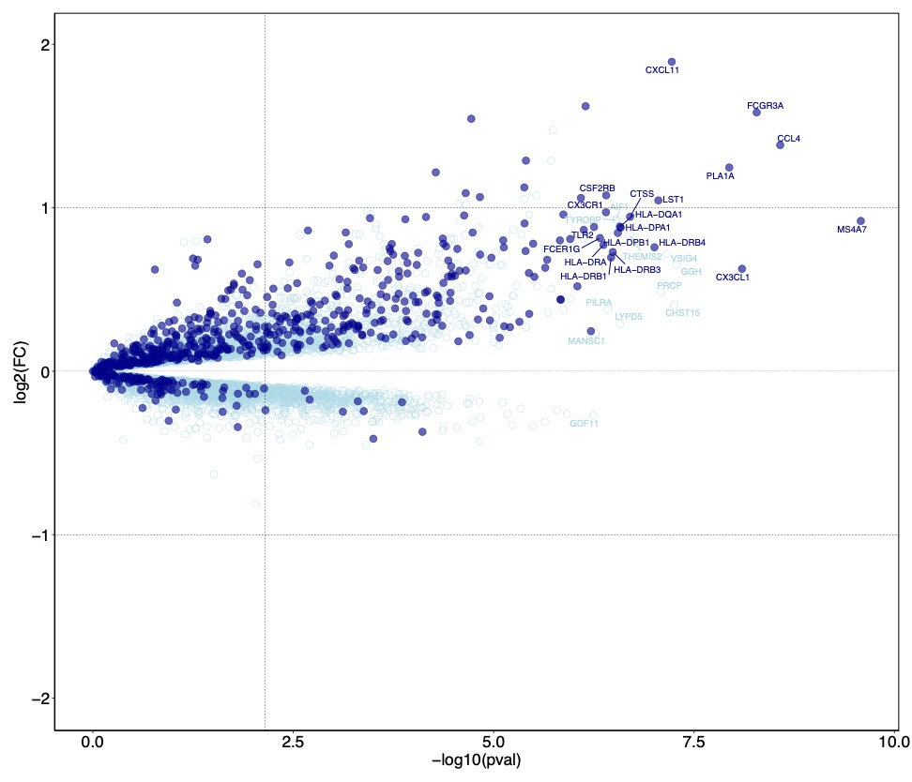
Banff human organ transplant consensus gene panel for detecting antibody mediated rejection in heart allograft biopsies
Background
Out of the 30 most differentially expressed genes (FDR<0.05) between AMR and non-AMR identified in whole-transcriptome analysis, 19 were included in the BHOT panel (Figure)
These genes covered major immune pathways and key cells involved in the physiology of AMR, including IFNG-inducible genes, NK-cells, monocytes-macrophages, injury and B-cells
The remaining genes not targeted in the BHOT were related to unspecific immune response
Major pathways related to AMR and graft injury identified in the targeted panel were associated with:
  Antigen processing cross presentation (q=2.86E-15)
  Lymphoid and non-lymphoid immune interaction (q=1.00E-22)
  Endothelial activation (q=6.80E-10)
  Toll-like receptor cascade (q=1.59E-10)
  Immunoregulatory interaction in adaptive immune system (q=1.01E-22)
Conclusions
The targeted molecular signature of AMR based on the B-HOT panel detected relevant AMR-related genes and pathways
This study demonstrate that the targeted panel can be used as a proxy to whole-transcriptome to analyze the molecular profile of heart allograft rejection
Giarraputo A. et al., ESOT Congress 2023; OS6_6
Notes:
Abbreviations: AMR, antibody-mediated rejection; BHOT, banff human organ transplant; FDR, false discovery rate; IFNG, interferon gamma; NK, natural killer.
OS6_6
BANFF HUMAN ORGAN TRANSPLANT CONSENSUS GENE PANEL FOR DETECTING ANTIBODY MEDIATED REJECTION IN HEART ALLOGRAFT BIOPSIES
Alessia Giarraputo*^{1;2}, Guillaume Coutance^{1;3}, Olivier Aubert¹, Marny Fedrigo², Dina Zielinski¹, Fariza Mezine¹, Michael Mengel⁴, Patrick Bruneval¹, Jean-Paul Duong van Huyen^{1;5}, Annalisa Angelini², Alexandre Loupy¹
¹Paris Institute for Transplantation and Organ Regeneration, Université Paris Cité, INSERM, U-970, AP-HP, Paris, Italy, ²Cardiovascular Pathology, Department of Cardiac, Thoracic, Vascular Sciences, University of Padua, Padua, Italy, ³Department of Cardiac and Thoracic Surgery, Cardiology Institute, Pitié Salpêtrière Hospital, Assistance Publique-Hôpitaux de Paris (AP-HP). Sorbonne University Medical School, Paris, France, ⁴Department of Laboratory Medicine and Pathology, University of Alberta, Alberta, Canada, ⁵Kidney Transplant Department, Necker Hospital, Assistance Publique - Hôpitaux de Paris, Paris, France
Background: Tissue-based gene expression approaches have been developed as a companion tool of routine pathology to refine the diagnosis of cardiac rejection. Whole-transcriptome profiling defined molecular phenotypes of rejection, but its clinical application remains limited by several hurdles. The consensus Banff Human Organ Transplant (BHOT) panel is developed to facilitate cost-effective and reproducible expression analysis of solid organ allografts. We aimed at validating the targeted panel as a proxy to whole-transcriptome analysis.
Methods: To assess the BHOT panel reliability in detecting gene expression pattern associated with antibody-mediated rejection (AMR), we performed in silico analysis and projected the BHOT panel on already published microarray data of 142 heart transplant biopsies (PMID:28148598). We compared the targeted and whole-transcriptome molecular profiles in AMR-biopsies (n=71) and non-AMR matched-control (non-rejection or acute cellular rejection, n=71) by performing differential expression, pathway, and network analyses.
Results: Out of the 30 most differentially expressed genes (FDR<0.05) between AMR and non-AMR identified in whole-transcriptome analysis, two-thirds (n=19) were included in the BHOT panel (Figure). These genes covered major immune pathways and key cells involved in the physiology of AMR, including IFNG-inducible genes, NK-cells, monocytes-macrophages, injury and B-cells. The remaining genes not targeted in the BHOT were related to unspecific immune response. Major pathways related to AMR and graft injury identified in the targeted panel were associated with: antigen processing cross presentation (q=2.86E-15), lymphoid and non-lymphoid immune interaction (q=1.00E-22), endothelial activation (q=6.80E-10), Toll-like receptor cascade (q=1.59E-10) and Immunoregulatory interaction in adaptive immune system (q=1.01E-22).
Conclusions: The targeted molecular signature of AMR based on the B-HOT panel detected relevant AMR-related genes and pathways. This study demonstrate that the targeted panel can be used as a proxy to whole-transcriptome to analyze the molecular profile of heart allograft rejection.

Slide 33
Pregnancy after heart transplant
Background
TPRI has been collecting pregnancy data for 32 years in solid organ transplant recipients
Aim: To analyze pregnancy outcomes in heart transplant recipients (HTR) reported to the TPRI
Results
Median age at conception was 28.6 (IQR 24-32) years and median transplant to conception interval was 5.8 (IQR 3.4-11.1) years
Unplanned pregnancies were reported in 44%
Immunosuppression consisted of tacrolimus-based in 63% and cyclosporine-based in 37%
40 pregnancies had MPA exposure: 22 miscarriages, 17 live births and 1 ectopic pregnancy
Comorbid conditions during pregnancy:
  Hypertension 48%
  Insulin treated diabetes 8%
  Infection during pregnancy 16%
  Cholestasis of pregnancy 6%
  Preeclampsia 27%
  Rejection 6.9%
Methods
Data collected by the TPRI via questionnaires, telephone interviews, and review of medical records
HTR, n=123
including 6 HTR from outside of North America
Pregnancies, n=208
Pregnancy outcomes, n=214 (3 twin, 1 triplet pregnancy)
149 live births
52 miscarriages
8 terminations
3 ectopic
2 stillbirths
Coscia L. et al., ESOT Congress 2023; OS6_7
Notes:
Abbreviations: HTR, heart transplant recipients; IQR, interquartile range; TPRI, transplantation pregnancy registry international; yrs, years.
OS6_7
PREGNANCY AFTER HEART TRANSPLANT
Lisa Coscia*¹, Dorothy Kliniewski¹, Serban Constantinescu¹, Michael Moritz¹
¹Transplant Pregnancy Registry International, Philadelphia, United States
Background: The Transplantation Pregnancy Registry International (TPRI) has been collecting data for 32 years in solid organ transplant recipients.
Methods: Data are collected by the TPRI via questionnaires, telephone interviews, and review of medical records. The purpose of this study is to analyze pregnancy outcomes in heart transplant recipients (HTR) reported to the TPRI.
Results: 123 HTR (including 6 HTR from outside of North America), 208 pregnancies and 214 pregnancy outcomes (3 twin, 1 triplet pregnancy) were analyzed. Pregnancy outcomes: 149 live births (70%), 52 miscarriages, 8 terminations, 3 ectopic and 2 stillbirths. Median age at conception was 28.6 (IQR 24-32) yrs and median transplant to conception interval was 5.8 (IQR 3.4-11.1) yrs. Unplanned pregnancies were reported in 44%. Immunosuppression consisted of tacrolimus-based in 63% and cyclosporine-based in 37%. Forty pregnancies had mycophenolate mofetil exposure (MPA): 22 miscarriages, 17 live births and 1 ectopic pregnancy. Comorbid conditions during pregnancy: hypertension 48%, insulin treated diabetes 8%, infection during pregnancy 16%, cholestasis of pregnancy 6%, preeclampsia 27%, and rejection 6.9%. Of the 149 live born, median gestational age was 37 (IQR 35-38.1) weeks, and median birthweight was 2693 (IQR 2324-3005) grams; 44% were premature (<37 weeks). There were 12 (8.1%) infants with birth defects; 3 infants had MPA exposure, defects included: laryngomalacia (1), facial malformations (1), and duodenal atresia, AV canal defect, Tetralogy of Fallot (3 defects in 1 child). At a median follow-up of 6.4 yrs most children are reported healthy and developing well. Nine children inherited their mothers heart disease; 4 had heart transplants. With a median follow-up of 7.5 (IQR 3.1-13.4) yrs: 36 recipients died, 4 had reduced function, 3 were lost to follow-up, and 80 (65%) had adequate function.
Conclusions: This is the largest reported series of pregnancies in HTR to date. Pregnancy in HTR is possible with 70% reporting live births. MPA exposure continues to present significant concerns. Pre-pregnancy counselling should include discussion of fertility post-transplant, the prospect of unplanned pregnancy, inheritable cardiac conditions, MPA avoidance, risk of rejection/graft dysfunction, and long-term maternal survival.

Slide 34
Pregnancy after heart transplant
Results
Of the 149 live born, median gestational age was 37 (IQR 35-38.1) weeks, and median birthweight was 2693 (IQR 2324-3005) grams; 44% were premature (<37 weeks)
There were 12 (8.1%) infants with birth defects; 3 infants had MPA exposure, defects included: laryngomalacia (1), facial malformations (1), and duodenal atresia, AV canal defect, Tetralogy of Fallot (3 defects in 1 child)
At a median follow-up of 6.4 years most children are reported healthy and developing well
9 children inherited their mothers heart disease; 4 had heart transplants
With a median follow-up of 7.5 (IQR 3.1-13.4) years: 36 recipients died, 4 had reduced function, 3 were lost to follow-up, and 80 (65%) had adequate function
Conclusions
This is the largest reported series of pregnancies in HTR to date
Pregnancy in HTR is possible with 70% reporting live births
MPA exposure continues to present significant concerns
Pre-pregnancy counselling should include discussion of fertility post-transplant, the prospect of unplanned pregnancy, inheritable cardiac conditions, MPA avoidance, risk of rejection/graft dysfunction, and long-term maternal survival
Coscia L. et al., ESOT Congress 2023; OS6_7
Notes:
Abbreviations: HTR, heart transplant recipients; IQR, interquartile range; TPRI, transplantation pregnancy registry international; yrs, years.
OS6_7
PREGNANCY AFTER HEART TRANSPLANT
Lisa Coscia*¹, Dorothy Kliniewski¹, Serban Constantinescu¹, Michael Moritz¹
¹Transplant Pregnancy Registry International, Philadelphia, United States
Background: The Transplantation Pregnancy Registry International (TPRI) has been collecting data for 32 years in solid organ transplant recipients.
Methods: Data are collected by the TPRI via questionnaires, telephone interviews, and review of medical records. The purpose of this study is to analyze pregnancy outcomes in heart transplant recipients (HTR) reported to the TPRI.
Results: 123 HTR (including 6 HTR from outside of North America), 208 pregnancies and 214 pregnancy outcomes (3 twin, 1 triplet pregnancy) were analyzed. Pregnancy outcomes: 149 live births (70%), 52 miscarriages, 8 terminations, 3 ectopic and 2 stillbirths. Median age at conception was 28.6 (IQR 24-32) yrs and median transplant to conception interval was 5.8 (IQR 3.4-11.1) yrs. Unplanned pregnancies were reported in 44%. Immunosuppression consisted of tacrolimus-based in 63% and cyclosporine-based in 37%. Forty pregnancies had mycophenolate mofetil exposure (MPA): 22 miscarriages, 17 live births and 1 ectopic pregnancy. Comorbid conditions during pregnancy: hypertension 48%, insulin treated diabetes 8%, infection during pregnancy 16%, cholestasis of pregnancy 6%, preeclampsia 27%, and rejection 6.9%. Of the 149 live born, median gestational age was 37 (IQR 35-38.1) weeks, and median birthweight was 2693 (IQR 2324-3005) grams; 44% were premature (<37 weeks). There were 12 (8.1%) infants with birth defects; 3 infants had MPA exposure, defects included: laryngomalacia (1), facial malformations (1), and duodenal atresia, AV canal defect, Tetralogy of Fallot (3 defects in 1 child). At a median follow-up of 6.4 yrs most children are reported healthy and developing well. Nine children inherited their mothers heart disease; 4 had heart transplants. With a median follow-up of 7.5 (IQR 3.1-13.4) yrs: 36 recipients died, 4 had reduced function, 3 were lost to follow-up, and 80 (65%) had adequate function.
Conclusions: This is the largest reported series of pregnancies in HTR to date. Pregnancy in HTR is possible with 70% reporting live births. MPA exposure continues to present significant concerns. Pre-pregnancy counselling should include discussion of fertility post-transplant, the prospect of unplanned pregnancy, inheritable cardiac conditions, MPA avoidance, risk of rejection/graft dysfunction, and long-term maternal survival.

Slide 35
Long-term outcomes of complement inhibition for prevention of antibody-mediated rejection in immunologically high-risk heart transplantation
Background
Allosensitization represents a major barrier to HTx
The efficacy and safety of complement inhibition at transplant in immunologically high-risk heart transplant recipients has been assessed
Favorable 1-year outcomes of this strategy has been previously reported
Aim: To report 5-year outcomes
Methods
Single-center, single-arm, open-label trial (DUET trial, NCT02013037)
Patients with PRA ≥ 70% and pre-formed DSA ≥ 5,000 MFI were eligible
Patients treated with standard of care + 9 infusions of eculizumab during the first two months post-transplant, n=20
Matched control group at equivalent immunologic risk and treated with perioperative plasmapheresis and intravenous immunoglobulins retrieved from the Paris Transplant Group reference set (propensity score matching)
Primary composite endpoint
AMR ≥ pAMR2 and/or left ventricular dysfunction during the first year
Secondary endpoints:
Hemodynamic compromise
Allograft rejection
Patient survival
Coutance G. et al., ESOT Congress 2023; OS6_8
Notes:
Abbreviations: AMR, antibody-mediated rejection; CI, confidence interval; DSA; donor-specific antibodies; HR, hazard ratio; HTx, heart transplantation; IVIG, intravenous immunoglobulins; LV, left ventricular; MFI, mean fluorescent intensity; PP, plasmapheresis; PRA, panel reactive antibodies.
OS6_8
LONG-TERM OUTCOMES OF COMPLEMENT INHIBITION FOR PREVENTION OF ANTIBODY-MEDIATED REJECTION IN IMMUNOLOGICALLY HIGH-RISK HEART TRANSPLANTATION
Guillaume Coutance*¹, Evan Kransdorf², Jon Kobashigawa³, Alexandre Loupy¹, Jignesh Patel³
¹Paris Transplant Group, Paris, France, ²Cedars Sinai Medical Center, Los Angeles, France, ³Cedars Sinai Medical Center, Los Angeles, United States
Background: Allosensitization represents a major barrier to heart transplantation (HTx). We assessed the efficacy and safety of complement inhibition at transplant in immunologically high-risk heart transplant recipients. We previously reported favorable 1-year outcomes of this strategy. The aim of the current study was to report 5-year outcomes.
Methods: We performed a single-center, single-arm, open-label trial (DUET trial, NCT02013037). Patients with panel reactive antibodies (PRA) ≥70% and pre-formed donor-specific antibodies (DSA) ≥ 5,000 MFI were eligible. In addition to standard of care, patients received 9 infusions of eculizumab during the first two months post-transplant. The primary composite endpoint was antibody-mediated rejection (AMR) ≥ pAMR2 and/or left ventricular dysfunction during the first year. Secondary endpoints included hemodynamic compromise, allograft rejection and patient survival. A matched control group at equivalent immunologic risk and treated with perioperative plasmapheresis and intravenous immunoglobulins was retrieved from the Paris Transplant Group reference set (propensity score matching).
Results: Twenty patients were included in the treatment group. Median post-transplant follow-up was 4.8 years. Beyond the first year post-transplant, there were no episodes of pAMR2 or greater and no LV dysfunction. Primary endpoint free-survival was 79.0% at 3- and 5-year post-transplant. Overall survival was 90% and 83.1% at 3- and 5-year post-transplant. Beyond the first year post-transplant, one episode of pAMR1 was diagnosed and one patient had minimal de novo cardiac allograft vasculopathy. Compared to a matched-control group, we observed a non-statistically significant benefit of eculizumab with a lower incidence of primary endpoint or death (primary endpoint: HR=0.50, 95%CI=0.15-1.67, p=0.26; mortality: HR=0.51, 95%CI=0.13-2.07, p=0.35, Figure 1A and 1B).
Conclusions: We report favorable 5-year outcomes of a complement inhibition-based strategy for the management of immunologically high-risk HTx. Chronic antibody-mediated allograft injuries were uncommon. Our results support the utility of complement inhibition for immunologically high-risk heart transplantation.

Slide 36
Long-term outcomes of complement inhibition for prevention of antibody-mediated rejection in immunologically high-risk heart transplantation
Results
Median post-transplant follow-up was 4.8 years
Beyond the first year post-transplant, there were no episodes of pAMR2 or greater and no LV dysfunction
Primary endpoint free-survival was 79.0% at 3- and 5-year post-transplant
Overall survival was 90% and 83.1% at 3- and 5-year post-transplant
Beyond the first year post-transplant, one episode of pAMR1 was diagnosed and one patient had minimal de novo cardiac allograft vasculopathy
Compared to a matched-control group, we observed a non-statistically significant benefit of eculizumab with a lower incidence of primary endpoint or death (primary endpoint: HR=0.50, 95%CI=0.15-1.67, p=0.26; mortality: HR=0.51, 95%CI=0.13-2.07, p=0.35, Figure A and B)
Figure A. Primary endpoint-free survival
Figure B. Post-transplant survival
Conclusions
Favorable 5-year outcomes of a complement inhibition-based strategy for the management of immunologically high-risk HTx
Chronic antibody-mediated allograft injuries were uncommon
Results support the utility of complement inhibition for immunologically high-risk heart transplantation
Coutance G. et al., ESOT Congress 2023; OS6_8
Notes:
Abbreviations: AMR, antibody-mediated rejection; CI, confidence interval; DSA; donor-specific antibodies; HR, hazard ratio; HTx, heart transplantation; IVIG, intravenous immunoglobulins; LV, left ventricular; MFI, mean fluorescent intensity; PP, plasmapheresis; PRA, panel reactive antibodies.
OS6_8
LONG-TERM OUTCOMES OF COMPLEMENT INHIBITION FOR PREVENTION OF ANTIBODY-MEDIATED REJECTION IN IMMUNOLOGICALLY HIGH-RISK HEART TRANSPLANTATION
Guillaume Coutance*¹, Evan Kransdorf², Jon Kobashigawa³, Alexandre Loupy¹, Jignesh Patel³
¹Paris Transplant Group, Paris, France, ²Cedars Sinai Medical Center, Los Angeles, France, ³Cedars Sinai Medical Center, Los Angeles, United States
Background: Allosensitization represents a major barrier to heart transplantation (HTx). We assessed the efficacy and safety of complement inhibition at transplant in immunologically high-risk heart transplant recipients. We previously reported favorable 1-year outcomes of this strategy. The aim of the current study was to report 5-year outcomes.
Methods: We performed a single-center, single-arm, open-label trial (DUET trial, NCT02013037). Patients with panel reactive antibodies (PRA) ≥70% and pre-formed donor-specific antibodies (DSA) ≥ 5,000 MFI were eligible. In addition to standard of care, patients received 9 infusions of eculizumab during the first two months post-transplant. The primary composite endpoint was antibody-mediated rejection (AMR) ≥ pAMR2 and/or left ventricular dysfunction during the first year. Secondary endpoints included hemodynamic compromise, allograft rejection and patient survival. A matched control group at equivalent immunologic risk and treated with perioperative plasmapheresis and intravenous immunoglobulins was retrieved from the Paris Transplant Group reference set (propensity score matching).
Results: Twenty patients were included in the treatment group. Median post-transplant follow-up was 4.8 years. Beyond the first year post-transplant, there were no episodes of pAMR2 or greater and no LV dysfunction. Primary endpoint free-survival was 79.0% at 3- and 5-year post-transplant. Overall survival was 90% and 83.1% at 3- and 5-year post-transplant. Beyond the first year post-transplant, one episode of pAMR1 was diagnosed and one patient had minimal de novo cardiac allograft vasculopathy. Compared to a matched-control group, we observed a non-statistically significant benefit of eculizumab with a lower incidence of primary endpoint or death (primary endpoint: HR=0.50, 95%CI=0.15-1.67, p=0.26; mortality: HR=0.51, 95%CI=0.13-2.07, p=0.35, Figure 1A and 1B).
Conclusions: We report favorable 5-year outcomes of a complement inhibition-based strategy for the management of immunologically high-risk HTx. Chronic antibody-mediated allograft injuries were uncommon. Our results support the utility of complement inhibition for immunologically high-risk heart transplantation.

